Slide 1
Error statistics in data assimilation
“All models are wrong …” (George Box)
“All models are wrong and all observations are inaccurate” (a data assimilator)
Ross Bannister
NCEO
University of Reading, UK, r.n.bannister@reading.ac.uk

Slide 2
Distinction between ‘errors’ and ‘error statistics’
When people say ‘errors’ they sometimes (but not always) mean ‘error statistics’
Error: The difference between some estimated/measured quantity and its true value.
E.g. ε_{est} = x_{est} – x_{true} or ε_{y} = y – y_{true}
Errors are unknown and unknowable quantities
Error Statistics: Some useful measure of the possible values that ε could have.
E.g. a PDF
Error statistics are knowable, although often difficult to determine – even in the Gaussian case.
Here, error statistics = second moment (ie assume PDFs are Gaussian and unbiased, <ε> = 0).
E.g. second moment of ε, <ε²> (called a variance), or <ε²>^{1/2} = σ (standard deviation). If only the variance is known, then the PDF is approximated as a Gaussian.
P(ε) ~ exp – ε²/2<ε²>
PDF(ε)
σ= √<ε²>
ε
ε

Slide 3
This talk ...
A B C D E F G H I
A. What quantities should be assigned error statistics in data assimilation?
B. How are error statistics important in data assimilation?
C. ‘Observation’ and ‘state’ vectors.
D. ‘Inner’ and ‘outer’ products.
E. Forms of (Gaussian) error covariances.
F. Link between Bayes’ Theorem and the variational cost function.
G. Link between the variational cost function and the ‘BLUE’ formula.
H. Example with a single observation.
I. Forecast error covariance statistics.

Slide 4
A. What quantities should be assigned error statistics in data assimilation?
A B C D E F G H I
All data that are being fitted to.
Observations (real-world data).
Prior data for the system’s state.
Prior data for any unknown parameters.
Data that have been fitted.
Data assimilation-fitted data (analysis, ie posteriori error statistics).
}
Information available about the system before observations are considered.

Slide 5
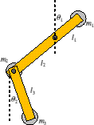
B. How are error statistics important in data assimilation?
A B C D E F G H I
1. Error statistics give a measure of confidence in data
No assim
Assim with large obs errors Assim with small obs errors

Slide 6
B. How are error statistics important in data assimilation?
A B C D E F G H I
2. Error statistics of prior data imply relationships between variables
time
x₂
Background forecast (no assim)
Analysis forecast (consistent with prior and ob errors)
x₁
x₁ and x₂ cannot be varied independently by the assimilation here because of the shape of the prior joint PDF.
Known relationships between variables are often exploited to gain knowledge of the complicated nature of the prior error statistics (e.g. changes in pressure are associated with changes in wind in the mid-latitude atmosphere (geostrophic balance).

Slide 7
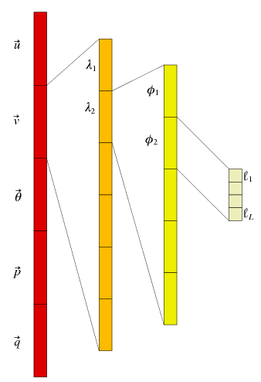
C. ‘Observation’ and ‘state’ vectors
A B C D E F G H I
y =
x =
The observation vector – comprising each observation made. There are p observations.
The structure of the state vector for the example of meteorological fields (u, v, θ, p, q are meteorological 3-D fields; λ, φ and ℓ are longitude, latitude and vertical level). There are n elements in total.

Slide 8
D. ‘Inner’ and ‘outer’ products
A B C D E F G H I
The inner product (‘scalar’ product) between two vectors gives a scalar
The outer product between two vectors gives a matrix
When ε is a vector of errors, <εε^{T}> is a (symmetric) error covariance matrix

Slide 9
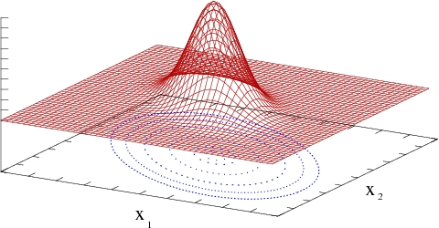
E. Forms of (Gaussian) error covariances
A B C D E F G H I
The one-variable case
The many variable case
σ= √<ε²>
<x>
0

Slide 10
F. Link between Bayes’ Theorem and the variational cost function
A B C D E F G H I
Bayes theorem links the following
PDF of the observations (given the truth)
PDF of the prior information (the background state)
PDF of the state (given the observations – this is the objective of data assimilation)

Slide 11
G. Link between the variational cost function and the ‘BLUE’ formula
A B C D E F G H I

Slide 12
H. Example with a single observation
A B C D E F G H I
Analysis increment of the assimilation of a direct observation of one variable.
Obs of atmospheric pressure →

Slide 13
I. Forecast error covariance statistics
A B C D E F G H I
In data assimilation prior information often comes from a forecast.
Forecast error covariance statistics (P_{f}) specify how the forecast might be in error
ε_{f} = x_{f} – x_{true}, P_{f} = <ε_{f} ε_{f}^{T}>.
How could P_{f} be estimated for use in data assimilation?
Analysis of innovations (*).
Differences of varying length forecasts.
Monte-Carlo method (*).
Forecast time lags.
Problems with the above methods.
A climatological average forecast error
covariance matrix is called B.

Slide 14
I.1 Analysis of innovations
A B C D E F G H I
We don’t know the truth, but we do have observations of the truth with known error statistics.
Definition of observation error : y = y_{true} + ε_{y} = h(x_{true}) + ε_{y}
Definition of forecast error : x_{true} = x_{f} – ε_{f}
Eliminate x_{true} : y = h(x_{f} – ε_{f}) + ε_{y} ≈ h(x_{f} ) - Hε_{f} + ε_{y}
‘Innovation’ : y - h(x_{f} ) ≈ ε_{y} - Hε_{f}
LHS (known), RHS(unknown)
Take pairs of in-situ obs whose errors are uncorrelated (for variable v₁, posn r and v₂, r+Δr)
y(v₁,r) - x_{f} (v₁,r) ≈ ε_{y}(v₁,r) - ε_{f}(v₁,r) y(v₂,r +Δr) - x_{f} (v₂,r +Δr) ≈ ε_{y}(v₂,r +Δr) - ε_{f}(v₂,r +Δr)
Covariances
<[y(v₁,r) - x_{f} (v₁,r)] [y(v₂,r +Δr) - x_{f} (v₂,r +Δr)]> = <[ε_{y}(v₁,r) - ε_{f}(v₁,r)] [ε_{y}(v₂,r +Δr) - ε_{f}(v₂,r +Δr)]>
= <ε_{y}(v₁,r) ε_{y}(v₂,r +Δr)> - <ε_{y}(v₁,r) ε_{f}(v₂,r +Δr)> - <ε_{f}(v₁,r ) ε_{y}(v₂,r +Δr)> + <ε_{f}(v₁,r) ε_{f}(v₂,r +Δr)>
↑ ↑ ↑ ↑
Obs error covariance Zero (obs and forecast errors Forecast error covariance
between (v₁, r) and (v₂, r+Δr) uncorrelated) between (v₁, r) and (v₂, r+Δr)
zero unless v₁=v₂ and Δr=0
(one particular matrix element of Pf or B)
<> average over available observations and sample population of forecasts

Slide 15
I.2 Monte-Carlo method (ensembles)
A B C D E F G H I
N members of an ensemble of analyses.
Leads to N members of an ensemble of forecasts.
The ensemble must capture the errors contributing to forecast errors.
Initial condition errors (forecast/observation/assimilation errors from previous data assimilation).
Model formulation errors (finite resolution, unknown parameters, …).
Unknown forcing.
Can be used to estimate the forecast error covariance matrix, e.g.
P_{f} ≈ < (x-<x>) (x-<x>) ^{T} > = 1/(N-1) ∑_{i=1,N} (x_{i} - <x>) (x_{i} - <x>)^{T}
Problem: for some applications N << n.
n elements of the state vector (in Meteorology can be 10⁷).
N ensemble members (typically 10²).
Consequence – when P_{f} acts on a vector, the result is forced to lie in the sub-space spanned by the N ensemble members.
Ensembles
x
t

Slide 16
Comments and Questions
!
?

