Slide 1


Accounting for large-scale circulation effects on extreme precipitation
Department of Meteorology
Richard P. Allan r.p.allan@reading.ac.uk @rpallanuk
Chunlei Liu (Guangdong Ocean University); Stephen Blenkinsop, Hayley Fowler (Newcastle)

Slide 2
Thoughts ON Regime effects On Scaling
Unexpected rise in extreme precipitation scaling can be caused by a shift in rain type, e.g. Haerter & Berg 2009 Nature Geosci.; Molnar et al. 2015 HESS; Prein et al. 2017 Nat. Clim.
Latent heating can plausibly intensify cloud system (e.g. Berg et al. 2013 Nat. Geosci; Nie et al. 2018 PNAS; Li et al. 2019 GRL; Pendergrass et al. 2019 GRL) yet suppress convection at larger space & time scales (Loriaux et al. 2017 J. Clim: Tandon et al. 2018 GRL; )
For scaling to be relevant to climate change need to remove non-climate weather/seasonal variability. Hottest T over land only possible with dry prior conditions? Less stable?
Extreme rainfall increasingly unusual for hottest temperatures. Negative scalings for hottest conditions can reflect this but thresholds not relevant for climate change (e.g. Roderick et al. (2019) GRL; Neelin et al. (2017) PNAS; Prein et al. 2017 Nat. Clim. )
At monthly scale, less cloud/rain can lead to hotter conditions over many tropical land regions (Trenberth & Shea (2005) GRL). Shorter duration events reduce this effect (conditioning on wetter events)
Scaling with T_{dew} better as it reduces regime effects (Ali et al. 2018 GRL; Barbero et al. 2018 WCE; Lenderink et al. 2011 HESS, 2017 J. Cim ; Wasko et al. (2018) ERL) but still T_{dew}=25ºC could reflect humid 26ºC or dry 32ºC where more difficult for convection access moisture?
Condition on dynamical regime (difficult) or look at trends (but big aerosol forcing change, data record length?) or by statistically sampling entire large-scale circulation & scaling with tropical/global temperature (Pendergrass & Hartmann 2014 J. Clim; Allan & Soden 2008)?

Slide 3
①
②
③
④
Allan et al. (2014) Surv. Geophys
① More positve dP/dT for heavier percentiles
② More positive observed sensitivity over ocean
③ More moderate sensitivity to climate change partly as additional CO₂ atmospheric heating supresses total (global) rainfall e.g. Allan & Soden (2008)
④ Negative land dP/dT as more rain during cool La Niña so interannual dP/dT not good direct proxy for climate change, especially over land but may be good indirect proxy and indicator of model diversity e.g. O’Gorman (2012)

Slide 4
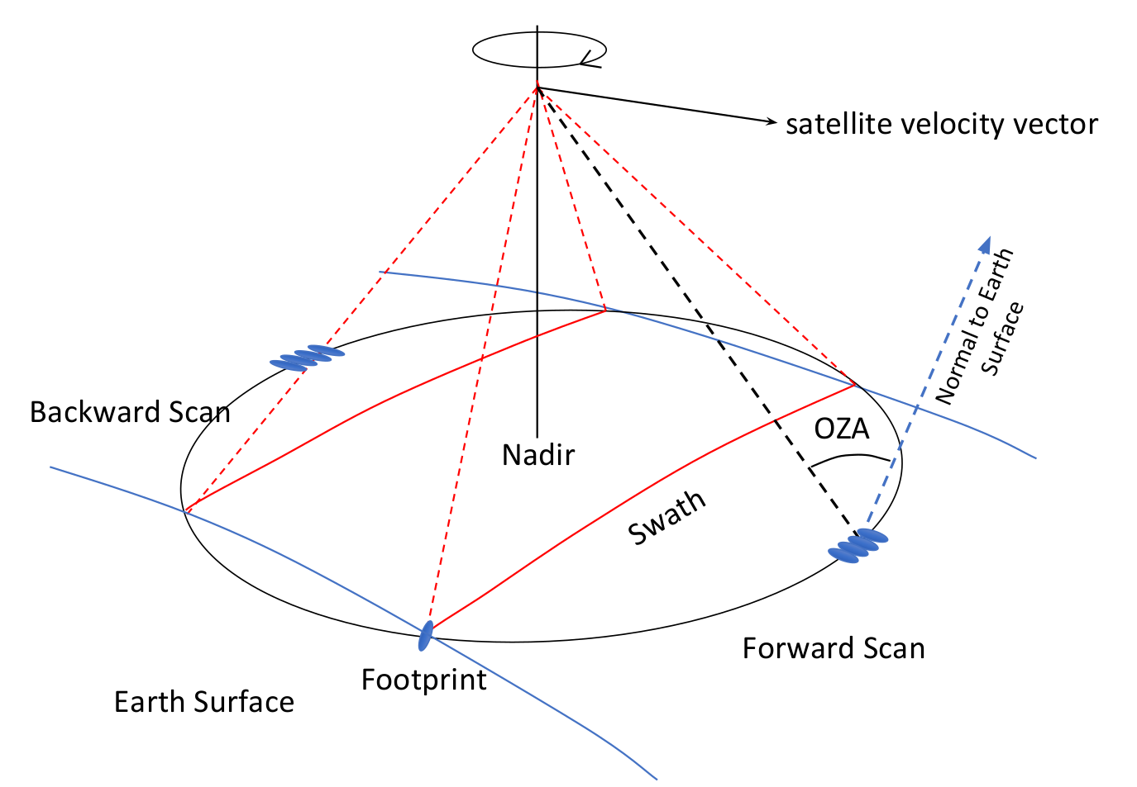
What is the effective space and time scale of the measurement?
How do storms and manifest across these scales?
How do drivers of change depend on these scales?
1 day 5 day
Precipitation intensity change with mean surface temperature (%/day)
Diagnosed intensity response between datasets (tropical oceans)
Liu & Allan (2012) JGR
Precipitation intensity percentile (%)

Slide 5
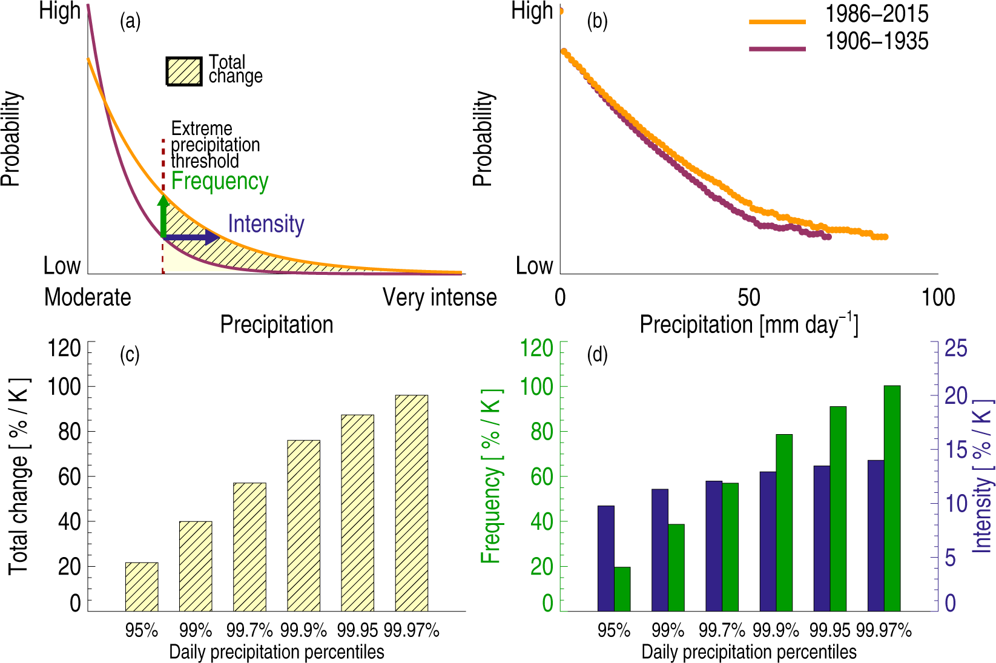
Thought ON Frequency vs intensity
Myhre et al. (2019) Sci. Adv.: Increases in rainfall above a fixed intensity threshold determined mostly by increases in frequency?
BUT less severe precipitation events intensifying above the threshold and intensification of heavy rainfall in weather events is the dominant process.
Most events will be near to fixed threshold, limiting increase →

Slide 6

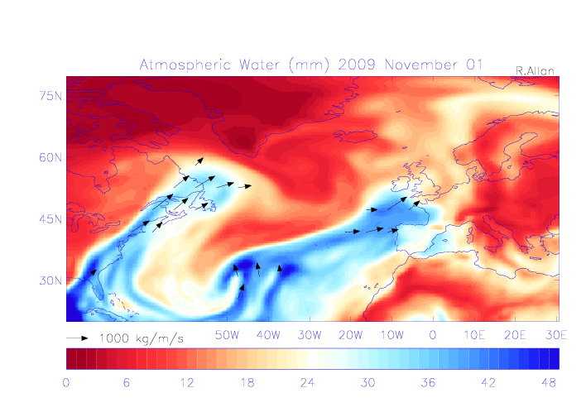
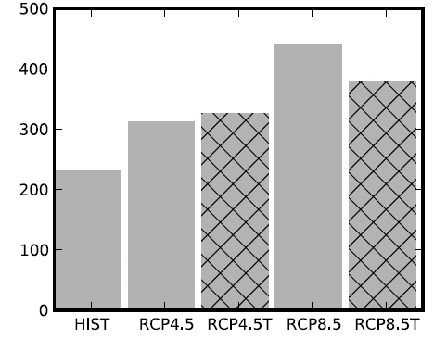
Atmospheric Precursors to
Heavy rainfall & flooding
  Lavers et al. (2013) ERL
“Number” of ARs
NorESM1-M
UK winter flooding linked to Atmospheric Rivers e.g. Cumbria November 2009 (Lavers et al. 2011 GRL), building on extensive research on ARs in USA & elsewhere
ARs will strengthen thermodynamically (rather than increase in “number”). What about dynamical intensity/location/orientation?
Zhang et al. (2019) GRL: Enhanced latent heat release can invigorate the parent storm
Are ARs diagnostic “snail trails” of moisture convergence ahead of the storm? Dacre et al. (2019) J. Hydromet show moisture ingested ahead of storm in centred view

Slide 7
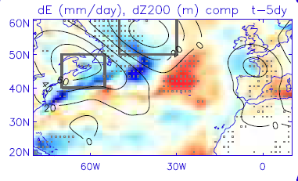
Atmospheric precursors to
Heaviest 3hr Summer EVENT
Heaviest observed events associated with northward transport of warm, moist airmass e.g. “Spanish Plume”
Geopotential height anomalies near Newfoundland 5-10 days prior (blocking)
Allan et al. (2020) Int. J Clim.
NW England & Wales
local

Slide 8
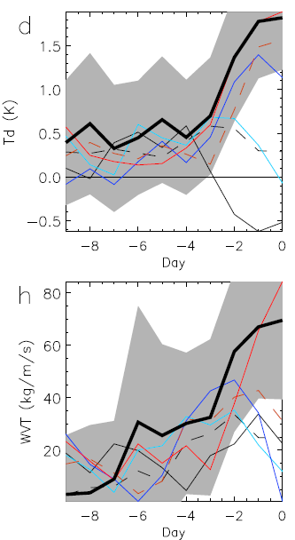
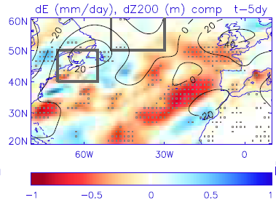
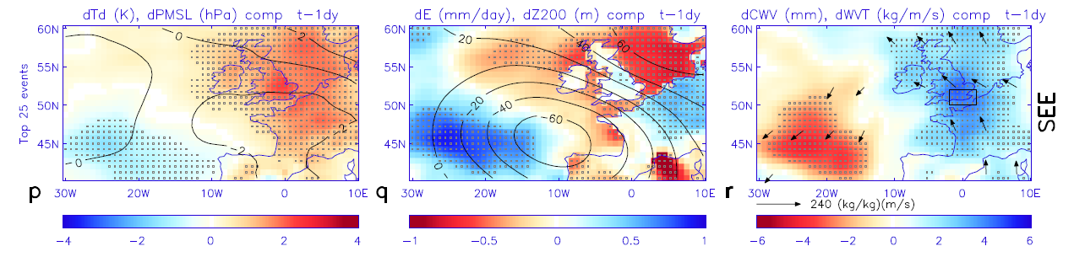
Atmospheric precursors to
Heaviest 3hr Summer EVENT
local
Heaviest observed events associated with northward transport of warm, moist airmass e.g. “Spanish Plume”
Geopotential height anomalies near Newfoundland 5-10 days prior (blocking)
Allan et al. (2020) Int. J Clim.
SE England
North Sea

Slide 9
Multiple Processes driving flooding

Slide 10
Circulation change
Intensification and narrowing of tropical rain belt (e.g. Byrne et al. (2018) CCCR)
Weaker tropical circulation increases rainfall duration from slower TCs (e.g. Kossin (2018) Nature + discussion) but reduces thermodynamic intensification of monsoon intensity/area plus reduced longitudinal contrast across Pacific
Subtropical expansion - different mechanisms in both hemispheres, not simple relationship with drying, season dependent (e.g. Brogli et al. (2019) ERL summer Mediterranean drying attributed to land-ocean warming contrast and thermodynamic stratification, less certain shift in atmospheric circulation explain winter drying), regionally dependent (e.g. more intense Sahara heat low, northward shift, later more intense seasons Dong and Sutton (2015) Nature Clim; Dunning et al. 2018 J Clim.)
Poleward migration of storm tracks; reduced low level Arctic-mid-latitude temperature gradient (slower/slacker jet stream plausible but multiple competing mechanisms) but stronger upper level temperature gradient & evidence for stronger westerlies at lower latitudes implying shorter duration events (Dwyre & O'Gorman (2017) GRL but see also Kharaman et al. poster)
Increased moisture transport into storm systems (TCs, ETCs/ARs, convective events/MCSs), ITCZ/monsoons and Arctic; increased contrast between wet/dry weather events, seasons and year to year variability (fb)
Local circulation shift effects on extreme precipitation uncertain but physical understanding and storyline approach can provide policy-relevant information

Slide 11
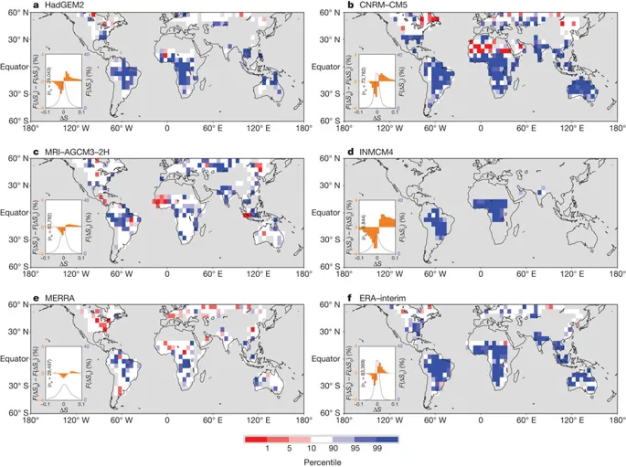
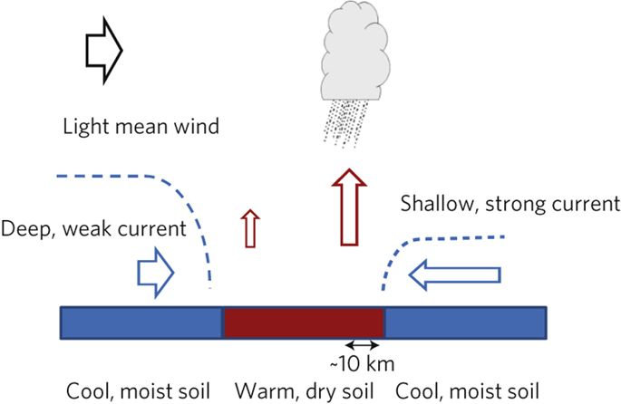
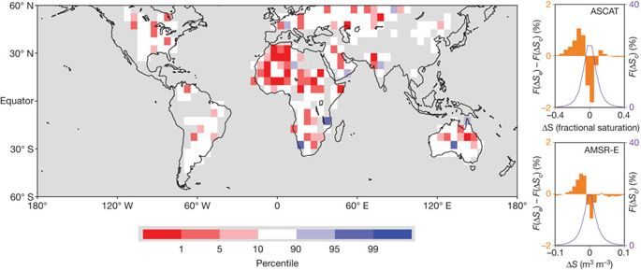
Role of Land surface Gradients
Taylor et al. (2017) Nature: Heating of Sahara by rising greenhouse gases intensifying Sahelian storms (MCS) through land-ocean warming contrasts rather than purely thermodynamics
Soil moisture patterns determine location of convection (Taylor et al. 2011 Nature Geosci.) & these forcings and potential for feedback are not adequately captured by lower resolution simulations (Taylor et al. 2013; 2015 GRL)
Chris Taylor didn’t pay me for this slide (…yet) + lots of Christoph Schär’s work.
Obs
Model
Taylor et al. Nature 2012
Dry soils
Wet soils

Slide 12
Some Conclusions/thoughts…
Distinct mechanisms leading to extreme precipitation events (e.g. tropical cyclones, thunderstorms, mesoscale convective systems, atmospheric rivers, frontal rain with/without embedded convection, orographic vs surface forced events, stalled or consecutive weather systems,….)
Storyline/pseudo global warming approaches beneficial in isolating important mechanisms and covering low probability, high impact events
Local scaling of extreme precipitation with temperature/moisture is not directly relevant for climate change unless meteorology is accounted for and even then there can be regime shifts with climate change (e.g. frontal to frontal with embedded convection, unprecedented MCSs/TCs?)
Large-scale circulation shifts including land surface feedbacks dominate/amplify regional water cycle changes in many regions but are least certain aspects of change leading to irreducible uncertainty at local level
But combining evidence from observations, physical basis and detailed modelling can provide policy relevant information/starting point e.g.
Heaviest rainfall events, where and when they occur, will intensify, close to 6%/ºC rate
Additional latent heating will dynamically invigorate some types of event (largest convection, cores of tropical cyclones) increasing this scaling above 6%/ºC
Flooding associated with the most intense events will become more severe, particularly for smaller catchments but drying of soil and changes in circulation will reduce flood frequency in some regions

Slide 14
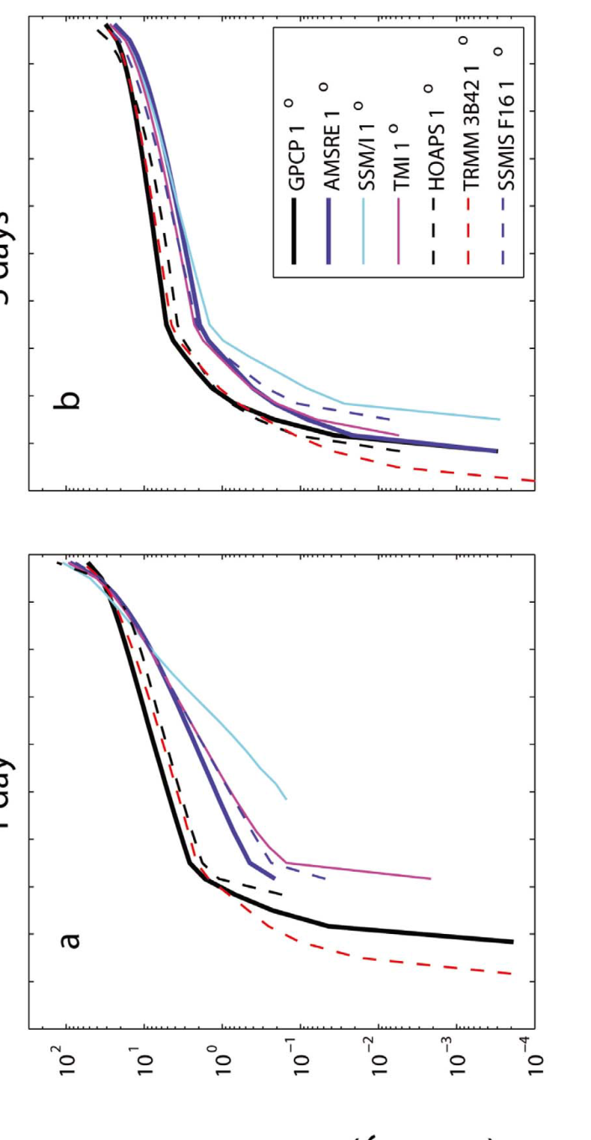



1 day 5 day
Precipitation intensity (mm/day)
Precipitation intensity distributions & responses between datasets (tropical oceans)
Precipitation intensity change with mean surface temperature (%/day)
Liu & Allan (2012) JGR
Precipitation intensity percentile (%)

Slide 16
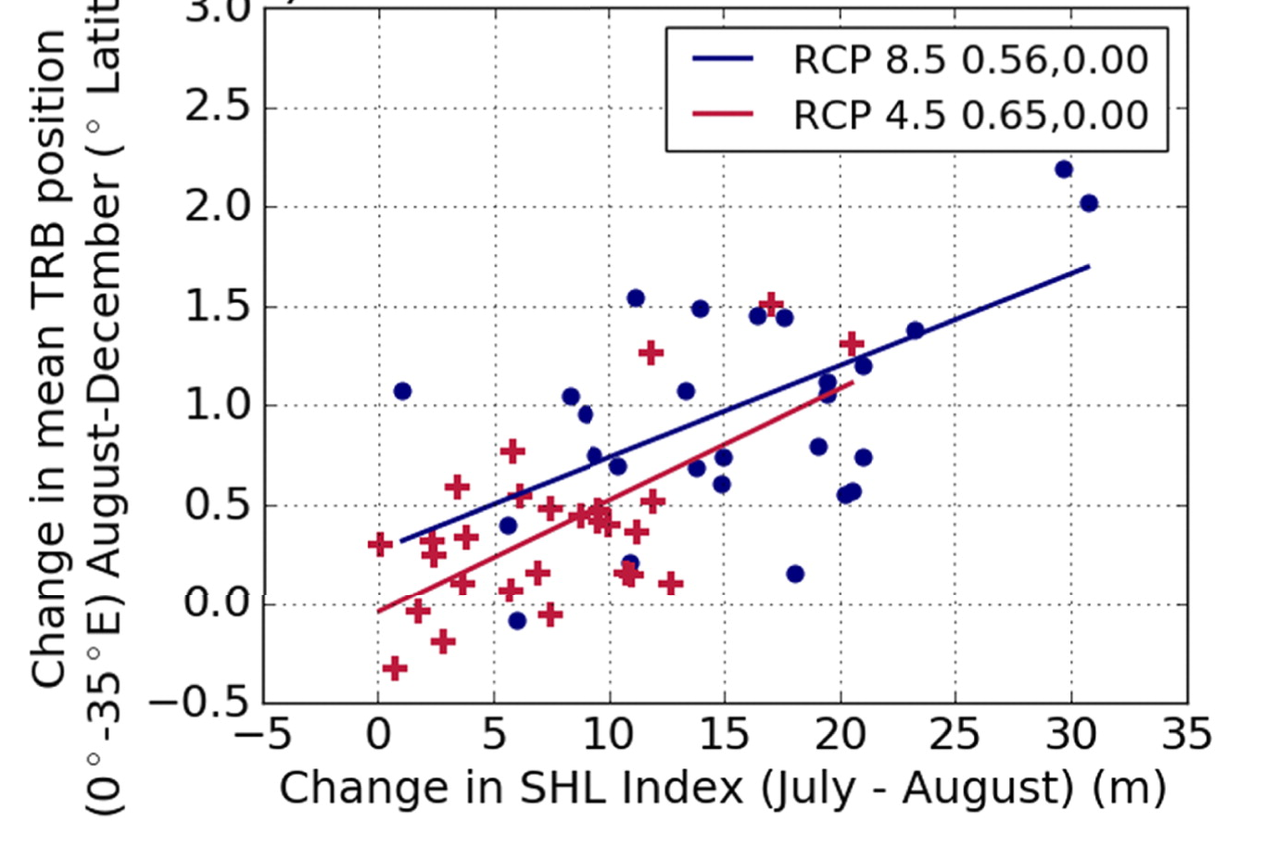
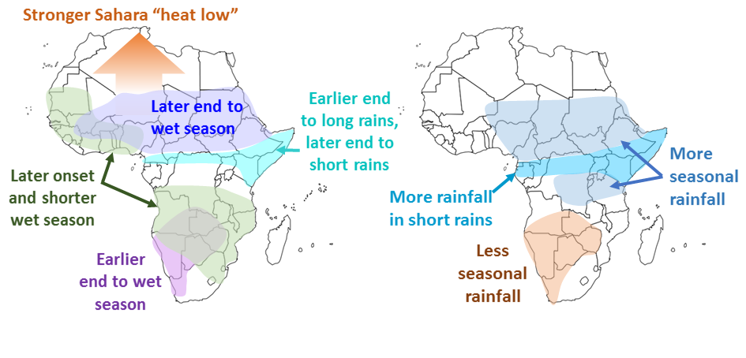

Strengthening Sahara HEAT
Low Delays Wet Season
Seasonal timing of wet season linked to impacts across Africa.
New method to define wet season in satellite products/models (Dunning et al. 2016 JGR)
Intensification of Sahara Heat Low drives later wet seasons in projections: Dunning et al. 2018 J. Clim
Rainy belt movement (ºN) →
Stronger Heat Low →

Slide 17
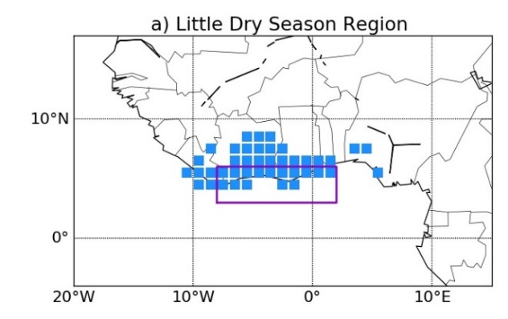

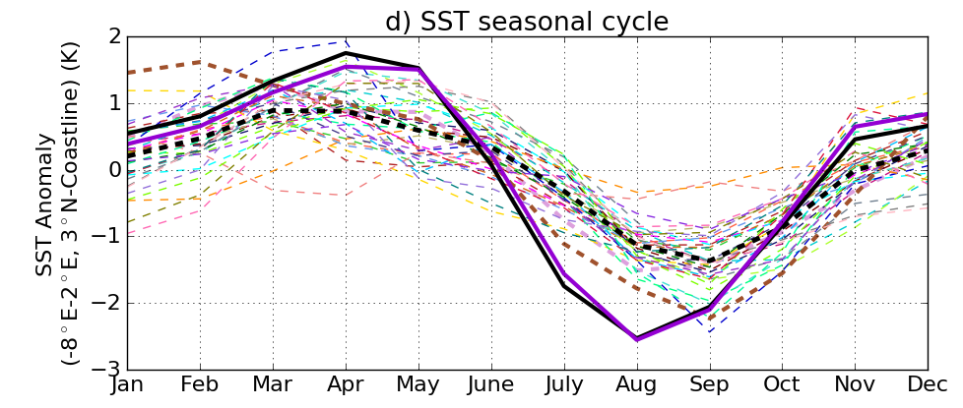
Biases in Seasonal Rainfall
SIMULATION HINDER PROJECTIONS
Dunning et al. 2017 ERL
SST seasonal cycle
CMIP5
OBS/AMIP
Atmosphere-only simulations capture seasonal cycle, coupled simulations don’t - Due to systematic biases in Gulf of Guinea sea surface temperature (SST) & deficient representation of SST/rainfall relationship (Wainwright et al. in prep)
- Are there links to Southern Ocean biases? (Hyder et al. in prep).

Slide 18

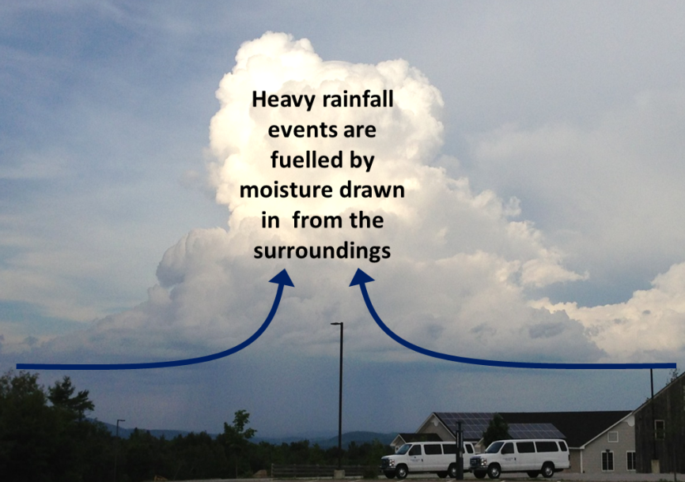
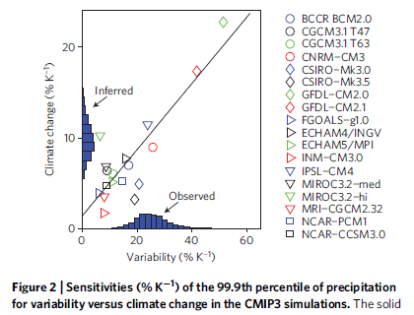
Extreme Precipitation
Moisture convergence fuels large-scale rainfall events
e.g. Trenberth et al. (2003) BAMS
Intensification of rainfall with warming ~Clausius Clapeyron?
e.g. Allan & Soden (2008) Science
Amplifying latent heat feedbacks?
e.g. Berg et al. (2013) Nature Geo
Time/space scale important
Observational constraints? →
e.g. O’Gorman (2012) Nature Geosci; Liu & Allan (2012) JGR

Slide 20
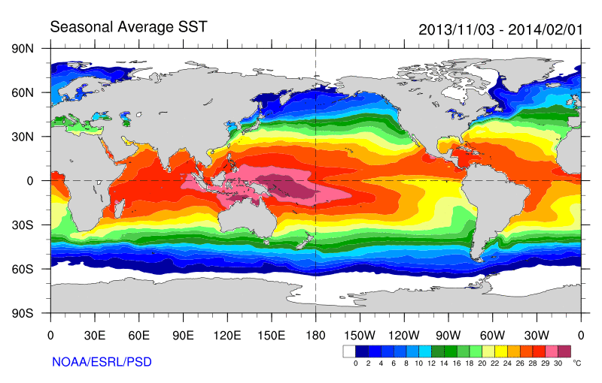
Some earlier strands
Radiative Forcing/Imbalance Johnson et al. (2016) ; Checa-Garcia et al. (2016) ; Huber & Knutti (2014) ;Santer et al. (2015) :
Continued heating from greenhouse gases
Aerosol forcing of circulation (Smith et al. 2016)
Unusual weather patterns (Ding et al. 2014; Trenberth et al. 2014b)
Pacific SST strengthens atmospheric circulation
Enhanced Walker Circulation
? Heat flux to Indian ocean Lee etal 2015
Increased sea height
Warm
Upwelling,
Cool water
Remote forcing from Atlantic:
Li et al. (2016) ;
McGregor et al. (2014)
Increased precipitation
Decreased salinity
Strengthening trade winds
Equatorial Undercurrent
Pacific dominates?
Mann et al. (2016) Kosaka & Xie (2013) England et al. (2014)
Enhanced mixing of heat below 100 metres depth by accelerating shallow overturning cells and equatorial undercurrent
See also: Merrifield (2010).; Sohn et al. (2013) .; L’Heureux et al. (2013) . Change; Watanabe et al. (2014) ; Balmaseda et al. (2013) ; Trenberth et al. (2014) .; Llovel et al. (2014) ;Durack et al. (2014) ; Nieves et al. (2015) ; Brown et al. (2015) JGR ; Somavilla et al. (2016) ; Liu et al. (2016)
Notes:
There is lots of new results focussing on the slower rates of surface warming and associated unusual climatic conditions at the beginning of the 21st century (see DEEP-C website: http://www.met.reading.ac.uk/~sgs02rpa/research/DEEP-C.html#PAPERS).

