Slide 1


Earth’s energy Budget Changes over Recent Decades
Department of Meteorology
Richard P. Allan r.p.allan@reading.ac.uk @rpallanuk
Chunlei Liu (Guangdong Ocean University, Zhanjiang, China)
Notes:
How is Earth’s energy budget driving and responding to climate change?
Where is energy accumulating in the oceans and what are the mechanisms?
Are models capturing Earth’s energy imbalance and the mechanisms of heat accumulation?
Can models represent water vapour and cloud feedbacks and their change over time?
What is the link between the energy budget and water cycle?

Slide 2
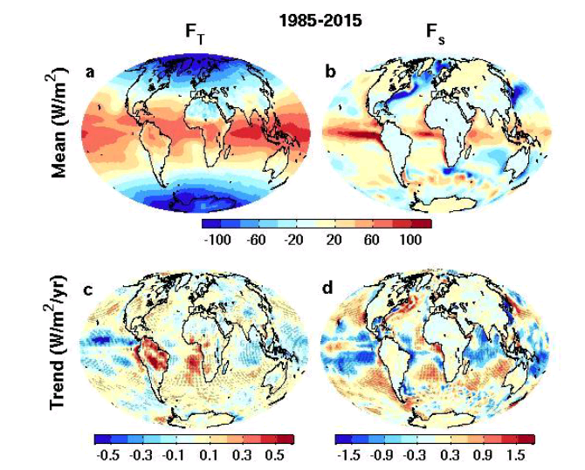
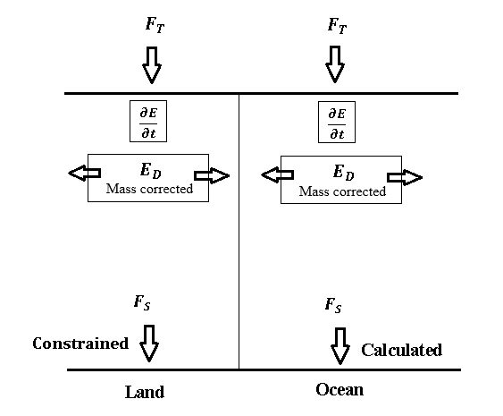

Earth’s Energy Budget SINCE 1985
top of atmosphere surface
ERBS CERES
reanalyses
Liu et al. (2017) JGR
Data: doi.org/10.17864/1947.111
Modelling to combine ERBS/CERES records & estimate uncertainty: Allan et al. (2014) GRL
Compute surface fluxes using modified energy budget approach: Liu et al. (2020) Clim. Dyn.
Evaluation of models, reanalyses, satellite products e.g. Williams et al. (2018) JAMES; Wittenberg et al. (2018) JAMES ; Roberts et al. (2018) GMD; Sus et al. (2018) AMT, etc
Southern Ocean cloud biases: Hyder et al. (2018) Nature Comms
Volcanic radiative responses: Schmidt et al. (2018) JGR
North Atlantic Heat transports: Brydon et al. (2020) J. Clim
Aerosol effects on energy budget: Schwarz et al. (2020) Nature Geosci.

Slide 3
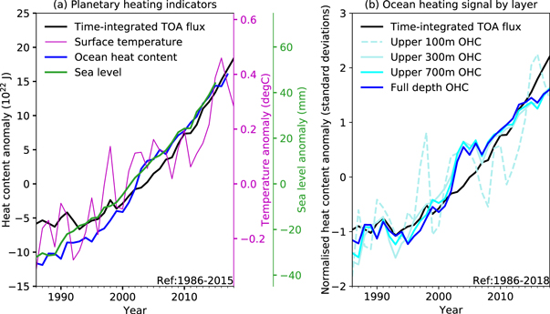
planetary heating since the 1980s from multiple independent datasets
Allison et al. (2020) ERC doi:10.1088/2515-7620/abbb39
See also Cheng et al. 2017 Sci. Adv.

Slide 4
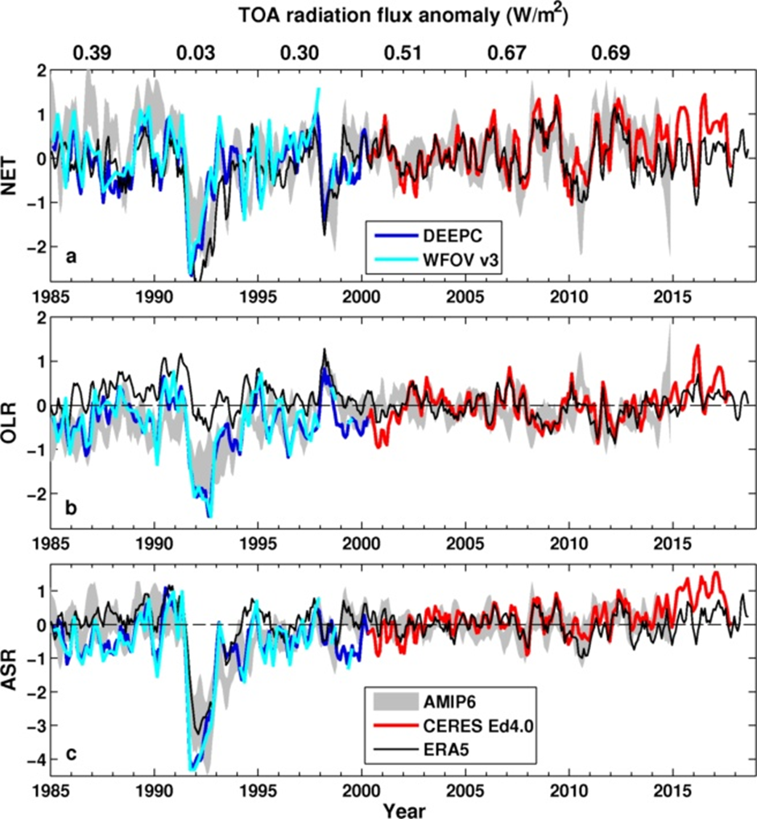
CURRENT Energy Budget Changes
Preliminary comparison with AMIP6 and ERA5
Large uncertainty in pre-CERES EEI remains
Pinatubo radiative effect Schmidt et al. (2018) JGR
Consistent with ocean heat content changes (Cheng et al. 2017 Sci. Adv.), lower than Resplandy et al. (2019) Sci. Rep. which now has larger range following correction (0.3-1.3 Wm⁻²)
ERA5 does not capture observed ASR increase after warming slowdown (e.g. Loeb et al. 2018)
  ↑Heating 2015/16
  Cloud plus aerosol?
  r = 0.46
?
  r = 0.57
  r = 0.7
Liu et al. (2020) Clim. Dyn.

Slide 5
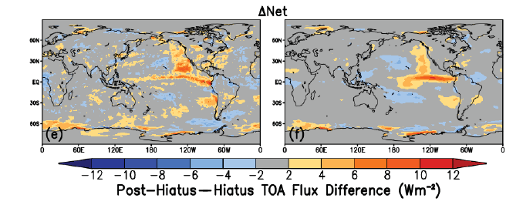
Cloud Feedbacks
SW
CERES EBAF v4.1
CMIP6 model ensemble
Net
July 2014–June 2017 minus July 2000–June 2014
Use 2015/16 El Nino as laboratory to test cloud feedbacks (Loeb et al. 2020 GRL)
  CMIP6 AMIP simulations generally able to capture net flux responses
  Depends on model ability to represent SW radiation changes in low cloud regions
Cloud errors and wind-feedbacks also determine systematic model biases in Southern Ocean (Hyder et al. 2018 Nature Comms) and globally (Hyder et al. in prep)

Slide 6
Hemispheric Asymmetry
In EARTH’S Energy Budget
Mean position of the tropical rainy belt in northern hemisphere determined by northward energy transport by ocean e.g. Frierson et al. (2013) Nature Geosci
Important to quantify hemispheric energy budget:
Inferred 2006-2013 cross equatorial energy flux (updated from Liu et al. 2017 & Loeb et al. (2015) Clim. Dyn using ocean heating from Roemmich et al. (2015) Nature Clim, Desbruyeres et al. (2016) GRL or ORAS4 reanalysis)
Remember days per month and enthalpy transfers!!
Liu et al. (2020) Clim. Dyn.

Slide 7
Inferred meridional energy transports
How is atmosphere and ocean circulation responding to energy imbalances?
Increased poleward heat transport by the atmosphere inferred from CERES period?
Liu et al. (2020) Clim. Dyn.
Notes:
Time series of global meridional transports at 30◦N, equator and 30◦S in ocean (left column) and atmosphere (right column). Contributions of net surface energy flux and heat storage integrated from the north pole to oceanic transport are also plotted. Heat storage contribution and MEI index are all adjusted up and down for clarity.

Slide 8
Inferred Ocean energy transports@26N
Liu et al. (2020) Clim. Dyn.
After Trenberth & Fasullo, 2017 GRL

Slide 9
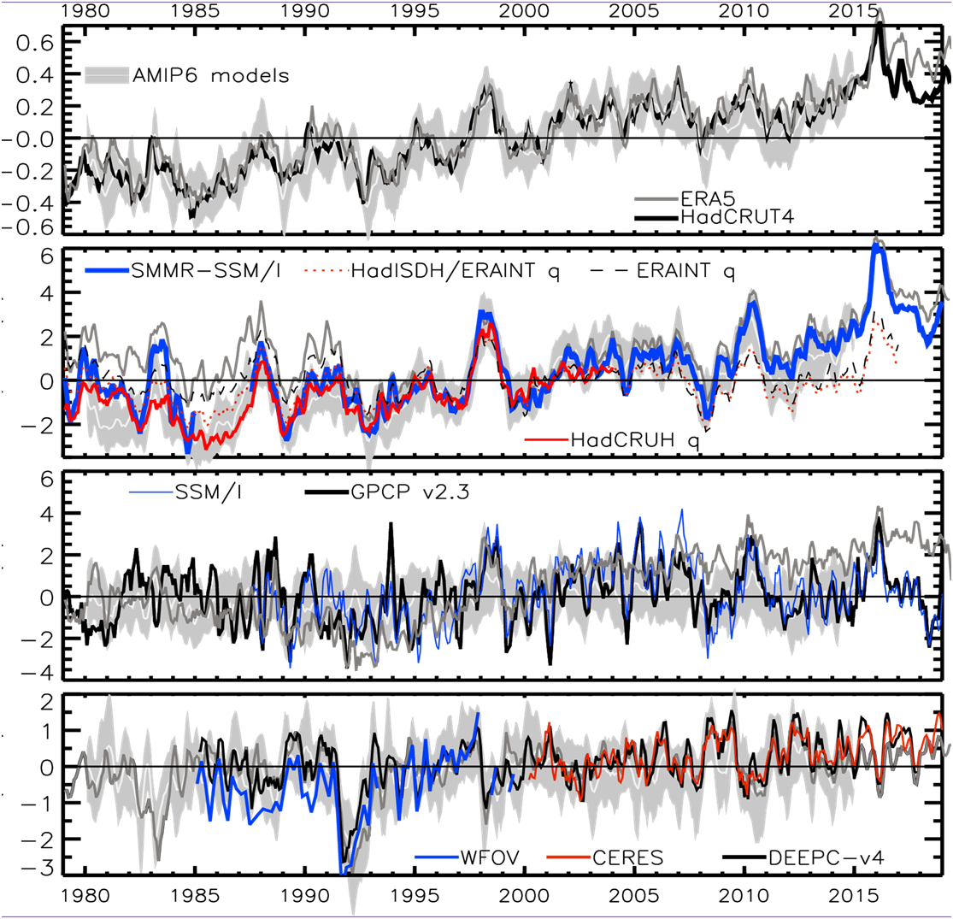
How is Earth’s energy budget Driving
Water CYCLE Changes?
+0.3 %/decade
Heating (Wm⁻²) Precipitation (%)
2.8
1.8
0.8
-0.2
-1.2
-2.2
+0.34 Wm⁻²/decade
Allan et al. (2014) Surv. Geophys.; Allan et al. (2014) GRL; Allan et al. (2020) NYAS

Slide 10
Summary
How is Earth’s energy budget driving and responding to climate change?
Multi-decadal estimates of Earth’s energy imbalance/sea level broadly consistent: Cheng et al. 2017 Sci. Adv.; Nerem et al. 2018 PNAS; Allison et al. 2020 ERL
What is accuracy of trends in Earth’s energy imbalance? “ensure orbital ERB measurements track true climate, rather than instrument changes” (e.g. using the moon) Matthews (2018) JAMC
Where is energy accumulating in the oceans and what are the mechanisms? Are models capturing Earth’s energy imbalance and the mechanisms of heat accumulation?
What are the mechanisms that determine N Atlantic variability and links with Pacific and ocean heat uptake? How are inter-hemispheric, land/ocean and low to high latitude heat transports changing? e. g. Trenberth & Fasullo, 2017 GRL; Liu et al. 2020 Clim. Dyn
Can models represent water vapour and cloud feedbacks and their change over time? Do climate models underestimate low cloud amplifying feedbacks, internal variability & climate sensitivity? Marvel et al. 2018; Silvers et al. 2017 ; Yuan et al. 2018 ; Loeb et al. 2020 GRL and response to spatial patterns of warming e.g. He & Soden (2016); Richardson et al. (2016); Ceppi & Gregory (2017); Andrews & Webb (2017)
Observational insight on fast/slow coupling between the energy and water cycles? Joint energy/water cycle approaches e.g. Rodell et al. 2015 J.Clim; Thomas et al. 2019 J. Clim

Slide 12
Earth’s Energy Budget SINCE 1985
top of atmosphere surface
ERBS CERES
reanalyses
Use modelling to combine ERBS+CERES records & estimate uncertainty: Allan et al. (2014) GRL
Compute surface fluxes using modified energy budget approach: Liu et al. (2020) Clim. Dyn.
Liu et al. (2017) JGR Data: doi.org/10.17864/1947.111

Slide 13
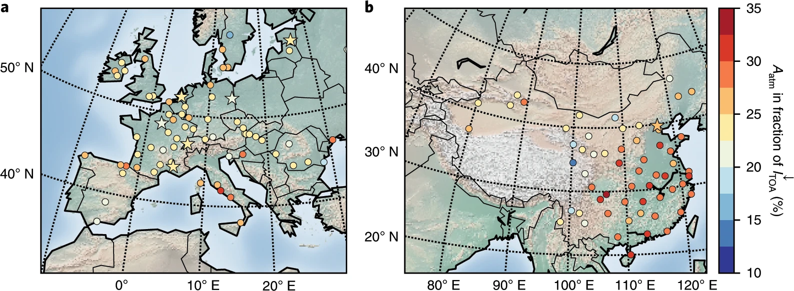
Observed
Changes in shortwave absorption
- Combine TOA & surface obs
- Surface dimming then brightening after air pollution control
- Atmospheric absorption more important than previously thought
- Implications for water cycle e.g. Wilcox et al. (2020) ACPD
Schwarz et al. (2020) Nature Geosci.

Slide 14
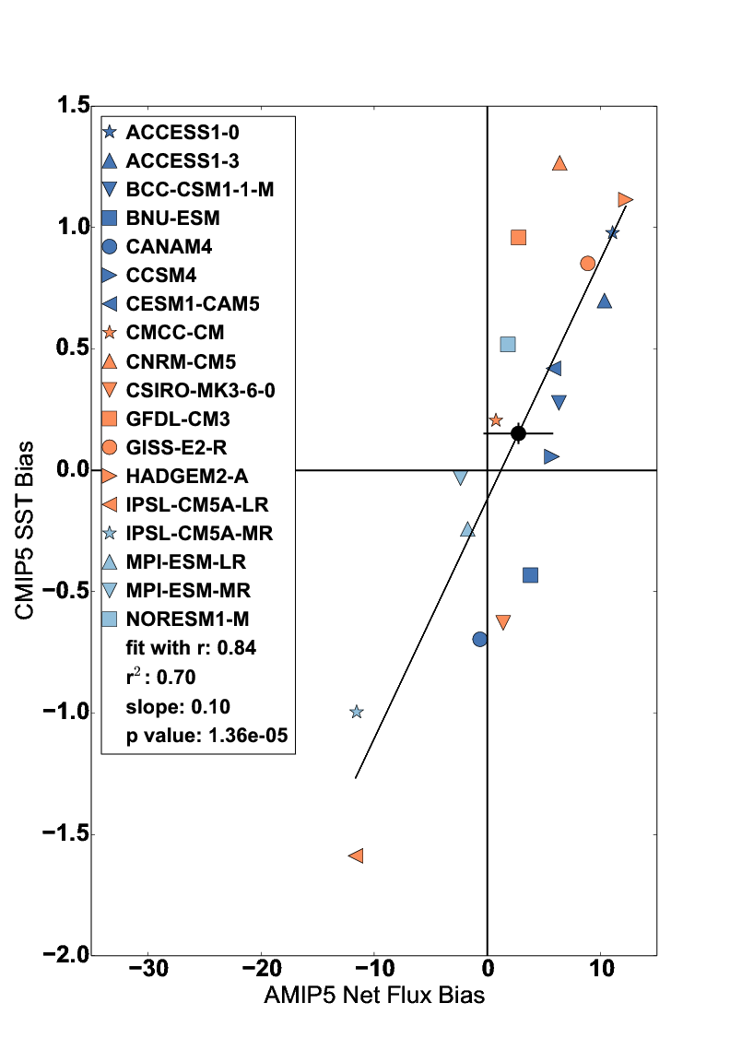
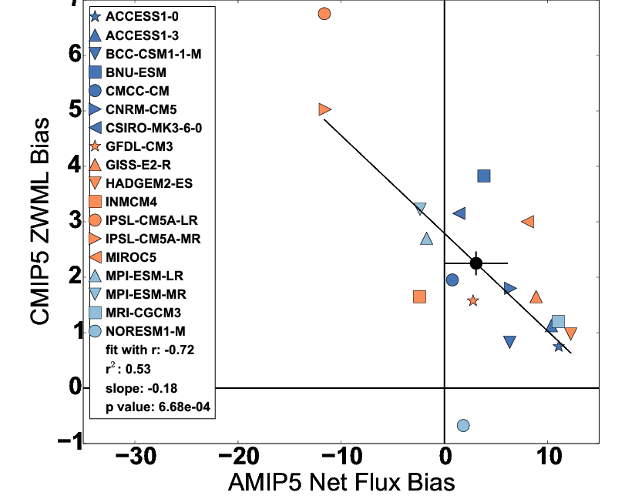
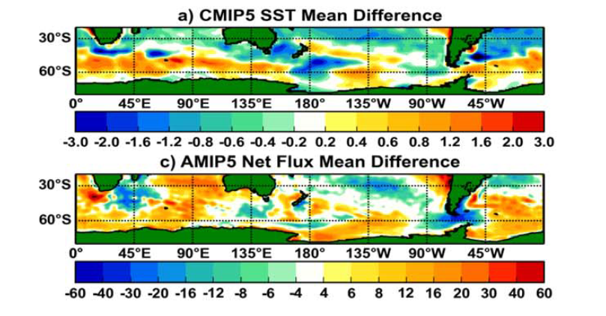
CLIMATE model biases in SOUTHERN OCEAN
Influence Asymmetry
Use surface flux product to trace causes of coupled SST biases to atmospheric model processes
Biases in AMIP5 simulations of cloud linked to SST & zonal wind maximum latitude (ZWML) bias
Hyder et al. (2018) Nature Comms
CMIP5 SST bias

Slide 15
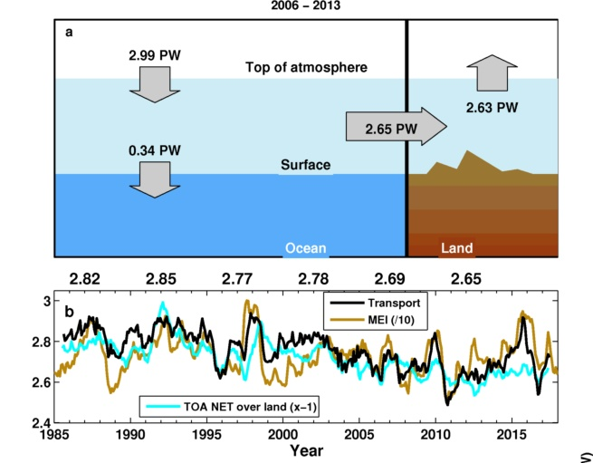
Ocean and land energy budget
Liu et al. in prep
Notes:
(a) Updated observations of energy flows between ocean and land regions in the climate system in petawatts (PW) over 2006–2013. TOA radiative flux is from CERES EBAF 4.0 anchored to 0.71 Wm-2 (0.36 PW) over 2006–2013. (b) Time series of the transport from ocean to land, together with the MEI index which is divided by 10 and shifted up to match the transport. The five year mean transports are displayed at the top.

