Slide 1

The Science of Climate change
Department of Meteorology
Professor Richard Allan @rpallanuk r.p.allan@reading.ac.uk
Virtual Global Citizens Conference, 12th November 2020
Notes:
OPEN IN CHROME:
https://scratch.mit.edu/projects/179953994
https://www.youtube.com/watch?v=tGqM1ZtOX7c
http://www.met.reading.ac.uk/outreach/docs/Upscale_climate_simulation.mp4
CLIMATE OUTREACH – here for Year 9 (age 13-14) ~45 minutes but plenty of extra slides for a longer session.
ACTIVITIES:
Infrared thermometer to demonstrate greenhouse effect
Scratch energy balance demonstration
Students demonstrate feedback loop
INTRODUCTION – see notes on next slide.
INTRO:
Why did I get interested in weather and climate, what I needed to study to be climate scientist
I talk about ice ages as getting me interested, you can mention that 20,000 years ago ice sheets crossed northern Britain and sea levels were >100m lower while global temperature was just 4-5oC lower than now.
Glacial cycles operate over tens of thousands of years, very slow compared to human civilisations (modern humans ~200k yr, modern societies last few thousand).
Climate has always changed (e.g. plate tectonics 100s Myr, glacial cycles, 10s kyr, changes in the sun and volcanic eruptions)
Ice cores drilled into Antarctica are like time machines going back nearly 1million years – they show natural swings in temperature, ice and sea level and natural greenhouse gases such as CO2
But now CO2 is nearly 50% higher than at any time over past million years
Human activities are causing the climate to heat up, but how does this work?

Slide 2
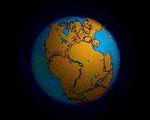
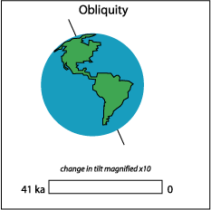
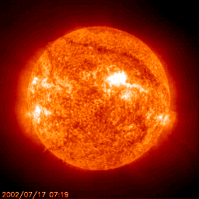
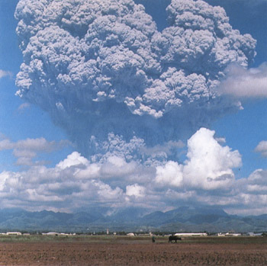
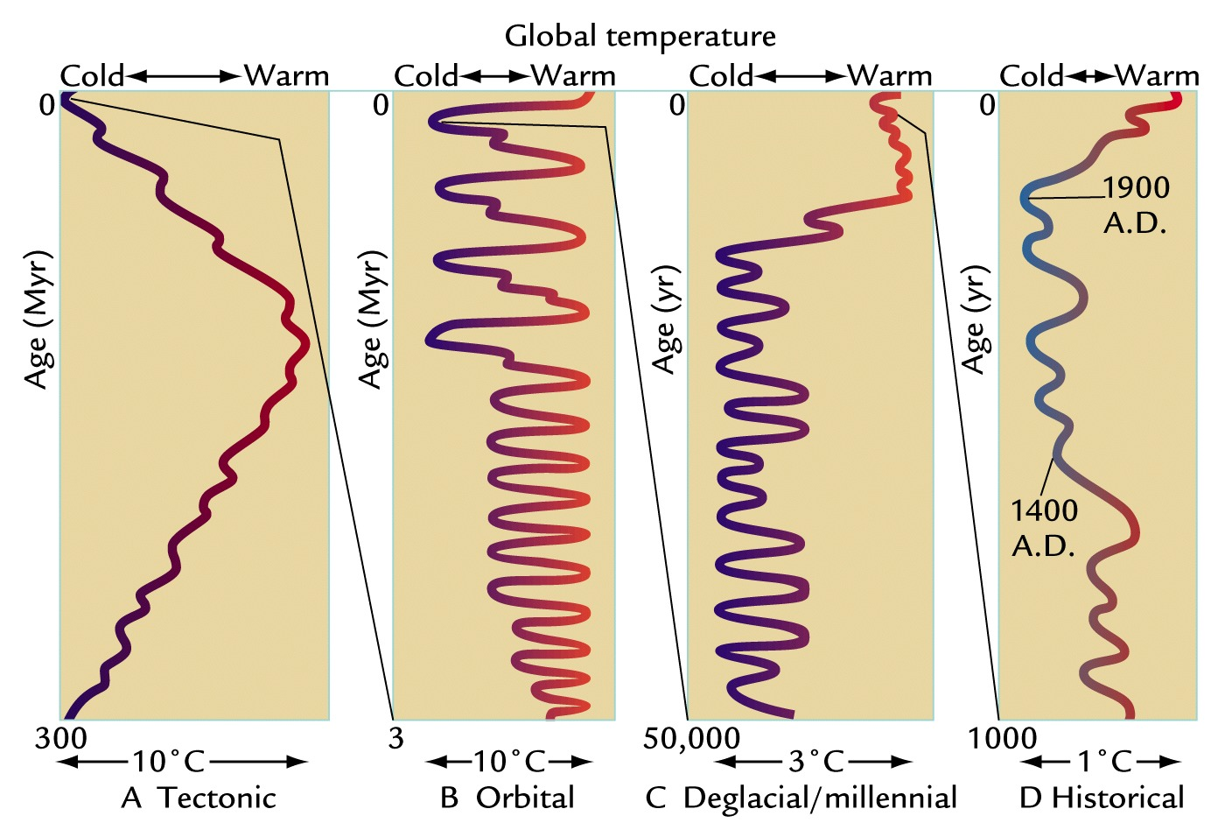
Earth’s Climate has always been changing
Ruddiman WF. 2001
Earth's Climate, Past and Future
Notes:
FIGURE 1-3 Time scales of climate change Changes in Earth’s climate span several time scales, arrayed from longer to shorter: (A) the last 300 million years, (B) the last 3 million years, (C) the last 50,000 years, and (D) the last 1000 years. Here progressively smaller changes in climate at successively shorter time scales are magnified out from the larger changes at longer time scales.
[Ruddiman WF. 2001. Earth's Climate, Past and Future. New York: W. H. Freeman.]
Climate changes on all time-scales. One of the most important determinants of climate is variations in the absorption of solar radiation by the planet.
Over billions of years the solar output has increased with time, as has the evolution of the Earth’s atmosphere and distribution of land and ocean which modifies the efficiency at which the Earth can cool to space via thermal/long wavelength radiation as well as impacting absorption of sunlight.
Over tens and hundreds of thousands of years, changes in the Earth’s orbit around the sun alter the amount of solar radiation reaching different parts of the planet. These cycles are predictable (they depend upon the gravitational pulls of the sun, planets and the moon) and they are widely believed to have caused glacial-interglacial cycles in which global temperatures swing by up to 10ºC. However, crucial to these swings are feedbacks which either amplify or dampen the radiative forcing from these Milankovic cycles. For example, cooler temperatures lead to more ice and greater reflection of solar radiation which amplifies the cooling.

Slide 3
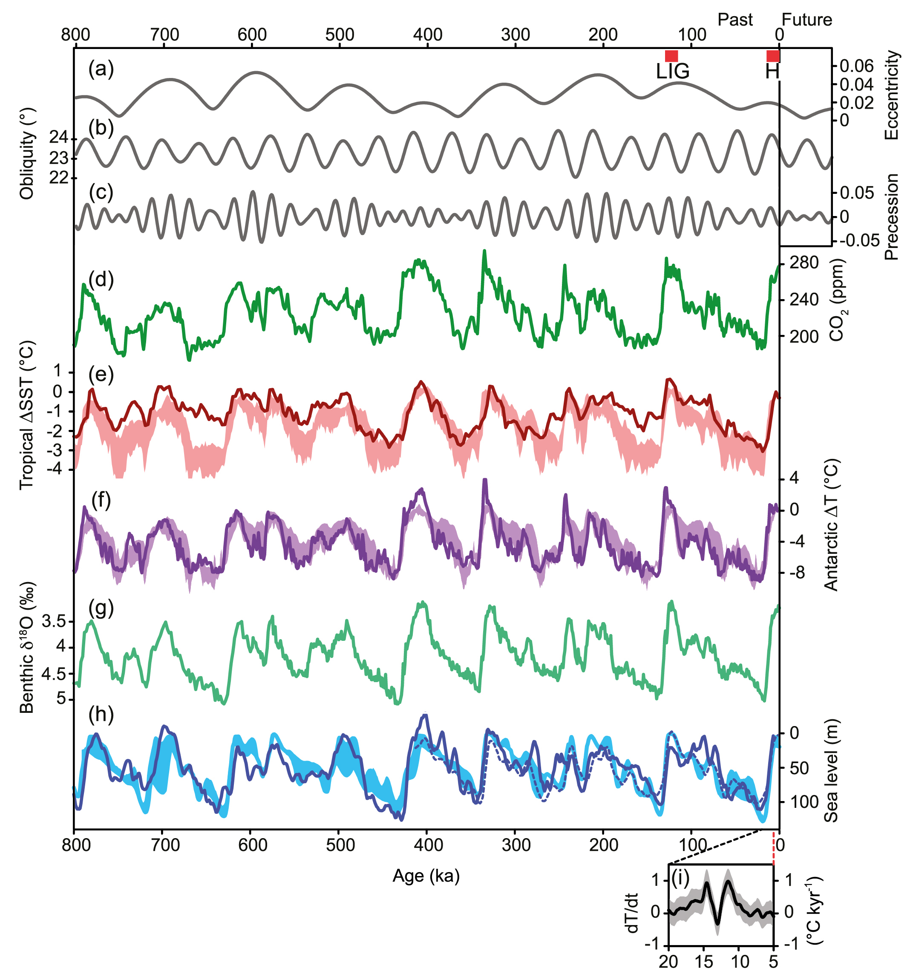
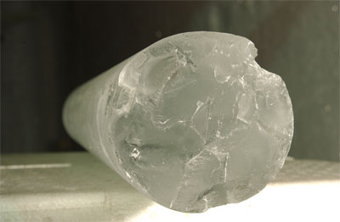


Climate change over last 800,000 years
413 ppm
CO₂
Antarctic Temperature
8ºC
Ice volume proxy
Sea level
Modern humans
100m
IPCC (2013) Chap. 5 Fig 5.3
Africa →
Europe
Agriculture
Notes:
During colder glacial periods:
More ¹⁶O locked away in ice sheets so higher ¹⁸O in oceans & air bubbles in ice cores: ice volume
Larger equator to pole temperature gradient leading to greater depletion of ¹⁸O in snow compacted in ice cores
Ice cores from Antarctica provide abundant evidence of climate change over the past 800,000 years. Trapped air bubbles record past atmospheric composition, including carbon dioxide and methane, and isotopic analysis of oxygen and hydrogen in the air bubbles or of the ice itself can tell us indirectly about changes in Antarctic temperature (or temperature difference between tropics and poles) and ice volume (additional evidence from ocean sediments is also particularly valuable). A series of milder interglacials punctuate the longer glacial periods of low temperature and high ice volume, the timings of which relate to changes in the Croll-Milankovic orbital cycles. Natural changes in carbon dioxide (and methane) in response to the substantial climate changes act to amplify the temperature responses over glacial cycles (more next week).

Slide 4
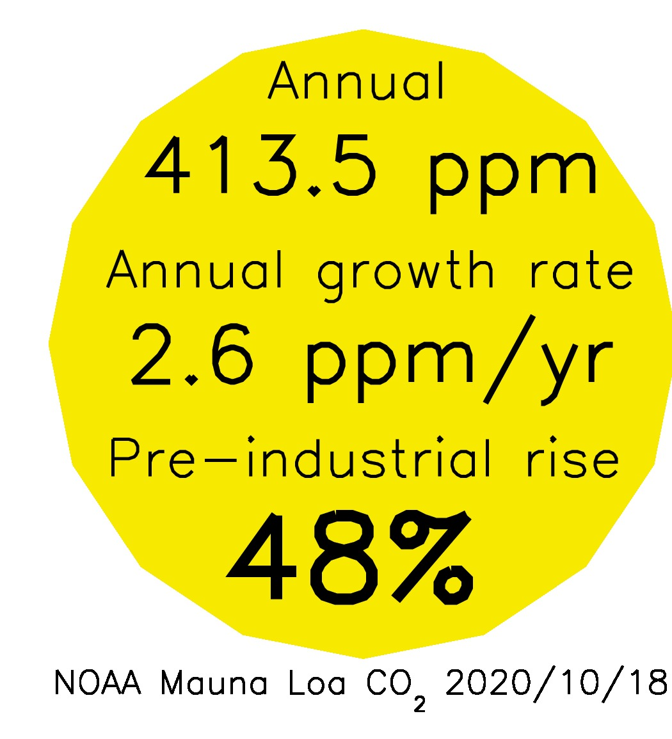
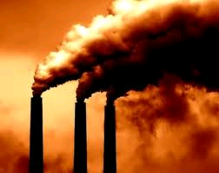
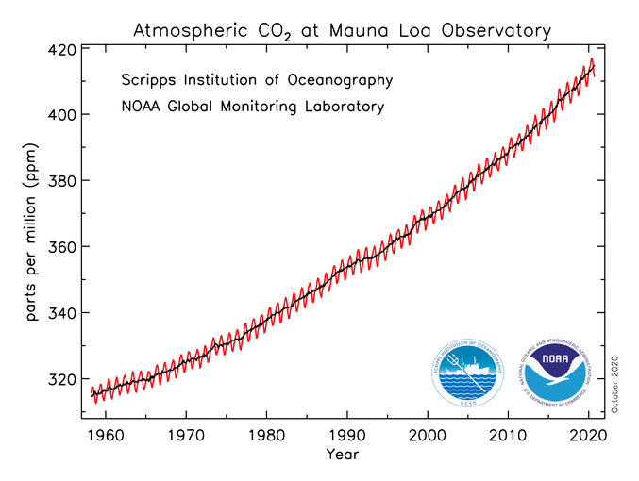
CO₂ Emissions are heating planet
Increases in greenhouse gases heat the planet by reducing how easily Earth can cool to space through infra-red emission
More small pollutant “aerosol” particles cool the planet by reflecting sunlight
More energy is arriving than leaving: Earth is heating up…
Currently energy is accumulating at rate equivalent to every person currently alive using 20 kettles (2kW) each to boil oceans (or about 300 trillion watts) Allan et al. (2014)

Slide 5
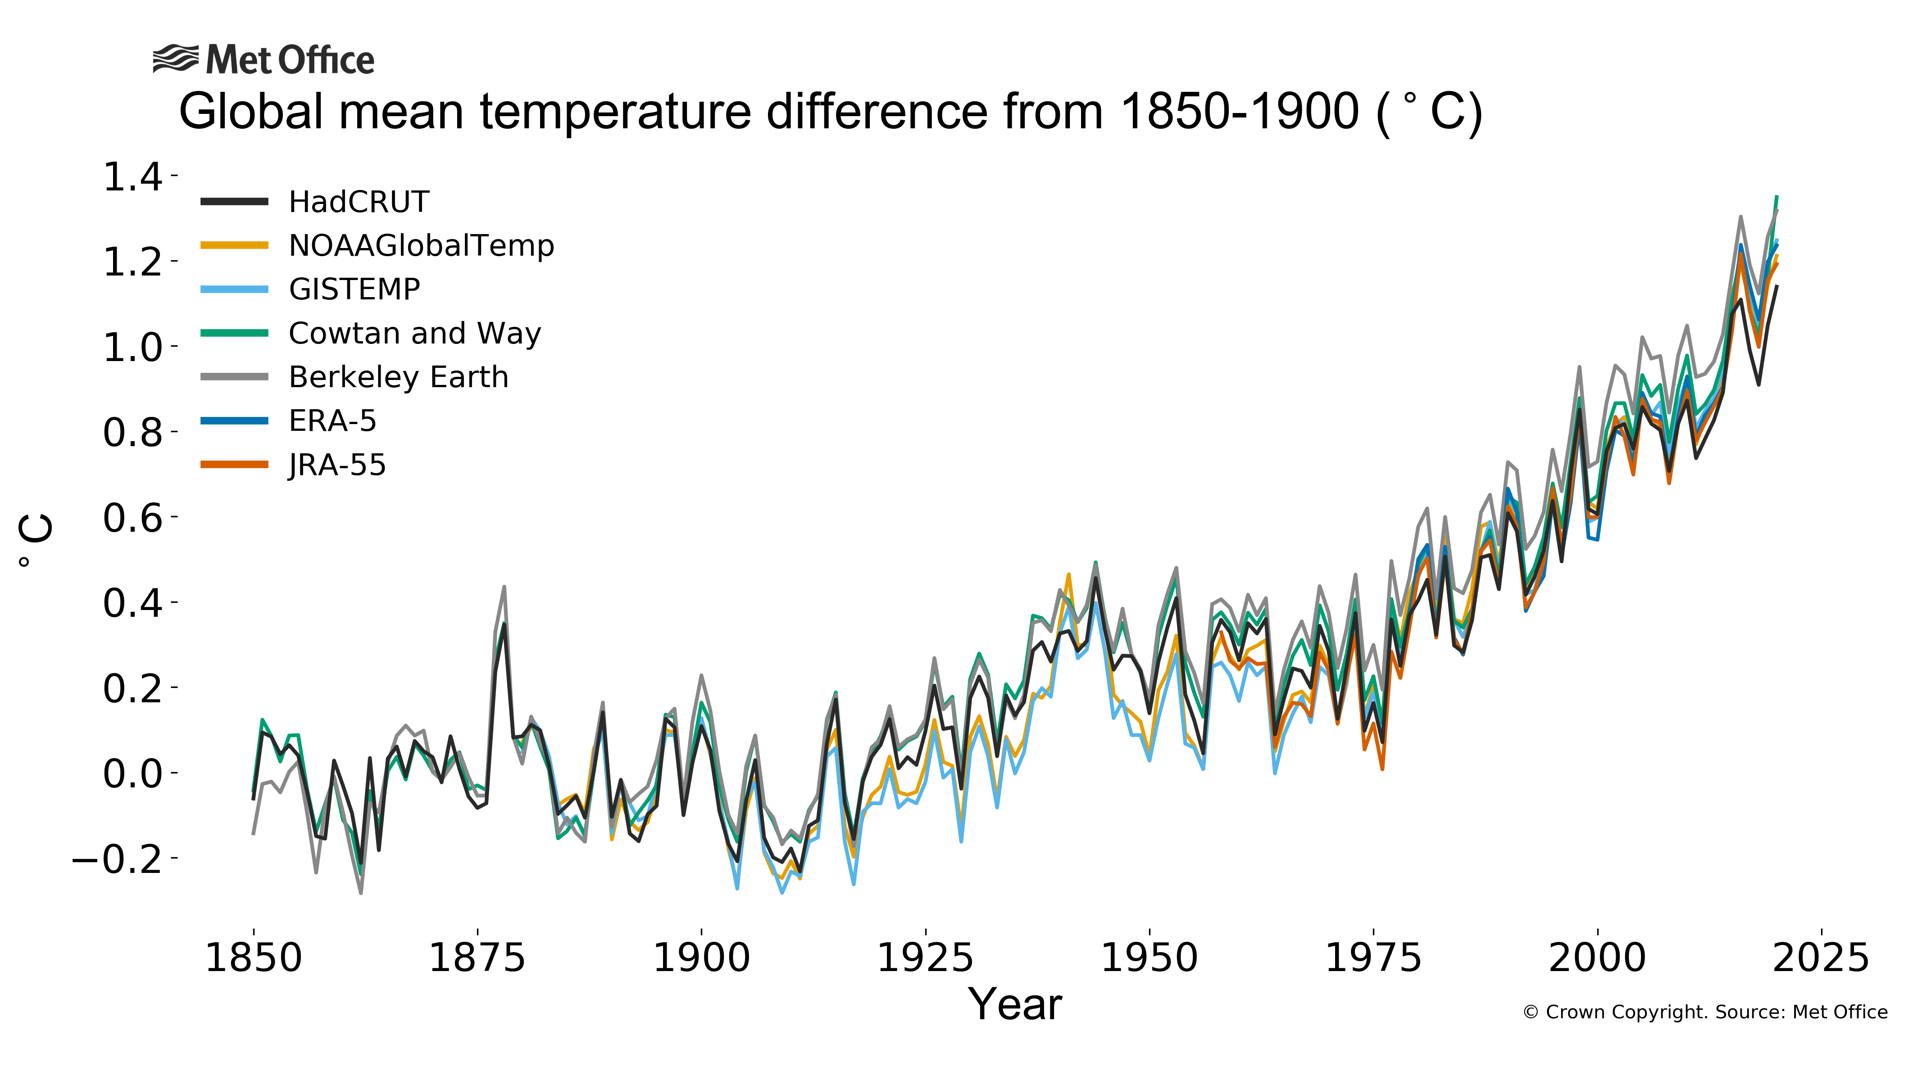
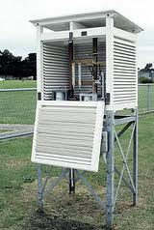

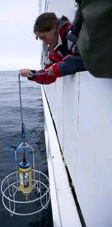
The planet is warming
1.5ºC above “pre-industrial”
47 years
https://www.metoffice.gov.uk/hadobs/monitoring/dashboard.html
Notes:
The instrumental record goes back to about 1850. A few areas of the globe have not warmed in recent decades, mainly over some parts of the Southern Hemisphere oceans and parts of Antarctica. The rate of surface warming is not smooth; there are lumps and bumps in the record and this rate has slowed in the recent decade.

Slide 6
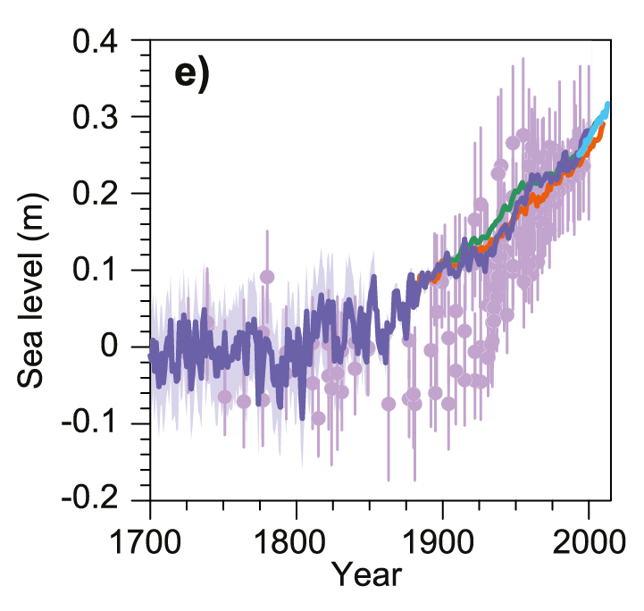
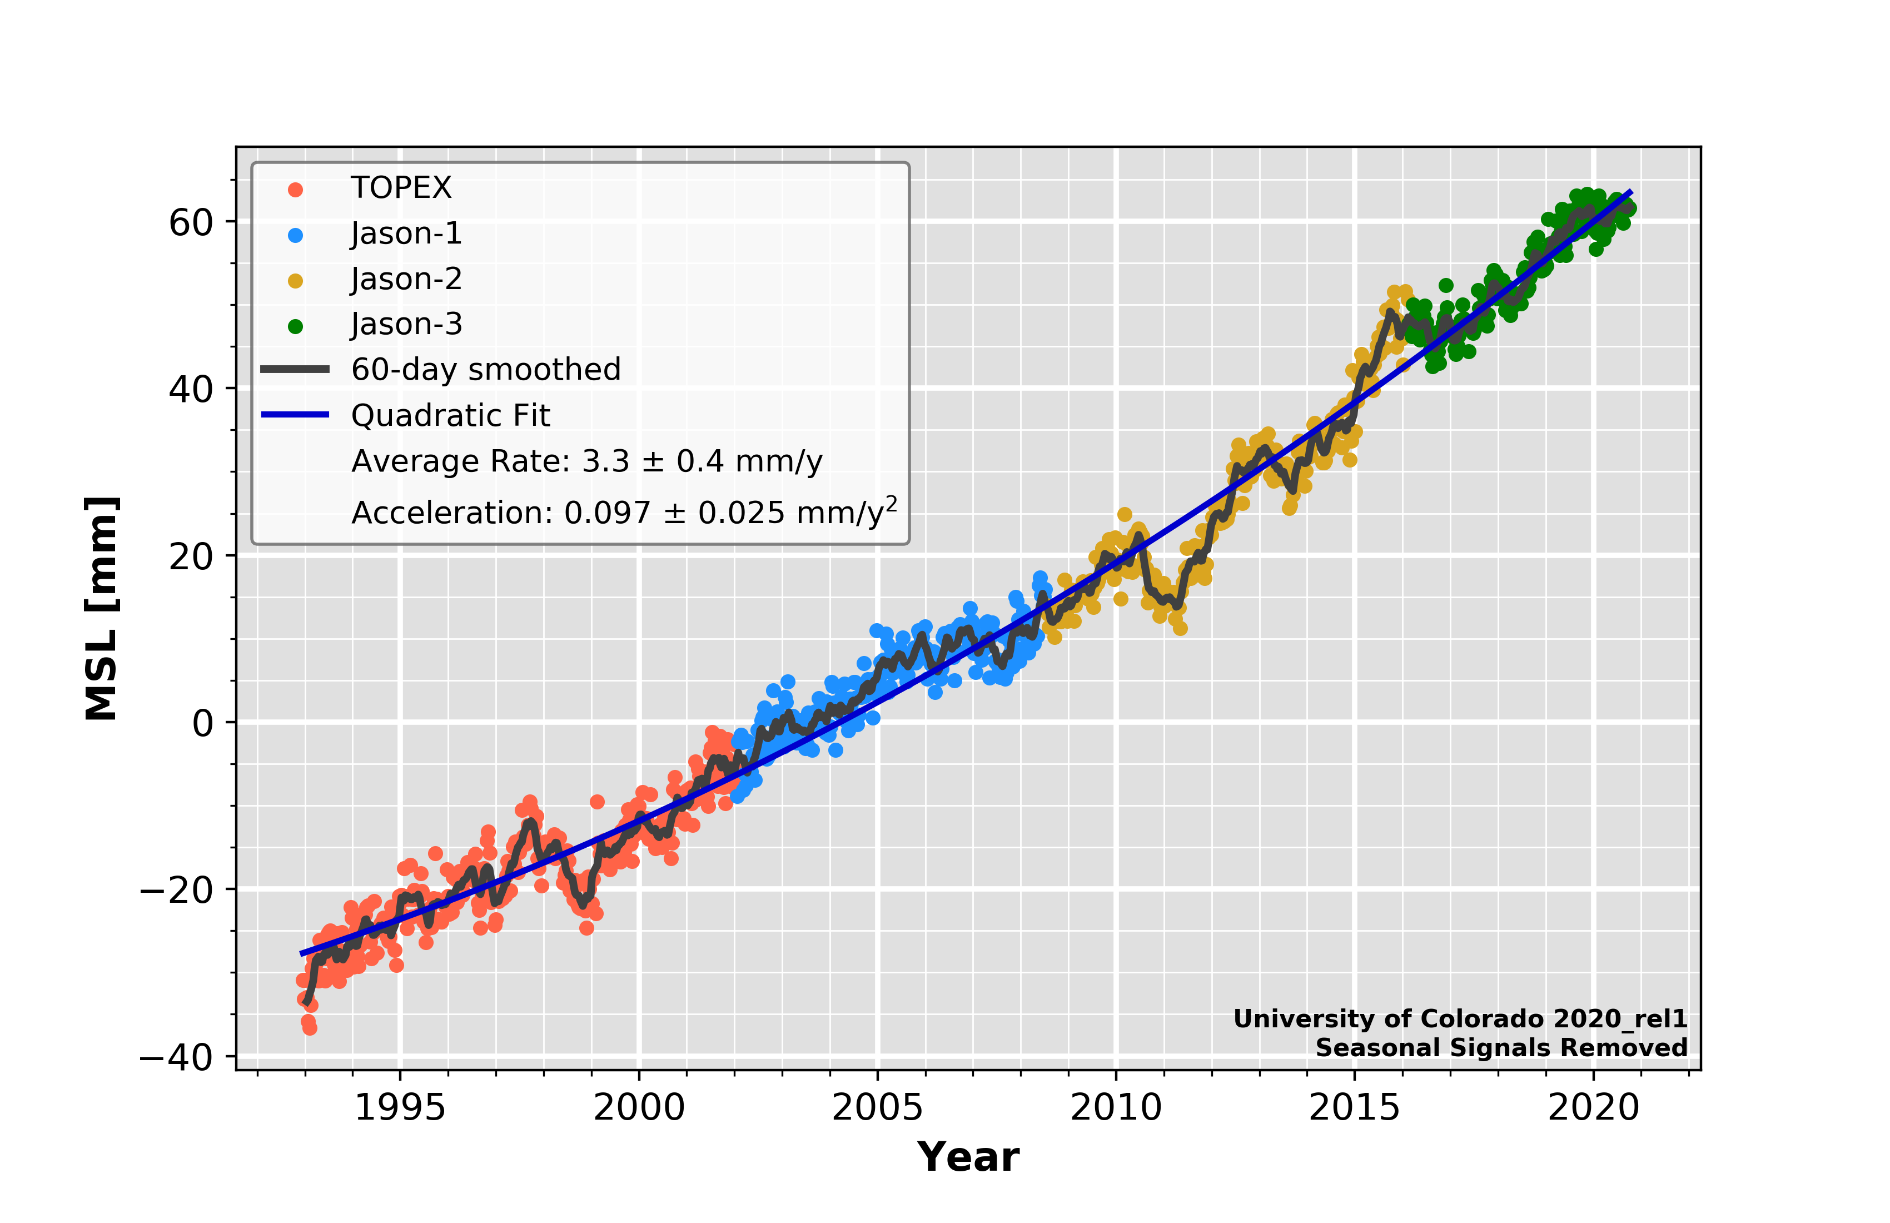
Global average sea level is rising…
Satellite Altimeter data
● paleo data
– tidal gauges – –
10cm in 30 years
http://sealevel.colorado.edu/
IPCC (2013) Figure 13.3
Notes:
Are there other indicators of the warming? Global sea level has risen, based on historical proxy data and tidal gauges that have been adjusted to allow for rising and falling of land and other factors. Global sea levels have risen about 20cm over the past 100 years – a rate of about 2mm a year. This is faster than the rise over any of the last 5000 years (less than 1mm a year), but still slower than the average rise of 5mm a year predicted for the next 80 years. Most of this rise occurs because as the oceans get warmer, their water takes up more space (thermal expansion). Melting glaciers in the Andes, Himalayas, the Rockies and the Alps are increasingly contributing to sea level rise and melting of ice sheets at the periphery of Greenland and Antarctica are increasingly contributing.

Slide 7
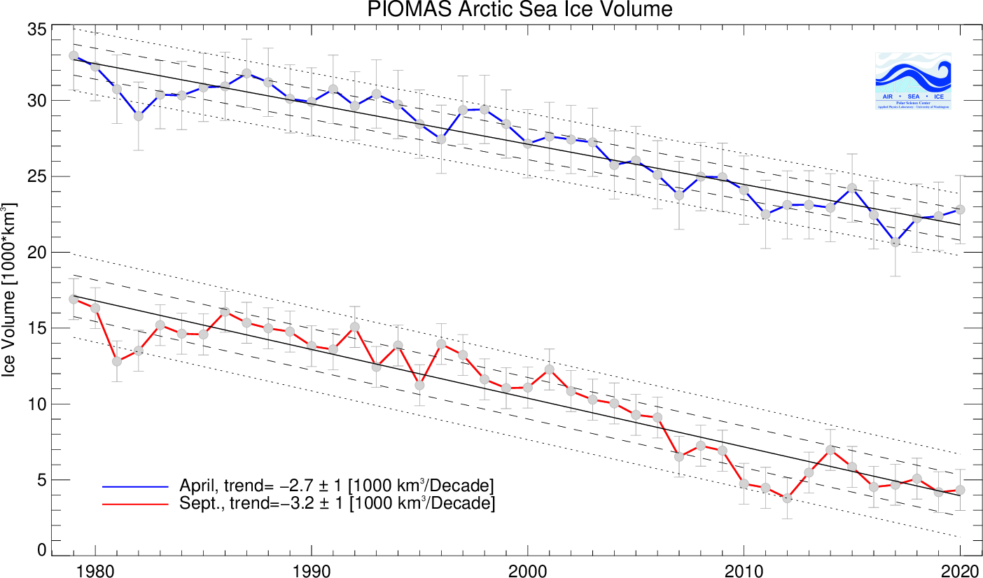
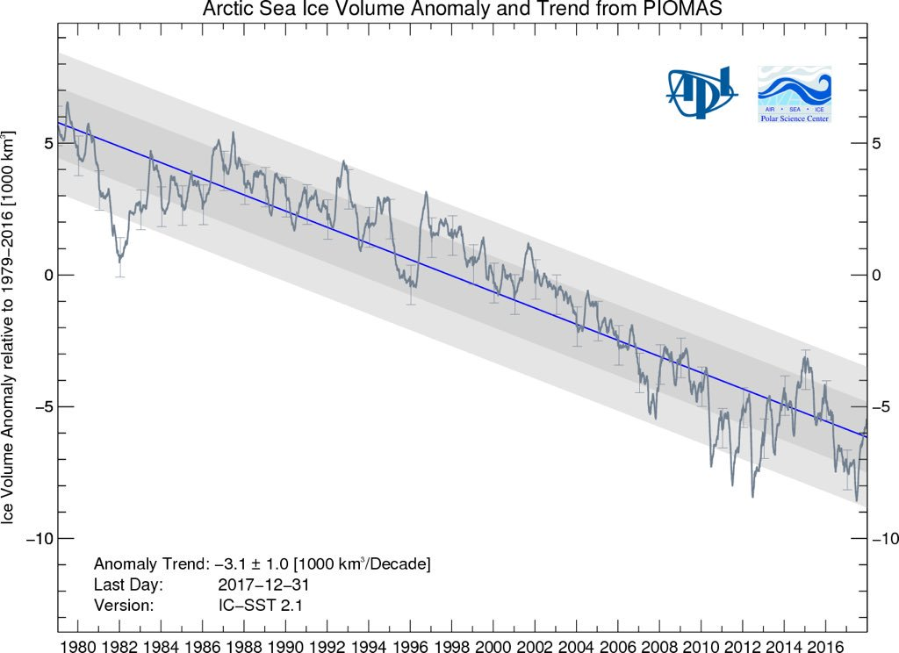
Arctic sea Ice IS MELTING
~3000 cubic km Artic sea ice lost per decade
NSIDC :
psc.apl.washington.edu/research/projects/arctic-sea-ice-volume-anomaly/
Notes:
Greenland is losing 300 Gt of ice every year = 3x10^9 t = 3x10^12 kg (3000 billion kg)
Elephant 6000 kg = 6 tonnes → 300 billion tonnes = 50 billion elephants (1 millionx elephant population)
Artic ice losing 300 km^3 ice per year (100 million Olympic Swimming Pools per year).
(3x10^11 m^3 ~ 1x10^8 swimming pools (100 million)
Olympic Swimming Pool: 2500 m^3
Changes in atmospheric and oceanic circulation cause variability in the coverage of Arctic sea ice. However, the declining coverage in the satellite record (passive microwave measurements made since 1979) is robust and further, there has been a drop in “old” ice (older than 2 years for example) since the grand minimum coverage in 2007 with a larger fractional coverage of young <1 year old ice (which is more transient in nature meaning that it can melt and reform more quickly).

Slide 8
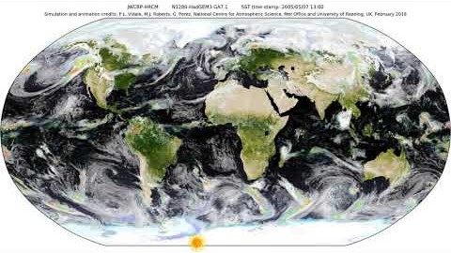
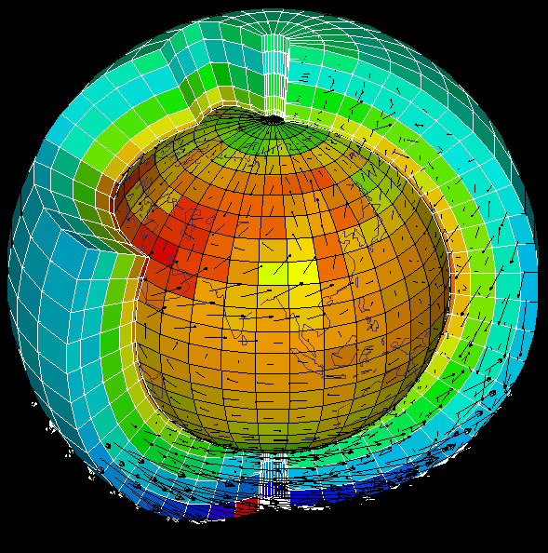
What are the predictions?
Physics of atmosphere, ocean & land encapsulated in millions of lines of computer code to construct climate simulations used to:
  understand past climate change
  project how climate will change over future decades and centuries
← By Pier Luigi Vidale (NCAS, University of Reading)
Notes:
To understand climate and make predictions of future climate change, scientists need to build complex simulations that are built on observations-based physics equations
These need to represent all the feedback loops
The atmosphere, oceans and surface are slit into millions of blocks, equations calculated for wind, cloud, vegetation, etc and information passed from cell to cell (just like students in classroom)
SHOW ANIMATION as an example
By prescribing scenarios in which atmospheric constituents change in response to human-related emissions and changes in natural forcing agents such as the sun or volcanos, experiments can be made with climate models to see how well they reproduce the past climate and then what they project for future climate.

Slide 9
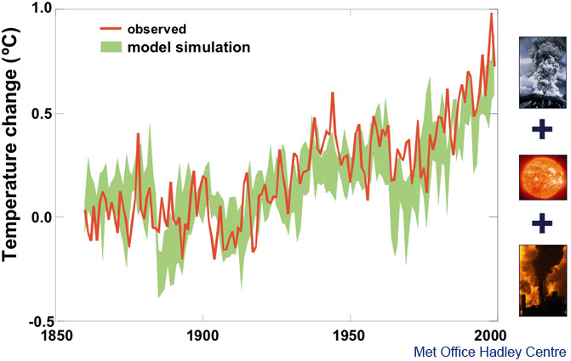
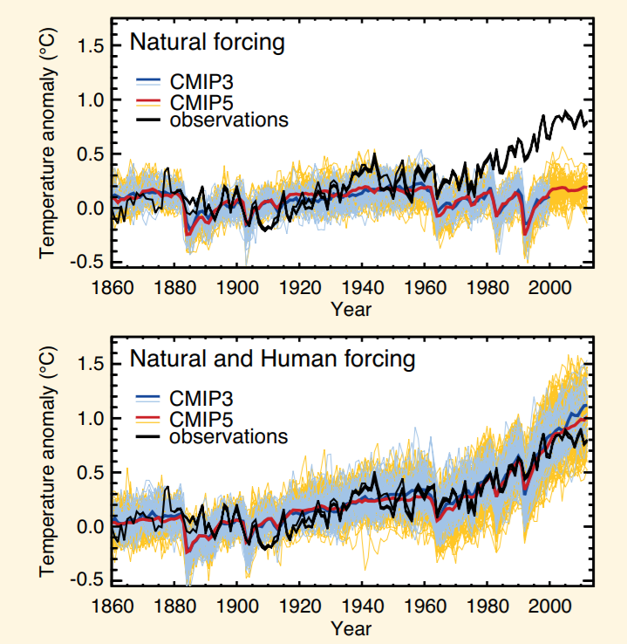
Natural factors can’T explain warming
Simulations
See IPCC FAQ 10.1 and Summary for Policy Makers Fig. 6
Notes:
As we have already outlined, natural factors include a chaotic variability of climate due largely to interactions between atmosphere and ocean, changes in the output of the Sun and changes in the optical depth of the atmosphere from volcanic emissions. Climate models have been driven by changes in all these natural factors, and it simulates changes in global temperature shown by the blue band in the slide above. This clearly does not agree with observations, particularly in the period since about 1970 when observed temperatures have risen by about 0.5 °C, but those simulated from natural factors have hardly changed at all.

Slide 10
Natural factors can’T explain warming
Simulations
See IPCC FAQ 10.1 and Summary for Policy Makers Fig. 6
Notes:
As we have already outlined, natural factors include a chaotic variability of climate due largely to interactions between atmosphere and ocean, changes in the output of the Sun and changes in the optical depth of the atmosphere from volcanic emissions. Climate models have been driven by changes in all these natural factors, and it simulates changes in global temperature shown by the blue band in the slide above. This clearly does not agree with observations, particularly in the period since about 1970 when observed temperatures have risen by about 0.5 °C, but those simulated from natural factors have hardly changed at all.

Slide 11
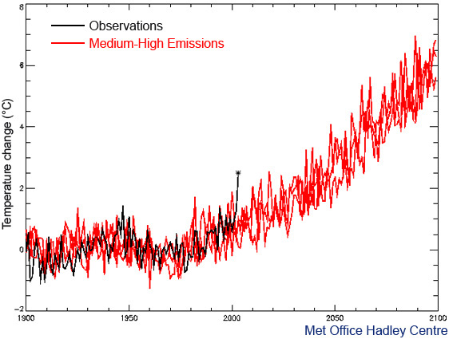

How will climate change over OUR lifetimes?
70
70
70
European summer temperature change (ºC) -2 0 2 4 6 8
1900 1950 2000 2050 2100
Notes:
2003 heatwave – students were embryos! Many died in France
My Dad was 70 5yrs ago
When I’m 70 2003 extreme temperature may be normal
When my son and students are 70 such “cold” summer temperatures will be unheard of! (but it’ll be a different sort of heat)
Notes:
The simulation from 1900 to 2000 agrees well with the observations (black), except for the summer of 2003 (black asterisk) which was much warmer than either the model simulation or the climatic norm. In the absence of any human modification of climate, temperatures such as those seen in Europe in 2003 are estimated to be a 1-in-1,000 year event. Despite this, it is seen that, by the 2040s, a 2003- type summer is predicted to be about average, and by the 2060s it would typically be the coldest summer of the decade. Recent work has demonstrated that hot, 2003-type, European summers would already be being experienced much more frequently (more than once per decade on average) were it not for the cooling effect of man-made sulphate aerosols. Once the shielding effect of these aerosols is removed, the warming commitment from past greenhouse gas emissions will mean that such hot summers are likely to become a regular occurrence, even without any further man-made greenhouse warming.

Slide 12
Future projections
1.0
0.8
0.6
0.4
0.2
0.0
High emissions
Low emissions
(m)
“Continued emissions of greenhouse gases will cause further warming and changes in all components of the climate system. Limiting climate change will require substantial and sustained reductions of greenhouse gas emissions.”
IPCC (2014) WG1 Summary for Policy Makers
Notes:
Higher emissions (e.g. burning coal/oil) = bigger impact (so reduce emissions)
High emissions: 4oC warming by 2100 (kids will be very old) – note that last ice age, global T only about 4-5oC colder
Notes:
Increase of global mean surface temperatures for 2081–2100 relative to 1986–2005 is projected to likely be in the ranges 0.3°C to 1.7°C for the lowest emissions scenario (RCP2.6) and 2.6°C to 4.8°C for the highest emissions scenario (RCP8.5). The Arctic region will warm more rapidly than the global mean, and mean warming over land will be larger than over the ocean.
Global mean sea level rise is projected to range from 0.52 to 0.98 m by 2100 for RCP8.5, with a rate during 2081 to 2100 of 8 to 16 mm per year. Further uptake of carbon by the ocean will increase ocean acidification.
Heavy rainfall is expected to become more intense with wet regions generally seeing more rainfall and dry sub-tropical regions or seasons less.
For further details, see the IPCC (2014) WG1 Summary For Policy Makers, Section E.

Slide 13
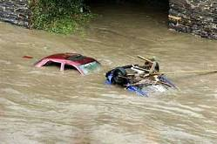
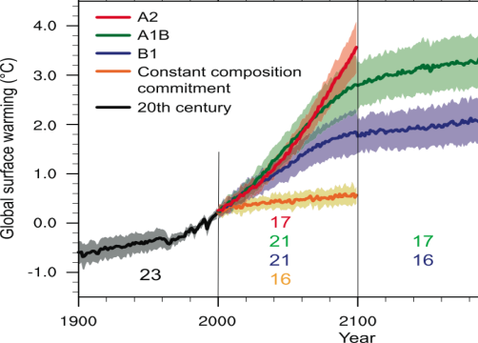
Climate change
Climate has always changed
Greenhouse gases such as carbon dioxide are at their highest levels for at least the last 800,000 years
This pollution from human activity is amplifying the natural greenhouse effect
This is heating the planet by impeding outgoing infrared cooling to space
Substantial changes in global temperature and rainfall patterns are projected using computer simulations
Predicting regional climate change is a challenge
Limit dangerous climate change requires substantial and sustained reductions of greenhouse gas emissions
Notes:
Summary and what can we do?? Questions?
Notes:
Scientists are now even more certain that the current warming since the mid-20th century is primarily due to mans impact on the atmosphere via fossil fuel burning, agriculture and changes in land-use.
Much of this certainty comes from the observations but a large component comes about applying physical laws and theory, refined by the observations, to develop sophisticated computer models of the Earth’s environment that help to understand the reasons for the warming and to enable predictions of future climate change over the next few hundred years…

Slide 15
COP21 Paris Climate Deal source: http://www.carbonbrief.org/analysis-the-final-paris-climate-deal
Target: global temperature well below 2ºC; efforts to limit to 1.5ºC
Mitigation: pursue policies aiming to achieve INDC climate pledges; subsequent pledges progressively more ambitious; global stocktake 2018 & then every 5 years; peak global greenhouse gas emissions “as soon as possible”; “balance” between emissions & sinks 2050-2100
Adaptation: $100bn/yr fund for developing countries: new collective quantified goal by 2025; periodic review of adaptive planning of Loss & damage has its own Article in the agreement — now on par with mitigation & adaptation; liability/compensation excluded.
Transparency: "facilitative, non-intrusive, non-punitive” system of review will track countries’ progress; emissions trading allowed; aviation/shipping not included
Treaty: deal enters force once 55+ parties, covering at least 55% of global emissions have signed up

Slide 16
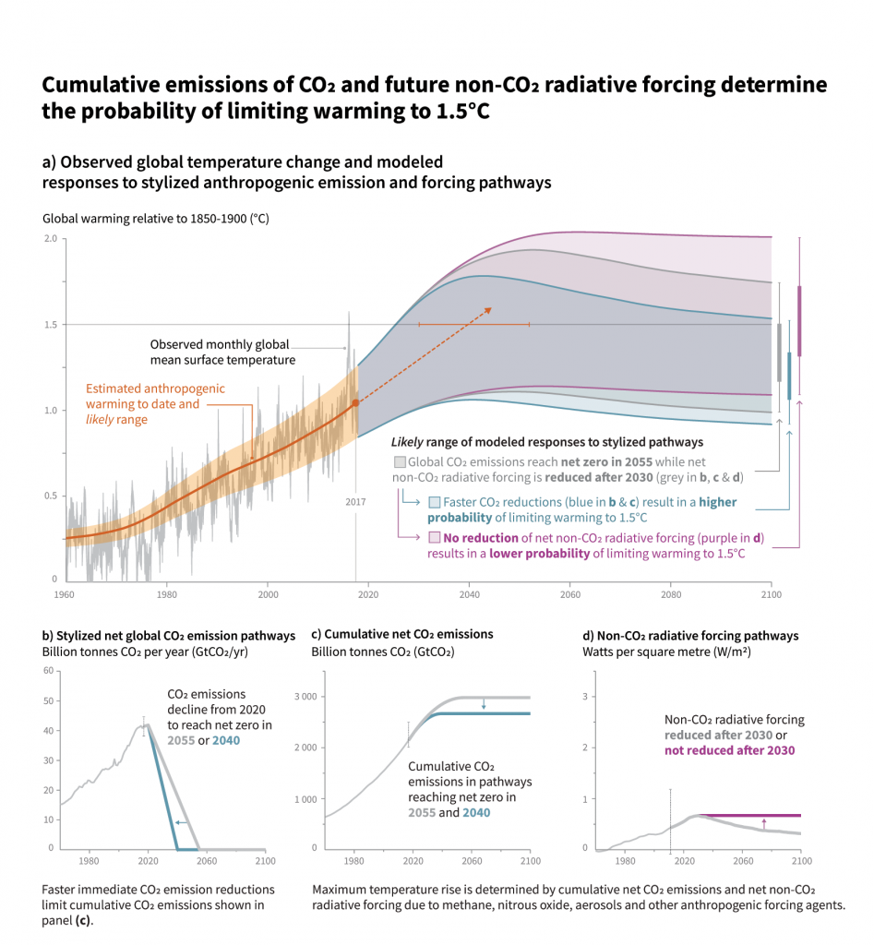
Act now
  To keep future options open
Act everywhere
  Efforts in all sectors are needed to reach global zero CO₂ emissions
Act thoughtfully
  Develop strategies maximising synergies and taking into account the local context, use a wide array of measures and actions
Act jointly
  Collaboratively and including national and sub-national authorities, civil society, the private sector and local communities
Joeri Rogelj (IPCC SR1.5 author)

Slide 17
Natural & man-made carbon cycles
Annual transfers,
natural and human-made (GtC)
1.1
7.8
ATMOSPHERE
1.7
5.4
3.3
4.0
2.6
2.3
1.9
1.9
60
90
60
110
OCEAN
LAND
Source: IPCC
Values in billions of tonnes of Carbon per year from IPCC (2013) Fig. 6.1
Notes:
The emission of CO₂ into the atmosphere (7.8 Giga tonnes of Carbon, GtC, per year) is small relative to the natural fluxes between land/ocean and atmosphere (170 GtC/year). Crucially, however, the natural carbon budget is in balance, so the emissions of CO₂ from fossil fuel burning (and land use changes) are causing a perturbation to the carbon balance of the atmosphere not seen for more than 800 000 years based upon ice core measurements.
Some of the excess CO₂ in the atmosphere is absorbed by the land and ocean but a large amount is stored in the atmosphere as CO₂. This build up of Carbon in the atmosphere at the rate of 4 GtC per year primarily reflects the increased atmospheric concentrations of CO₂.
Changes in this carbon balance in the future may yield a further slow positive feedback to climate change…

Slide 18
Warming will be greater over the land and greatest in the Arctic
Change in average surface temperature (1986−2005 to 2081−2100) RCP 8.5 Scenario
Notes:
CAN SKIP TO SUMMARY IF SHORT OF TIME, just mention sea level rise and intensification of rainfall to link with impacts.
Land will warm up more than ocean, Artic the most.
Notes:
Models show a stronger warming over land and over polar regions compared to the oceans due to changes in circulation but also due the large heat capacity of the deep oceans.
Temperatures over land are expected to increase about twice as rapidly as temperatures over the ocean. The annual average warming by 2100 over land areas, where of course we live and work, is predicted to be in the range 3 °C to 8 °C for the high emissions scenario. Although the Earth's temperature has varied considerably over the last 1,000 years for natural reasons, the rise over the next 100 years due to human activities is predicted to be very much larger than natural variability, even with the lowest projected man-made emissions scenario.

Slide 19
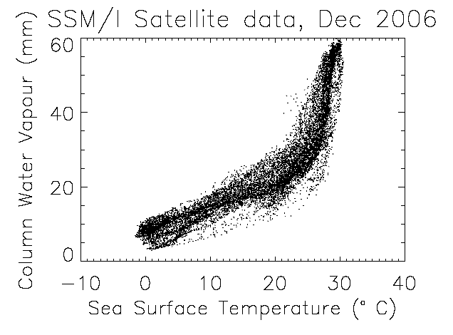
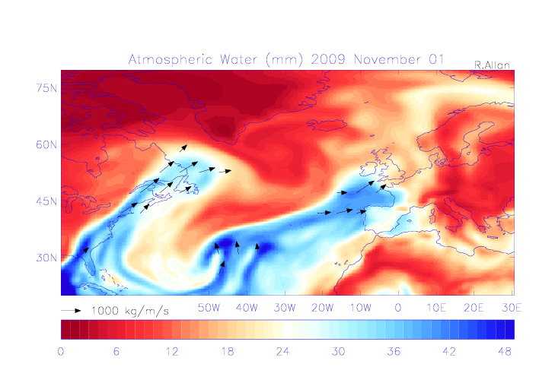
THE WATER
CYCLE IS Changing
Water vapour - a powerful greenhouse gas that increases with warming
amplifies climate change
intensifies extreme rainfall
← Nov 2009 Cumbria flooding event
atmospheric “thirst” for water vapour increases
more intense droughts
The weather will always generate extreme rainfall and droughts events but warming of climate will increase their severity
Lavers et al. (2013) Environ. Res. Lett.

Slide 20
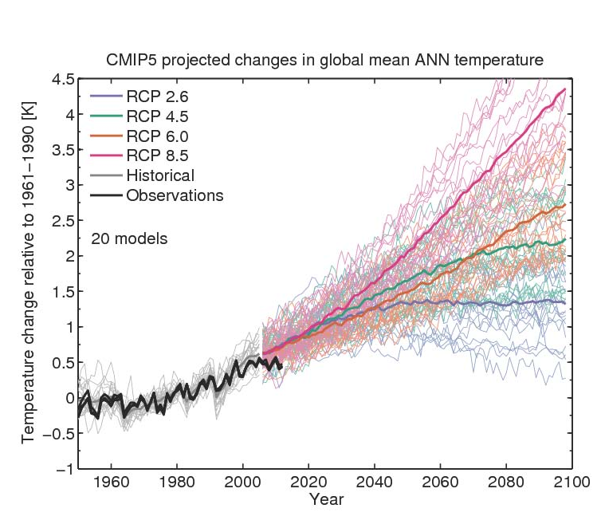
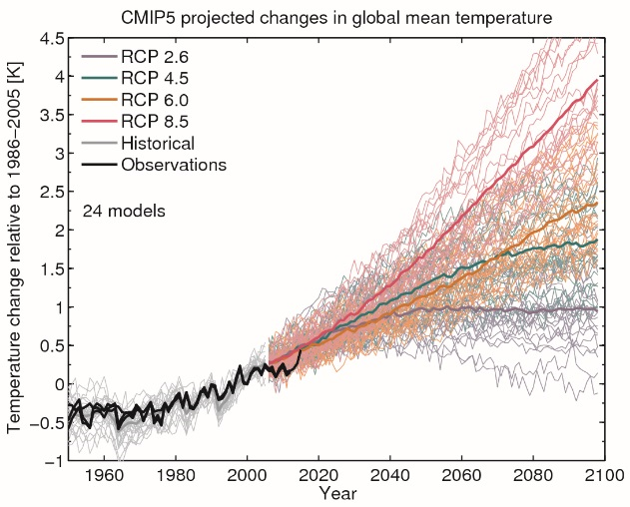
How much will planet warm?
Climate sensitivity and socioeconomic scenario
Climate sensitivity
By Ed Hawkins: see Climate Lab Book

Slide 21
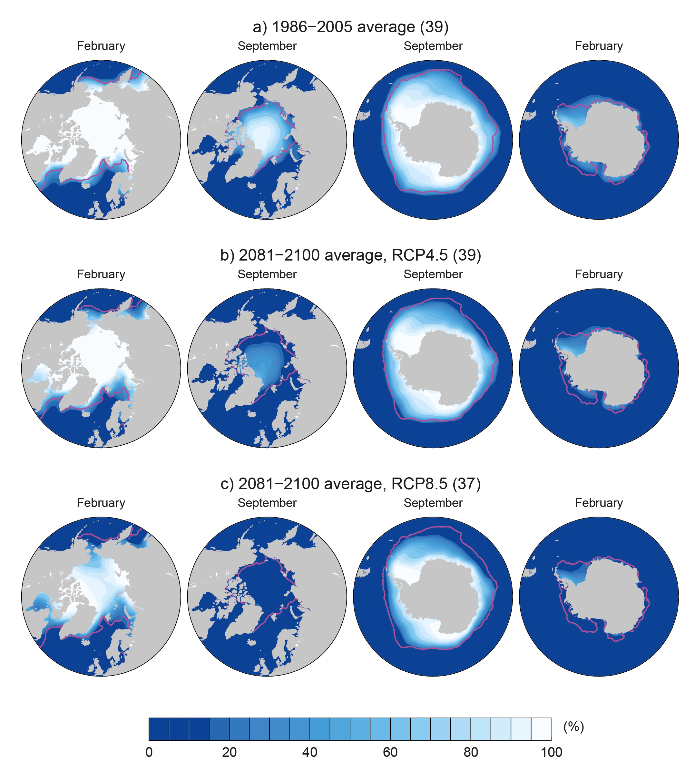

Projections:
Arctic sea ice extent decline in 21st century
2081-2100 (RCP 8.5) 1986-2005
94% decrease in September
34% decrease in
February
high emissions scenario
IPCC (2013) WG1 Fig. 12.29
Notes:
Arctic ice is melting at a rate of 3000 cubic km per decade.
Note: O2 Arena is about 4 million m^3 (0.004 km^3) so ¾ million O2 Arenas per decade
Arctic ice will be effectively absent by middle-late century
Notes:
Under the High Emissions scenario many models find that ice in the month of September (when it is at its minimum extent in the annual cycle) will have almost completely disappeared the middle of the 21st century. Other emissions scenarios lead to a slower reduction in Arctic ice. Reductions are also predicted for other seasons and also for the Antarctic although models are at present not able to capture the observed increases in Antarctic sea ice extent which is thought to relate to changes in atmospheric and oceanic circulation changes in response to increases in greenhouse gases and decreased stratospheric ozone.

Slide 22
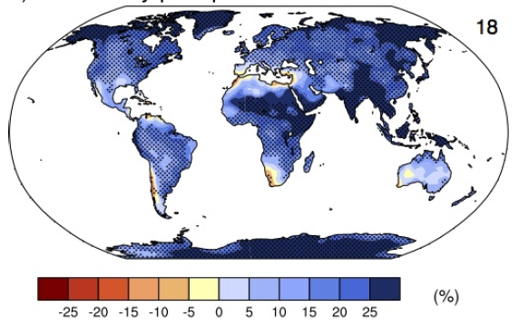
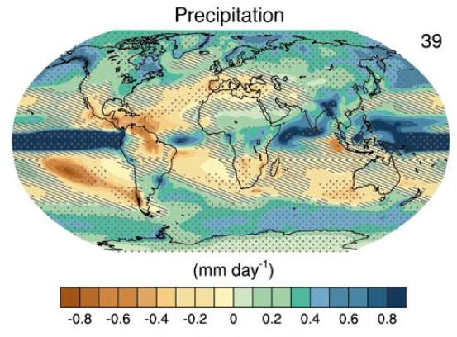
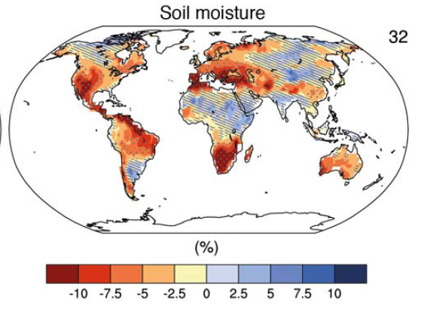
The water cycle
Precipitation intensity
Increased Precipitation
More intense rainfall
More intense droughts
Intensification of wet and dry events
Regional projections??
IPCC WGI (2013)
Notes:
The above graphs from the IPCC (2014) WG1 report show:
(top left) Increases in 5-day precipitation intensity (%) for 2081-2100 relative to 1981-2000 for RCP8.5 (Fig. 12.26, Chapter 12) where stippling denotes a significant change.
(bottom left) Annual average % changes in soil moisture in the upper 10cm of soil in the RCP8.5 scenario where stippling shows significant changes (Technical Summary, TFE.1, Figure 3)
(bottom right) Annual average changes in precipitation (mm per day) for the RCP8.5 scenario where stippling shows significant changes (Technical Summary, TFE.1, Figure 3).

Slide 23
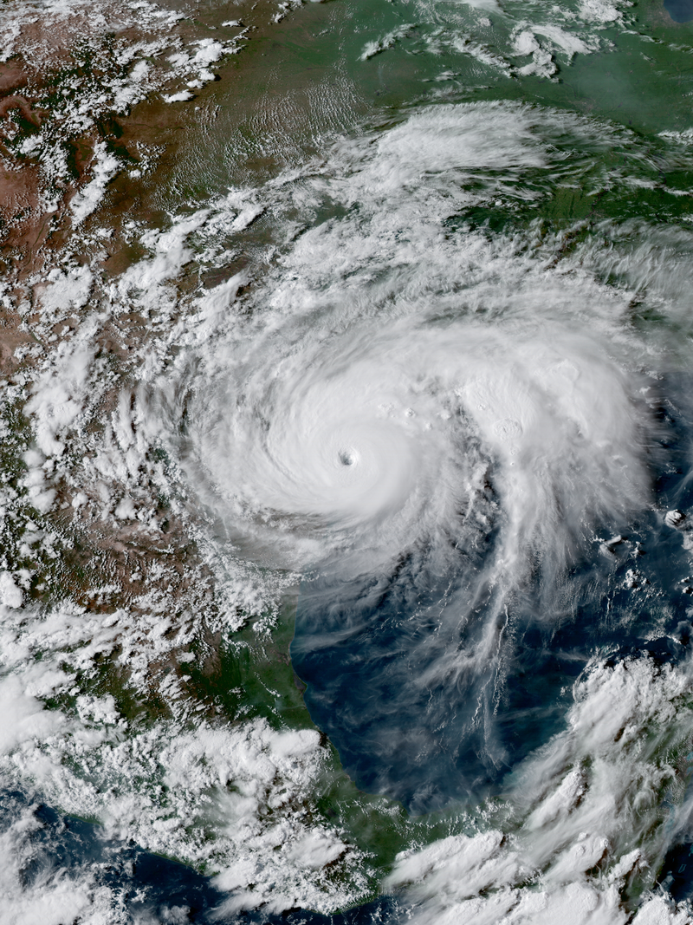
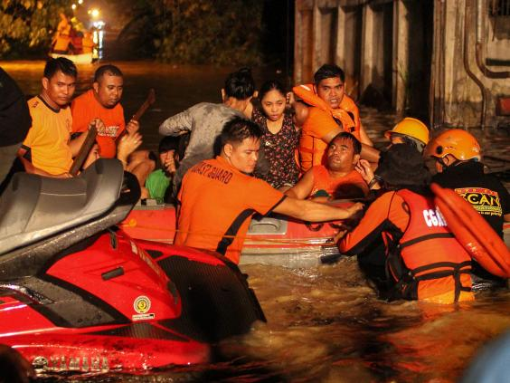
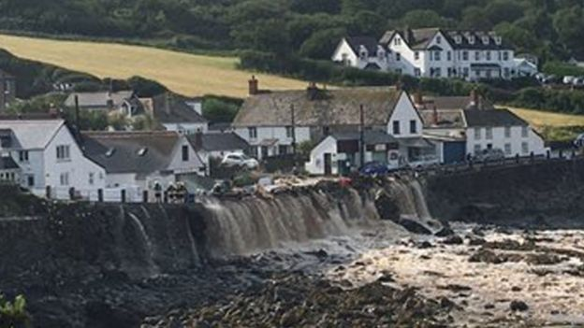
Intensification of heavy rainfall
Notes:
Note that water vapour is increasing and this is making heavy rainfall events more intense

Slide 24
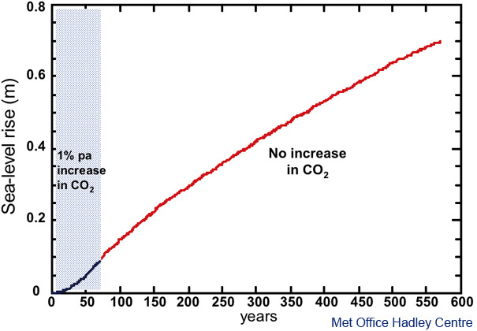
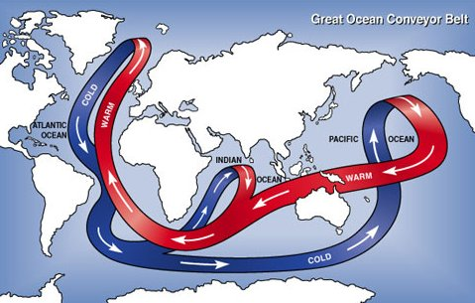
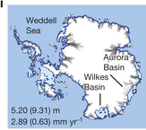
Long-term commitment to sea-level rise
RCP 8.5, Year 5000
CO₂ increase stops here
2.3m sea level rise per ºC warming over long term (e.g. 2000 years) [IPCC Fig. 13.14]
Current melt/ accumulation
Golledge et al. (2015) Nature

