Slide 1


Some examples of exploiting remote
sensing data in model evaluation
Richard Allan, Tristan Quaife (NCEO Reading)
UKESM meeting, April 12th 2018

Slide 2
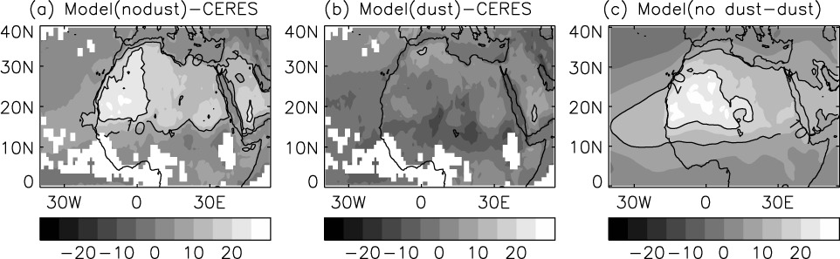
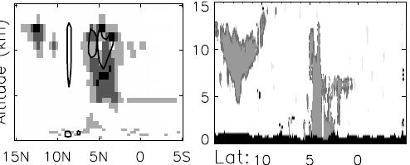
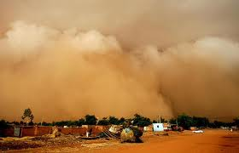
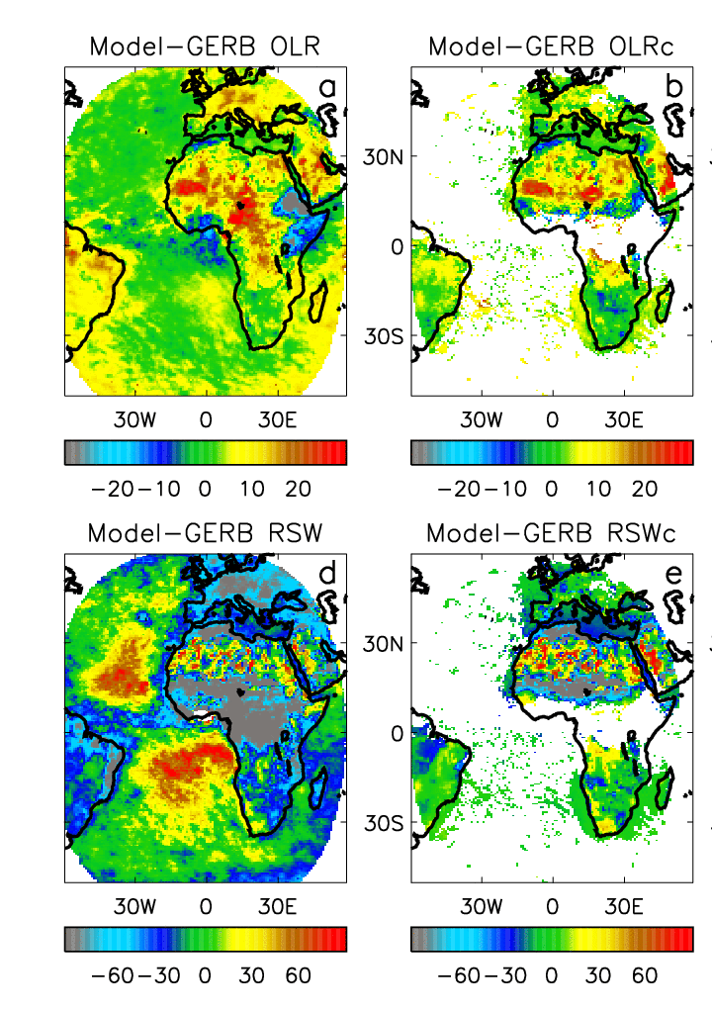
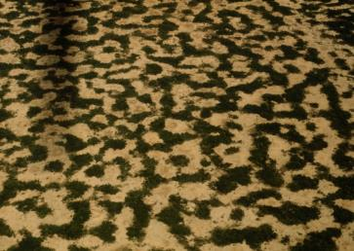
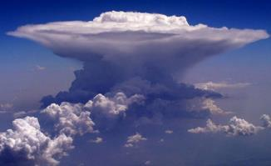

All-sky Clear-sky
Radiative biases in Met Office global NWP model
Mineral dust
Convective outflow
Shortwave Longwave
Exploiting GERB to improve Met Office forecast model physics
Surface albedo
Marine stratocumulus
Convective cloud
Allan et al (2007) QJRMS

Slide 3
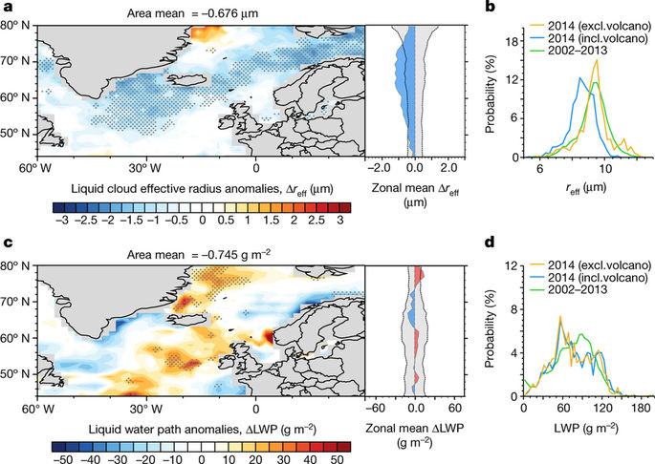
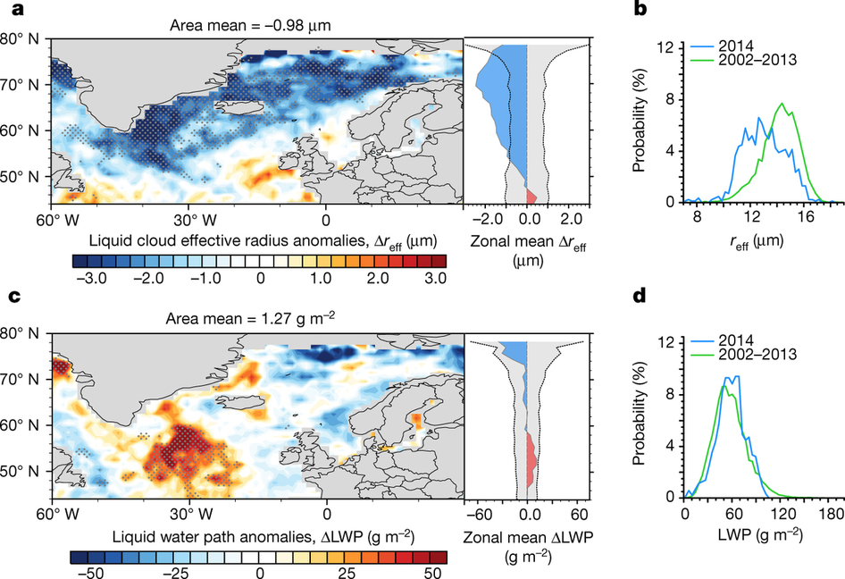
Evaluating cloud-aerosol interaction: natural laboratory
Cloud droplet size
MODIS-Aqua HadGEM3
Malavelle et al. (2017) Nature
Volcanic aerosol haze causes noticeable expected decrease in cloud drop size
Further indirect effects of aerosol haze on cloud water were undetectable in observations but large in some climate model simulations

Slide 4
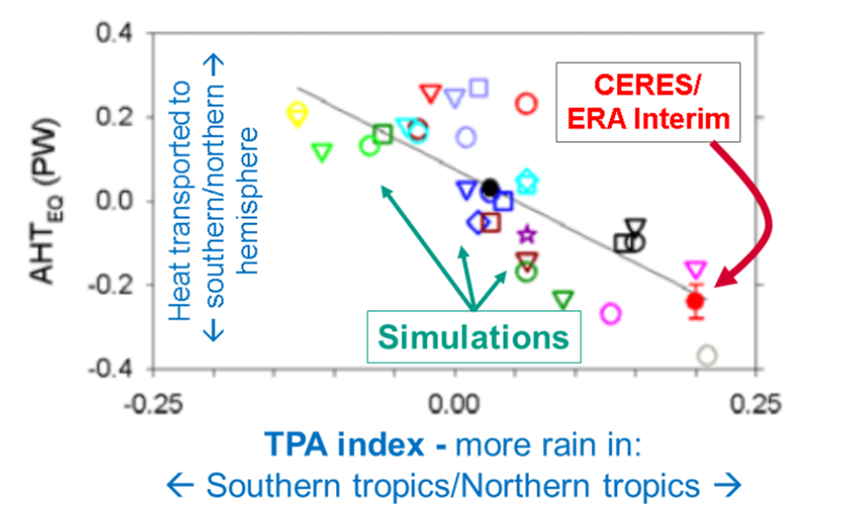
Interpreting & connecting systemic model biases
Combine top of atmosphere radiation budget data with reanalyses in evaluating surface energy budget, energy flows and systemic precipitation biases in CMIP5 simulations.
Loeb et al. (2016) Clim. Dyn
See also Liu et al. (2017) JGR; Stephens et al. 2016 CCCR
Models with large precip biases (left) underestimate south hemisphere cloud reflection
Notes:
Combining top of atmosphere energy buget and reanalysis horizontal energy transports allows new estimates of global surface energy budget
This has enabled advances in observing/understanding inter-hemispheric energy imbalance/transports and precipitation and links to model biases
Many CMIP5 models contain gross errors in cross equatorial energy fluxes which coincide with incorrect depiction of hemispheric precipitation asymmetries offering a potential constraint on climate models

Slide 5
Precipitation extremes
99th%
Evaluation across intensity bins to avoid spatial mismatches
5-day means chosen; inconsistent time-sampling at “daily” scale
Possible “emergent constraints” from variability on future projections
Allan et al. (2014) Surv. Geophys
light
heavy

Slide 6
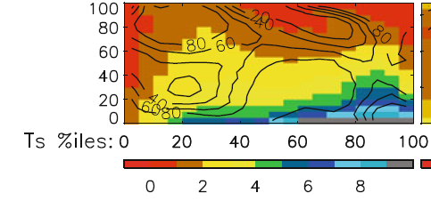
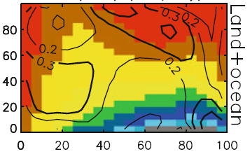
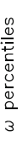

Using dynamical regime composites to analyse precipitation
Subtropical, dry
Model ensemble mean GPCP observations
←Stronger ascent
Precipitation (mm/day)
Warmer surface temperature →
Allan (2012) Clim. Dyn
Extra-tropical
Tropical moist
Composite precipitation by percentiles of vertical motion (strong decent to strong ascent) and temperature
Contour values enclose % of total area (left) or show percentage contribution of each composite box to total area (right)

Slide 7
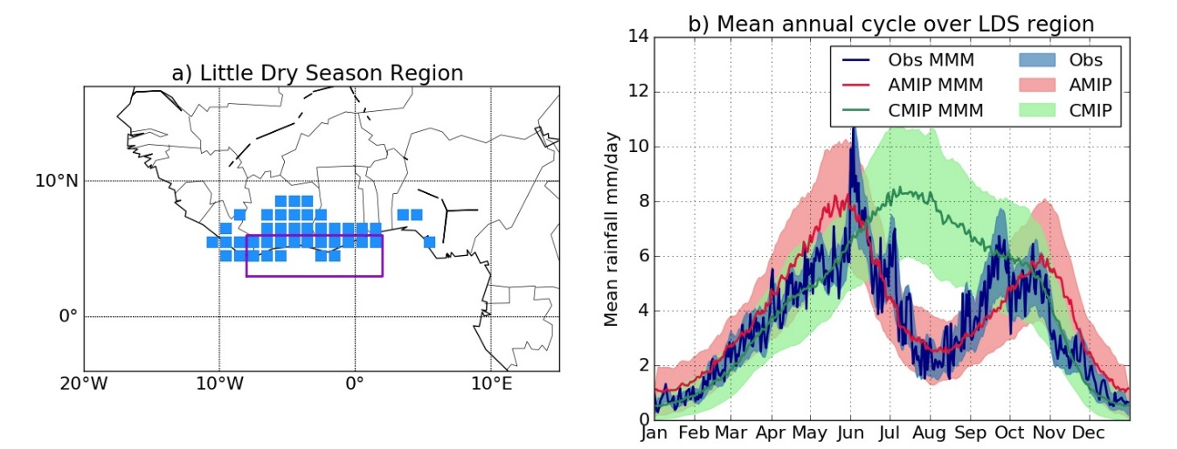
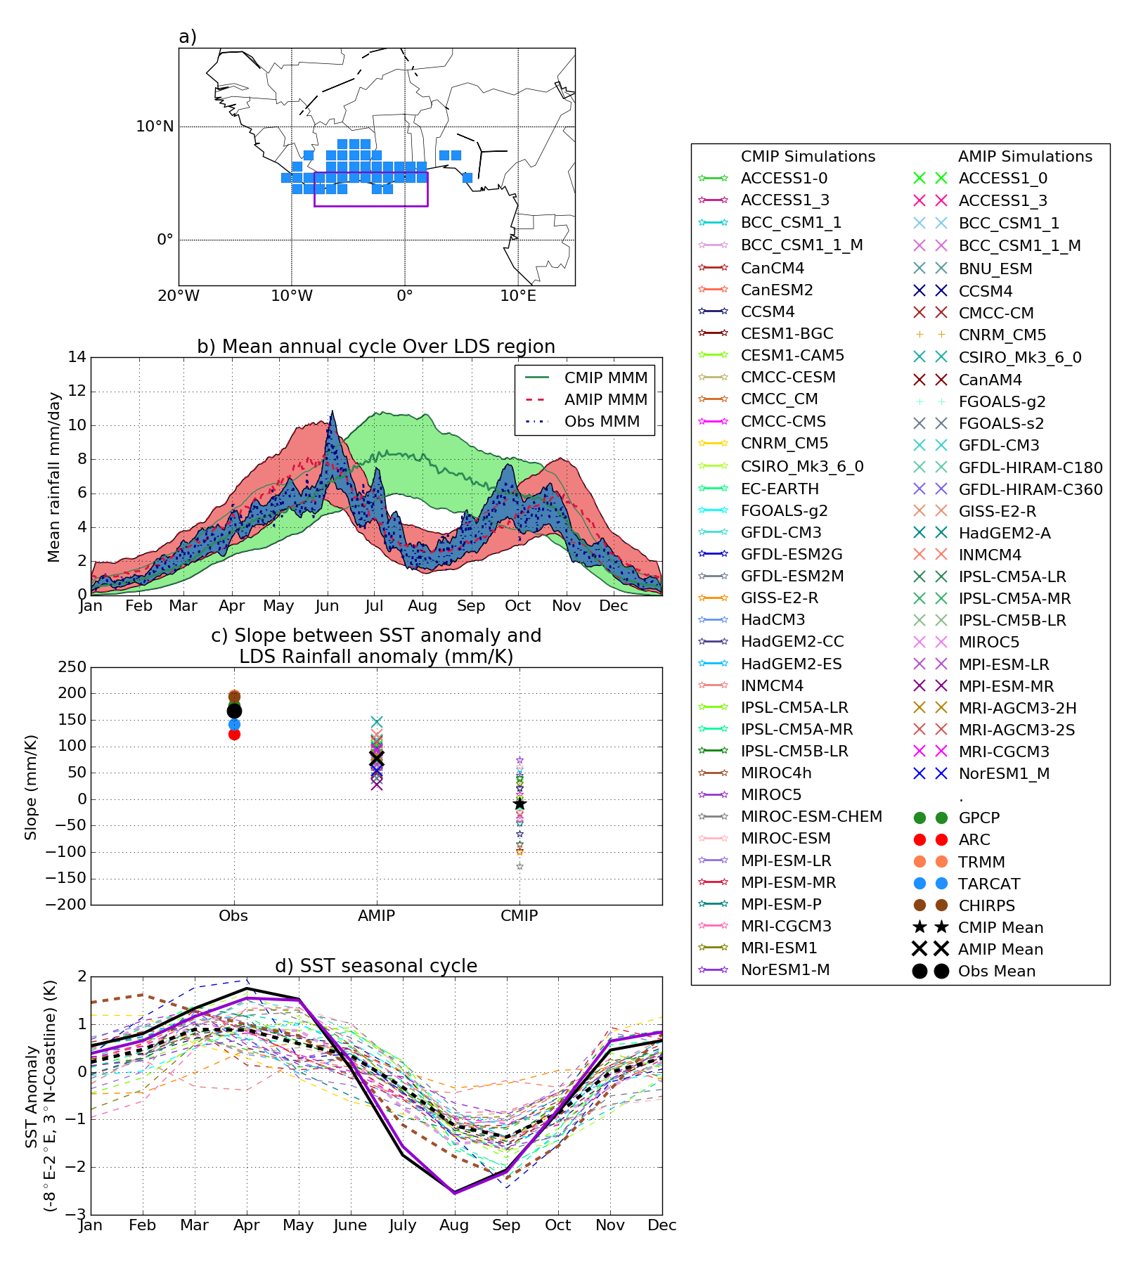
Deficient CMIP5 simulation of seasonal rainfall over West Africa
Coupled models fail to simulate biannual precipitation regime in coastal west Africa
Dunning et al. 2017 ERL
Atmosphere-only simulations capture seasonal cycle, coupled simulations don’t
Relates to bias in Gulf of Guinea sea surface temperature (SST) & deficient representation of SST/rainfall relationship: See also Okumura & Xie (2004) J. Clim., Cabos et al. (2017) Clim. Dyn.
SST seasonal cycle
CMIP5
OBS/AMIP

Slide 8
Soil moisture and the carbon cycle
Part of the story with getting the C-cycle response to precipitation right is getting the model soil moisture response to precipitation correct
EO derived soil moisture still has some significant caveats with regard to making comparisons with models BUT has a relatively long time series (since mid 1980s) and does a reasonable job of representing the seasonal cycle

Slide 9
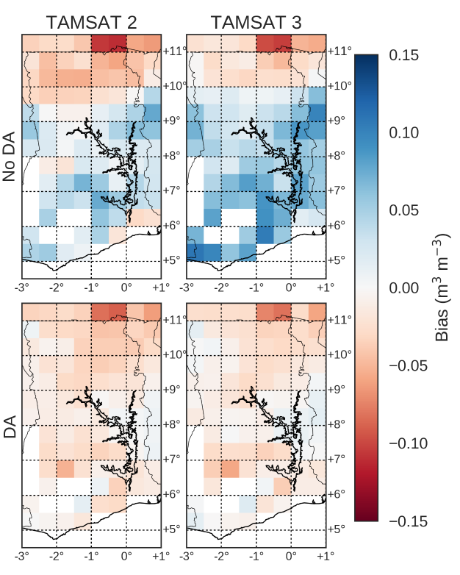
Bias in JULES soil moisture vs. ESA CCI data
Default JULES
soil ancillaries
Pinnington, E., Quaife, T., and Black, E.: Using satellite observations of precipitation and soil moisture to constrain the water budget of a land surface model, Hydrol. Earth Syst. Sci. Discuss., https://doi.org/10.5194/hess-2017-705
New JULES
soil ancillaries
getting precipitation right is crucial for the start of season wetting-up, whereas getting the soil description right is crucial for the end of season dry-down
Notes:
This is from our recent HESS paper. Region is Ghana. In essence we tested the relative information in TAMSAT data and ESA soil moisture data for constraining the soil moisture estimates from JULES (assessed using a hindcast experiment). The conclusion is basically that getting precipitation right is crucial for the start of season wetting-up, whereas getting the soil description right is crucial for the end of season dry-down. [Kind of obvious when you think about it, but nice to have it demonstrated in an experiment.]

Slide 10
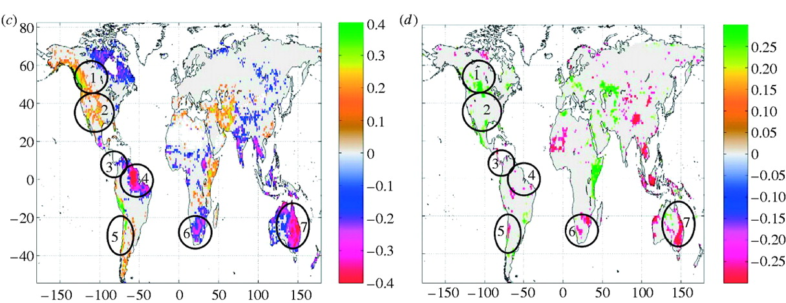
Evaluating model response to ENSO
Woodward, F.I., Lomas, M.R. and Quaife, T., 2008. Global responses of terrestrial productivity to contemporary climatic oscillations. Philosophical Transactions of the Royal Society B: Biological Sciences, 363(1504), pp.2779-2785.areas considered in the discussion.
Model correlation with MEI
NDVI correlation with MEI
Key result from this paper was that the model (SDGVM) is overly reliant on precipitation to prescribe the response of vegetation to ENSO. Subsequent papers have shown this to be true for a number of other models.
Notes:
ENSO responses shown as regression gradients between climatic index and selected variables. Positive values indicate increases during the warm ENSO phase and the reverse during the cool phase. Only geographical areas where there is equal to or greater than a 95% probability of repeat occurrence in ENSO events are shown. Gradient responses are shown for yearly (a) temperature, (b) precipitation, (c) gross primary production (GPP) and (d) NDVI. Circles with numbers indicate
Woodward, F.I., Lomas, M.R. and Quaife, T., 2008. Global responses of terrestrial productivity to contemporary climatic oscillations. Philosophical Transactions of the Royal Society B: Biological Sciences, 363(1504), pp.2779-2785.areas considered in the discussion.

Slide 11
Many EO based C-cycle products not suitable for evaluation of ESMs
A clear example is the MODIS GPP product
It is, essentially, a very simple model on top of other retrieved variables (LAI and fAPAR)
Also include some driving climate data
Similar arguments can be made about other EO products

Slide 12
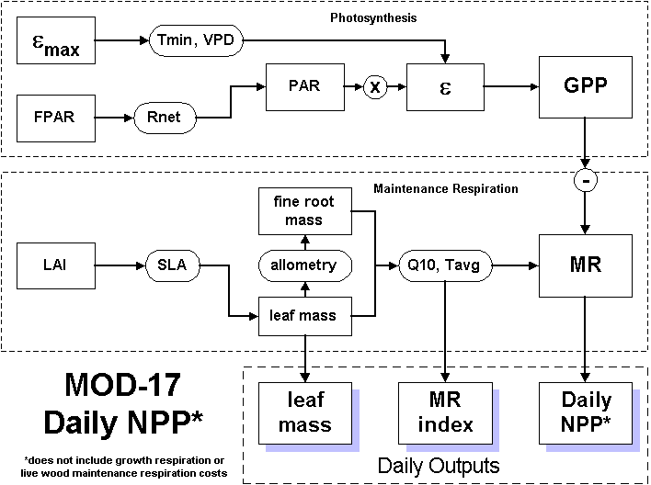
MODIS GPP
MODIS data
Look up table
Climate data
http://www.ntsg.umt.edu/remote_sensing/netprimary/
Notes:
This is the MODIS GPP/NPP algorithm. Red boxes are the only EO observations entering product.

Slide 13
Vegetation indices – NDVI and co.
Vegetation indices should be used with caution
Their simplicity makes them attractive but they do not tend to perform reliably when trying to make physical inferences from them
HOWEVER…
It is possible to forward model NDVI directly from UKESM
If we want to evaluate against long timescale (30+ years) EO records of vegetation activity they are probably our only choice

Slide 14
What could we do better: Use albedo
Available for the same time period as NDVI (since early 1980s)
Physically meaningful variable
Calculated by JULES in both NIR and PAR domains
BUT…
Interpretation w.r.t. the C-cycle is more complex than NDVI
There are some issues with the physical representation of canopy albedo in most land surface models, primarily to do with the physical structure of the canopy…
  But, of course, these issues also affect anything derived with optical EO data in principle ,so really also apply to NDVI, LAI, GPP etc etc.

Slide 15
What could we do better: Use SIF
Solar Induced Fluorescence (SIF)
A seemingly direct observation of GPP
Physically meaningful variable with direct implications for the C-cycle
BUT…
Not directly modelled by JULES so probably compare with GPP
Still a lot need to be understood about the […?]
Time series are relatively short (less than 10 years)

Slide 16
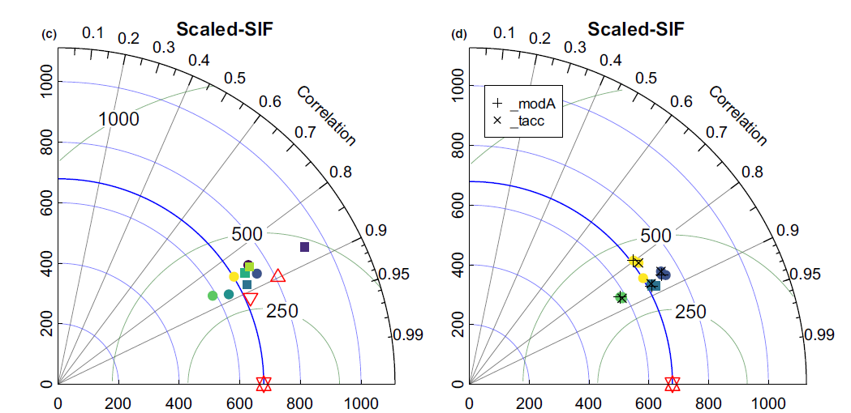
Testing VC_{max} hypotheses against SIF
Walker, A.P., Quaife, T., Bodegom, P.M., De Kauwe, M.G., Keenan, T.F., Joiner, J., Lomas, M.R., MacBean, N., Xu, C., Yang, X. and Woodward, F.I., 2017. The impact of alternative trait‐scaling hypotheses for the maximum photosynthetic carboxylation rate (Vcmax) on global gross primary production. New Phytologist, 215(4), pp.1370-1386.
A global test of various hypotheses about max rate of carboxylation (a key parameter for photosynthesis) in SDGVM as tested, globally, against SIF observations from NASA OCO2.
Notes:
A global test of various hypotheses about the maximum rate of carboxylation (a key parameter for photosynthesis) in SDGVM as tested, globally, against SIF observations from NASA OCO2.

Slide 17
Conclusions
You can get a long way with simple evaluation (e.g. radiation)
But advances requires multi-satellite/model analysis
Model to observation or observation to model approaches
  Most observations involve detailed modelling
  pdfs and suitable compositing/averaging can aid interpretation
We should avoid “high level” EO products (e.g. GPP & LAI)
  NDVI & soil moisture probably necessary evils for time being
  Evaluation against albedo should be a priority as it tells us much more about the physics of the model (includes info in NDVI and more)
SIF shows a lot of promise – it is possibly the only direct(ish) observation of photosynthesis on large scales available

Slide 19
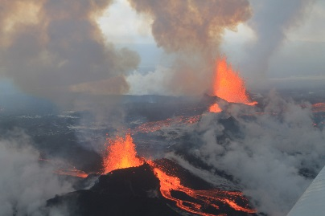
Diverse simulated cloud response to volcanic aerosol emissions
Malavelle et al. (2017) Nature

Slide 20
Volcanic aerosol haze causes noticeable expected decrease in cloud drop size
MODIS-Aqua Observations
Cloud water Droplet size
Malavelle et al. (2017) Nature
Further indirect effects of aerosol haze on cloud water undetectable

Slide 21
Volcanic aerosol haze causes noticeable expected decrease in cloud drop size
HadGEM3 simulations
Cloud water Droplet size
Malavelle et al. (2017) Nature
Further indirect effects of aerosol haze on cloud water undetectable

Slide 22
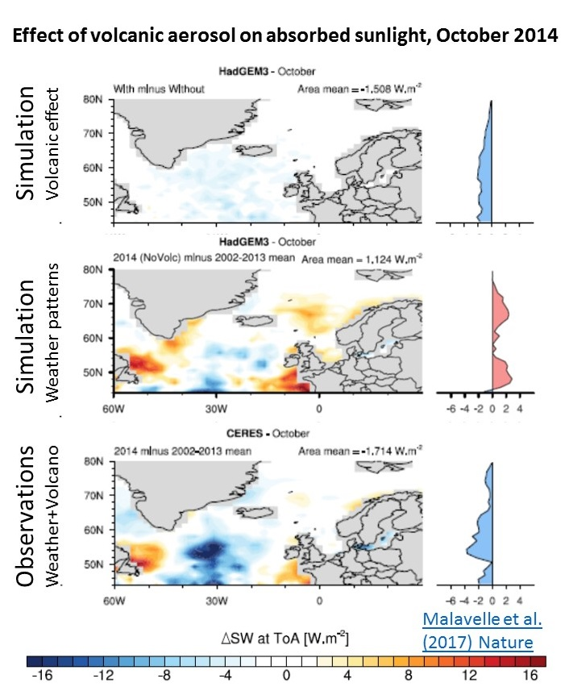
TOA irradiance
Influence of cloud/aerosol interaction on TOA shortwave undetectable above weather noise
Swath level measurements required to further evaluation
Malavelle et al. (2017) Nature

Slide 23

Conclusions
Extended Top of atmosphere radiation dataset (Allan et al. 2014 GRL)
  Earth’s energy imbalance relatively stable (~0.7 Wm⁻²), increased since 1980s?
New method for deriving surface energy flux (Liu et al. 2017 JGR)
  How do clouds and surface fluxes determine decadal climate variability?
  Link between hemispheric energy balance and climate
Observed constraint on aerosol-cloud interactions (Malavelle et al. 2017 Nature)
  Use volcano to mimic aerosol pollution haze
  Decrease in cloud droplet size detectable
  Further indirect effects on cloud and the radiation budget not distinguishable from weather noise

Slide 24
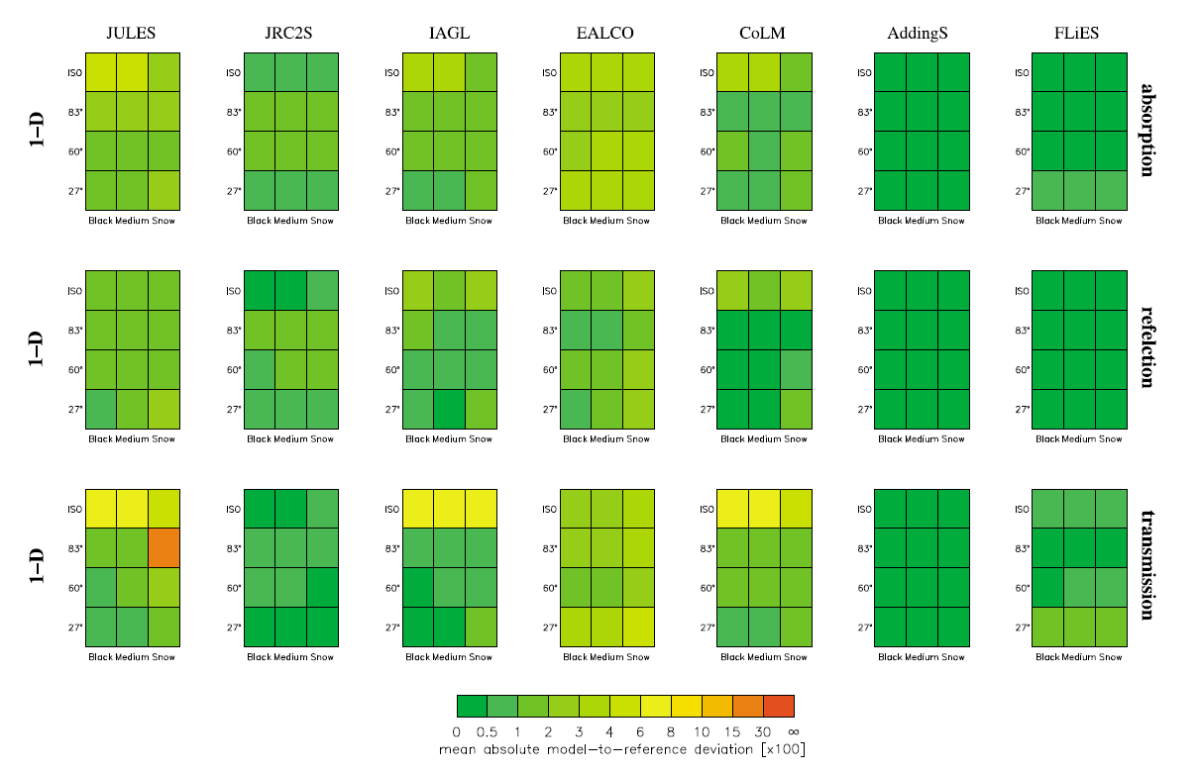
RAMI4PILPS
Bottom line is that JULES is OK but has some issues representing some photon scattering processes (see that red box!). Note, however, that most of the other models in the exercise were not global land models.
Widlowski, J.L., Pinty, B., Clerici, M., Dai, Y., De Kauwe, M., De Ridder, K., Kallel, A., KobayaRAMI4PILPS: An intercomparison of formulations for the partitioning of solar radiation in land surface models. Journal of Geophysical shi, H., Lavergne, T., Ni‐Meister, W. and Olchev, A., 2011. Research: Biogeosciences, 116(G2).
Notes:
This is a very detailed test of the canopy radiative transfer physics in JULES and a number of other models. In my humble opinion – which slightly contrasts with the lead author - JULES does a pretty good, especially as the other models are far more specialised and none of them are used in ESMs (as far as I am aware).

Slide 25
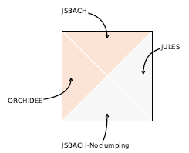
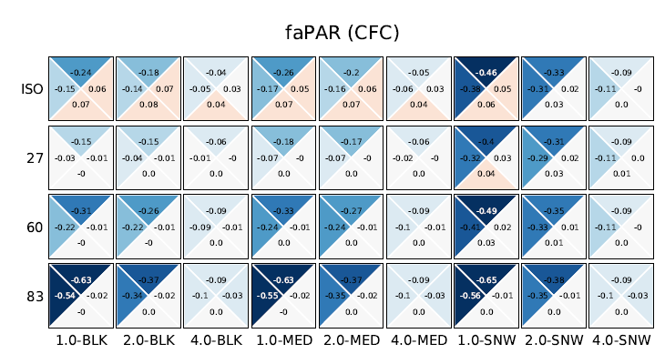

RAMI4PILPS revisited
JULES is represented by this triangle in each square.
Each square represents a specific experiment.
Upshot – compared with JSBACH and ORCHIDEE, JULES is pretty good!
Yes – I know it’s a horrible figure
Loew, Alexander, P. M. van Bodegom, J-L. Widlowski, Juliane Otto, Tristan Quaife, Bernard Pinty, and Thomas Raddatz. "Do we (need to) care about canopy radiation schemes in DGVMs? An evaluation and assessment study." Biogeosciences Discussions 10, no. 10 (2013): 16551-16613.
Notes:
We went on to repeat the RAMI4PILPS tests for more comparable models (JSBACH and ORCHIDEE). The conclusion is that JULES actually has a better representation of canopy radiative transfer than either of these models.

Slide 26
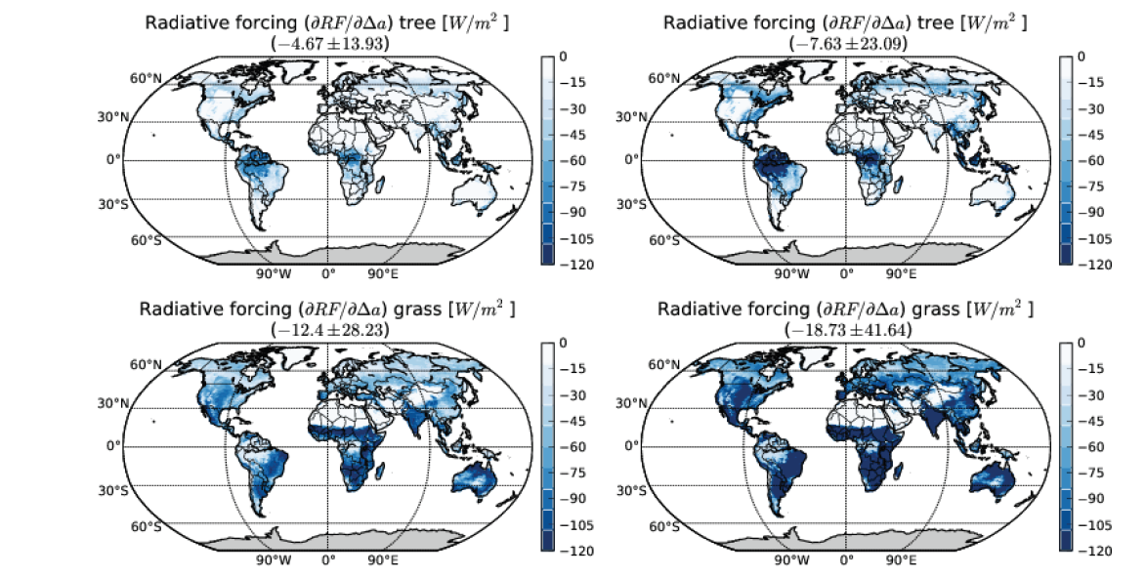
Implications for radiative forcing
Loew, Alexander, P. M. van Bodegom, J-L. Widlowski, Juliane Otto, Tristan Quaife, Bernard Pinty, and Thomas Raddatz. "Do we (need to) care about canopy radiation schemes in DGVMs? An evaluation and assessment study." Biogeosciences Discussions 10, no. 10 (2013): 16551-16613.
Notes:
This figure is slightly later on in the same paper. It doesn’t follow directly from the previous slide but is, in essence, a prediction of the bias in radiative forcing that could arise due to misrepresentation of the 3D structure of the vegetation.
NOTE – this is not directly applicable to JULES – it is averaged across JULES, ORCHIDEE and JSBACH. Some of the models exhibited quite significant biases. Also, I was never 100% behind this particular extrapolation of the data if I am honest.

Slide 27
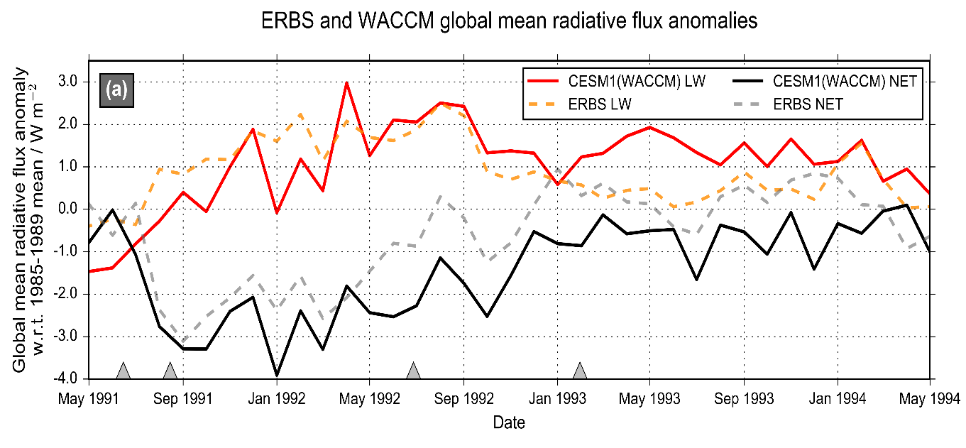
Advancing understanding of volcanic aerosol effects on climate
Malavelle et al. (2017) Nature
MODIS-Aqua Observations
Cloud water Droplet size
Volcanic aerosol haze brightens low altitude clouds, cooling climate
Further indirect effects in cloud water found to be negligible
Results will help to improve climate change projections
New assessment of direct volcanic influence on climate combining nudged models & observations
Schmidt et al. (2017) in prep

