Slide 1





the role of Earth's Energy Budget in recent Climate Variability and Change
Department of Meteorology
National Centre for Earth Observation
Richard P. Allan r.p.allan@reading.ac.uk @rpallanuk
Chunlei Liu (University of Reading); Pat Hyder, Matt Palmer, Chris Roberts (Met Office)
Notes:
Earth’s energy balance is a nexus between climate forcing, feedback and response.
It’s distinct role in climate variability and change through forced and chaotic responses are only slowly emerging.
This talk will touch on a few examples of ongoing analysis as part of the NERC DEEP-C and SMURPHS projects with thanks to a number of collaborators listed and members of the project teams.

Slide 2
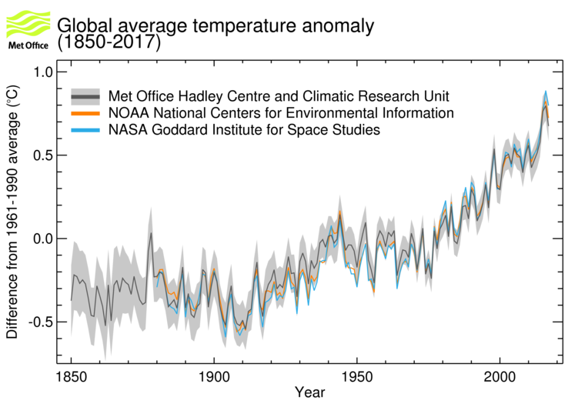

Slide 3
Did global warming go on holiday?
Global surface warming rate slower in early 2000s than 1980s/90s
  Energy imbalance remains positive/strengthens, sea level rise accelerates
  Ocean heat uptake to deeper levels, distinct Pacific variability pattern
Unusual climate phenomena
  Unprecedented Pacific trades, suppressed El Niño, AMOC & ITF ocean changes, Arctic warming, cold northern winters, NAO/PDV/AMV phase
Warming rate unusually low compared to climate simulations
  Radiative Forcing & sampling explains some of discrepancy
  Internal variability explains much of remaining discrepancy
  Amplified by SST-pattern related cloud/circulation feedbacks
  Unrepresented forced circulation responses can’t be discounted
  http://www.met.reading.ac.uk/~sgs02rpa/research/DEEP-C.html#PAPERS
Multiple factors explain hiatus/surge events: understanding decadal variability advances climate science Cassou et al. 2018 BAMS

Slide 4
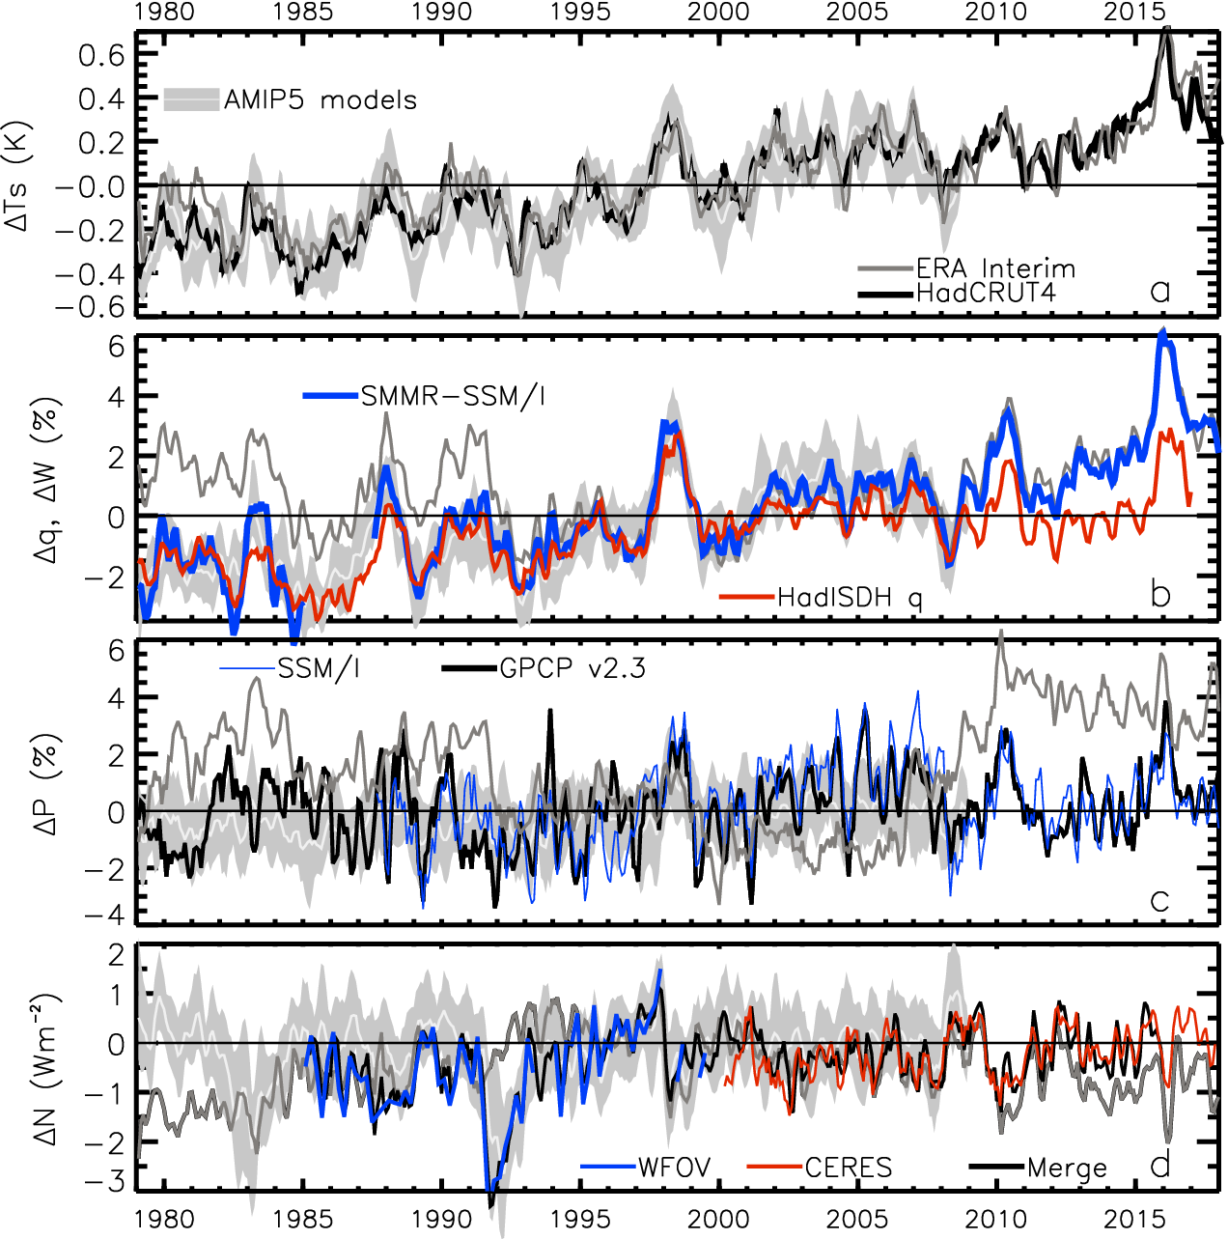
Recent global climate variability
Surface temperature anomaly (degC)
Water Vapour anomaly (%)
?
Update from Allan et al.(2014) Surv. Geophys

Slide 5
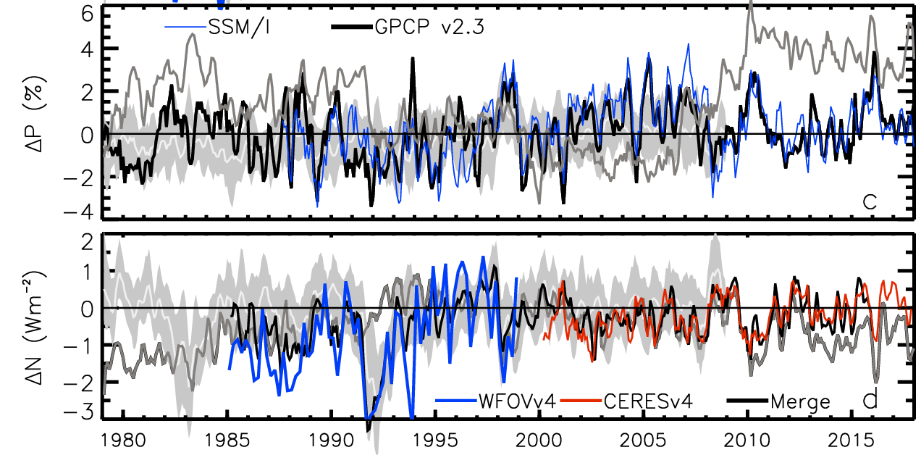
Recent global climate variability
Precip anomaly (%)
2.8
1.8
0.8
-0.2
-1.2
-2.2
Energy Imbalance anomaly (Wm⁻²)
Energy Imbalance anomaly (Wm⁻²)
?
Update from Allan et al.(2014) Surv. Geophys.; Allan et al. (2014) GRL

Slide 6
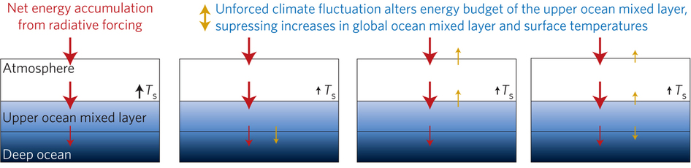
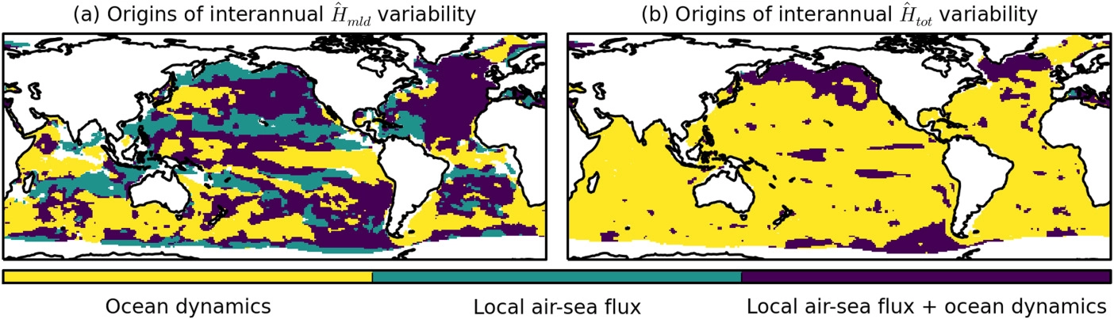
Ocean mixed layer energy budget
Allan (2017) Nature Clim.
Energy imbalance increase since 1990s, steady in 2000s 0.6-0.8 Wm⁻² Cheng et al. 2017 Sci. Adv.; Allan et al. 2014 GRL
Slowdown events simulated by climate models
  ↑ocean heat uptake below 300m Meehl et al. 2011 Nature Hiatus
Upper ocean mixed layer heat budget interface of energy imbalance/global surface temperature Hedemann et al. 2017 Nature Clim.
  Small perturbations obfuscate attribution
  Useful interpretive framework
Dynamics Heat Flux Both
Origins of ocean mixed layer heat content variability Roberts et al. 2017 JGR
Notes:
Improved and longer records of ocean heating and top of atmosphere radiation measurements have improved estimates of Earth’s energy imbalance and its changes over recent decades.
Simulations with prescribed observed SST and radiative forcing are able to capture variations in energy budget
Greater appreciation for the role of internal variability in influencing global energy budget and the link between energy imbalance and surface temperature via heat budget of upper ocean

Slide 7
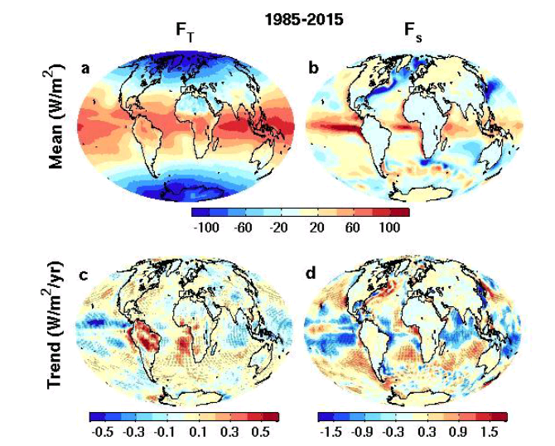
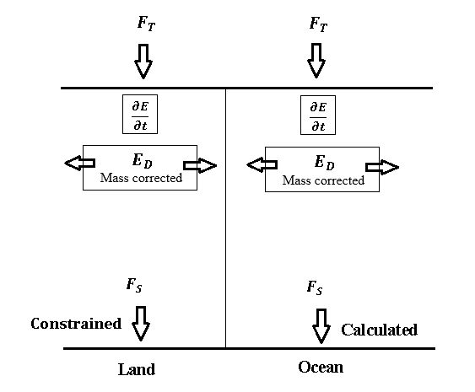

New global surface flux estimates
top of atmosphere surface
ERBS CERES
reanalyses
Surface energy flux dataset combines top of atmosphere satellite reconstruction with reanalysis energy transports: Liu et al. (2015) JGR
Liu et al. (2017) JGR Data: http://dx.doi.org/10.17864/1947.111

Slide 8
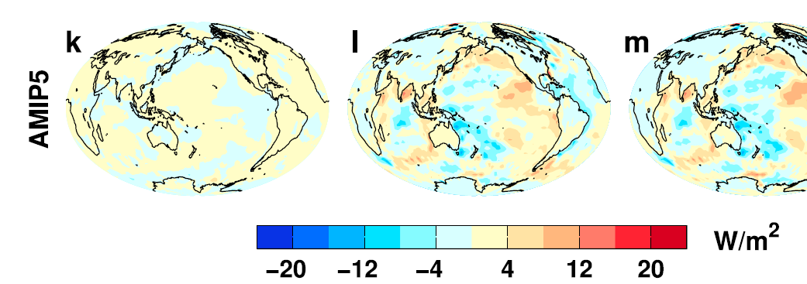
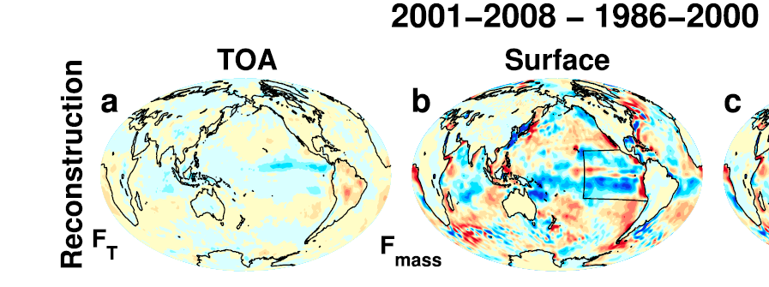
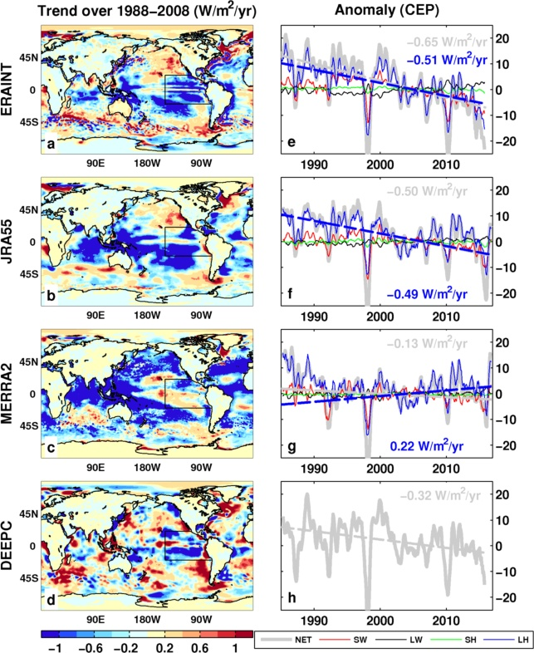
Feedbacks on internal & forced climate change involving regional energy budget
Liu et al. (2015) JGR
Cloud feedbacks in east Pacific important for internal decadal variability e.g. Zhou et al. (2016) Nature Geosci
Latent heat flux changes dominate observed negative trend in east Pacific? Liu&Allan(2018)
Distinct feedbacks on internal variability & forced change e.g. Brown et al. 2016; Xie et al. 2015 ; England et al. (2014)
Spatial patterns of warming crucial for feedbacks & climate sensitivity e.g. He & Soden (2016); Richardson et al. (2016); Ceppi & Gregory (2017); Andrews & Webb (2017)
Do climate models underestimate low cloud amplifying feedbacks, internal variability & climate sensitivity? Marvel et al. 2018; Silvers et al. 2017 ; Yuan et al. 2018
Changes in downward surface flux
2001-2008 minus 1986-2000
OBSERVATIONS AMIP MODELS
LHF
SW
Notes:
Combining decadal observations of cloud, radiation and energy transports is leading to advances in understanding regional to global feedbacks
There is emerging evidence of contrasting energy budget responses/feedbacks acting on internal and forced variability
The spatial pattern of warming is crucial in determining global feedback responses; accounting for this may help in determining climate sensitivity from observations

Slide 9
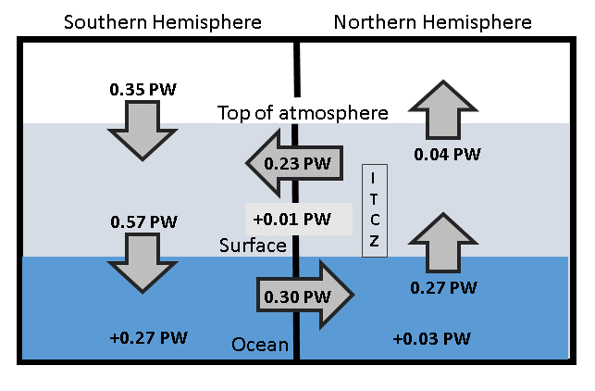
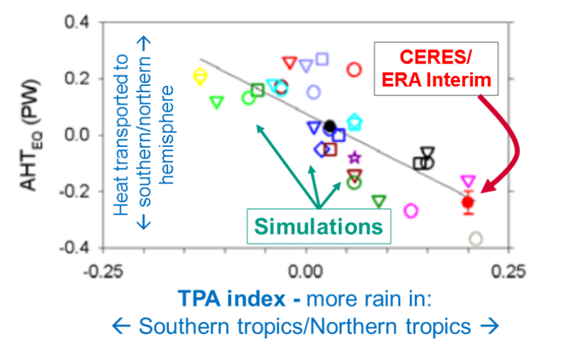
hemispheric energy imbalance
& precipitation biases in climate models
← Inferred 2000-15 cross equatorial energy flux (Liu et al. 2017) using ocean heating (Roemmich et al. (2015) Nature Clim.)
Gross hemispheric precipitation biases linked to cross-equatorial heat transport e.g. Frierson et al. (2013) Nature Geoscience; Haywood et al. (2016) GRL; Hawcroft et al. (2016) Clim. Dyn.
← Many climate models simulate incorrect sign of cross equatorial energy flow and northern minus southern hemispheric precipitation difference
Historical shifts in tropical rainy belts linked to high latitude volcanic eruptions (Haywood et al. (2013) Nature Clim) & anthropogenic aerosol-cloud interactions (He & Soden (2016) Nature Clim.; Wilcox et al. ERL 2013) but greenhouse gas forcing may now dominate (Dong & Sutton 2015 NatureCC)
Loeb et al. (2016) Clim. Dyn
Notes:
Combining top of atmosphere energy budget and reanalysis horizontal energy transports allows new estimates of global surface energy budget
This has enabled advances in observing/understanding inter-hemispheric energy imbalance/transports and precipitation and links to model biases
Many CMIP5 models contain gross errors in cross equatorial energy fluxes which coincide with incorrect depiction of hemispheric precipitation asymmetries offering a potential constraint on climate models

Slide 10
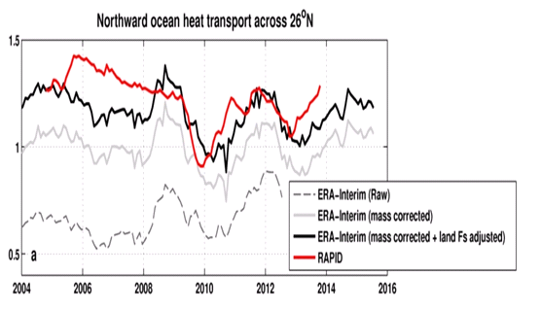
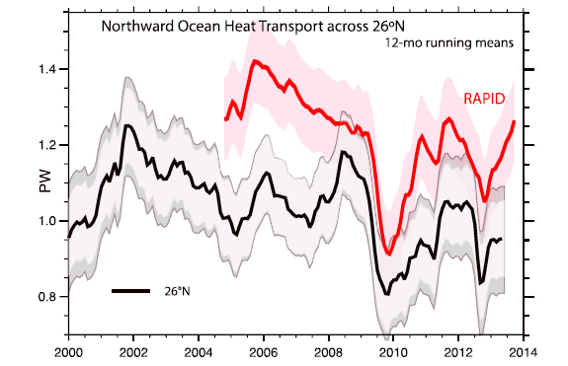
Inferred North Atlantic ocean heat transport
Surface flux product combined with ORAS4 ocean heating to infer N Atlantic ocean heat transport at 26ºN
Compare indirect method with RAPID observations
Improved agreement over Trenberth & Fasullo 2017 GRL
2004-2013
RAPID 1.23 PW
TF2017 1.00 PW
Liu et al: 1.16 PW
large uncertainty

Slide 11
summary
Earth’s energy imbalance central to climate change:
  nexus between forcing, feedback & responses
  Ocean mixed layer interface between energy budget & surface temperature
  Spatial warming pattern important for regional feedbacks that influence internal variability and climate sensitivity
Energy budget & water cycle intimately linked
  Hemispheric/regional energy budget asymmetries key to tropical precipitation
  Ongoing monitoring of energy imbalance essential in linking forcing/response
Outstanding Questions:
How do feedbacks in east Pacific determine internal variability and climate sensitivity?
Can net zero global radiative forcing with spatial pattern drive temperature change?
Is there a missing ocean dynamical feedback on warming?
Is internal variability adequately represented by models?
What is the role of anthropogenic aerosol and volcanic eruptions?
How does rebound from volcanic eruptions (e.g. Pinatubo) influence climate system?

Slide 12
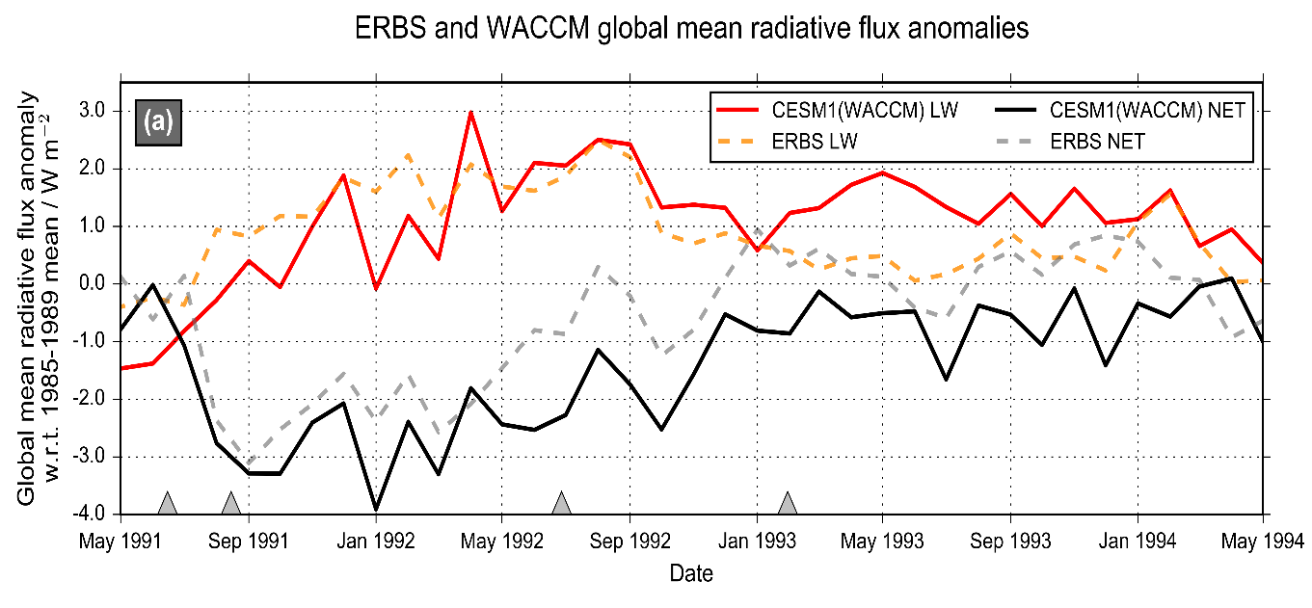
AEROSOL effects on
CLIMATE remain uncertain
Malavelle et al. (2017) Nature
MODIS-Aqua Observations
Cloud water Droplet size
Volcanic aerosol haze brightens low altitude clouds, cooling climate
Further indirect effects in cloud water found to be negligible
Malavelle et al. (2017) Nature
But not for cyclones? McCoy et al. (2018) ACPD
New assessment of direct volcanic influence on climate combining nudged models & observations
Schmidt et al. (2017) in prep

Slide 14
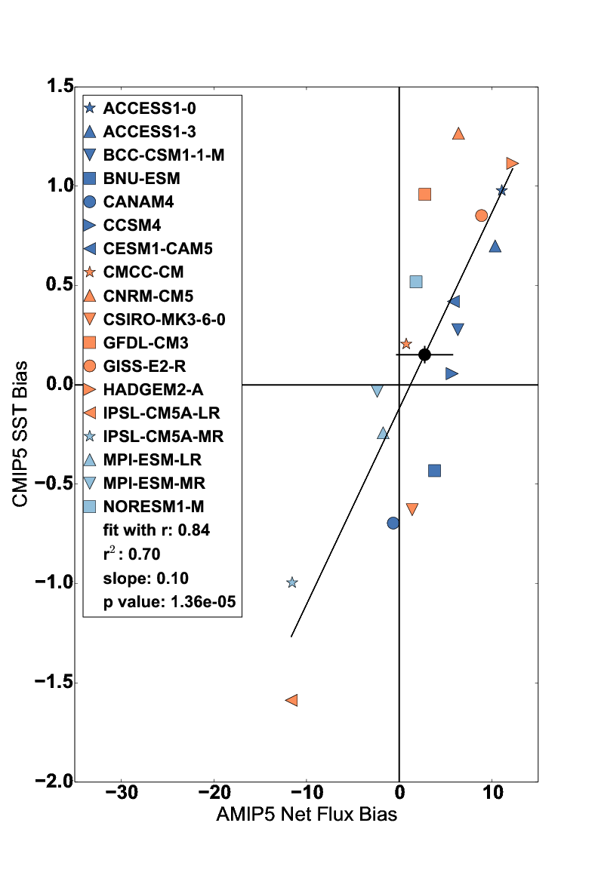
Southern ocean SST bias
Hyder et al. in prep

Slide 15
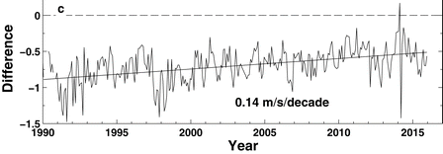
Energy budget changes in east pacific
Changes in downward surface flux
2001-2008 minus 1986-2000
OBSERVATIONS AMIP MODELS
LHF
SW
ERAINT – buoy wind speed
Liu et al. (2017) JGR
Cloud feedbacks in east Pacific important for internal decadal variability e.g. Zhou et al. (2016) Nature Geosci
Liu & Allan (2018) J. Clim
Notes:
Combining decadal observations of cloud, radiation and energy transports is leading to advances in understanding regional to global feedbacks
There is emerging evidence of contrasting energy budget responses/feedbacks acting on internal and forced variability
The spatial pattern of warming is crucial in determining global feedback responses; accounting for this may help in determining climate sensitivity from observations

Slide 16
Recent global climate variability
Precip anomaly (%)
2.8
1.8
0.8
-0.2
-1.2
-2.2
Energy Imbalance anomaly (Wm⁻²)
?
Update from Allan et al.(2014) Surv. Geophys.; Allan et al. (2014) GRL

Slide 17
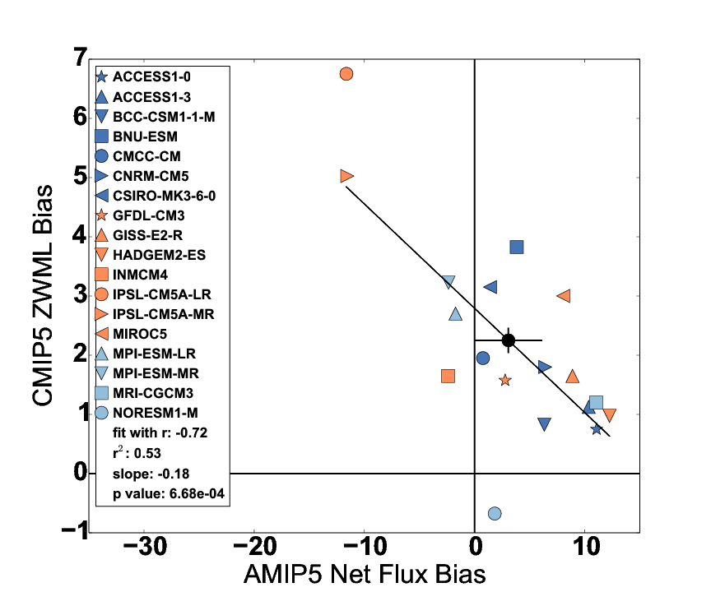
Evaluation of model biases in surface flux
Use surface flux product to trace causes of coupled SST biases to atmospheric model processes
Biases in AMIP5 simulations of cloud linked to coupled bias in SST & zonal wind maximum latitude →
Hyder et al. in prep

Slide 18
Recent global climate variability
Surface temperature anomaly (degC)
2.8
1.8
0.8
-0.2
-1.2
-2.2
Energy Imbalance anomaly (Wm⁻²)
Update from Allan et al.(2014) Surv. Geophys.; Allan et al. (2014) GRL

Slide 19
Summary
More accurate multi-decadal global estimates of Earth’s energy budget and its variability (e.g. Cheng et al. 2017 Sci. Adv.; Allan et al. 2014 GRL)
  Better indicator of global climate change than surface temperature but gaps in observing deep ocean (e.g. Palmer 2017 CCCR)
  Link to observed cloudiness? e.g. Norris et al (2016) Nature
Link between energy imbalance and surface warming depends on energy budget of upper mixed ocean layer (Roberts et al. 2015 JGR; Hedemann et al. 2017 Nature Climate Change; Xie & Kosaka 2017 CCCR)
  Better appreciation of mechanisms of decadal global climate variability
Distinct feedbacks on internal variability/forced change (Brown et al. 2016 J. Clim; Xie et al. 2015 Nature Geosci; Zhou et al. (2016) Nature Geosci
  Obs. estimates of climate sensitivity (Richardson et al. (2016) Nature Climate)
  Spatial patterns of warming crucial (Gregory and Andrews (2016) GRL)
  What explains decreased heating of E Pacific and is it realistic?
Advances in observing/understanding inter-hemispheric energy imbalance/transport and links to CMIP5 precipitation biases (Frierson et al. 2013; Loeb et al. 2016 Clim. Dyn; Stephens et al. 2016 CCCR)
  Possible constraint on realism of climate models (Haywood et al. (2016) GRL)

Slide 20
Outstanding questions
Can net zero global radiative forcing but with spatial pattern drive temperature change?
Does the east Pacific control hiatus/surge events? Does the Atlantic drive the Pacific? Do the tropics drive the N Atlantic?
How does rebound from volcanic eruptions (e.g. Pinatubo) influence the climate system; is this represented by models?
Is there a missing ocean dynamical feedback on warming?
Is internal variability adequately represented by models?
What is the role of aerosol changes/uncertainty in determining observed/simulated warming rate & difference?
Need clever people with big models to address some of these…

Slide 21
TEMPERATURE anomaly (degC)
WATER VAPOUR anomaly (%)
PRECIPITATION anomaly (%)
2.8
1.8
0.8
-0.2
-1.2
-2.2
ENERGY BUDGET anomaly (Wm⁻²)
Energy imbalance (Wm⁻²)

Slide 22
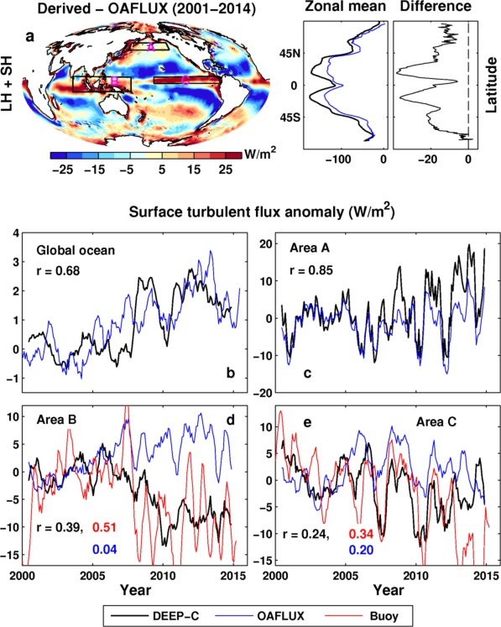
Has increased evaporation driven east Pacific cooling?
downward LHF
Increased cloud cover plays a role? Zhou et al. (2016) Nature Geosci
LHF
SW
Decreases in East Pacific surface fluxes since 1990s
Discrepancy to simulations without coupled feedbacks
Is surface evaporation amplifying cooling?
Liu & Allan (2018) J. Clim (top); Liu et al. 2017 JGR (bottom)

Slide 23
Interpreting & connecting systemic model biases
Combine top of atmosphere radiation budget data with reanalyses in evaluating surface energy budget, energy flows and systemic precipitation biases in CMIP5 simulations.
Loeb et al. (2016) Clim. Dyn
See also Liu et al. (2017) JGR; Stephens et al. (2016) CCCR
Models with large precip biases (left) underestimate south hemisphere cloud reflection
Notes:
Combining top of atmosphere energy buget and reanalysis horizontal energy transports allows new estimates of global surface energy budget
This has enabled advances in observing/understanding inter-hemispheric energy imbalance/transports and precipitation and links to model biases
Many CMIP5 models contain gross errors in cross equatorial energy fluxes which coincide with incorrect depiction of hemispheric precipitation asymmetries offering a potential constraint on climate models

Slide 24
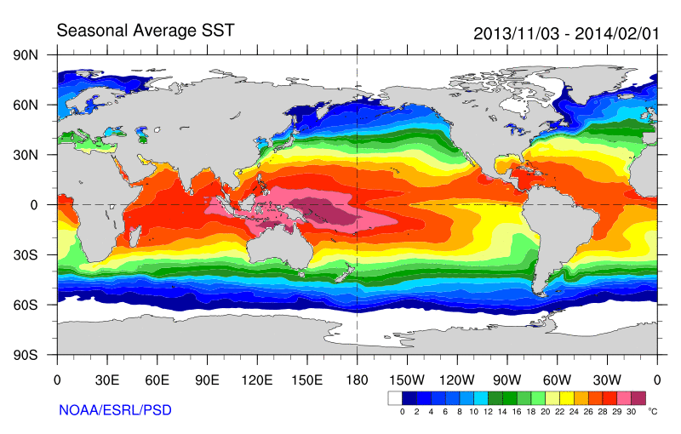
Some earlier strands
Radiative Forcing/Imbalance Johnson et al. (2016) ; Checa-Garcia et al. (2016) ; Huber & Knutti (2014) ;Santer et al. (2015) :
Continued heating from greenhouse gases
Aerosol forcing of circulation (Smith et al. 2016)
Unusual weather patterns (Ding et al. 2014; Trenberth et al. 2014b)
Pacific SST strengthens atmospheric circulation
Enhanced Walker Circulation
? Heat flux to Indian ocean Lee etal 2015
Increased sea height
Warm
Upwelling,
Cool water
Remote forcing from Atlantic:
Li et al. (2016) ;
McGregor et al. (2014)
Increased precipitation
Decreased salinity
Strengthening trade winds
Equatorial Undercurrent
Pacific dominates?
Mann et al. (2016) Kosaka & Xie (2013) England et al. (2014)
Enhanced mixing of heat below 100 metres depth by accelerating shallow overturning cells and equatorial undercurrent
See also: Merrifield (2010).; Sohn et al. (2013) .; L’Heureux et al. (2013) . Change; Watanabe et al. (2014) ; Balmaseda et al. (2013) ; Trenberth et al. (2014) .; Llovel et al. (2014) ;Durack et al. (2014) ; Nieves et al. (2015) ; Brown et al. (2015) JGR ; Somavilla et al. (2016) ; Liu et al. (2016)
Notes:
There is lots of new results focussing on the slower rates of surface warming and associated unusual climatic conditions at the beginning of the 21st century (see DEEP-C website: http://www.met.reading.ac.uk/~sgs02rpa/research/DEEP-C.html#PAPERS).

Slide 25
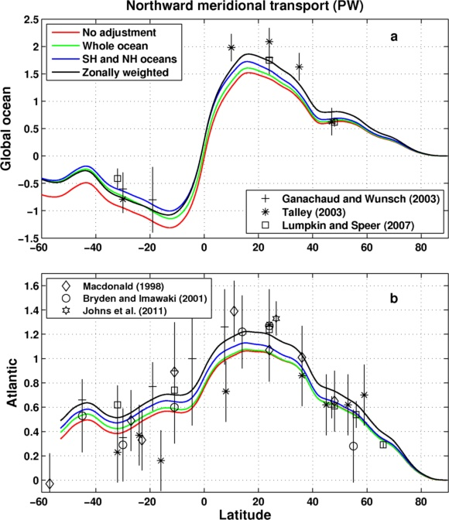
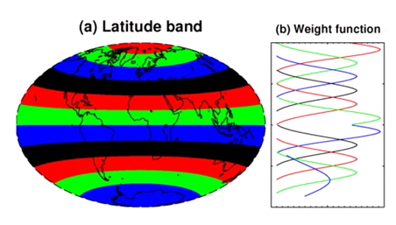
Meridional Heat Transport Estimate
Inferred from DEEP-C surface energy flux data (Liu et al. 2017 JGR) & ocean heating (Roemmich et al 2015) 2006-2013
Sensitivity of method to land flux correction
Zonal land correction
26ºN

