Slide 1

Weather and climate science for society
Department of Meteorology
Professor Richard Allan @rpallanuk r.p.allan@reading.ac.uk
Virtual Open Day, 23rd May 2018
Notes:
OPEN IN CHROME:
https://scratch.mit.edu/projects/179953994
https://www.youtube.com/watch?v=tGqM1ZtOX7c
http://www.met.reading.ac.uk/outreach/docs/Upscale_climate_simulation.mp4
CLIMATE OUTREACH – here for Year 9 (age 13-14) ~45 minutes but plenty of extra slides for a longer session.
ACTIVITIES:
Infrared thermometer to demonstrate greenhouse effect
Scratch energy balance demonstration
Students demonstrate feedback loop
INTRODUCTION – see notes on next slide.
INTRO:
Why did I get interested in weather and climate, what I needed to study to be climate scientist
I talk about ice ages as getting me interested, you can mention that 20,000 years ago ice sheets crossed northern Britain and sea levels were >100m lower while global temperature was just 4-5oC lower than now.
Glacial cycles operate over tens of thousands of years, very slow compared to human civilisations (modern humans ~200k yr, modern societies last few thousand).
Climate has always changed (e.g. plate tectonics 100s Myr, glacial cycles, 10s kyr, changes in the sun and volcanic eruptions)
Ice cores drilled into Antarctica are like time machines going back nearly 1million years – they show natural swings in temperature, ice and sea level and natural greenhouse gases such as CO2
But now CO2 is nearly 50% higher than at any time over past million years
Human activities are causing the climate to heat up, but how does this work?

Slide 2
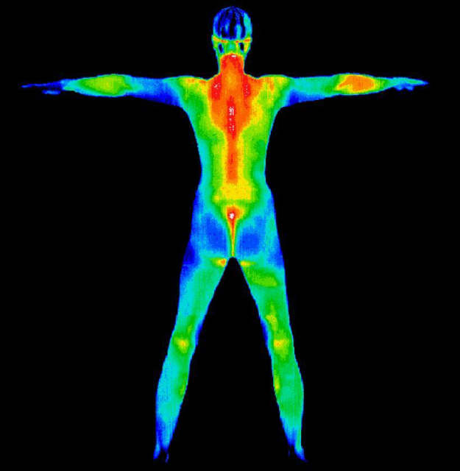
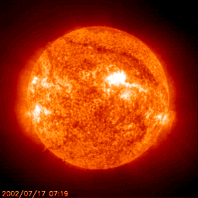
Everything emits radiation energy units: Watts per square metre (Wm⁻²)
Cool things: long wave-length/thermal infrared radiation, e.g. us ~300 K
Hot things: short wave-length radiation, e.g. the sun ~6000 K
Temperature in Kelvin = Temperature in ºC + 273.15
IR thermometer activity
Notes:
Warmer things emit more radiation energy at shorter wavelengths – example of us and sun.
Mention Kelvin temperature scale.
Example of electromagnetic spectrum
point out where Earth and sun are emitting
note that atmosphere lets in lots of sunlight but blocks outgoing energy
Example of water molecule which absorbs both
IR THERMOMETER ACTIVITY:
Get 2 students, one fires gun at other, measures temperature (aim close at head)
2nd student does same and also measures floor, other students (we are warmer than floor, hopefully!)
Q: How does this measure temperature from far away? (IR radiation)
1st or another student then points at sky out of window then at sky through open window
Q: why is it colder? (window blocks IR radiation, like atmosphere)
Can also note that this is in part of IR spectrum where water vapour absorption is small so you can see the temperature of cloud base – used in Met to measure height of cloud base.

Slide 3
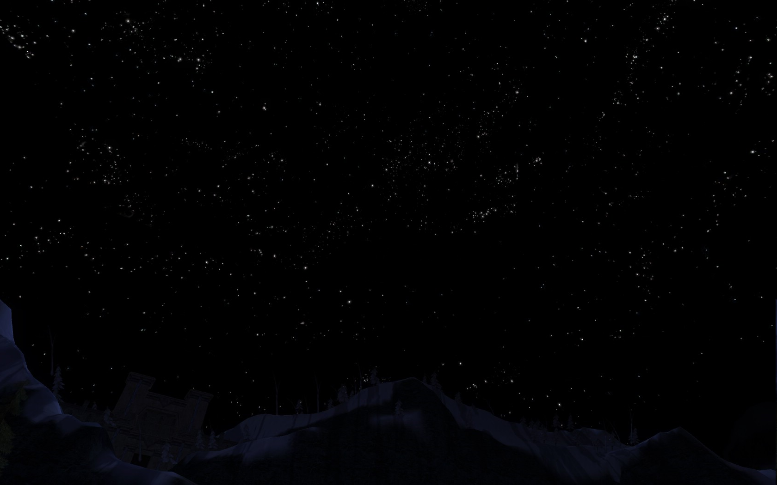


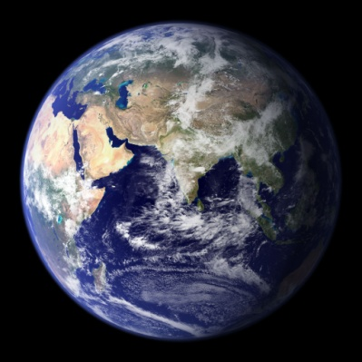
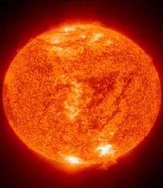
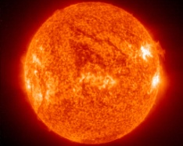
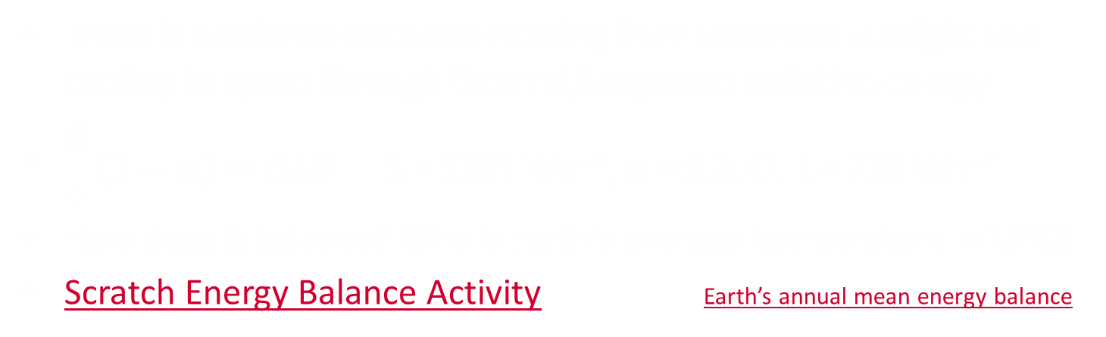

Earth’s Radiative energy balance in space
4πr²
Thermal/Infra-red or Outgoing Longwave Radiation (OLR)
S
πr²
Absorbed Solar or Shortwave Radiation $\frac{S}{4}$x$\left(1−α\right)$
α is “albedo” – the proportion of incoming solar radiation reflected back
There is a balance between heating from absorbed sunlight and cooling to space through thermal/longwave radiative energy
$\frac{S}{4}$ $\left(1−α\right)=OLR$ S ≈ 1361 Wm⁻², α ≈ 0.3, OLR ≈ 239 Wm⁻²
How does it balance? Why is Earth’s average temperature ~15ºC?
Scratch Energy Balance Activity Earth’s annual mean energy balance
Notes:
3
Earth’s climate is determined by the balance between absorbed sunlight and outgoing infrared cooling to space
If more energy is arriving than leaving, Earth heats up until it emits enough energy to space to balance (at a new higher temperature)
NOTE: observations show currently 300 billion kW energy accumulating (every person alive has 20 kettles (2kW) to slowly boil ocean (babies will need supervision) – this is causing climate to heat up (7x10^9 x20 x2 = 280 billion kW)
Use Scratch activity (click link, go full screen, top left button):
Turn on calc temperature, how low will T go if we remove the atmosphere (emissivity to zero)
Click green flag, turn on and then off calc temperature
What happens if we increase emissivity by 2%? (more energy in than out)
Note surface temperature then turn on calc T and show increase
BUT: it’s not that simple (feedback loops)…

Slide 4
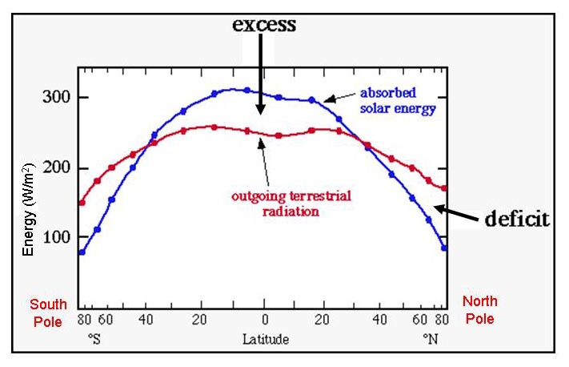
Earth’s Radiative energy balance
Tropics
Click for movie Why doesn’t the tropics keep getting hotter and hotter?
Notes:
Due to the angles of incident solar radiation, there is more energy received nearer to the equator than at the poles. This leads to an excess of solar energy over thermal outgoing energy in the tropics. Why doesn’t the tropics get hotter and hotter and the poles colder and colder?

Slide 5
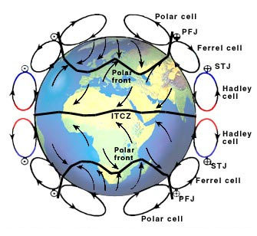
Earth’s energy budget and
Atmospheric circulation

Slide 6
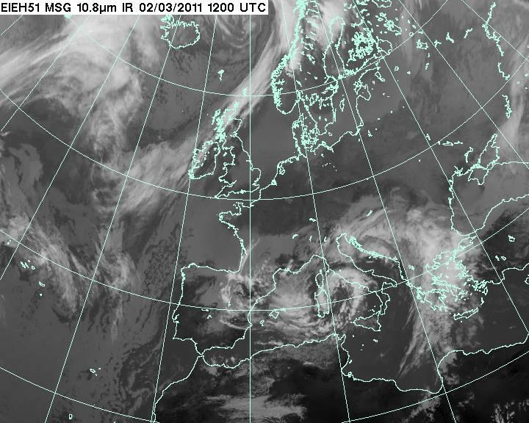

Slide 7
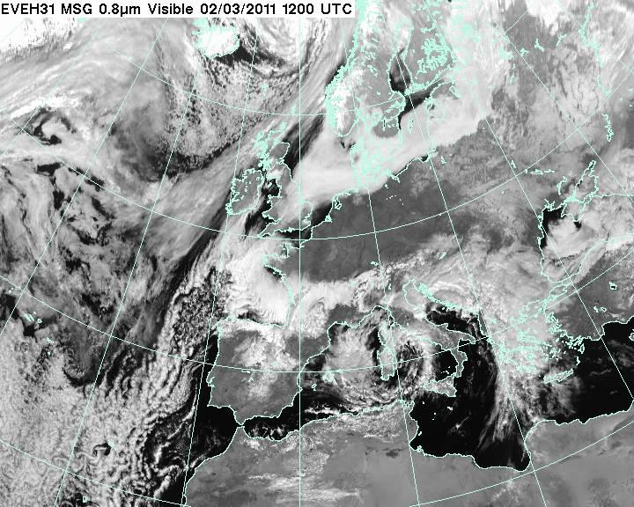

Slide 8
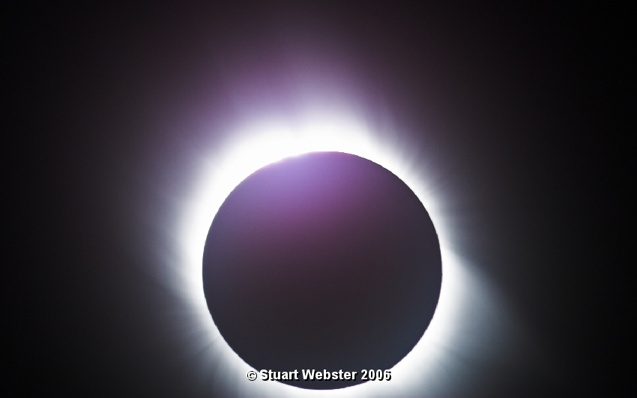
Forcing and response: a natural experiment
Notes:
In this example, my friend took pictures of solar eclipse in Turkey.
Show the sky before, during (still light at horizon) and afterwards.
Q: did anyone spot the difference in the sky? (clouds went)
One hypothesis – they blew away – perfectly possible.
But why are clouds there? (think lava lamp, remove heating source (sun) cloud go)

Slide 9
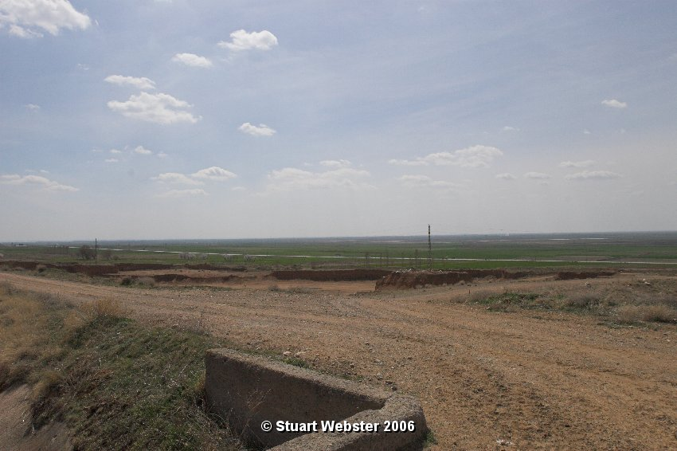
29/3/06 11.05am

Slide 10
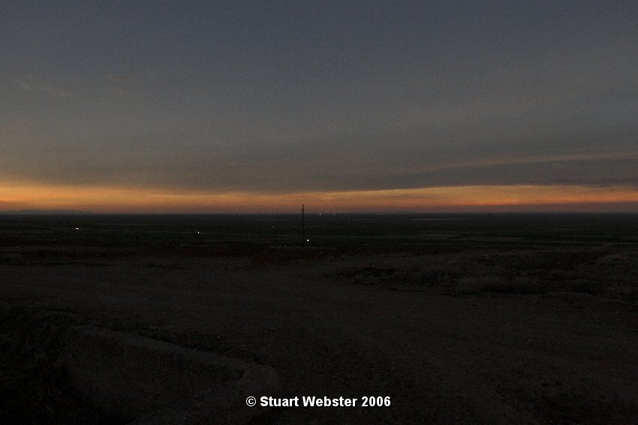

Slide 11
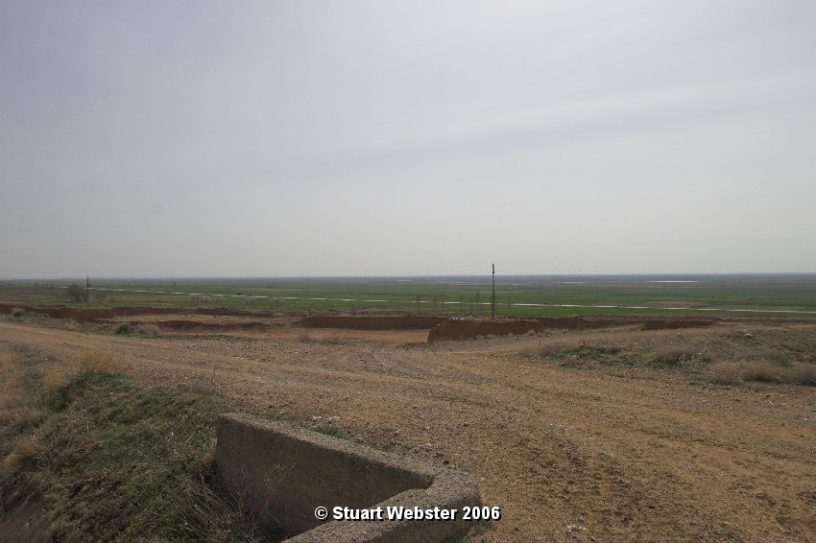
29/3/06 12.26pm

Slide 12
Clouds affect radiation fluxes
Radiation fluxes affect clouds
Notes:
Take away message: Clouds depend on sunlight heating surface, sunlight reaching surface also depends on clouds!
Possibility for feedback loop.
Feedback loop demonstration:
Get back row up to front (~10 students?)
Form a line, one pushes, the other response (impact is at the end, hopefully not severe!)
Now in a loop, one pushes, others respond but feedback to beginning again.
An example is ice albedo feedback (e.g. higher T → ice melts → less sunlight reflected → more heating → even higher T)

Slide 13
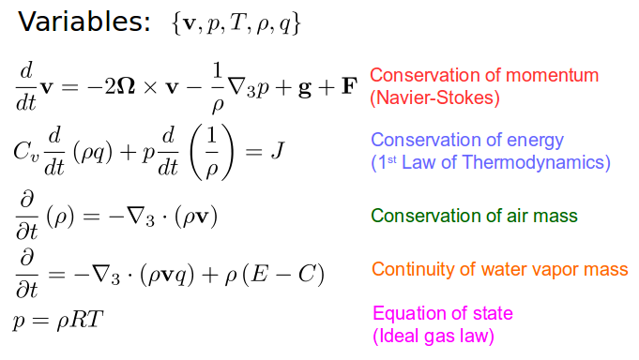
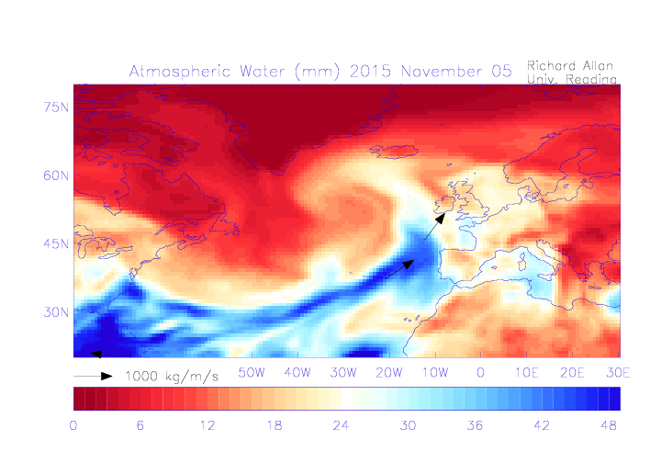
Weather forecasts
& climate prediction
What’s a prediction?
Scientists use observations and physics to forecast the weather and predict how climate will change
This can make a difference to lives and wellbeing
Budding forecasters and research scientists use physics and maths to make a difference to people
Ingredients:
Observations, Experiments, Physics, Computer Simulation
Notes:
What’s a prediction?
We all use predictions. Predict the sun will rise in the morning, it always does. Statistical can work.
Can predict how long it takes to get to school, based on how long it normally takes (statistical). Could also calculate traffic flows, etc (simulation e.g. google maps).
Weather is complicated – need to split the world into cubes and solve physical equations.
Climate is the same but we’re trying to predict general responses e.g. not
Just the same that we can simulate how much warmer summer will be than winter due to more sunlight we can simulate how much warmer the planet will be with more greenhouse gases in the future. +ocean and atmospheric circulation, rainfall patterns, etc.

Slide 14
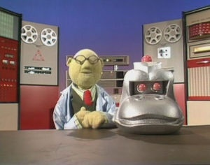
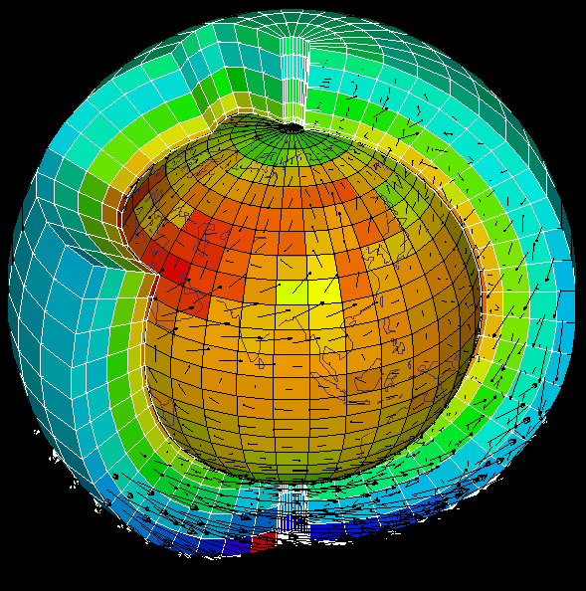
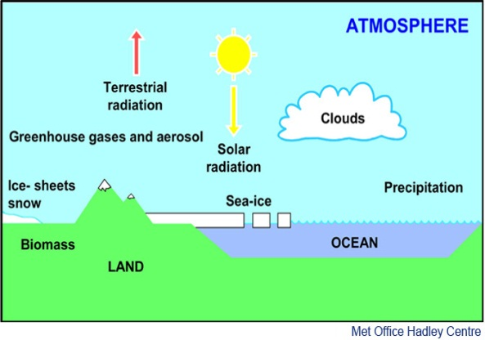
Climate simulations
Scientists code all the physics of the atmosphere, oceans and land in complex computer simulations
Many millions of lines of code are used to calculate physics equations & pass information between grid cells
These simulations build on weather forecast simulations but add more physics (oceans, vegetation, chemistry, …)
They are used to:
  understand how past climate changed
  project how climate will change over future decades and centuries
climate model animation
Notes:
To understand climate and make predictions of future climate change, scientists need to build complex simulations that are built on observations-based physics equations
These need to represent all the feedback loops
The atmosphere, oceans and surface are slit into millions of blocks, equations calculated for wind, cloud, vegetation, etc and information passed from cell to cell (just like students in classroom)
SHOW ANIMATION as an example
By prescribing scenarios in which atmospheric constituents change in response to human-related emissions and changes in natural forcing agents such as the sun or volcanos, experiments can be made with climate models to see how well they reproduce the past climate and then what they project for future climate.

Slide 15
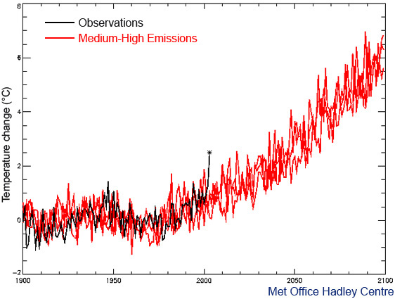

How will climate change over your lifetimes?
70
70
70
European summer temperature change (ºC) -2 0 2 4 6 8
1900 1950 2000 2050 2100
Notes:
2003 heatwave – students were embryos! Many died in France
My Dad was 70 5yrs ago
When I’m 70 2003 extreme temperature may be normal
When my son and students are 70 such “cold” summer temperatures will be unheard of! (but it’ll be a different sort of heat)
Notes:
The simulation from 1900 to 2000 agrees well with the observations (black), except for the summer of 2003 (black asterisk) which was much warmer than either the model simulation or the climatic norm. In the absence of any human modification of climate, temperatures such as those seen in Europe in 2003 are estimated to be a 1-in-1,000 year event. Despite this, it is seen that, by the 2040s, a 2003- type summer is predicted to be about average, and by the 2060s it would typically be the coldest summer of the decade. Recent work has demonstrated that hot, 2003-type, European summers would already be being experienced much more frequently (more than once per decade on average) were it not for the cooling effect of man-made sulphate aerosols. Once the shielding effect of these aerosols is removed, the warming commitment from past greenhouse gas emissions will mean that such hot summers are likely to become a regular occurrence, even without any further man-made greenhouse warming.

Slide 16
Degrees in Meteorology AND CLIMATE
  BSc Meteorology & Climate (BB physics and maths)
  MMet Meteorology & Climate with a year in Oklahoma (AA physics and maths)
  BSc Mathematics & Meteorology (AAB-ABB including A in Maths)
  MMath Mathematics & Meteorology (AAB-ABB including A in Maths)
  BSc Physics of the Environment (ABB-AAC from three A levels including Mathematics & Physics, one of which must be at grade A)
  Modules: Atmospheric physics, dynamics, numerical methods, energy exchange, differential equations & calculus, Aran field course, dissertation, boundary layer, optional extra physics, weather forecasting, climate change, remote sensing, oceanography, environmental chemistry, global circulation, atmospheric electricity, …
More information at www.reading.ac.uk/met/undergraduate-courses
Work Experience Programme (February 2019): https://research.reading.ac.uk/meteorology/work-experience/

Slide 17
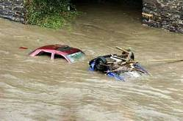
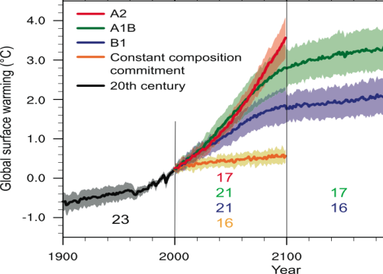
Climate change
Climate has always changed
Greenhouse gases such as carbon dioxide are at their highest levels for at least the last 800,000 years
This pollution from human activity is amplifying the natural greenhouse effect
This is heating the planet by impeding outgoing infrared cooling to space
Substantial changes in global temperature and rainfall patterns are projected using computer simulations
Predicting regional climate change is a challenge
What can we do to avoid dangerous climate change?
Notes:
Summary and what can we do?? Questions?
Notes:
Scientists are now even more certain that the current warming since the mid-20th century is primarily due to mans impact on the atmosphere via fossil fuel burning, agriculture and changes in land-use.
Much of this certainty comes from the observations but a large component comes about applying physical laws and theory, refined by the observations, to develop sophisticated computer models of the Earth’s environment that help to understand the reasons for the warming and to enable predictions of future climate change over the next few hundred years…

Slide 18
COP21 Paris Climate Deal source: http://www.carbonbrief.org/analysis-the-final-paris-climate-deal
Target: global temperature well below 2ºC; efforts to limit to 1.5ºC
Mitigation: pursue policies aiming to achieve INDC climate pledges; subsequent pledges progressively more ambitious; global stocktake 2018 & then every 5 years; peak global greenhouse gas emissions “as soon as possible”; “balance” between emissions & sinks 2050-2100
Adaptation: $100bn/yr fund for developing countries: new collective quantified goal by 2025; periodic review of adaptive planning of Loss & damage has its own Article in the agreement — now on par with mitigation & adaptation; liability/compensation excluded.
Transparency: "facilitative, non-intrusive, non-punitive” system of review will track countries’ progress; emissions trading allowed; aviation/shipping not included
Treaty: deal enters force once 55+ parties, covering at least 55% of global emissions have signed up

Slide 20
Warming will be greater over the land and greatest in the Arctic
Change in average surface temperature (1986−2005 to 2081−2100) RCP 8.5 Scenario
Notes:
CAN SKIP TO SUMMARY IF SHORT OF TIME, just mention sea level rise and intensification of rainfall to link with impacts.
Land will warm up more than ocean, Artic the most.
Notes:
Models show a stronger warming over land and over polar regions compared to the oceans due to changes in circulation but also due the large heat capacity of the deep oceans.
Temperatures over land are expected to increase about twice as rapidly as temperatures over the ocean. The annual average warming by 2100 over land areas, where of course we live and work, is predicted to be in the range 3 °C to 8 °C for the high emissions scenario. Although the Earth's temperature has varied considerably over the last 1,000 years for natural reasons, the rise over the next 100 years due to human activities is predicted to be very much larger than natural variability, even with the lowest projected man-made emissions scenario.

Slide 21
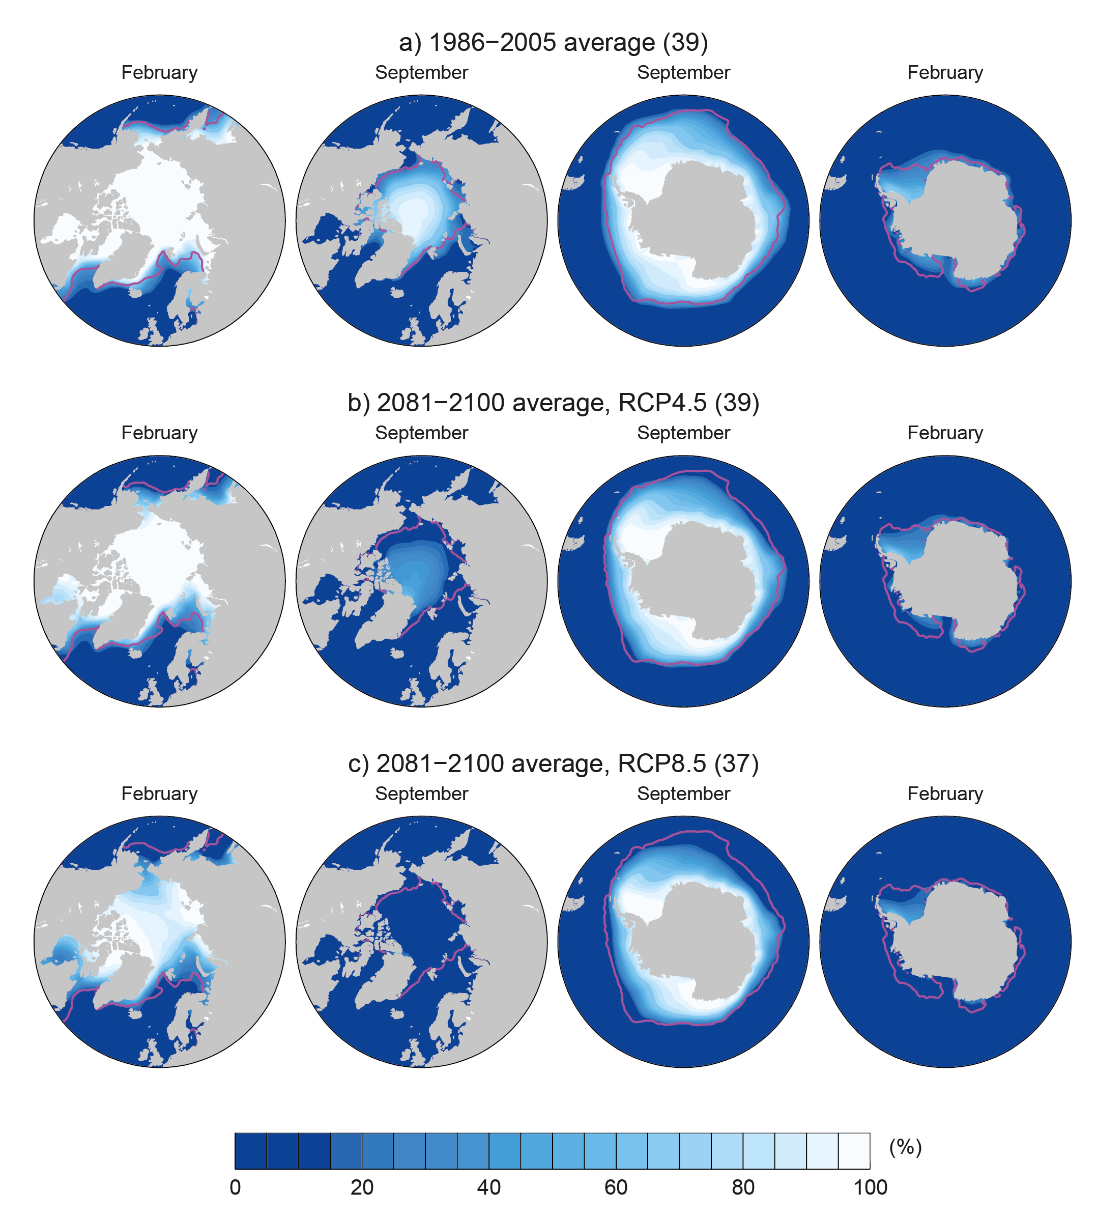

Projections:
Arctic sea ice extent decline in 21st century
94% decrease in
September and
34% decrease in
February for the
RCP8.5 scenario
2081-2100 (RCP 8.5) 1986-2005
IPCC (2013) WG1 Fig. 12.29
Notes:
Arctic ice is melting at a rate of 3000 cubic km per decade.
Note: O2 Arena is about 4 million m^3 (0.004 km^3) so ¾ million O2 Arenas per decade
Arctic ice will be effectively absent by middle-late century
Notes:
Under the High Emissions scenario many models find that ice in the month of September (when it is at its minimum extent in the annual cycle) will have almost completely disappeared the middle of the 21st century. Other emissions scenarios lead to a slower reduction in Arctic ice. Reductions are also predicted for other seasons and also for the Antarctic although models are at present not able to capture the observed increases in Antarctic sea ice extent which is thought to relate to changes in atmospheric and oceanic circulation changes in response to increases in greenhouse gases and decreased stratospheric ozone.

Slide 22
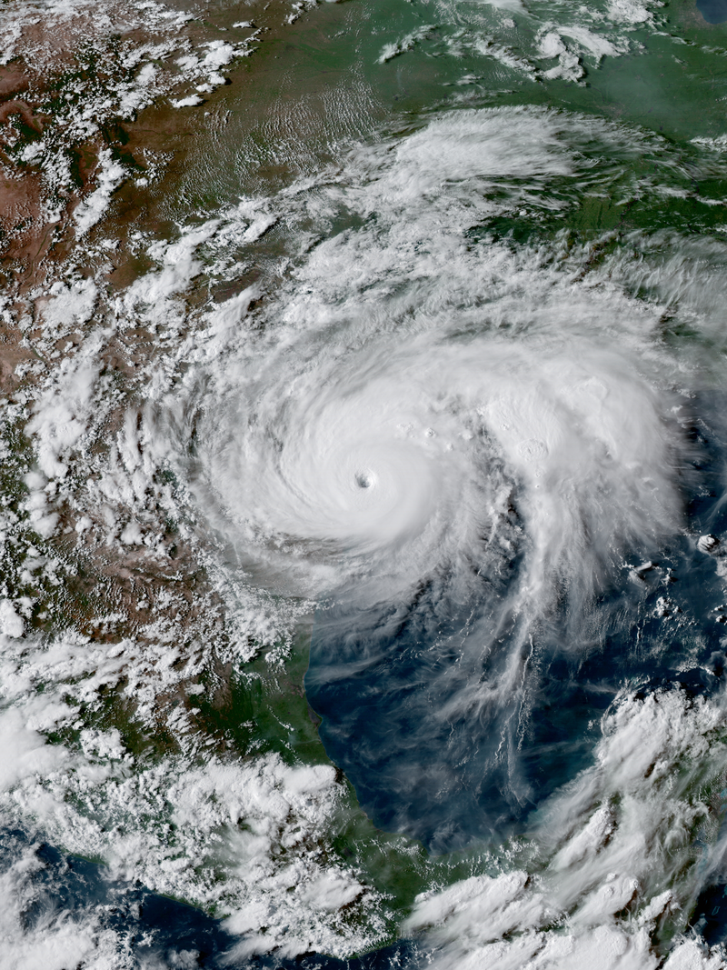
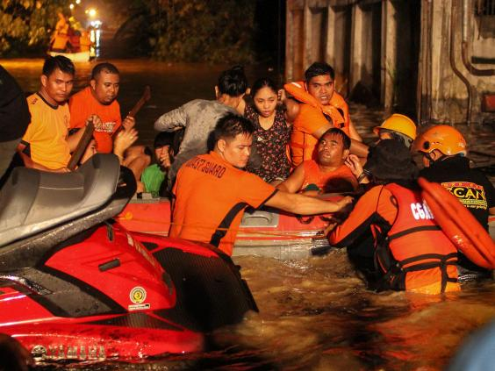
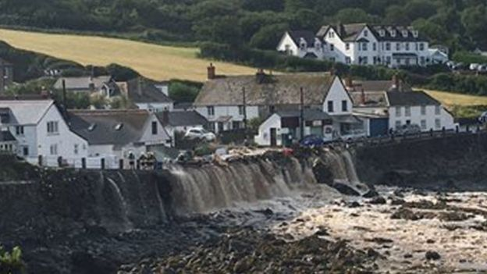
Intensification of heavy rainfall
Hurricane Harvey
Philippines
Coverack, Cornwall
Notes:
Note that water vapour is increasing and this is making heavy rainfall events more intense

Slide 23
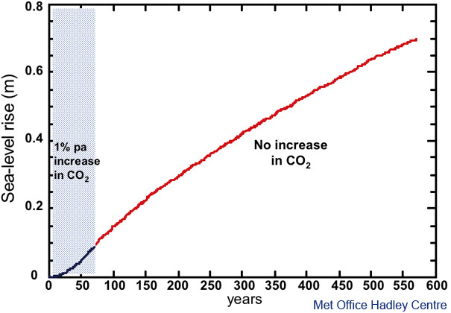
Sea-level rise will rise for centuries
CO₂ increase stops here
Notes:
Sea level is rising at 3.5mm/year because warmer water expands and melting ice sheets add water to the ocean
It takes hundreds to thousands of years for ice sheets and the deep ocean to fully respond to warmer surface temperature
So sea level will continue to rise for many hundreds of years to come (most big cities are near sea level)

Slide 24
EXTRA SLIDES

Slide 25
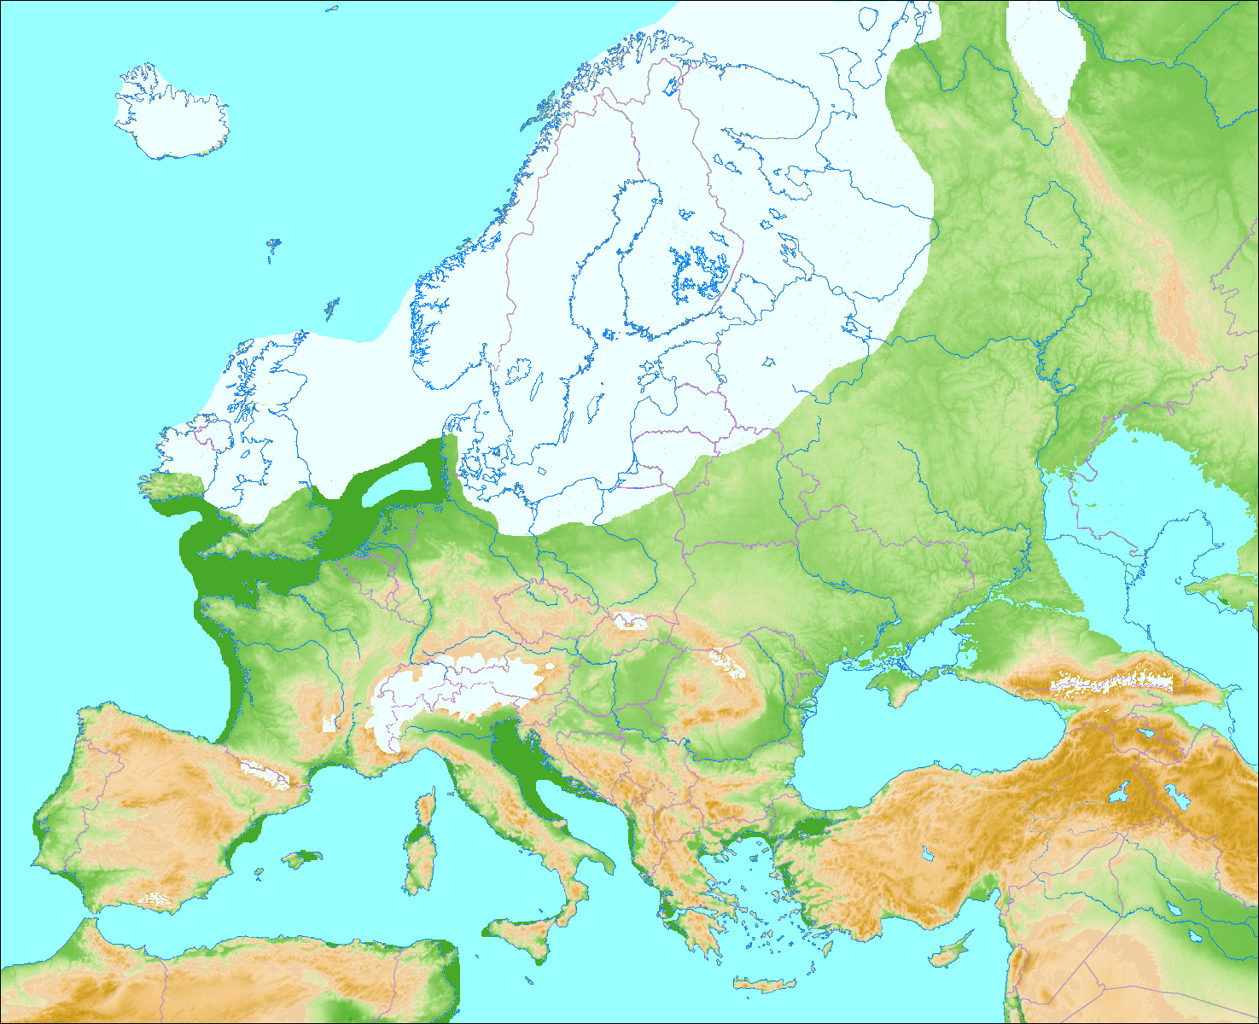
The last glacial maximum
About 20,000 years ago…
Northern Britain was covered by an ice sheet
Sea level was 100 metres lower

Slide 26
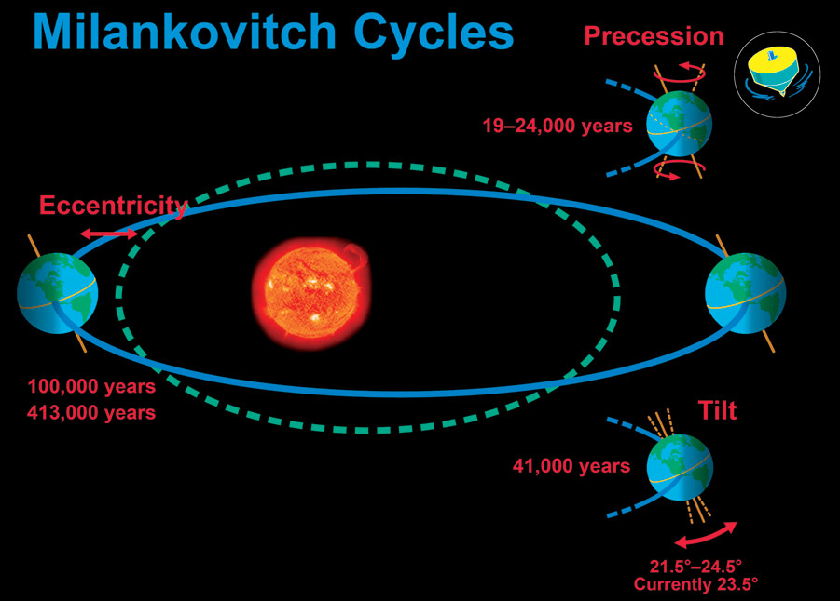
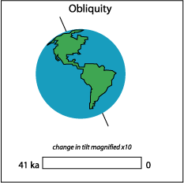
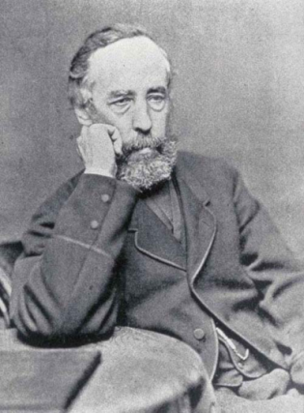
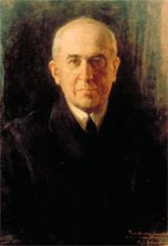
Croll-Milankovitch Cycles

Slide 27

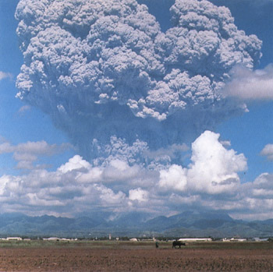
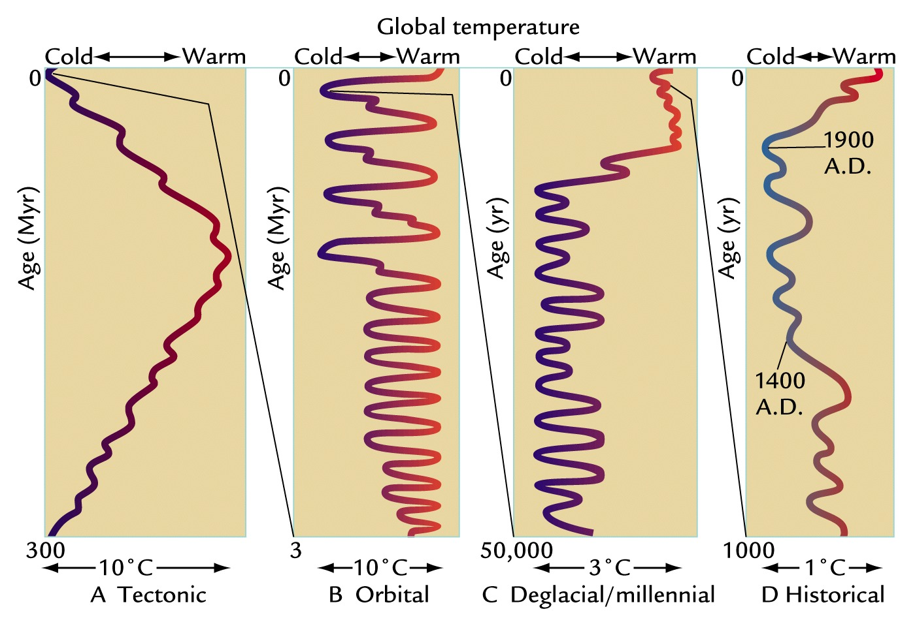
Earth’s Climate has always been changing
Ruddiman WF. 2001
Earth's Climate, Past and Future
Notes:
FIGURE 1-3 Time scales of climate change Changes in Earth’s climate span several time scales, arrayed from longer to shorter: (A) the last 300 million years, (B) the last 3 million years, (C) the last 50,000 years, and (D) the last 1000 years. Here progressively smaller changes in climate at successively shorter time scales are magnified out from the larger changes at longer time scales.
[Ruddiman WF. 2001. Earth's Climate, Past and Future. New York: W. H. Freeman.]
Climate changes on all time-scales. One of the most important determinants of climate is variations in the absorption of solar radiation by the planet.
Over billions of years the solar output has increased with time, as has the evolution of the Earth’s atmosphere and distribution of land and ocean which modifies the efficiency at which the Earth can cool to space via thermal/long wavelength radiation as well as impacting absorption of sunlight.
Over tens and hundreds of thousands of years, changes in the Earth’s orbit around the sun alter the amount of solar radiation reaching different parts of the planet. These cycles are predictable (they depend upon the gravitational pulls of the sun, planets and the moon) and they are widely believed to have caused glacial-interglacial cycles in which global temperatures swing by up to 10ºC. However, crucial to these swings are feedbacks which either amplify or dampen the radiative forcing from these Milankovic cycles. For example, cooler temperatures lead to more ice and greater reflection of solar radiation which amplifies the cooling.

Slide 28
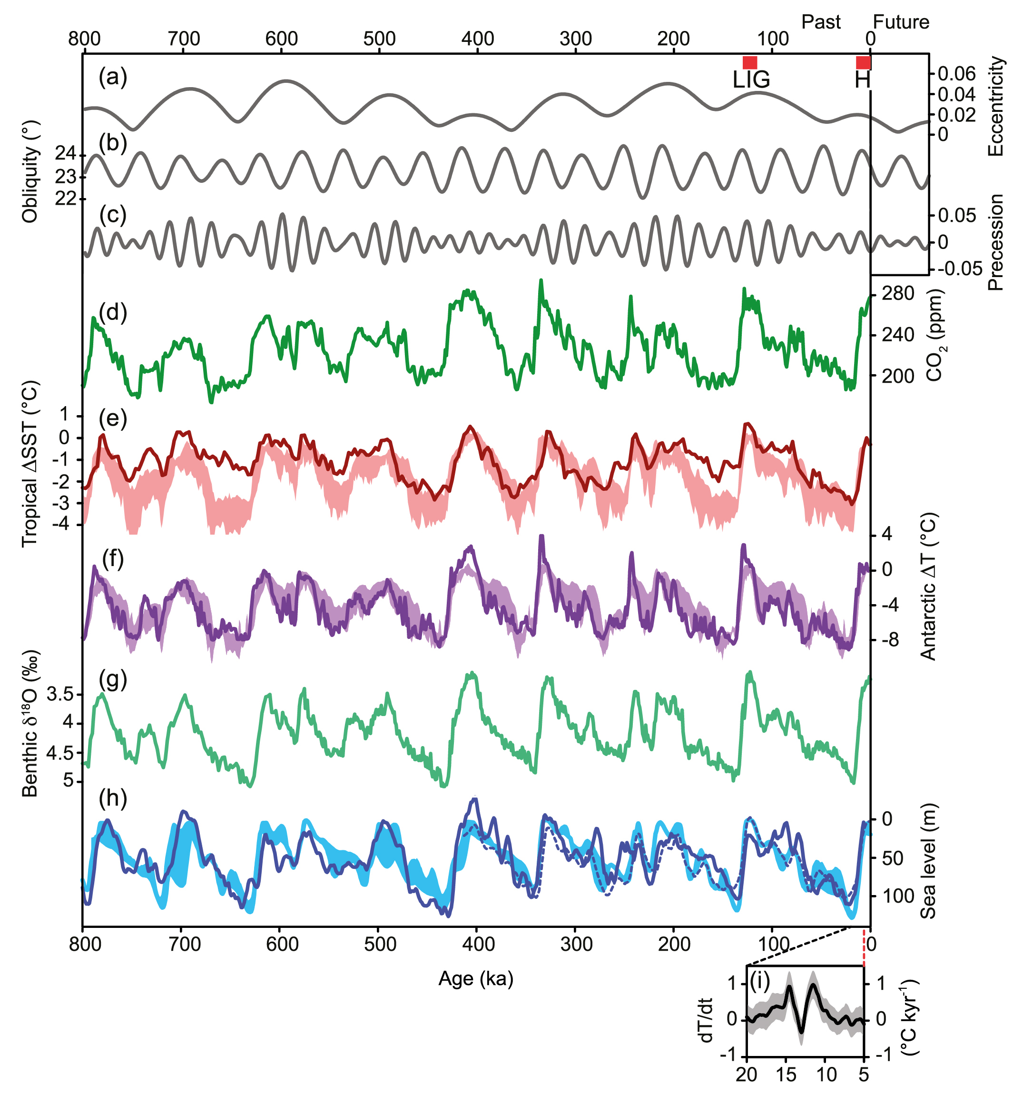
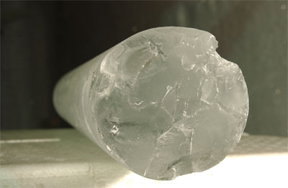


Climate change over last 800,000 years
410 ppm
CO₂
Antarctic Temperature
8ºC
Ice volume proxy
Sea level
Modern humans
100m
IPCC (2013) Chap. 5 Fig 5.3
Africa →
Europe
Agriculture
Notes:
During colder glacial periods:
More ¹⁶O locked away in ice sheets so higher ¹⁸O in oceans & air bubbles in ice cores: ice volume
Larger equator to pole temperature gradient leading to greater depletion of ¹⁸O in snow compacted in ice cores
Ice cores from Antarctica provide abundant evidence of climate change over the past 800,000 years. Trapped air bubbles record past atmospheric composition, including carbon dioxide and methane, and isotopic analysis of oxygen and hydrogen in the air bubbles or of the ice itself can tell us indirectly about changes in Antarctic temperature (or temperature difference between tropics and poles) and ice volume (additional evidence from ocean sediments is also particularly valuable). A series of milder interglacials punctuate the longer glacial periods of low temperature and high ice volume, the timings of which relate to changes in the Croll-Milankovic orbital cycles. Natural changes in carbon dioxide (and methane) in response to the substantial climate changes act to amplify the temperature responses over glacial cycles (more next week).

Slide 29
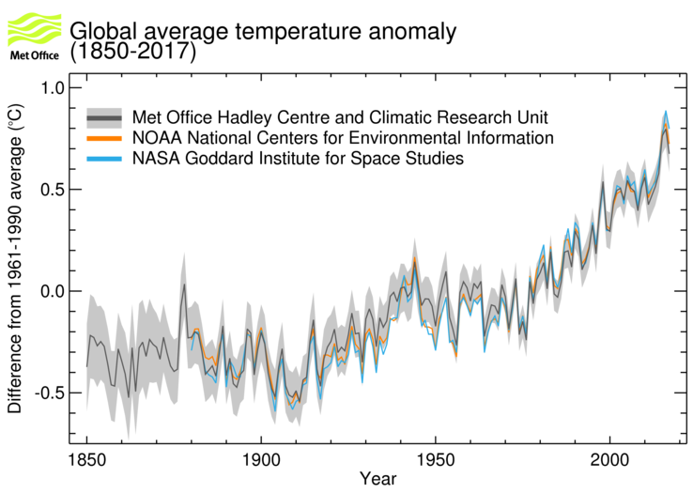
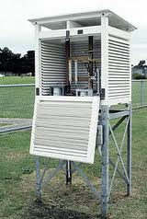
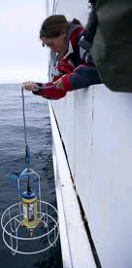

The planet is warming
44 years
www.metoffice.gov.uk/research/monitoring/climate/surface-temperature
Notes:
The instrumental record goes back to about 1850. A few areas of the globe have not warmed in recent decades, mainly over some parts of the Southern Hemisphere oceans and parts of Antarctica. The rate of surface warming is not smooth; there are lumps and bumps in the record and this rate has slowed in the recent decade.

Slide 30
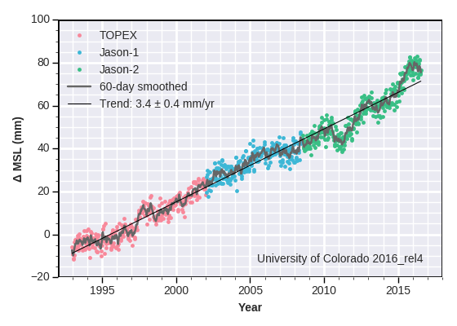
Global average sea level is rising…
http://sealevel.colorado.edu/
Notes:
Are there other indicators of the warming? Global sea level has risen, based on historical proxy data and tidal gauges that have been adjusted to allow for rising and falling of land and other factors. Global sea levels have risen about 20cm over the past 100 years – a rate of about 2mm a year. This is faster than the rise over any of the last 5000 years (less than 1mm a year), but still slower than the average rise of 5mm a year predicted for the next 80 years. Most of this rise occurs because as the oceans get warmer, their water takes up more space (thermal expansion). Melting glaciers in the Andes, Himalayas, the Rockies and the Alps are increasingly contributing to sea level rise and melting of ice sheets at the periphery of Greenland and Antarctica are increasingly contributing.

Slide 31
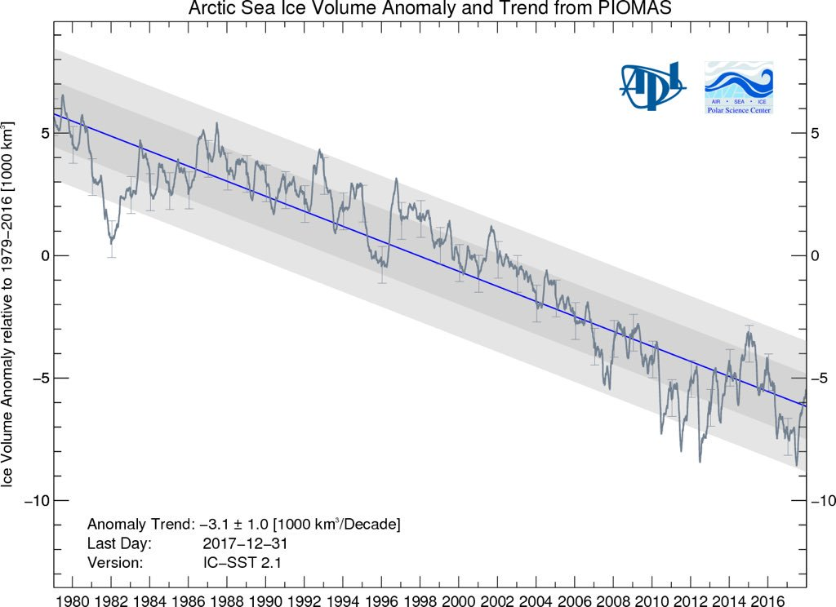
Melting of Arctic sea Ice
NSIDC :
Notes:
Greenland is losing 300 Gt of ice every year = 3x10^9 t = 3x10^12 kg (3000 billion kg)
Elephant 6000 kg = 6 tonnes → 300 billion tonnes = 50 billion elephants (1 millionx elephant population)
Artic ice losing 300 km^3 ice per year (100 million Olympic Swimming Pools per year).
(3x10^11 m^3 ~ 1x10^8 swimming pools (100 million)
Olympic Swimming Pool: 2500 m^3
Changes in atmospheric and oceanic circulation cause variability in the coverage of Arctic sea ice. However, the declining coverage in the satellite record (passive microwave measurements made since 1979) is robust and further, there has been a drop in “old” ice (older than 2 years for example) since the grand minimum coverage in 2007 with a larger fractional coverage of young <1 year old ice (which is more transient in nature meaning that it can melt and reform more quickly).

Slide 32
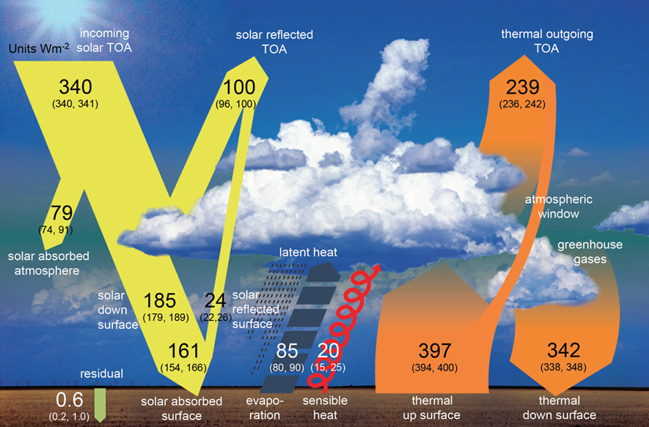
Earth’s Global Annual Average Energy Balance
Wild et al. (2012) Clim. Dynamics. See also: RMetS Climate Science updates

Slide 33
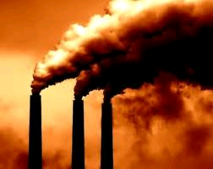
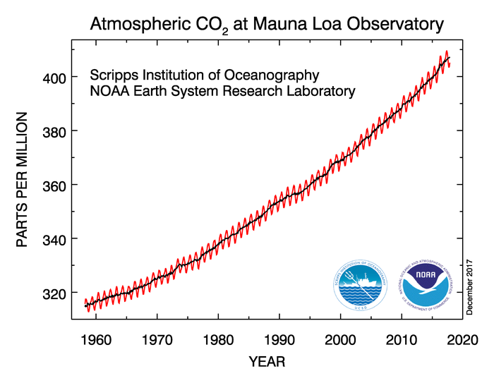
“Radiative forcing” of climate
140 billion 2kW kettles heating up the oceans!
44 years
Notes:
Currently energy is accumulating at a rate equivalent to every person currently alive using 20 kettles (2kW) each to boil oceans (or about 300 trillion watts) Allan et al. (2014)

Slide 34
Future projections to 2100 from climate models
1.0
0.8
0.6
0.4
0.2
0.0
High emissions
Low emissions
(m)
“Continued emissions of greenhouse gases will cause further warming and changes in all components of the climate system. Limiting climate change will require substantial and sustained reductions of greenhouse gas emissions.” [IPCC 2013 SPM]
IPCC (2014) WG1 Summary for Policy Makers
Notes:
Higher emissions (e.g. burning coal/oil) = bigger impact (so reduce emissions)
High emissions: 4oC warming by 2100 (kids will be very old) – note that last ice age, global T only about 4-5oC colder
Notes:
Increase of global mean surface temperatures for 2081–2100 relative to 1986–2005 is projected to likely be in the ranges 0.3°C to 1.7°C for the lowest emissions scenario (RCP2.6) and 2.6°C to 4.8°C for the highest emissions scenario (RCP8.5). The Arctic region will warm more rapidly than the global mean, and mean warming over land will be larger than over the ocean.
Global mean sea level rise is projected to range from 0.52 to 0.98 m by 2100 for RCP8.5, with a rate during 2081 to 2100 of 8 to 16 mm per year. Further uptake of carbon by the ocean will increase ocean acidification.
Heavy rainfall is expected to become more intense with wet regions generally seeing more rainfall and dry sub-tropical regions or seasons less.
For further details, see the IPCC (2014) WG1 Summary For Policy Makers, Section E.

Slide 35
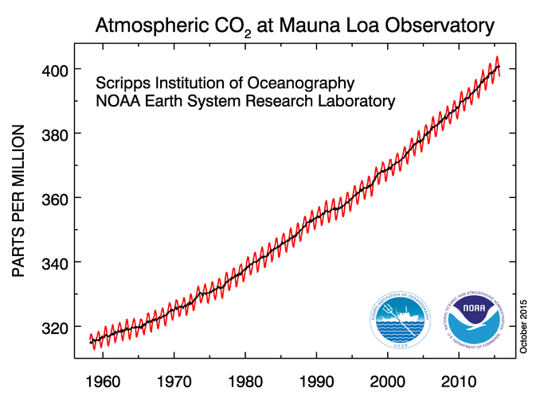
“Radiative forcing” of climate
Increases in greenhouse gases heat the planet by reducing how easily Earth can cool to space through infra-red emission
More small pollutant “aerosol” particles cool the planet by reflecting sunlight
If more energy is arriving than leaving, Earth should heat up…
Currently energy is accumulating at rate equivalent to every person currently alive using 20 kettles (2kW) each to boil oceans (or about 300 trillion watts) Allan et al. (2014)

Slide 36
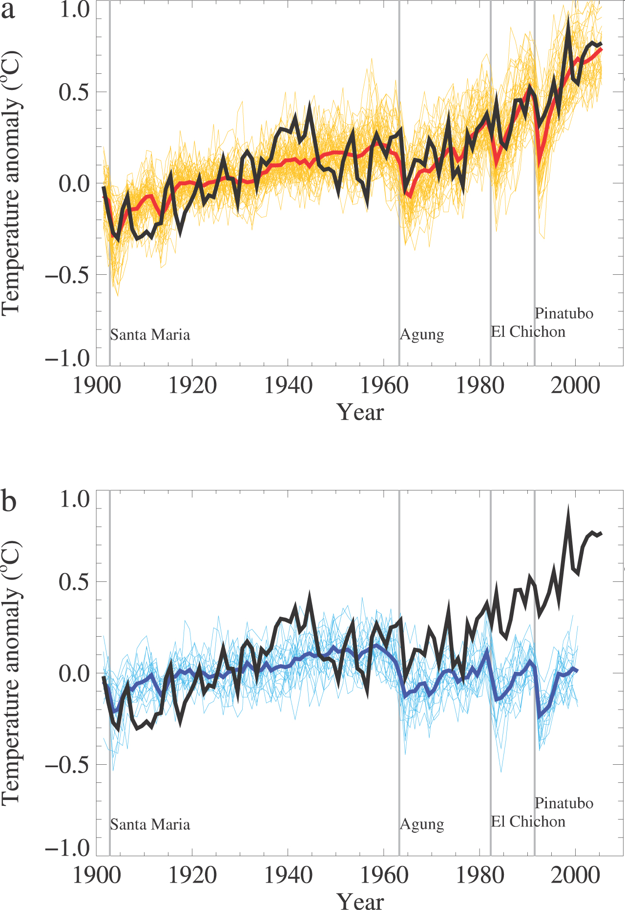
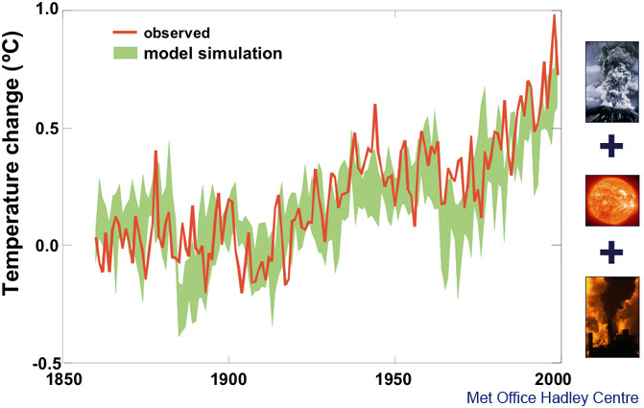
Natural factors cannot explain recent warming
See IPCC FAQ 10.1
and SPM Fig. 6
Notes:
As we have already outlined, natural factors include a chaotic variability of climate due largely to interactions between atmosphere and ocean, changes in the output of the Sun and changes in the optical depth of the atmosphere from volcanic emissions. Climate models have been driven by changes in all these natural factors, and it simulates changes in global temperature shown by the blue band in the slide above. This clearly does not agree with observations, particularly in the period since about 1970 when observed temperatures have risen by about 0.5 °C, but those simulated from natural factors have hardly changed at all.

Slide 37
Recent warming can be simulated when man-made factors are included
See IPCC FAQ 10.1
and SPM Fig. 6
Notes:
If the climate model is now driven by changes in human-made factors — changes in greenhouse gas concentrations and sulphate particles — in addition to natural factors, observations (black) and model simulation (red/orange) are in much better agreement. In particular, the warming since about 1970 is captured. Of course, this agreement may, to some extent, be fortuitous, for example, if the heating effect of man-made greenhouse gases and the cooling effect of man-made aerosols have been overestimated. Nevertheless, the ability to simulate recent warming only when human activities are taken into account is a powerful argument for the influence of man on climate. In addition to simulating the global mean temperature, the model also simulates the pattern of changes in temperature, across the surface of the Earth and through the depth of the atmosphere. These ‘fingerprints of man-made warming’ have been compared to observations, providing even stronger evidence for the majority of the long-term trend over the last 50 years having been due to human activity.

Slide 38
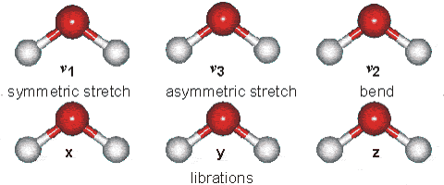
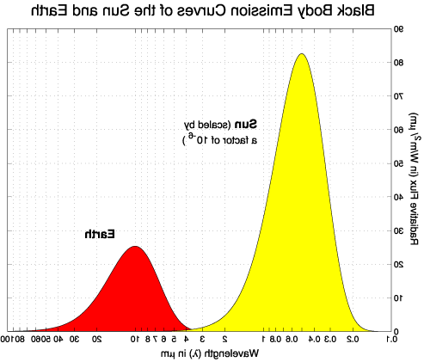

The Electromagnetic Spectrum
Figure from NASA.
IR thermometer activity
Notes:
38
Example of electromagnetic spectrum
point out where Earth and sun are emitting
note that atmosphere lets in lots of sunlight but blocks outgoing energy
Example of water molecule which absorbs both
IR THERMOMETER ACTIVITY:
Get 2 students, one fires gun at other, measures temperature (aim close at head)
2nd student does same and also measures floor, other students (we are warmer than floor, hopefully!)
Q: How does this measure temperature from far away? (IR radiation)
1st or another student then points at sky out of window then at sky through open window
Q: why is it colder? (window blocks IR radiation, like atmosphere)
Can also note that this is in part of IR spectrum where water vapour absorption is small so you can see the temperature of cloud base – used in Met to measure height of cloud base.
Notes:
In the above graph, the first bar is a key to the electromagnetic radiation that either, do or don't penetrate the earth's atmosphere. Y is for yes and N is for no. Although some radiation are marked as N for no in the diagram, some waves do in fact penetrate the atmosphere, although extremely minimally compared to the other radiations. Next the wavelengths are expressed in terms of meters, using scientific notation. Notice the spectrum goes from the longer Radio waves, at 103 meters, all the way to the shorter Gamma Rays, at 10-12 meters. Next the various wavelengths are compared to sizes found in everyday life.
Frequency, wavelength and wavenumber
Atmospheric radiation has been influenced by many different fields, each with its own preferred nomenclature and units. For example, physicists mainly use frequency, others use wavelength and spectroscopists use wavenumber.
Relationship between frequency and wavelength: c = ν λ
where ν (Greek nu) is frequency (cycles per second) and λ is wavelength
c is the speed of light (299,792,458 ms-1 by definition)
Wavenumber is the reciprocal of the wavelength expressed in cm.
Example: the peak of the main infrared absorption band of carbon dioxide is at;
Wavelength: 15 μm (microns: 10-6 metres)
Wavenumber: 667 cm-1 (667 cycles per cm)
Frequency: 2.1013 Hz = 20THz (teraHertz)

