Slide 1


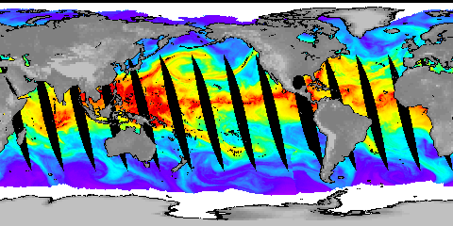
Physically consistent responses in the atmospheric hydrological cycle in models and observations
Richard P. Allan
Department of Meteorology/NCAS, University of Reading
Collaborators: Chunlei Liu, Matthias Zahn, David Lavers, Brian Soden
http://www.met.reading.ac.uk/~sgs02rpa
r.p.allan@reading.ac.uk
Notes:
Projected Responses in Extreme Precipitation and Atmospheric Radiative Energy
Energetics response
Wet/dry responses
Intense rainfall
Transient responses

Slide 2
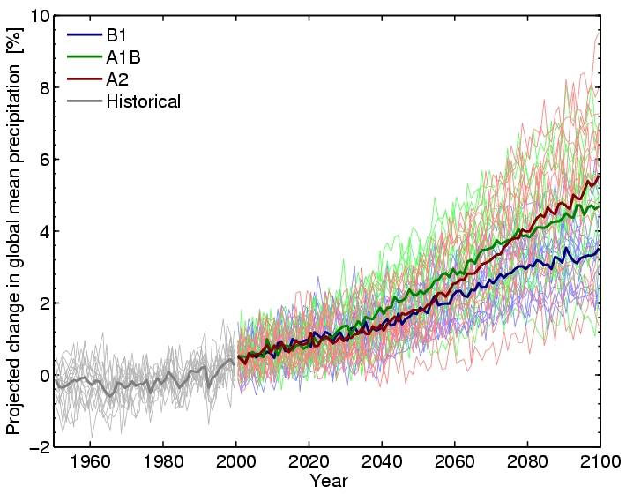
How should global precipitation respond to climate change?
Hawkins and Sutton (2010) Clim. Dyn
see also Allen and Ingram (2002) Nature; Trenberth (2011) Climate Research
Notes:
2
There is huge uncertainty in global precipitation projections, relating both to climate sensitivity and mitigation pathways.

Slide 3
Climate model projections (IPCC 2007)
Precipitation Intensity
Increased Precipitation
More Intense Rainfall
More droughts
Wet regions get wetter, dry regions get drier?
Regional projections??
Dry Days
Precipitation Change (%)

Slide 4
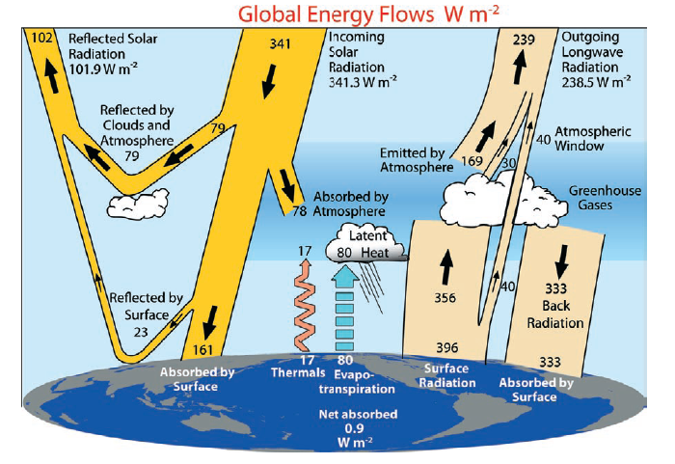
Physical basis: energy balance
Trenberth et al. (2009) BAMS
Notes:
Unpublished Kiehl and Trenberth (2008) BAMS

Slide 5

Models simulate robust response of clear-sky radiation to warming (~2 Wm⁻²K⁻¹) and a resulting increase in precipitation to balance (~2 %K⁻¹) e.g. Stephens & Ellis (2008) J Clim, Lambert and Webb (2008) GRL
Allan (2009) J. Clim
Radiative cooling, clear (Wm⁻²K⁻¹)
NCAS-Climate Talk
15th January 2010

Slide 6
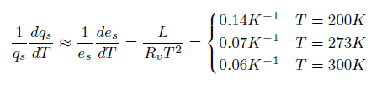
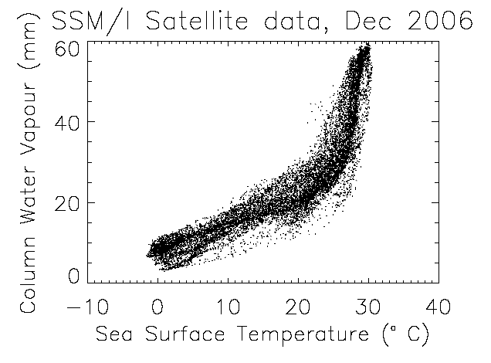
Physical basis: Clausius Clapeyron
Strong constraint upon low-altitude water vapour over the oceans
Land regions?
e.g. Allan (2012) Surv. Geophys. in press
Notes:
Then radiation? SNLc vs CWV (could show ERA Int and CERES SRBAVG?) also show Prata curve.
6

Slide 7
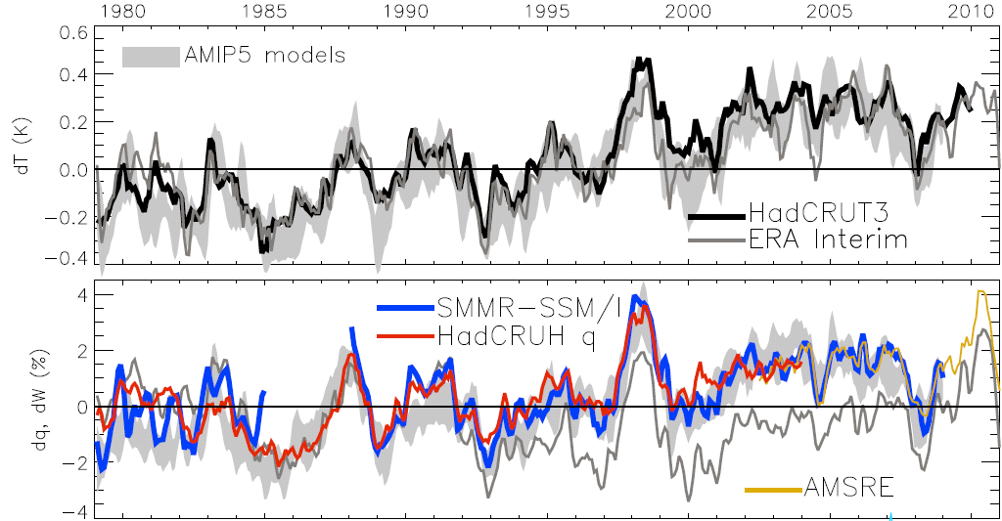
Global changes in water vapour
Updated from O’Gorman et al. (2012) Surv. Geophys; see also John et al. (2009) GRL
Notes:
The main point to note is that models and observations are consistent in showing increases in low level water vapour with warming. Reanalyses such as ERA Interim, which are widely used, are not constrained to balance their energy or water budgets.
For ocean-only satellite datasets I apply ERA Interim for poleward of 50 degrees latitude and for missing/land grid points.
Note that SSM/I F13 2003-2007 CWV = 24.7794 mm; AMSRE 2003-2007 CWV = 24.8850
7

Slide 8
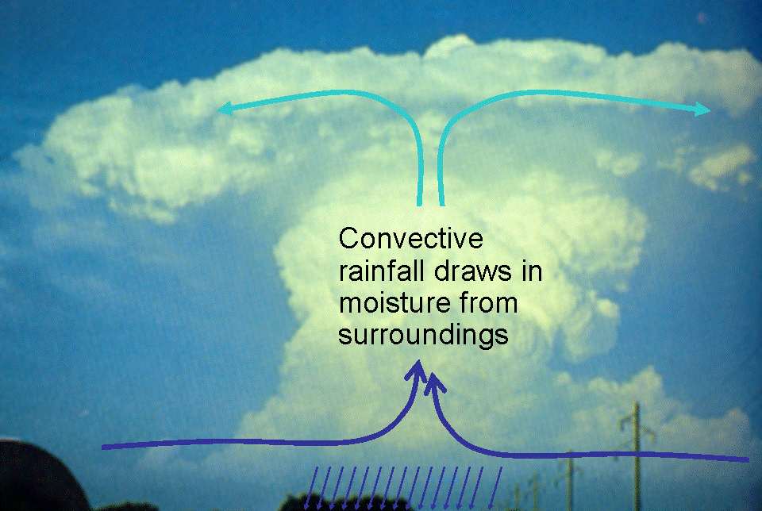
Extreme Precipitation
Large-scale rainfall events fuelled by moisture convergence
  e.g. Trenberth et al. (2003) BAMS. But see Wilson and Toumi (2005) GRL
Intensification of rainfall (~7%/K?)
O’Gorman and Schneider (2009) PNAS; Gastineau and Soden (2009) GRL

Slide 9
Observed and Simulated responses in extreme Precipitation
Increase in intense rainfall with tropical ocean warming
SSM/I satellite observations at upper range of models
Allan et al. (2010) Environ. Res. Lett.
Tropical response uncertain: O’Gorman and Schneider (2009) PNAS…. but see also: Lenderink and Van Meijgaard (2010) ERL; Haerter et al. (2010) GRL

Slide 10


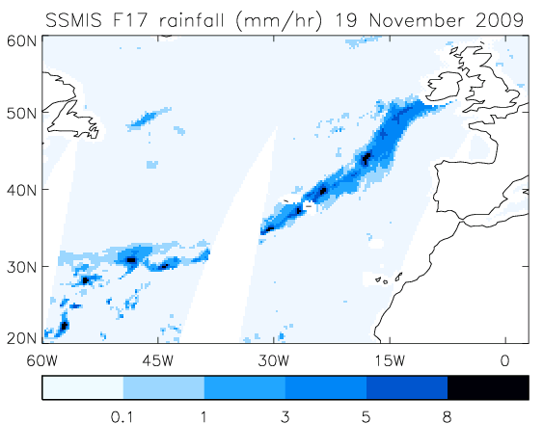
HydEF project:
Extreme precipitation & mid-latitude Flooding
Links UK winter flooding to moisture conveyor events
  e.g. Nov 2009 Cumbria floods
Lavers et al. (2011) Geophys. Res. Lett.

Slide 11
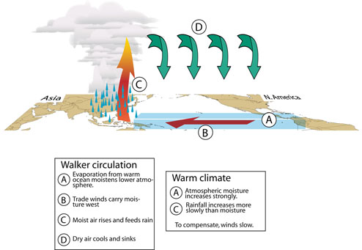

Physical Basis: Moisture Balance
P-E ~ (▼. (u q)) (units of s⁻¹; scale by (p/gρ_{w}) for units of mm/day)
scaling
Change in Moisture Transport, dF (pg/day)
If the flow field remains relatively constant, the moisture transport scales with low-level moisture.
Model simulation
Held and Soden (2006) J Climate

Slide 12
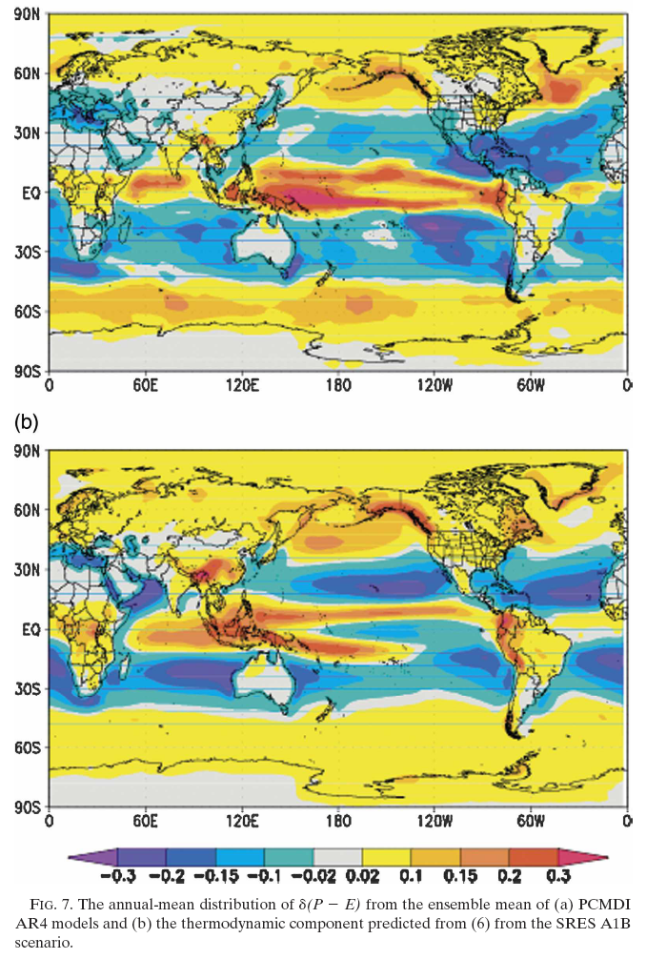
Projected (top) and estimated (bottom) changes in P-E
~
Held and Soden (2006) J Climate

Slide 13
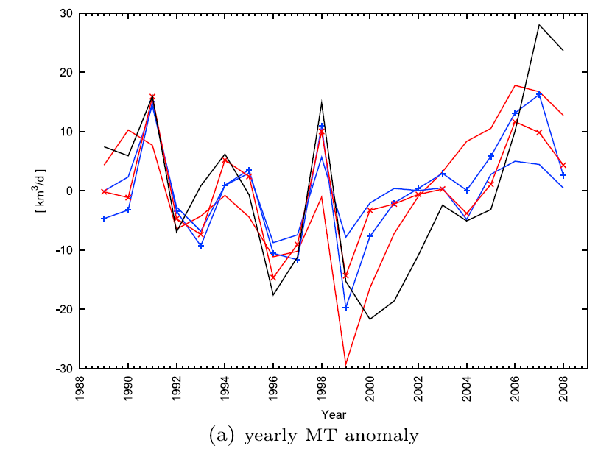
Moisture transports from ERA Interim
Instantaneous field
Moisture transport into tropical ascent region
Significant mid-level outflow
2000s: increases in inflow?
outflux
influx
Zahn and Allan (2011) JGR
PREPARE project
Notes:
We are also interested in calculating observationally based water budgets including moisture transports and P-E and how this relates to ocean salinity observations.

Slide 14
Physical Basis: Circulation response
First argument:
P ~ Mq.
So if P constrained to rise more slowly than q, this implies reduced M
Second argument:
ω=Q/σ.
Subsidence (ω) induced by radiative cooling (Q) but the magnitude of ω depends on (Г_{d}-Г) or static stability (σ).
If Г follows MALR → increased σ. This offsets Q effect on ω.
See Held & Soden (2006) and Zelinka & Hartmann (2010) JGR
P~Mq
Notes:
14

Slide 15
Physical Basis: Circulation response
P~Mq
Models/observations achieve muted precipitation response by reducing strength of Walker circulation. Vecchi and Soden (2006) Nature
Notes:
15

Slide 16
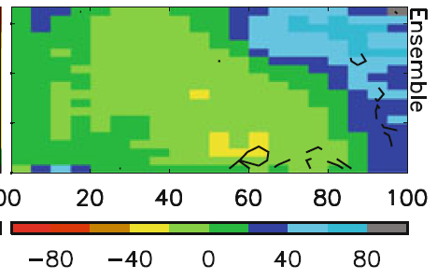
Precipitation bias and response binned by dynamical regime
Warmer surface temperature →
Model biases in warm, dry regime
Strong wet/dry fingerprint in model projections (below)
Stronger ascent →
Allan (2012) Clim. Dyn.
Stronger ascent →

Slide 17

Contrasting precipitation response expected
Heavy rain follows moisture (~7%/K)
Mean Precipitation linked to radiation balance (~3%/K)
Precipitation →
Light Precipitation (-?%/K)
Temperature →

Slide 18
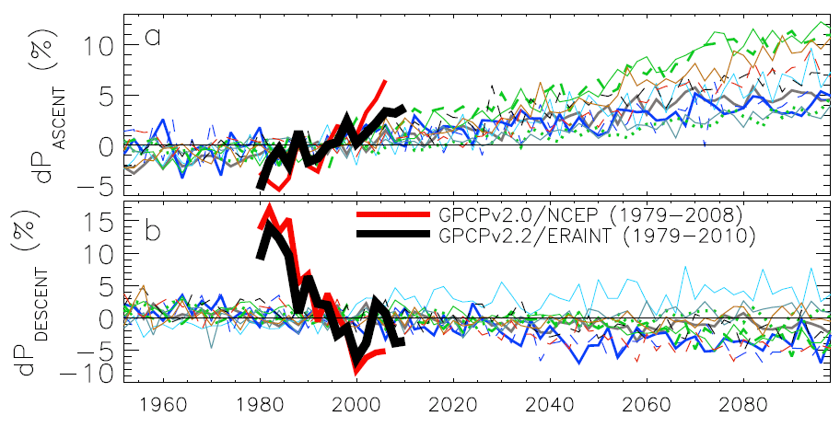
Contrasting precipitation response in wet and dry regions of the tropical circulation
ascent
Observations
Models
Precipitation change (%)
descent
Sensitivity to reanalysis dataset used to define wet/dry regions
Updated from Allan and Soden (2007) GRL; Allan et al. (2010) Environ. Res. Lett.
Notes:
Note that the wet getting wetter and dry getting drier signal in the tropics is robust in models. The recently updated GPCP observations (black) show a slightly larger trend in the wet region. The dry region trend is probably spurious before 1988 since microwave data began in 1987.

Slide 19
Exploiting satellite estimates of precipitation
Liu and Allan (2011) JGR in press.
HOAPS and TRMM 3B42 are outliers
Strong sensitivity to ENSO
Notes:
We are analysing tropical and global variability and responses of PDFs of precipitation to present day temperature variability.
We have identified two outliers: HOAPS (divided by 3 on plot) data overestimates variability while TRMM 3B42 (widely used) displays spurious variability over the oceans.

Slide 20
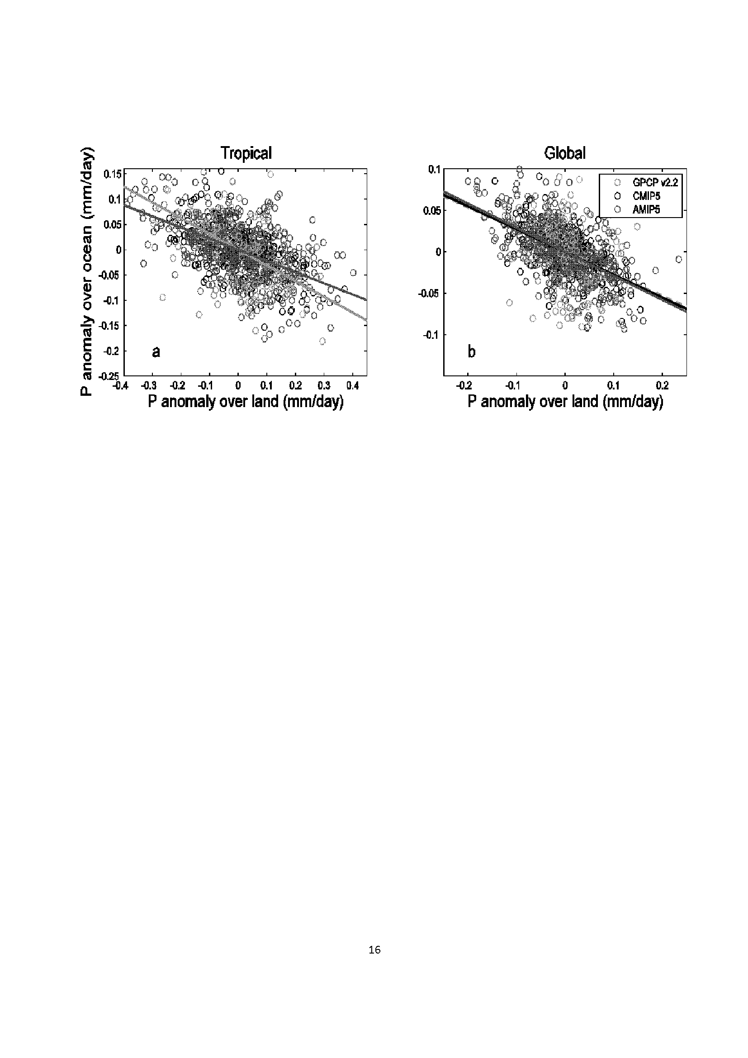
Contrasting land/ocean changes relate to ENSO
Liu and Allan (2012) in preparation
See also Gu et al. (2007) J Clim

Slide 21


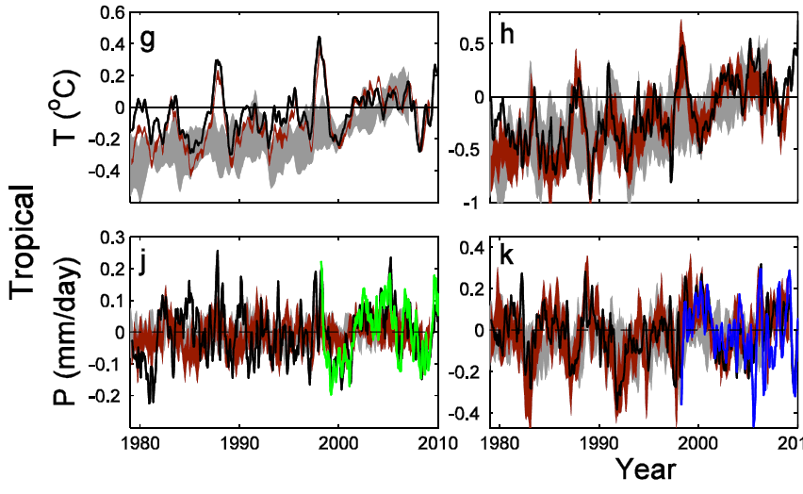
PAGODA: Understanding global changes in the water cycle
Oceans Land
Above: Current changes in tropical precipitation in CMIP5 models & satellite-based observations
Note realism of atmosphere-only AMIP model simulations
Liu and Allan (2012) JGR, in press; Liu and Allan in prep…

Slide 22
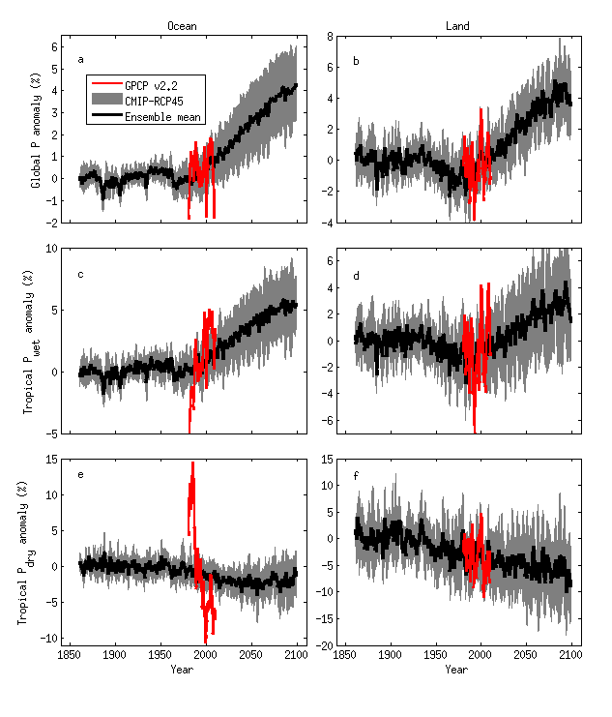
Simulated & projected % changes in precipitation
Ocean Land
HadGEM2
Tropical dry Tropical wet Global
Pre 1988 GPCP ocean data does not contain microwave data

Slide 23
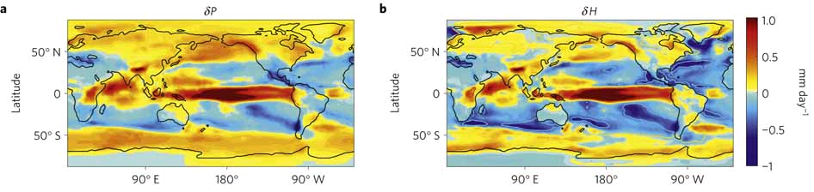
Regional precipitation changes: energetic contraints
ΔPrecipitation ΔDry static energy
Muller and O’Gorman (2011) Nature Climate Change
Implications for monsoon? Levermann et al. (2009) PNAS

Slide 24
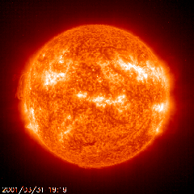
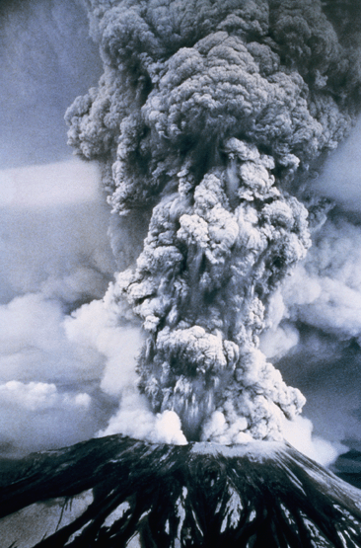

Transient responses
Andrews et al. (2009) J Climate
Notes:
24
CO2 heats the atmosphere increasing stability and reducing precipitation while solar changes have a smaller effect. While the model response to temperature increases in consistent, based upon the enhanced net radiative cooling of a warmer atmosphere, the response of the water cycle to a complex pattern of forcing is less clear. Observations of surface and top of atmosphere radiation from CERES and GERB will address this question.

Slide 25
Transient responses
CO₂ forcing experiments
Initial precip response supressed by CO₂ forcing
Stronger response after CO₂ rampdown
CMIP3 coupled model ensemble mean: Andrews et al. (2010) Environ. Res. Lett.
Degree of hysteresis determined by forcing related fast responses and linked to ocean heat uptake
HadCM3: Wu et al. (2010) GRL

Slide 26
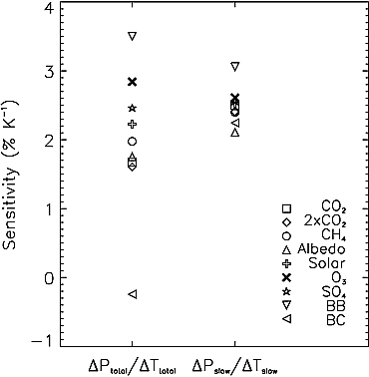
Forcing related fast responses
Total Slow
Surface/Atmospheric forcing determines “fast” precipitation response
Robust slow response to T
Mechanisms described in Dong et al. (2009) J. Clim
CO₂ physiological effect potentially substantial (Andrews et al. 2010 Clim. Dyn.; Dong et al. 2009 J. Clim)
Hydrological Forcing:
  HF=kdT-dAA-dSH
  (Ming et al. 2010 GRL; also Andrews et al. 2010 GRL)
Precipitation response (%/K)
Andrews et al. (2010) GRL

Slide 27
Conclusions
Robust Responses
  Low level moisture; clear-sky radiation
  Mean and Intense rainfall
  Contrasting wet/dry region responses
Less Robust/Discrepancies
  Observed precipitation response at upper end of model range?
  Moisture at upper levels/over land and mean state
  Inaccurate precipitation frequency/intensity distributions
  Magnitude of change in precipitation from satellite datasets/models
Further work
  Decadal changes in global energy budget, aerosol forcing effects and cloud feedbacks: links to water cycle?
  Separating forcing-related fast responses from slow SST response
  Are regional changes in the water cycle, down to catchment scale, predictable?
Notes:
27
Projected Responses in Extreme Precipitation and Atmospheric Radiative Energy

Slide 28
Increases in the frequency of the heaviest rainfall with warming: daily data from models and microwave satellite data (SSM/I)
Reduced frequency Increased frequency
Allan and Soden (2008) Science; Allan et al. (2010) Environ. Res. Lett.
Notes:
28
Daily data from AMIP climate model simulations (observed SST forcing) and microwave data from the F08/F11/F13 SSM/I series of satellite microwave measurements. The heaviest rainfall events are separated into bins ranging from heavy up to torrential events and the variation in the frequency of events in each bin is calculated (red=more frequent, blue=less frequent). The response of the heaviest rainfall events is consistent with models but the models appear to underestimate the response to warming and the details of the changes away from the heaviest rainfall regimes are not in agreement.

Slide 29
The Rich Get Richer?
Is there a contrasting precipitation response in wet and dry regions?
Models ΔP [IPCC 2007 WGI]
Precip trends, 0-30ºN
Rainy season: wetter
Dry season: drier
Chou et al. (2007) GRL
Notes:
29

Slide 30
Detection of zonal trends
Zhang et al. 2007 Nature

Slide 31

Evaporation
Richter and Xie (2008) JGR
CC Wind T_{s}-T_{o} RH_{o}
Muted Evaporation changes in models are explained by small changes in Boundary Layer:
1) declining wind stress
2) reduced surface temperature lapse rate (T_{s}-T_{o})
3) increased surface relative humidity (RH_{o})
NCAS-Climate Talk
15th January 2010
Notes:
31
Evaporation increases more slowly than moisture in the models due to reductions in wind stress, increases in surface stability and increases in low-level relative humidity. In situ and satellite observations will be key in determining the realism of this response. There are also obvious links to ocean fluxes including Keith Haines’ work.

Slide 32
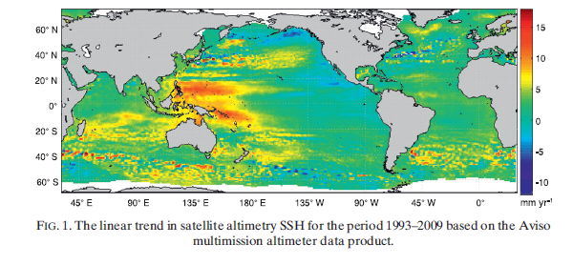
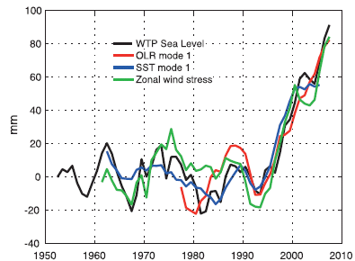
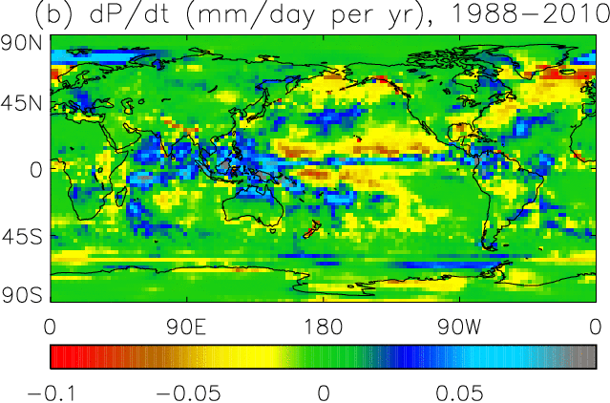
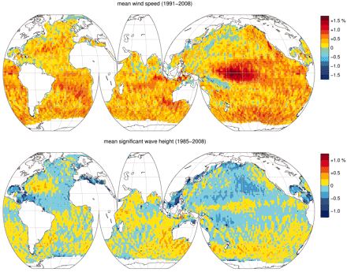
Changes in tropical circulation?
Wind-driven changes in sea surface height Merrifield (2011) J Clim
http://journals.ametsoc.org/doi/abs/10.1175/2011JCLI3932.1
Increases in satellite altimeter wind speed?
Young et al. (2011) Science
http://www.sciencemag.org/content/332/6028/451.full

Slide 33
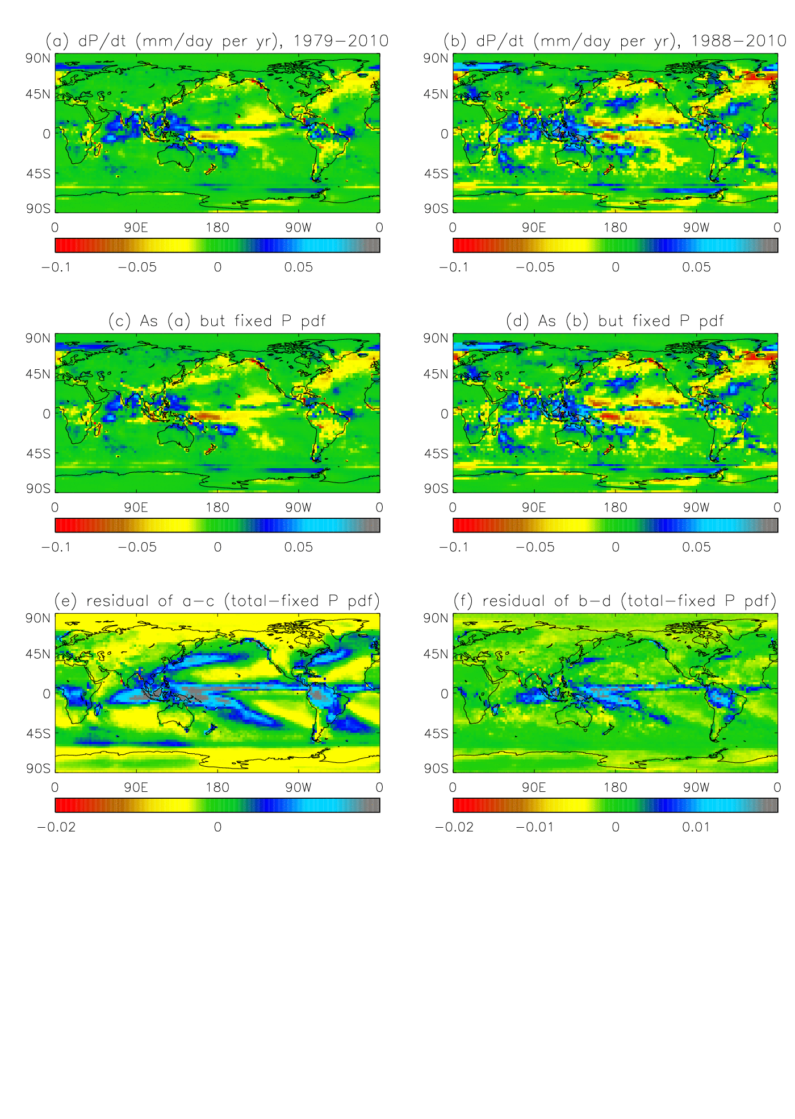
Separating dynamical thermodynamic trends
Top: fixed P intensity PDF
Bottom: residual (total trend minus fixed PDF)
We are currently applying this technique to CMIP5 models

