Slide 1




Evaluation of decadal variability
Department of Meteorology
APPLICATIONS OF SATELLITE CLIMATE DATA RECORDS IN NUMERICAL MODELING , CMSAF/EUMETSAT workshop, ECMWF
Richard Allan r.p.allan@reading.ac.uk @rpallanuk

Slide 2
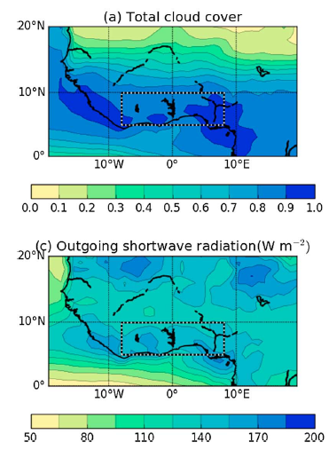
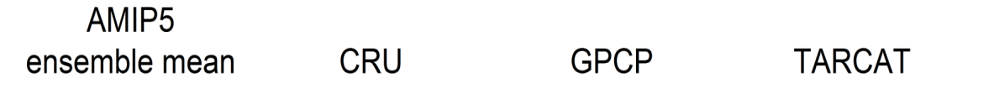


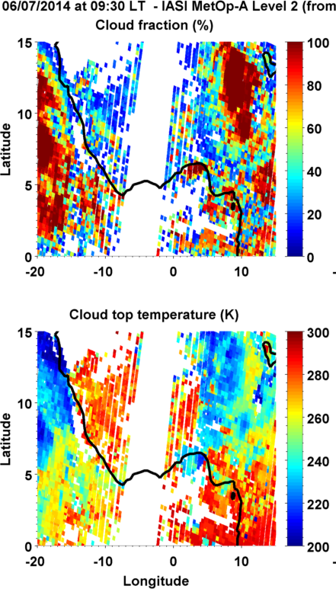
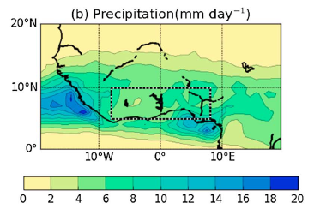
multiple roles of satellite data
Maidment et al. (2015) GRL
Above: Interpreting climate change
Field Campaign context →
Climatological context
Below: Process level evaluation
e.g. Hill et al. 2016 JGR
Liu et al. (2014) JAMC

Slide 3
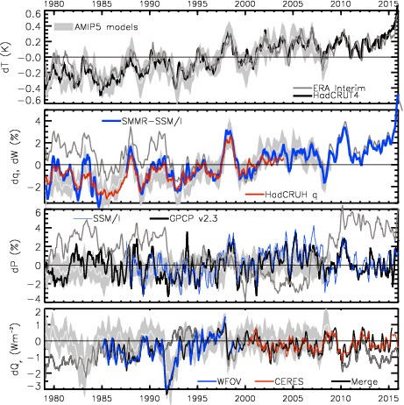
MONITORING Current Climate Change
MOISTURE (%) TEMPERATURE (K)
Update from: Allan et al. (2014) Surv. Geophys

Slide 4
MONITORING Current Climate Change
ERA-Interim
NET RADIATION (Wm⁻²) PRECIPITATION (%)
2.8
1.8
0.8
-0.2
-1.2
-2.2
Update from: Allan et al. (2014) Surv. Geophys & Allan et al. (2014) GRL

Slide 5
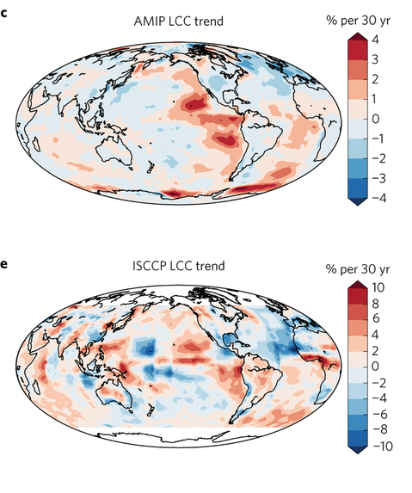
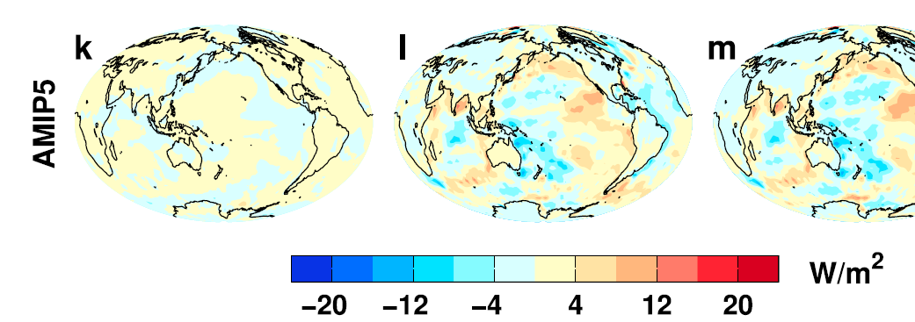
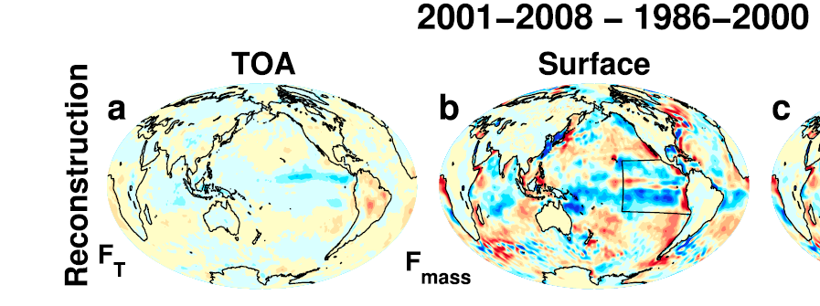
ASSESSING Feedbacks on internal CLIMATE variability
Low Cloud Cover trend 1980s-2005 Surface energy flux change ~1986-2008
OBSERVATIONS AMIP MODELS
Zhou et al. (2016) Nature Geosci
Liu et al. (2015) JGR

Slide 6
EVALUATING feedbackS
ON CLIMATE CHANGE
Trend in brightness temperature difference: 1983-2004
Observations
Model
Moistening
Constant RH model
Constant water vapour model
Soden et al. (2005) Science

Slide 7

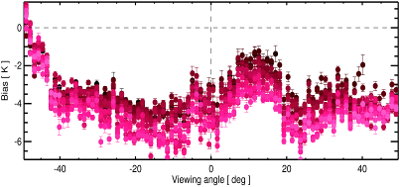
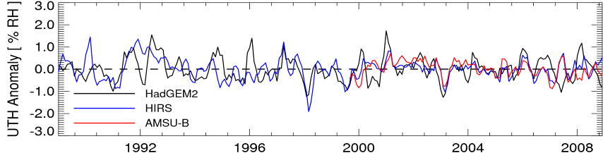
Correction of drift/bias
Correct for scan-dependent biases
Correct for time-dependent biases
John et al. (2013) JGR
Evaluate climate model processes using the generated data sets

Slide 8
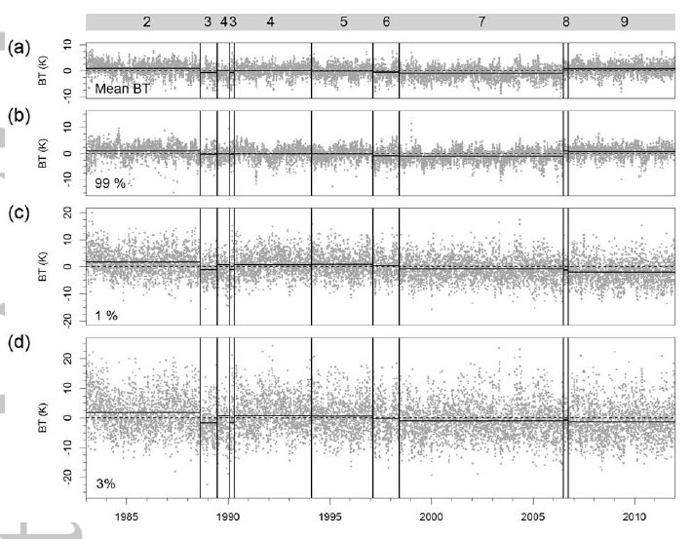
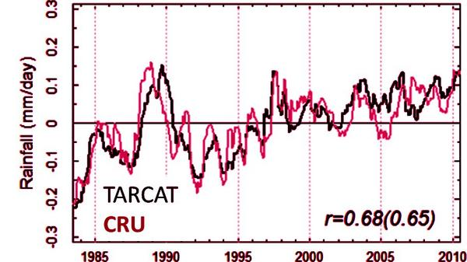
Long term changes in africaN rainfall
30 year Meteosat 10.8/11.5 μm window channel BT record
Cold Cloud Duration rainfall proxy Maidment et al. (2014)
Simple method but: variability independent of gauges & simple to simulate BTs in model
Rain-gauge (CRU) variability captured by TAMSAT →
TAMSAT CRU

Slide 9
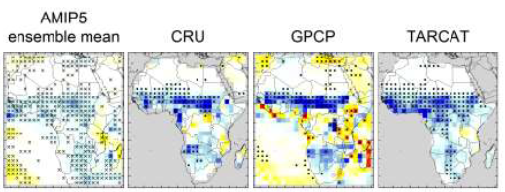
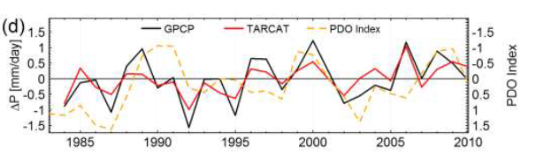
Evaluating trends in africa rainfall
Evaluating and understanding recent changes in Africa rainfall Maidment et al. (2015) GRL
PhD project extending this work: impact-relevant metrics for Africa (Caroline Dunning)
Maidment et al. (2015) in prep

Slide 10
Thoughts/conclusions
Why do we care about decadal variability?
  Climate monitoring, additional test of model fidelity, understanding decadal processes/variability, more relevant to climate change?
  Internal variability, short term feedbacks, unexpected changes
Do we have any truly homogeneous decadal records?
Combination of satellite data and models leads to better characterisation of deficiencies in both and advances in scientific understanding
  AMIP experiments are the most homogeneous (basic) reanalyses
  Could there be dedicated reanalyses for each key variable e.g. UTH?
CMSAF/EUMETSAT climate records for numerical modelling
  UTH, radiation budget, Cloud… all key to climate processes/feedbacks

Slide 12
Sanity check
Gross biases
Timely evaluation
NWP process
Availability →
Process studies
Uncertainty estimates required
Accuracy →
Diagnostic process evaluation
Monitoring
Climate
(rubbish data)
Homogeneity →

Slide 13
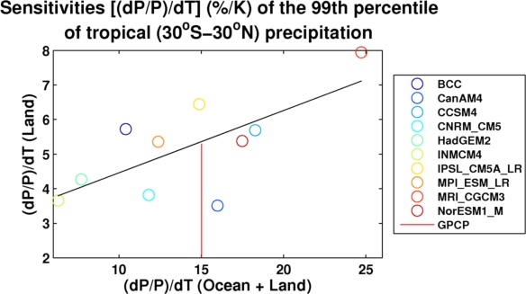
emergent constraintS on precipitation extremes?
Sensitivity of tropical 5-day precipitation extremes to ENSO-related temperature variability (x-axis) plotted against future land response (y-axis)
Future response (RCP4.5)
GPCP
ENSO variability (AMIP)
Plot by Chunlei Liu, based on data from Allan et al. (2014) Surv. Geophys
See O’Gorman (2012) Nature Geosci

Slide 14
Discrepancy between radiation budget & ocean heating
Large ocean heating anomaly in 2002
Inconsistent with radiation budget observations and simulations
Changing observing system influence?
Slight drop in net flux 1999-2005?
Smith et al. (2015) GRL

Slide 15
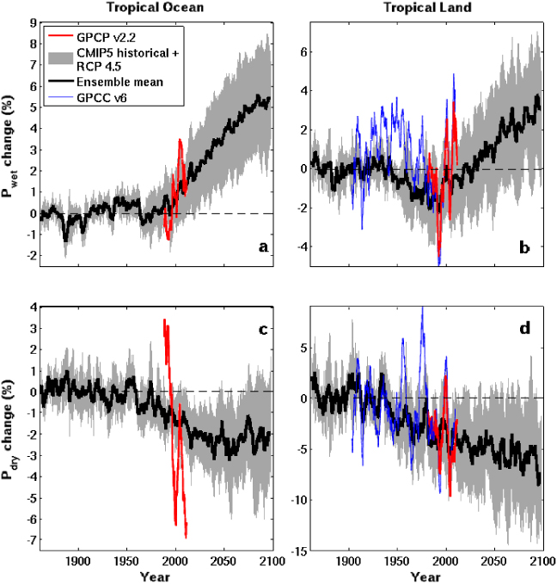
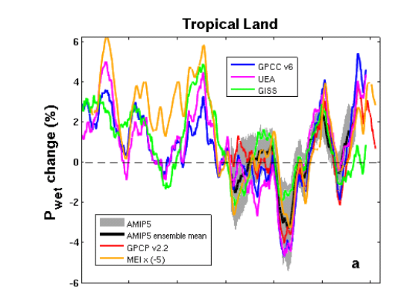
Evaluating physically-based changes in hydrological cycle
Tropical Land
Interannual-decadal changes in continental rainfall dominated by: La Niña (more rain) & El Niño (less rain)
Increased moisture with warming implies amplified P-E (e.g. Held & Soden 2006)
Multi-annual P-E > 0 over land implies increased P-E (e.g. Greve et al. 2014)
Changes in T/RH gradients also important (Byrne & O’Gorman 2015)
P-E < 0 in dry season over land: more intense dry and wet seasons? (Chou et al. 2013; Liu & Allan 2013; Kumar et al. 2014)
Aridity metrics more relevant (Scheff & Frierson 2015; Greve & Seneviratne 2015; Roderick et al. 2014 ; Milly & Dunne 2016 )
Changes in circulation dominate locally (e.g. Scheff & Frierson 2012; Chadwick et al. 2013; Muller & O’Gorman 2011; Allan 2014)
6
4
2
0
-2
-4
GPCC GPCP
WET
Precipitation Change (%)
1900 1950 2000 2050 2100
5
0
-5
-10
-15
DRY
GISS AMIP
volcano
CMIP5 Simulations
1900 1950 2000 2050 2100
Liu & Allan 2013 ERL

Slide 16
surge
slowdown
Current
climate
Change
through
surge and
slowdown
HEATING (Wm⁻²) PRECIP (%) MOISTURE (%) TEMPERATURE (K)
Update from:
Allan et al. (2014) Surv. Geophys &
Allan et al. (2014) GRL
2.8
1.8
0.8
-0.2
-1.2
-2.2
Earth’s energy imbalance (Wm⁻²)

Slide 17
Net Imbalance Anomaly (Wm⁻²)
Earth continues to heat up
Imbalance: 0.23 0.00 0.78 0.63 0.63 (Wm⁻²)
0.34±0.67 Wm⁻²
0.62±0.43 Wm⁻²
La Niña
El Niño
Volcano
Allan et al. (2014) GRL

Slide 18
lw & sw fluxes

Slide 19
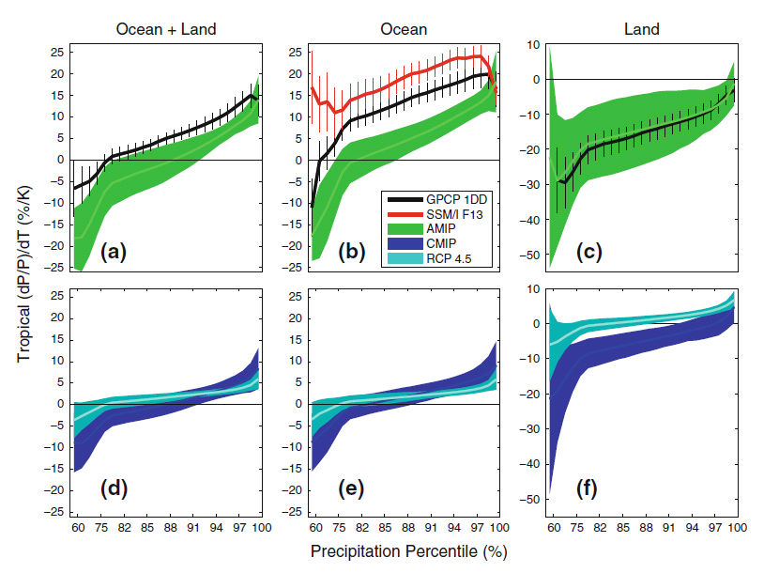
evaluating sensitivity of precipitation extremes to warming
Observed/simulated 5-day mean response
① More positve dP/dT for heavier percentiles
② More positive observed sensitivity over ocean
③ Negative land dP/dT as more rain during cold La Nina
④ Interannual dP/dT not good direct proxy for climate change, especially over land
…but may be good global indicator of model diversity e.g. O’Gorman (2012)
②
①
③
dP/dT (%) Tropics
1998-2008
RCP4.5
2080-2099 minus 1985-2005
④
amip
amip
④
Historical 1985-2005
Allan et al. (2014) Surv. Geophys
Notes:
5-day means.
More positve dP/dT for heavier percentiles (obs and models)
Higher observed sensitivity than models over ocean, good agreement over land.
Mostly negative dP/dT for all percentiles (apart from heaviest) over land. Partly due to less rainfall over land in El Nino when warmer tropical T
Coupled models: similar picture over ocean. Smaller sensitivity for highest percentiles under climate change since global increases in P with warming are muted by increasing CO2 levels.

Slide 20
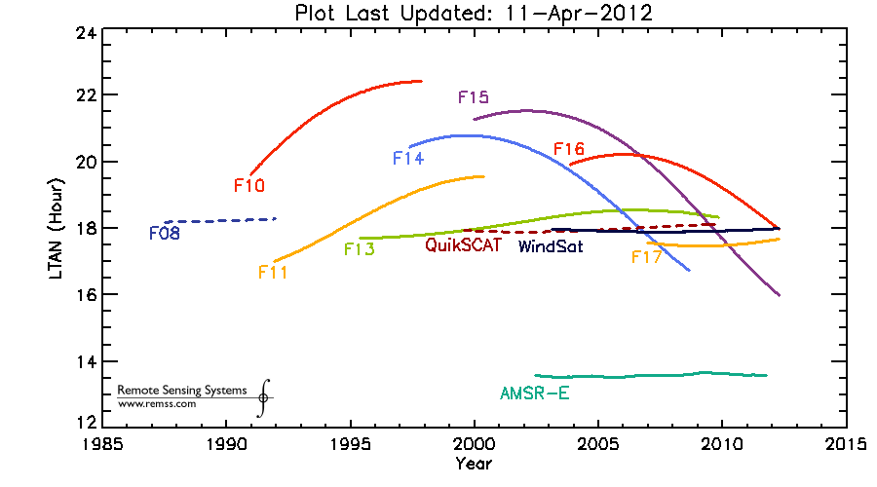
SSM/I(S) Equator Crossing Times

