Slide 1
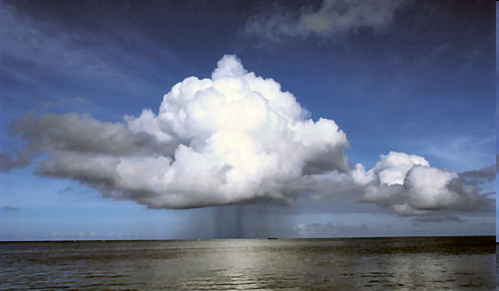
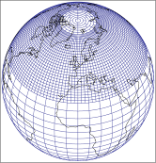
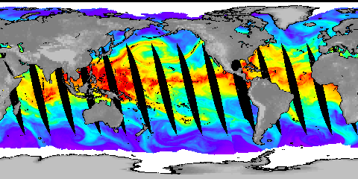



Richard Allan, Emily Black, Chunlei Liu
Department of Meteorology/NCAS Climate, University of Reading
Lead PI: Pier Luigi Vidale (Reading/NCAS Climate)
Consortium between: Reading, Edinburgh, Exeter, Met Office, Southampton

Slide 2
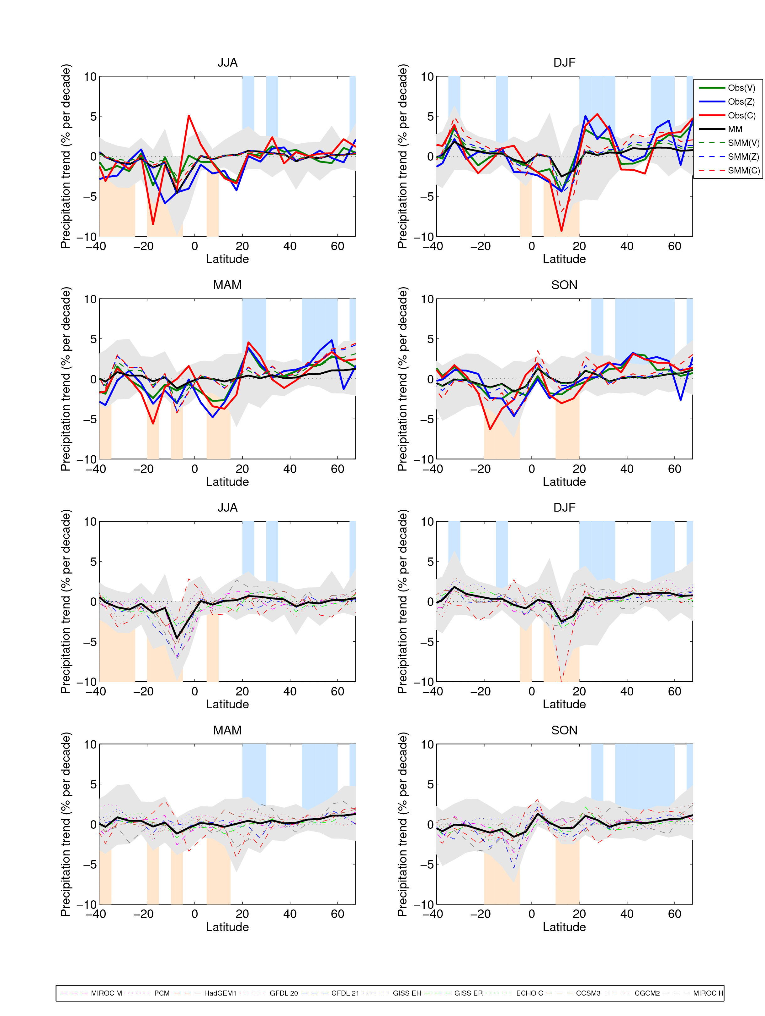
Detection & attribution of zonal mean trends in precipitation
Work at Edinburgh and Reading to analyse CMIP3 and CMIP5 model simulations and land-based gauge observations
Noake et al 2011 GRL.
Notes:
This graph shows changes in the trend of winter rainfall within latitude bands. Observations in solid colours (based on Zhang et al dataset); multi-model mean in solid black and model mean. Blue and orange areas show where the observational and model means give positive and negative trends respectively.

Slide 3
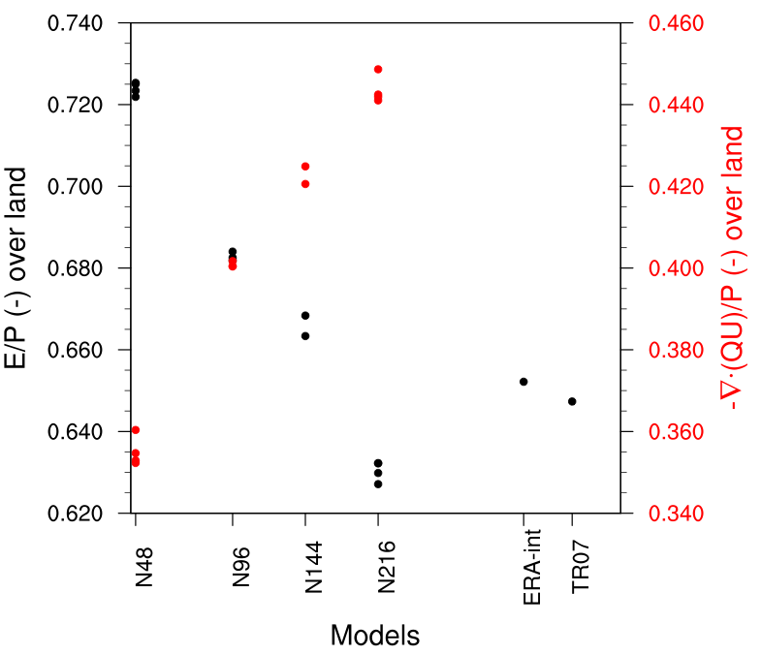
Process Understanding: Influence of resolution on moisture transports
Resolution leads to:
Stronger moisture transport from ocean to land with resolution
Change in partitioning of moisture sources for precip over land
Work at Reading: Demory et al., in preparation

Slide 4
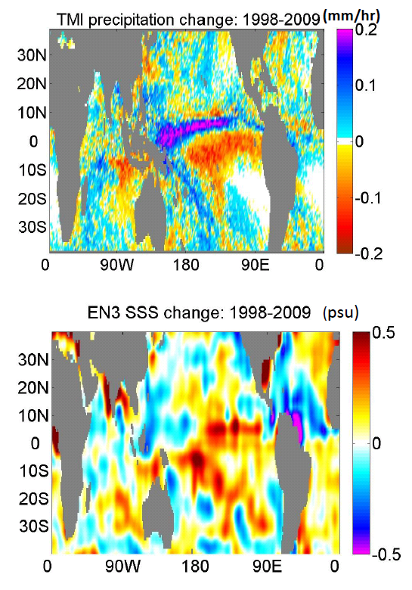
Trends in P-E and Surface Salinity
Can we reconcile observed changes in P-E & sea surface salinity (SSS)?
What are the main drivers of current trends in P and SSS?
Southampton & Reading
Plot courtesy of Nikolaos Skliris (NOCS)

Slide 5
Observed and Simulated responses in extreme Precipitation
Increase in intense rainfall with tropical ocean warming
SSM/I satellite observations at upper range of models
Allan et al. (2010) Environ. Res. Lett.
Tropical response uncertain: O’Gorman and Schneider (2009) PNAS….
but see also: Lenderink and Van Meijgaard (2010) ERL; Haerter et al. (2010) GRL

Slide 6
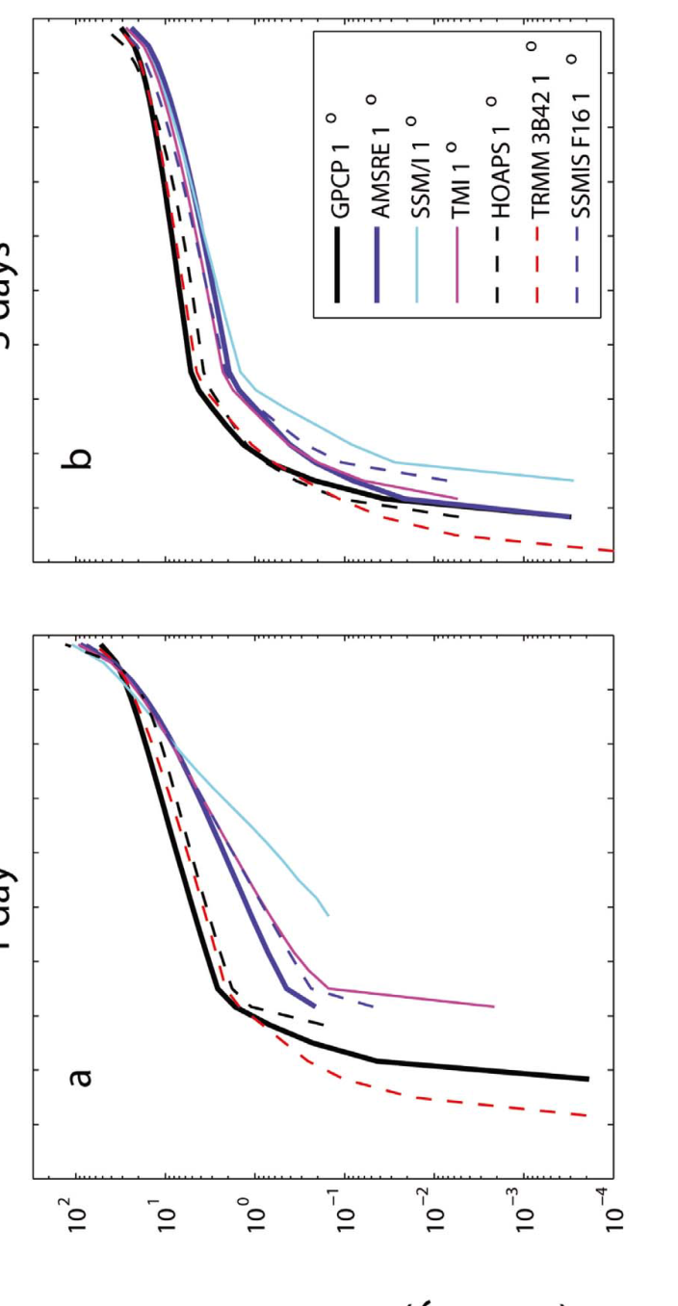
1 day 5 day
Precipitation intensity (mm/day)
Precipitation intensity distributions & responses between datasets (tropical oceans)
Precipitation intensity change with mean surface temperature (mm/day)
Liu and Allan (2012) JGR
Precipitation intensity percentile (%)

Slide 7
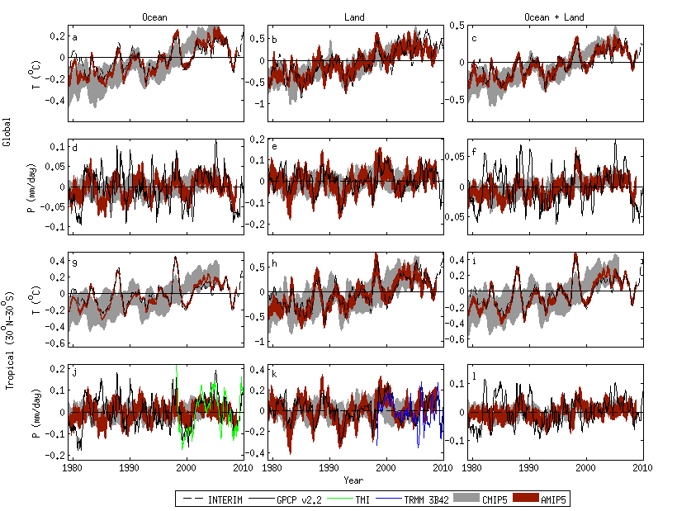
Current changes in tropical precipitation in CMIP5 models & satellite-based observations
Note realism of atmosphere-only AMIP model simulations
Oceans Land
Liu and Allan in prep…

Slide 8
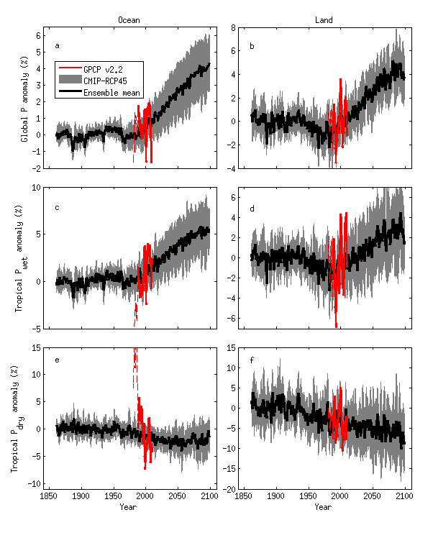
CMIP5 simulated & projected % changes in precipitation
Ocean Land
Tropical dry Tropical wet Global
Pre 1988 GPCP ocean data does not contain microwave data
Robust drying of dry tropical land

