Slide 1
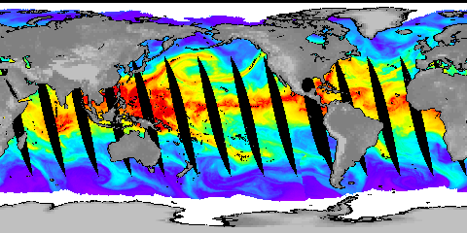




Satellite measurements of changes in column integrated water vapour and upper tropospheric humidity
Richard P. Allan¹, Viju O. John²
¹Department of Meteorology, University of Reading; ²Met Office
http://www.met.reading.ac.uk/~sgs02rpa
r.p.allan@reading.ac.uk

Slide 2
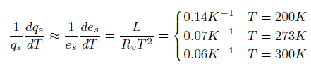
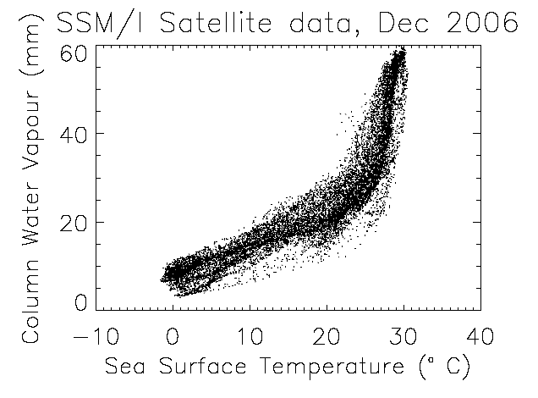
Clausius Clapeyron
Strong constraint upon low-altitude water vapour over the oceans
Water vapour is a very forgiving climate variable!
Land regions?
Upper troposphere?
e.g. see Allan (2012) Surv Geophys
Notes:
Then radiation? SNLc vs CWV (could show ERA Int and CERES SRBAVG?) also show Prata curve.

Slide 3
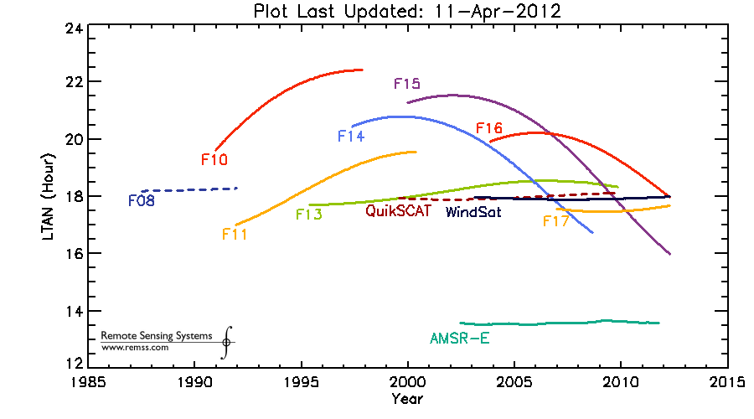
Equator Crossing Times

Slide 4
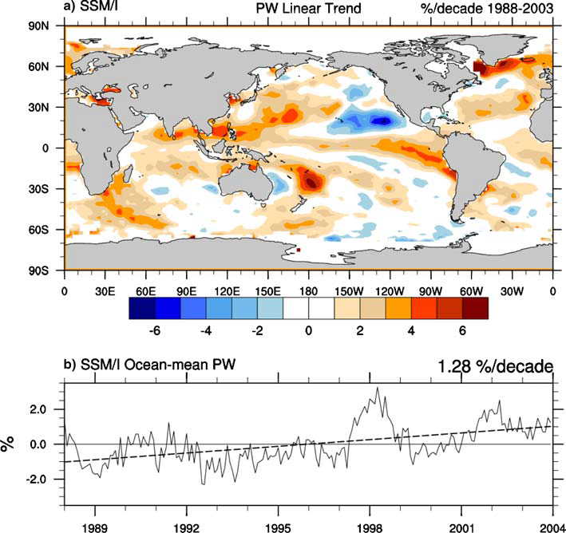
Trenberth et al. (2005) Clim Dyn
See also:
Wentz and Schabel (2000) Nature;
Soden (2000) J Clim; Allan et al. (2003) QJRMS

Slide 5
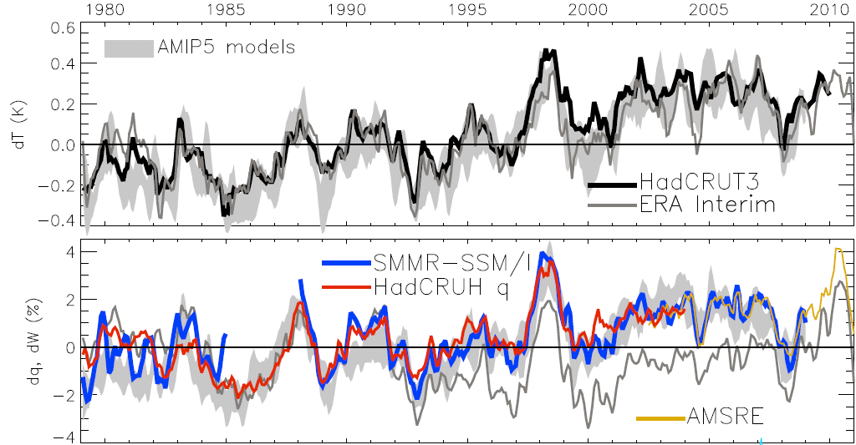
Global changes in water vapour
Updated from O’Gorman et al. (2012) Surv. Geophys; see also John et al. (2009) GRL
Notes:
For ocean-only satellite datasets I apply ERA Interim for poleward of 50 degrees latitude and for missing/land grid points.
Note that SSM/I F13 2003-2007 CWV = 24.7794 mm; AMSRE 2003-2007 CWV = 24.8850

Slide 6
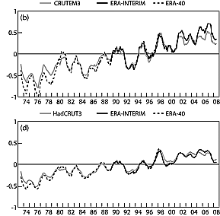
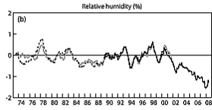
Declining RH over land?
Land T
global T
Stalling of ocean temperatures in 2000s
Continued warming of land
Reduced relative humidity over land?
Implications for hydrological cycle
Land RH
Simmons et al. (2010) JGR

Slide 7
Reduction in UTH* with warming?
Minschwaner et al. (2006) J Clim
Lindzen (1990) BAMS
Mitchell et al. (1987) QJRMS
* ‘upper’ tropospheric humidity or relative humidity above the boundary layer

Slide 8
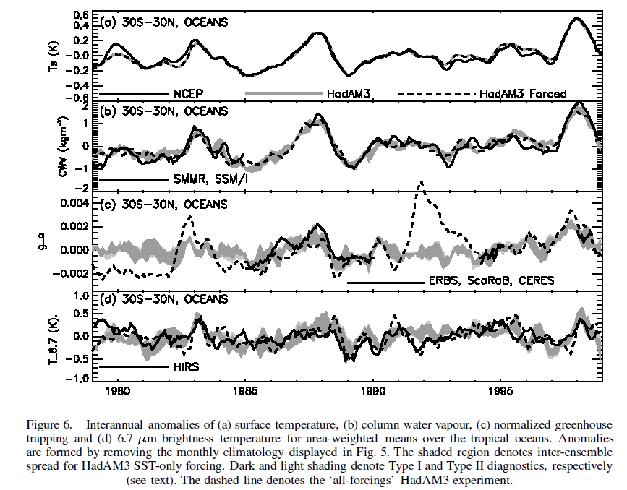
Surface temperature
Column water vapour
Clear-sky greenhouse effect
6.7 μm (UTH) brightness temperature
Allan et al. (2003) QJRMS

Slide 9

Time-scale dependence?
Soden et al. (2002) Science; Forster/Collins (2004) Clim Dyn; Harries/Futyan (2006) GRL
Notes:
9
The eruption of Mt. Pinatubo provided a natural experiment for evaluation of feedbacks, in particular for upper tropospheric water vapour.
Analysing water vapour radiances, Brian Soden and colleagues demonstrated that a climate model could reproduce the drying in response to the cooling following the eruption. Furthermore, the satellite observations and model both conserved relative humidity to first order.
In a separate experiment where water vapour was held fixed in the radiation scheme, the model reduction in water vapour channel radiance was overestimated (reduced relative humidity). Note that the radiance channel is also sensitive to temperature as well as humidity; this explains the drop in brightness temperature for the constant relative humidity case.

Slide 10
Trends in Upper Tropospheric Humidity (UTH)
Trend in brightness temperature difference: 1983-2004
Observations
Model
Moistening
Constant RH model
Constant water vapour model
Soden et al. (2005) Science
Notes:
10
Trends in water vapour radiance channel differences, sensitive to upper tropospheric water vapour, also show consistency between models and satellite observations over the period 1983-2004. The constant water vapour model could not capture the observed changes over the tropics.
Water vapour feedback is likely to be the most important amplifier of warming in the current climate and observations suggest that models can capture the large-scale feedback well.

Slide 11
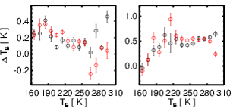
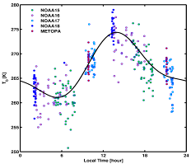
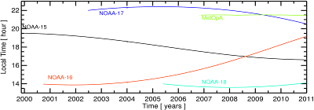
Intercalibration of satellite UTH data HadIR project (HadMW?)
Sampling issues
  Infra-red vs microwave
Inter-Calibration using satellite nadir overpasses
  Polar overpasses
  Satellite drift overpasses
Correction for orbit drift
  Diurnal correction
Equator crossing times using ascending nodes
Channel 1
Viju John and HadIR project
(31.25 N, 1.25 E)

Slide 12
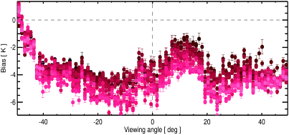
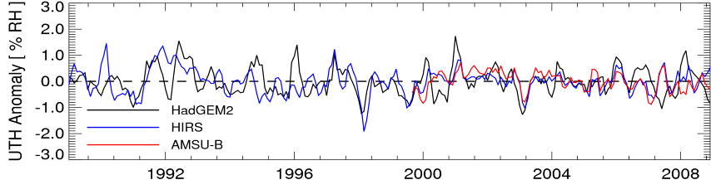
Ongoing work and future plans
Correct for scan-dependent biases
Correct for time-dependent biases
Evaluate climate model processes using the generated data sets
Extend the comparisons to other CMIP5 models and ERA-Interim

Slide 13
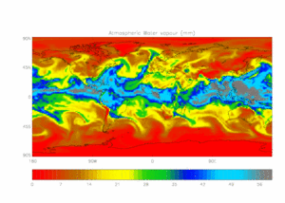
Satellite record of water vapour
Physically well understood
  …at least, at low levels over oceans
  changes over land and upper troposphere?
Maturing observing system
  CWV record over oceans (SMMR, SSM/I, SSMIS)
  Agreement with ground based observations (e.g. Willett et al.)
  Infra-red UTH sampling an issue → microwave?
Reanalyses?
  Limitations: trends in large-scale ocean averages inaccurate
  Strengths: dynamical fields/transports?
Regional changes:
  Dynamical vs thermodynamic drivers
Constraints on extreme precipitation & cloud feedbacks?

