Slide 1
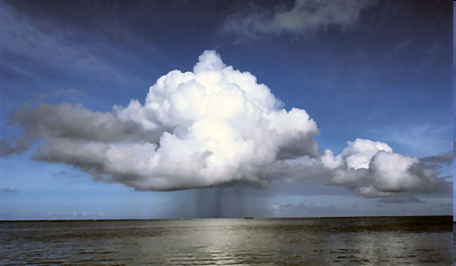
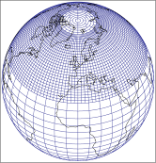
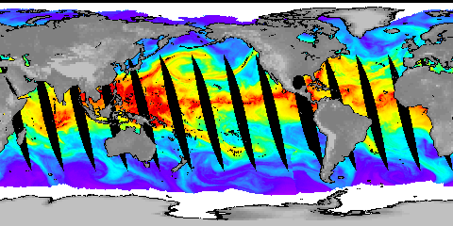






Current changes in precipitation and moisture
Richard P. Allan, Chunlei Liu, Matthias Zahn
Department of Meteorology, University of Reading
Thanks to George Huffman, Viju John, Brian Soden, William Ingram
http://www.met.reading.ac.uk/~sgs02rpa
r.p.allan@reading.ac.uk
Notes:
1

Slide 2
How well do we understand current changes in precipitation and moisture?
Seeking robust responses in the hydrological cycle that are:
(1) physically understandable
(2) observable
Is Clausius Clapeyron a sufficient contraint for:
  Low level water vapour amount?
  The rich get richer (wetter, fresher)?
  Heavier heavy rainfall?
Global precipitation changes constrained by energy balance
  Slow responses (κΔT) and fast response to radiative forcing (F)
  LΔP ≈ κΔT - F(1-R)
Combine models and observations to understand system
Notes:
Day 2 - Discussion of robust changes and our analyses of them
Each discussion topic is introduced by a presentation from a CWC person that explains what we have done
so far and are trying to do, reflects on what was learned from the previous day and adds specific questions to
kickstart discussions
20 minutes, ~10-15 slides?
Warming planet:
- stronger radiative cooling → gloabal contraint on precipitation (~2-3%/K)
- more water vapour → amplification of extreme precipitation; amplification of P-E patterns
- combination/other factors → change in circulation
What can we observe?
Outstanding issues:
- observing system (length, quality)
- influence of aerosol
- regional changes

Slide 3

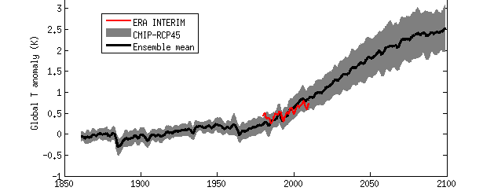
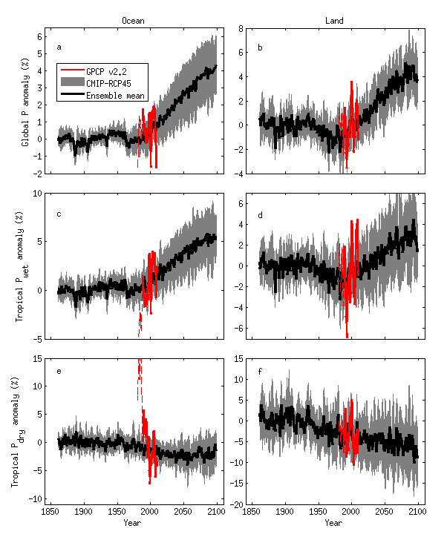
Projected precipitation response
Response ~2%/K
Precipitation (%) Temperature (K)
Ocean
Land

Slide 4
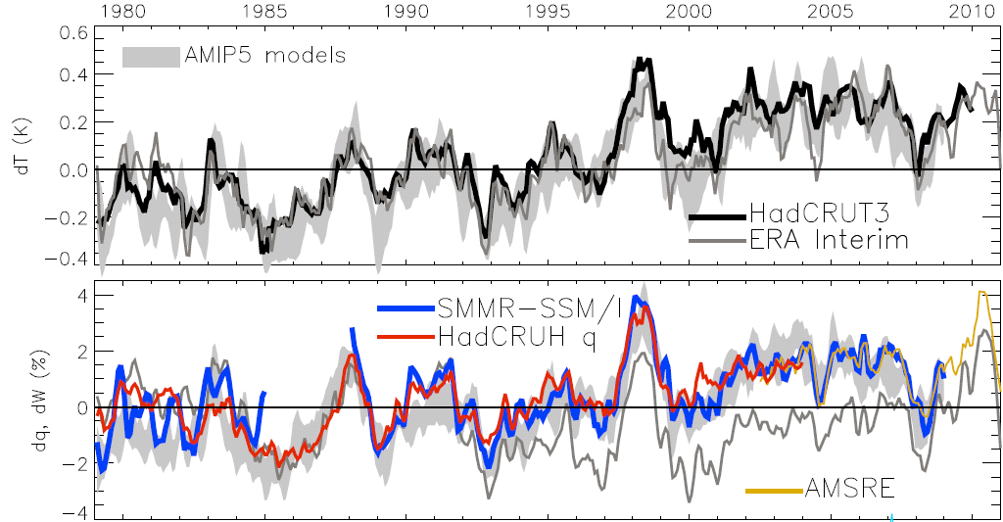
Current changes in global water vapour
dW/dT~8%/K
Updated from O’Gorman et al. (2012) Surv. Geophys; see also John et al. (2009) GRL
Notes:
For ocean-only satellite datasets I apply ERA Interim for poleward of 50 degrees latitude and for missing/land grid points.
Note that SSM/I F13 2003-2007 CWV = 24.7794 mm; AMSRE 2003-2007 CWV = 24.8850
4

Slide 5


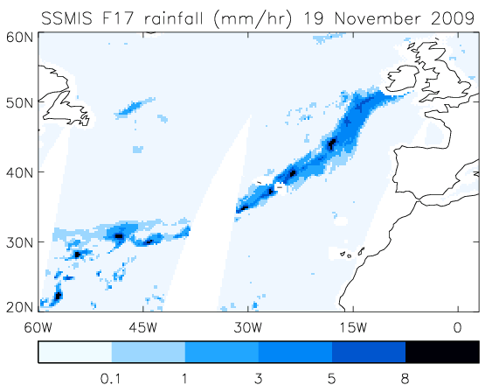
Extreme precipitation & mid-latitude flooding
Links UK winter flooding to moisture conveyor events
  e.g. Nov 2009 Cumbria floods
Lavers et al. (2011) Geophys. Res. Lett.

Slide 6
Increase in intense rainfall with tropical ocean warming
SSM/I satellite observations at upper range of substantial model spread (see also O’Gorman and Schneider 2009 PNAS)
Allan et al. (2010) ERL
Turner and Slingo (2009) ASL: dependence on convection scheme?
Observational evidence of changes in intensity/duration (Zolina et al. 2010 GRL)
Links to physical mechanisms/relationships required (Haerter et al. 2010 GRL)

Slide 7
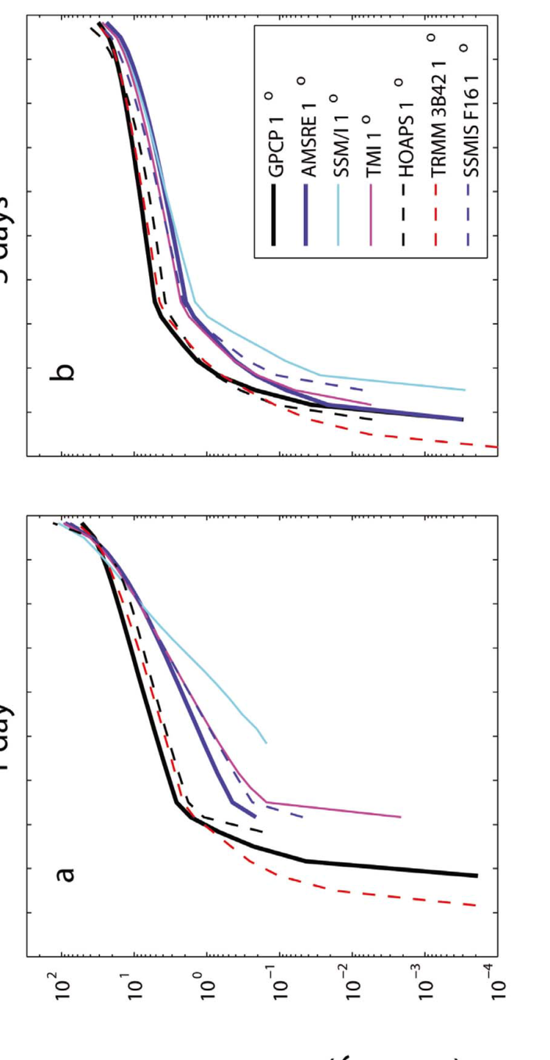
1 day 5 day
Precipitation intensity (mm/day)
Precipitation intensity distributions & responses between datasets (tropical oceans)
Precipitation intensity change with mean surface temperature (mm/day)
Liu & Allan (2012) JGR
Precipitation intensity percentile (%)

Slide 8
Comparing precipitation products
←v6
Liu & Allan (2012) JGR

Slide 9
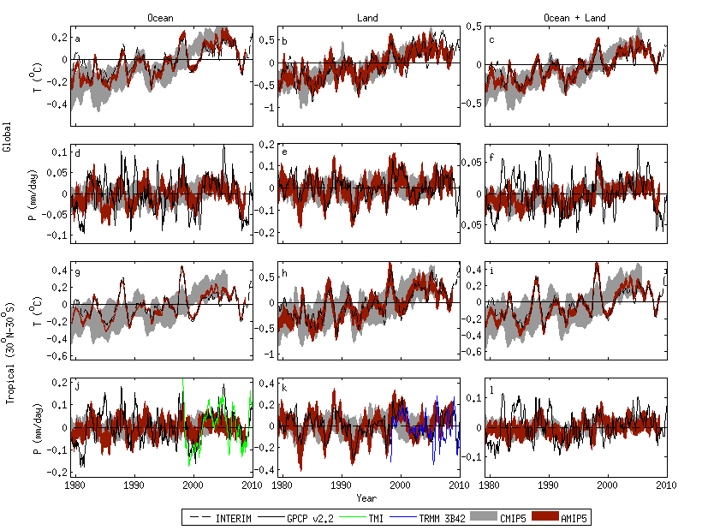
Current changes in tropical precipitation in CMIP5 models & satellite-based observations
Note realism of atmosphere-only AMIP model simulations
Oceans Land
Liu, Allan, Huffman (2012) GRL in press

Slide 10
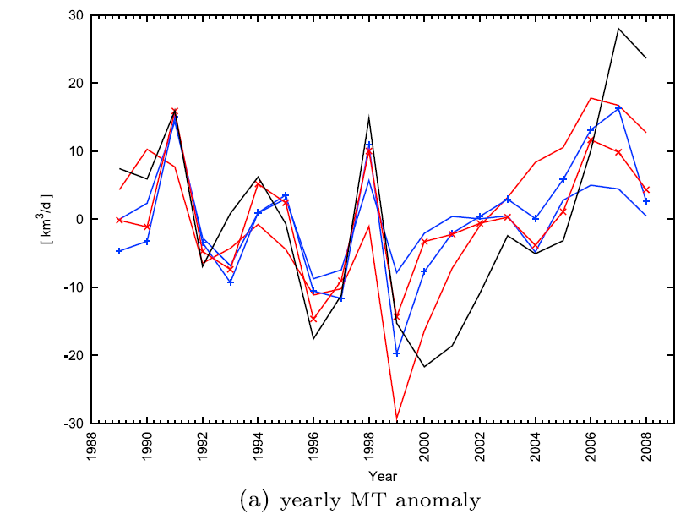
Changing tropical moisture transports
Instantaneous field
Moisture transport into tropical ascent region
Significant mid-level outflow
2000s: increases in inflow or drift in ERA Interim?
outflux
influx
PREPARE project
Zahn and Allan (2011) JGR see also Sohn and Park (2010) JGR
Notes:
We are also interested in calculating observationally based water budgets including moisture transports and P-E and how this relates to ocean salinity observations.

Slide 11
CMIP5 projections: wet regions get wetter, dry regions get drier
Ocean Land
Pre 1988 GPCP ocean data does not contain microwave data
Tropical dry Tropical wet
Robust drying of dry tropical land
Allan et al. (2010) ERL.; Liu and Allan in prep

Slide 12
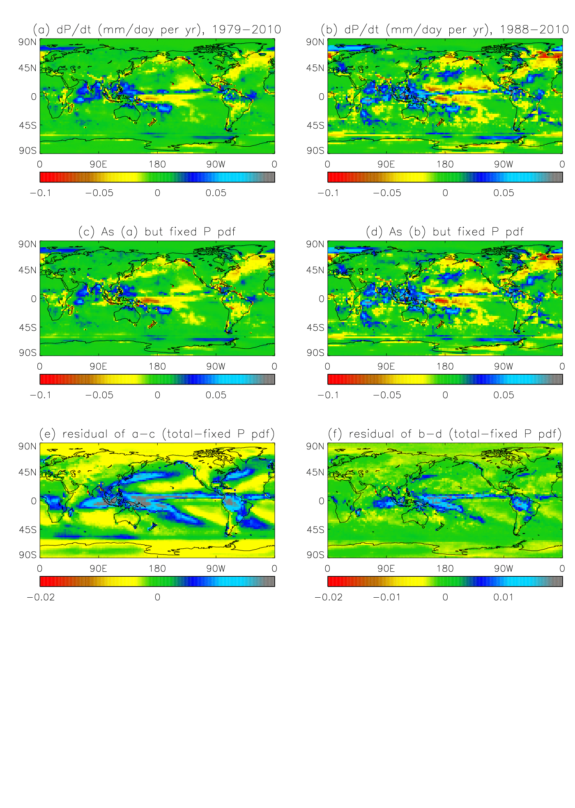
Separating dynamical / thermodynamic trends
Top: fixed P intensity PDF
Bottom: residual (total trend minus fixed PDF)
We are currently applying this technique to CMIP5 models

Slide 13
Open Issues for discussion
Trends are meaningless especially for short periods (decadal variability)…unless physical basis…or comparing datasets…ok, they’re quite useful
Regional trends are overwhelmed by changes in atmospheric circulation
Mechanisms for decadal variability are unclear (oscillations, climate shifts, forced responses)
The diversity of approaches for inter-calibration and inter-comparison is valuable
The sampling issue is a non-issue solved by model to satellite approach…but this is non trivial.
You are the weakest link! Calibration, orbital drift, sensor decay, retrieval assumptions, …
Current reanalyses are inadequate for ocean-wide decadal changes
Should we have observing system-specific reanalyses? e.g. UTH,P,..?
Notes:
Moisture transports and atmospheric circulation
Water vapour reanalysis? Surface radiation budget?
Upper tropospheric water vapour datasets
Retrieval/drifts/calibration
Links to cloud feedback
High cloud and FAT/PHAT hypothesis
Low cloud and boundary layer processes
Changes in relative humidity over land
Low level water vapour and extreme precipitation events: dynamics and thermodynamics

Slide 14
Open Issues for discussion
The observing system remains inadequate for monitoring precipitation change over the ocean.
Models underestimate precipitation response… Observations overestimate precipitation response?
Models overestimate mean precipitation… Observations underestimate mean precipitation?
Testing understanding of what? Models or the observing system?
Beyond ‘blob’ plot: process-level understanding (just fine words?)
Why has the land RH declined recently?
What explains stalled ocean surface warming?
Can precipitation changes be directly attributed to radiative forcing, separate to slow response to surface warming?
We are at a pivotal point in the climate record…
Notes:
Moisture transports and atmospheric circulation
Water vapour reanalysis? Surface radiation budget?
Upper tropospheric water vapour datasets
Retrieval/drifts/calibration
Links to cloud feedback
High cloud and FAT/PHAT hypothesis
Low cloud and boundary layer processes
Changes in relative humidity over land
Low level water vapour and extreme precipitation events: dynamics and thermodynamics

Slide 16
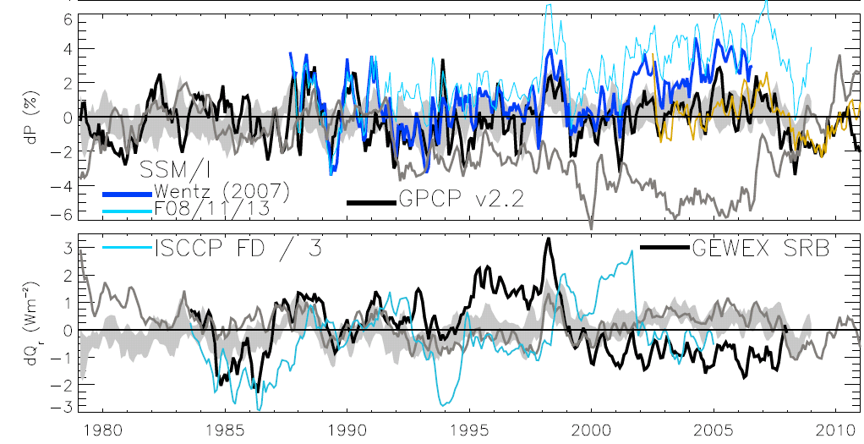

Changes in net atmospheric radiative cooling and precipitation
AMSRE
Updated from O’Gorman et al. (2012) submitted; see also John et al. (2009) GRL

Slide 17
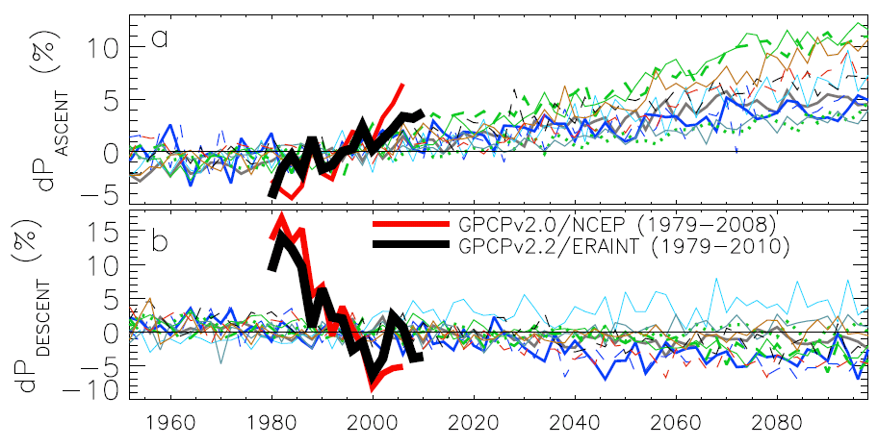
Contrasting precipitation response in wet and dry regions of the tropical circulation
ascent
Observations
Models
Precipitation change (%)
descent
Sensitivity to reanalysis dataset used to define wet/dry regions
Updated from Allan et al. (2010) Environ. Res. Lett.

Slide 18
Current trends in wet/dry regions of tropical oceans
Wet/dry trends remain
  1979-1987 GPCP record may be suspect for dry region
  SSM/I dry region record: inhomogeneity 2000/01?
GPCP trends 1988-2008
  Wet: 1.8%/decade
  Dry: -2.6%/decade
  Upper range of model trend magnitudes
DRY WET
Models
Allan et al. (2010) Environ. Res. Lett.

