Slide 1




Air-sea fluxes from atmospheric reanalyses
Department of Meteorology
Richard Allan r.p.allan@reading.ac.uk @rpallanuk
Thanks to Chunlei Liu, Pat Hyder, Norman Loeb and others

Slide 2
introduction
Are reanalysis air-sea fluxes worth their salt?
How can we best utilise reanalyses to their strengths?
Air-sea energy flux magnitudes (e.g. Wild et al. 2015 Clim Dyn):
  SW 170 Wm⁻²; LW 50 Wm⁻²; LH 100 Wm⁻²; SH 10-20 Wm⁻²
Considerable range across reanalysis/observational products
  e.g. Josey et al. (2013) in Ocean Circ. & Clim.
  ~20 Wm⁻² range but includes compensating errors between components
AIM: Discuss general issues and strengths/weaknesses
Notes:
Method and key physical variables
Climatological and extreme fluxes
Interannual & decadal variability and trends
Indirect methods for estimating surface energy fluxes
Conclusions: Strengths & Weaknesses

Slide 3
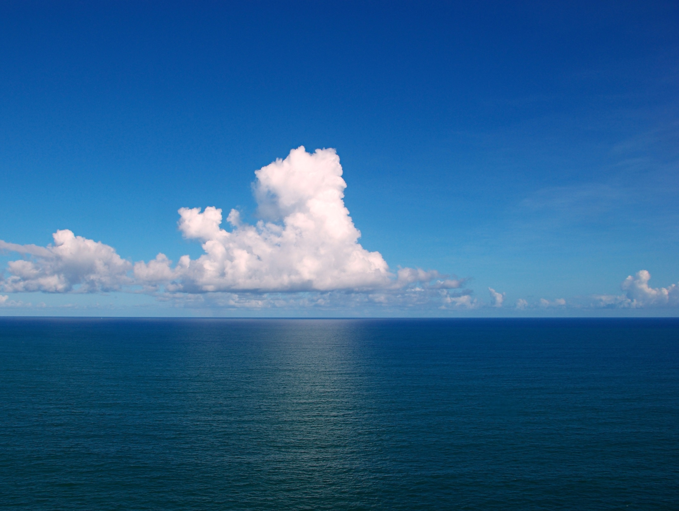
Solar “Constant”
Air-sea fluxes
in reanalyses
Atmospheric absorption (water vapour, ozone, aerosol)
SENSIBLE & LATENT HEAT FLUXES
Scattering (clouds, aerosol)
Near-surface water vapour near-surface & skin temperature, wind speed, transfer coefficient
Absorption: surface albedo
Surface emission:
Skin temperature (& emissivity)
Atmospheric emission:
near-surface temperature, water vapour, cloud cover/altitude
SHORTWAVE RADIATION
LONGWAVE RADIATION

Slide 4
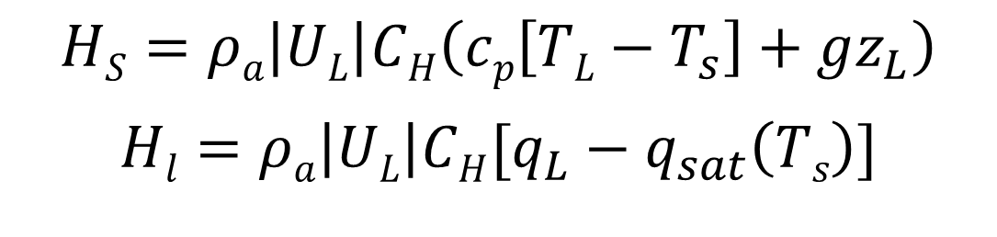
Turbulent fluxes
Parametrized:
Assimilation of water vapour, temperature and wind
Interpolation over lower atmospheric layers important
Turbulent exchange coefficient and skin properties depend on surface type and atmospheric stability
Turbulent exchange coefficient
Temperature gradient
$$HS=ρa\left|UL\right|CH\left(cp\left[TL−T_{s}\right]+gz_{L}\right)$$
$$Hl=ρa\left|UL\right|CH[q_{L}−q_{sat}\left(Ts\right)]$$
Wind speed
Specific humidity gradient

Slide 5
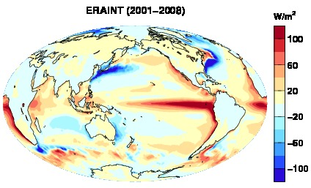
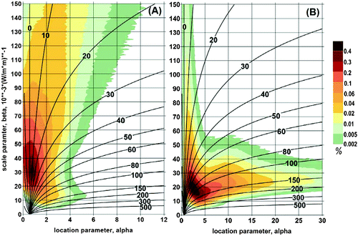
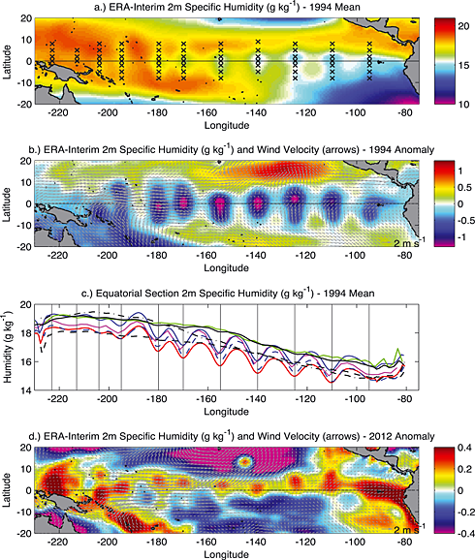
ClimatologY, biases & extremes
Climatological biases related to realism of determinent variables
Climatologies hide characteristics of extremes e.g. Gulev et al. (2013) J. Clim
Observing system artifacts: e.g. Josey et al. (2014) GRL

Slide 6
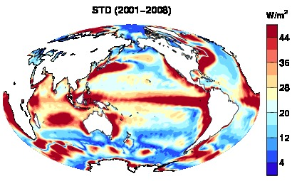
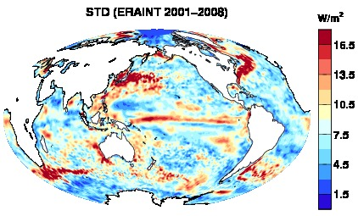
inter-reanalysis uncertainty
Standard deviation of multi-annual mean net surface flux (ERAINT, ERA20C, 20thCR, JRA55 and MERRA).
What about interannual variability?

Slide 7
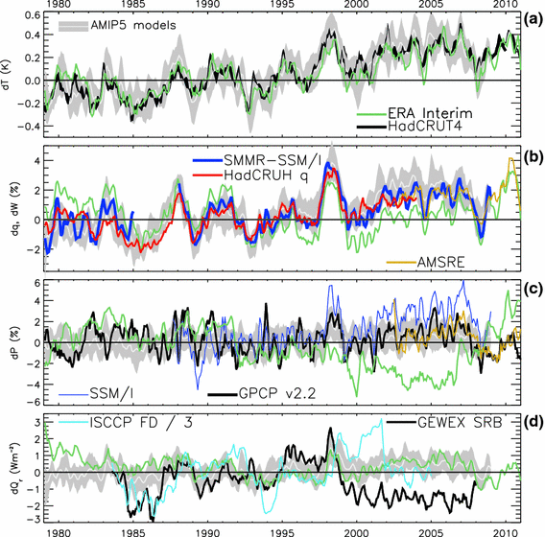
Trends in reanaLyses
ERA Interim
ΔPrecipitation (%) ΔWater Vapour (%)
Allan et al. (2014) Surv. Geophys
See also e.g. Dee et al. (2011) QJRMS, Trenberth et al. (2001) J. Clim

Slide 8
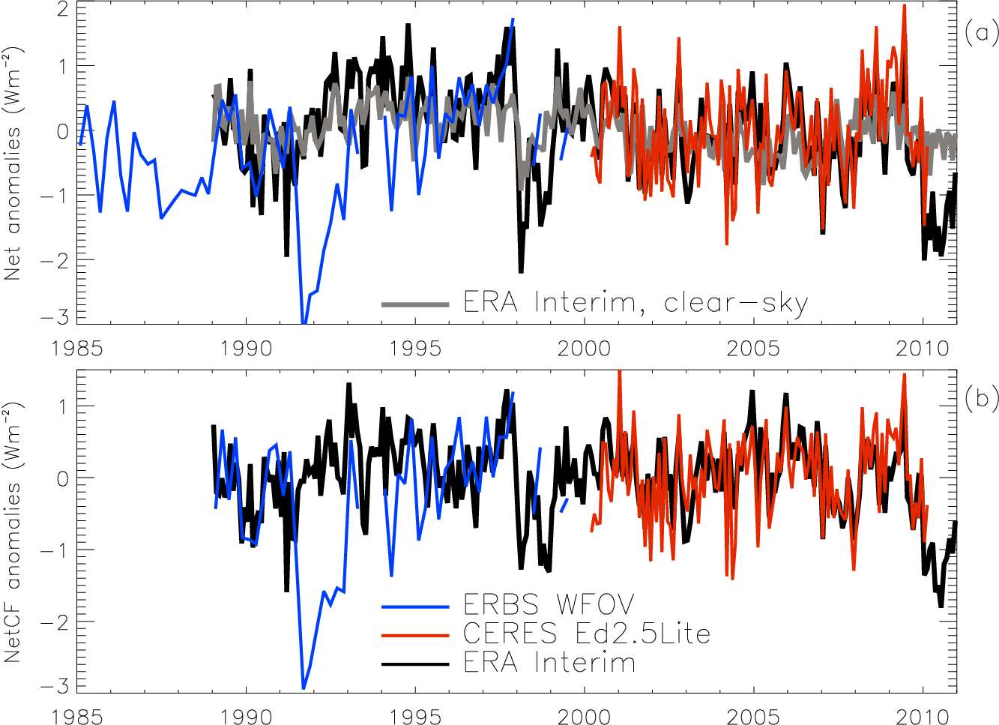
Month-to-month variability
Allan (2011) Met Apps
60S-60N Net TOA radiation
ERA Interim: suspect energy and water cycle climatology & trends but realistic variability in clouds and non-aerosol atmospheric properties

Slide 9
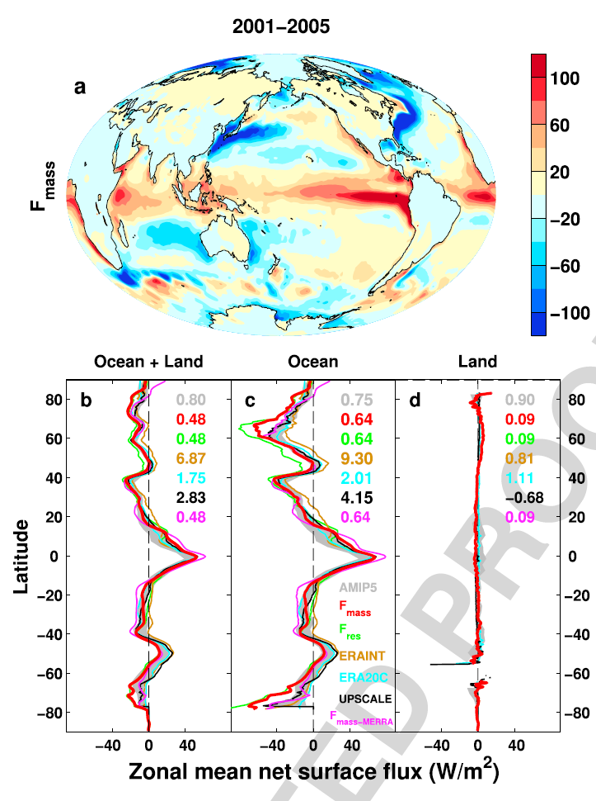
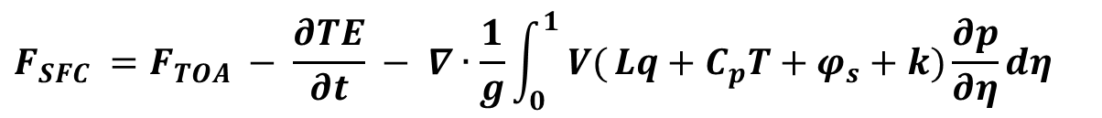
Indirect estimates of air-sea energy fluxes from satellite/reanalysES
$$F_{SFC} =F_{TOA} − \frac{∂TE}{∂t} − ∇∙\frac{1}{g}\int_{0}^{1}{ V(}Lq+C_{p}T+φ_{s}+k)\frac{∂p}{∂η}dη$$
CERES/Argo Net Flux
Estimate horizontal energy flux
Surface Flux
Net surface downward energy flux (Wm⁻²)
Liu et al. (2015) JGR, Allan et al. (2014) GRL
see also Loeb et al. (2015) Clim. Dyn , Trenberth et al. (2001) Clim. Dyn.

Slide 10
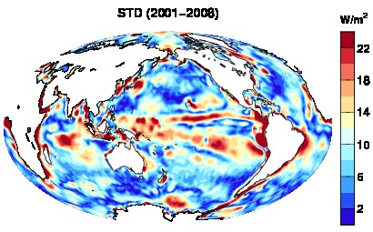
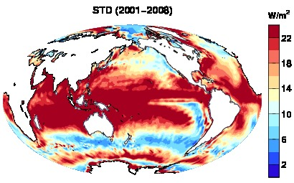
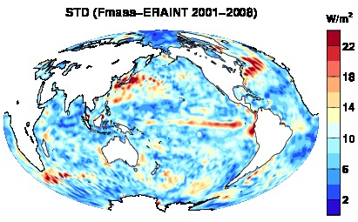
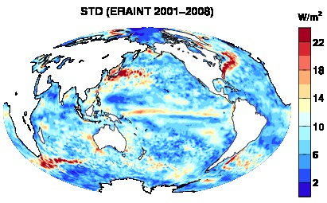
How uncertain are direct/indirect surface energy flux estimates?
StDev indirect (3) StDev Direct (5)
Climatology (above), Interannual variability (below)

Slide 11
changes in surface energy flux
Changes in energy fluxes 1986-2000 to 2001-2008
Surface energy flux dominated by atmospheric transports
Contrasting model pattern of change
Are reanalysis transports reliable?
Liu et al. (2015) JGR

Slide 12
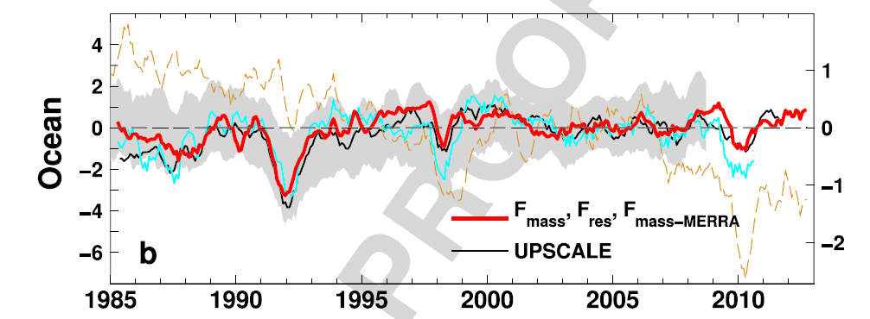
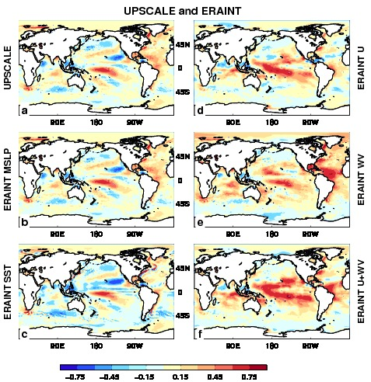
ERA Interim
Understanding
discrepancies
Spurious trends in air sea fluxes in ERA Interim
Dominated by latent heat fluxes
Use simple bulk formula model to understand causes of differences with other reanalyses & models

Slide 13
conclusions
How can we best utilise information from reanalyses to improve understanding of air-sea fluxes?
Strengths: good coverage in space and time (sparse in situ observations), links to determining variables, observationally-based, reasonable month to month and regional interannual variability
Weaknesses: dependence on model-based parametrizations, require interpolation of variables in lowest layers, observing system artifacts in space and time, moisture and energy budget’s not closed
Indirect methods for constraining surface energy and moisture fluxes promising as complimentary method

Slide 15
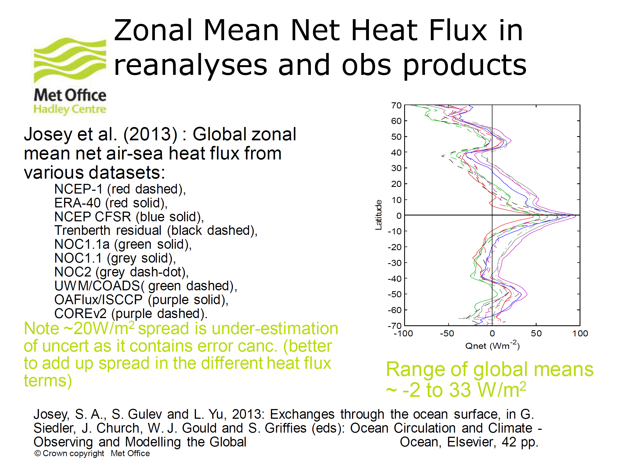

Slide 16
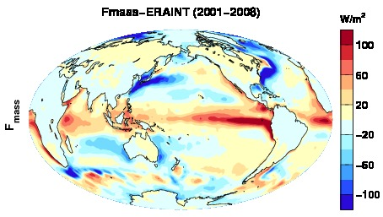
Climatology and inter-reanalysis spread: direct (left), indirect (right)

Slide 17
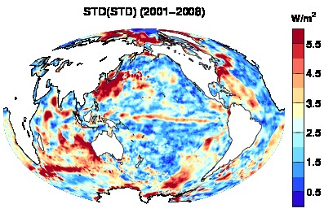
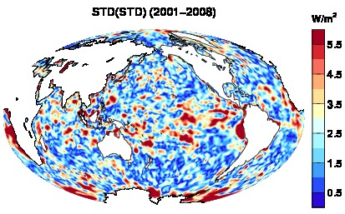
Interannual variability and spread: direct (left), indirect (right)

Slide 18
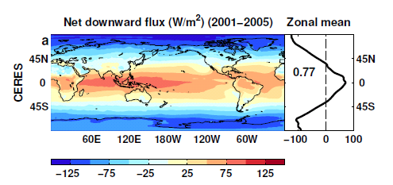
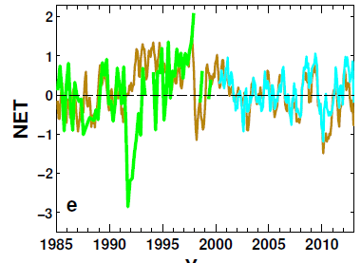
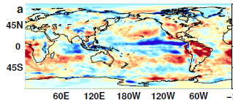
indirect method of estimating Air-sea fluxes from reanalyses
ERBS/CERES variability
CERES monthly climatology
ERBS WFOV
CERES
ERA Interim
ERA Interim spatial anomalies
Combine CERES/ARGO accuracy, ERBS WFOV stability and reanalysis circulation patterns to reconstruct radiative fluxes
Allan et al. (2014) GRL

Slide 19
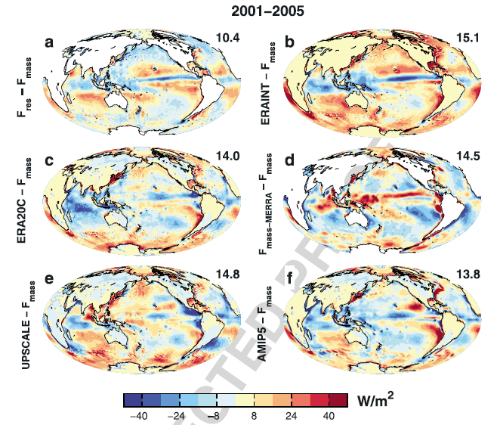

Slide 22
Air-sea flux components
Radiative energy fluxes
  Longwave Radiation
    Near surface water vapour and temperature
    Low-altitude cloud fraction and cloud-base
    Aerosol
  Shortwave Radiation
    Solar “Constant”
    Cloud fraction and optical depth
    Aerosol (and water vapour, ozone, …)
Turbulent heat fluxes
  Latent Heat
    Near-surface temperature and humidity gradient, wind speed, transfer coefficient
  Sensible Heat
    Near-surface temperature profile, wind speed, transfer coefficient

Slide 23
Net Imbalance Anomaly (Wm⁻²)
Earth continues to heat up
Imbalance: 0.23 0.00 0.78 0.63 0.63 (Wm⁻²)
0.34±0.67 Wm⁻²
0.62±0.43 Wm⁻²
La Niña
El Niño
Volcano
Allan et al. (2014) GRL

Slide 24
conclusions
Heating of Earth continues at rate of ~0.6 Wm⁻²
  Manifest as positive imbalance in Southern Hemisphere
  Energy transport by ocean to Northern Hemisphere offset by atmospheric energy transport to Southern Hemisphere
  Variability from radiative forcings & ocean internal changes
Where is the excess energy going in the oceans?
Toward reconciled ocean heating & radiation budget changes
Do feedbacks amplify/extend hiatus/surge events?
Inter-hemispheric heating links to model precipitation biases
See posters on:
Changing water cycle and interhemispheric energy transports (Allan & Liu)
Recent changes in precipitation over Africa (Maidment et al. )
Clouds, radiation and precipitation in west Africa (DACCIWA; Hill et al.)

