Slide 1
Use of Satellite data within DACCIWA
Richard Allan | University of Reading | Leeds 2016

Slide 2

Primary use of satellite data
Modes of usage:
  Processed, climatology and variability to provide context
  Swath-level data for detailed examination and process understanding
  Near-real time instantaneous data during field campaign
Physical variables of interest
  Primary fields: Radiation, Cloud, Precipitation, Aerosol
  Integrating fields: water vapour, energy/moisture transports, anciliary data (temperature, humidity, winds)

Slide 3
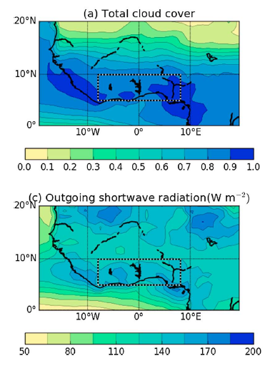
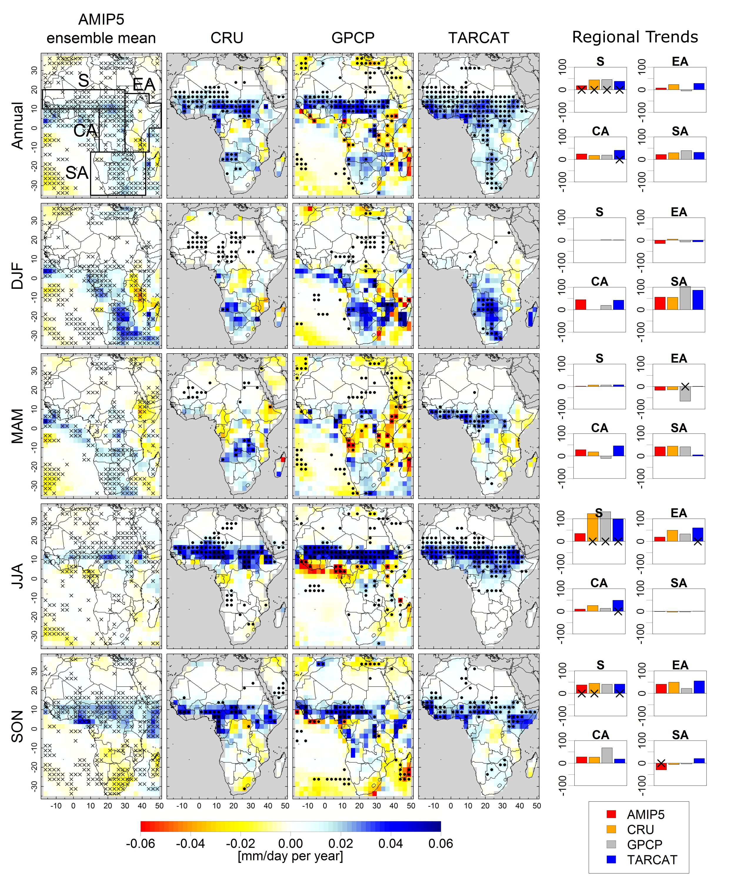
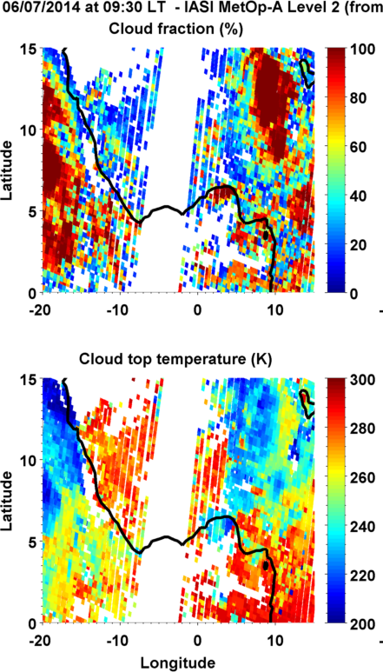
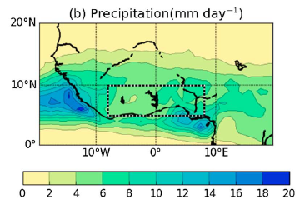
Primary use of satellite data
Maidment et al. (2015) GRL
Above: Climate change
Climatology
Field Campaign →
Below: Process level evaluation
e.g. Hill et al. 2016 JGR
Liu et al. (2014) JAMC

Slide 4
Satellite products summary
ESA CCI VIIRS/NPP
CLOUD
ISCCP
MODIS
SEVIRI
CloudSAT/CALIPSO
AEROSOL
MODIS/MISR
SEVIRI
CloudSat/CALIPSO
RADIATION
ERBE-derived
CERES
GERB/SEVIRI
PRECIPITATION
GPCP (CMAP)
TAMSAT (CHIRPS)
TRMM (PERSIAN)
CloudSat
ATMOSPHERE
ERA Interim
CMSAF
1980 1985 1990 1995 2000 2005 2010 2016
GPM, Megha Tropique, IASI
Project Meeting 2-4 Novermber 2016

Slide 5
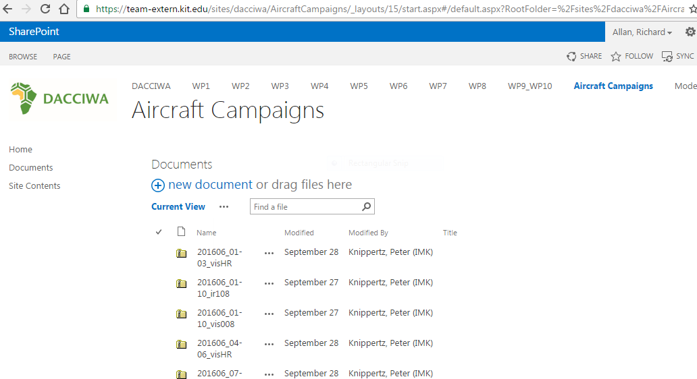
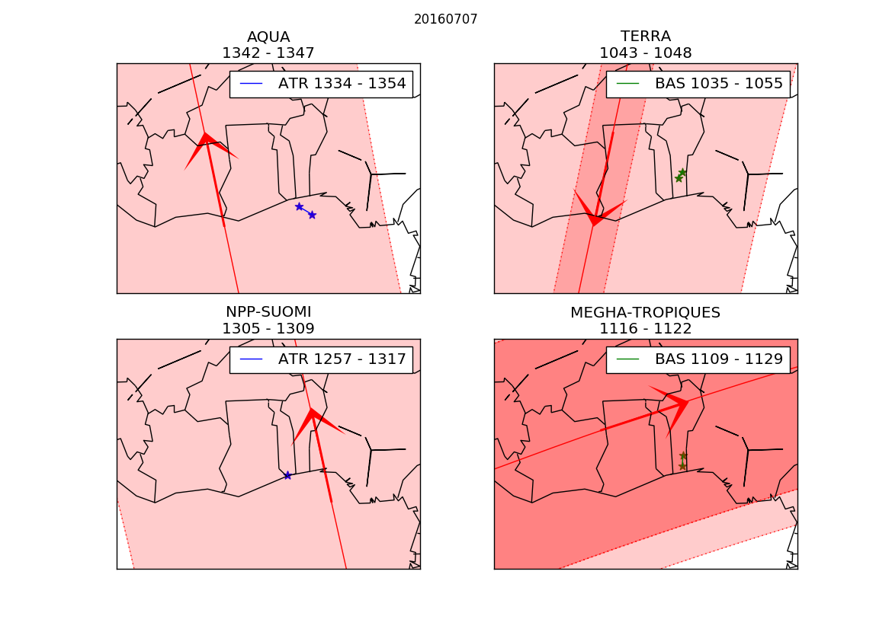
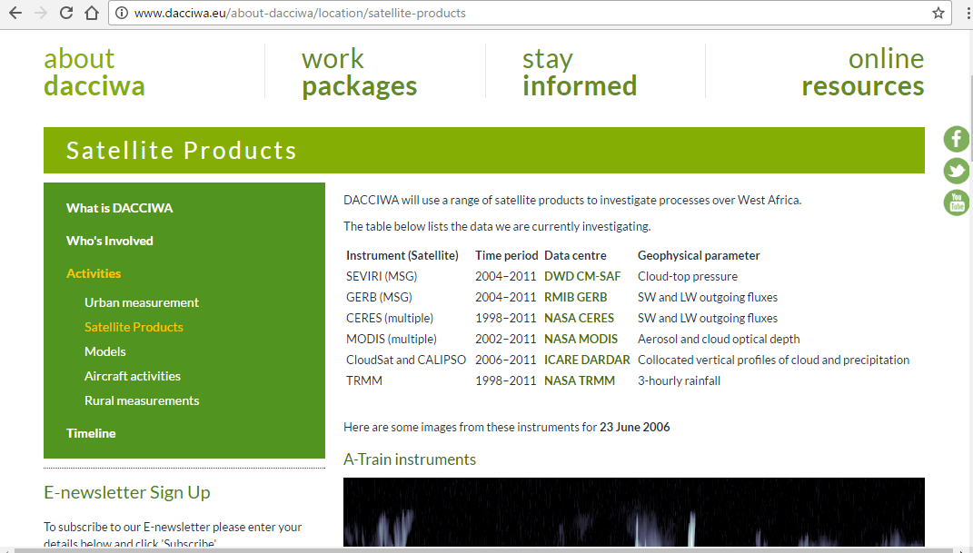
Example Activities
Sharepoint SEVIRI images
Satellite product lists
Satellite overpass times

Slide 6
Discussion
What coordinated satellite data activities would be beneficial? e.g. sharing/visualisation/communication
What are the recommended satellite products for precip, radiation, LWC, IWC, cloud cover, aerosols etc.?
Are there known problems with any products?
Do we need to define some "gold standards” for people to use?
Is there any point in having some data centrally or does everybody download their own copy?
What specific DACCIWA-generated products will become available when?

