Slide 1


DEEP-C:
WP1 overview and future plans
Richard Allan, Chunlei Liu - University of Reading
Thanks to: Norman Loeb
DEEP-C Meeting, NOC-Southampton, 6th November 2015

Slide 2
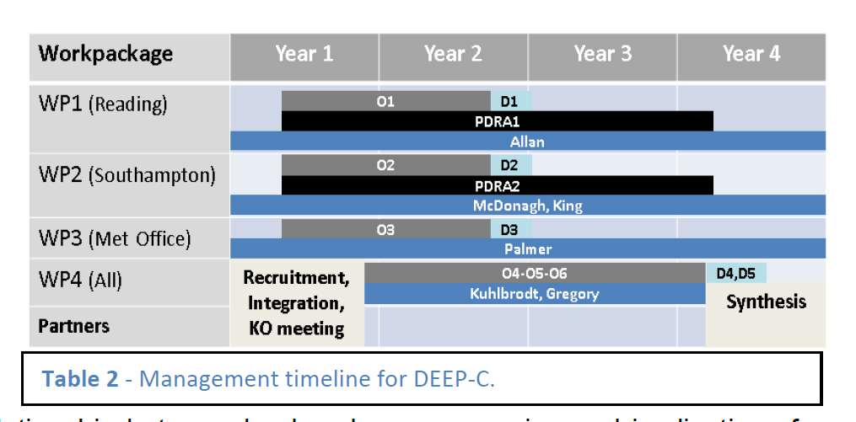
DEEP-C Work Plan
Start date: March 2013; Project Ends February 2017
Workpackage | Year 1 | Year 2 | Year 3 | Year 4
WP1 (Reading)
WP2 (Southampton)
WP3 (Met Office)
WP4 (All)
Partners
O1
D1
PDRA1
Allan
O2
D2
PDRA2
McDonagh, King
O3
D3
Palmer
Recruitment, Integration, KO meeting
O4-O5-O6
D4,D5
Kuhlbrodt, Gregory
Synthesis

Slide 3
WP1 Objectives/Deliverables
O1. Combine satellite radiation budget measurements with atmospheric reanalyses, providing improved 2D estimates of surface heat fluxes across the ocean surface (WP1)
D1. Combined satellite-reanalysis atmosphere/surface energy flows: methodology, uncertainty and exploring lags in the climate system (paper 1,2; WP1, O1,4)
O5. Monitor co-variations in net radiative energy imbalance and ocean heating (from O1,O2,O4); quantify and understand lags between OHC and TOA radiation (WP1-4)
O6. Characterise spatial signatures/mechanisms of ocean and atmospheric heat re-distribution (from O4-5) during the hiatus period 2000-2013 using observations and simulations (WP1-4)

Slide 4
WP1 - Planned work
Analyse and update observed variability in TOA radiation balance (Allan et al. 2014: delivered)
Combine reanalyses/satellite data to provide independent estimates of surface flux (C. Liu et al. 2015:delivered)
  - Wider use of flux products by Pat Hyder et al. (Met Office)
Uncertainty estimates for reconstructed surface fluxes
Inter-hemispheric heating asymmetry (and water cycle)
Regional changes in surface fluxes (link to SMURPHS)
Reconcile TOA radiation balance and ocean heating (WP2/4)
Improved estimate of imbalance & changes (ongoing)
Other topics:
  Investigate lags in climate system
  Evaluation of ERA CLIM/reanalysis radiation budget?

Slide 5
Net Imbalance Anomaly (Wm⁻²)
Changes in imbalance in models & observations
Imbalance: 0.23 0.00 0.78 0.63 0.63 (Wm⁻²)
0.34±0.67 Wm⁻²
0.62±0.43 Wm⁻²
La Niña
El Niño
Volcano
Allan et al. (2014) GRL

Slide 6
Energy imbalance-implied temperature changes

Slide 7

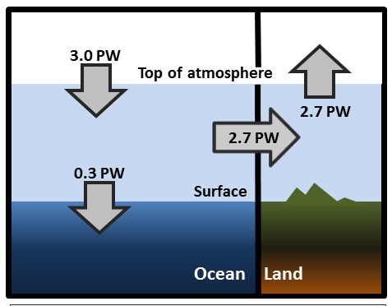
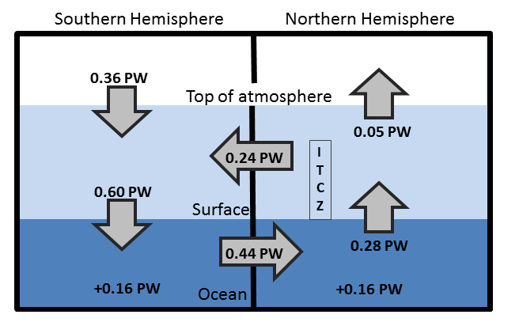
Observed Asymmetry in earth’s energy budget
Adapted from Liu et al. (2015) JGR (above) & Loeb et al. (2015) Clim. Dyn. (left)
Observed inter-hemispheric imbalance in Earth’s energy budget
Not explained by albedo: brighter NH surface but more clouds in SH (Stephens et al. 2015)
Imbalance explains position of ITCZ (Frierson et al. 2013)

Slide 8
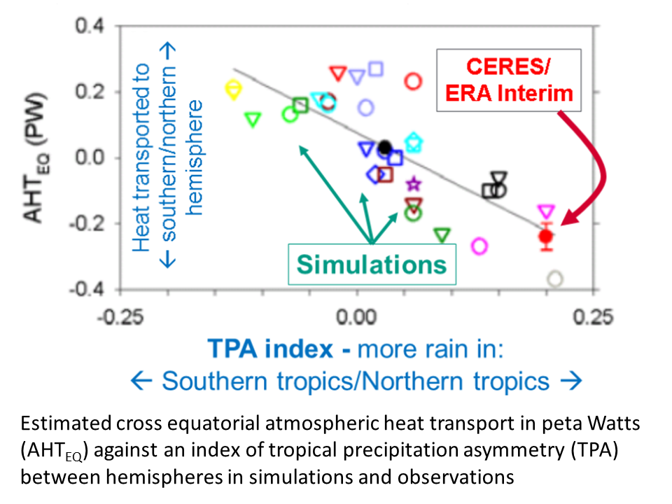
Equatorial heat transport and model precipitation bias
Clear link between bias in cross-equatorial heat transport by atmosphere and inter-hemispheric precipitation asymmetry Loeb et al. (2015) Clim. Dyn.

Slide 9
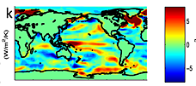
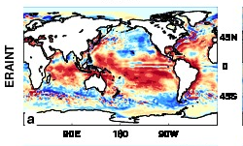

feedbacks on internal variability?
← less heat flux out of east Pacific during warm phases?
Models may underestimate interdecadal variability
Are there positive heat flux feedbacks which amplify internal climate variability?
New project: SMURPHS
surface flux (up)
Brown et al. (2015) JGR
ERAINT latent heat flux trend 1988-2008

Slide 10
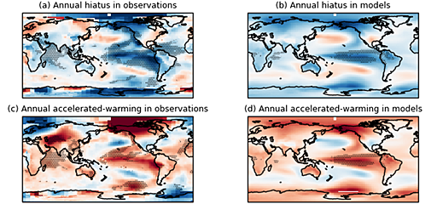
Some recent updates to the literature:
Unforced variability:
Schurer et al. (2015) GRL:
Probability of hiatus or rapid warming in observations consistent with previous model studies (e.g. Roberts et al. 2015); Spatial pattern relating to Interdecadal Pacific & Atlantic Variability. Combination of unforced variability and timing of volcanic eruptions also important.
Brown et al. (2015) JGR: strong link between east Pacific and sub-decadal global mean temperature variability. Two clusters display link with inter-decadal variability: E. Pacific and S. Ocean; models underestimate interdecadal variability and this is especially pronounced where the E. Pacific link dominates. There is some evidence of positive heat flux feedbacks to inter-decadal variability in the E. Pacific and also for high latitudes involving sea ice.

Slide 11
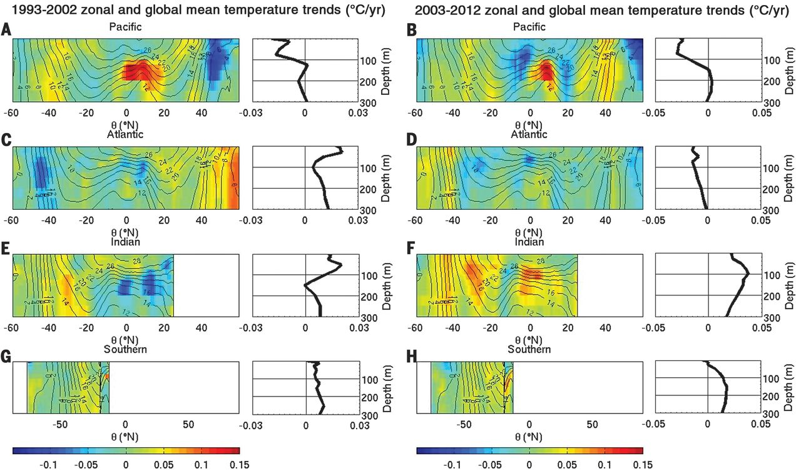
Some recent updates to the literature:
Ocean Heating:
Nieves et al. (2015) Science: observations show that heating below the upper 100m ocean have more than compensated slight cooling in the upper 100m over the 2003-2013 period, confirming that redistribution of the heat in the vertical, and in particular in the 100-300m layer in the Indian and Pacific oceans, explain the suppressed rates of surface warming.
Zika et al. (2015) GRL: deep ocean heating due to collapse of "thermally direct" circulation (reduced upward heat flux at higher latitudes e.g. Antarctic bottom water circulation) but continued thermally indirect circulation (upwelling/ downwelling at same density) at lower latitudes. The large-scale circulation rather than small-scale mixing determine the heat uptake changes.

Slide 12
Some recent updates to the literature:
Morphology:
Gettelman et al. (2015) Clim. Dyn.: Forcing from aerosol-cloud interactions may have contributed to the spatial patterns of recent temperature change, but not to the global mean slowing of surface warming for the period 2000-2010.
Li et al. (2015) GRL: observed Eurasian winter cooling trend 1998-2012 contributed to suppressing of global warming trend; arises from internal variability
Saffioti et al. (2015) GRL: Northern Hemisphere winter cooling 1998-2012 mostly explained by missing observations (particularly for recent years) and internal variability in the atmospheric circulation of the NH extratropics.
Gleisner et al. (2015) GRL: Recent global warming hiatus dominated by low latitude surface temperature trends and not explained by missing data in high latitude regions
Papers & links listed on DEEP-C website: http://www.met.reading.ac.uk/~sgs02rpa/research/DEEP-C.html#PAPERS

Slide 13
WP1 Dissemination Activities
Nov 2015: Paris Water/energy cycle, Paris; U3A talk; NASA sensing our planet
Oct 2015: Reading International Festival outreach talk
Sep 2015: NCEO meeting Southampton; CliVar workshop Exeter
July 2015: Commented on Nieves et al on BBC Radio 4 Today program
July 2015: Talks/posters at IUGG Prague & Common Future Climate conf.
June 2015: Comments on Karl et al. paper (Carbon Brief/SMC/Reuters); Seminars at Imperial College & NCAS
April 2015: Presentation at Decision Analysis for Policy Support workshop
Feb 2015: Comment on detection of greenhouse gas radiative effect
Jan 2015: Smith et al. (2015) GRL dissemination work & U3A outreach
October 2014: Conversation article on Durack/Llovel papers; BBC2 Jeremy Vine show; CERES/GERB/ScaRaB meeting talk
August 2014: Allan et al. (2014) NCAS highlight, Nature Climate Change highlight ; Climate Lab Book , Carbon Brief , Met Department & Conversation blogs; Telegraph ; Eddington Astronomical Society talk
July 2014: DEEP-C talks at GEWEX and AMS conferences
April 2014 – Royal Society “Hiatus” discussion meeting; EGU talk
Feb 2014 - "Where has the warming gone?" RMetS local group ; Comment on England et al. (see also Guardian article).
Aug/Sep2013 - Comment on recent Nature paper by Kosaka and Xie (see also BBC and Independent articles); Voice of Russia; IPCC Sky/BBC/etc
July 2013 - Science Media Centre briefing on “slowdown”
May 2013: Carbon Brief article on DEEP-C temperature obs.
April 2013 - Meeting with DECC partners in London
Also: twitter, Walker Institute, media interaction
http://www.met.reading.ac.uk/~sgs02rpa/research/DEEP-C.html

Slide 14
Conclusions / PLAns
Top of atmosphere/surface heat flux product delivered
  Further work required to determine uncertainties
Characterising changes in Earth’s energy imbalance
  Variability from radiative forcings & internal variability
  Manifest as positive imbalance in Southern Hemisphere
    Ocean energy transport to North offset by atmos. energy trans. to South
    Links to model precipitation biases
    Decadal changes in energy imbalance? [idea → NERC]
  Toward reconciled ocean heating/radiation budget changes
  Where in oceans is energy going (regional/vertical structure)?
  What are time-scales/lags associated with net imbalance?
Do feedbacks amplify/extend hiatus/surge events?
  New SMURPHS project
  Toward an observational constraint on climate sensitivity?
Links to WP2-4

Slide 15
Spare slides

Slide 16
Project Objectives
O1. Combine satellite radiation budget measurements with atmospheric reanalyses, providing improved 2D estimates of surface heat fluxes across the ocean surface (WP1)
O2. Calculate global 3D ocean heat content and its changes since 2003 using ARGO and ship-based observations, leading to improved understanding of energy propagation through the climate system (WP2)
O3. Investigate spatial patterns of surface and sub-surface temperature changes in distinct hiatus decades using simulations and observations (e.g. Fig. 4); evaluate the processes fundamental for ocean heat uptake and redistribution (WP3)
O4. Combine ocean and satellite data (from O1-2) to provide new estimate of Earth's net radiative energy balance (2000-2015) and compare with CMIP5 climate simulations (from O3) (WP1-4)
O5. Monitor co-variations in net radiative energy imbalance and ocean heating (from O1,O2,O4); quantify and understand lags between OHC and TOA radiation (WP1-4)
O6. Characterise spatial signatures and mechanisms of ocean and atmospheric heat re-distribution (from O4-5) during the hiatus period 2000-2015 using observations and simulations (WP1-4)

Slide 17
Discussion
Activities to combine work packages?
  Joint publications
  Intercomparison of ocean heating/imbalance data
  Assess uncertainty in surface flux product
  Lags in system/feedbacks on decadal variability
  Estimated imbalance + regional/vertical structure
  Heating by ocean basin and surface fluxes
Big issue questions to aim for?
Future funding opportunities?
Next meeting
  Dates…
  Should we arrange a larger 2-day workshop?

Slide 18
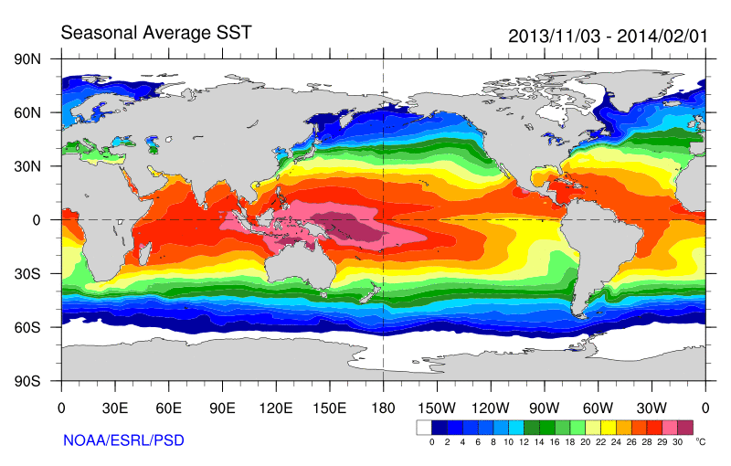
Role of Pacific Ocean Variability?
Continued heating from rising greenhouse gas concentrations
Unusual weather patterns (Ding et al. 2014; Trenberth et al. 2014b)
Enhanced Walker Circulation
Ocean circulation strengthens atmospheric circulation
? Heat flux to Indian ocean Lee etal 2015
Increased sea height
Warm
Upwelling,
Cool water
Remote link to Atlantic?
McGregor et al. (2014)
Increased precipitation
Decreased salinity
Strengthening trade winds
Equatorial Undercurrent
Enhanced mixing of heat below 100 metres depth by accelerating shallow overturning cells and equatorial undercurrent
See: Merrifield (2010) J. Clim.; Sohn et al. (2013) Clim. Dyn.; L’Heureux et al. (2013) Nature Clim. Change; Kosaka and Xie (2013) Nature; England et al. (2014) Nature Clim. Change; Watanabe et al. (2014) Nature Clim. Change; Balmaseda et al. (2013) GRL; Trenberth et al. (2014) J. Clim.; Llovel et al. (2014) Nature Clim;Durack et al. (2014) Nature Clim; Nieves et al. (2015) Science;

Slide 19
Possible Future work
Can we reconcile ocean heating and top of atmosphere imbalance?
Time-scales and lags associated with net imbalance (Harries & Futyan 2006 GRL)
Observational constraint on radiative feedbacks & climate sensitivity
What controls decadal variability: “hiatus” and “surge” events?
Feedbacks associated with unforced variability
  Cloud and latent heat fluxes in the Pacific e.g. Brown et al. 2014 GRL
Do patterned radiative forcings force distinct feedback responses?
To what extent does inter-hemispheric imbalance control rainfall patterns? e.g. Hwang et al. (2012) GRL

