Slide 1


DEEP-C: final plans for WP1
energy budget work
Richard Allan, Chunlei Liu - University of Reading
DEEP-C Meeting, Met Office, Exeter, 18th March 2016

Slide 2
Outline
Introduction/project objectives/dissemination
Brief discussion of new literature
Ongoing WP1 project outputs:
  Regional mechanisms and feedbacks
  Surface energy flux product issues and solutions
  Interhemispheric heating imbalance
Final plans and conclusions

Slide 3
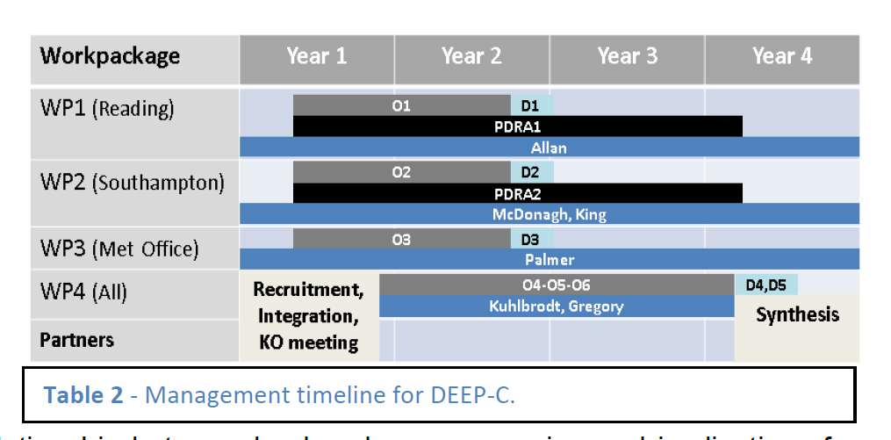
DEEP-C Work Plan
Start date: March 2013; Project Ends February 2017
Workpackage | Year 1 | Year 2 | Year 3 | Year 4
WP1 (Reading)
WP2 (Southampton)
WP3 (Met Office)
WP4 (All)
Partners
O1
D1
PDRA1
Allan
O2
D2
PDRA2
McDonagh, King
O3
D3
Palmer
Recruitment, Integration, KO meeting
O4-O5-O6
D4,D5
Kuhlbrodt, Gregory
Synthesis

Slide 4
Project Objectives
O1. Combine satellite radiation budget measurements with atmospheric reanalyses, providing improved 2D estimates of surface heat fluxes across the ocean surface (WP1)
O2. Calculate global 3D ocean heat content and its changes since 2003 using ARGO and ship-based observations, leading to improved understanding of energy propagation through the climate system (WP2)
O3. Investigate spatial patterns of surface and sub-surface temperature changes in distinct hiatus decades using simulations and observations (e.g. Fig. 4); evaluate the processes fundamental for ocean heat uptake and redistribution (WP3)
O4. Combine ocean and satellite data (from O1-2) to provide new estimate of Earth's net radiative energy balance (2000-2015) and compare with CMIP5 climate simulations (from O3) (WP1-4)
O5. Monitor co-variations in net radiative energy imbalance and ocean heating (from O1,O2,O4); quantify and understand lags between OHC and TOA radiation (WP1-4)
O6. Characterise spatial signatures and mechanisms of ocean and atmospheric heat re-distribution (from O4-5) during the hiatus period 2000-2015 using observations and simulations (WP1-4)

Slide 5
WP1 Dissemination Activities
Jan 2016: Energy and water cycle seminar, Reading; El Nino comments (WSJ)
Nov 2015: Paris COP BBC Breakfast, etc; U3A talk; NASA sensing our planet
Sep/Oct 2015: NCEO meeting Southampton; CliVar workshop; outreach talks
July 2015: Commented on Nieves et al on BBC Radio 4 Today program; Talks/posters at IUGG Prague & Common Future Climate conf.
June 2015: Comments on Karl et al. paper (Carbon Brief/SMC/Reuters); Seminars at Imperial College & NCAS
April 2015: Presentation at Decision Analysis for Policy Support workshop
Feb 2015: Comment on detection of greenhouse gas radiative effect
Jan 2015: Smith et al. (2015) GRL dissemination work & U3A outreach
October 2014: Conversation article on Durack/Llovel papers; BBC2 Jeremy Vine show; CERES/GERB/ScaRaB meeting talk
August 2014: Allan et al. (2014) NCAS highlight, Nature Climate Change highlight ; Climate Lab Book , Carbon Brief , Met Department & Conversation blogs; Telegraph ; Eddington Astronomical Society talk
July 2014: DEEP-C talks at GEWEX and AMS conferences
April 2014 – Royal Society “Hiatus” discussion meeting; EGU talk
Feb 2014 - "Where has the warming gone?" RMetS local group ; Comment on England et al. (see also Guardian article).
Aug/Sep2013 - Comment on recent Nature paper by Kosaka and Xie (see also BBC and Independent articles); Voice of Russia; IPCC Sky/BBC/etc
July 2013 - Science Media Centre briefing on “slowdown”
May 2013: Carbon Brief article on DEEP-C temperature obs.
April 2013 - Meeting with DECC partners in London
Also: twitter, Walker Institute, media interaction http://www.met.reading.ac.uk/~sgs02rpa/research/DEEP-C.html

Slide 6
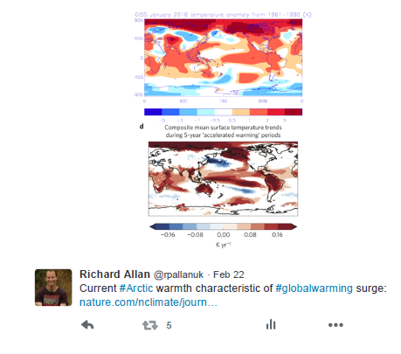
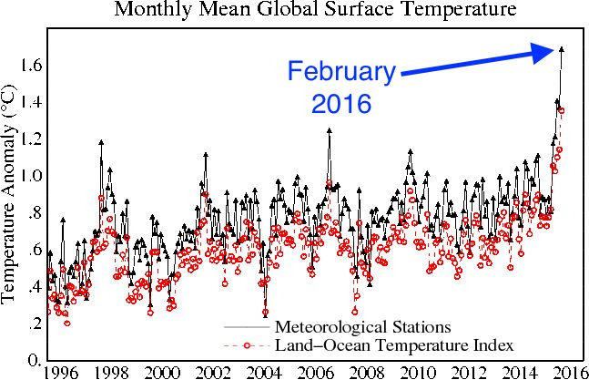
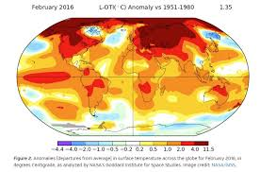
Welcome to the new surge!

Slide 7
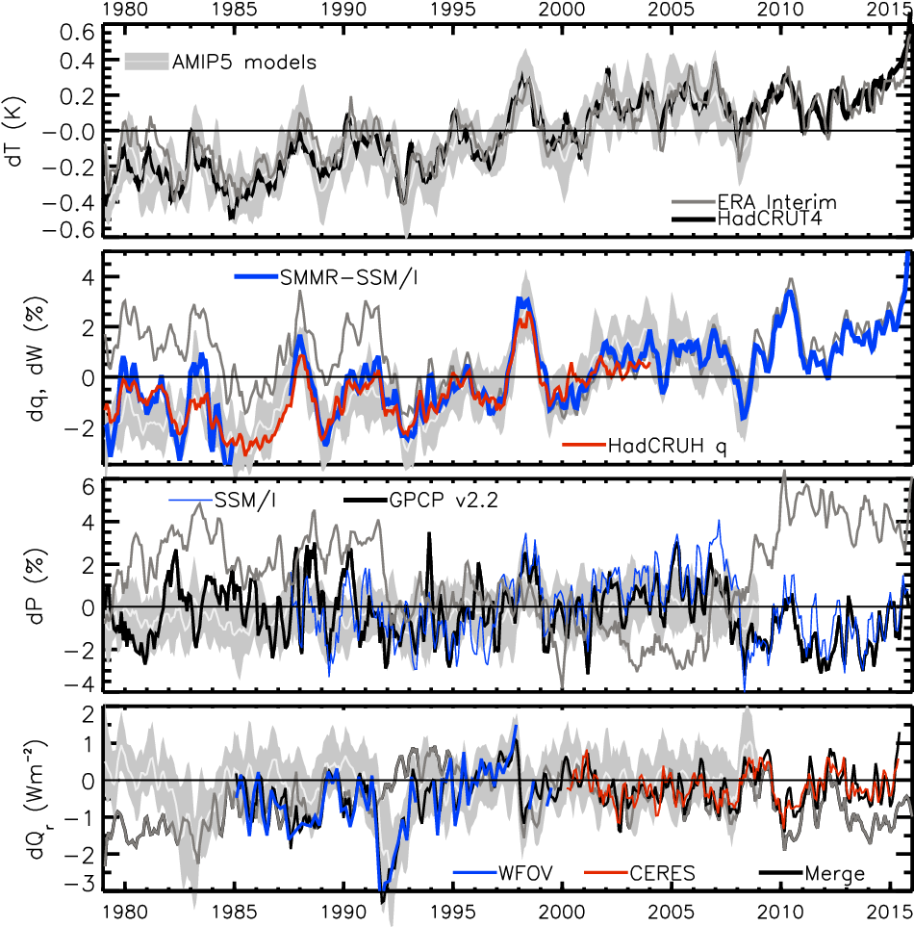
Changes in
Temperature, moisture, precipitation
& net radiation through a surge and slowdown
surge
slowdown
HEATING (Wm⁻²) PRECIP (%) MOISTURE (%) TEMPERATURE (K)
Update from Allan et al. (2014) Surv. Geophys & Allan et al. (2014) GRL

Slide 8
Recent Literature
Fyfe et al. (2016) Nature Climate Change: there was a significant slowing in surface warming from the 1990s to the 2000s
Xie et al. (2015) Nature Geoscience: top-of-the-atmosphere radiation and global mean surface temperature less tightly coupled for natural decadal variability than for greenhouse-gas-induced response.
Li et al. (2015) Nature Climate Change: Atlantic control on Pacific ocean responses through wind-evaporation-SST feedbacks (role of radiative forcing or Atlantic internally generated variability in driving this seems unclear)
Brown et al. (2016) J. Clim.: Role of remote responses to local SST changes in explaining global responses of energy budget
Radel et al. (2016) Nature Geosci. Cloud longwave effect amplifies El Niño through influence on atmospheric circulation
Wijffels et al. (2016) Nature Climate Change: steady accumulation of heat by the oceans up to the large El Niño of 2015/16; an intensifying hemispheric asymmetry, with 75-99% of the heat accumulating south of the Equator, merits consideration.
Glecker et al. (2016) Nature Climate Change: nearly half industrial-era increases in global ocean heat content occurred since ~1997, over a third below 700m depth.
http://www.met.reading.ac.uk/~sgs02rpa/research/DEEP-C.html#PAPERS NOW BACK!

Slide 9
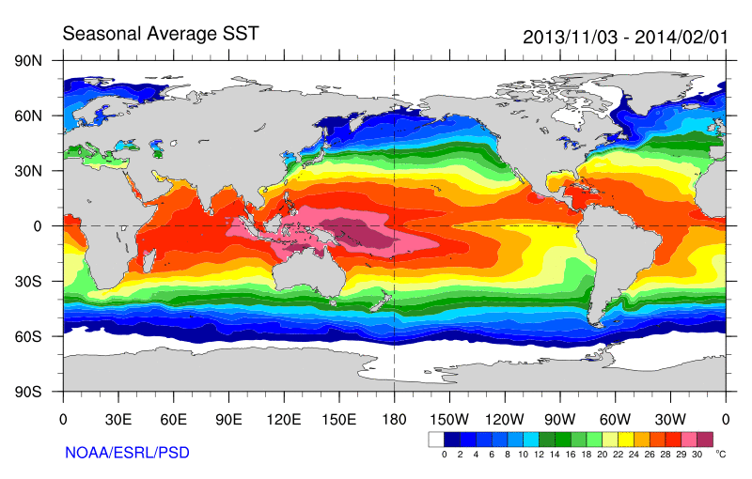
Role of Atlantic/Pacific Variability?
Continued heating from rising greenhouse gas concentrations
Unusual weather patterns (Ding et al. 2014; Trenberth et al. 2014b)
Pacific SST strengthens atmospheric circulation
Enhanced Walker Circulation
? Heat flux to Indian ocean Lee etal 2015
Increased sea height
Warm
Upwelling,
Cool water
Remote forcing from Atlantic:
Li et al. (2016) Nature Clim ;
McGregor et al. (2014)
Increased precipitation
Decreased salinity
Strengthening trade winds
Equatorial Undercurrent
Enhanced mixing of heat below 100 metres depth by accelerating shallow overturning cells and equatorial undercurrent
See: Merrifield (2010) J. Clim.; Sohn et al. (2013) Clim. Dyn.; L’Heureux et al. (2013) Nature Clim. Change; Kosaka and Xie (2013) Nature; England et al. (2014) Nature Clim. Change; Watanabe et al. (2014) Nature Clim. Change; Balmaseda et al. (2013) GRL; Trenberth et al. (2014) J. Clim.; Llovel et al. (2014) Nature Clim;Durack et al. (2014) Nature Clim; Nieves et al. (2015) Science;

Slide 10
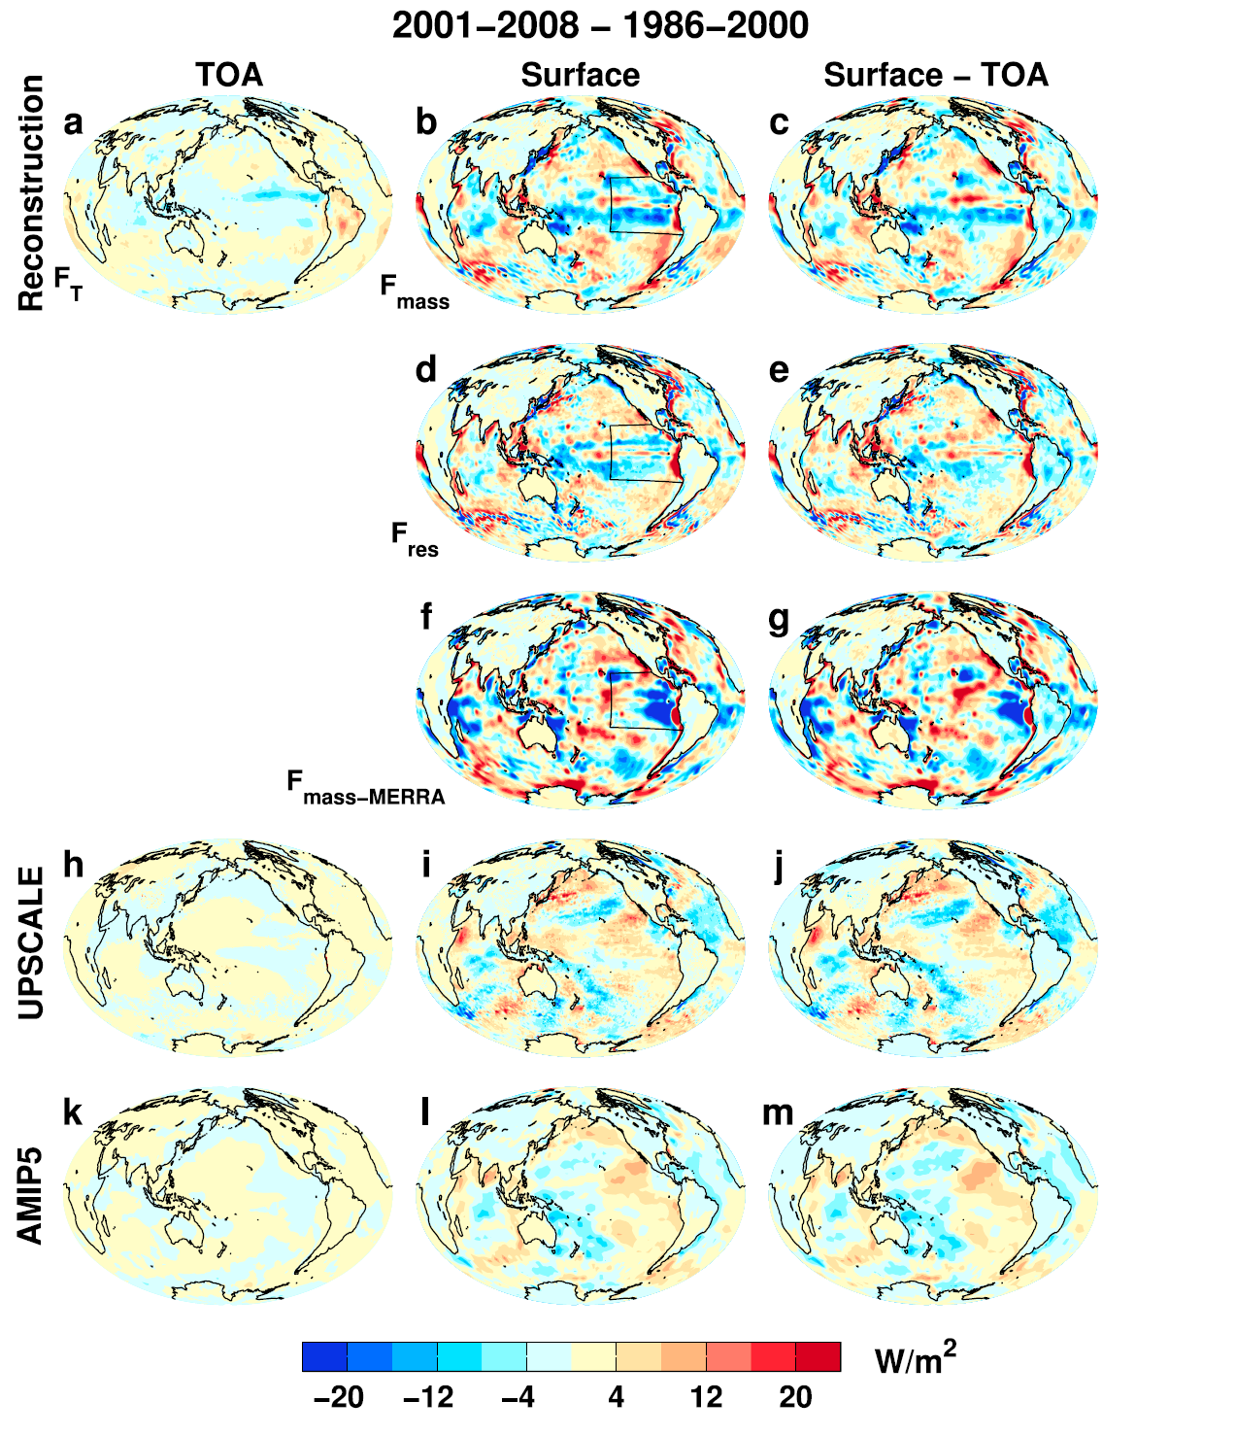
Mechanisms for regional changes in top of atmosphere/surface energy flux
Changes in ↓energy fluxes 1986-2000 to 2001-2008
Surface energy flux dominated by atmos. Transports
Is this realistic? If so, what are the physical mechanisms?
Liu et al. (2015) JGR

Slide 11
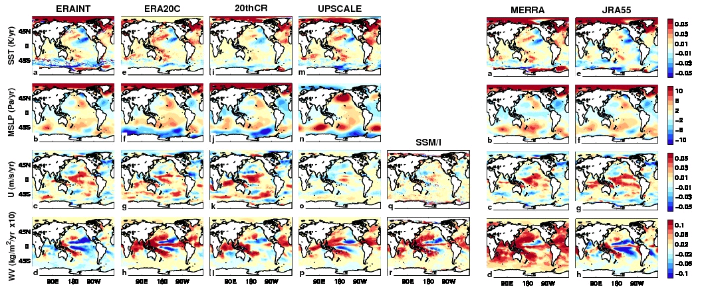
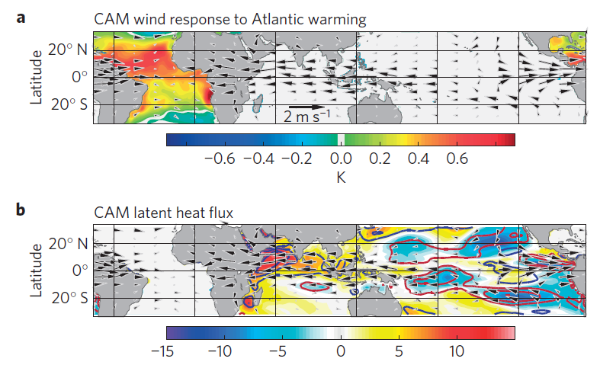
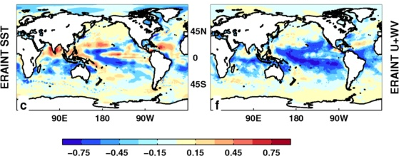
Role of Atlantic & evaporative fluxes in forcing pacific?
Li et al. (2016) Nature Climate

Slide 12
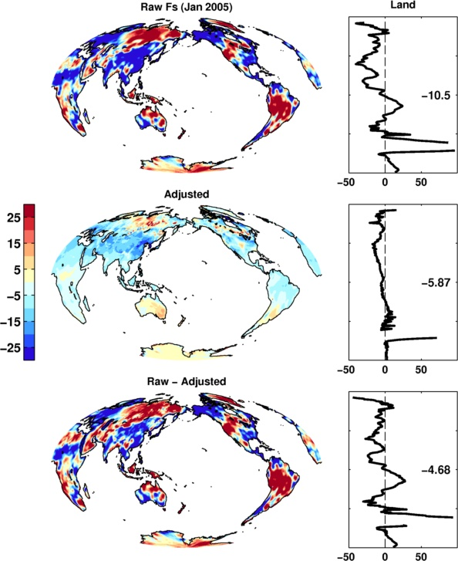
Heat flux product artefacts and solutions
Work by Chunlei Liu
  Unrealistic regional heat fluxes over land
  Constrain based on simple energy balance model
  Redistribute flux “error” over the ocean
  Does this tell us about regional uncertainty?

Slide 13
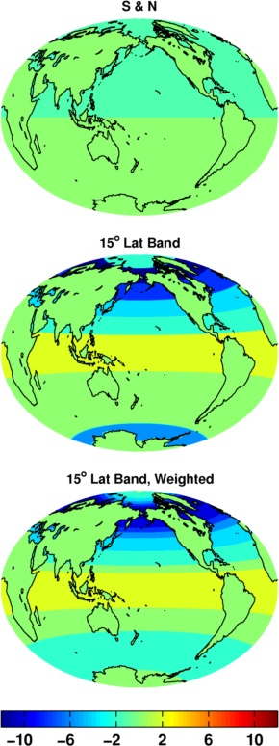
Unphysical land energy flux: solutions?
No correction to land surface fluxes
    - Unrealistic global land/ocean energy budget
Adjust land fluxes and distribute energy
  Evenly over global oceans
    - Unrealistic interhemispheric energy imbalance?
  As (a) but separately for each hemisphere
    - Jump at the equator
  Apply for discrete bands (e.g. 15º latitude)
    - Jumps at band edges
  Apply at each latitude
    - unphysical? Jumps too large.
  Apply at each latitude, weighting function
    - Too complicated, not much more physical than a-d?
2001-2008 mean

Slide 14
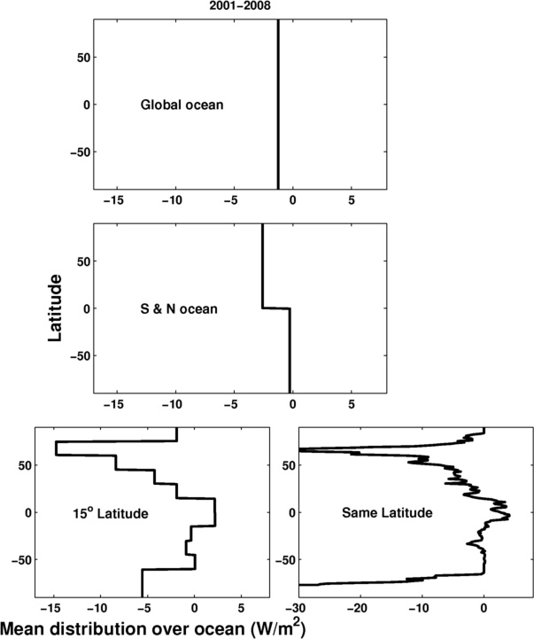
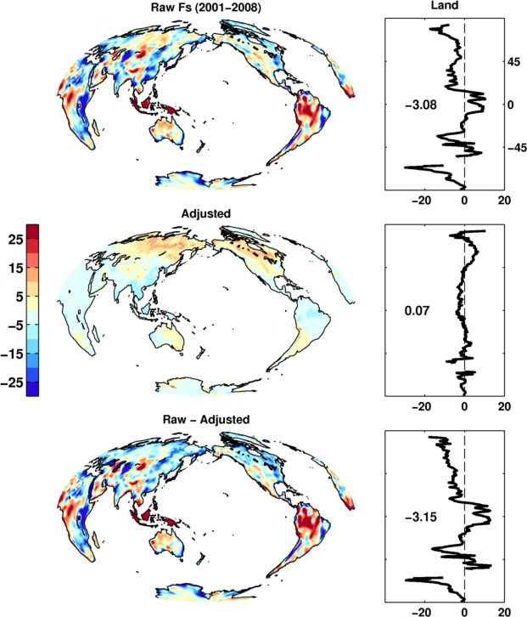
Example: 2001-2008

Slide 15
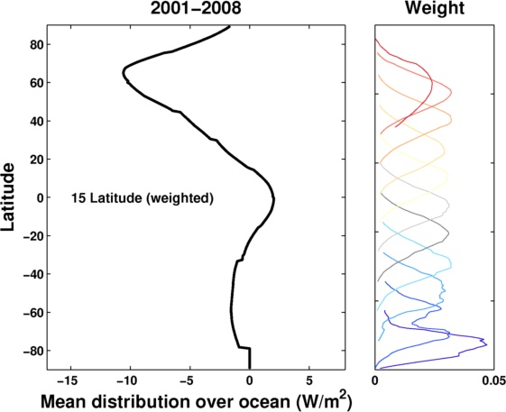
Weighting method?
Solutions?
Global method: small correction, inaccurate cross equatorial transport
Weighted method: more physical, smaller jumps but big correction in NH
Hemispheric method: jump at equator – smooth?

Slide 16
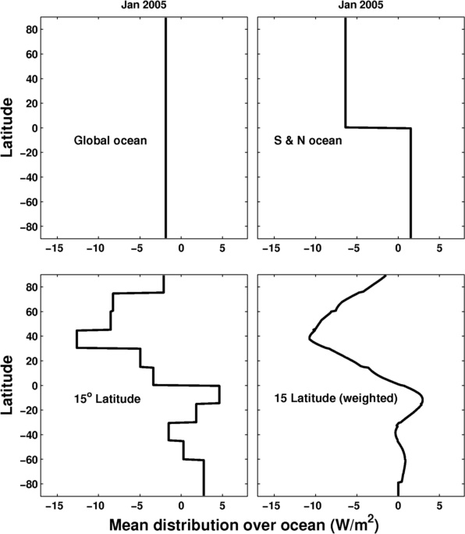
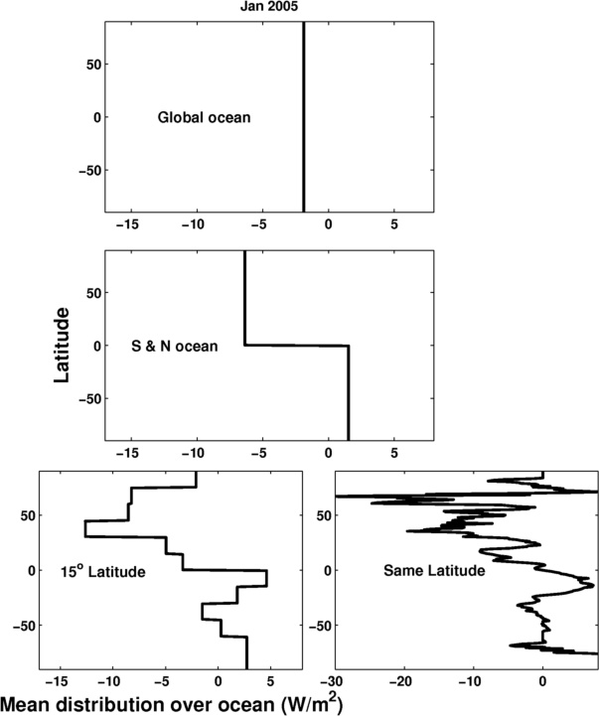
Example: January 2005

Slide 17
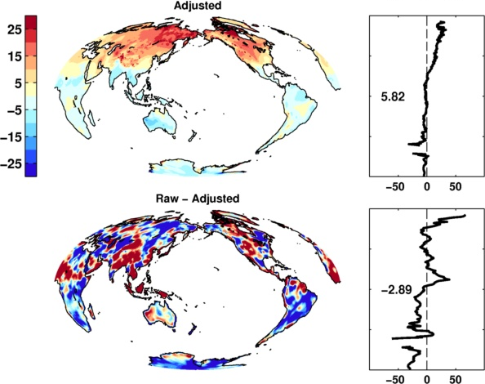
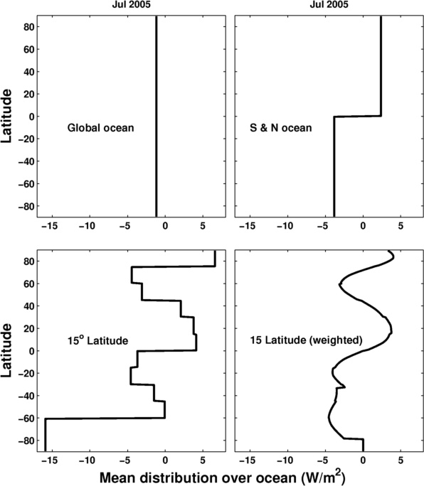
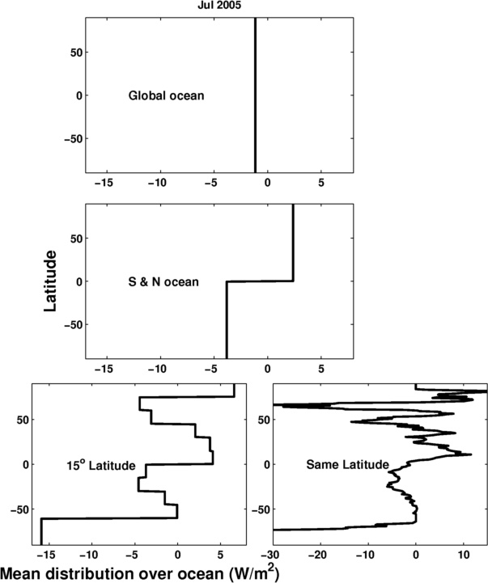
Example: July 2005

Slide 18
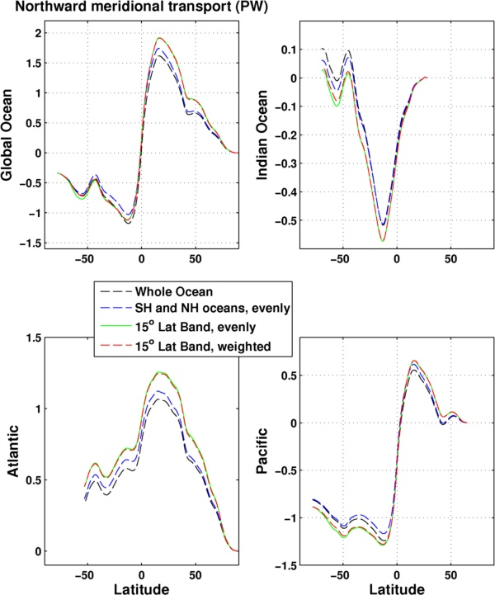
Influence on implied meridional transports

Slide 19
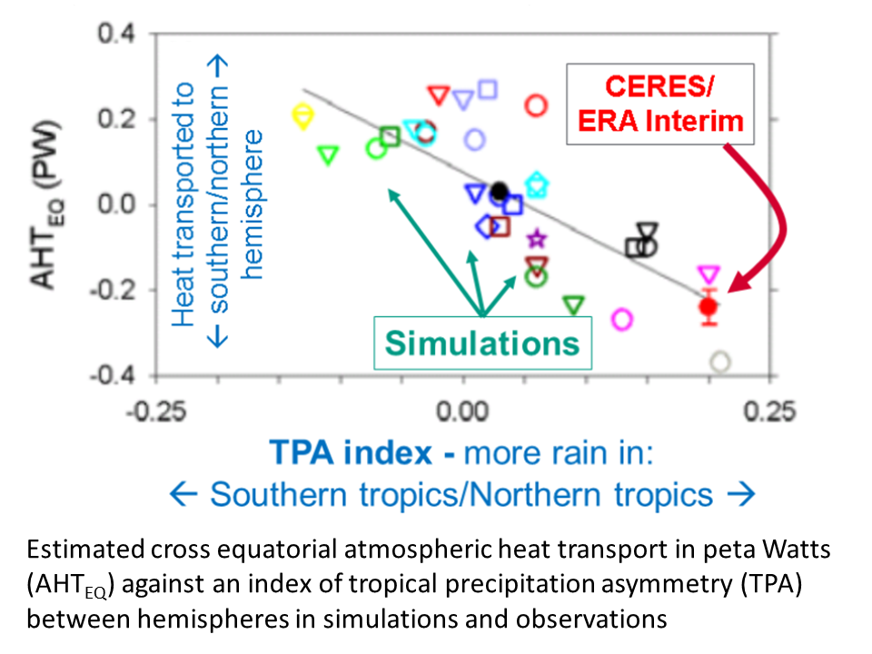
Cross-Equatorial heat transport and CMIP5 model precipitation asymmetry bias
Clear link between bias in cross-equatorial heat transport by atmosphere and inter-hemispheric precipitation asymmetry Loeb et al. (2015) Clim. Dyn
Anthropogenic controls and emergent constraints on precipitation asymmetry: Haywood et al. (2016) GRL ; Hwang et al. (2013) GRL ; Dong & Sutton (2015) Nature Clim.

Slide 20
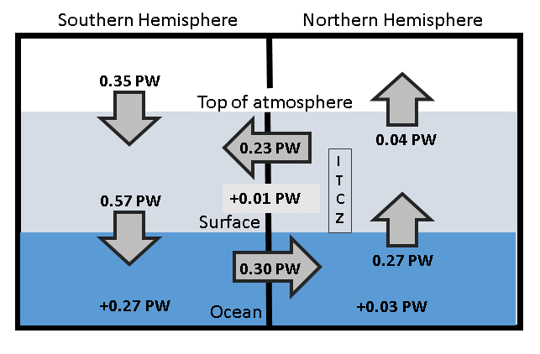
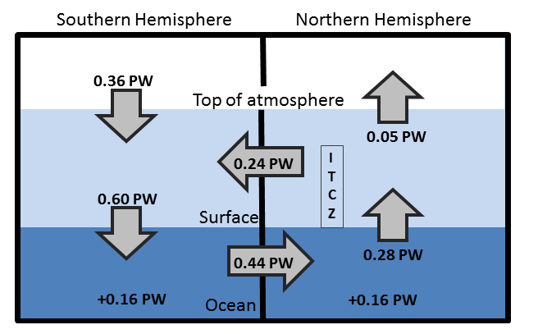
Updated observed energy budget asymmetry
Updated from Loeb et al. (2015) Clim. Dyn. For 2000-2015 based on Liu et al. (2015) JGR
Observed inter-hemispheric imbalance in Earth’s energy budget
Use asymmetric ocean heating observed by Roemmich et al. (2015) Nature Climate and Purkey & Johnson (2010)
Derive implied ocean heat transport: smaller that Loeb et al. (2015) and Frierson et al. 2013 (0.44 PW) – unrealistically so?

Slide 21

Final WP1 outputs/conclusions
  Finalised energy flux dataset version
  Understanding Pacific discrepancy in heat flux changes
  Cross equatorial heat transport (NERC highlight topic?)
  Heat flux product uncertainty estimates (Pat et al.)
  Basin scale changes in heat flux, energy content, energy export (Damien et al., Chris et al.)
  SMURPHS work
    spatial signatures/morphology,
    links to water cycle,
    quantify/understand lags between OHC and TOA radiation
    mechanisms for feedbacks on internal variability)

Slide 23
Spare slides

Slide 24
WP1 - Planned work
Analyse and update observed variability in TOA radiation balance (Allan et al. 2014: delivered)
Combine reanalyses/satellite data to provide independent estimates of surface flux (C. Liu et al. 2015:delivered)
  - Wider use of flux products by Pat Hyder et al. (Met Office)
Uncertainty estimates for reconstructed surface fluxes
Inter-hemispheric heating asymmetry (and water cycle)
Regional changes in surface fluxes (link to SMURPHS)
Reconcile TOA radiation balance and ocean heating (WP2/4)
Improved estimate of imbalance & changes (ongoing)
Other topics:
  Investigate lags in climate system
  Evaluation of ERA CLIM/reanalysis radiation budget?

Slide 25
WP1 Objectives/Deliverables
O1. Combine satellite radiation budget measurements with atmospheric reanalyses, providing improved 2D estimates of surface heat fluxes across the ocean surface (WP1)
D1. Combined satellite-reanalysis atmosphere/surface energy flows: methodology, uncertainty and exploring lags in the climate system (paper 1,2; WP1, O1,4)
O5. Monitor co-variations in net radiative energy imbalance and ocean heating (from O1,O2,O4); quantify and understand lags between OHC and TOA radiation (WP1-4)
O6. Characterise spatial signatures/mechanisms of ocean and atmospheric heat re-distribution (from O4-5) during the hiatus period 2000-2013 using observations and simulations (WP1-4)

Slide 26
Future work
  Which ocean basins are taking up 0.6 Wm⁻² energy imbalance?
  Can we observationally constrain climate sensitivity & feedbacks on internal variability?
  How do changes in cloud/circulation amplify slowdowns/surges? e.g. Brown et al. (2015) JGR ; Radel et al. (2016) Nature Geosci. ; Li et al. (2016) Nature Climate
  Decadal changes in interhemispheric imbalance, ITCZ and global atmospheric/ocean circulation (highlight topic?)
  How has the “hiatus” affected the water cycle?

Slide 27
Net Imbalance Anomaly (Wm⁻²)
Changes in imbalance in models & observations
Imbalance: 0.23 0.00 0.78 0.63 0.63 (Wm⁻²)
0.34±0.67 Wm⁻²
0.62±0.43 Wm⁻²
La Niña
El Niño
Volcano
Allan et al. (2014) GRL

Slide 28
Energy imbalance-implied temperature changes

Slide 29
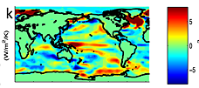
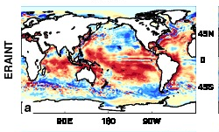
feedbacks on internal variability?
← less heat flux out of east Pacific during warm phases?
Models may underestimate interdecadal variability
Are there positive heat flux feedbacks which amplify internal climate variability?
New project: SMURPHS
surface flux (up)
Brown et al. (2015) JGR
ERAINT latent heat flux trend 1988-2008

Slide 30
Conclusions / PLAns
Top of atmosphere/surface heat flux product delivered
  Further work required to determine uncertainties
Characterising changes in Earth’s energy imbalance
  Variability from radiative forcings & internal variability
  Manifest as positive imbalance in Southern Hemisphere
    Ocean energy transport to North offset by atmos. energy trans. to South
    Links to model precipitation biases
    Decadal changes in energy imbalance? [idea → NERC]
  Toward reconciled ocean heating/radiation budget changes
  Where in oceans is energy going (regional/vertical structure)?
  What are time-scales/lags associated with net imbalance?
Do feedbacks amplify/extend hiatus/surge events?
  New SMURPHS project
  Toward an observational constraint on climate sensitivity?
Links to WP2-4

Slide 31
Discussion
Activities to combine work packages?
  Joint publications
  Intercomparison of ocean heating/imbalance data
  Assess uncertainty in surface flux product
  Lags in system/feedbacks on decadal variability
  Estimated imbalance + regional/vertical structure
  Heating by ocean basin and surface fluxes
Big issue questions to aim for?
Future funding opportunities?
Next meeting
  Dates…
  Should we arrange a larger 2-day workshop?

Slide 32
Possible Future work
Can we reconcile ocean heating and top of atmosphere imbalance?
Time-scales and lags associated with net imbalance (Harries & Futyan 2006 GRL)
Observational constraint on radiative feedbacks & climate sensitivity
What controls decadal variability: “hiatus” and “surge” events?
Feedbacks associated with unforced variability
  Cloud and latent heat fluxes in the Pacific e.g. Brown et al. 2014 GRL
Do patterned radiative forcings force distinct feedback responses?
To what extent does inter-hemispheric imbalance control rainfall patterns? e.g. Hwang et al. (2012) GRL

Slide 33
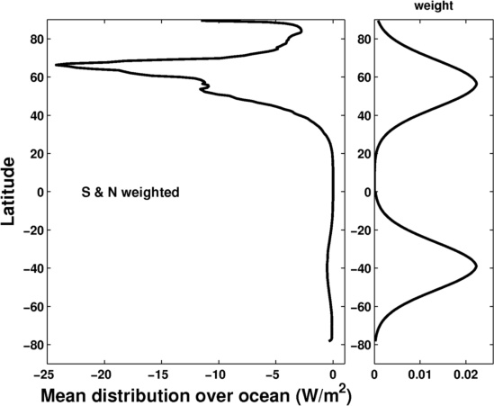

Slide 34
