Slide 1





DEEP-C – update on literature, WP1 radiation budget and WP4 dissemination
Richard Allan, Chunlei Liu
University of Reading
Partners: Walker Institute, NASA Langley, DECC, NCAS, NCEO.
Notes:
This is the title slide, PowerPoint will automatically format the first slide with the title master, although this can be changed in the design palette.

Slide 2
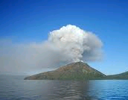
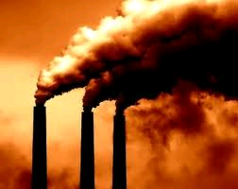
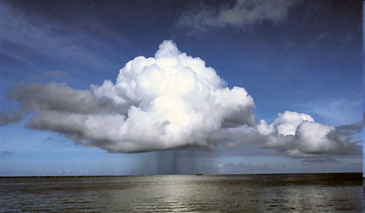
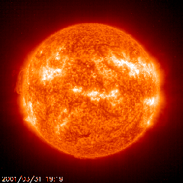
Radiative forcing or energy redistribution?
Journal articles: http://www.met.reading.ac.uk/~sgs02rpa/research/DEEP-C.html#PAPERS
Radiative forcing?
  volcanic, solar, sulphate, stratospheric water vapour, Pinatubo overshoot
  Fyfe et al. (2013) Nature Climate; Fyfe et al. (2013) GRL ; Murphy (2013) Nature Geosci ; Kaufmann et al. (2011) PNAS; Solomon et al. (2011) Science ; Hansen et al. (2011) ACP ; Solomon et al. (2010) Science ; Murphy et al. (2009) JGR
Unforced variability?
  Cloud forcing/adjustment/feedbacks, El Niño, PDO/IPO/climate shift, ocean circulation
  Kosaka & Xie (2013) Nature; Watanabe et al. (2013) GRL ; Balmaseda et_al._(2013)_GRL; Guemas et al. (2013) Nature Climate ; Loeb et al. (2012) Nature Geosci.; Chikamoto et al.(2012) GRL ; Katsman & van Oldenborgh (2011) GRL; Foster and Rahmstorf (2011) ERL ; Meehl et al. (2011) Nature Climate Change (NCC); Palmer et al. (2010) GRL

Slide 3
Causes of Climate Change 1998-2012
Cause | Estimated Change in Radiative Forcing (W per sq.m)¹
Greenhouse gases | + 0.48
Solar | – 0.16
Volcanoes | ‒ 0.06
Other (e.g. aerosols) | ± ?
TOTAL | + 0.26 ± ?
Since 1998 natural factors have masked some of the greenhouse gas warming influence
In the 1990s natural factors (especially recovery from Mt. Pinatubo) added to the greenhouse warming influence
Little overall influence of natural factors since the 1950s
¹ Quantifying other forcings and
uncertainties is ongoing research
Piers Forster, University of Leeds

Slide 4
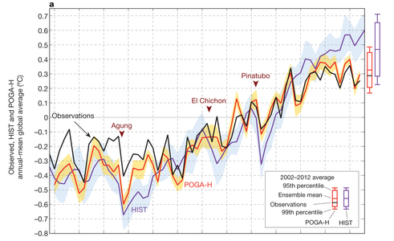
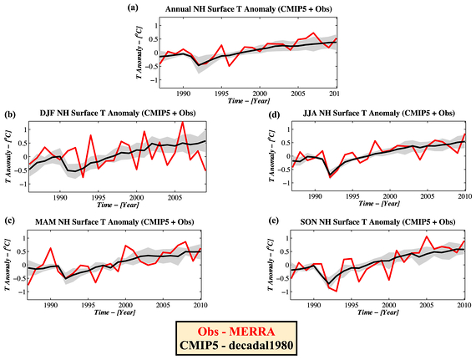
Role of Pacific Ocean Natural Variability
← Kosaka & Xie (2013) Nature
Adjust heating in E Pacific to agree with obs SST
Simulations reproduces hiatus and some regional climate anomalies
Also explains why hiatus dominates NH winter (e.g. Cohen et al. 2012, below)
Note, some models do not simulate natural variability well e.g. CNRM, CanCM4; Watanabe et al. 2013)

Slide 5
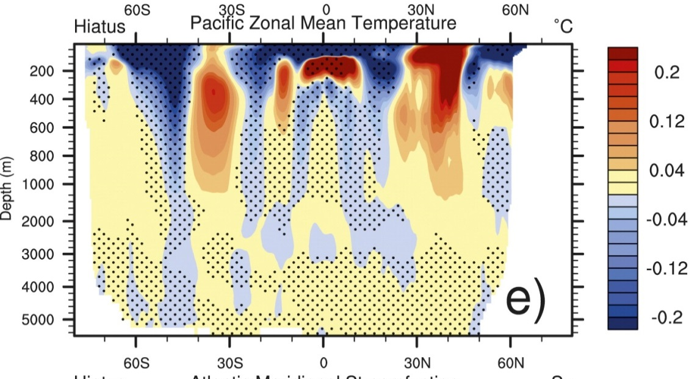
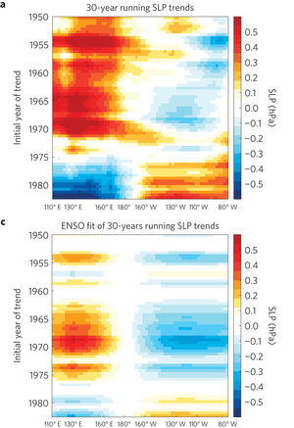
Vertical profiles of heating in Pacific during hiatus decades →
Meehl et al. (2013) J Clim
Trends in SLP and decadal ENSO signal (L’Heureux et al. 2013; Sohn et al. 2012; Merrifield 2011; England et al. 2014)
Strengthening of Walker circulation in response to IPO pattern? Or has change in wind stress increased heat uptake below 700m (Balmaseda et al. 2013)?
Slowdown predicted with initialisation (Guemas et al. 2013; Smith 2013)
Other notable changes: freshening of Antarctic bottom waters since 1980s (Purkey & Johnson 2013)

Slide 6
Cartoon above, but what are the mechanisms? WP2…
Natural fluctuation or some externally forced effect?
Heating due to rising greenhouse gas concentrations
also influenced by aerosol pollution and natural factors e.g. volcanoes, the sun
Rising surface Temperature
Stable surface Temperature
heating
Weak heating
heating
1980s-1990s: heating of upper layers of the ocean – rising surface temperature
2000s: heating of deeper layers of the ocean – slow rises in surface temperature
Notes:
6

Slide 7
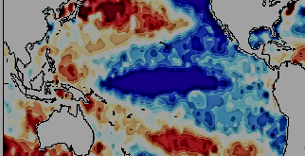
Mechanisms during SST warming hiatus?
After calculations from 4XCO₂ from Cao et al. 2012 ERL
N
~ 0.5-0.6 Wm⁻² e.g. Loeb et al. (2012) Nature Geo
↑ Monsoonal circulations: Levermann et al. (2009) PNAS
↑CO₂, etc: heating
↑ Walker circ? Sohn et al. (2012) Clim Dyn
Energy flows: Muller & O’Gorman (2011) Nature Clim.
CO₂ bio. Effects – small over 15yrs?: Andrews et al. 2010 Clim. Dyn ; Dong et al. (2009) J. Clim
↑P, ↓P? ↓RH
↑stability, ↓P
↑CO₂ ↓ET
M, H
↑P ↓P
↑T
stable SSTs
N
IPO pattern
e.g. Meehl et al. (2012) Nat. Clim.
Change from EP to CP El Nino? Xiang et al. (2013) Clim Dyn

Slide 8
Combining Earth Radiation Budget and Ocean Heat Content data
Tie 10-year CERES record with SORCE TSI and ARGO-estimated heating rate 2005-2010
Best estimates for additional storage terms
Variability relating to ENSO reproduced by CERES and ERA Interim
Estimate of decade long net energy imbalance of 0.50±0.43 Wm^{–2}
Loeb et al. (2012) Nat. Geosci. See also Hansen et al. (2011) ACP; Trenberth et al. (2014) J. Climate
Notes:
Fi gure 3 (a) Global annual average net TOA flux from CERES observations and (b) ERA Interim reanalysis are anchored to an estimate of Earth’s heating rate for 2006–2010 ⁵ The Pacific Marine Environmental Laboratory/Jet Propulsion Laboratory/Joint Institute for Marine and Atmospheric Research (PMEL/JPL/JIMAR) ocean heating rate estimates⁴ use data from Argo and World Ocean Database 2009; uncertainties for upper ocean heating rates are given at one-standard error derived from sampling uncertainties. The gray bar in (b) corresponds to one standard deviation about the 2001–2010 average net TOA flux of 15 CMIP3 models.

Slide 9
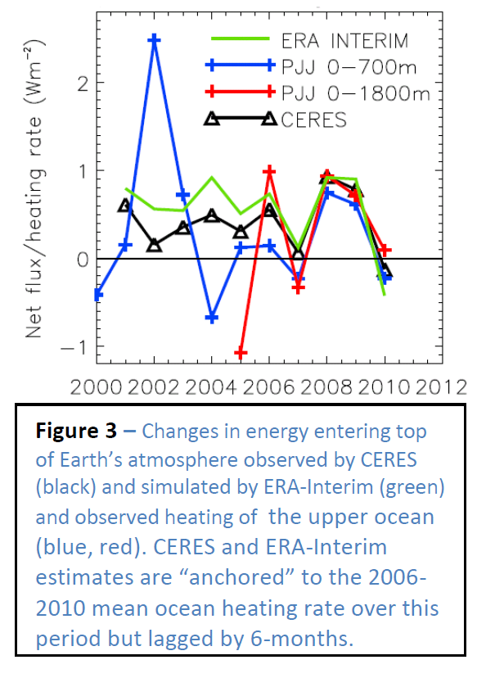
WP1 - Planned work
Analyse and update observed variability in TOA radiation balance
Investigate lags in climate system
Combine ERA Interim and CERES to provide new estimate of surface heating
Monitoring of changes in energy balance
Reconcile TOA radiation balance and ocean heating

Slide 10
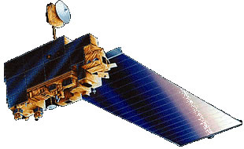
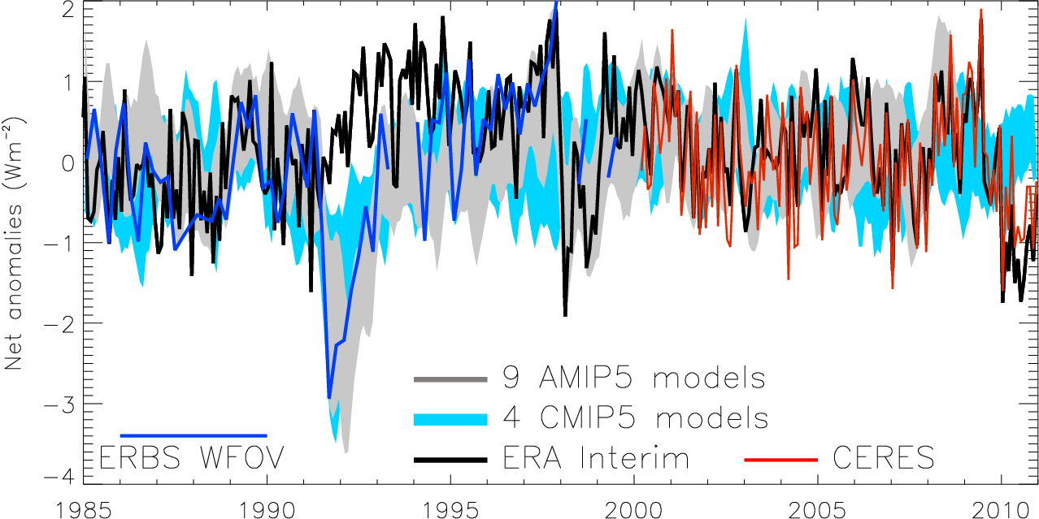
Variation in net radiation since 1985
60S-60N, after Allan (2011) Meteorol. Apps; see also Harries and Bettolli (2010) J. Clim
Notes:
Deseasonalised monthly anomalies of net radiation (60ºS-60ºN) from satellite data (ERBS WFOV; CERES) and reanalysis simulations (ERA Interim) updated from ref 6 to include CMIP5 climate model simulations (AMIP 5 simulations from CNRM, NorESM1, HadGEM2 and INMCM4 in grey and combined historical and RCP4.5 scenario coupled simulations from CNRM, CanESM, HadGEM2-ES and INMCM4 in blue shading). CERES has been updated to EBAF2.6 and ERA Interim to 1985-2010.

Slide 11
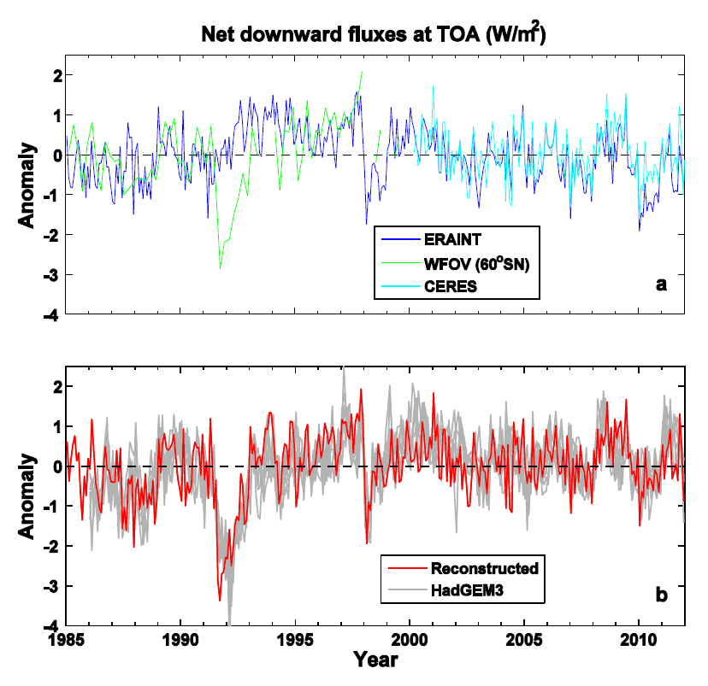
Reconstruction of global net radiation:
ERA Interim
CERES
ERBS-WFOV
Compared with UK Met Office HadGEM3 simulations with observed sea surface temperature
See talk by Chunlei Liu

Slide 12
Minor energy flux terms
Changes in atmospheric energy (ΔA) from ERA Interim (thin black)
Changes in energy required to melt Arctic ice (ΔI). I assumed that additional land ice melt and heating increased these changes by factor of 2.
Heating of the land surface (ΔL) from ERA Interim (brown)
I adjusted the sum so that the average equalled the 0.07+0.04 Wm⁻² minor heating terms assumed in Loeb et al. (thick black line) which included the deep ocean (ΔD) term.

Slide 13
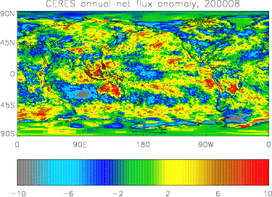
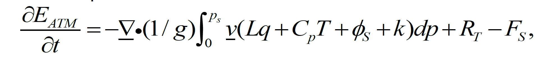
New estimates of surface fluxes
WP1 – improved 2D estimate of surface fluxes combining ERA Interim transports and CERES TOA radiation budget
e.g. Berrisford et al. (2011) QJRMS

Slide 14
Preliminary work on surface fluxes

Slide 15
Preliminary findings
Previously highlighted “missing energy” explained by ocean heat content uncertainty combined with inappropriate net radiation satellite products
Heating of Earth continues at rate of ~0.5 Wm⁻²
  Radiative forcing alone can’t explain surface warming slowdown
  Energy continues to accumulate below the ocean surface
  Role of the Pacific Kosaka & Xie (2013) Nature;
  Strengthening of Walker circulation, e.g. Merrifield (2011) J Clim; implications for hydrological cycle, e.g. Simmons et al. (2010) JGR?
Ongoing WP1 work
  Understanding current variability in TOA radiation (1985-2013)
  Provide new estimates of surface radiation (preliminary analysis)
  Lag/lead in climate system (preliminary analysis)
  Plans: collaborative work with WP2 (surface fluxes) and WP3 (simulations)

Slide 16
Dissemination Activities
April 2013 - Science Media Centre briefing on warming slowdown
April 2013 - Meeting with DECC partners in London to discuss project
July 2013: Article on DEEP-C and how scientists measure Earth's temperature Carbon Brief
Also: twitter, Walker Institute, media interaction

Slide 17
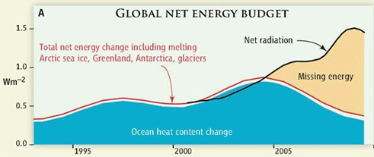

Motivation (1) Missing energy?
Trenberth and Fasullo (2010, Science) highlighted an apparent large discrepancy between net radiation and ocean heat content changes
H1 – “Missing Energy” in the climate system is explained by deficiencies in the observing system and can be resolved through improved combination and analysis of updated satellite and in situ measurements and modelling

Slide 18
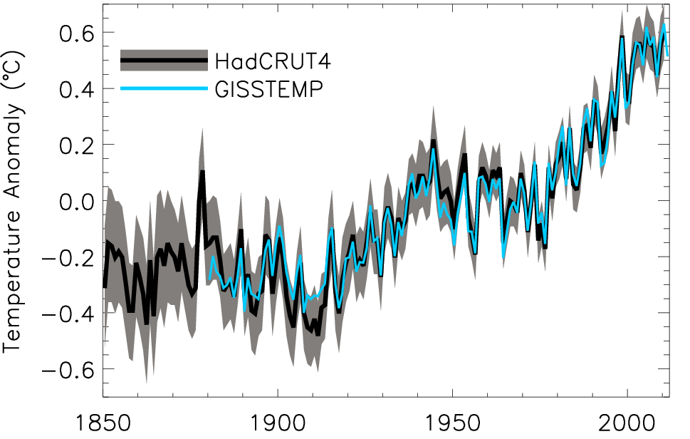
Motivation (2) What has caused the decline in rate of global surface warming?
H2 – The recent slow rates of surface warming (the so-called warming hiatus) are primarily due to an enhanced transport of heat to the deep ocean caused by natural variability in ocean circulation with changes in external forcing playing a secondary role.
Global annual average temperature anomalies relative to 1951–1980 mean (shading denotes lower and upper 95% uncertainty range for HadCRUT4)

Slide 19
DEEP-C project structure
WP1 Reading
Atmosphere obs
R. Allan, C. Liu
WP2 NOCS
Ocean obs
E. McDonagh, B. King, +PDRA
WP4
Integration
Reading Co-Is:
T. Kuhlbrodt, J. Gregory
Climate modelling, ocean
Project Partners:
N. Loeb (NASA Langley) Satellite Radiation budget
K. Maskell (Walker Institute, Reading)
C. Sear (DECC)
WP3 Met Office
Climate Modelling
M. Palmer, C. Roberts
Additional partners:
Reading, NOCS, Met Office & UK community

