Slide 1


Was there a pause in global warming?
Results from the DEEP-C project
Richard Allan - University of Reading
St. Anne’s College Oxford, 3rd Nov 2017

Slide 2
Outline
Intro – climate has always changed
Global surface Ts plot (with context)
Earth’s energy balance
Argo floats
Satellite record/time series
Schematic
NH, SH schematic
Summary

Slide 3
Introduction
Global warming apparently slowed in the early 2000s
This motivated scientists to:
  Test whether global warming had slowed
  See if warming was less than expected on physical grounds
  Understand mechanisms that can explain any discrepancy
The University of Reading teamed up with scientists from the Met Office, National Oceanography Centre-Southampton, the Met Office and NASA to tackle these questions
Did global warming pause at the beginning of the century and if so, why?
What mechanisms explain reduced global surface warming rate 2000-2013?
Where is excess energy from rising greenhouse gas concentrations accumulating?

Slide 4
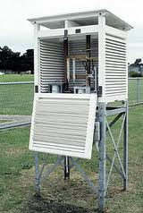
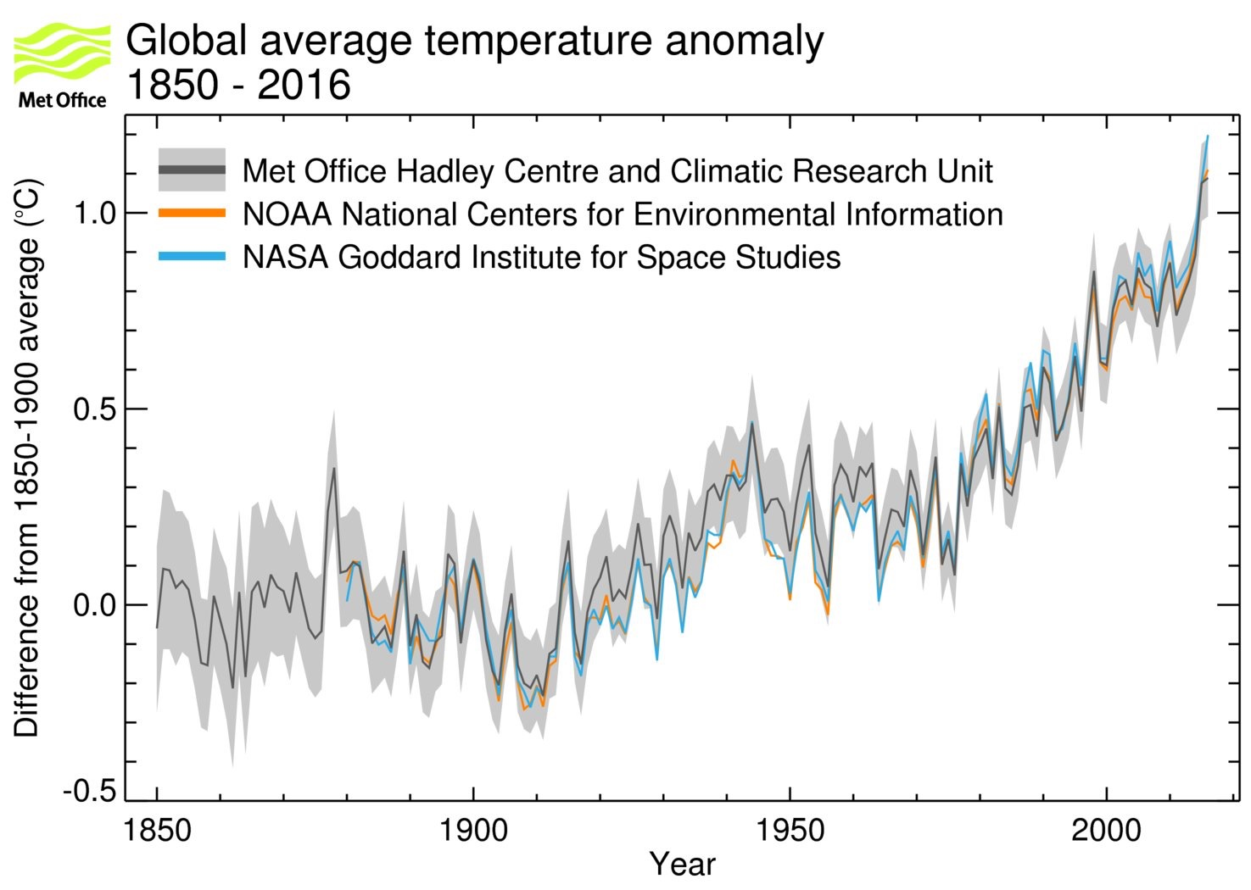
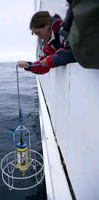

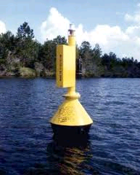
The planet is warming isn’t it?
40 years
1973-2013
www.metoffice.gov.uk/research/monitoring/climate/surface-temperature
Notes:
The instrumental record goes back to about 1850. A few areas of the globe have not warmed in recent decades, mainly over some parts of the Southern Hemisphere oceans and parts of Antarctica. The rate of surface warming is not smooth; there are lumps and bumps in the record and this rate has slowed in the recent decade.

Slide 5
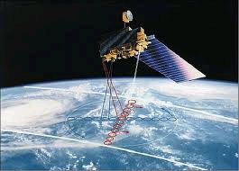
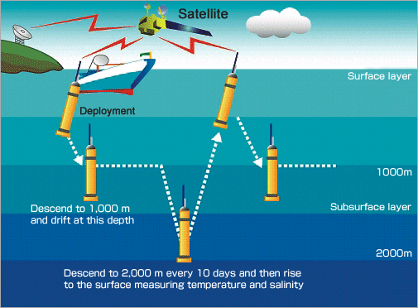
DEEP-C project Diagnosing Earth’s Energy Pathways in the Climate system
CERES
Combine expertise on Earth’s energy budget (Reading, NASA), computer simulations (Met Office) and ocean science (NOC-Southampton)
Satellite instruments measure energy arriving & leaving planet
  Sunlight & thermal radiation
Automated floats measure heating of ocean (ARGO)
Computer simulations of the atmosphere and ocean provide a laboratory
Hypotheses:
Heating of Earth did not slow
Heat went into the “deep” ocean

Slide 6
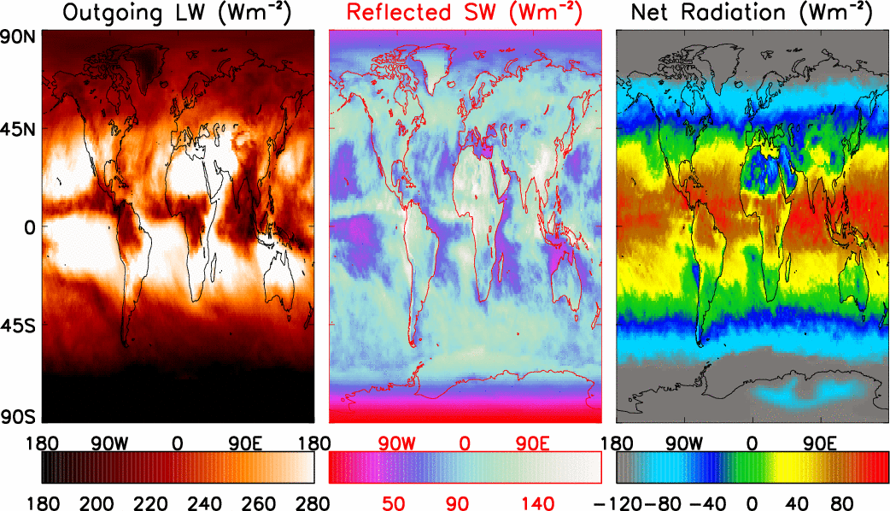
Top of Atmosphere Radiative Energy Fluxes CERES/TERRA, September 2004

Slide 7
Top of Atmosphere Radiative Energy Fluxes CERES/TERRA, September 2004

Slide 8
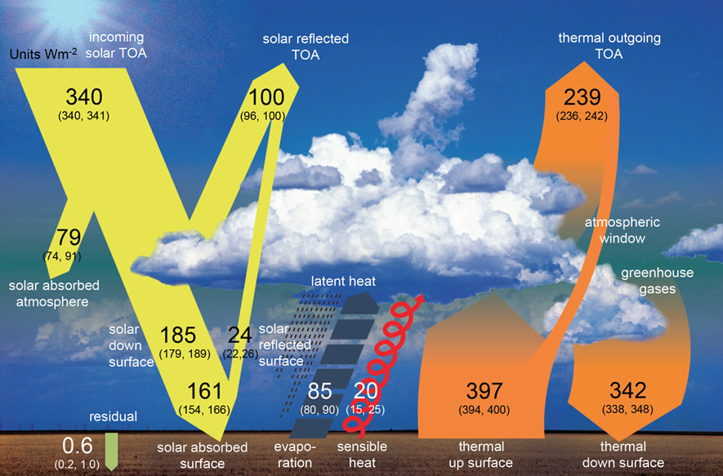
Earth’s Global Annual Average Energy Balance
Wild et al. (2012) Clim. Dynamics. See also: Trenberth et al. (2009) BAMS

Slide 9
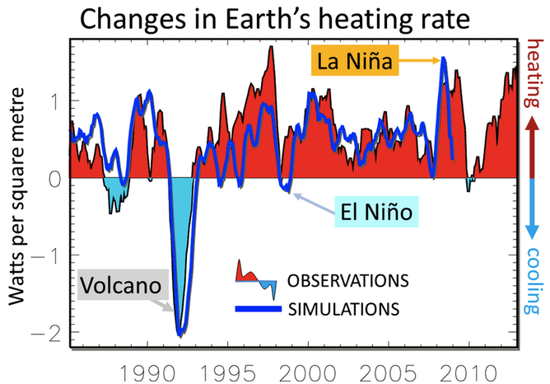
Planet Earth continues to heat up…
The planet is gaining heat at the rate of 300 trillion Watts…
Loeb et al. (2012) Nat. Geosci. ; Allan et al. (2014) GRL

Slide 10
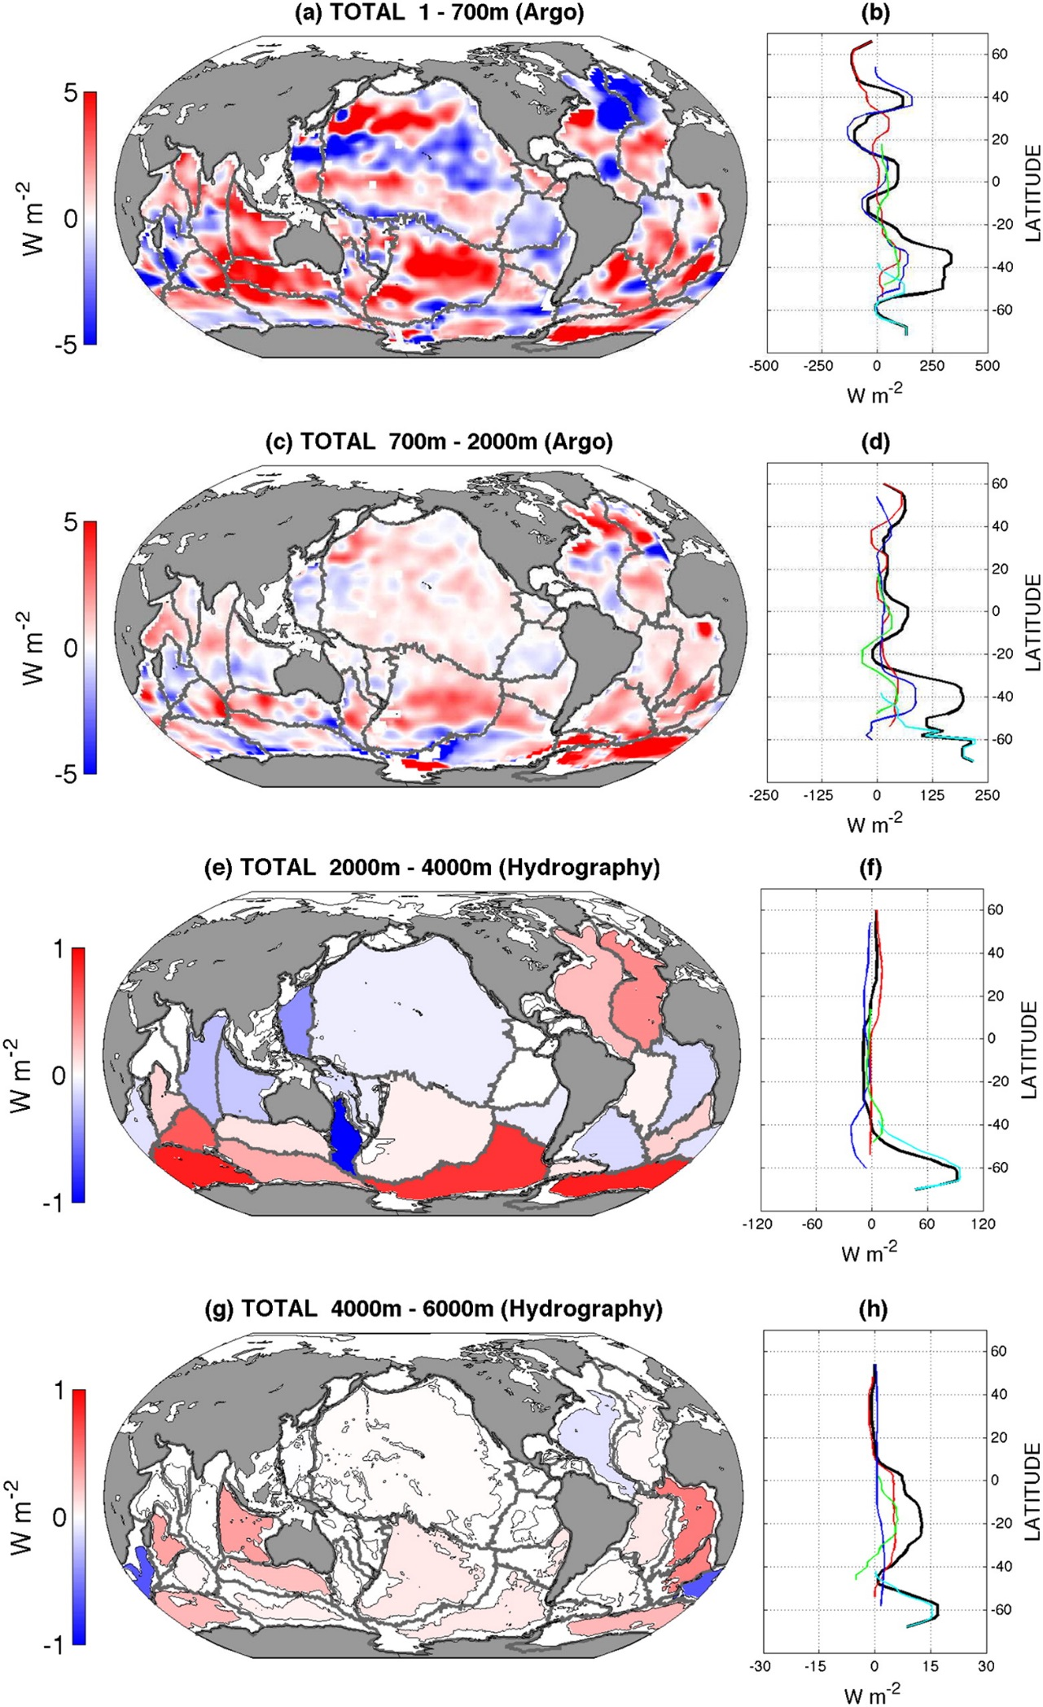
Deep ocean continues to heat up
Desbruyères et al. (2017) J. Climate

Slide 11
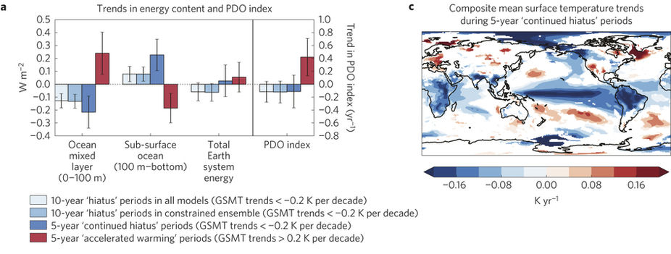
Climate Simulations of hiatus events
In simulated “hiatus” events less energy accumulates in upper mixed layer of the ocean, more heats deeper layers
The pattern of east Pacific cooling has a fingerprint of ocean decadal variability, akin to the observed pattern
Roberts et al. (2015) Nature Climate Change

Slide 12
Ocean climate fluctuations explain slowdown
e.g. Allan (2017) Nature Climate Change
Heating due to rising greenhouse gas concentrations
also influenced by aerosol pollution and natural factors e.g. volcanoes, the sun
Rapid surface warming
Slower surface warming
heating
Weak heating
heating
1980s-1990s: heating of upper layers of the ocean – rapidly rising surface temperature
2000s: heating of deeper layers of the ocean – slower rises in surface temperature
Large body of research – listed on DEEP-C project website
Notes:
12

Slide 13

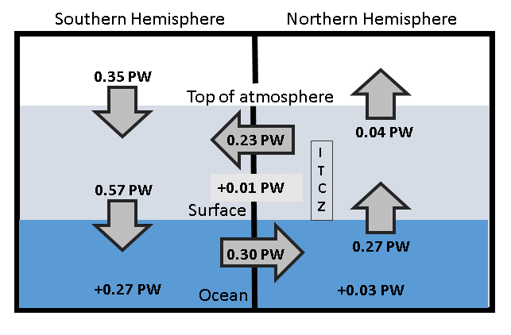
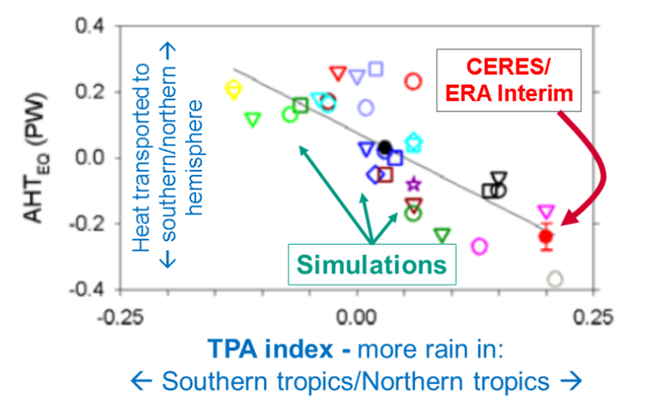
Energy flows are important for climate and the tropical rainy belt
Left: We can now reconstruct how energy is accumulating and moving between each of Earth;’s hemispheres (energy flow in peta watts) Liu et al. (2017) JGR
See also Weather & Climate blog post
Right: The flows between hemispheres are important for climate and in the position of the tropical rainy belt which climate simulations struggle to capture
Loeb et al. (2016) Clim. Dyn
Notes:
Combining top of atmosphere energy buget and reanalysis horizontal energy transports allows new estimates of global surface energy budget
This has enabled advances in observing/understanding inter-hemispheric energy imbalance/transports and precipitation and links to model biases
Many CMIP5 models contain gross errors in cross equatorial energy fluxes which coincide with incorrect depiction of hemispheric precipitation asymmetries offering a potential constraint on climate models

Slide 14
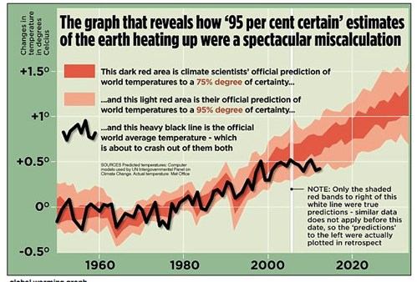
A hiatus in global warming?
No: the oceans have continued to warm, sea levels have continued to rise…
But…natural factors temporarily suppressed the rate of surface warming… slightly
  A slight dimming of the sun and small volcanic eruptions offset some of the heating from rising greenhouse gases but…
  Crucially, ocean fluctuations rearranged where heat has accumulated
  Climate models can simulate ocean fluctuations but are not designed to capture timings of lumps and bumps in temperature record.
  Accounting for improved understanding of radiative forcing and ocean “weather” climate simulations are consistent with observations
DEEP-C contributed to understanding how Earth is continuing to heat, building on a large body of evidence
How much the planet will warm this century and beyond mostly depends on total greenhouse gas emissions… so us

Slide 16
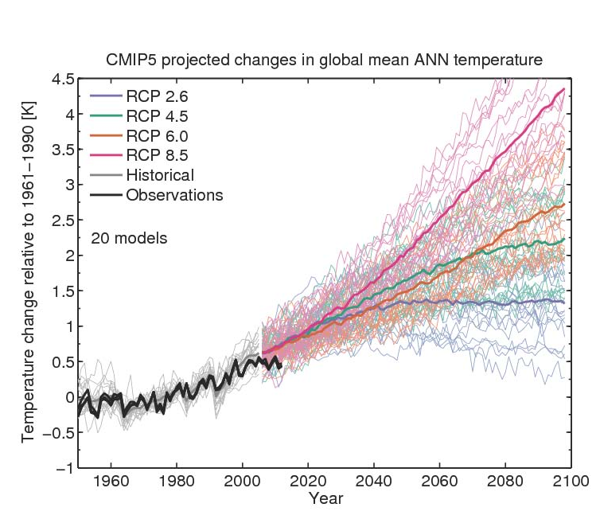
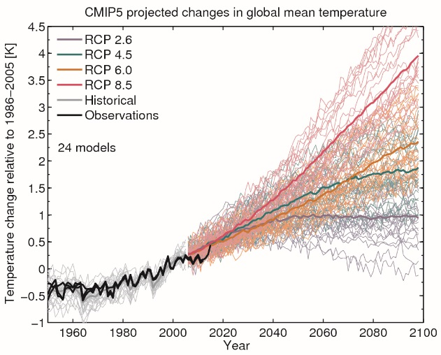
How much will planet warm?
Climate sensitivity and socioeconomic scenario
Climate sensitivity
By Ed Hawkins: see Climate Lab Book

Slide 17
COP21 Paris Climate Deal source: http://www.carbonbrief.org/analysis-the-final-paris-climate-deal
Target: global temperature well below 2ºC; efforts to limit to 1.5ºC
Mitigation: pursue policies aiming to achieve INDC climate pledges; subsequent pledges progressively more ambitious; global stocktake 2018 & then every 5 years; peak global greenhouse gas emissions “as soon as possible”; “balance” between emissions & sinks 2050-2100
Adaptation: $100bn/yr fund for developing countries: new collective quantified goal by 2025; periodic review of adaptive planning of Loss & damage has its own Article in the agreement — now on par with mitigation & adaptation; liability/compensation excluded.
Transparency: "facilitative, non-intrusive, non-punitive” system of review will track countries’ progress; emissions trading allowed; aviation/shipping not included
Treaty: deal enters force once 55+ parties, covering at least 55% of global emissions have signed up

Slide 18
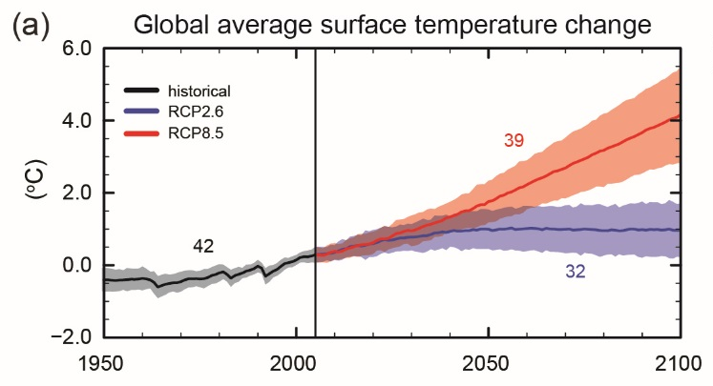
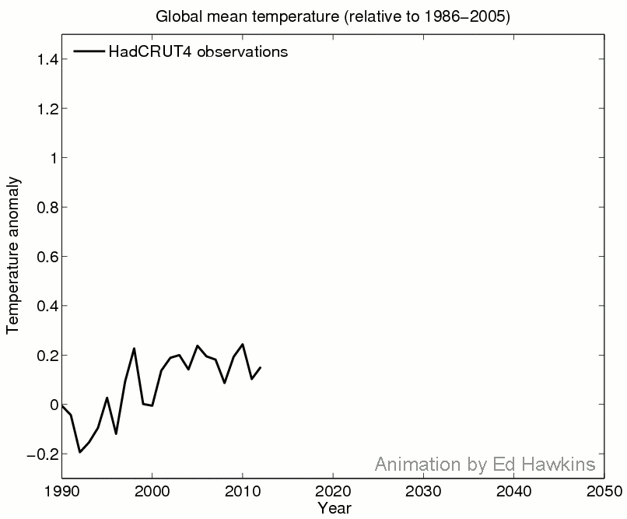
Implications for future
From Climate Lab Book blog (Ed Hawkins)

Slide 19
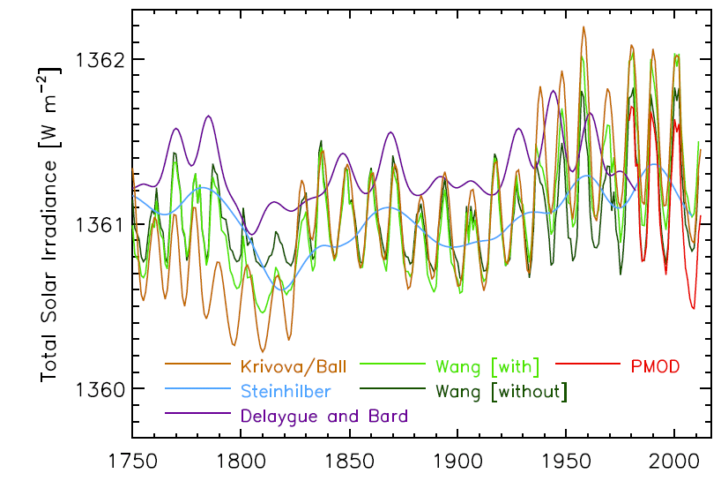
Changes in the sun
Solar “constant”
Figure 8.11 IPCC(2013) – Reconstruction of Total Solar Irradiance
See also: http://www.pmodwrc.ch/pmod.php?topic=tsi/composite/SolarConstant

Slide 20
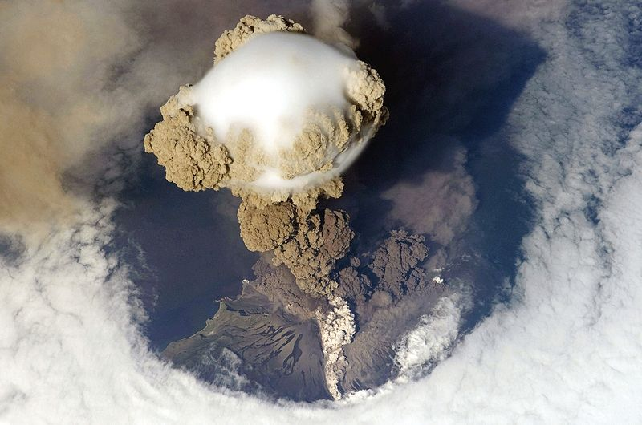
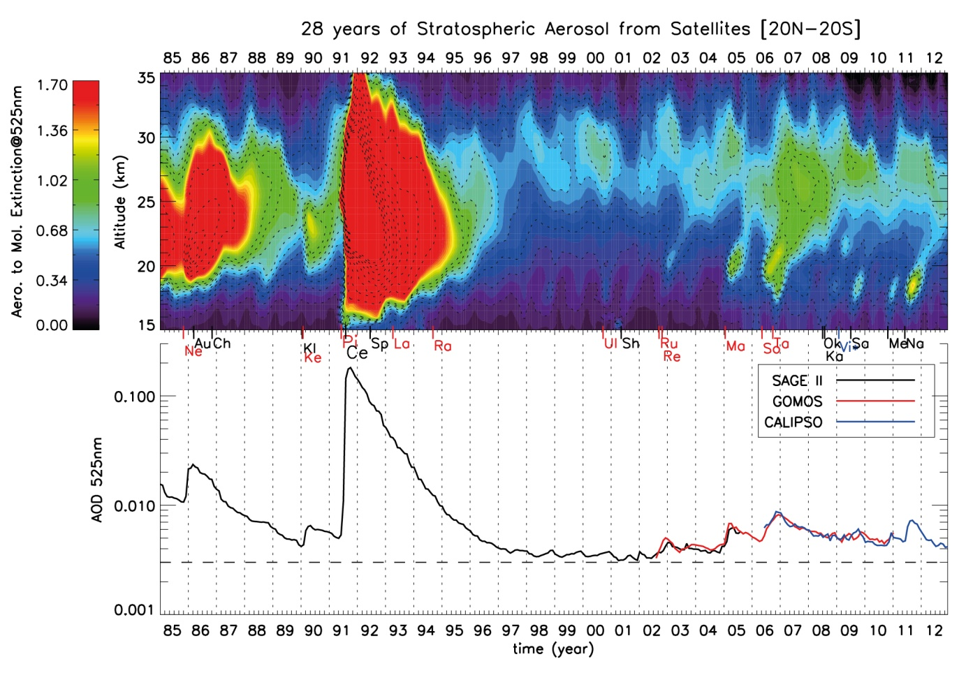
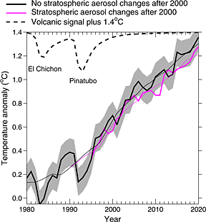
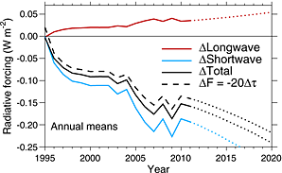
Cooling from small volcanos?
El Chichon Pinatubo
IPCC (2013) Fig. 8.13
Work by Solomon et al. (2011) Science; Vernier et al. (2011) GRL; Fyfe et al. (2013) GRL; Schmidt et al. (2014) Nature Geosci; Santer et al. (2014) Nature Geosci.

Slide 21
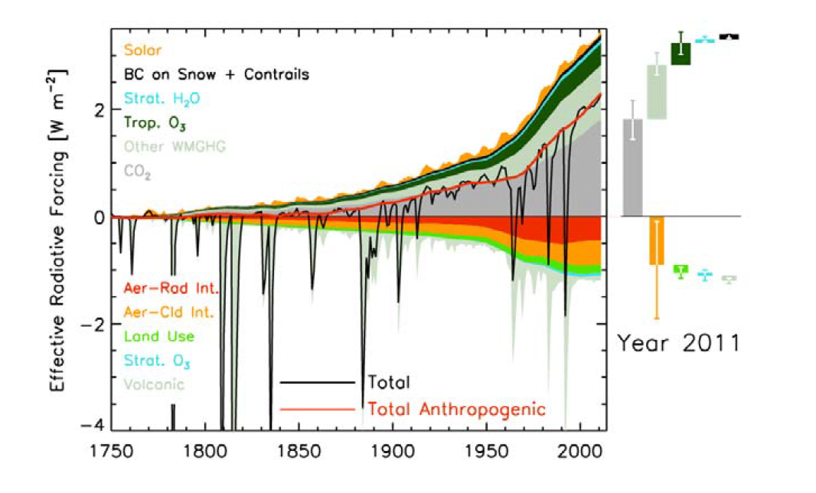
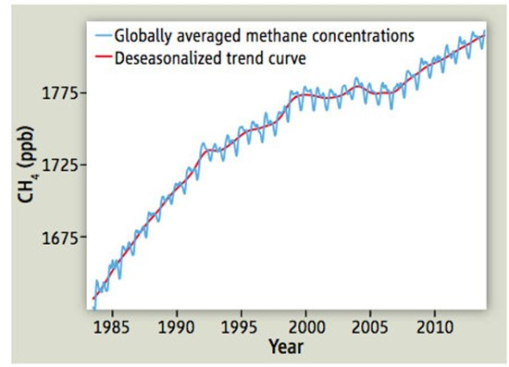
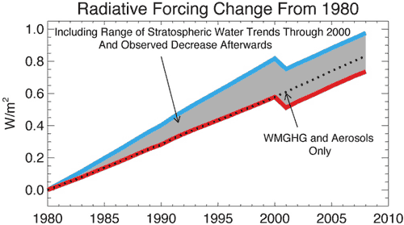
Changes in radiative forcing since 1750
IPCC (2013) Figure 8.18
Nisbet et al. (2014) Science on Methane
Solomon et al. (2010) Science on Stratospheric Water Vapour

Slide 22
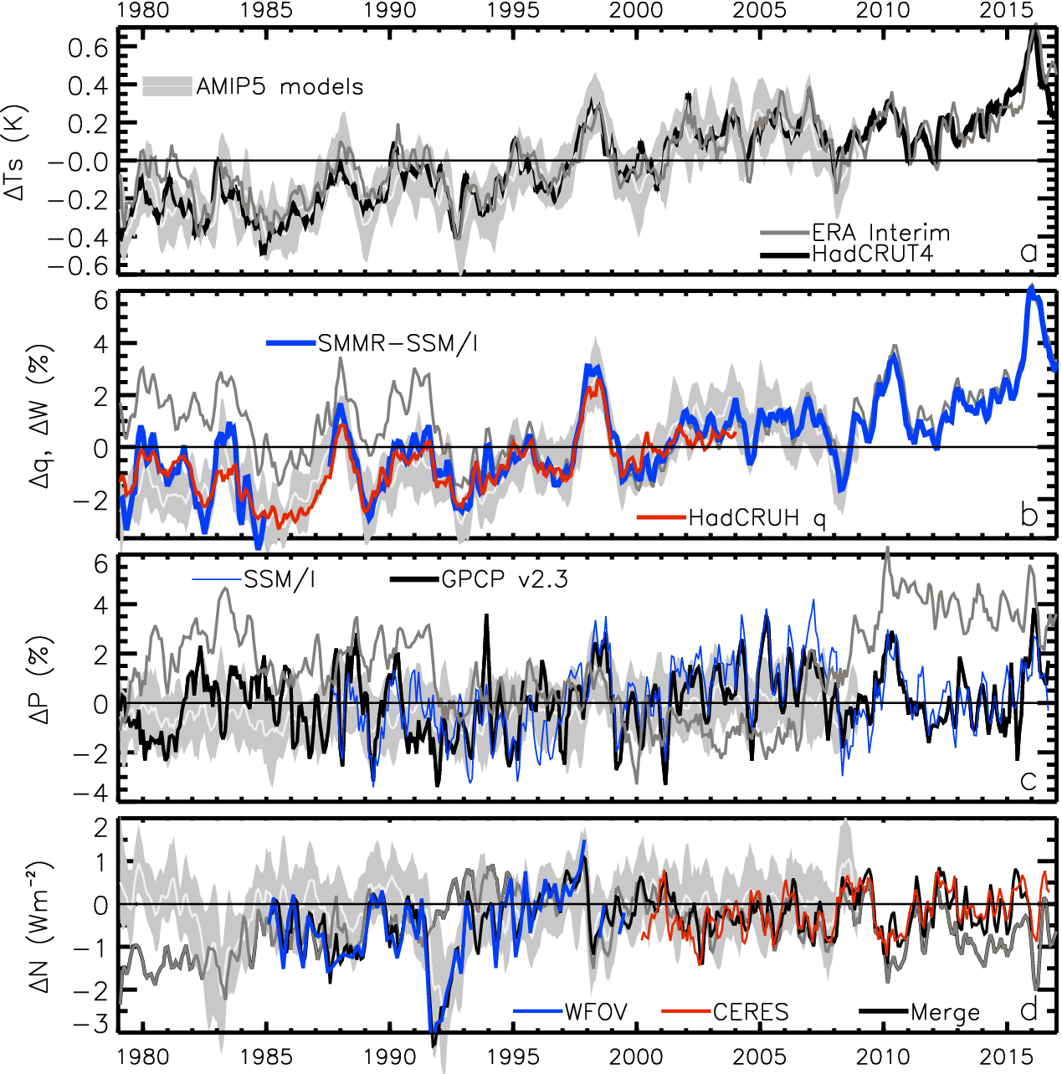
Earth’s global surface temperature & energy imbalance variability since the 1980s
TEMPERATURE anomaly (degC)
2.8
1.8
0.8
-0.2
-1.2
-2.2
ENERGY BUDGET anomaly (Wm⁻²)
Energy imbalance (Wm⁻²)

Slide 23
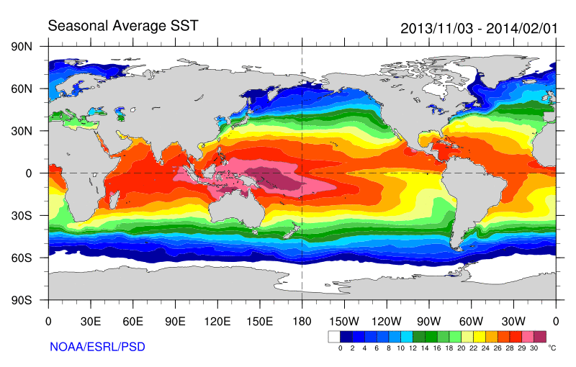
Role of Atlantic/Pacific Variability?
Radiative Forcing/Imbalance Johnson et al. (2016) ; Checa-Garcia et al. (2016) ; Huber & Knutti (2014) ;Santer et al. (2015) :
Continued heating from greenhouse gases
Aerosol forcing of circulation (Smith et al. 2016)
Unusual weather patterns (Ding et al. 2014; Trenberth et al. 2014b)
Pacific SST strengthens atmospheric circulation
Enhanced Walker Circulation
? Heat flux to Indian ocean Lee etal 2015
Increased sea height
Warm
Upwelling,
Cool water
Remote forcing from Atlantic:
Li et al. (2016) ;
McGregor et al. (2014)
Increased precipitation
Decreased salinity
Strengthening trade winds
Equatorial Undercurrent
Pacific dominates?
Mann et al. (2016) Kosaka & Xie (2013) England et al. (2014)
Enhanced mixing of heat below 100 metres depth by accelerating shallow overturning cells and equatorial undercurrent
See also: Merrifield (2010).; Sohn et al. (2013) .; L’Heureux et al. (2013) . Change; Watanabe et al. (2014) ; Balmaseda et al. (2013) ; Trenberth et al. (2014) .; Llovel et al. (2014) ;Durack et al. (2014) ; Nieves et al. (2015) ; Brown et al. (2015) JGR ; Somavilla et al. (2016) ; Liu et al. (2016)
Notes:
There is lots of new results focussing on the slower rates of surface warming and associated unusual climatic conditions at the beginning of the 21st century (see DEEP-C website: http://www.met.reading.ac.uk/~sgs02rpa/research/DEEP-C.html#PAPERS).

Slide 24
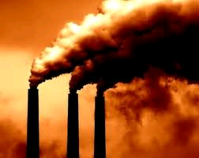
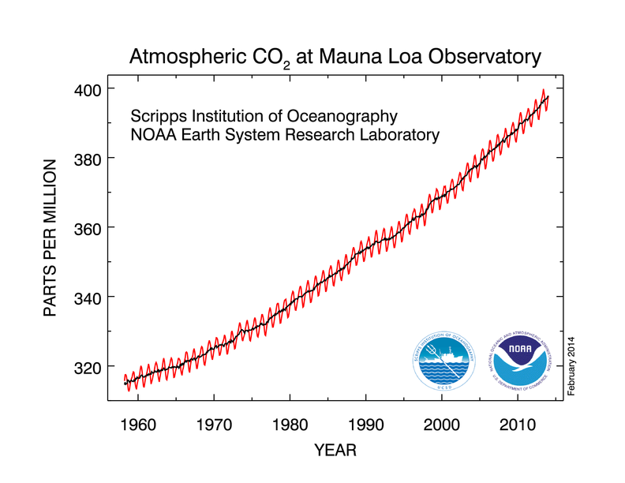
“Radiative forcing” of climate
Increased concentrations of greenhouse gases heat planet by reducing the efficiency at which Earth can cool to space
More small pollutant particles (aerosols) can cool the planet by reflecting sunlight
If more energy is arriving than is leaving the planet should heat up…

Slide 25
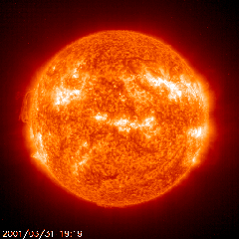
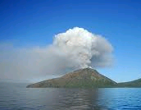
Have other factors offset warming from greenhouse gases?
The sun has weakened in the 2000s
There were a series of small volcanic eruptions causing reflection of sunlight
Particle pollution from Asia, changes in stratosphere water vapour, changes in Methane and sampling of temperature observations may also be important
Natural chaotic fluctuations in the ocean appear to play an important role

Slide 26
Weaker Solar Output?
IPCC: Solar Radiative Forcing change of –0.04 Wm⁻² from 1986 to 2008
~0.25 Wm⁻²
Solar Radiative Forcing
Hansen et al. (2013) PLOSONE; see also Kaufmann et al. (2011) PNAS

Slide 27
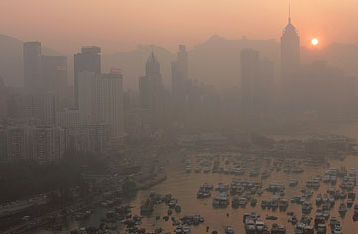
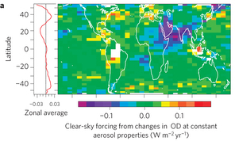
Has increased aerosol pollution refelected more sunlight back to space ?
Increased Asian aerosol offset by decreases elsewhere – little change in 2000s: Murphy (2013) Nature Geosci (below)
ALEX HOFFORD / EPA

Slide 28
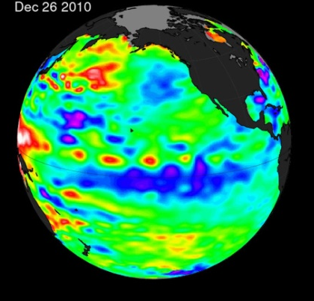
Conclusions
Heating of Earth continues mainly from rising greenhouse gas concentrations
A mixture of factors (mostly natural) have offset some of this heating since 2000 (weaker sun, small volcanoes, …)
Pacific ocean circulation currently mixing more heat below surface layers explaining lack of surface warming
Fascinating science: the climate system is complex and will continue to surprise us but the implications of burning fossil fuels are clear
More links on DEEP-C website

Slide 29
Introduction
Climate has always changed
Humans are now influencing Earth’s climate
How much will climate change in the future and how will it affect societies?
To answer this we need to monitor and understand current climate change
For example, did global warming pause at the beginning of the century and if so, why?

Slide 30

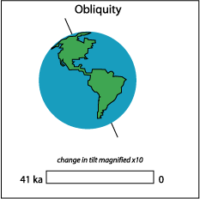
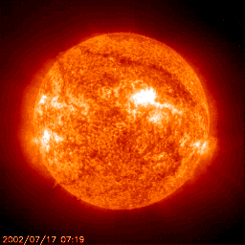
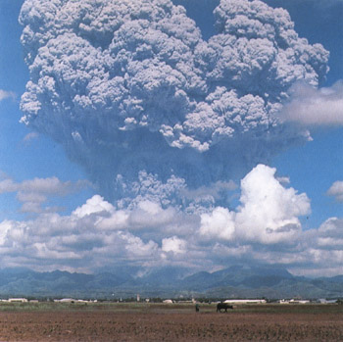
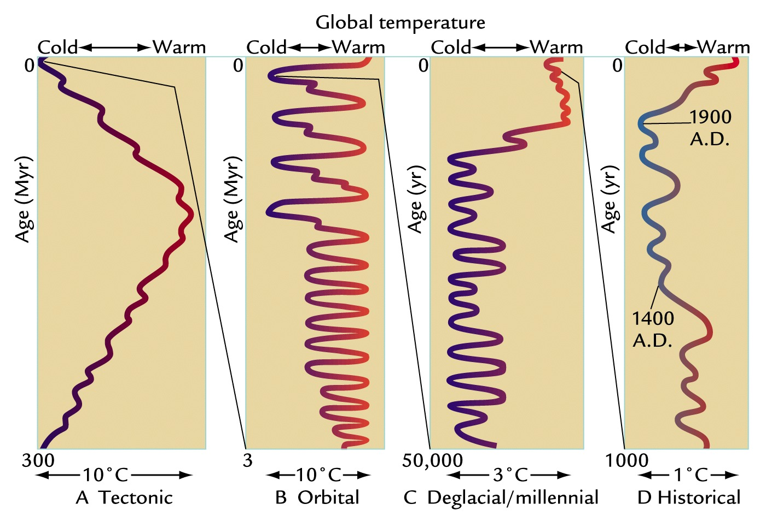
Earth’s Climate has always been changing
Notes:
Climate changes on all time-scales. One of the most important determinants of climate is variations in the absorption of solar radiation by the planet.
Over billions of years the solar output has increased with time, as has the evolution of the Earth’s atmosphere and distribution of land and ocean which modifies the efficiency at which the Earth can cool to space via thermal/long wavelength radiation as well as impacting absorption of sunlight.
Over tens and hundreds of thousands of years, changes in the Earth’s orbit around the sun alter the amount of solar radiation reaching different parts of the planet. These cycles are predictable (they depend upon the gravitational pulls of the sun, planets and the moon) and they are widely believed to have caused glacial-interglacial cycles in which global temperatures swing by up to 10ºC. However, crucial to these swings are feedbacks which either amplify or dampen the radiative forcing from these Milankovic cycles. For example, cooler temperatures lead to more ice and greater reflection of solar radiation which amplifies the cooling.

Slide 31
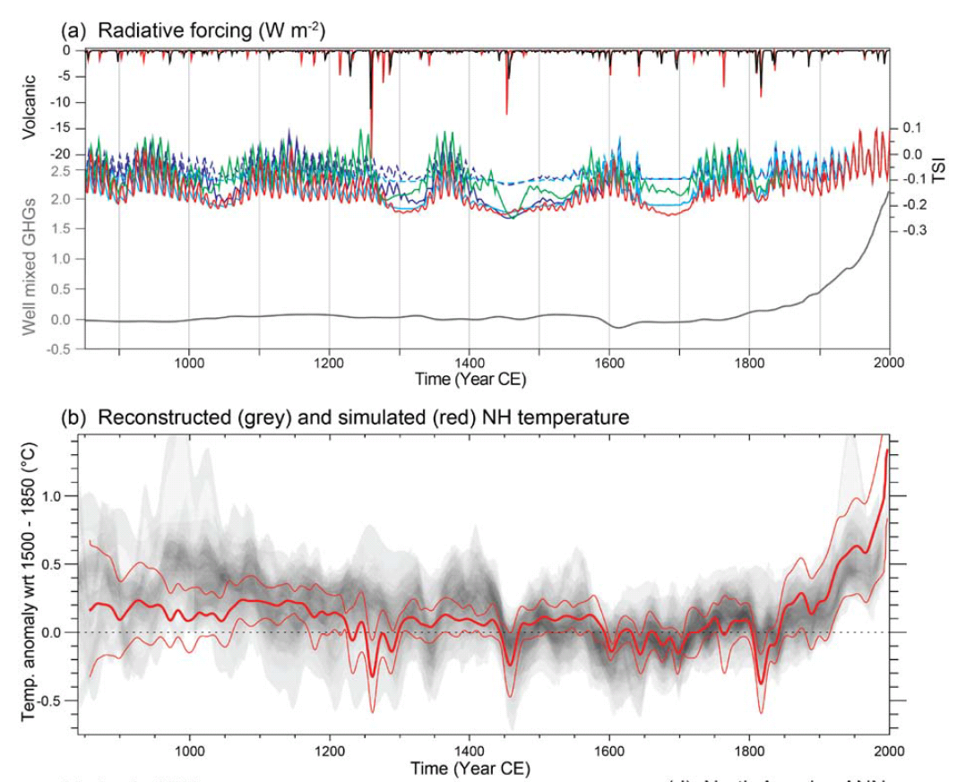
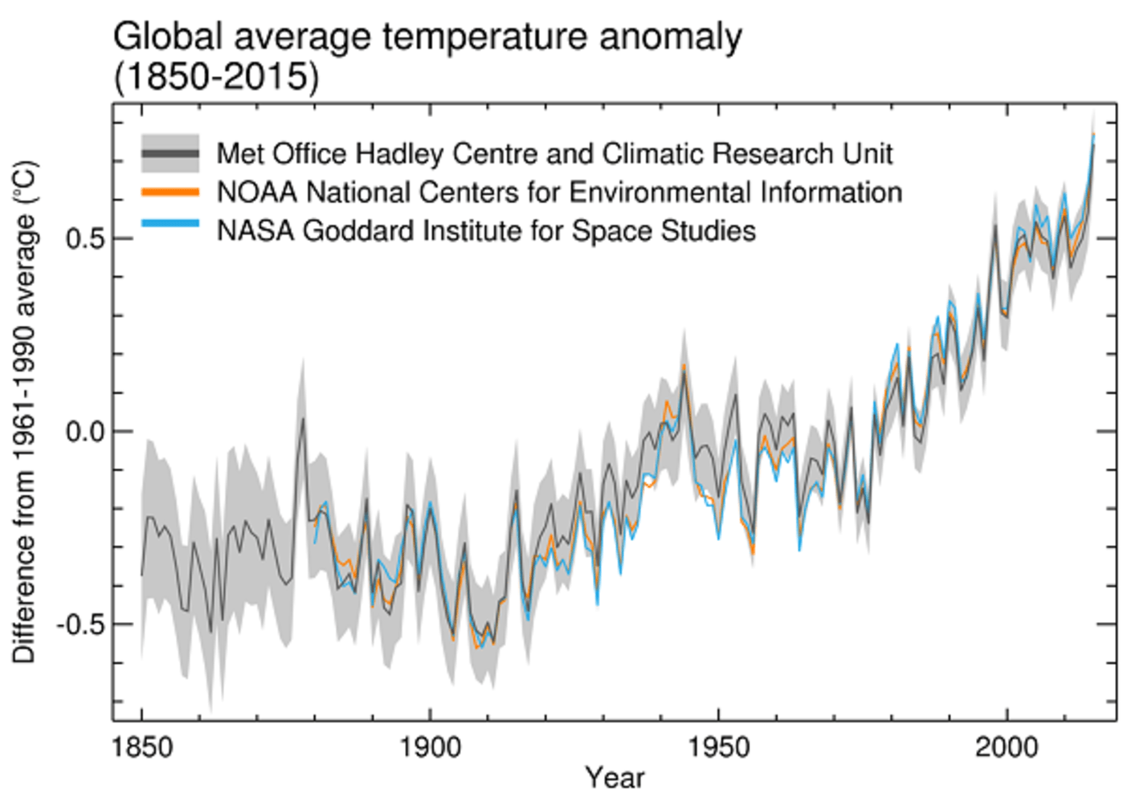
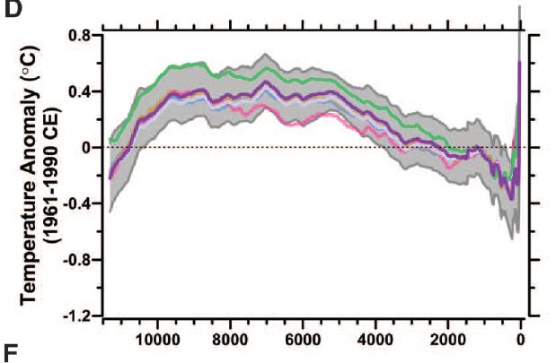
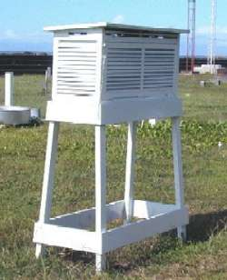
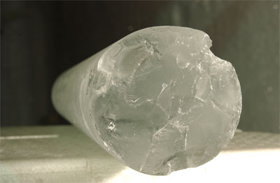
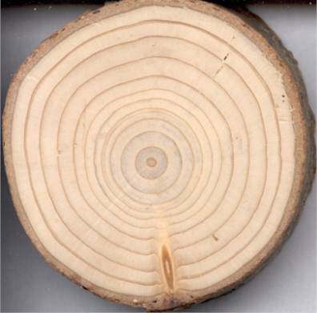
Northern Hemisphere, Proxies IPCC (2013) Tech. Summary, Box TS.5
GLOBAL, Instrumental
Northern hemisphere proxies
Indirect (or “proxy”) observations must be used to piece together past climate. These help us to understand how climate has changed in the past and put current direct observations (top right) in context
GLOBAL, proxies, Marcott et al. (2013) Science

Slide 32
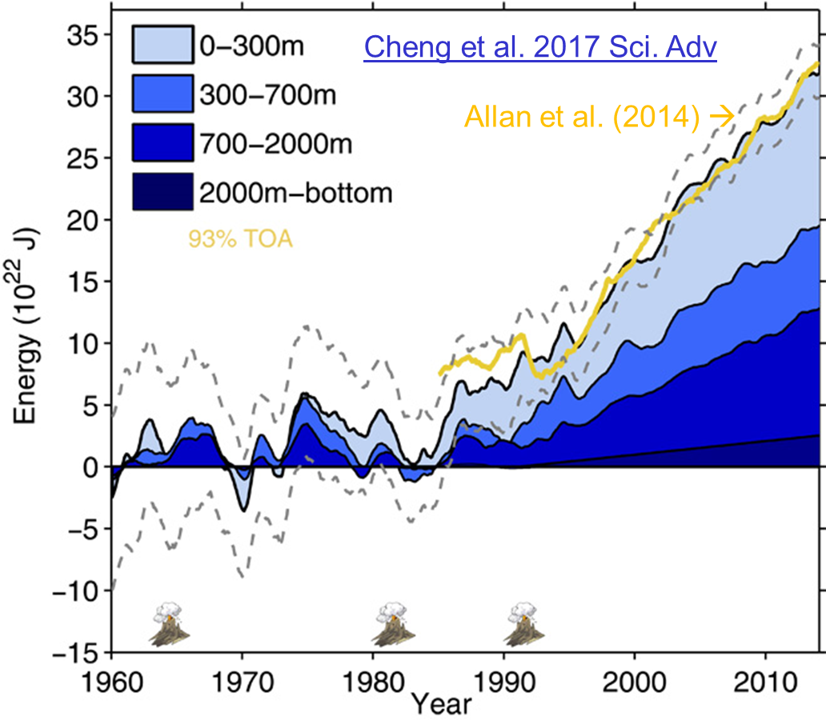
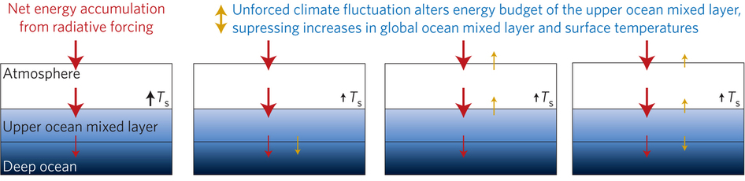
Improved global energy imbalance estimates
More accurate global imbalance from ocean and satellite observations: Cheng et al. 2017:
Steady decadal ocean heating since 2000: 0.6-0.8 Wm⁻² (Johnson et al. 2016)
Radiative forcing/internal variability influence TOA radiation (Palmer/ McNeall 2014; Allan et al. 2014; Huber/Knutti 2014; Xie/Kosaka 2017)
Upper ocean heat budget explains surface temperature: Hedemann et al. 2017 NatureCC
Allan (2017) Nature Climate Change
Notes:
Improved and longer records of ocean heating and top of atmosphere radiation measurements have improved estimates of Earth’s energy imbalance and its changes over recent decades.
Simulations with prescribed observed SST and radiative forcing are able to capture variations in energy budget
Greater appreciation for the role of internal variability in influencing global energy budget and the link between energy imbalance and surface temperature via heat budget of upper ocean

Slide 33
Inter-hemispheric energy imbalance/transport and precipitation biases in CMIP5 models
Observed inter-hemispheric imbalance in Earth’s energy budget 2000-15 (Liu et al. submitted update of Loeb et al. (2016) Clim. Dyn using Roemmich et al. (2015) Nature Climate ocean heating)
Implied ocean heat transport less than Loeb et al. (2016) & Frierson et al. 2013
Cross-equatorial heat transport by atmosphere & hemispheric precipitation asymmetry linked
Loeb et al. (2016) Clim. Dyn
See also: Haywood et al. (2016) GRL;
Hawcroft et al. (2016) Clim. Dyn.
Notes:
Combining top of atmosphere energy buget and reanalysis horizontal energy transports allows new estimates of global surface energy budget
This has enabled advances in observing/understanding inter-hemispheric energy imbalance/transports and precipitation and links to model biases
Many CMIP5 models contain gross errors in cross equatorial energy fluxes which coincide with incorrect depiction of hemispheric precipitation asymmetries offering a potential constraint on climate models

Slide 34
Global energy budget: advances/questions
More accurate multi-decadal global estimates of Earth’s energy budget and its variability (e.g. Cheng et al. 2017 Sci. Adv.; Allan et al. 2014 GRL)
  Better indicator of global climate change than surface temperature but gaps in observing deep ocean (e.g. Palmer 2017 CCCR)
  Link to observed cloudiness? e.g. Norris et al (2016) Nature
Link between energy imbalance and surface warming depends on energy budget of upper mixed ocean layer (Roberts et al. 2015 JGR; Hedemann et al. 2017 Nature Climate Change; Xie & Kosaka 2017 CCCR)
  Better appreciation of mechanisms of decadal global climate variability
Distinct feedbacks on internal variability/forced change (Brown et al. 2016 J. Clim; Xie et al. 2015 Nature Geosci; Zhou et al. (2016) Nature Geosci
  Obs. estimates of climate sensitivity (Richardson et al. (2016) Nature Climate)
  Spatial patterns of warming crucial (Gregory and Andrews (2016) GRL)
  What explains decreased heating of E Pacific and is it realistic?
Advances in observing/understanding inter-hemispheric energy imbalance/transport and links to CMIP5 precipitation biases (Frierson et al. 2013; Loeb et al. 2016 Clim. Dyn; Stephens et al. 2016 CCCR)
  Possible constraint on realism of climate models (Haywood et al. (2016) GRL)

Slide 36
Changes in global water cycle
WATER VAPOUR anomaly (%)
PRECIPITATION anomaly (%)

