Slide 1




Current changes in Earth’s ENERGY imbalance 1985-2014
Department of Meteorology
Richard Allan r.p.allan@reading.ac.uk @rpallanuk
Thanks to Chunlei Liu, Norman Loeb and all co-authors

Slide 2
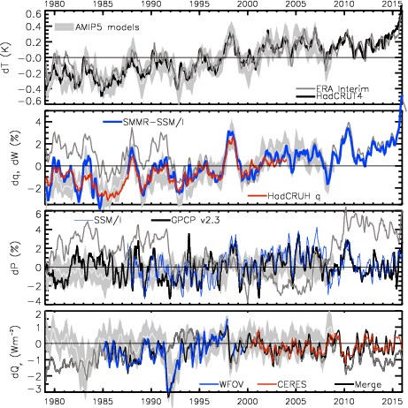
surge
slowdown
Current
climate
Change
through
surge and
slowdown
HEATING (Wm⁻²) PRECIP (%) MOISTURE (%) TEMPERATURE (K)
Update from Allan et al. (2014) Surv. Geophys & Allan et al. (2014) GRL
2.8
1.8
0.8
-0.2
-1.2
-2.2
Earth’s energy imbalance (Wm⁻²)

Slide 3
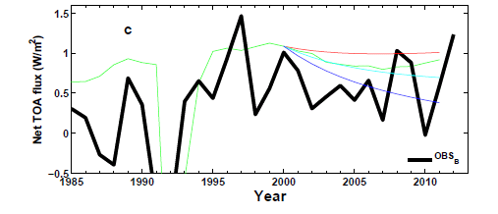
Interpreting changes in net imbalance
+ve RF trend
AR5 RF
zero RF trend
-ve RF trend
N
N=ΔF–YΔT_{s}
Analysis using simple energy balance model Allan et al. (2014) GRL supplementary
ΔT_{s}
D
ΔT_{D}
See also Checa-Garcia et al. (2016) ERL

Slide 4
Discrepancy between radiation budget & ocean heating
Large ocean heating anomaly in 2002
Inconsistent with radiation budget observations and simulations
Changing observing system influence?
Slight drop in net flux 1999-2005?
Smith et al. (2015) GRL

Slide 5
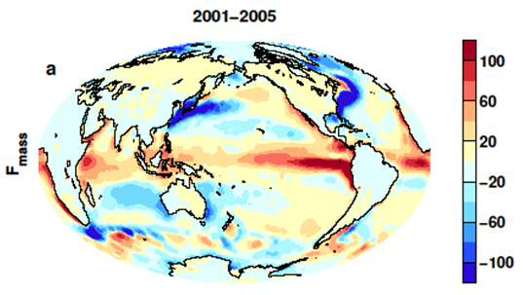
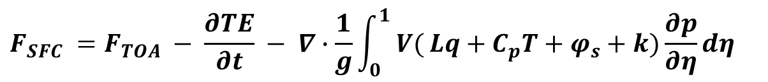
Where is the heat going?
New Estimates of surface energy flux
$$F_{SFC} =F_{TOA} − \frac{∂TE}{∂t} − ∇∙\frac{1}{g}\int_{0}^{1}{ V(}Lq+C_{p}T+φ_{s}+k)\frac{∂p}{∂η}dη$$
CERES/Argo Net Flux
Estimate horizontal energy flux
Surface Flux
Net surface downward energy flux (Wm⁻²)
Liu et al. (2015) JGR

Slide 6
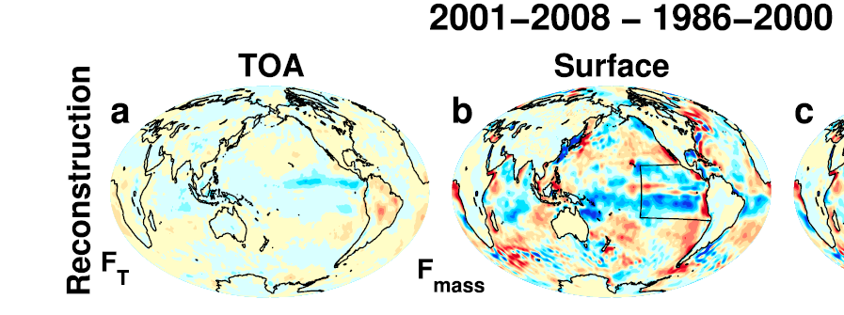
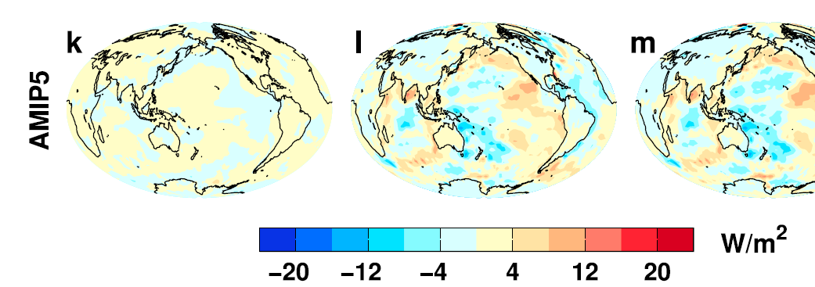
Where is the heat going? changes in surface energy flux
Changes in energy fluxes 1986-2000 to 2001-2008
Surface energy flux dominated by atmospheric transports
Contrasting model pattern of change, realistic? e.g. He & Soden (2016) J. Clim
Are reanalysis transports reliable?
Liu et al. (2015) JGR

Slide 7
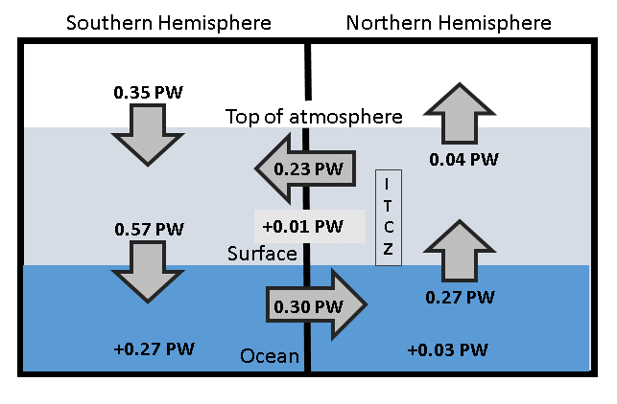
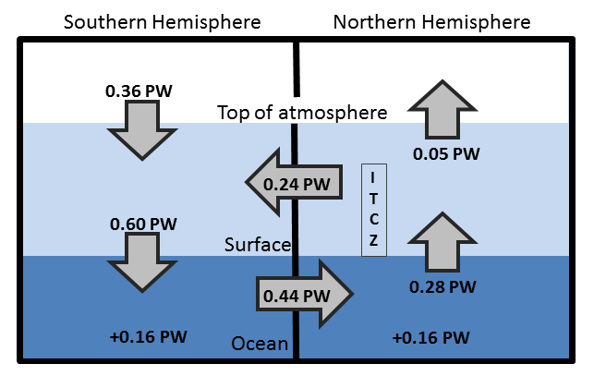
Updated observed energy budget asymmetry
Updated from Loeb et al. (2016) Clim. Dyn. For 2000-2015 based on Liu et al. (2015) JGR
see also Stephens et al. (2016)
Observed inter-hemispheric imbalance in Earth’s energy budget
Use asymmetric ocean heating observed by Roemmich et al. (2015) Nature Climate and Purkey & Johnson (2010)
Derive implied ocean heat transport: smaller that Loeb et al. (2015) and Frierson et al. 2013 (0.44 PW) – unrealistically so?

Slide 8
conclusions
Heating of Earth continues at rate of ~0.6-0.8 Wm⁻²
  Manifest as positive imbalance in Southern Hemisphere
  Variability from radiative forcings & ocean internal changes
What are pathways/mechanisms for ocean heat uptake?
Toward reconciled ocean heating & radiation budget changes
  are realanysis energy transports reliable?
  do climate models capture internal variability & coupling?
Do feedbacks amplify/extend hiatus/surge events?
  e.g. Brown et al. (2016) J. Clim ; Kosaka and Xie (2013) Nature, etc
See also poster by Chunlei Liu on DEEP-C surface and TOA energy budget products
See DEEP-C website for data and links to journal paper:
http://www.met.reading.ac.uk/~sgs02rpa/research/DEEP-C.html
Peter Hill: talk on clouds, radiation & precipitation in west Africa (DACCIWA project)

Slide 10
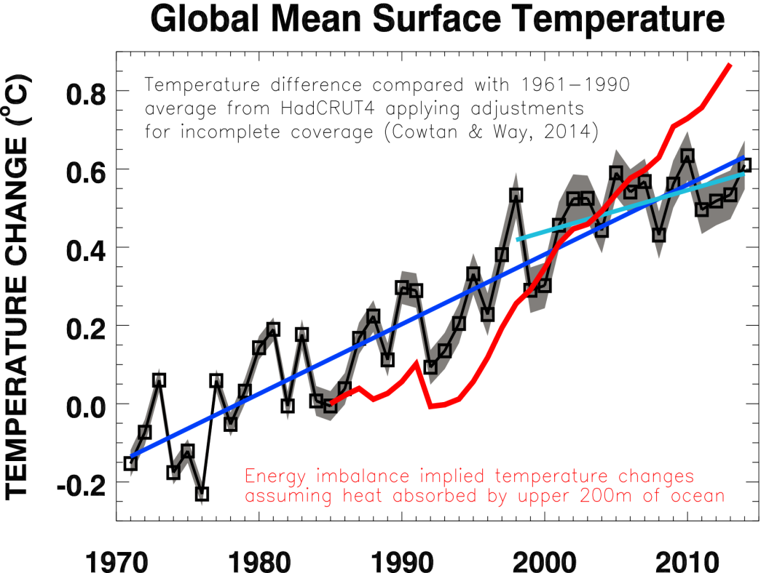
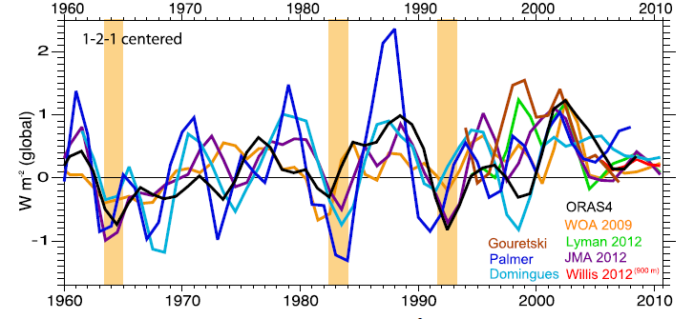
At what rate is Earth heating?
What are implications for climate sensitivity and the global water cycle?
Upper ocean heating rate (Wm⁻²)
Harries & Belotti (2010) J. Clim | Loeb et al. (2012) Nat. Geosci | Trenberth et al. (2014) J Clim

Slide 11
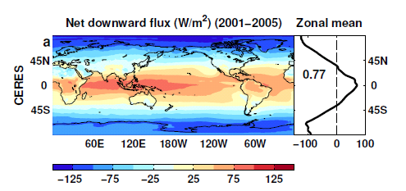
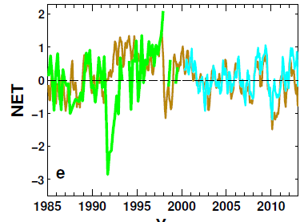
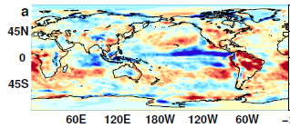
Reconstructing global radiative fluxes since 1985
ERBS/CERES variability
CERES monthly climatology
ERBS WFOV
CERES
ERA Interim
ERA Interim spatial anomalies
Combine CERES/ARGO accuracy, ERBS WFOV stability and reanalysis circulation patterns to reconstruct radiative fluxes

Slide 12
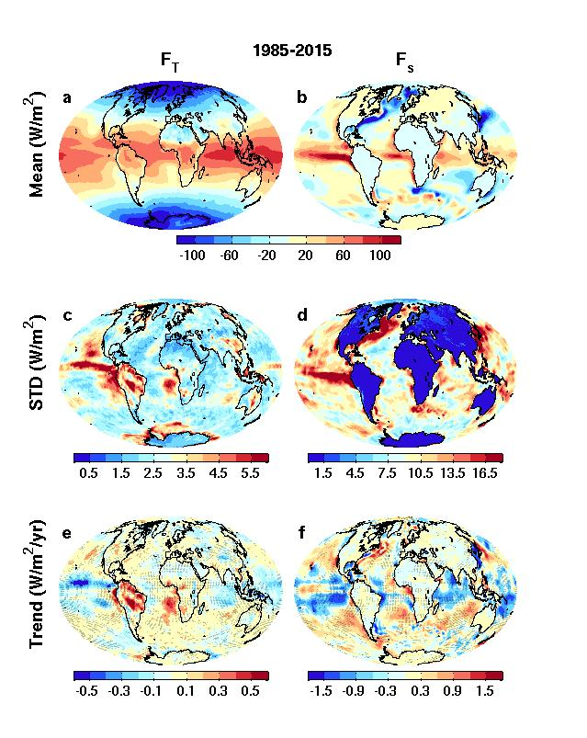
Net energy flux & trends
Top of atmosphere Surface

Slide 13
Net Imbalance Anomaly (Wm⁻²)
Earth continues to heat up
Imbalance: 0.23 0.00 0.78 0.63 0.63 (Wm⁻²)
0.34±0.67 Wm⁻²
0.62±0.43 Wm⁻²
La Niña
El Niño
Volcano
Allan et al. (2014) GRL

Slide 14
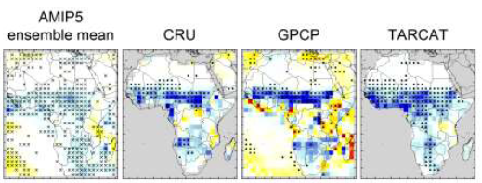
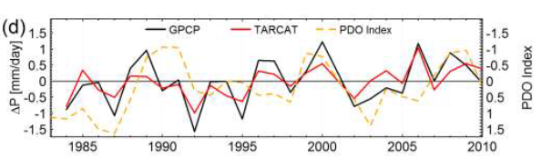
TAMSAT projects:
Recent trends in africa rainfall
Evaluating and understanding recent changes in Africa rainfall (Ross Maidment, Emily Black)
PhD project extending this work: changes in impact-relevant metrics for Africa (Caroline Dunning, Emily Black)
Maidment et al. (2015) submitted

Slide 15
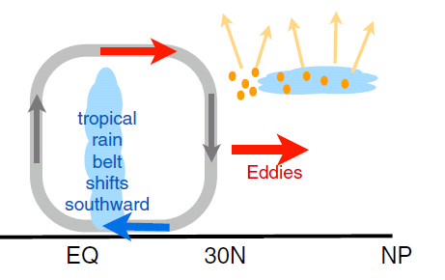
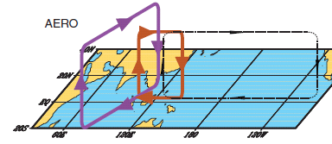
earth’s energy budget & regional changes in the water cycle
Regional precipitation changes sensitive to asymmetries in Earth’s energy budget
N. Hemisphere cooling: stronger heat transport into hemisphere
Reduced Sahel rainfall from:
Anthropogenic aerosol cooling 1950-1980s: Hwang et al. (2013) GRL →
Asymmetric volcanic forcing e.g. Haywood et al. (2013) Nature Climate
Enhanced energy transport
cooling
Sulphate aerosol effects on Asian monsoon e.g. Bollasina et al. 2011 Science (left)
Links to drought in Horn of Africa? Park et al. (2011) Clim Dyn
GHGs & Sahel rainfall recovery?
Dong & Sutton (2015) Nature Clim.

Slide 16
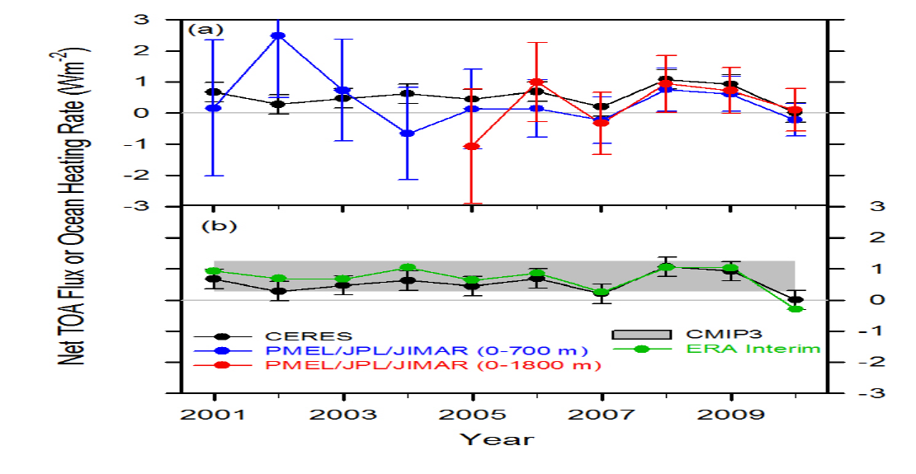
Combining Earth Radiation Budget and Ocean Heat Content data (2)
Replotted so that CERES and ERA Interim sample 6-months later than ARGO
Is there a lag in the system?
Where in ocean is energy accumulating?
Mechanism?
Notes:
Fi gure 3 (a) Global annual average net TOA flux from CERES observations and (b) ERA Interim reanalysis are anchored to an estimate of Earth’s heating rate for 2006–2010 ⁵ The Pacific Marine Environmental Laboratory/Jet Propulsion Laboratory/Joint Institute for Marine and Atmospheric Research (PMEL/JPL/JIMAR) ocean heating rate estimates⁴ use data from Argo and World Ocean Database 2009; uncertainties for upper ocean heating rates are given at one-standard error derived from sampling uncertainties. The gray bar in (b) corresponds to one standard deviation about the 2001–2010 average net TOA flux of 15 CMIP3 models.

Slide 17
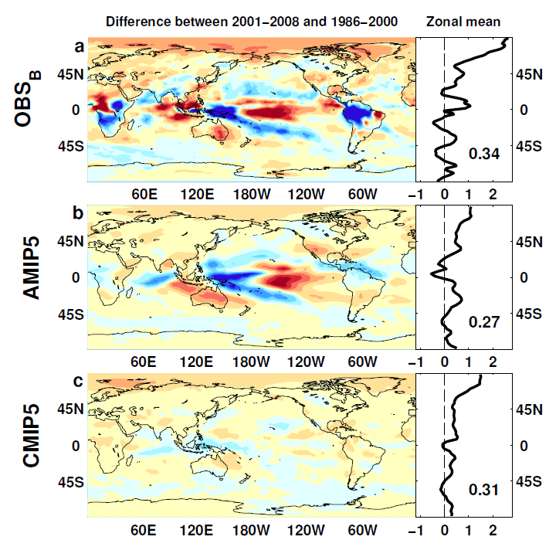

Outgoing Longwave Radiation
Wm⁻²

Slide 18
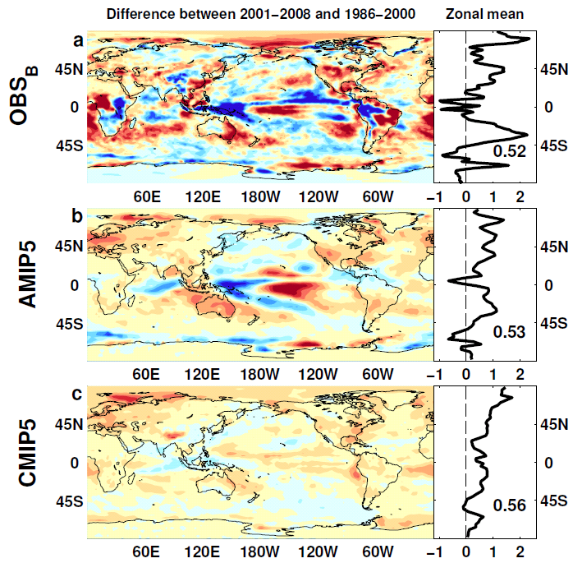
Absorbed Shortwave Radiation
Wm⁻²

Slide 19
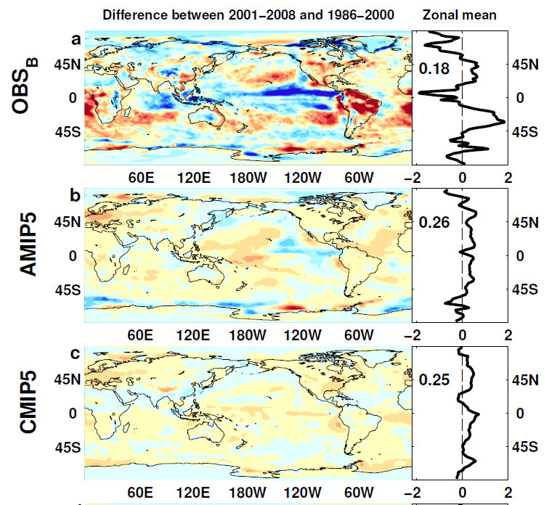

NET Radiation

Slide 20
lw & sw fluxes

