Slide 1




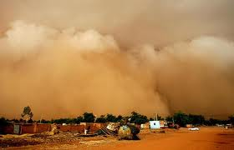
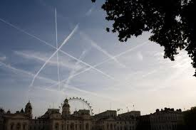
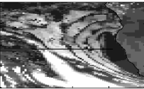
Using Geostationary Earth Radiation Budget data to evaluate global models and radiative processes
Richard Allan
Department of Meteorology, University of Reading
1
© University of Reading 2012
Notes:
1

Slide 2
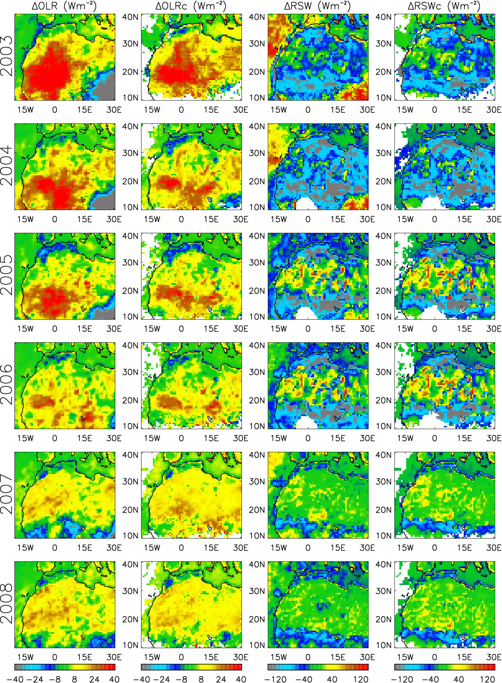
Mineral dust and surface albedo (model-GERB bias, Wm⁻²)
LW LW_{clear} SW_{clear}
Progressive reduction in model biases through continual evaluation and improvement
From Allan et al. (2011) QJRMS

Slide 3
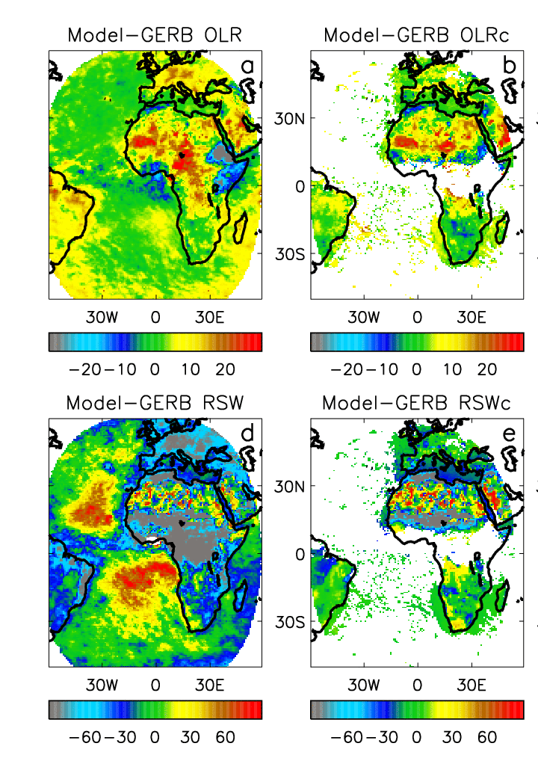
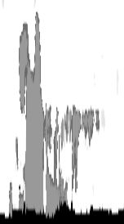
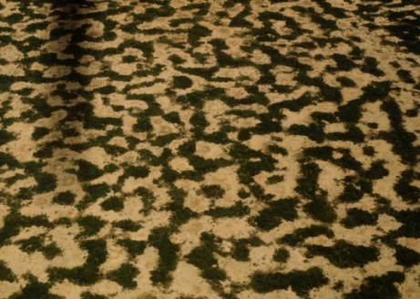
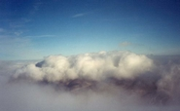
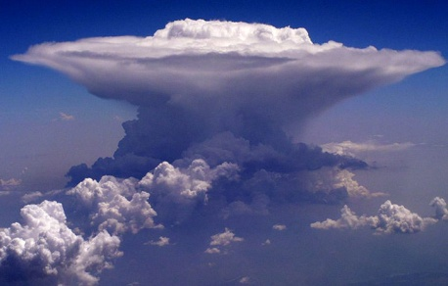
Contrail Cirrus
All-sky Clear-sky
Radiative biases in Met Office global NWP model
Mineral dust
Shortwave Longwave
Convective outflow
Surface albedo
Convective cloud
Marine stratocumulus

Slide 4
All-sky Clear-sky
Radiative biases in Met Office global NWP model
Contrail Cirrus
Haywood et al. (2009)
Mineral dust
Haywood et al. (2005)
Slingo et al. (2006)
Allan et al. (2011)
Shortwave Longwave
Milton et al. (2008)
Allan et al. (2005)
Convective outflow
Surface albedo
Allan et al. (2007)
Gruelle et al. (2011)
Convective cloud
Pearson et al. (2010)
Marine stratocumulus
Energy Balance
Allan (2011)
Notes:
References:
Tropical Convection:.; Allan et al. (2007) QJRMS; Gruelle et al. (2011) J App Met
Surface Albedo: Allan et al. (2005) JGR; Allan et al. (2007) , Milton et al. (2008)
Energy budget: Allan (2011) Met Apps
Contrails: Haywood et al. (2009) J Geophys Res
Mineral Dust: Haywood et al. (2005) JGR, Slingo et al. (2006) GRL; Allan et al. (2010) QJRMS

