Slide 1





Radiative constraints on current and future changes in the global water cycle
Richard P. Allan r.p.allan@reading.ac.uk @rpallanuk
Department of Meteorology, University of Reading, UK
Thanks to: Chunlei Liu, Matthias Zahn, Norman Loeb, Brian Soden, Viju John
Notes:
30 mins + 10 minutes (20-25 slides?)
Energy balance (briefly)
Global precipitation
EBM – fast/slow responses
Andrews, etc
include Moyet study, Wu as well
Implications for global circulation
Inc Chadwick, Bony, …
Intense rainfall, wet dry regions…
Links to regional energy budgets (Muller & O’Gorman, Levermann)
Observational evidence?
Links to hiatus?

Slide 2
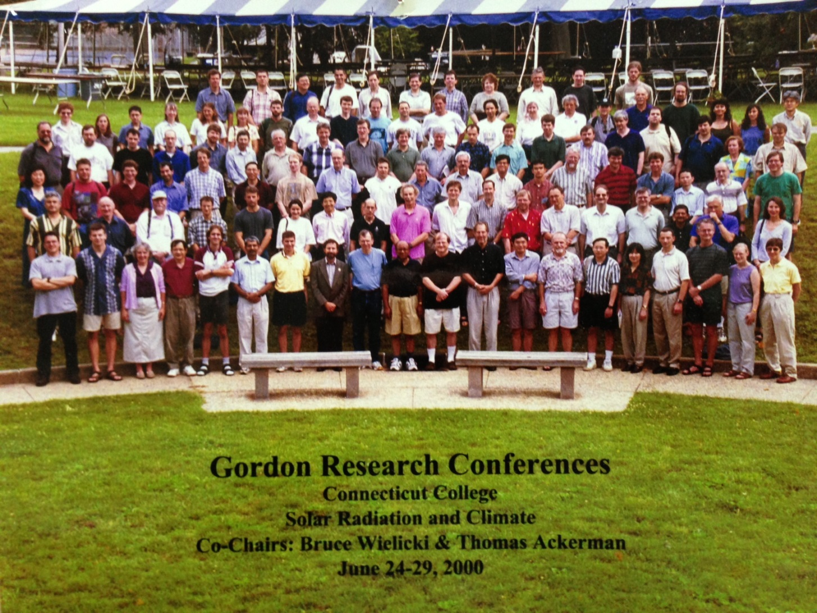
Young(er) scientists!
Troublemakers
V. Ramaswamy

Slide 3
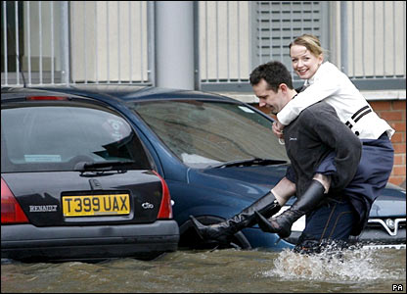
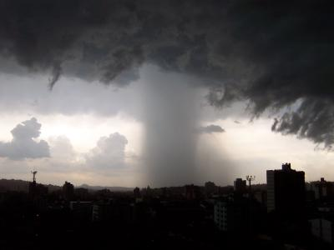
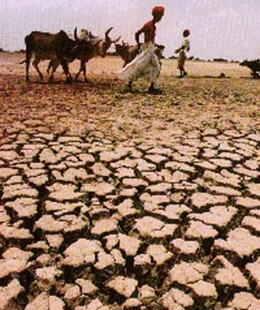
Introduction
“Observational records and climate projections provide abundant evidence that freshwater resources are vulnerable and have the potential to be strongly impacted by climate change, with wide-ranging consequences for human societies and ecosystems.” IPCC (2008) Climate Change and Water
Notes:
3
Intro stuff – current understanding of the nature and importance of the problem: the water cycle is changing and vulnerability is inevitable…
Model projections/intro
Water vapour
Intense rainfall events
Evaporation
Soil Moisture
Precipitation and extremes
Anticipated large-scale responses
Toward regional responses
Unanswered questions

Slide 4
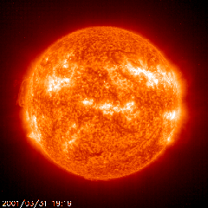

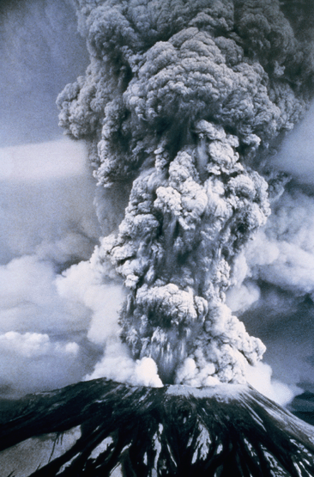
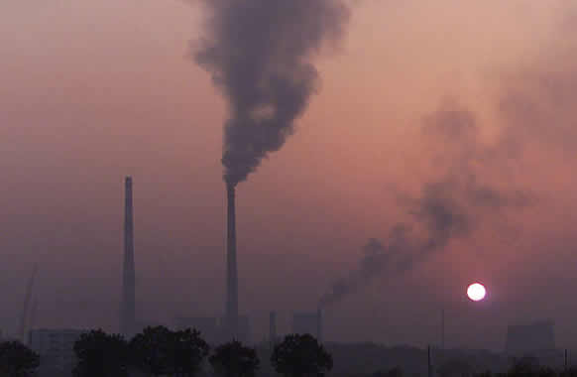
How will global precipitation respond to climate change?
Observations
Simulations:
Simulations:
RCP 8.5
Historical
RCP 4.5
Allan et al. (2013) Surv. Geophys
See also Hawkins & Sutton (2010) Clim. Dyn
Notes:
4
There is huge uncertainty in global precipitation projections, relating both to climate sensitivity and mitigation pathways.

Slide 5
Climate model projections
Precipitation Intensity
Increased Precipitation
More Intense Rainfall
More droughts
Wet regions get wetter, dry regions get drier?
Regional projections??
Dry Days
Precipitation Change (%)
IPCC WGI (2007)

Slide 6
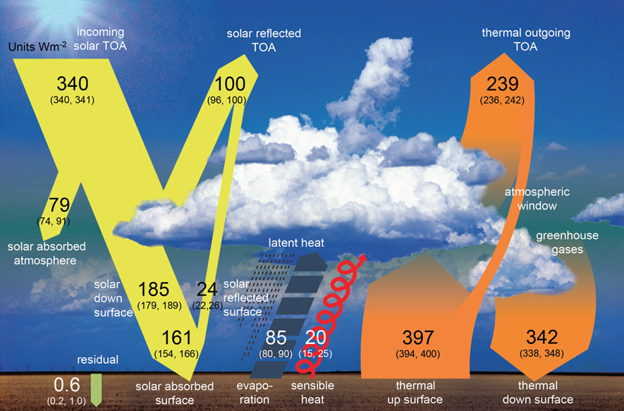
Earth’s Energy Budget & the Global Water Cycle
Wild et al. (2012) Clim. Dynamics (see talk Tuesday!). Also: Trenberth et al. (2009) BAMS

Slide 7
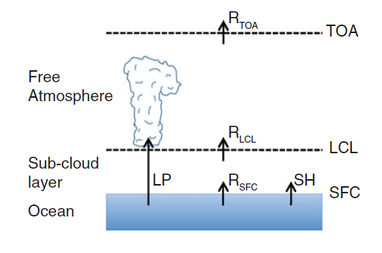
Radiative energy budget of the atmosphere and hydrological response
Adjustments in latent heating LP (precipitation) for change in radiative energy budget ΔR above LCL (lifting condensation level)
ΔR below LCL → adjustments in SH (sensible heat flux) important
O’Gorman et al. (2012) Surv. Geophys; after Takahashi (2009) JAS.
See also Manabe & Wetherald (1975) JAS

Slide 8

Models simulate robust clear-sky radiation response to warming (~2-3 Wm⁻²K⁻¹) and resulting increase in latent heating (precipitation) to balance (~2 %K⁻¹) e.g. Lambert & Webb (2008) GRL; Stephens & Ellis (2008) J. Clim;
Allan (2009) J. Clim
Radiative cooling clear Wm⁻²K⁻¹
LW_{TOA} LW_{SFC} LW_{ATM} SW_{ATM}
Also: Previdi (2010) ERL
Huang et al. (2013) J Clim
NCAS-Climate Talk
15th January 2010

Slide 9

Evaporation
Richter and Xie (2008) JGR
“Clausius Clapeyron”
Wind T_{s}-T_{o} RH_{o}
“Muted” Evaporation changes in models are explained by small adjustments in Boundary Layer:
1) declining wind stress
2) reduced surface temperature lapse rate (T_{s}-T_{o})
3) increased surface relative humidity (RH_{o})
NCAS-Climate Talk
15th January 2010
Notes:
9
Evaporation increases more slowly than moisture in the models due to reductions in wind stress, increases in surface stability and increases in low-level relative humidity. In situ and satellite observations will be key in determining the realism of this response. There are also obvious links to ocean fluxes including Keith Haines’ work.

Slide 10
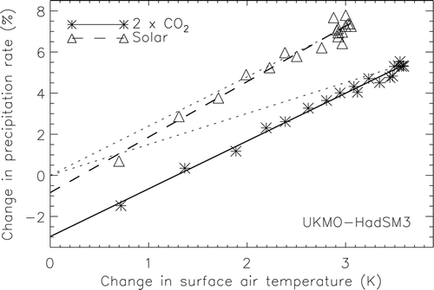
Direct influence of radiative forcing and climate response on precipitation changes
Andrews et al. (2009) J Climate
Notes:
10
CO2 heats the atmosphere increasing stability and reducing precipitation while solar changes have a smaller effect. While the model response to temperature increases in consistent, based upon the enhanced net radiative cooling of a warmer atmosphere, the response of the water cycle to a complex pattern of forcing is less clear. Observations of surface and top of atmosphere radiation from CERES and GERB will address this question.

Slide 11


Fast precipitation adjustments to contrasting radiative forcing
See also poster by Sun & Moyer at this meeting!
↑CO2 heating
↑Ta, ↑Q
↑Ta, ↑stability
↓P
↓E
↑Q
↑P:
dP/dT < 2%/K
↑P:
dP/dT ~ 2%/K
↑E…?
heating: ↑T
heating: ↑T
See Cao et al. 2012 ERL for more details:
Contrasting land/ocean responses (heat capacity)

Slide 12
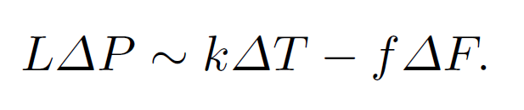
Energetic constraint upon global precipitation
(i) k ~ 2 Wm⁻²K⁻¹ depends on spatial pattern of warming
(ii) f dependent upon nature of radiative forcing ΔF
Precipitation change ΔP determined by:
“slow” response to warming ΔT (enhanced radiative cooling of warmer troposphere)
“fast” direct influence of radiative forcing on surface/tropospheric energy budget (rapid adjustment)
See Allen and Ingram (2002) Nature for detailed discussion

Slide 13
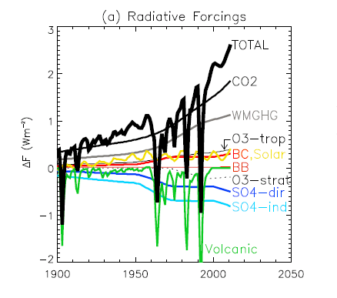
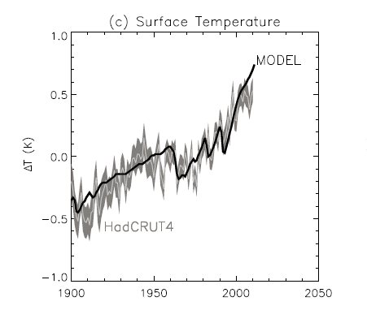
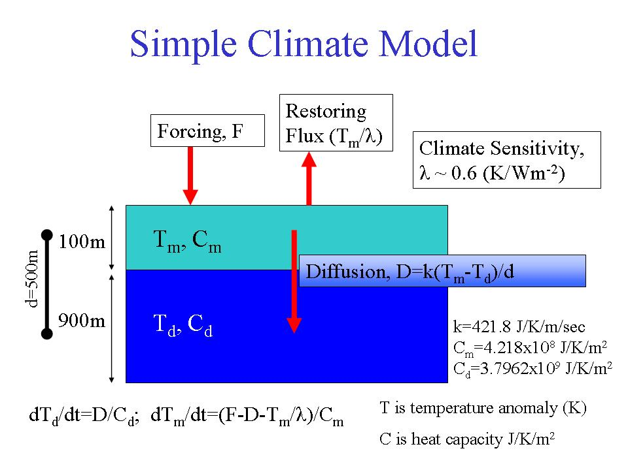
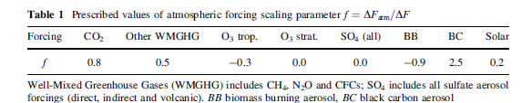
Simple model of precipitation change
Thanks to Keith Shine and Evgenios Koukouvagias

Slide 14
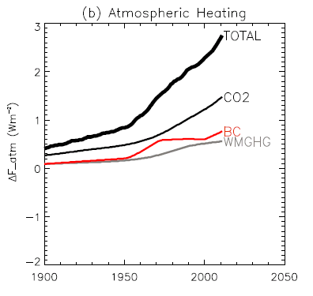
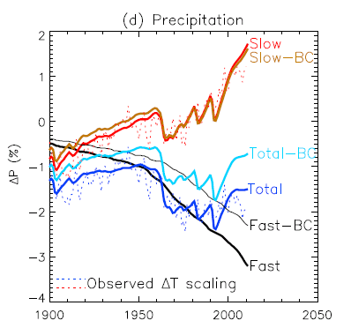
A simple model of precipitation change
direct radiative heating of troposphere
Allan et al. (2013) Surv. Geophys, using f calculated by Andrews et al. (2010) GRL see also Kvalevåg et al. (2010) GRL

Slide 15
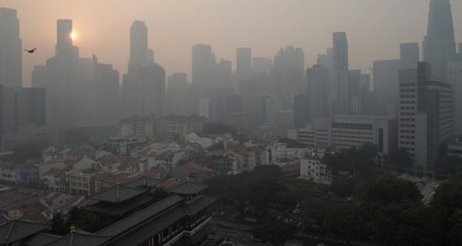
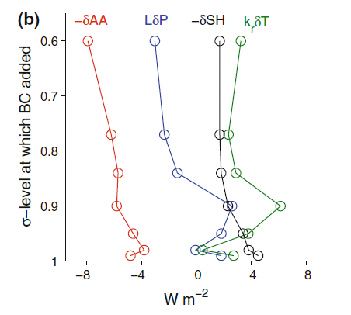
It matters where you put your radiative forcing
Surface sensible heat flux adjustment (rather than latent heat adjustment) increasingly important for absorbing aerosol within boundary layer e.g. Black Carbon (BC) Ming et al. (2010) GRL →
Hydrological Forcing:
  HF=kdT-dAA-dSH
Geographical location also important for regional response
= 1.8∆T_{s}
O’Gorman et al. (2012) Surv. Geophys; after Ming et al. (2010) GRL
See also Pendergrass & Hartmann (2012) GRL; Previdi (2010) ERL

Slide 16
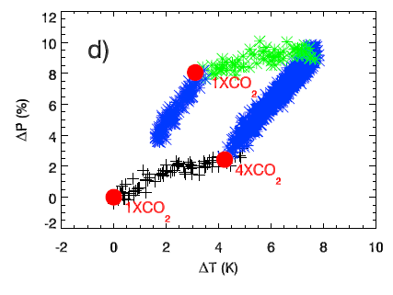
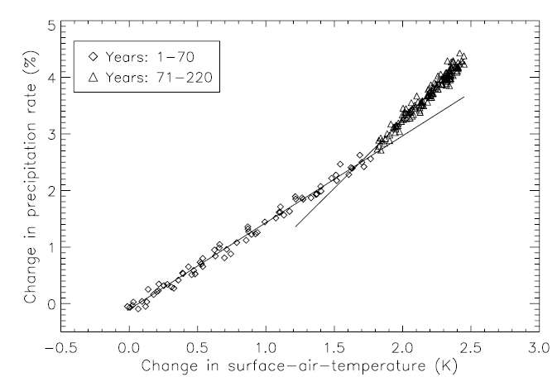
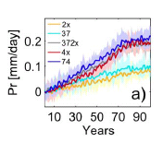
Implications for transient responses
HadCM3: Wu et al. (2010) GRL
CO₂ forcing experiments
Initial precipitation response supressed by CO₂ forcing
Stronger response after CO₂ rampdown
CMIP3 coupled model ensemble mean: Andrews et al. (2010) Environ. Res. Lett.
Degree of hysteresis determined by forcing related fast responses and linked to ocean heat uptake
Work also by: McInerney & Moyer ; Schaller et al. (2013) ESDD

Slide 17
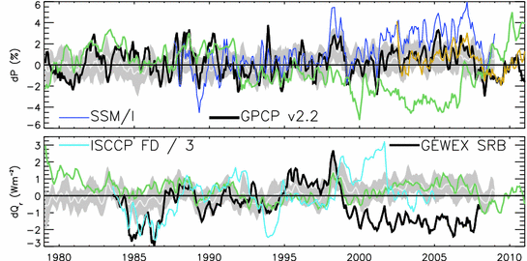
How is global precipitation and radiative cooling currently changing?
GPCP dP/dT ≈ 2.8 %/K
AMSRE
ΔR (Wm⁻²) Precipitation (%)
ERA Interim
AMIP
Allan et al. (2013) Surv. Geophys
1988-2008: Precipitation trends not significant
Global mean estimates (use ERA Interim over land and high latitudes for SSM/I & AMSRE)

Slide 18
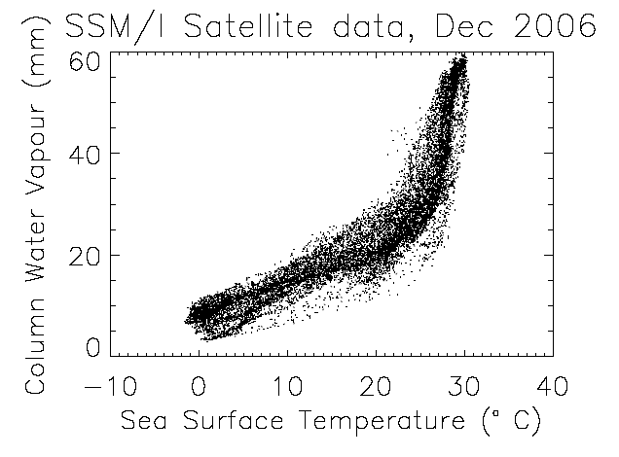
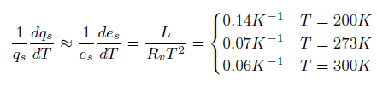
The role of water vapour
Physics: Clausius-Clapeyron
Low-level water vapour concentrations increase with atmospheric warming at about 6-7%/K
  Wentz & Shabel (2000) Nature; Raval & Ramanathan (1989) Nature

Slide 19

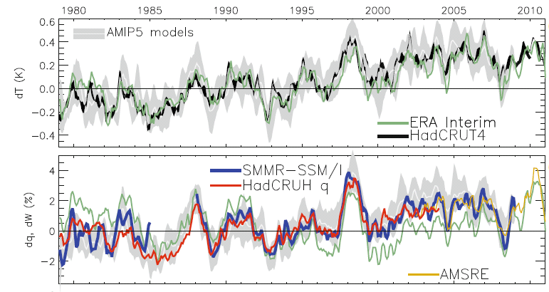
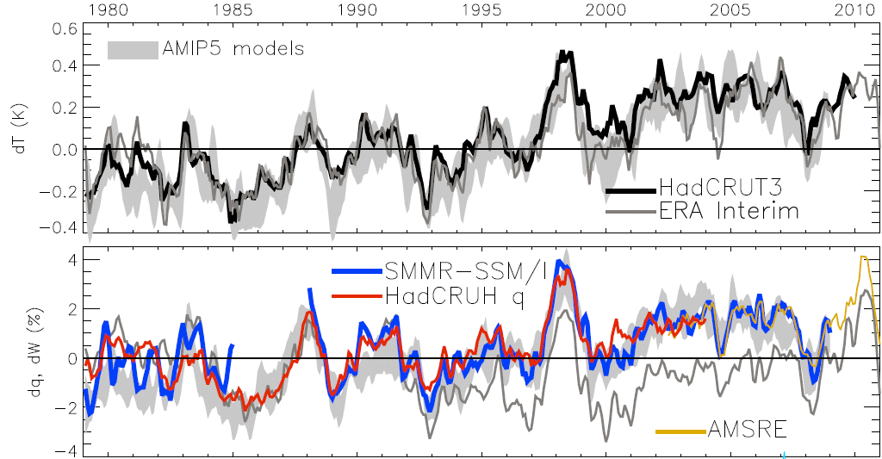
Global changes in water vapour
Water Vapour (%) Surface Tempertaure (K)
dW/dT ≈ 7%/K
≈ 1%/decade
Allan et al. (2013) Surv. Geophys
Global mean estimates (use ERA Interim over land and high latitudes, SMMR-SSM/I & AMSRE)
Notes:
The main point to note is that models and observations are consistent in showing increases in low level water vapour with warming. Reanalyses such as ERA Interim, which are widely used, are not constrained to balance their energy or water budgets.
For ocean-only satellite datasets I apply ERA Interim for poleward of 50 degrees latitude and for missing/land grid points.
Note that SSM/I F13 2003-2007 CWV = 24.7794 mm; AMSRE 2003-2007 CWV = 24.8850
19

Slide 20

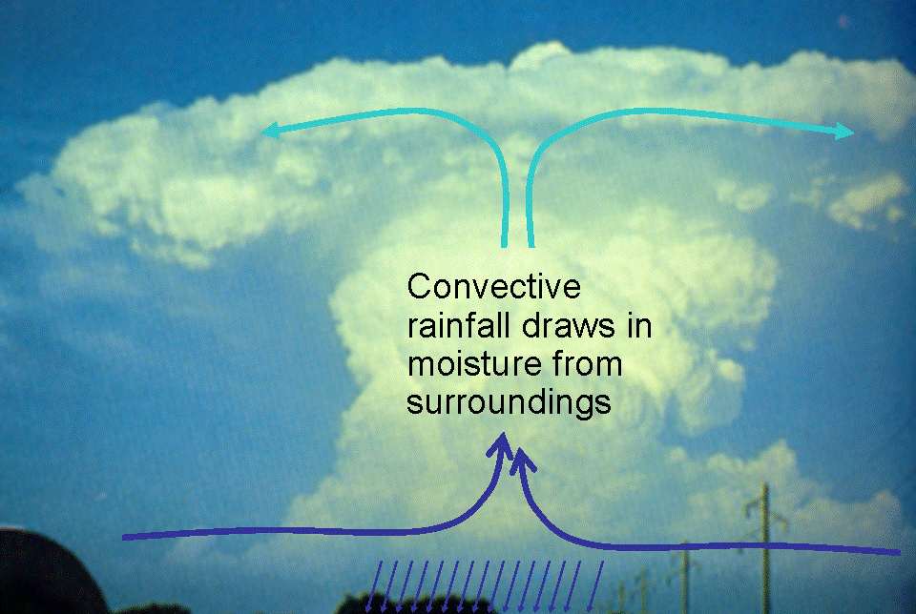
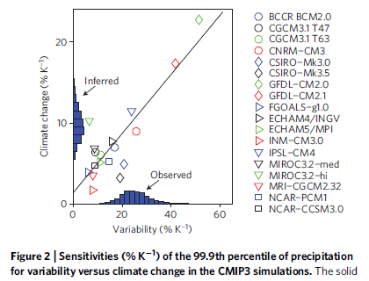
Extreme Precipitation
Moisture convergence fuels large-scale rainfall events
e.g. Trenberth et al. (2003) BAMS
Intensification of rainfall with warming
e.g. Allan & Soden (2008) Science
Amplifying latent heat feedbacks?
e.g. Berg et al. (2013) Nature Geo
Time/space scale important
Observational constraints? →
e.g. O’Gorman (2012) Nature Geosci; Liu & Allan (2012) JGR

Slide 21

Contrasting precipitation response expected
Heavy rain follows moisture (~7%/K)
Mean Precipitation linked to energy balance (~2-3%/K)
Precipitation →
Light Precipitation (-?%/K)
Temperature →
e.g. Allen and Ingram (2002) Nature ; Allan et al. (2010) Environ. Research Lett.

Slide 22
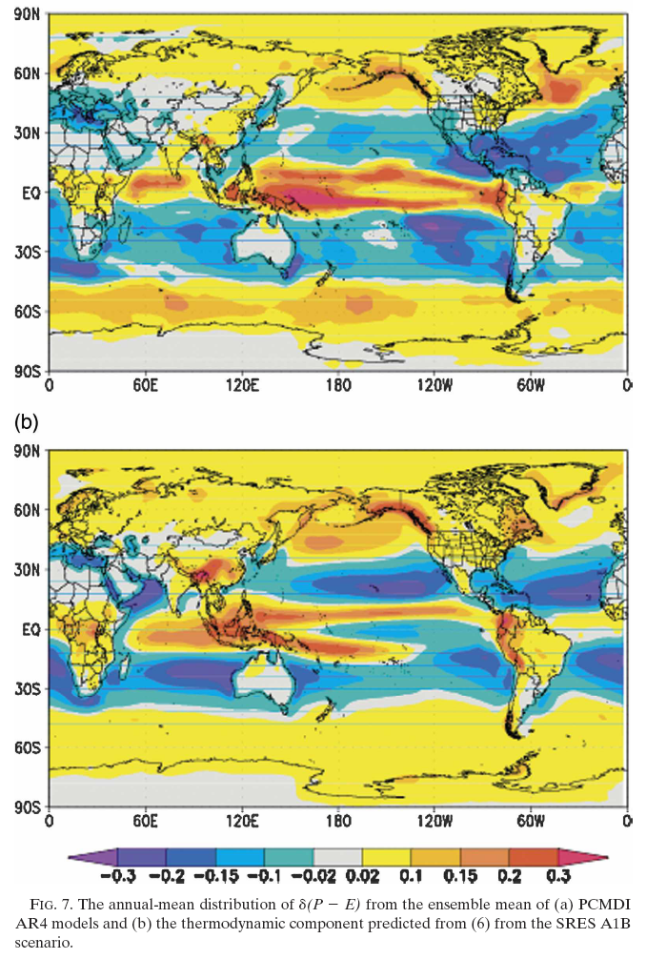

Moisture Balance
Enhanced moisture transport F leads to amplification of
(1) P–E patterns (left)
Held & Soden (2006) J Climate
(2) ocean salinity patterns
Durack et al. (2012) Science
≈
See also Mitchell et al. (1987) QJRMS

Slide 23
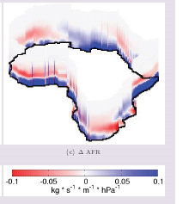
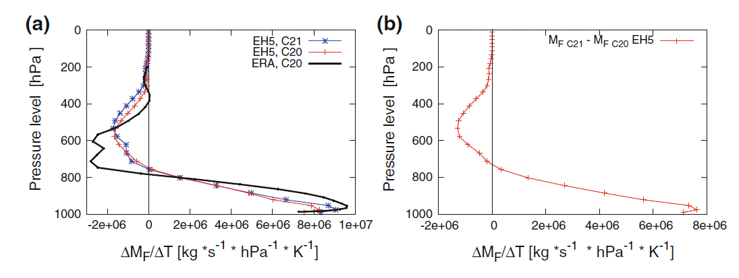
Enhanced moisture transports into the “wet” tropics, high latitudes and continents
PREPARE project
Zahn & Allan, submitted to WRR
Enhanced outflow
Enhanced inflow
(dominates)
Allan et al. (2013) Surv. Geophys see also: Zahn and Allan (2013) J Clim

Slide 24
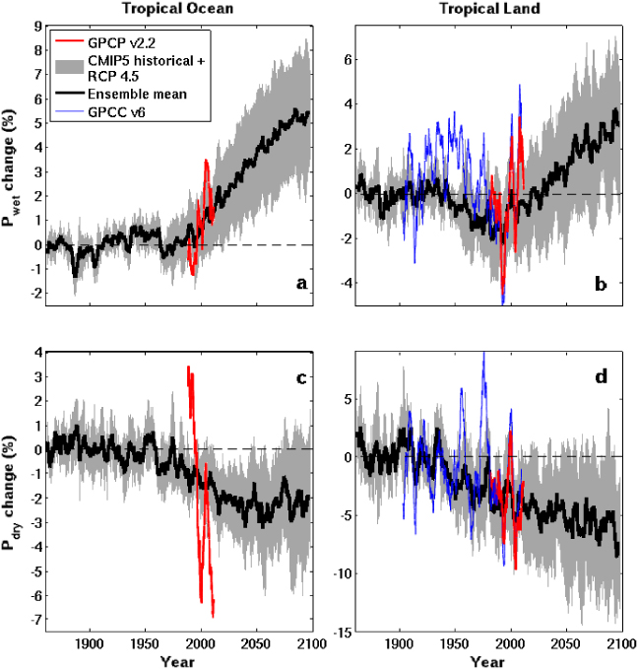

CMIP5 simulations: Wettest tropical grid-points get wetter, driest drier
Ocean Land
Wet land: strong ENSO influence
GPCC GPCP
Pre 1988 GPCP observations over ocean don’t use microwave data
dry tropical region wet
Precipitation Change (%)
Tropical dry Tropical wet
Robust drying of dry tropical land
30% wettest gridpoints vs 70% driest each month
Liu and Allan (2013) ERL; see also: Chou et al. (2013) Nature Geosci; Chadwick et al. (2013) J Clim ; Allan (2012) Clim. Dyn.

Slide 25
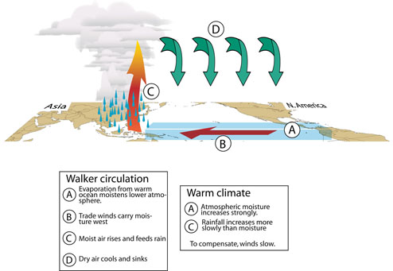
Circulation response
First argument:
P ~ Mq
So if P constrained to rise more slowly than q, this implies reduced M:
Bony et al. (2013) Nat Geosci Chadwick et al. (2012) J Clim
Second argument:
ω = Q/σ
Subsidence (ω) induced by radiative cooling (Q) but the magnitude of ω depends on static stability (σ = Г_{d} - Г).
If Г follows MALR → increased σ. This offsets Q effect on ω.
See Held & Soden (2006) and Zelinka & Hartmann (2010) JGR
ω = Q/σ
P ~ Mq
Q
ω
P
M
q
Schematic from Gabriel Vecchi
Notes:
25

Slide 26
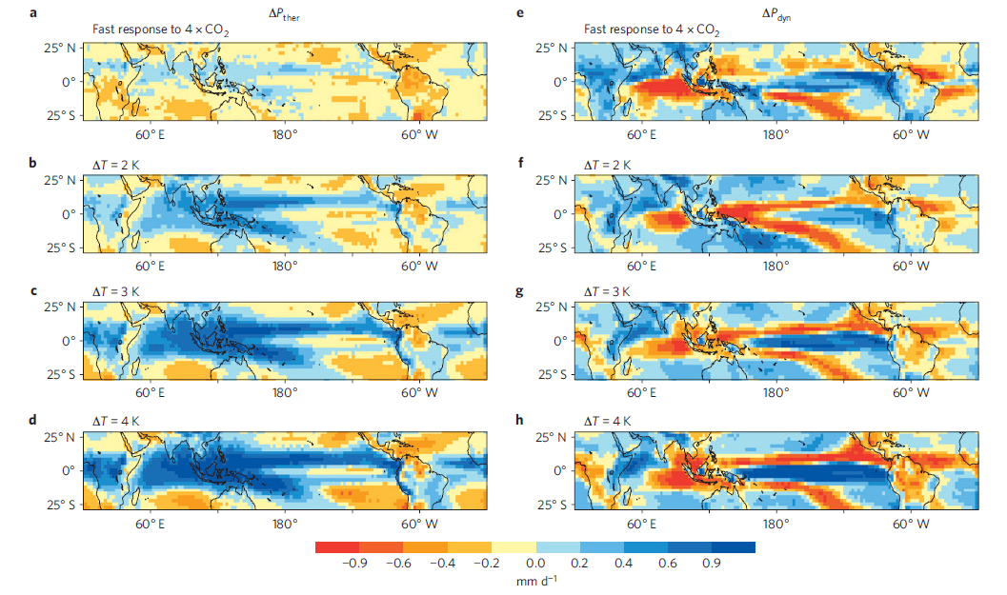
Walker circulation response to fast and slow precipitation effects
Thermodynamic response to warming Fast response to CO₂
Bony et al. (2013) Nature Geosciences (see talk on Tuesday!)
Both fast and slow responses to CO₂ forcings induce reduced Walker circulation in response to P = Mq constraint
Reduced Walker circulation: Vecchi et al. (2006) Nature Recent strengthening of circulation? Merrifield (2011) J Clim; Sohn et al. (2011) Clim Dyn; L’Heureux et al. (2013) Nature Climate

Slide 27
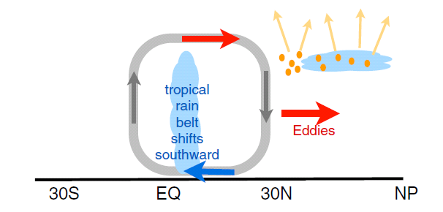
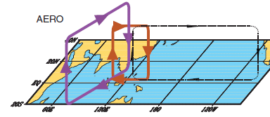
Aerosol & regional circulation response
N Hemisphere Aerosol cooling 1950-1980s
Induces southward movement of ITCZ
Reduced Sahel rainfall →
Recovery after 1980s e.g. Wild 2012 BAMS
+Asymmetric volcanic forcing e.g. Haywood et al. (2013) Nature Climate
Enhanced energy transport
cooling
Hwang et al. (2013) GRL
Sulphate aerosol effects on Asian monsoon e.g. Bollasina et al. 2011 Science
Links to drought in Horn of Africa? Park et al. (2011) Clim Dyn

Slide 28
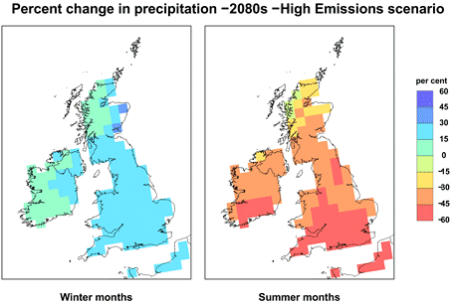
Challenge: Regional projections
Shifts in circulation systems are crucial to regional changes in water resources and risk yet predictability is often poor (but see Power et al. (2012) J Clim )
How will jet stream positions and monsoons respond to warming? e.g. Levermann et al. (2009) PNAS
How will primary land-surface and ocean-atmosphere feedbacks affect the local response to global warming?

Slide 29


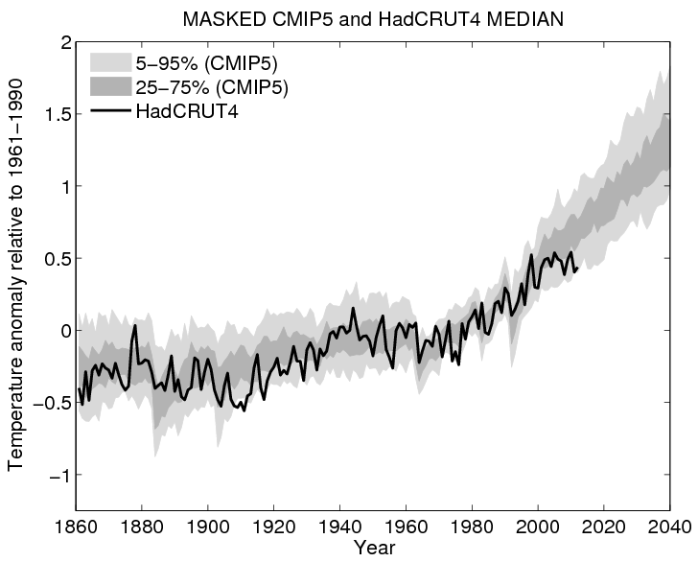
Outstanding Issues
Observing systems can’t monitor changes in precipitation & radiation adequately
Regional responses are unpredictable
Extreme precipitation is outpacing Clausius Clapeyron constraint
What are changes in radiative forcings and their associated fast adjustments?
Implications for geoengineering of climate
What is the effect of the global surface temperature hiatus on the water cycle?

Slide 30
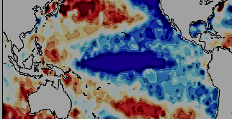
Mechanisms during SST warming hiatus?
After calculations from 4XCO₂ from Cao et al. 2012 ERL
N
~ 0.5-0.6 Wm⁻² e.g. Loeb et al. (2012) Nature Geo
↑ Monsoonal circulations: Levermann et al. (2009) PNAS
↑CO₂, etc: heating
↑ Walker circ? Sohn et al. (2012) Clim Dyn
Energy flows: Muller & O’Gorman (2011) Nature Clim.
CO₂ bio. Effects – small over 15yrs?: Andrews et al. 2010 Clim. Dyn ; Dong et al. (2009) J. Clim
↑P, ↓P? ↓RH
↑stability, ↓P
↑CO₂ ↓ET
M, H
↑P ↓P
↑T
stable SSTs
N
IPO pattern
e.g. Meehl et al. (2012) Nat. Clim.
Change from EP to CP El Nino? Xiang et al. (2013) Clim Dyn

Slide 31
Conclusions
Radiative energy balance is fundamental to climate response
Energy and moisture balance powerful constraints on global water cycle
Global precipitation rises with surface warming (~2%/K)
Direct effects of radiative forcing from greenhouse gases/ absorbing aerosol cause rapid adjustments in E and P (+cloud)
Current & future increases in wet and dry extremes
  Linked to rises in low-level moisture of about 7%/K
  Combined energy and moisture balance constraints via circulation
Aerosol radiative forcing appears key in determining global and circulation-driven precipitation responses
Heating of Earth continues at rate of ≈ 0.6 Wm^{–2} over the last decade despite stable Surface Temperature

Slide 33
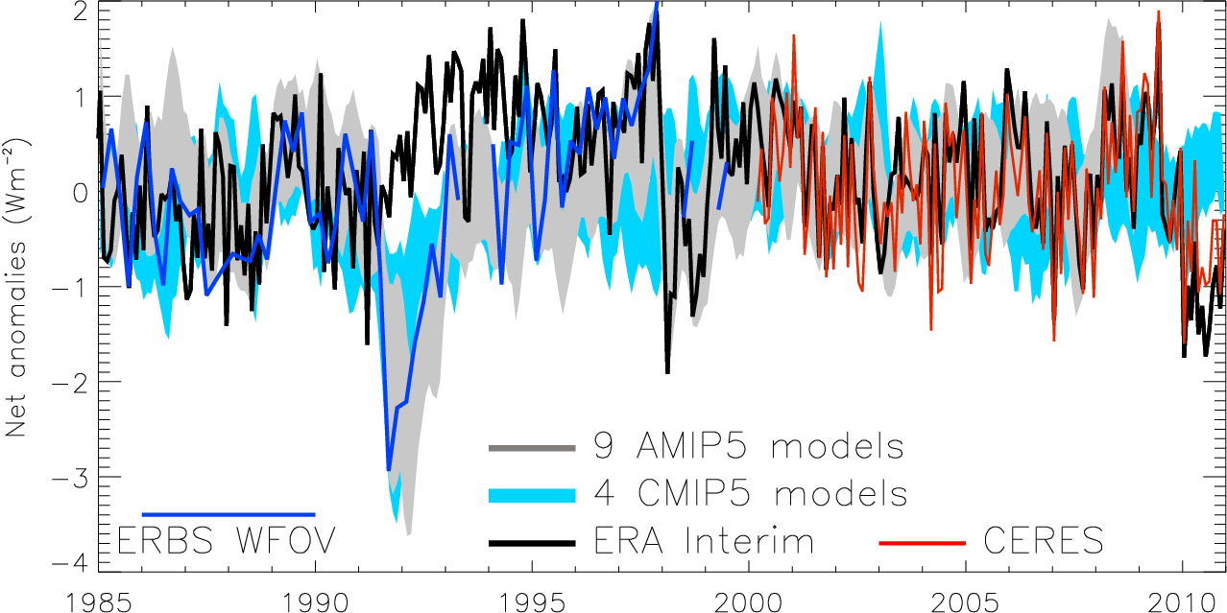
Variation in net radiation since 1985
60S-60N, after Allan (2011) Meteorol. Apps
Notes:
Deseasonalised monthly anomalies of net radiation (60ºS-60ºN) from satellite data (ERBS WFOV; CERES) and reanalysis simulations (ERA Interim) updated from ref 6 to include CMIP5 climate model simulations (AMIP 5 simulations from CNRM, NorESM1, HadGEM2 and INMCM4 in grey and combined historical and RCP4.5 scenario coupled simulations from CNRM, CanESM, HadGEM2-ES and INMCM4 in blue shading). CERES has been updated to EBAF2.6 and ERA Interim to 1985-2010.

Slide 34
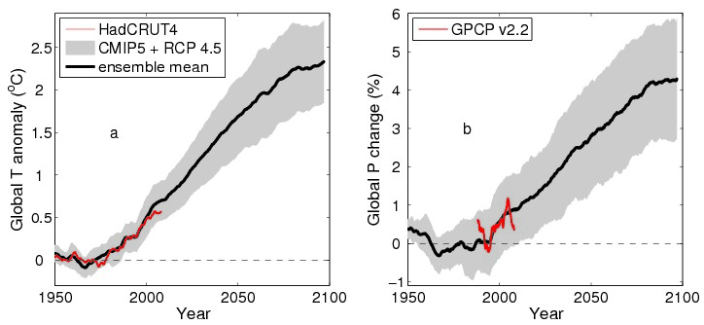
How is global climate change progressing?
Global Heating Global Wetting
Notes:
EXTRA SLIDE….

Slide 35
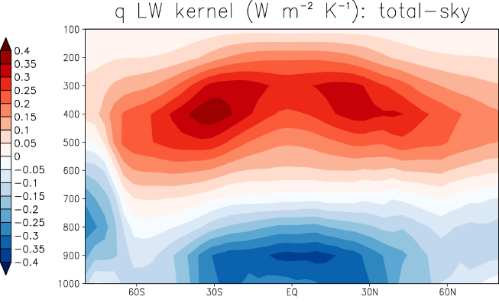
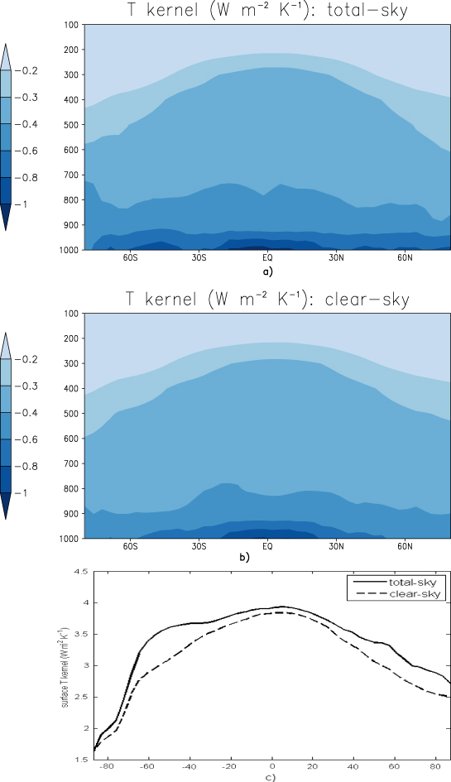
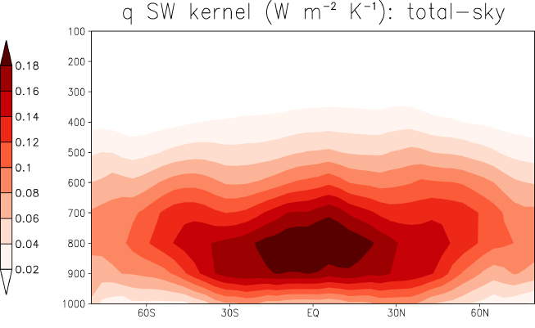
Altitude dependence of response (kernels)
Previdi (2010) ERL
See also O’Gorman et al. (2012) Surv. Geophys
Notes:
EXTRA SLIDE?????
Increase in R (down) for specific humidity increase associated with 1 K temperature rise assuming constant RH [left]. Use 19 layer ECHAM5 model.

Slide 36
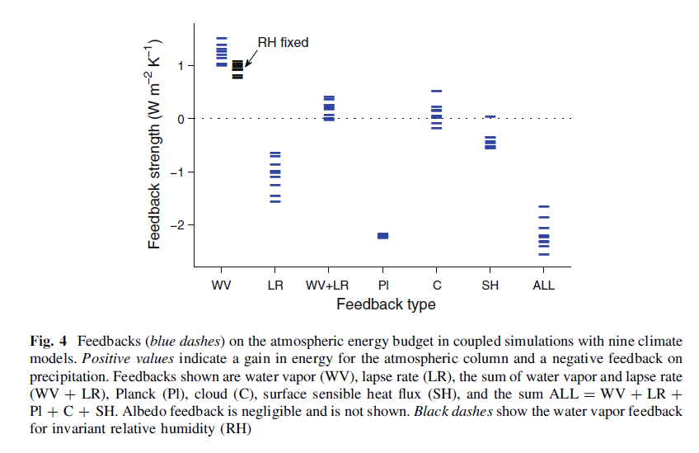
Quantifying Hydrological Feedbacks
↑ Radiative heating
↓ Radiative cooling
~ –2 Wm⁻²K⁻¹
O’Gorman et al. (2012) Surv. Geophys; see also Previdi (2010) ERL

Slide 37
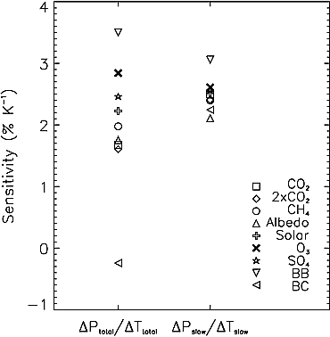
Forcing related fast responses
Total Slow
Surface/Atmospheric forcing determines “fast” precipitation response
Robust slow response to T
Mechanisms described in Dong et al. (2009) J. Clim; Cao et al. 2012 ERL
CO₂ physiological effect potentially substantial Andrews et al. 2010 Clim. Dyn.; Dong et al. (2009) J. Clim
Hydrological Forcing:
  HF=kdT-dAA-dSH
  Ming et al. (2010) GRL
Precipitation response (%/K)
Andrews et al. (2010) GRL; see also Kvalevåg et al. (2010) GRL

Slide 39
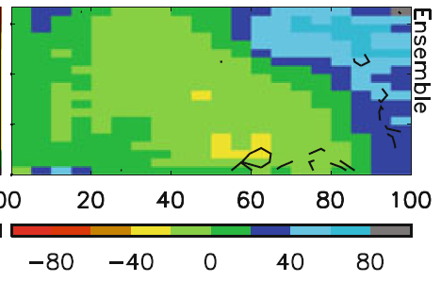
Fingerprints of precipitation response by dynamical regime
PREPARE project
Warmer surface temperature →
Model biases in warm, dry regime
Strong wet/dry fingerprint in model projections (below)
Stronger ascent →
Allan (2012) Clim. Dyn.
Stronger ascent →

Slide 40
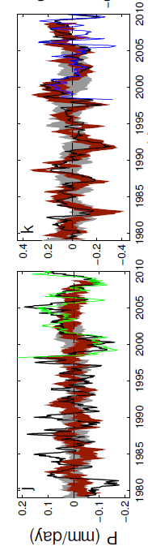
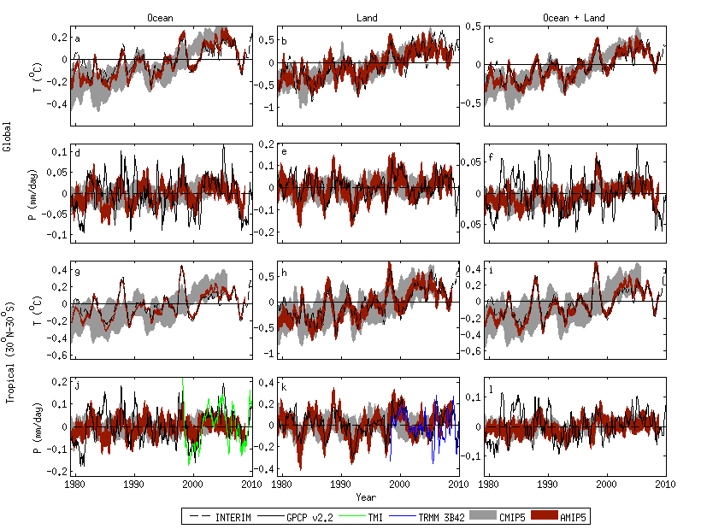
Challenge: Observing systems
Observed precipitation variability over the oceans is questionable. Over land, gauges provide a useful constraint.
Combining observational platforms is a powerful strategy e.g. microwave, gravity, ocean heat content, reanalysis transports
Oceans Land
Liu, Allan, Huffman (2012) GRL

Slide 41

1 day 5 day
Precipitation intensity (mm/day)
Uncertainty in observed P intensity & response (tropical oceans)
Precipitation intensity change with mean surface temperature (%/day)
Liu & Allan (2012) JGR
Precipitation intensity percentile (%)

Slide 42

Response of Precipitation intensity distribution to warming:
Observations and CMIP5, 5-day mean
Is present day variability a good proxy for climate response?
dP_{i}/dT (%/K)
CMIP5 AMIP/OBS
Allan et al. (2013) Surv. Geophys

Slide 43



Slide 44
Conclusions (1)
Previously highlighted “missing energy” explained by ocean heat content uncertainty combined with inappropriate net radiation satellite products
Heating of Earth continues at rate of ~0.5 Wm⁻²
  Negative radiative forcing does not appear to contribute strongly
Implications/mechanisms?
  Energy continues to accumulate below the ocean surface
  Strengthening of Walker circulation, e.g. Merrifield (2011) J Clim?
  Implications for hydrological cycle, e.g. Simmons et al. (2010) JGR?
New NERC project: Diagnosing Earth’s Energy Pathways in the Climate System (DEEP-C)
  + NOC Southampton/Met Office/Jonathan Gregory/Till Kuhlbrodt)

Slide 45

What has Earth’s Energy Budget got to do with current changes in the Global Water Cycle?
338-348
0.6
LH ~ 80-90
Trenberth et al. (2009) BAMS, but see update by Wild et al. (2012) Clim. Dynamics

