Slide 1
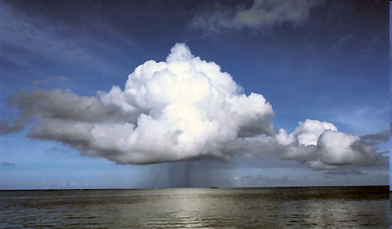
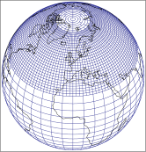

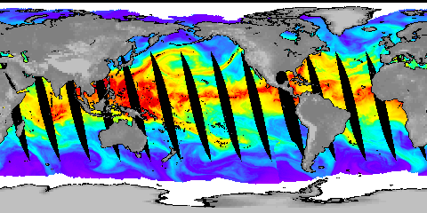

Climate change and the global water cycle
Richard P. Allan r.p.allan@reading.ac.uk @rpallanuk
Department of Meteorology/NCAS, University of Reading
www.met.reading.ac.uk/~sgs02rpa
Climate-KIC – TheJourney. University of Reading 22nd August 2013
Notes:
Projected Responses in Extreme Precipitation and Atmospheric Radiative Energy
Energetics response
Wet/dry responses
Intense rainfall
Transient responses

Slide 2
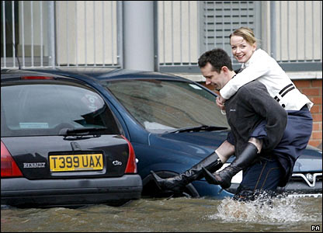
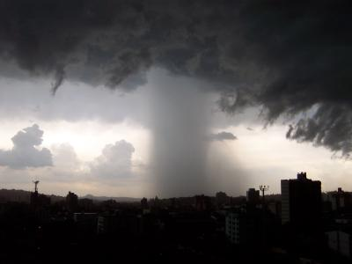
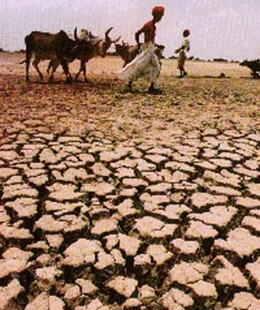
Introduction
“Observational records and climate projections provide abundant evidence that freshwater resources are vulnerable and have the potential to be strongly impacted by climate change, with wide-ranging consequences for human societies and ecosystems.” IPCC (2008) Climate Change and Water
Notes:
2
Intro stuff – current understanding of the nature and importance of the problem: the water cycle is changing and vulnerability is inevitable…
Model projections/intro
Water vapour
Intense rainfall events
Evaporation
Soil Moisture
Precipitation and extremes
Anticipated large-scale responses
Toward regional responses
Unanswered questions

Slide 3
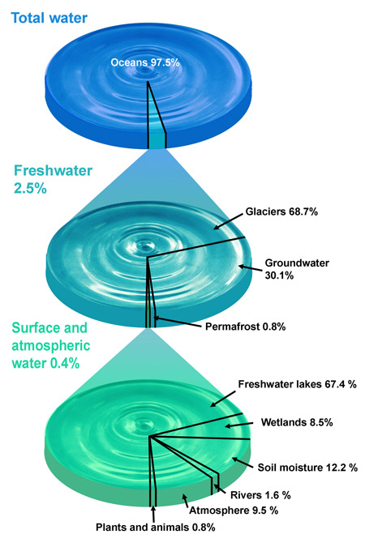
Water resources
Most water on Earth is salty
Most fresh water is locked away in glaciers or is deep in the ground
Water that is usable depends strongly on the water cycle

Slide 4
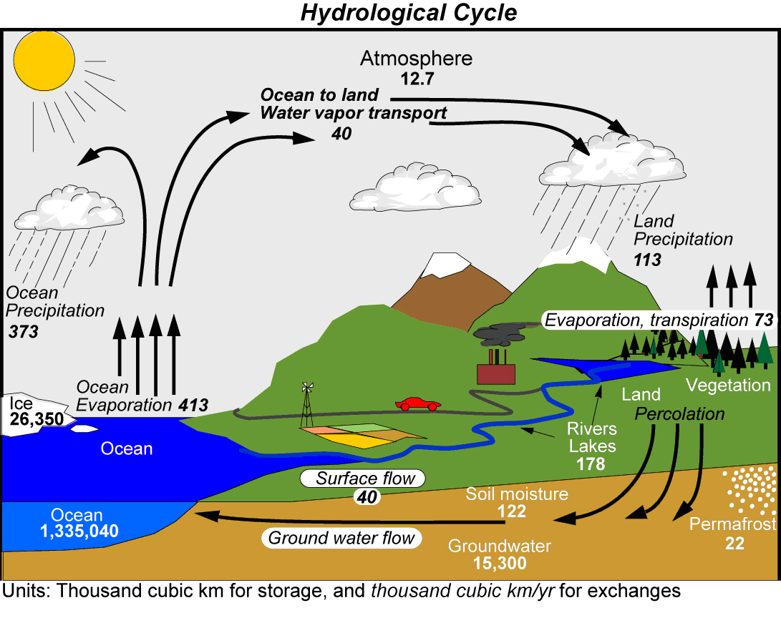
Kevin Trenberth and co-authors (2007) J Hydromet

Slide 5

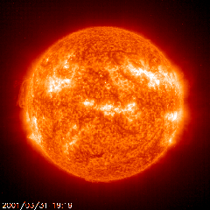
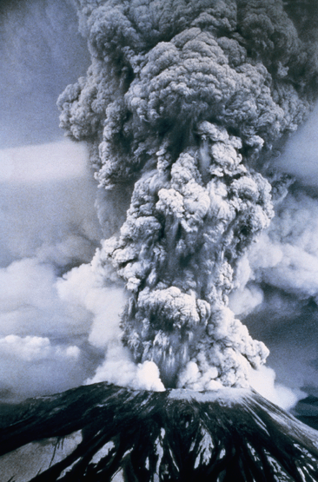
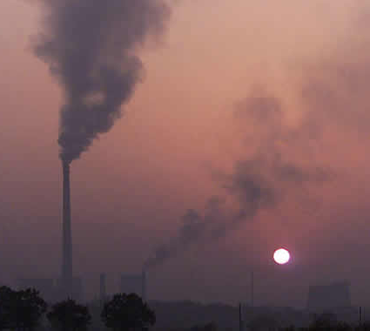
How will global precipitation respond to climate change?
Observations
Simulations:
Simulations:
RCP 8.5
Historical
RCP 4.5
Allan et al. (2013) Surv. Geophys
See also Hawkins & Sutton (2010) Clim. Dyn
Notes:
5
There is huge uncertainty in global precipitation projections, relating both to climate sensitivity and mitigation pathways.

Slide 6
Climate model projections
Precipitation Intensity
Increased Precipitation
More Intense Rainfall
More droughts
Wet regions get wetter, dry regions get drier?
Regional projections??
Dry Days
Precipitation Change (%)
IPCC WGI (2007)

Slide 7
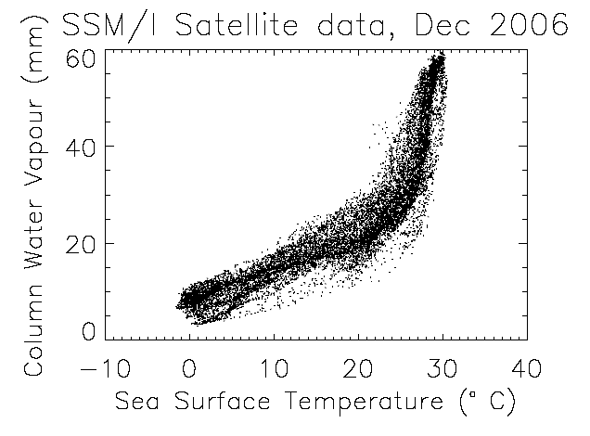
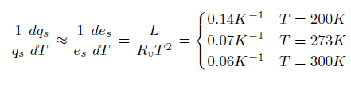
The role of water vapour
Physics: Clausius-Clapeyron
Low-level water vapour concentrations increase with atmospheric warming at about 6-7%/K
  Wentz & Shabel (2000) Nature; Raval & Ramanathan (1989) Nature

Slide 8
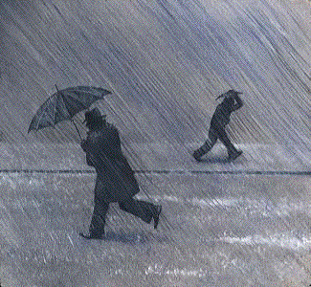
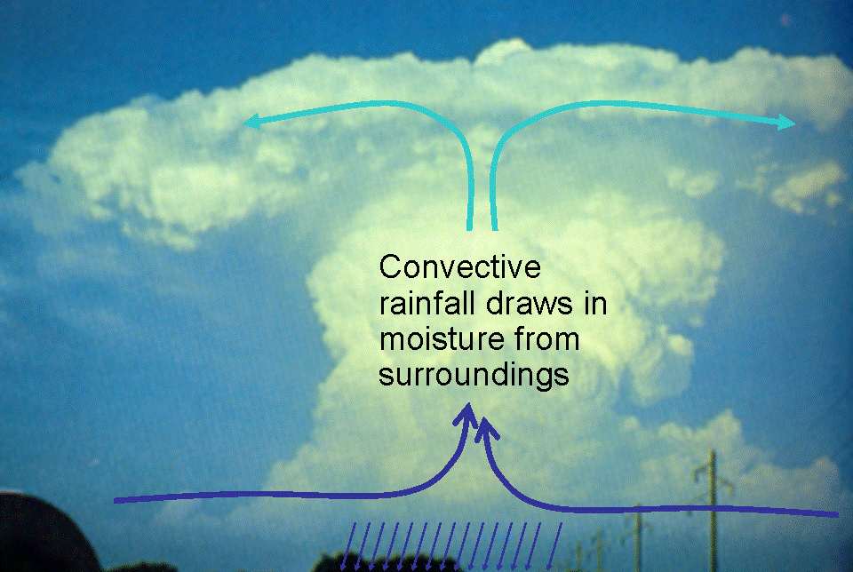
Extreme Precipitation
Large-scale rainfall events fuelled by moisture convergence
  e.g. Trenberth et al. (2003) BAMS
Intensification of rainfall with global warming
  e.g. Allan and Soden (2008) Science

Slide 9


Extreme precipitation & mid-latitude flooding
UK winter flooding linked to “Atmospheric Rivers” (ARs) e.g. Nov 2009 Cumbria floods
Lavers et al. (2011) Geophys. Res. Lett.
Climate change response: intensification of AR events Lavers et al. (2013) Environ. Res. Lett.

Slide 10

Contrasting precipitation response expected
Heavy rain follows moisture (~7%/K)
Mean Precipitation linked to energy balance (~3%/K)
Precipitation →
Light Precipitation (-?%/K)
Temperature →
e.g. Allen and Ingram (2002) Nature; Allan (2011) Nature

Slide 11
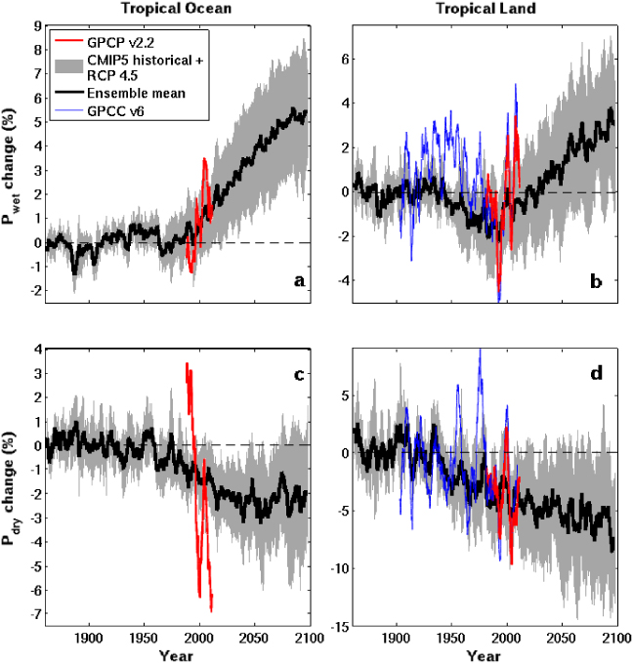

The Rich Get Richer…
Tropical Land
6
4
2
0
-2
-4
Simulations
Wet regions become wetter, already dry regions drier
Observations and detailed computer simulations (CMIP5)
Wet
Precipitation Change (%)
1900 1950 2000 2050 2100
5
0
-5
-10
Dry
Liu & Allan (2013) Environmental Research Letters
Observations
1900 1950 2000 2050 2100
Notes:
Note that the wet getting wetter and dry getting drier signal in the tropics is robust in models. The recently updated GPCP observations (black) show a slightly larger trend in the wet region. The dry region trend is probably spurious before 1988 since microwave data began in 1987.

Slide 12
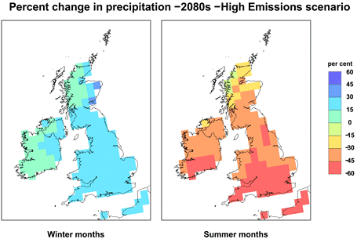
Challenge: Regional projections
Changes in circulation systems are crucial to regional changes in water resources and risk yet predictability is poor.
How will catchment-scale runoff and crucial local impacts and risk respond to warming?
What are the important land-surface and ocean-atmosphere feedbacks which determine the response?

Slide 13
Conclusions
Global precipitation will rise with warming ~2-3%/K
  Constrained by energy budget
Heavy rainfall becomes more intense
  Fuelled by increased water vapour (~7%/K)
Wet get wetter, dry get drier
  More flooding, more drought ?
Regional projections are a challenge
  Sensitive to small changes in atmospheric circulation
How do we make large-scale projections relevant for small scale impacts?
Notes:
13
Projected Responses in Extreme Precipitation and Atmospheric Radiative Energy

