Slide 1

Climate change and the global water cycle
Department of Meteorology
Richard Allan

Slide 2
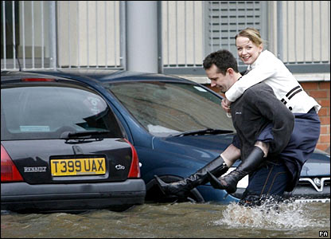
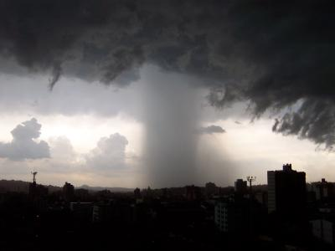
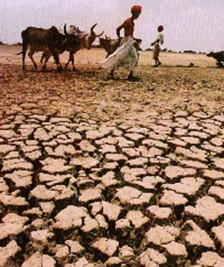
introduction
“Observational records and climate projections provide abundant evidence that freshwater resources are vulnerable and have the potential to be strongly impacted by climate change, with wide-ranging consequences for human societies and ecosystems.” IPCC (2008) Climate Change and Water
Notes:
Intro stuff – society is already vulnerable to fluctuations in the global cycle of water and its availability.
Climate change will disrupt the global water cycle leading to more severe impacts from flooding and drought.

Slide 3
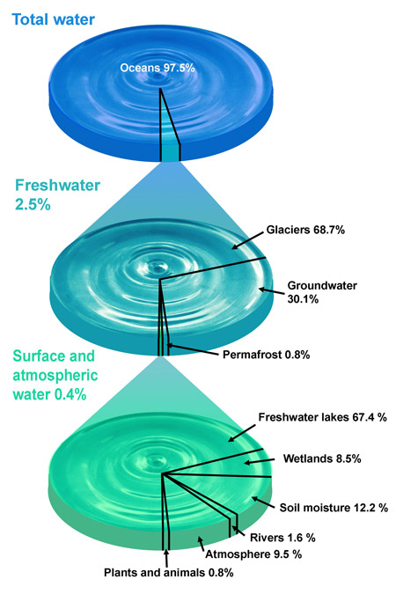
Water resources
Most water on Earth is salty
Most fresh water is locked away in glaciers or is deep in the ground
Water that is usable depends strongly on the water cycle

Slide 4
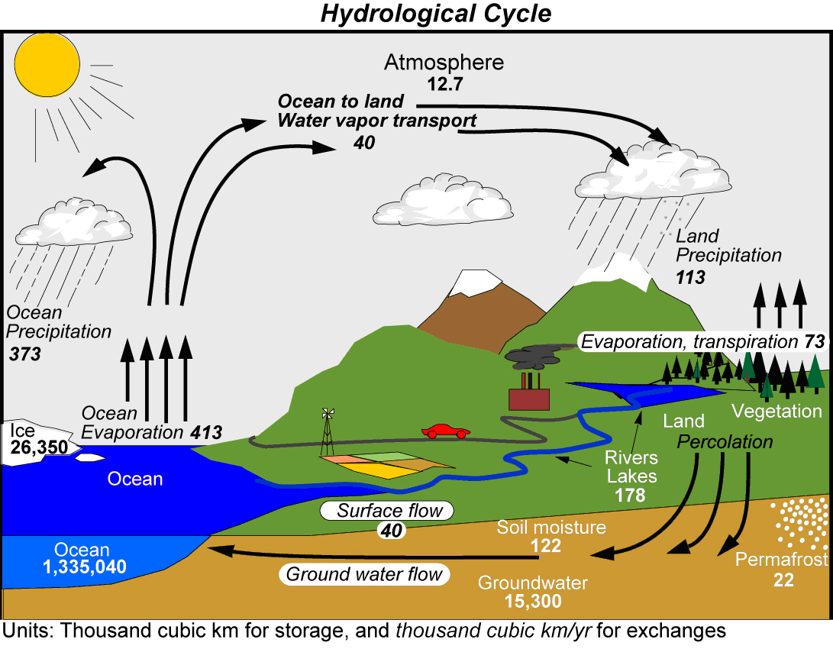
114
74
386
426
Kevin Trenberth and co-authors (2007) J Hydromet; (2011) J. Climate

Slide 5
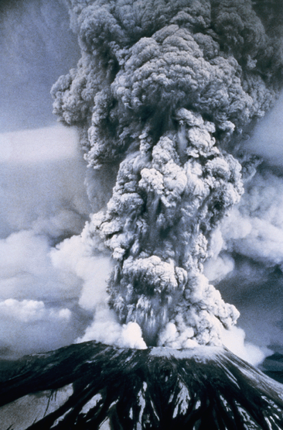
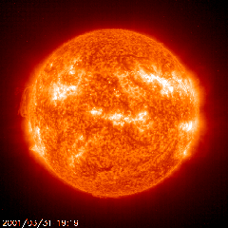
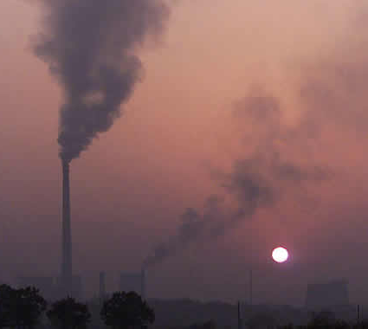
How will global precipitation respond to climate change?
12
10
8
6
4
2
0
-2
Observations
Simulations:
RCP 8.5
Historical
RCP 4.5
Allan et al. (2013) Surv. Geophys
Global Precipitation Change (%)
1950 2000 2050 2100
Notes:
We know that the total global precipitation (including rain, hail and snow) will increase as the planet warms. The amount of warming and consequent increases in precipitation depend mostly on future emissions of greenhouse gases. The forcing factors that are currently heating (and cooling) the planet influence the details of how precipitation are currently changing.

Slide 6
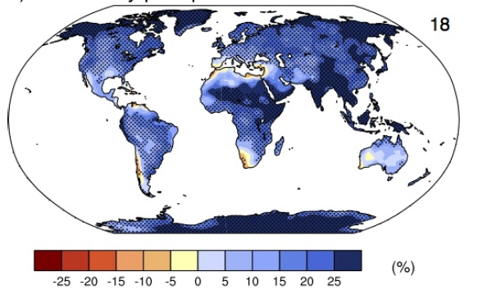
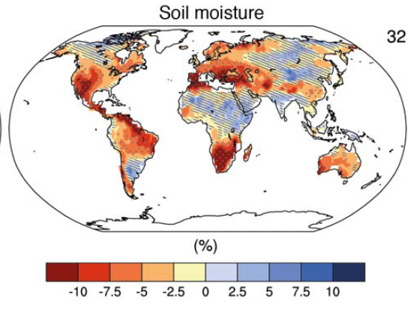
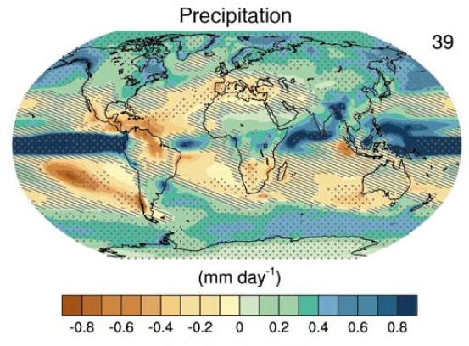
changing water cycle
Precipitation intensity
Increased Precipitation
More Intense Rainfall
More droughts
Wet regions get wetter, dry regions get drier?
Regional projections??
IPCC WGI (2013)
Notes:
Although we know global precipitation will increase with warming, more local changes are less coherent (bottom right). The moist tropics and higher latitude regions will indeed experience increased rainfall but many subtropical regions will experience diminishing precipitation and reduced soil moisture content (bottom right). Despite this mixed signal for annual and seasonal average precipitation, most land regions will experience an intensification of the heaviest rainfall events (top right).
PRECIPITATION: [Tech Summ Fig. 2]
RCP8.5 ANN: Multi-model CMIP5 average mm/day change.
Hatching: multi-model mean change is small (<1SD of internal variability)
Stippling: multi-model mean change is big (>2SD of internal variability and 90% of models agree on sign)
P INTENSITY:
Percent change in annual maximum 5-day precipitation 2081-2100 relative to 1981-2000 for RCP8.5 CMIP5 ensemble.
Fig. 12.26, Chapter 12.
Stippling → significant change
SOIL MOISTURE: [Tech Summ, Fig. 2]
RCP8.5 ANN change in %, Upper 10cm
Hatching: multi-model mean change is small (<1SD of internal variability)
Stippling: multi-model mean change is big (>2SD of internal variability and 90% of models agree on sign)

Slide 7
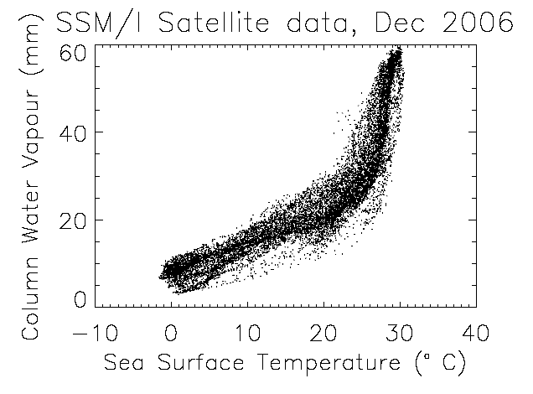
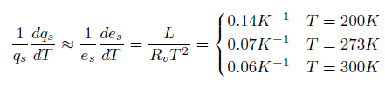
The role of water vapour
Physics: Clausius-Clapeyron
Low-level water vapour concentrations increase with atmospheric warming at about 6-7%/K
Notes:
Most of the water in the air is invisible gaseous vapour. This water vapour produces a strong greenhouse effect and is also the fuel for precipitation. Simple physics dictates that the capacity for the atmosphere to carry water vapour rises rapidly with temperature. This causes a changes in climate to be larger (an amplifying or positive feedback) and also explains why we expect heavy rainfall events to become more intense as the planet warms.

Slide 8
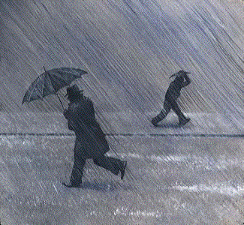
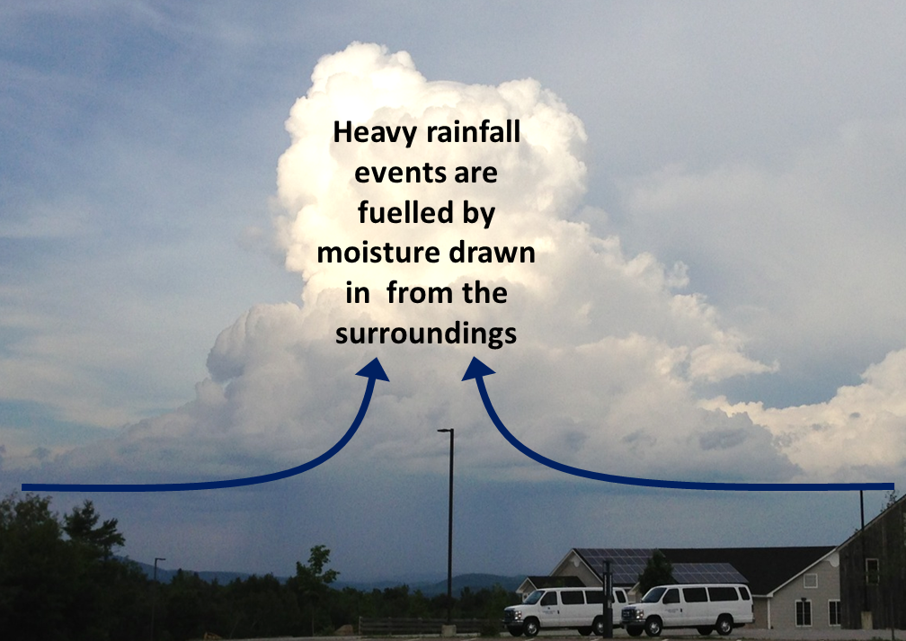
Extreme precipitation
During heavy precipitation events, more water often falls than is contained in the column of air above
This is only possible by converging moisture from the surroundings
e.g. Trenberth et al. (2003) BAMS
Greater quantities of atmospheric moisture in a warmer world will lead to an intensification of rainfall
e.g. Allan & Soden (2008) Science

Slide 9


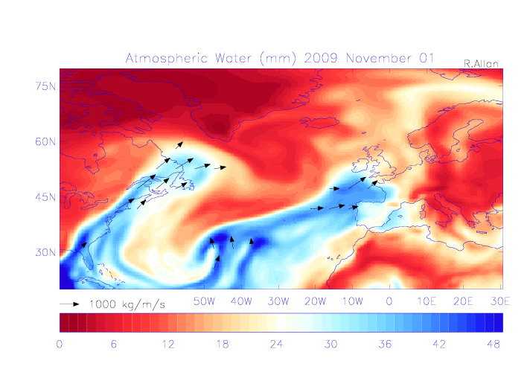
Extreme precipitation
& mid-latitude flooding
UK winter flooding linked to “Atmospheric Rivers” (ARs) e.g. Nov 2009 Cumbria floods
Lavers et al. (2011) Geophys. Res. Lett.
Climate change response: intensification of AR events Lavers et al. (2013) Environ. Res. Lett.
Notes:
The animation shows total column water vapour (blue colours correspond to greater amounts of moisture). The arrows show strong flows of water in the atmosphere, often referred to as “Atmospheric Rivers”. These events can often lead to heavy mountain rainfall over a number of days resulting in flooding such as was experienced in Cumbria in November 2009 (the top right shows the river flow of the Eden at Temple Sowerby during late November 2009. Research has shown that increased water vapour in the air will intensify these Atmospheric River events i9ncreasing the severity of flooding resulting from similar events occurring in a warmer world.

Slide 10

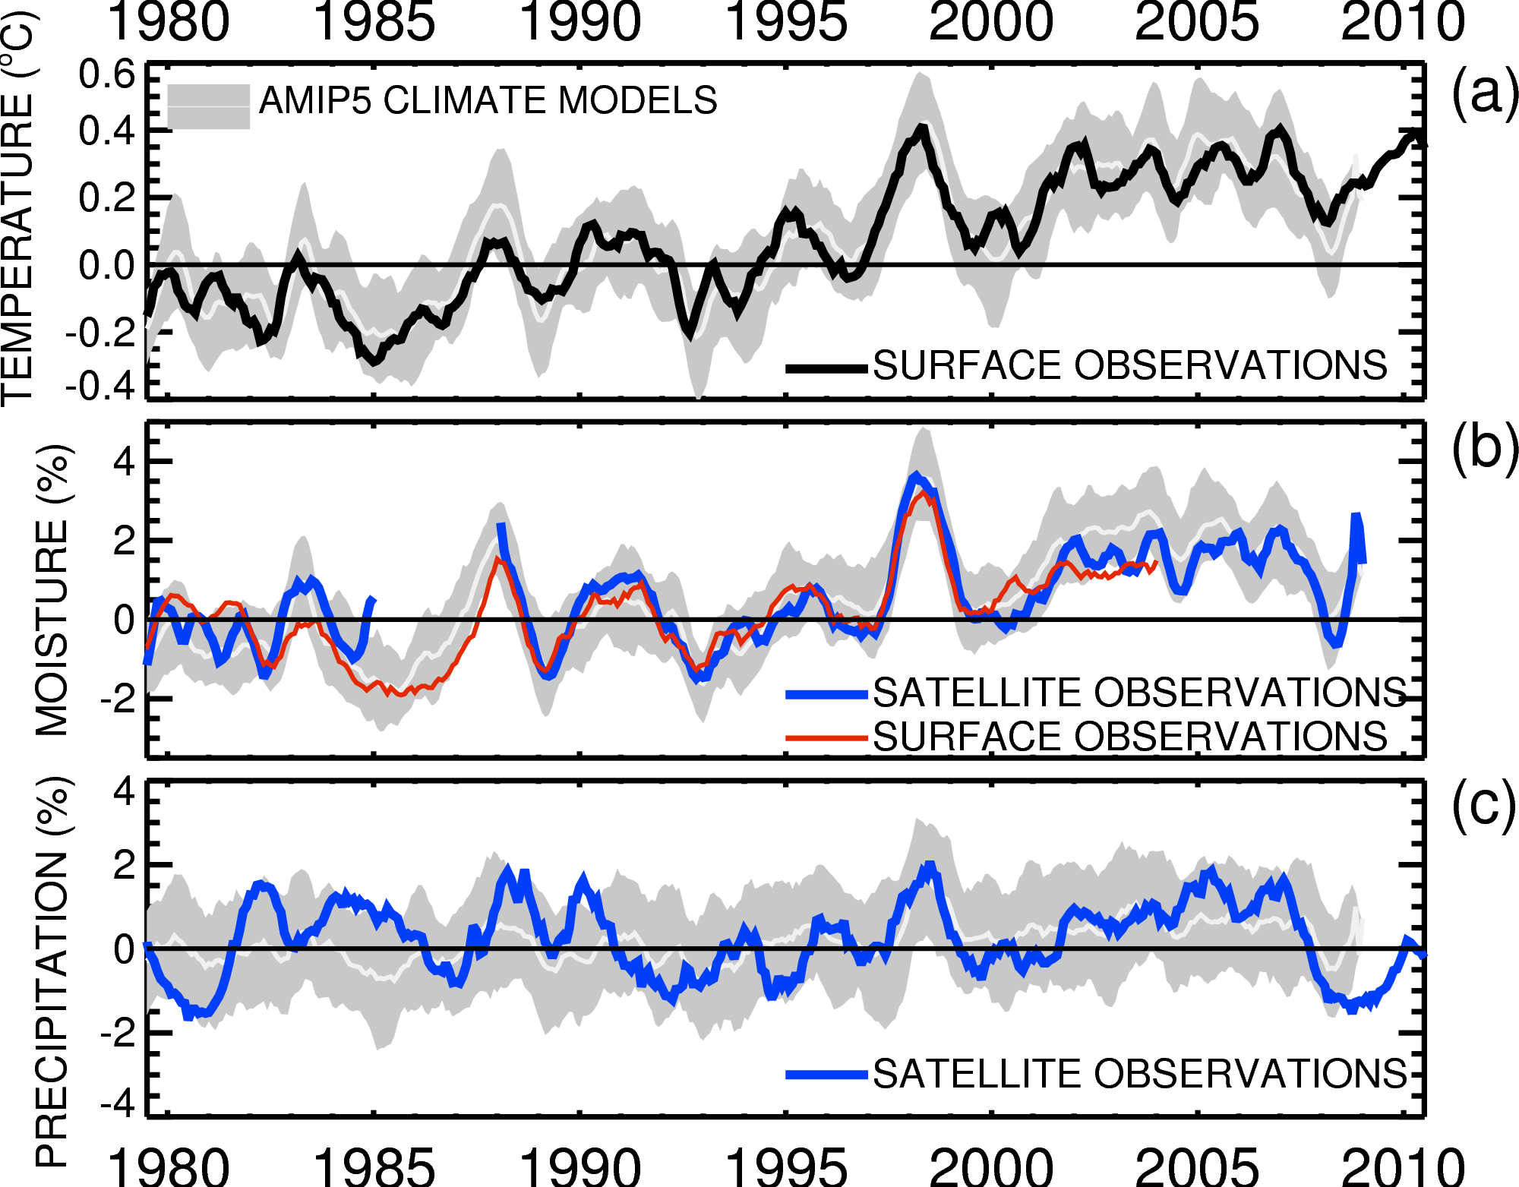

Current changes in THE global water cycle
Water vapour increases by around 7% for each degree C of warming.
~1%/decade trend
Adapted from: Allan et al. (2014) Surv. Geophys
Notes:
Observations confirm that water vapour and extreme precipitation increases with warming. However, global changes in total precipitation are less coherent.

Slide 11
Contrasting precipitation response expected
Basic physics indicates that precipitation changes will not be uniform in space.
Some regions will experience increases and others decreases
e.g. Allen and Ingram (2002) Nature; Allan (2011) Nature

Slide 12
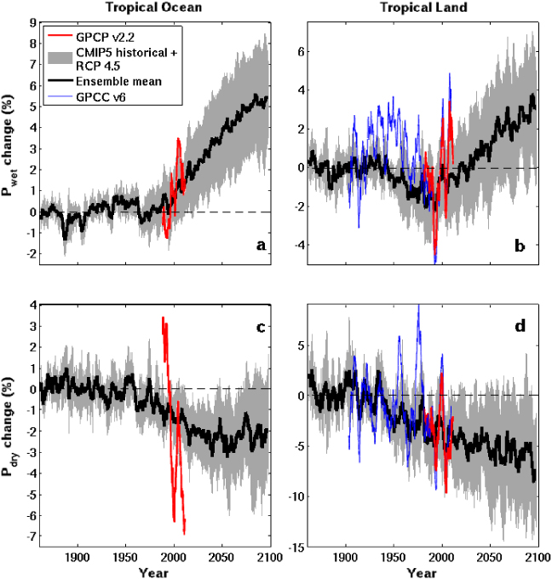
The Rich
Get RicheR?
Tropical Land
6
4
2
0
-2
-4
Simulations
More intense wet and dry spells in future
Observations and detailed computer simulations (CMIP5)
Wet
Precipitation Change (%)
1900 1950 2000 2050 2100
5
0
-5
-10
Dry
Observations
Liu & Allan (2013) ERL Allan (2014) Nature Geosci.
1900 1950 2000 2050 2100
Notes:
The plot shows precipitation changes for the wettest and driest tropical land regions wherever they are each year. Observations and simulations show a tendency for the wettest areas are currently becoming wetter and the driest regimes drier and this continues into the future. However, the wettest and driest regions move with time and so locally small changes in circulation pattern are extremely important.

Slide 13
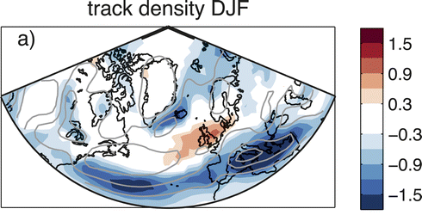
Projected changes in storms
Fewer storms over Iceland and Mediterranean UK: Little signal.
Robust signal: more extreme precipitation from all storms.
Zappa et al. 2013 J. Clim.
Changes in storm frequency (2070-2100 minus 1980-2005) from CMIP5 high-range emissions scenario
Notes:
Changes in number of cyclones per month per unit area. There is not a strong signal of how storminess over Europe will change in the future but the most extreme precipitation from storms is projected to increase.

Slide 14
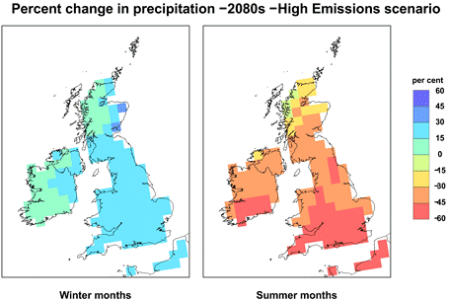
Challenge:
Regional projections
Changes in circulation systems are crucial to regional changes in water resources and risk yet predictability is poor.
How will catchment-scale runoff and crucial local impacts and risk respond to warming?
Aerosol particle pollution can strongly influence the spatial pattern/characteristics of rainfall

Slide 15
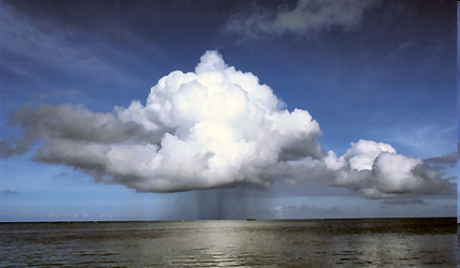
Conclusions
Global precipitation will rise with warming ~2-3%/ºC
  Constrained by physics: conservation of energy
Heavy rainfall becomes more intense
  Fuelled by increased water vapour (~7% increase per ºC)
Wet seasons get wetter, dry spells get more intense
  More flooding, more drought ?
Regional projections are a challenge
  Sensitive to small changes in atmospheric circulation
How are large-scale projections relevant for local impacts?
Notes:
15
Projected Responses in Extreme Precipitation and Atmospheric Radiative Energy

Slide 17
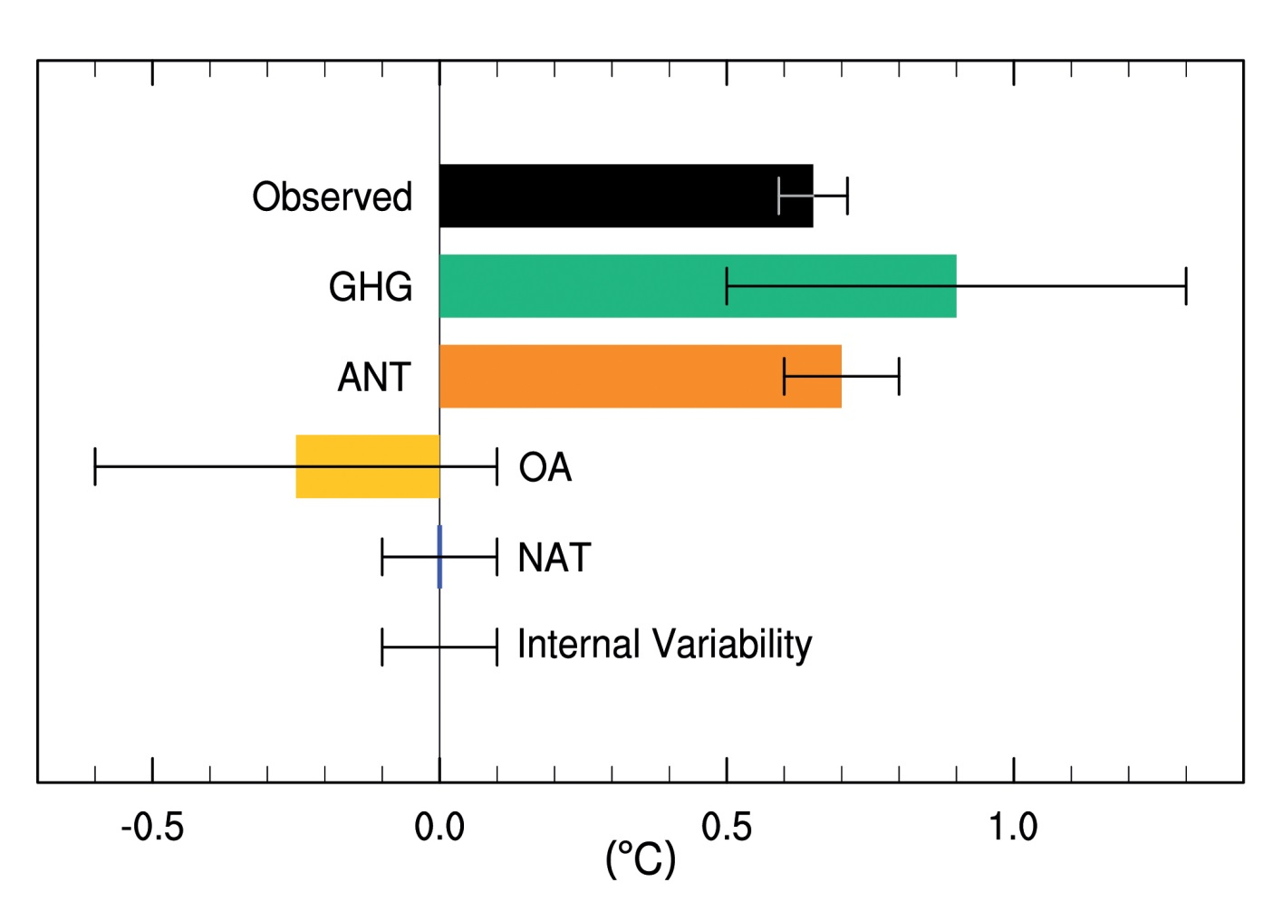
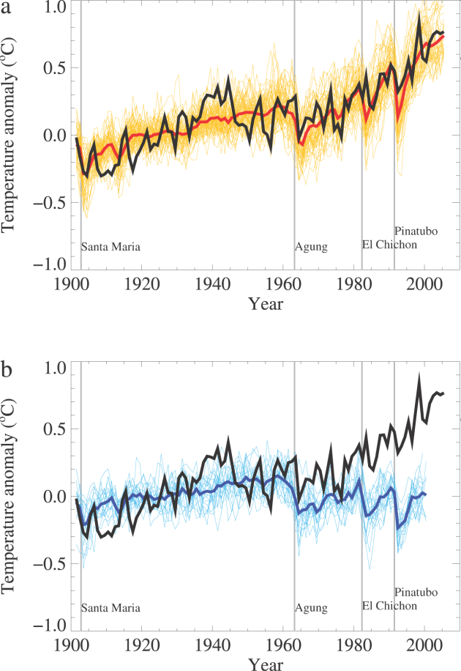
DETECTION & attribution
IPCC (2013) WG1 Fig. 10.5 (see also IPCC updates for schools)

Slide 18
1.0
0.8
0.6
0.4
0.2
0.0
IPCC: Future PROJECTIONS
High emissions
Low emissions
(m)
IPCC (2013) WG1 Summary for Policy Makers
Notes:
Increase of global mean surface temperatures for 2081–2100 relative to 1986–2005 is projected to likely be in the ranges 0.3°C to 1.7°C for the lowest emissions scenario (RCP2.6) and 2.6°C to 4.8°C for the highest emissions scenario (RCP8.5). The Arctic region will warm more rapidly than the global mean, and mean warming over land will be larger than over the ocean.
Global mean sea level rise is projected to range from 0.52 to 0.98 m by 2100 for RCP8.5, with a rate during 2081 to 2100 of 8 to 16 mm per year. Further uptake of carbon by the ocean will increase ocean acidification.
Heavy rainfall is expected to become more intense with wet regions generally seeing more rainfall and dry sub-tropical regions or seasons less.
For further details, see the IPCC (2014) WG1 Summary For Policy Makers, Section E.

Slide 19
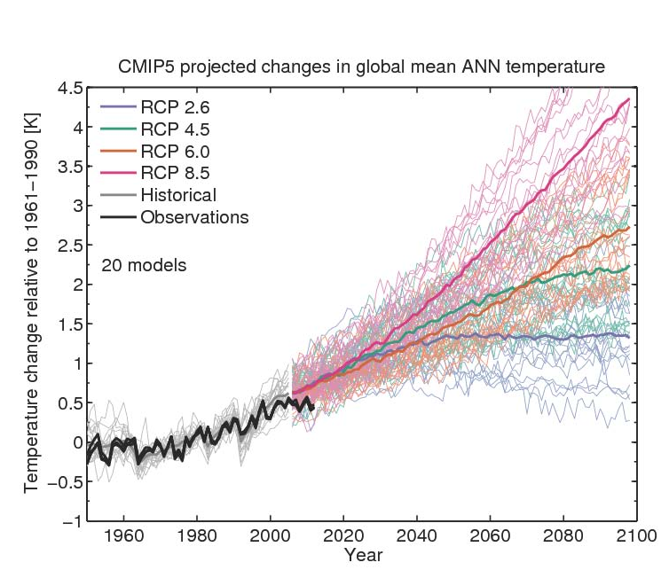
UNCERTAINTY ranges
Climate sensitivity and socioeconomic scenario
Climate sensitivity
From Ed Hawkins: see Climate Lab Book

Slide 20
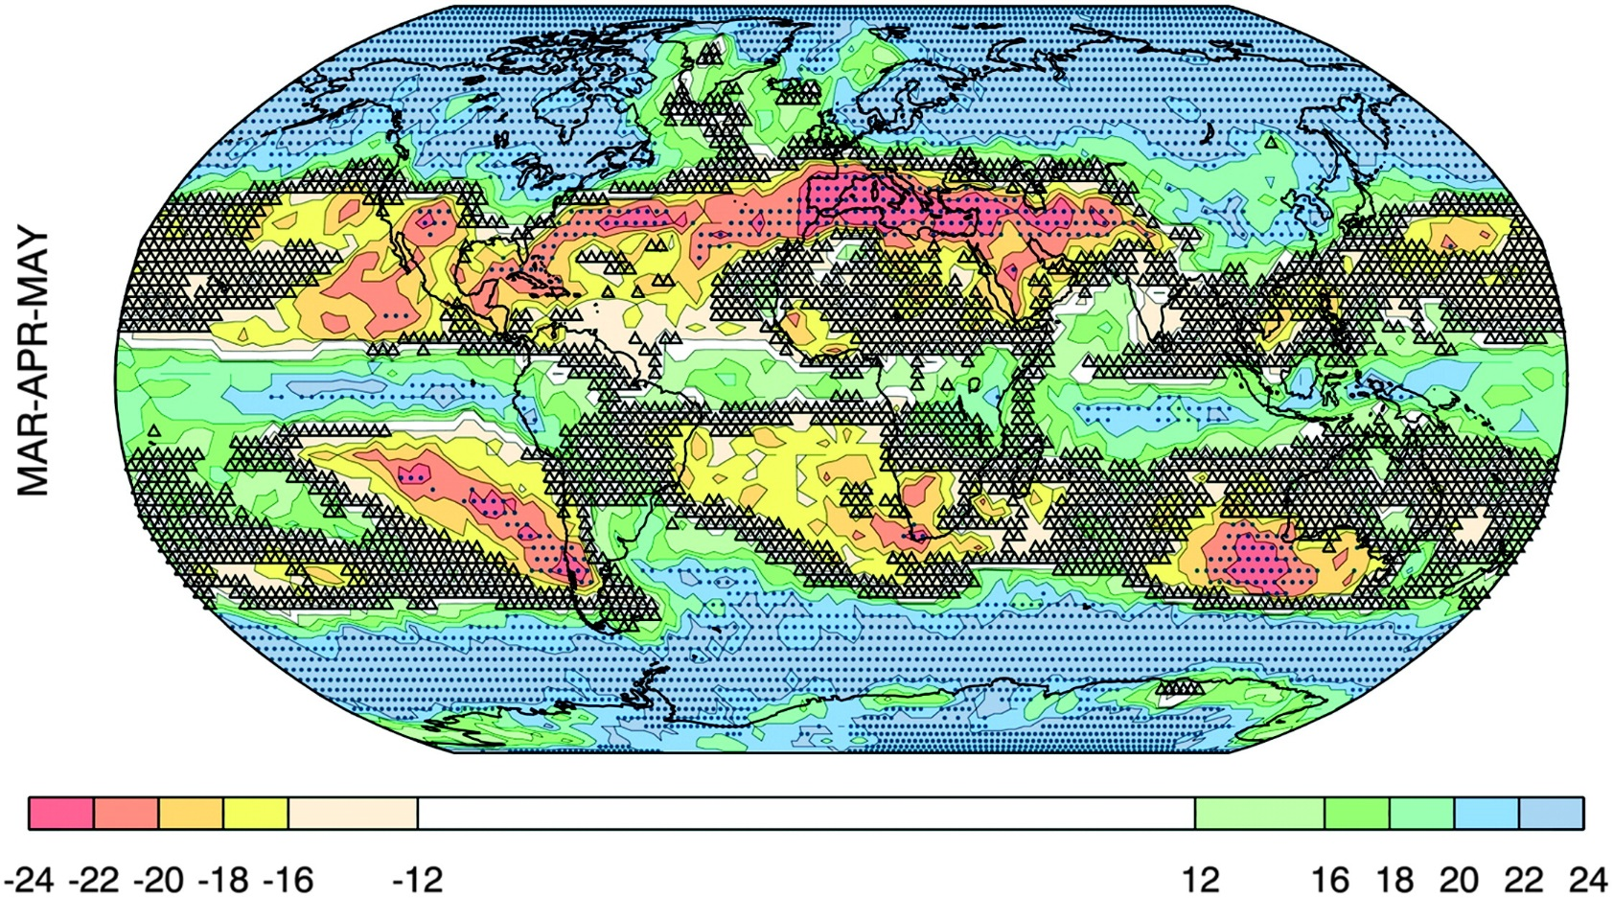
Changing PRECIPITATION:
WHERE IS BIG/SMALL CHANGE ROBUST?
Change > σ_{models}
Small change vs. variability
Number of models that agree on sign of change
Power, et al. (2012) J. Climate
Notes:
The degree of consensus on the sign of the projected change (colored shading), the areas where the MMEM change exceeds the intermodel standard deviation (dots), and regions where the projected change is very likely small relative to variability (small triangles). In virtually all cases triangles only appear where the degree of consensus is very low or absent—for MAM only.

