Slide 1
Diagnosing Recent changes in onset & cessation of wet season over africa
Department of Meteorology
Richard Allan r.p.allan@reading.ac.uk @rpallanuk
Caroline Dunning, Ross Maidment, Emily Black
NCEO national conference 2016 University of Warwick

Slide 2
introduction
Africa vulnerable to variability and changes in rainfall
Limited availability of rain gauge records in many regions
Many satellite-based products rely an gauge data for calibration and this dictates long-term changes
We apply a simple but consistent method based on the relationship between the duration of cloud tops below a threshold temperature as a reliable proxy for convective rainfall
Timing and duration characteristics of the wet and dry seasons over Africa are of importance for agriculture and impacts
We develop a methodology to diagnose the onset and cessation dates of wet seasons over Africa

Slide 3
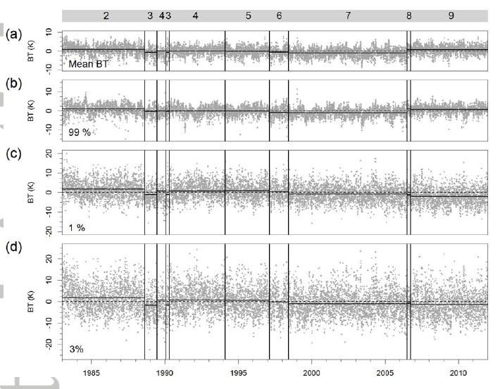
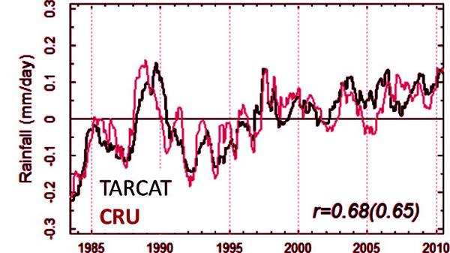
Homogeneous Africa rainfall record from Meteosat
30 year Meteosat 10.8/11.5 μm window channel BT record
Cold Cloud Duration rainfall proxy Maidment et al. (2014)
Climate model BT simulations (MSc project)
Rain-gauge (CRU) variability captured by TAMSAT →
TAMSAT CRU

Slide 4
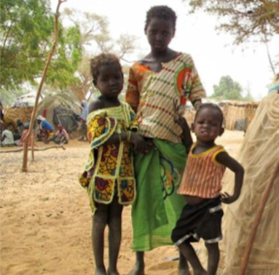
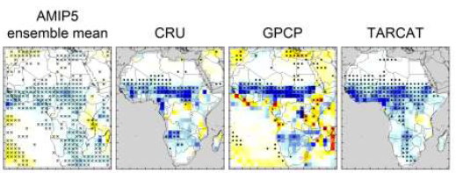
Trends in Africa rainfall
Regional rainfall sensitive to radiative forcings, inter-hemispheric heating & internal variability
Africa susceptible to changes in water cycle: monitoring essential (e.g. TAMSAT group)
West Africa - mix of pollution/cloud/dynamics: DACCIWA project, Knippertz et al. 2015
Recent trends Africa rainfall: Maidment et al. (2015) GRL
Role of GHGs in Sahel rainfall recovery:
Dong & Sutton (2015) Nature Clim
Radiative forcing?
Internal variability?

Slide 5
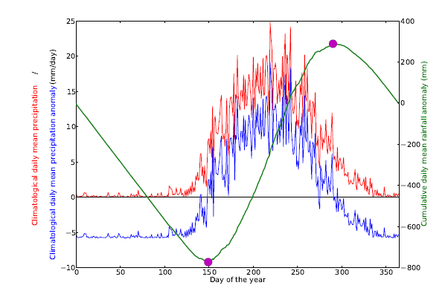
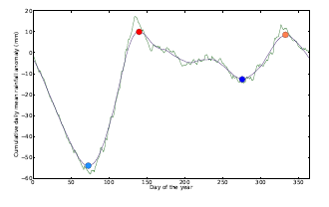
Diagnosing onset/cessation of wet season
Harmonic analysis to diagnose single/double wet season or humid/arid regimes
Use cumulative daily rainfall anomalies (multiple satellite and gauge datasets)
Apply Liebmann et al. (2012) method to diagnose min/max for single season regimes
Modify method to apply to 2 wet season regimes
Consistency across datasets and indigenous methods (Dunning et al. 2016, submitted)

Slide 6
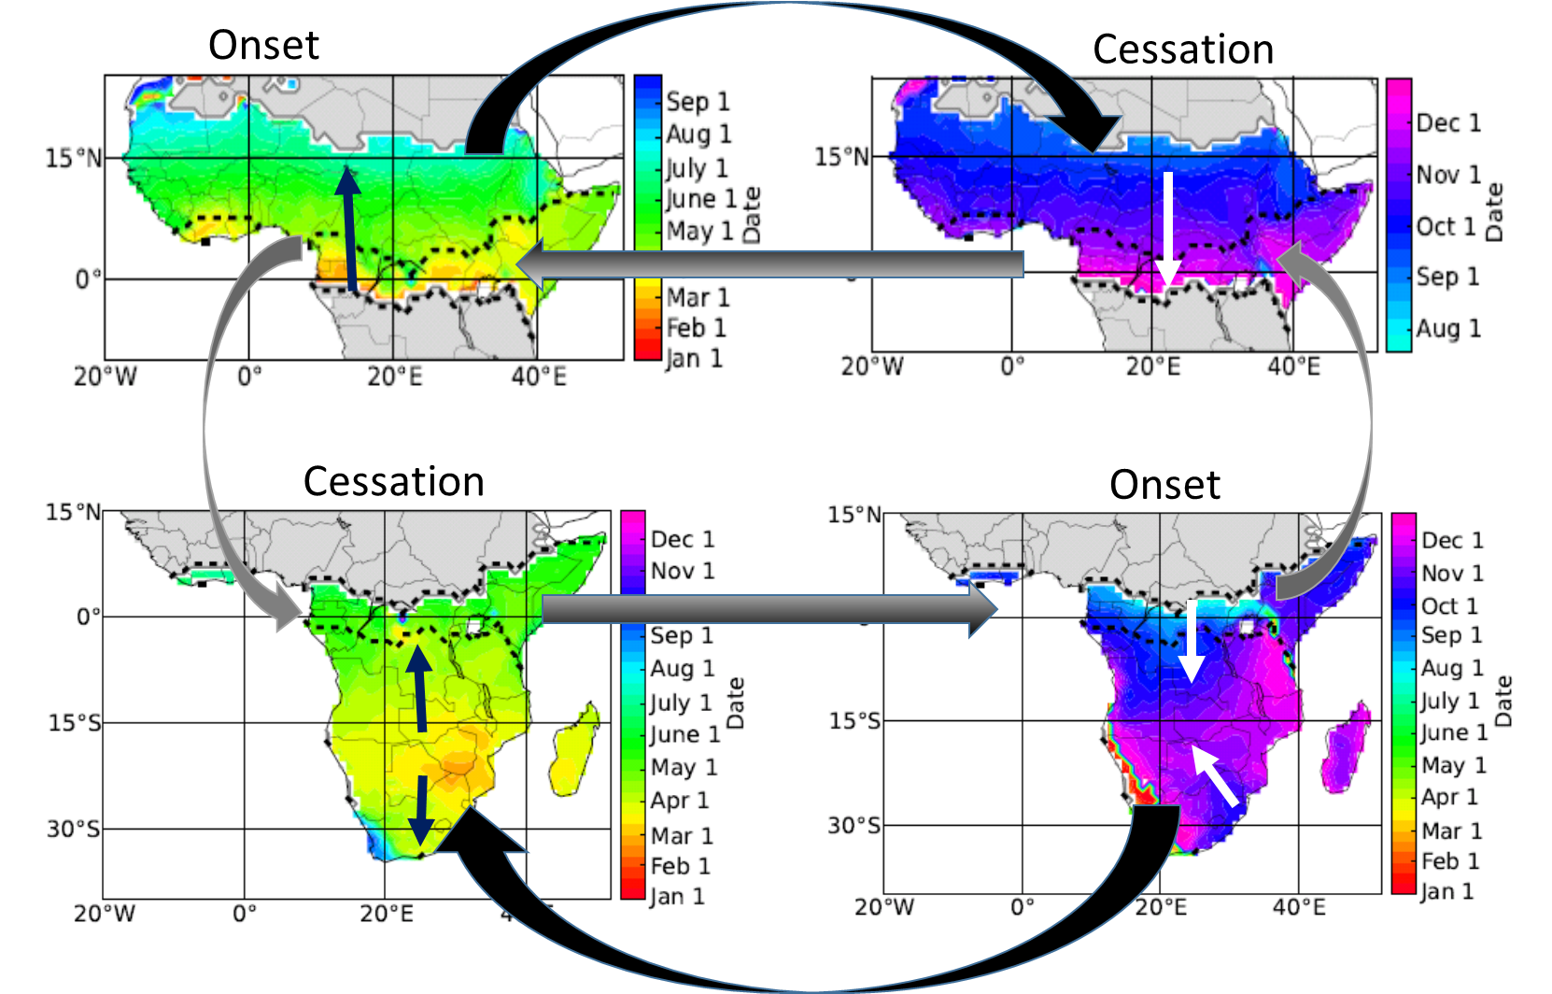
Example progression of onset/ cessation of wet season(s) - gpcp
Considered GPCP 1DD, TRMM 3B42, ARCv2, TARCATv2, CHIRPS, ERA Interim in subsequent analysis (Dunning et al., 2016, submitted)

Slide 7
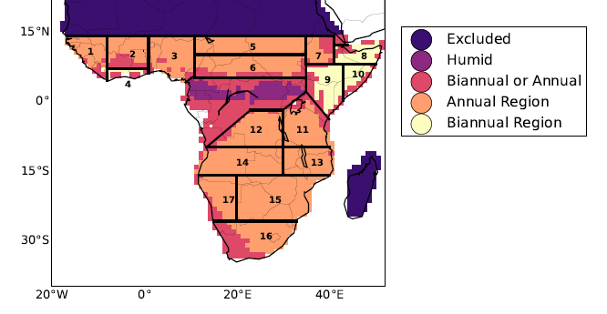
Mean onset/cessation
Assessment of mean onset/cessation dates across datasets (Dunning et al. 2016 submitted)

Slide 8
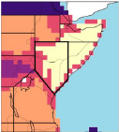
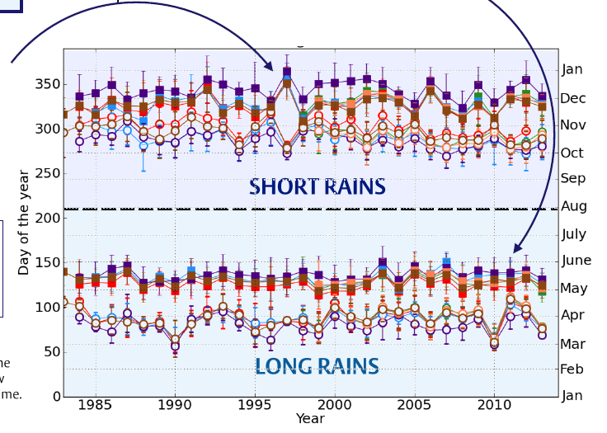
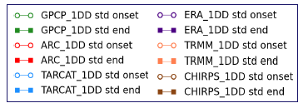
Interannual variability: East Africa
Next steps: assess physical mechanisms, evaluate climate models and develop impact-relevant metrics
Weak long rains in 2011 associated with humanitarian disaster
Early onset/late cessation associated with flooding during 1997 El Nino

Slide 9
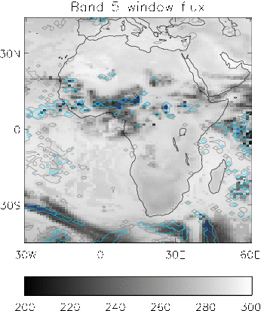
conclusions
Rainfall proxies from 10.8/11.5μm BT: consistent variability compared with homogeneous gauge-based estimates (Maidment et al. 2014, JGR)
MSc project plans to use simulated window channel BT to diagnose synthetic relationships
Africa rainfall trends: Maidment et al. (2015) GRL
Coherent increases in Sahel rainfall 1983-2012 related to radiative forcing
Increases in southern Africa rainfall linked to Pacific decadal variability
Methodology to diagnose the onset and cessation dates of wet seasons over Africa (in prep)
Future work will apply methodology to climate model simulations, investigate mechanisms and develop impact relevant metrics (PhD project)

Slide 10
Median onset/cessation date for single wet season regimes
Considered GPCP 1DD, TRMM 3B42, ARCv2, TARCATv2, CHIRPS, ERA Interim
Dunning et al. (2016) submitted

Slide 12
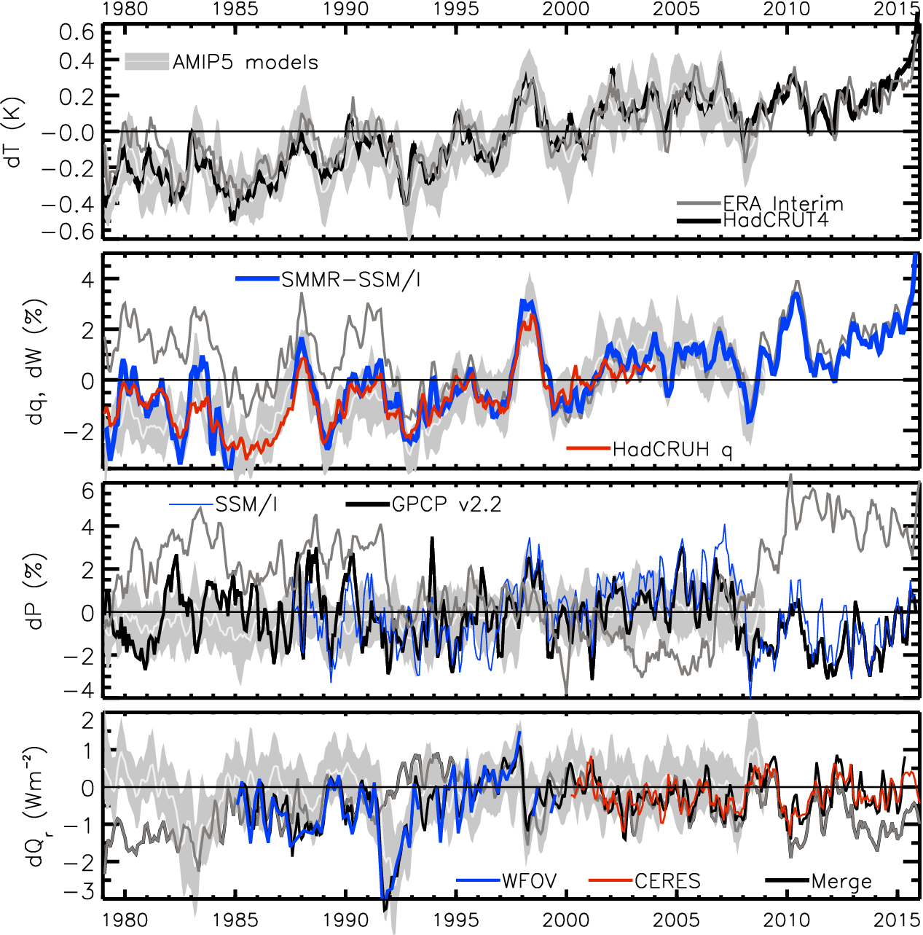
TRACKING global climate change
HEATING (Wm⁻²) PRECIP (%) MOISTURE (%) TEMPERATURE (K)
Updated from Allan et al. (2014) Surveys of Geophys & Allan et al. (2014) GRL
2.8
1.8
0.8
-0.2
-1.2
-2.2
Earth’s energy imbalance (Wm⁻²)

Slide 13
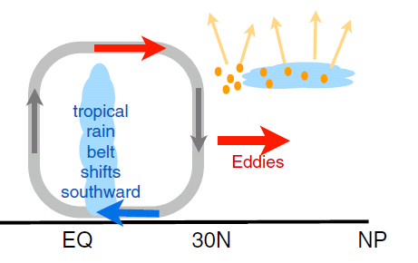
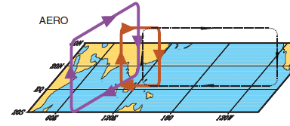
earth’s energy budget & regional changes in the water cycle
Regional precipitation biases/changes sensitive to asymmetries in Earth’s energy budget e.g. Loeb et al. (2015) Clim. Dyn; Haywood et al. (2016) GRL
N. Hemisphere cooling: less heat transport out of hemisphere
Reduced Sahel rainfall from:
Anthropogenic aerosol cooling 1950s-1980s: Hwang et al. (2013) GRL →
Asymmetric volcanic forcing e.g. Haywood et al. (2013) Nature Climate
Enhanced energy transport
cooling
Anomalous heat fluxes
Sulphate aerosol effects on Asian monsoon e.g. Bollasina et al. 2011 Science (left) & links to drought in Horn of Africa? Park et al. (2011) Clim Dyn
GHGs & Sahel rainfall recovery? Dong & Sutton (2015) Nature Clim

Slide 14
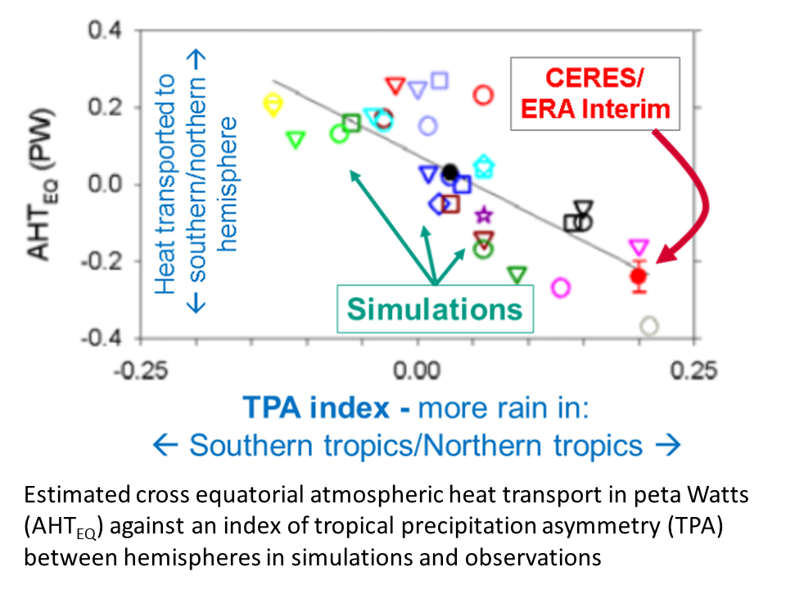
Cross-Equatorial heat transport linked to model precipitation bias
Clear link between bias in cross-equatorial heat transport by atmosphere and inter-hemispheric precipitation asymmetry Loeb et al. (2015) Clim. Dyn
Also: Haywood et al. (2016) GRL
Hawcroft et al. (2016) Clim. Dyn.

