Slide 1



New energy budget estimates at
top of Earth’s atmosphere and surface
Richard Allan, Chunlei Liu, Keith Haines: NCEO-Reading
NCEO national meeting, June 28th 2017

Slide 2
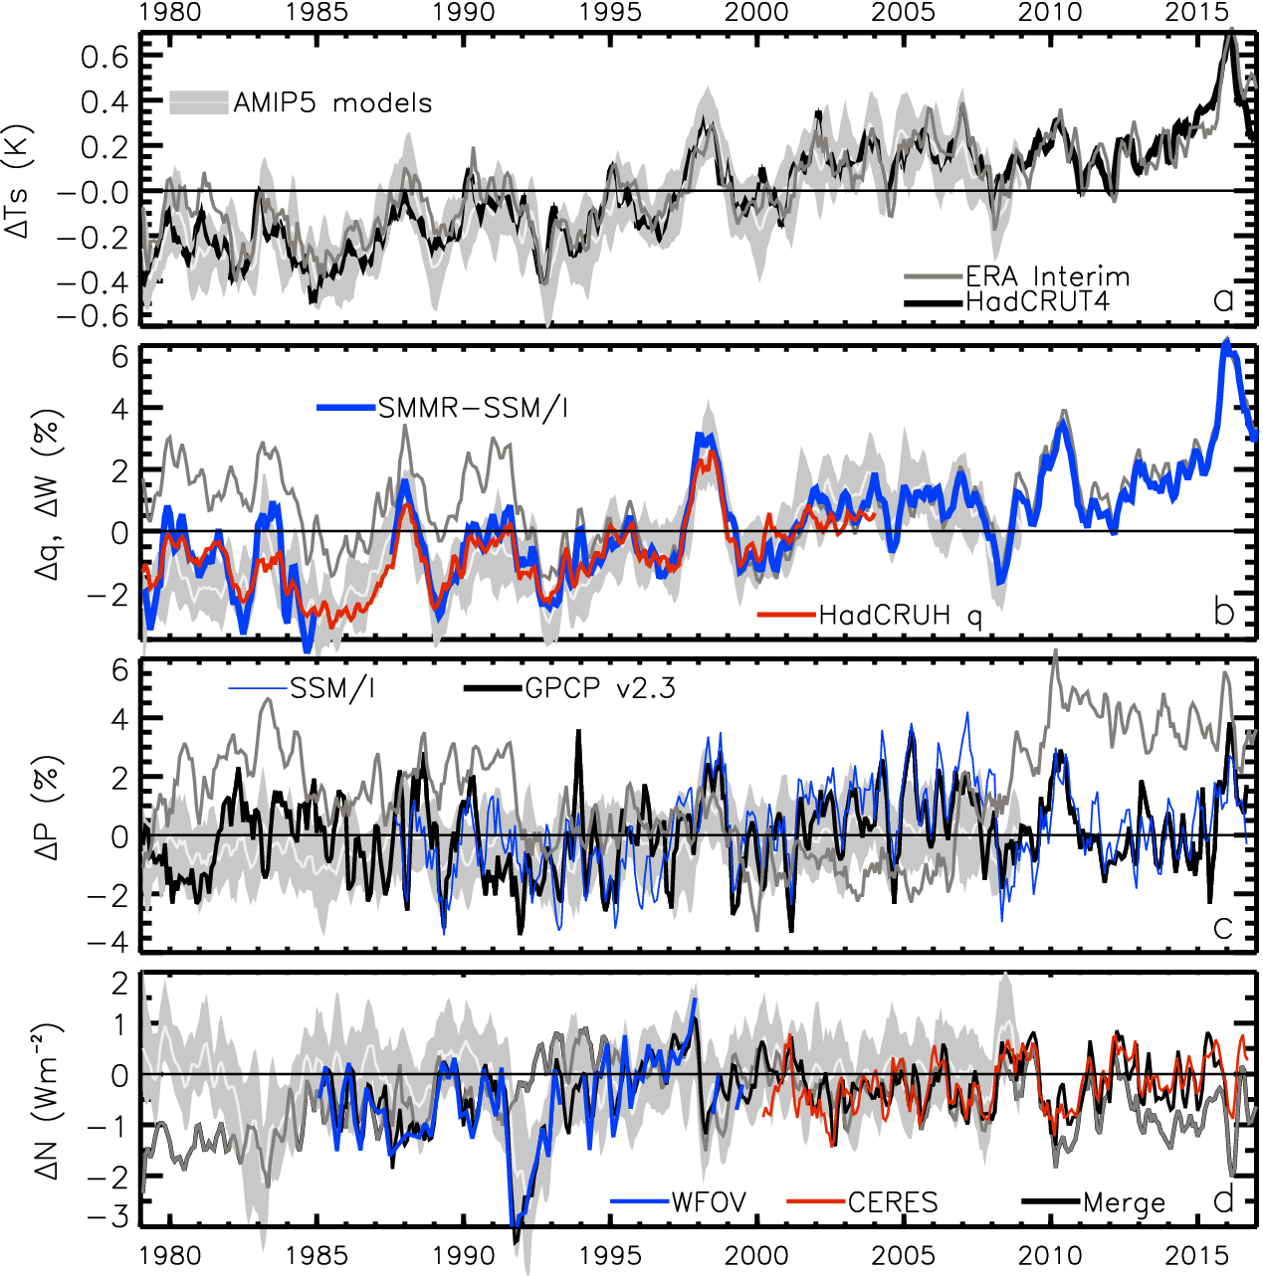
Variation in Earth’s global energy imbalance since the 1980s
TEMPERATURE anomaly (degC)
2.8
1.8
0.8
-0.2
-1.2
-2.2
ENERGY BUDGET anomaly (Wm⁻²)
Energy imbalance (Wm⁻²)
Allan et al. 2014 GRL

Slide 3
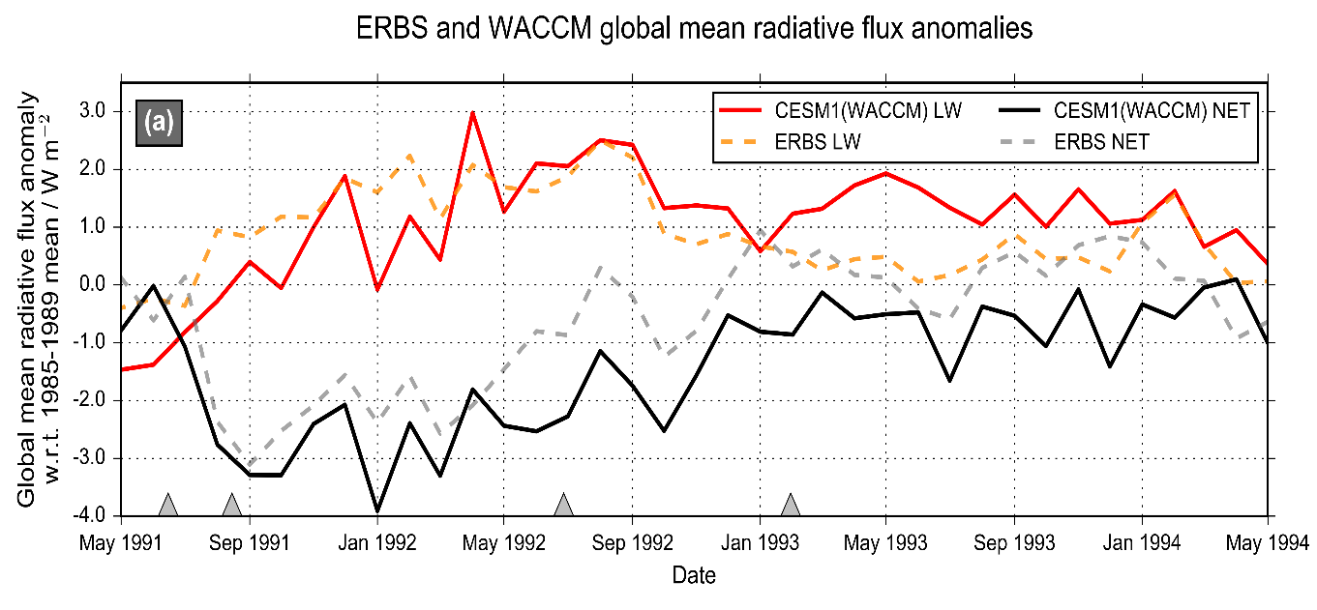
Advancing understanding of volcanic aerosol effects on climate
Malavelle et al. (2017) Nature
MODIS-Aqua Observations
Cloud water Droplet size
Volcanic aerosol haze brightens low altitude clouds, cooling climate
Further indirect effects in cloud water found to be negligible
Results will help to improve climate change projections
New assessment of direct volcanic influence on climate combining nudged models & observations
Schmidt et al. (2017) in prep

Slide 4
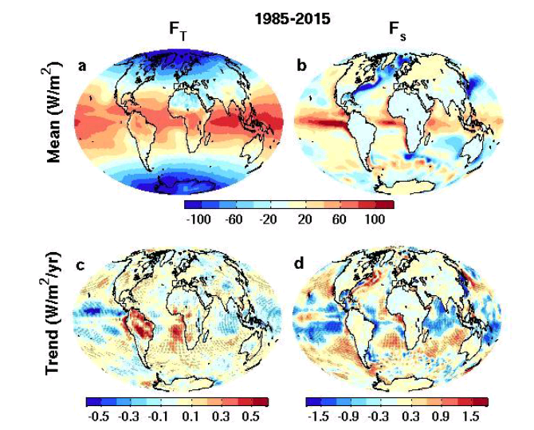
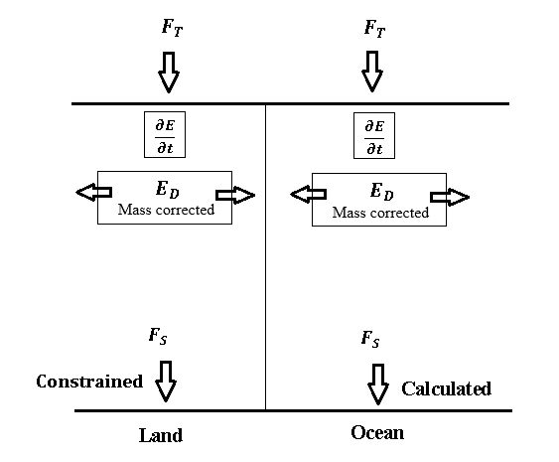

New global surface flux estimates
top of atmosphere surface
ERBS CERES
reanalyses
Surface energy flux dataset combining TOA reconstruction with reanalysis energy transports: Liu et al. (2015) JGR
Liu et al. (2017) JGR Data: http://dx.doi.org/10.17864/1947.111

Slide 5
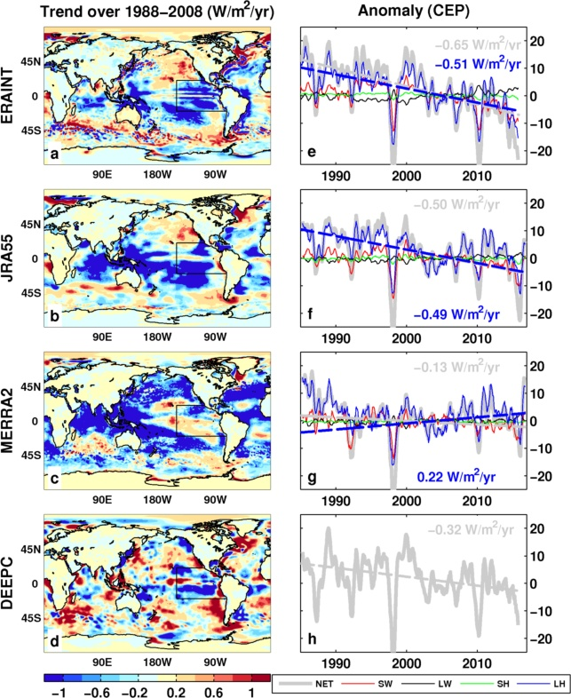
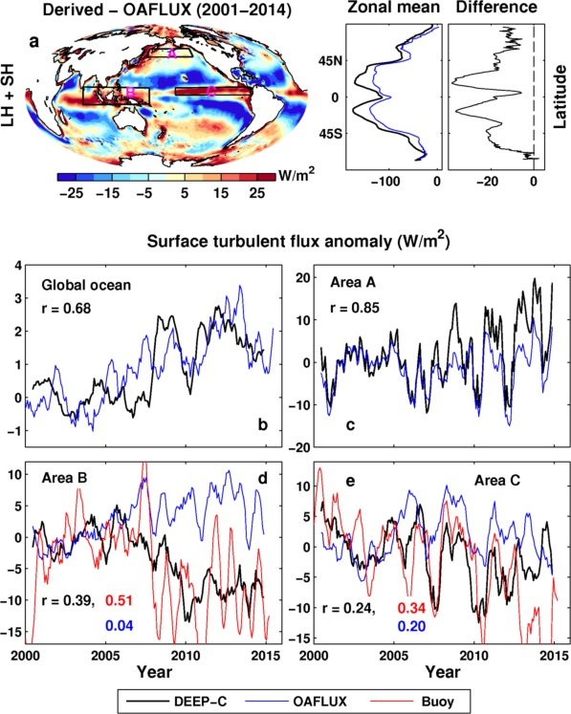
Has increased evaporation driven East Pacific cooling?
Increased cloud cover plays a role? Zhou et al. (2016) Nature Geosci
downward LHF
Decreases in East Pacific surface fluxes since 1990s
Discrepancy to simulations without coupled feedbacks
Is surface evaporation amplifying cooling?

Slide 6
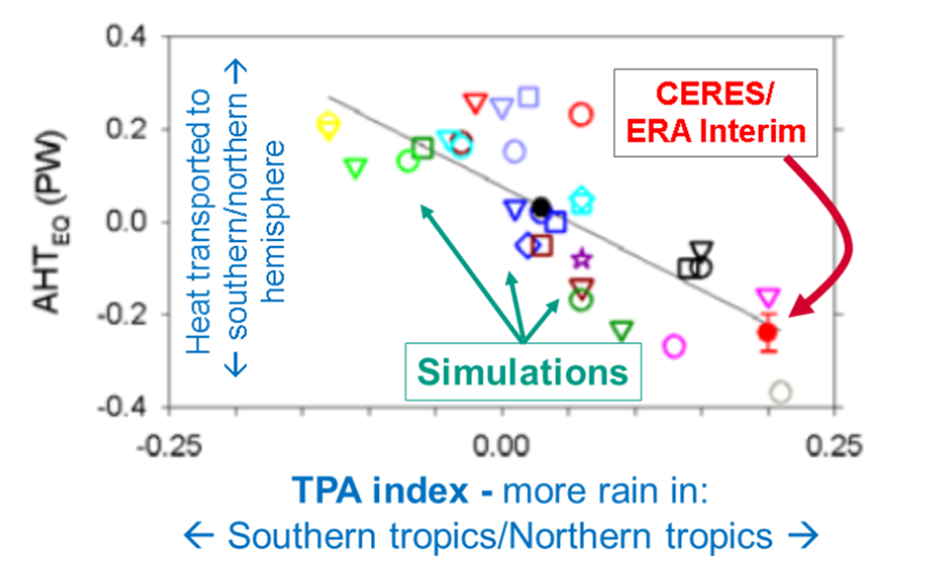
Cross-hemispheric energy transport & precipitation biases
Left: New observational estimates of inter-hemispheric energy budget (peta watts):
Liu et al. (2017) JGR
- see also Stephens et al. 2016 CCCR
Right: Model precipitation biases linked to cross-equatorial heat transport:
Loeb et al. (2016) Clim. Dyn
Notes:
Combining top of atmosphere energy buget and reanalysis horizontal energy transports allows new estimates of global surface energy budget
This has enabled advances in observing/understanding inter-hemispheric energy imbalance/transports and precipitation and links to model biases
Many CMIP5 models contain gross errors in cross equatorial energy fluxes which coincide with incorrect depiction of hemispheric precipitation asymmetries offering a potential constraint on climate models

Slide 7
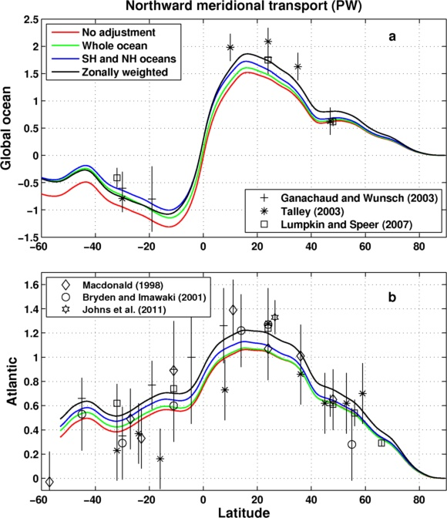
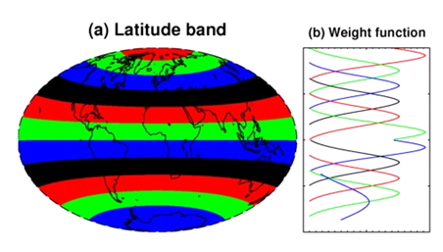
Meridional Heat Transport Estimate
Inferred from DEEP-C surface energy flux data (Liu et al. 2017 JGR) & ocean heating (Roemmich et al 2015) 2006-2013
Sensitivity of method to land flux correction
Zonal land correction
26ºN

Slide 8
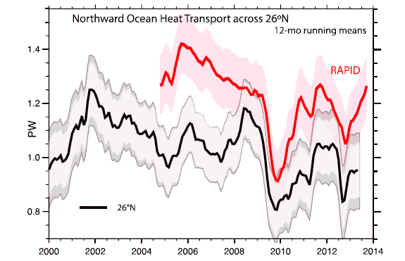
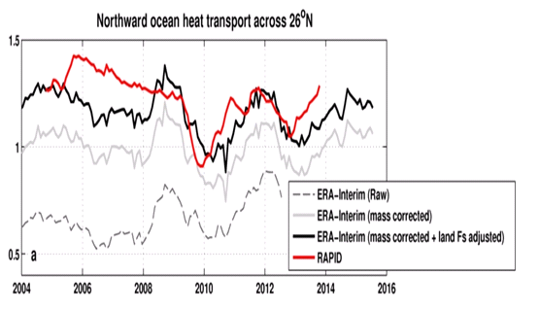
Inferred ocean heat transport@26ºN
Trenberth & Fasullo (2017) GRL
Compare indirect method with RAPID observations
Is TF2017 discrepancy due to lack of land F_{s} adjustment?
Ocean heating from ORAS4 (0-700m).
Better agreement after land Fs adjustment
2004-2013
RAPID 1.23 PW
TF2017 1.00 PW
Liu et al: 1.16 PW
large uncertainty

Slide 9
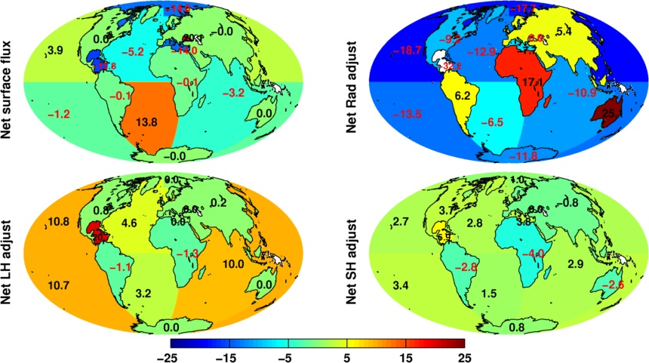
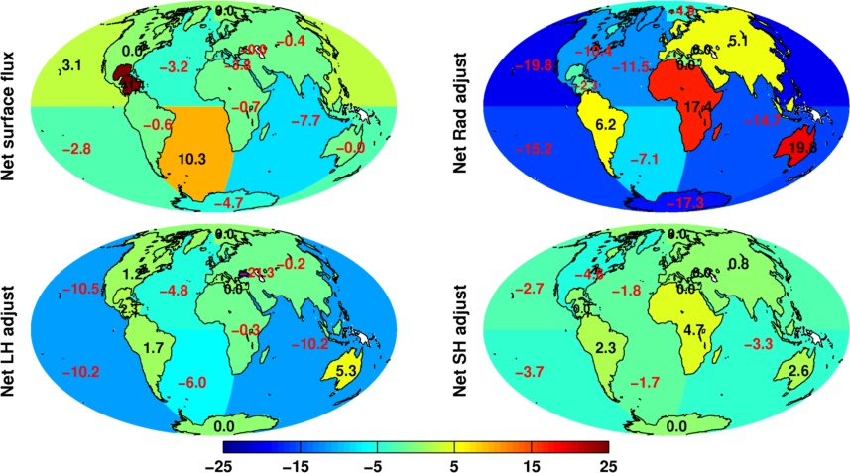
Coupled Energy and Water Cycle
Variational analysis of TOA and Surface Energy and Water cycles
Follows work by L’Ecuyer et al (2015) J. Clim, Liu et al (2015) JGR
Uses CERES + Multi-EO products (from L’Ecuyer) and ERA Interim transports + N Atlantic/Arctic ocean transport constraint + Land surface heat flux constraint.
Treats Radiation (SW/LW) and Latent/ Sensible fluxes separately
Solve over 7 Land areas, 9 Ocean areas with 14 d.o.f. (fluxes) for each region = 224 degrees of freedom
Excellent preliminary balanced adjustments to all fluxes
Could apply these as low resolution adjustments to higher resolution product eg as in Liu et al (2017) JGR
New Results - See poster 54 by Keith Haines et al.
Wm⁻²
L’Ecuyer et al Results

Slide 10
Conclusions
Extended Top of atmosphere radiation dataset (Allan et al. 2014 GRL)
  Links between radiative forcing, feedbacks and climate response
  Understanding volcanic aerosol climate effects (e.g. Malavelle et al. 2017 Nature)
New method for deriving surface energy flux (Liu et al. 2017 JGR)
  Combine satellite data with reanalysis energy transports
  New estimates of hemispheric energy imbalance and ocean heat transports
  Has increased evaporation in East Pacific contributed to decadal cooling?
Future work
  Basin-scale combined energy and water cycle budgets through using variational data assimilation inverse techniques: see Keith Haines’ poster
  Tracking changes in ocean heat transports (e.g. vs RAPID array)
  Understand feedbacks in East Pacific determining decadal climate variability
  Exploitation of surface energy flux in diagnosing systematic model biases in the Southern Ocean and monsoon regions

Slide 12
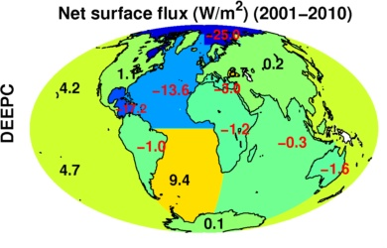
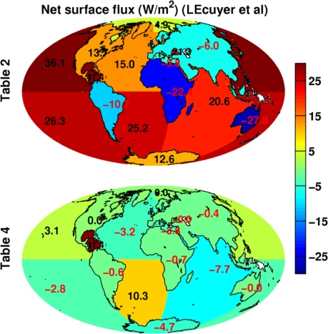
Coupled Energy & Water Cycle
Future work: extend residual energy budget to whole system
Use Variational Data Assimilation methods constrain Energy and Water budget residuals (Net flux, LHF, SHF, SW, LW, etc)
See poster by Keith Haines
L’Ecuyer et al. (2015)

Slide 13
Coupled Energy & Water Cycle
Future work: extend residual energy budget to whole system
Use Variational Data Assimilation methods constrain Energy and Water budget residuals (Net flux, LHF, SHF, SW, LW, etc)
See poster by Keith Haines
L’Ecuyer et al. (2015)

Slide 14
Coupled Energy & Water Cycle
Future work: extend residual energy budget to whole system
Use Variational Data Assimilation methods constrain Energy and Water budget residuals
See poster by Keith Haines
L’Ecuyer et al. (2015)

Slide 15
Summary
More accurate multi-decadal global estimates of Earth’s energy budget and its variability (e.g. Cheng et al. 2017 Sci. Adv.; Allan et al. 2014 GRL)
  Better indicator of global climate change than surface temperature but gaps in observing deep ocean (e.g. Palmer 2017 CCCR)
  Link to observed cloudiness? e.g. Norris et al (2016) Nature
Link between energy imbalance and surface warming depends on energy budget of upper mixed ocean layer (Roberts et al. 2015 JGR; Hedemann et al. 2017 Nature Climate Change; Xie & Kosaka 2017 CCCR)
  Better appreciation of mechanisms of decadal global climate variability
Distinct feedbacks on internal variability/forced change (Brown et al. 2016 J. Clim; Xie et al. 2015 Nature Geosci; Zhou et al. (2016) Nature Geosci
  Obs. estimates of climate sensitivity (Richardson et al. (2016) Nature Climate)
  Spatial patterns of warming crucial (Gregory and Andrews (2016) GRL)
  What explains decreased heating of E Pacific and is it realistic?
Advances in observing/understanding inter-hemispheric energy imbalance/transport and links to CMIP5 precipitation biases (Frierson et al. 2013; Loeb et al. 2016 Clim. Dyn; Stephens et al. 2016 CCCR)
  Possible constraint on realism of climate models (Haywood et al. (2016) GRL)

Slide 16
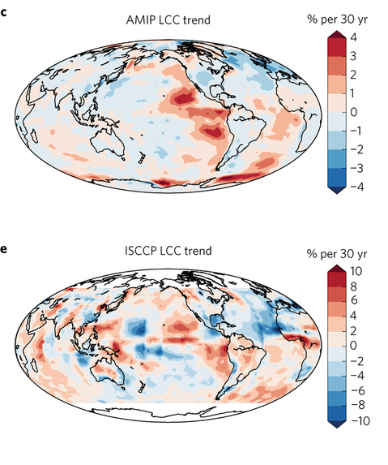
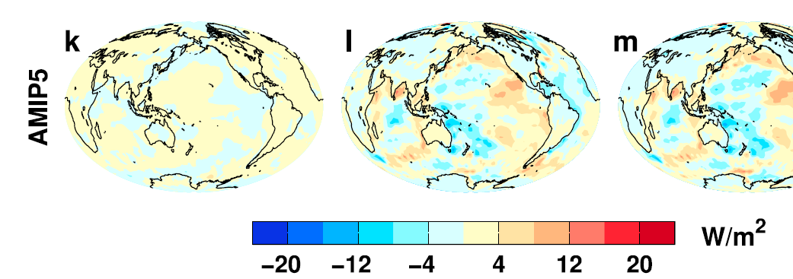
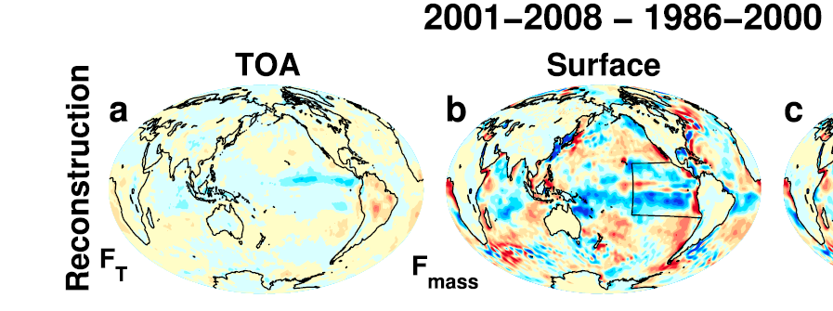
Feedbacks on internal and forced climate change involving regional energy budget
Low Cloud Cover trend 1980s-2000s Surface energy flux change
Distinct feedbacks on internal variability & forced change e.g. Brown et al. 2016 J. Clim; Xie et al. 2015 Nature Geosci; England et al. (2014) Nature Clim
Spatial patterns of warming crucial for feedbacks & climate sensitivity e.g. He & Soden (2016) J. Clim; Richardson et al. (2016) Nature Clim Change; Gregory & Andrews (2016) GRL
OBSERVATIONS AMIP MODELS
Zhou et al. (2016) Nature Geosci
Liu et al. (2015) JGR
What explains decreased heating of E Pacific; is it realistic?
Notes:
Combining decadal observations of cloud, radiation and energy transports is leading to advances in understanding regional to global feedbacks
There is emerging evidence of contrasting energy budget responses/feedbacks acting on internal and forced variability
The spatial pattern of warming is crucial in determining global feedback responses; accounting for this may help in determining climate sensitivity from observations

Slide 17
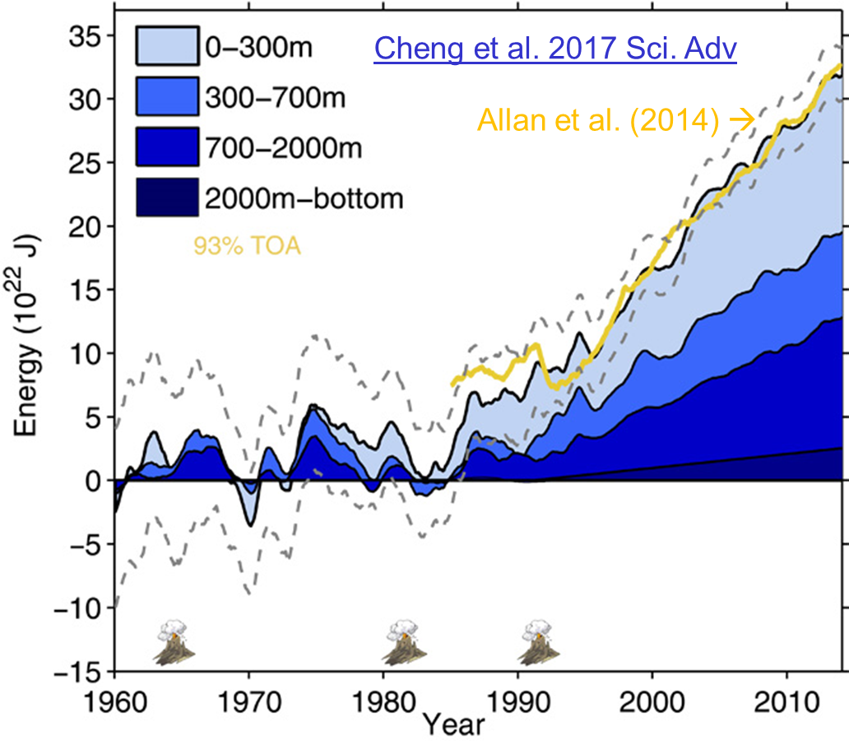
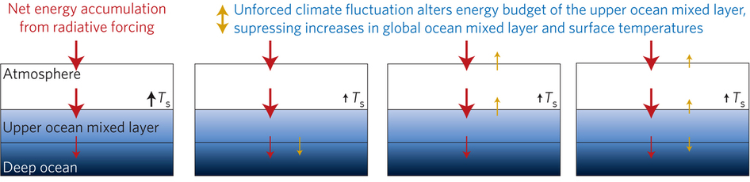
Improved global energy imbalance estimates
More accurate global imbalance from ocean and satellite observations: Cheng et al. 2017:
Steady decadal ocean heating since 2000: 0.6-0.8 Wm⁻² (Johnson et al. 2016)
Radiative forcing/internal variability influence TOA radiation (Palmer/ McNeall 2014; Allan et al. 2014; Huber/Knutti 2014; Xie/Kosaka 2017)
Upper ocean heat budget explains surface temperature: Hedemann et al. 2017 NatureCC
Allan (2017) Nature Climate Change
Notes:
Improved and longer records of ocean heating and top of atmosphere radiation measurements have improved estimates of Earth’s energy imbalance and its changes over recent decades.
Simulations with prescribed observed SST and radiative forcing are able to capture variations in energy budget
Greater appreciation for the role of internal variability in influencing global energy budget and the link between energy imbalance and surface temperature via heat budget of upper ocean

Slide 18
Evaluation of turbulent flux changes
Surface flux change 2000-2008 minus 1986-1999
Kato et al (2013) J Clim
CERES
Turbulent flux: F_{s} - F_{RAD}
OAFlux systematically lower (removed)
Good agreement in anomaly variability
Buoy data agree better with our product than with OAFlux
Are trends in reanalysis winds reliable?

