Slide 1


DEEPC: WP1 overview
& rapid trawl through the literature…
Richard Allan, Chunlei Liu - University of Reading
Thanks to: Norman Loeb, Matt Palmer, Doug Smith, Malcolm Roberts, Pier Luigi Vidale, Piers Forster
DEEP-C Meeting, NOC-Southampton, 26th March 2014

Slide 2
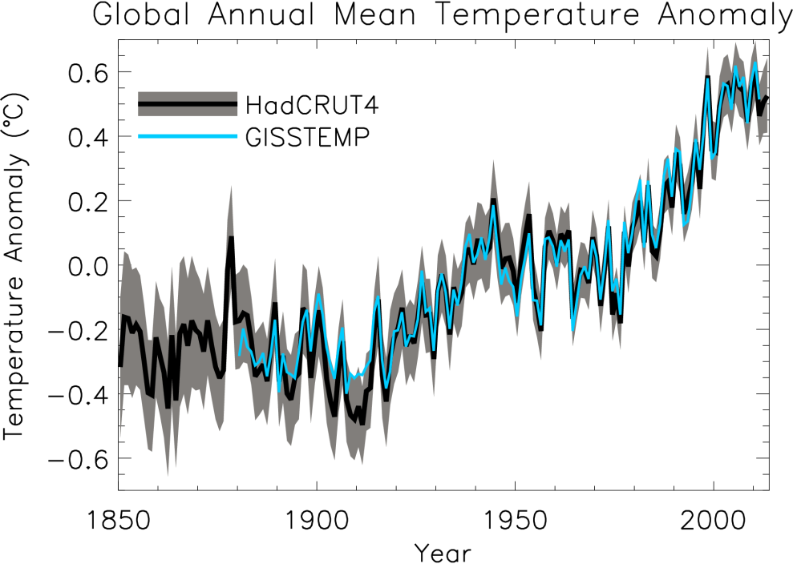
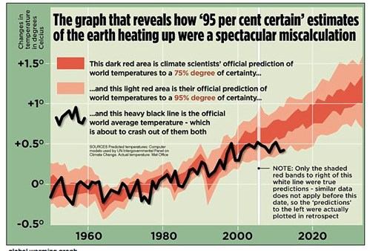
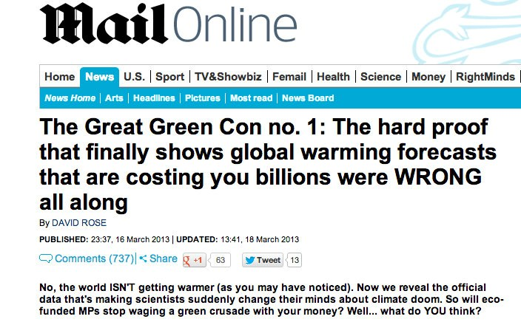
Global Warming……
Global Warming……
slowdown
pause
hiatus
has stalled?
Mail on Sunday 16th March 2013

Slide 3
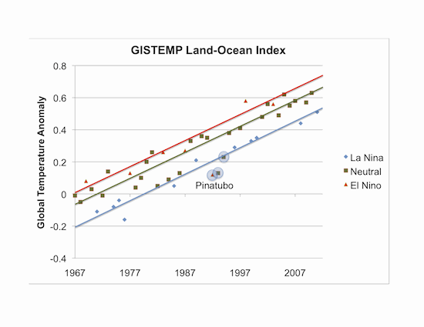
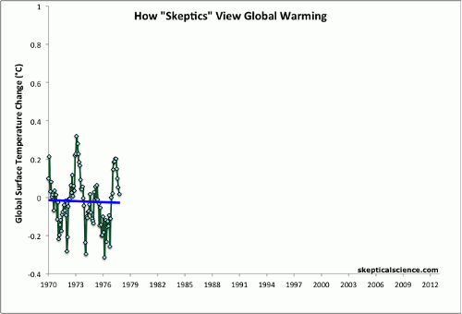
We’ve just had less El Niños?
But why have there been more La Niñas recently and hasn’t the slowdown in surface warming lasted a long time?
John Nielsen-Gammon, Texas A&M University
see Foster & Rahmstorf (2012) Environ. Res. Lett.

Slide 4
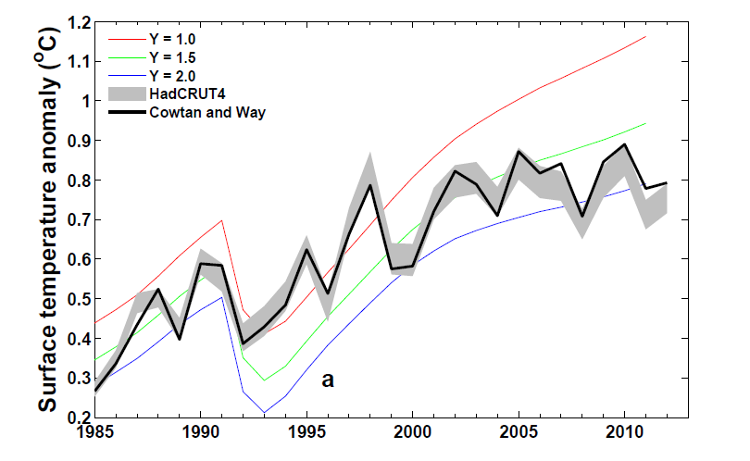
Is the temperature record wrong or are computer models inaccurate?
Can comparisons tell us about how sensitive climate is to radiative forcing? e.g. Otto et al. (2013) Nature Geosci
Spatial infilling of data gaps influences trends in surface temperature (Cowtan & Way, 2013 QJRMS) and ocean heat content (Lyman & Johnson 2014 J. Clim.)
Graph by Chunlei Liu

Slide 5
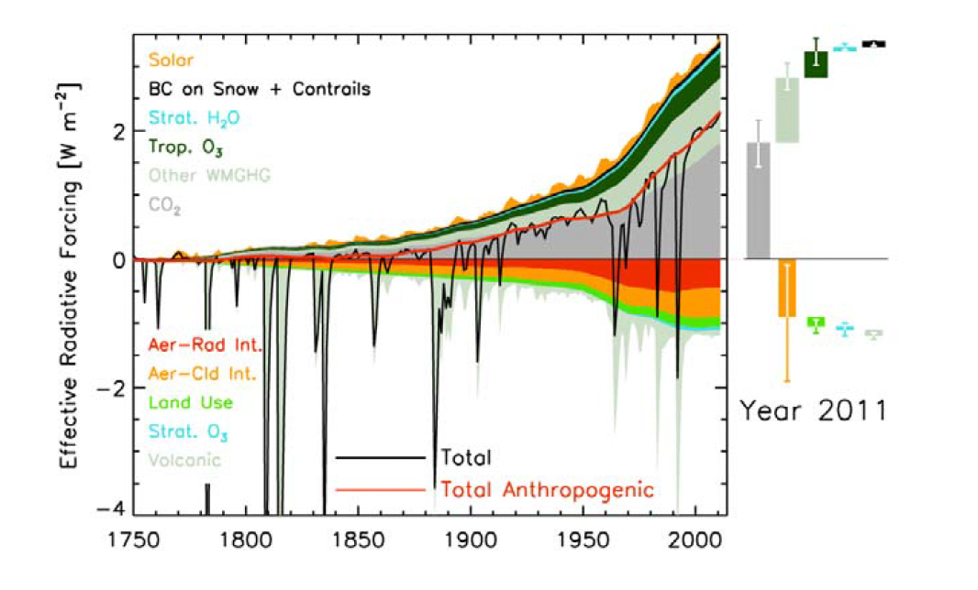
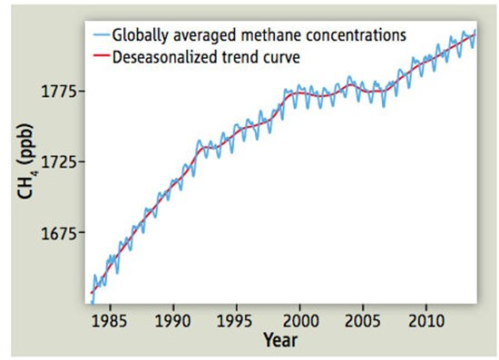
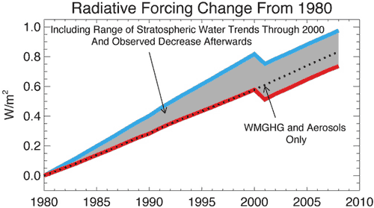
Drop in minor radiative forcings?
IPCC (2013) Figure 8.18
Nisbet et al. (2014) Science on Methane
Solomon et al. (2010) Science on Stratospheric Water Vapour

Slide 6
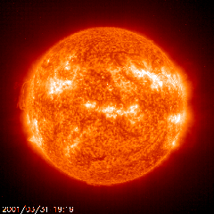
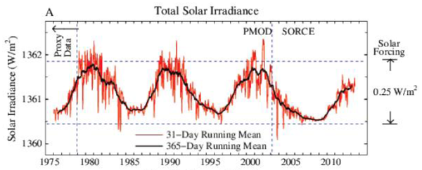
Weaker Solar Output?
IPCC: Solar Radiative Forcing change of –0.04 Wm⁻² from 1986 to 2008
Solar Radiative Forcing
~0.5 Wm⁻²
Hansen et al. (2013) PLOSONE; see also Kaufmann et al. (2011) PNAS

Slide 7
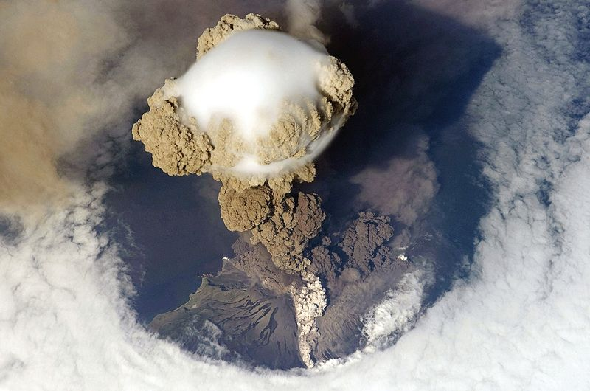
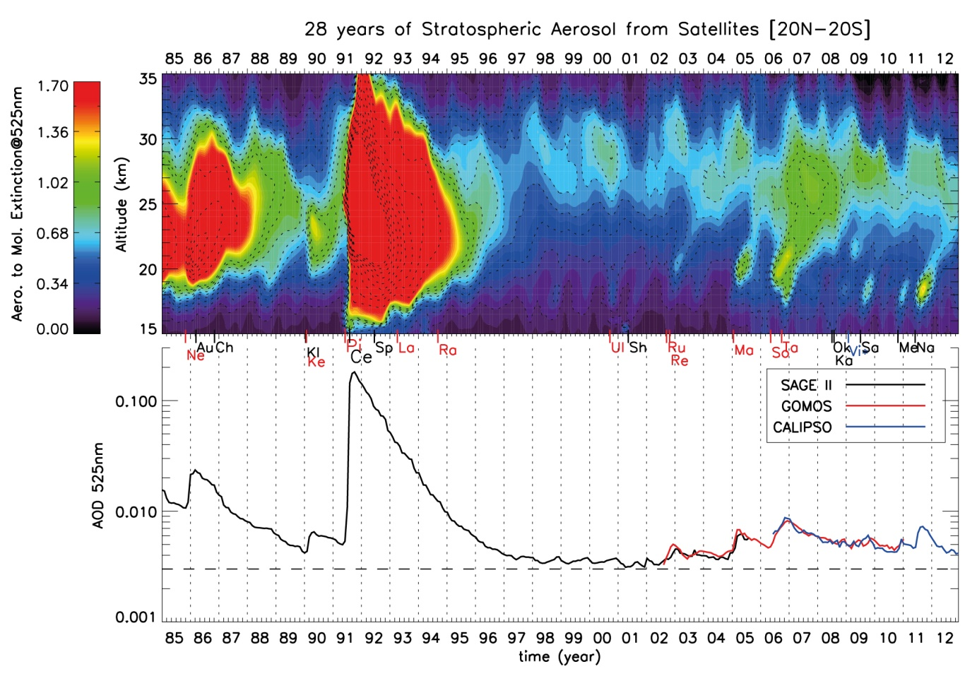
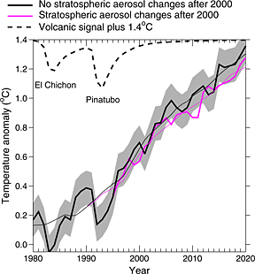
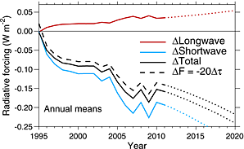
Cooling from small volcanos?
El Chichon Pinatubo
IPCC (2013) Fig. 8.13
Work by Solomon et al. (2011) Science; Vernier et al. (2011) GRL; Fyfe et al. (2013) GRL; Schmidt et al. (2014) Nature Geosci; Santer et al. (2014) Nature Geosci.

Slide 8
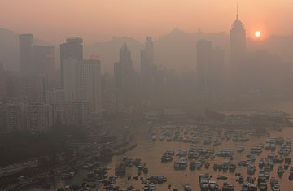
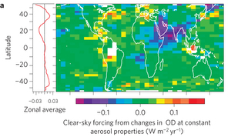
Increased aerosol pollution over Asia?
Increased Asian aerosol offset by decreases elsewhere – little change in 2000s: Murphy (2013) Nature Geosci (below)
ALEX HOFFORD / EPA

Slide 9
Causes of Climate Change 1998-2012
Cause | Estimated Change in Radiative Forcing (W per sq.m)¹
Greenhouse gases | + 0.48
Solar | – 0.16
Volcanoes | ‒ 0.06
Other (e.g. aerosols) | ± ?
TOTAL | + 0.26 ± ?
Since 1998 natural factors have masked some of the greenhouse gas warming influence
In the 1990s natural factors (especially recovery from Mt. Pinatubo) added to the greenhouse warming influence
Little overall influence of natural factors since the 1950s
¹ Quantifying other forcings and
uncertainties is ongoing research
Piers Forster, University of Leeds

Slide 10
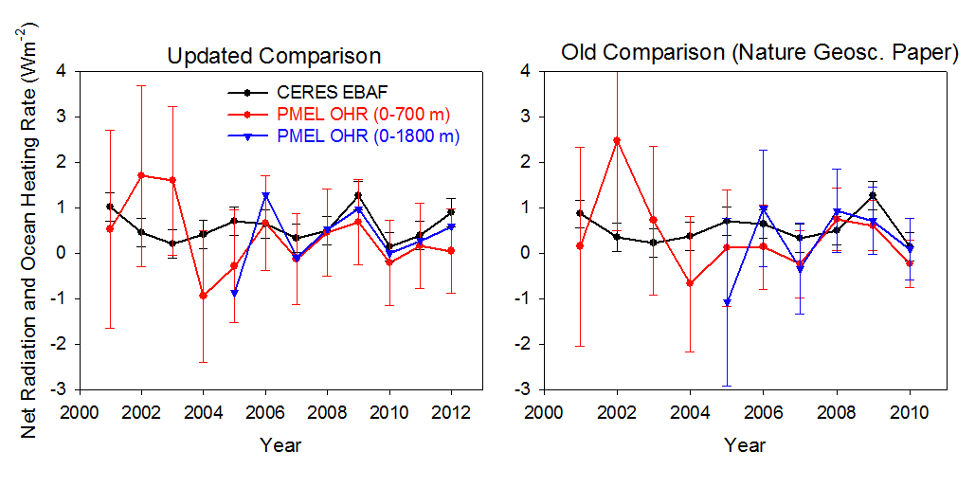
Combining Earth Radiation Budget and Ocean Heat Content data
Tie 10-year CERES record with SORCE TSI and ARGO-estimated heating rate 2005-2010 + minor additional storage terms
Variability relating to ENSO reproduced by CERES and ERA Interim
Updated estimate of net energy imbalance of 0.60±0.43 Wm^{–2}
Loeb et al. (2012) Nat. Geosci.
unpublished
Increased heat flux to deeper layers of the ocean: Watanabe et al. (2013) GRL; Balmaseda et al. (2013) GRL
Loeb et al. (2012) Nat. Geosci. See also Hansen et al. (2011) ACP; Trenberth et al. (2014) J. Climate
Notes:
Fi gure 3 (a) Global annual average net TOA flux from CERES observations and (b) ERA Interim reanalysis are anchored to an estimate of Earth’s heating rate for 2006–2010 ⁵ The Pacific Marine Environmental Laboratory/Jet Propulsion Laboratory/Joint Institute for Marine and Atmospheric Research (PMEL/JPL/JIMAR) ocean heating rate estimates⁴ use data from Argo and World Ocean Database 2009; uncertainties for upper ocean heating rates are given at one-standard error derived from sampling uncertainties. The gray bar in (b) corresponds to one standard deviation about the 2001–2010 average net TOA flux of 15 CMIP3 models.

Slide 11
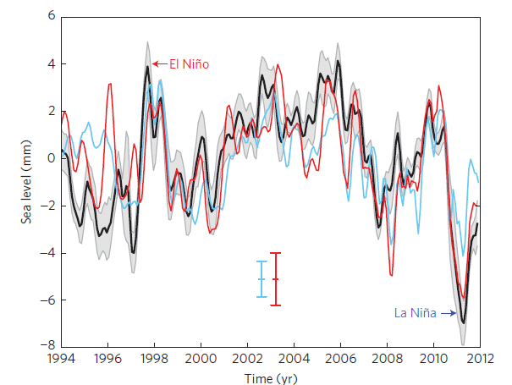
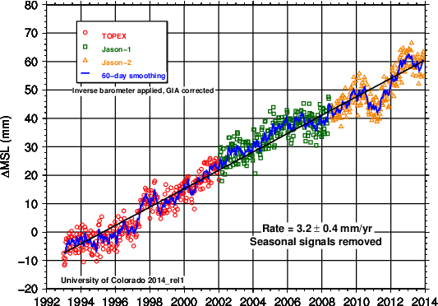
Reduced rate of sea level rise?
Detrended global sea level changes: mass only and mass+thermosteric
Slowing in sea level rise? Not in recent data. Varia-bility expected from movement of water mass over land & redistribution of heat in ocean during La Nina.
Cazenave et al. (2014) Nature Climate Change

Slide 12
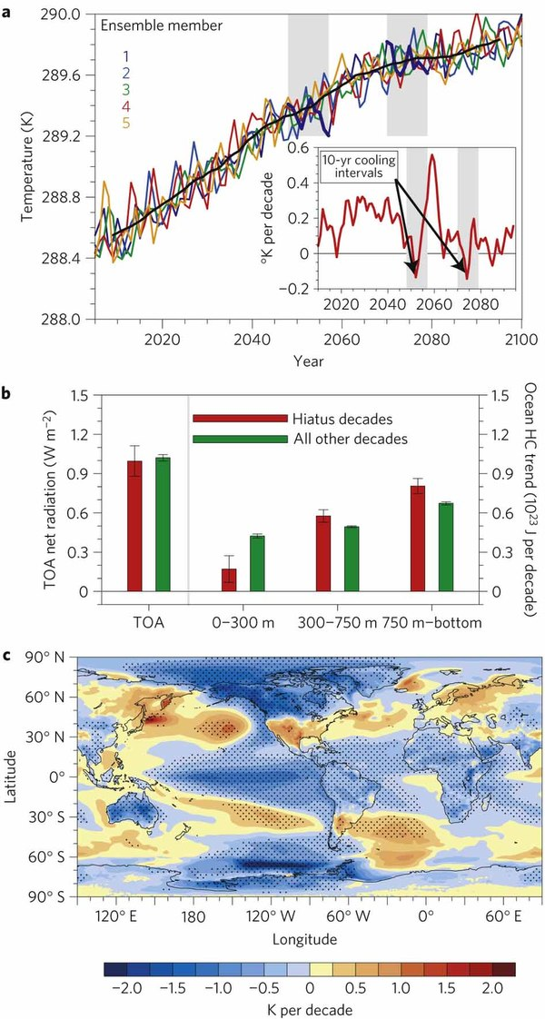
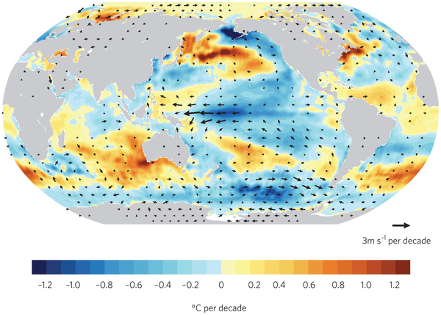
Climate models simulate decades with little surface warming despite CO₂ increases
Ocean variability causes heat to mix to deeper levels in some decades
Associated pattern of sea surface temperature trends match current observations
Heating rate
Temperature (K)
Temperature Trend (K/decade)
Model (Meehl et al. 2011, 2013) Observations 2001-2013 (Kosaka 2014)

Slide 13
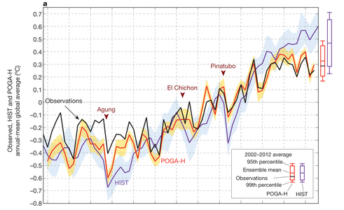
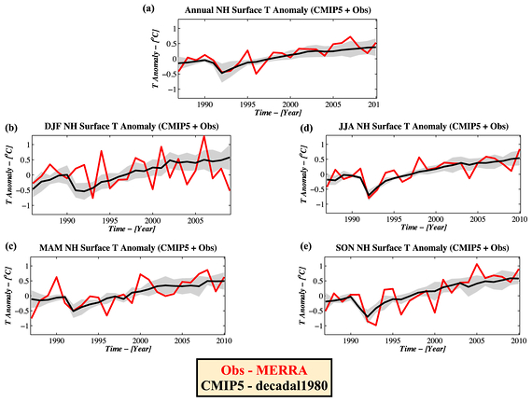
Role of Pacific Ocean Natural Variability
Kosaka & Xie (2013) Nature
← Kosaka & Xie (2013) Nature
Adjust heating in E Pacific to agree with obs SST
Simulations reproduces hiatus and some regional climate anomalies
Also explains why hiatus dominates NH winter (e.g. Cohen et al. 2012, below)
Note, some models do not simulate natural variability well e.g. CNRM, CanCM4; Watanabe et al. 2013)
Cohen et al. 2012

Slide 14
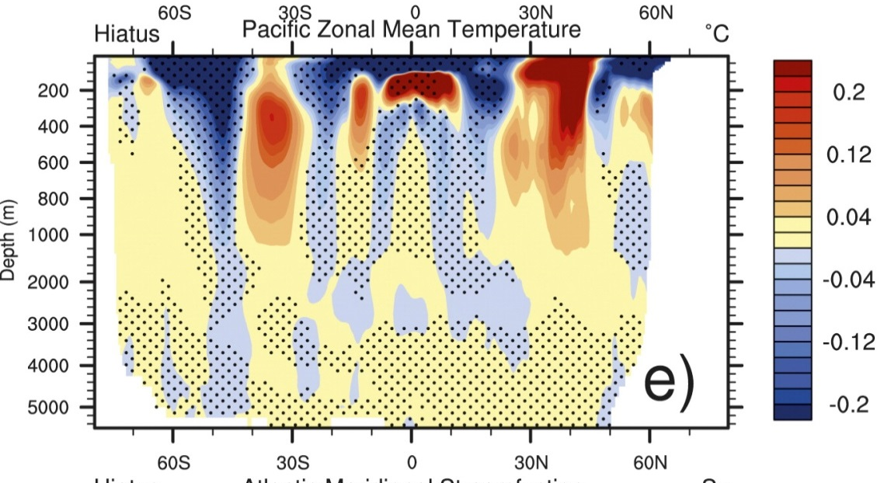
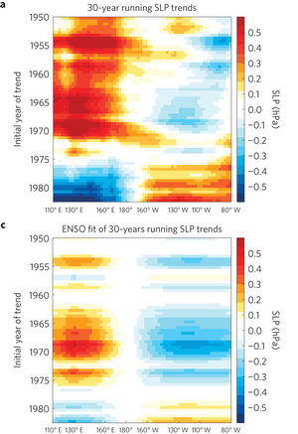
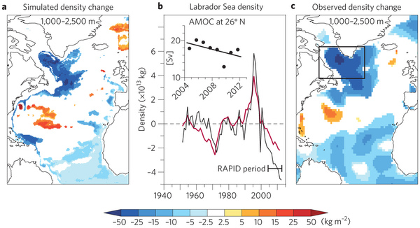
Vertical profiles of heating in Pacific during hiatus decades →
Meehl et al. (2013) J Clim
Trends in SLP and decadal ENSO signal (L’Heureux et al. 2013; Sohn et al. 2012; Merrifield 2011; England et al. 2014)
Strengthening of Walker circulation in response to IPO pattern? Or has change in wind stress increased heat uptake below 700m (Balmaseda et al. 2013)?
Slowdown predicted with initialisation (Guemas et al. 2013; Smith 2013)
Other notable changes: freshening of Antarctic bottom waters since 1980s (Purkey & Johnson 2013) ; slowing of AMOC? (Robson et al. 2014)

Slide 15
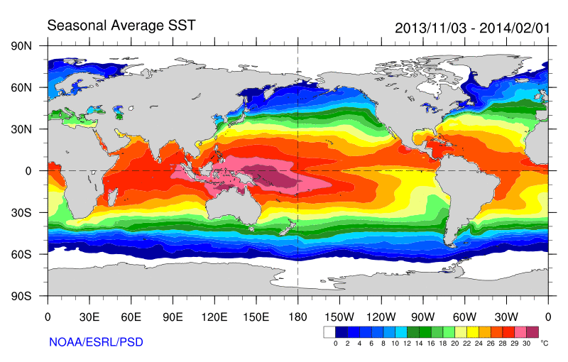
Role of Pacific ocean variability
Continued heating from rising greenhouse gas concentrations
Unusual weather patterns
Enhanced Walker Circulation
Ocean circulation strengthens atmospheric circulation
Increased sea height
Warm
Upwelling,
Cool water
Increased precipitation
Decreased salinity
Strengthening trade winds
Equatorial Undercurrent
Enhanced mixing of heat below 100 metres depth by accelerating shallow overturning cells and equatorial undercurrent
Work by Merrifield (2010) J. Climate; Sohn et al. (2013) Clim. Dyn.; L’Heureux et al. (2013) Nature Climate Change; Kosaka and Xie (2013) Nature; England et al. (2014) Nature Climate Change

Slide 16
WP1 - Planned work
Analyse and update observed variability in TOA radiation balance (under review)
Investigate lags in climate system (in prepatation)
Combine ERA Interim and CERES to provide new estimate of surface heating (in preparation)
  - Wider use of flux products by Pat Hyder et al. (Met Office)
Monitoring of changes in energy balance
Reconcile TOA radiation balance and ocean heating

Slide 17
WP1 Objectives/Deliverables
O1. Combine satellite radiation budget measurements with atmospheric reanalyses, providing improved 2D estimates of surface heat fluxes across the ocean surface (WP1)
O5. Monitor co-variations in net radiative energy imbalance and ocean heating (from O1,O2,O4); quantify and understand lags between OHC and TOA radiation (WP1-4)
O6. Characterise spatial signatures/mechanisms of ocean and atmospheric heat re-distribution (from O4-5) during the hiatus period 2000-2015 using observations and simulations (WP1-4)
D1. Combined satellite-reanalysis atmosphere/surface energy flows: methodology, uncertainty and exploring lags in the climate system (paper 1,2; WP1, O1,4)

Slide 18
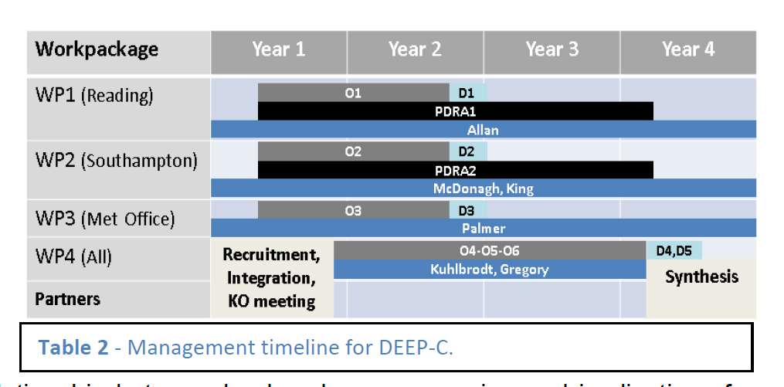
DEEP-C Work Plan
Start date: March 2013; Project Ends February 2017
Workpackage | Year 1 | Year 2 | Year 3 | Year 4
WP1 (Reading)
WP2 (Southampton)
WP3 (Met Office)
WP4 (All)
Partners
O1
D1
PDRA1
Allan
O2
D2
PDRA2
McDonagh, King
O3
D3
Palmer
Recruitment, Integration, KO meeting
O4-O5-O6
D4,D5
Kuhlbrodt, Gregory
Synthesis

Slide 19
DEEPC: WP1
Earth’s energy imbalance 1985-2012
Richard Allan, Chunlei Liu (University of Reading); Norman Loeb (NASA Langley); Matt Palmer, Doug Smith, Malcolm Roberts (Met Office); Pier Luigi Vidale (Reading/NCAS)
DEEP-C Meeting, NOC-Southampton, 26th March 2014
Notes:
Over the last decade the rate of global warming appears to have dwindled. Is this important and what are the implications?

Slide 20
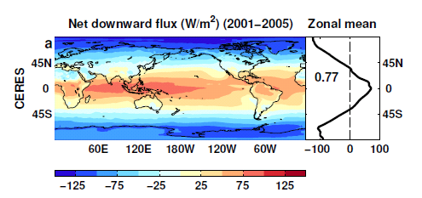
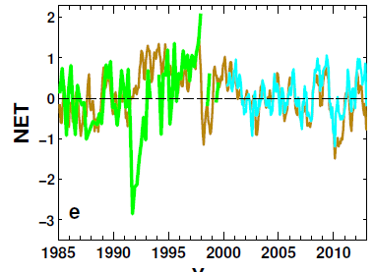
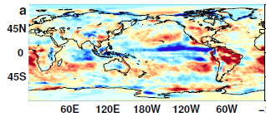
Reconstructing global radiative fluxes prior to 2000
ERBS WFOV variability
CERES monthly climatology
ERBS WFOV
CERES
ERA Interim
ERA Interim spatial anomalies
Combine CERES/ARGO accuracy, ERBS WFOV stability and reanalysis circulation patterns to reconstruct radiative fluxes

Slide 21
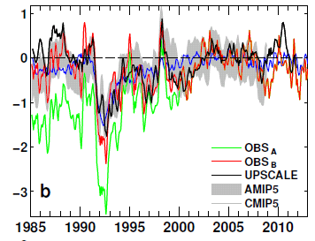
Use reanalyses or models to bridge gaps in record (1993 and 1999/2000)
Outgoing Longwave Radiation Anomalies (Wm⁻²)
ERA Interim trends suspect. Use model…
UPSCALE simulations (obs. SST, sea ice & realistic radiative forcings) “OBS_{B}”
Net less sensitive to method than OLR/ASR

Slide 22
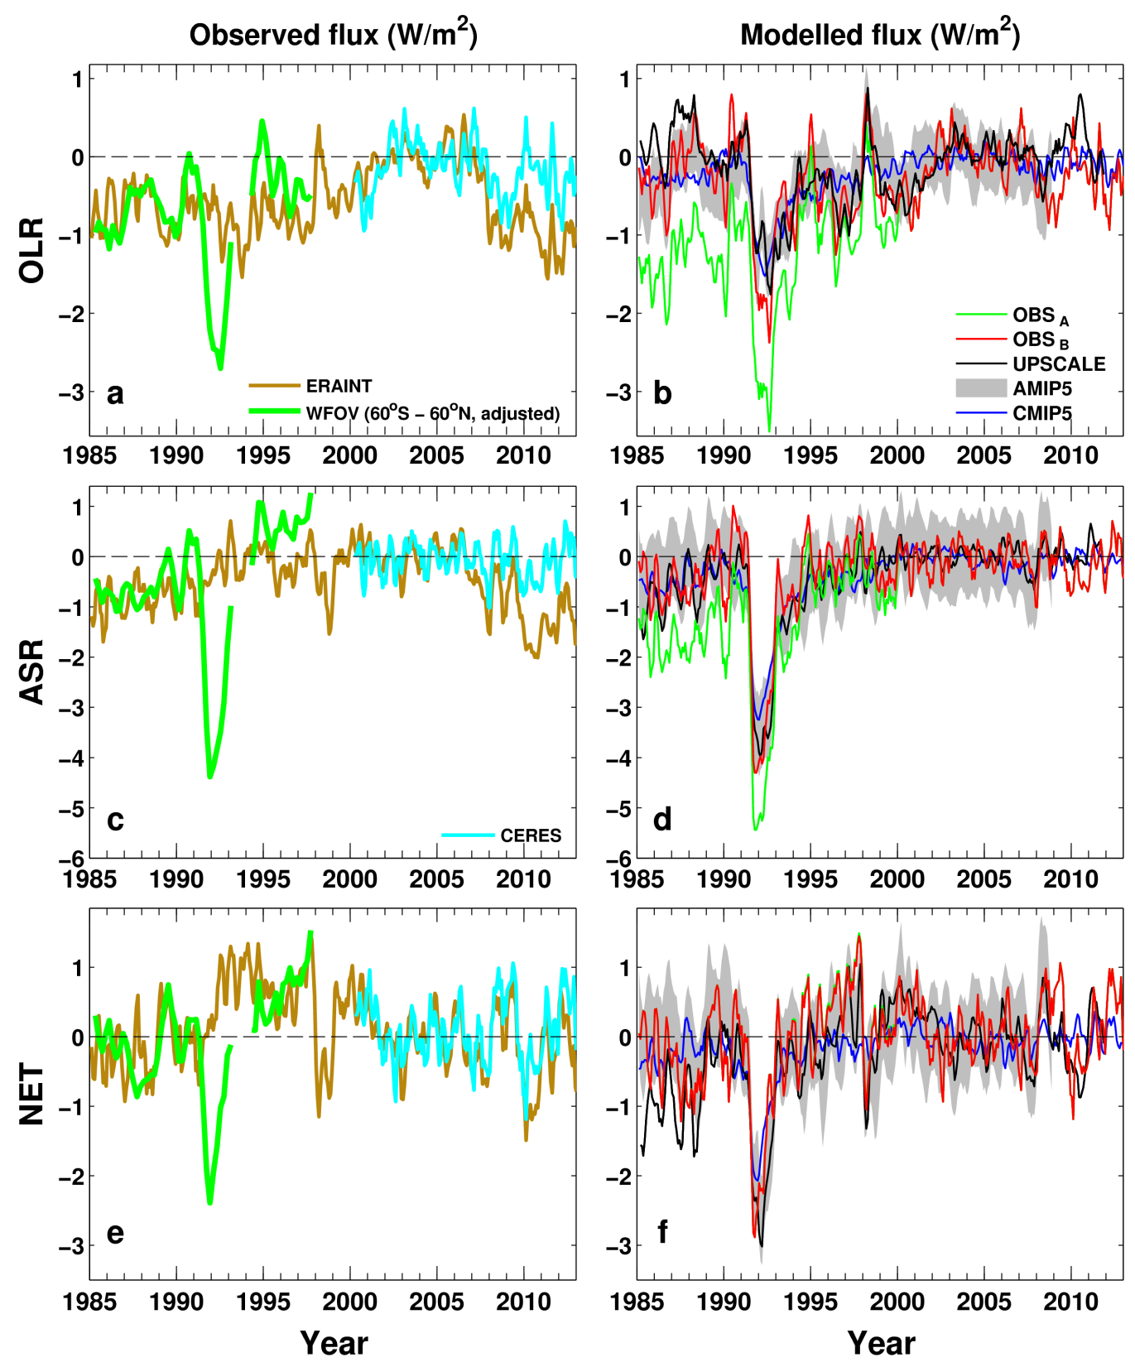
Net Imbalance Anomaly (Wm⁻²)
Reconstructed Net Flux (Wm⁻²)
0.25 0.02 0.91 0.51 0.55

Slide 23
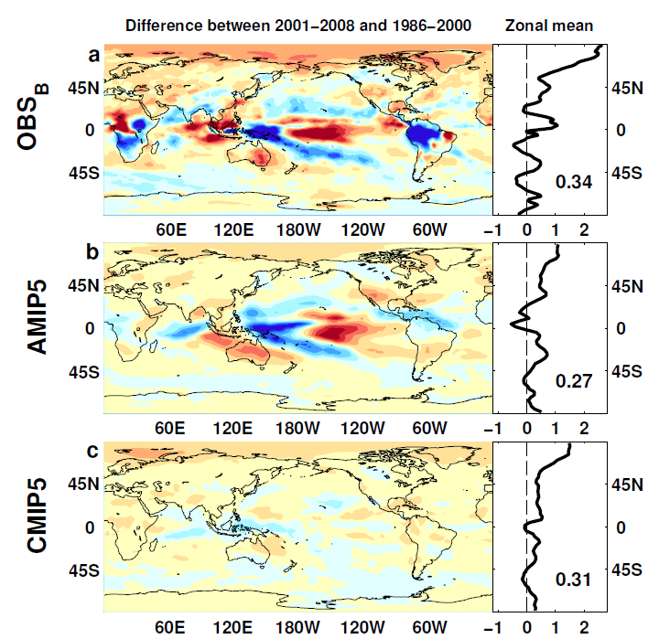

Outgoing Longwave Radiation
Wm⁻²

Slide 24
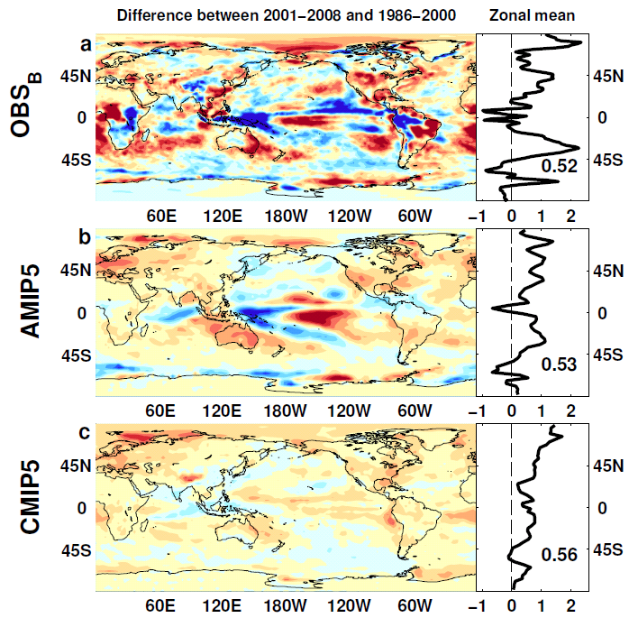
Absorbed Shortwave Radiation
Wm⁻²

Slide 25
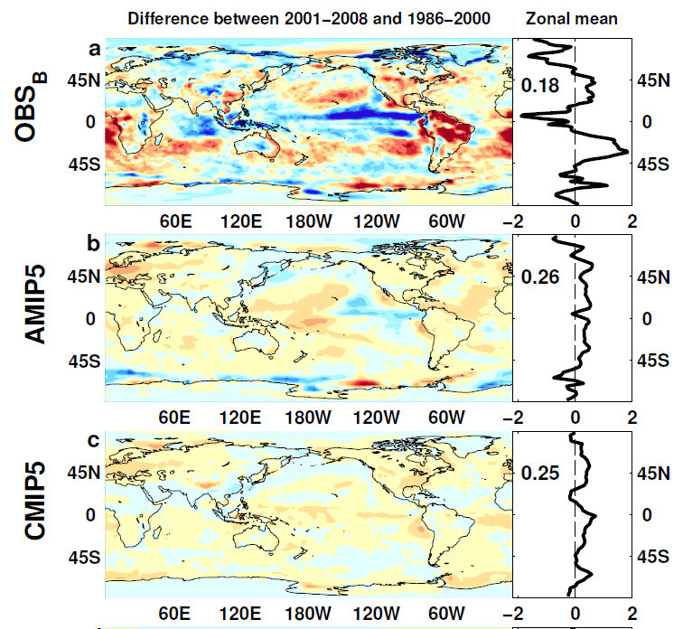

NET Radiation

Slide 26
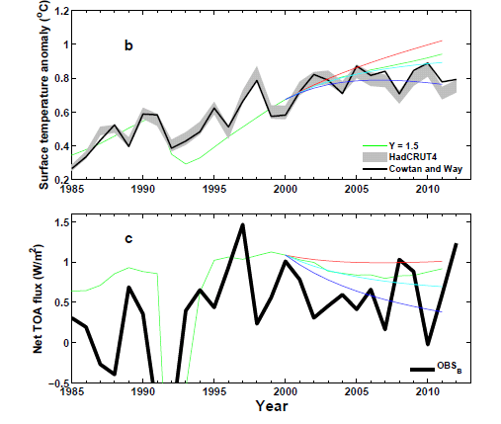
Analysis using simple energy balance model
+ve RF trend
0 RF trend
-ve RF trend
Use AR5 RF

Slide 27
Preliminary results
Heating of Earth continues at rate of ~0.6 Wm-2
Radiative forcing alone can’t explain surface warming slowdown: internal variability important
Current variability in TOA radiation (1985-2013)
Net flux higher in 1995-1999 than 2000-2012 period
Distinct East Pacific signal in ΔT and ΔN
Plans:
  Development of surface flux dataset (next)
  Lag-lead analysis (some preliminary work)
  Work with WP2 (surface fluxes) and WP3 (simulations) and use/comparison of surface fluxes (Met Office)

Slide 28
Dissemination Activities
April 2014 – Royal Society “Hiatus” discussion meeting
February 2014 - "Where has the warming gone?" talk to the Royal Meteorological Sociaty South East Group
February 2014 - Comment on recent Nature Climate Change paper by England et al. (see also Guardian article).
August 2013 - Comment on recent Nature paper by Kosaka and Xie (see also BBC and Independent articles).
July 2013 - Science Media Centre briefing on “slowdown”
May 2013: Carbon Brief article on DEEP-C temperature obs.
April 2013 - Meeting with DECC partners in London
Also: twitter, Walker Institute, media interaction
Links to journal papers on website: Google “DEEP-C Climate”
http://www.met.reading.ac.uk/~sgs02rpa/research/DEEP-C.html

Slide 30
Development of a surface flux estimates
See Chunlei Liu talk

Slide 31
Changes in top of atmosphere radiative fluxes since 1985
Net Imbalance Anomaly (Wm⁻²)
Absorbed Solar (Wm⁻²) Outgoing Longwave
Chunlei Liu
Research in DEEP-C project at Reading…

Slide 32
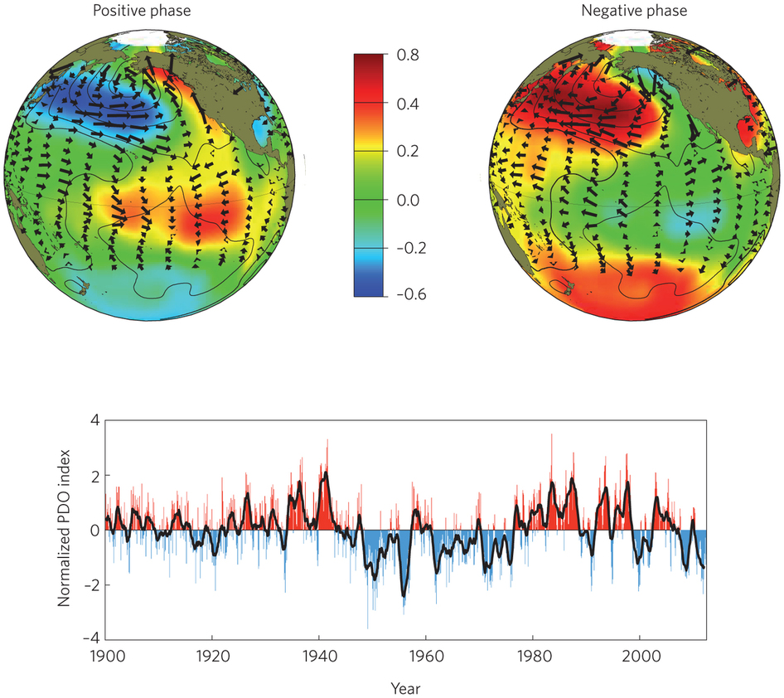
Goddard (2014) Nature Climate Change

Slide 33
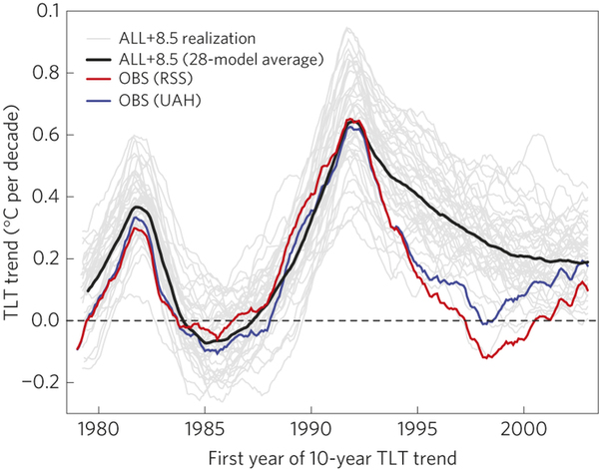
Santer et al. (2014) Nature Geosci
Figure 4: Behaviour of overlapping 10-year trends in the ‘ENSO removed’ near-global (82.5° N–70° S) TLT data.
Least-squares linear trends were calculated over 120 months, with overlap by all but one month; that is, the first trend is over January 1979–December 1988, the second trend over February 1979–January 1989, and so on. The last trend is over January 2003–December 2012.

Slide 34
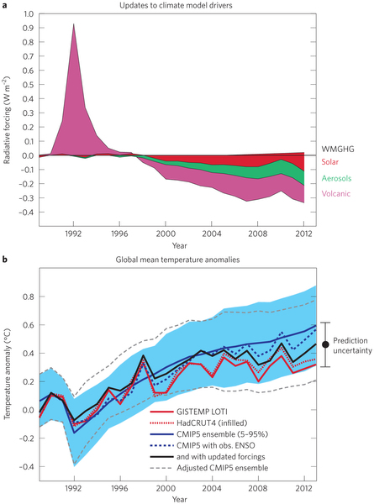
Schmidt et al. (2014) Nature Geoscience
Notes:
a, The latest reconstructions of optical depth for volcanic aerosols9, 10 from the Mount Pinatubo eruption in 1991 suggest that the cooling effect of the eruption (1991–1993) was overestimated in the CMIP5 runs, making the simulated temperatures too cool. From about 1998 onwards, however, the cooling effects of solar activity (red), human-made tropospheric aerosols (green) and volcanic eruptions (pink) were all underestimated. WMGHG, well-mixed greenhouse gases. b, Global mean surface temperature anomalies, with respect to 1980–1999, in the CMIP5 ensemble (mean: solid blue line; pale blue shading: 5–95% spread of simulations) on average exceeded two independent reconstructions from observations (GISTEMP Land–Ocean Temperature Index (LOTI)6, solid red; HadCRUT4 with spatial infilling7, dashed red) from about 1998. Adjusting for the phase of ENSO by regressing the observed temperature against the ENSO index11 adds interannual variability to the CMIP5 ensemble mean (dashed blue), and adjusting for updated external influences as in a further reduces the discrepancy between model and data from 1998 (black). The adjusted ensemble spread (dashed grey) clearly shows the decadal impact of the updated drivers. As an aside, we note that although it is convenient to use the CMIP5 ensemble to assess expected spreads in possible trends, the ensemble is not a true probabilistic sample.

