Slide 1
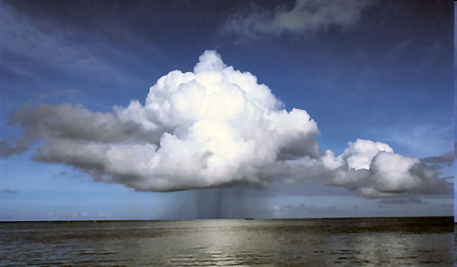
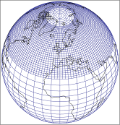

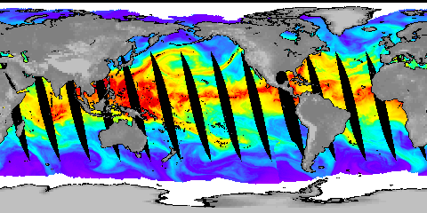

PAGODA WP3 - Observed changes in the global water cycle
Richard P. Allan, Chunlei Liu
Department of Meteorology/NCAS Climate, University of Reading
www.met.reading.ac.uk/~sgs02rpa
Thanks to Nicolaos Skliris, Matthias Zahn (PREPARE), David Lavers (HydEF)
Notes:
Projected Responses in Extreme Precipitation and Atmospheric Radiative Energy
Energetics response
Wet/dry responses
Intense rainfall
Transient responses

Slide 2
Introduction (WP3)
Primary Goals
  characterise observed changes in the water cycle on global-to-regional space scales and decadal timescales,
  evaluate, at a process level, the consistency between observed and modelled changes.
  Focus here upon satellite era
Notes:
2
Intro stuff – current understanding of the nature and importance of the problem: the water cycle is changing and vulnerability is inevitable…
Model projections/intro
Water vapour
Intense rainfall events
Evaporation
Soil Moisture
Precipitation and extremes
Anticipated large-scale responses
Toward regional responses
Unanswered questions

Slide 3
How does/will global to regional precipitation respond to climate change?
Global constraints: energy balance
Surface T
Radiative forcing (GHG, AA)
Regional constraints:
Water vapour transports
Radiative forcing:
Land vs ocean
Circulation change
Feedbacks
Land vs ocean
Circulation change
Allan et al. (2013) Surv. Geophys. in press.
See also: Hawkins & Sutton (2010) Clim. Dyn.
Notes:
3
There is huge uncertainty in global precipitation projections, relating both to climate sensitivity and mitigation pathways.

Slide 4
Primary Focus
Satellite Era (blended satellite/gauge)
Daily-monthly diagnostics, decadal changes
Water vapour and transports, Precipitation
Simulations: reanalyses, NWP, CMIP5
Links:
P–E and salinity changes (WP2, WP3.2b,e)
Processed-based detection and attribution, metrics (WP1, WP4)
Met Office NWP drifts/HadGEM2 bias
Land evaporation - WP3.2f (CEH);

Slide 5
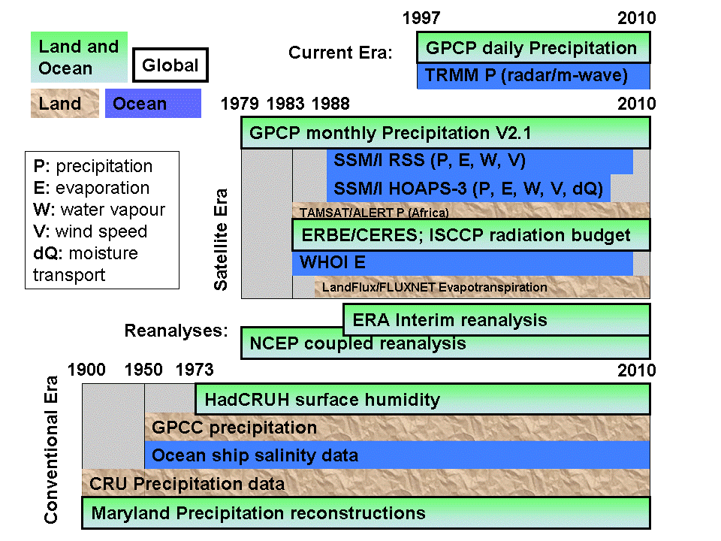
✓
✓
✓
✓
✓
←
✓
✓
←
←

Slide 6
WP3 Objectives
1. Quantify observed changes in the water cycle on global-to-regional space scales and decadal time scales and evaluate consistency with processes anticipated by simple models and depicted by GCMs.
2. Elucidate key regional processes and feedbacks relating to energy and water fluxes, ocean salinity, ocean surface heat flux tendencies and the partitioning between land interception, evaporation and transpiration.
3. Monitor current observed changes in global water cycle variables, also employing global NWP forecasts to evaluate model drifts from analyses linking mean state errors to predicted hydrological response.

Slide 7
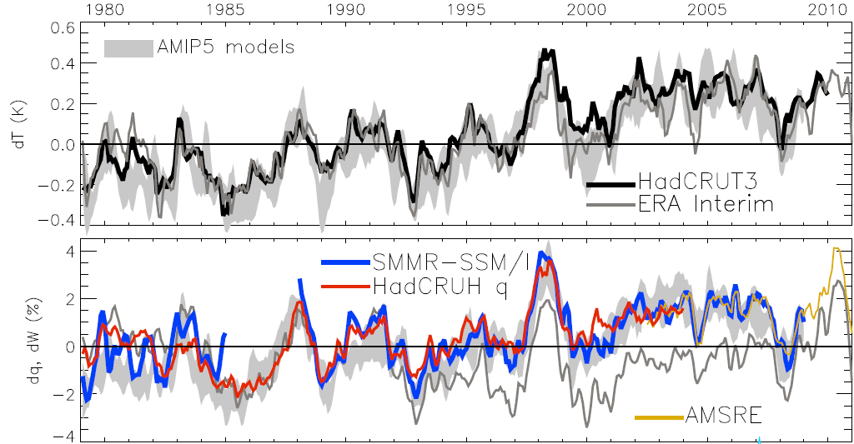
Global changes in water vapour
Water Vapour (%) Surface Tempertaure (K)
Allan et al. (2013) Surv. Geophys; see also O’Gorman et al. (2012); John et al. (2009)
Notes:
The main point to note is that models and observations are consistent in showing increases in low level water vapour with warming. Reanalyses such as ERA Interim, which are widely used, are not constrained to balance their energy or water budgets.
For ocean-only satellite datasets I apply ERA Interim for poleward of 50 degrees latitude and for missing/land grid points.
Note that SSM/I F13 2003-2007 CWV = 24.7794 mm; AMSRE 2003-2007 CWV = 24.8850
7

Slide 8
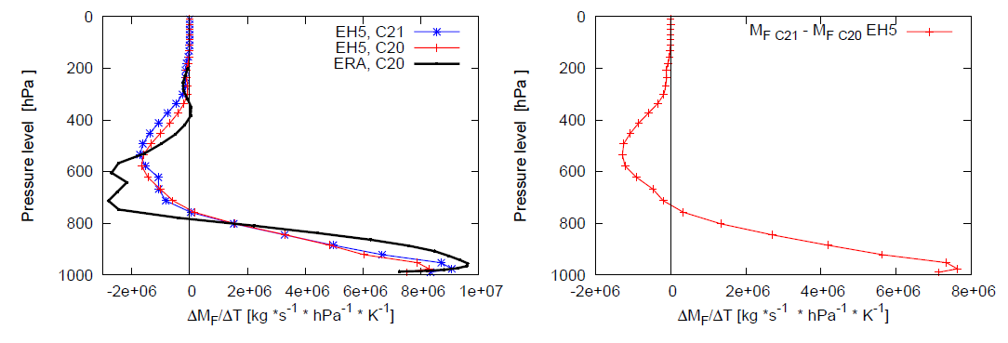
Changes in moisture transports into tropical wet region per K warming PREPARE project
interannual variability climate change
Enhanced moisture convergence at low levels with warming
Significant but smaller enhancement in mid-level outflow
Zahn and Allan (2013) J Clim, in press; Allan et al. (2013) Surv Geophys, in press

Slide 9
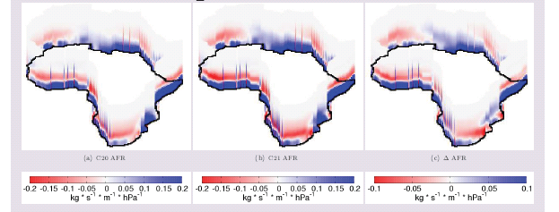
Moisture transports into continental regions
20C 21C 21C-20C
PREPARE project
Zahn and Allan, submitted to WRR

Slide 10
How consistent are satellite precipitation datasets?
TRMM3B42 has now been corrected
Liu & Allan (2012) JGR

Slide 11
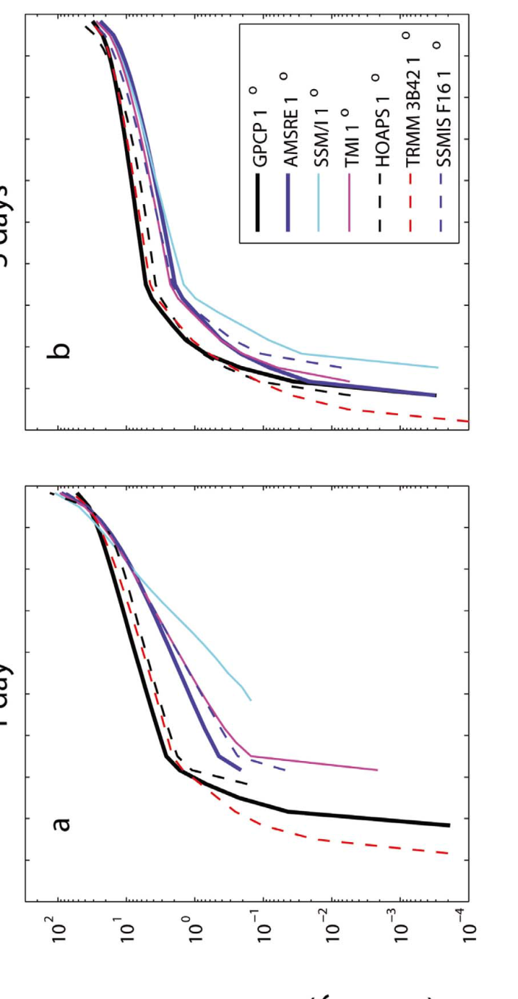

1 day 5 day
Precipitation intensity (mm/day)
Observed P intensity & responses across datasets (tropical oceans)
Precipitation intensity change with mean surface temperature (%/day)
Liu & Allan (2012) JGR
Precipitation intensity percentile (%)

Slide 12
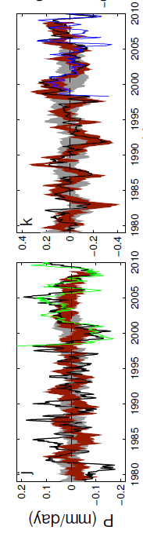
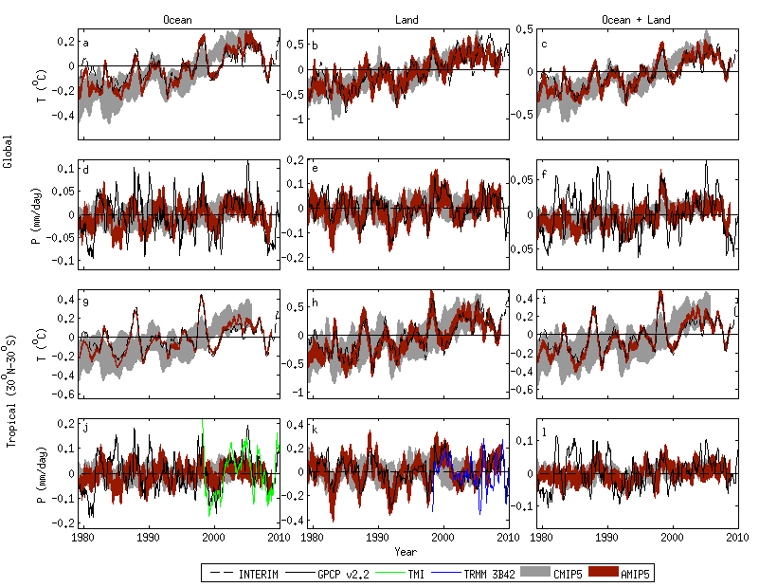
Tropical precipitation variability in satellite data and CMIP5 simulations
Note consistency between atmosphere-only AMIP model simulations over land and GPCP observations. This is not the case for the ocean, in particular before about 1996.
Oceans Land
Liu, Allan, Huffman (2012) GRL

Slide 13
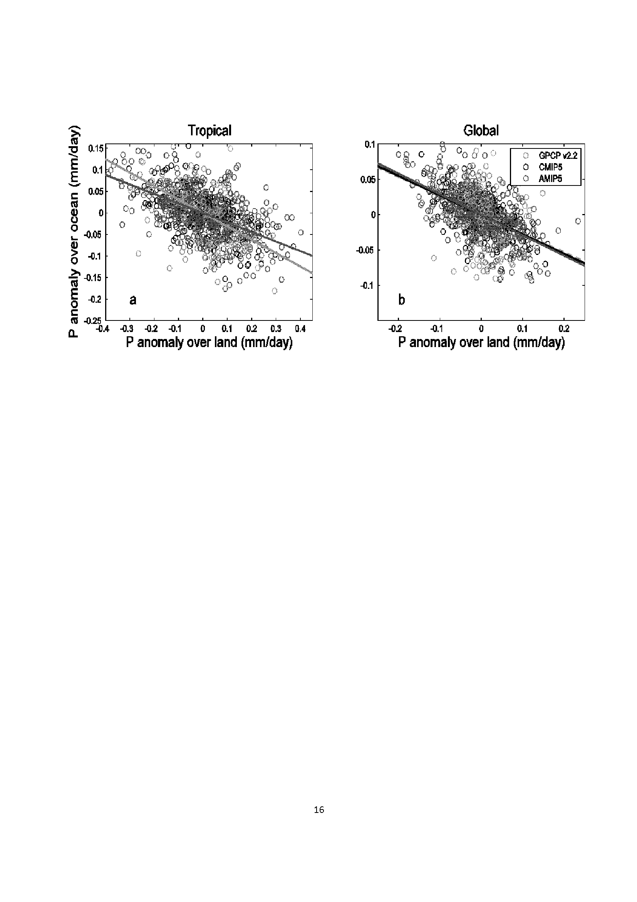
Contrasting land/ocean changes relate to ENSO
Liu et al. (2012)
See also Gu et al. (2007) J Clim

Slide 14
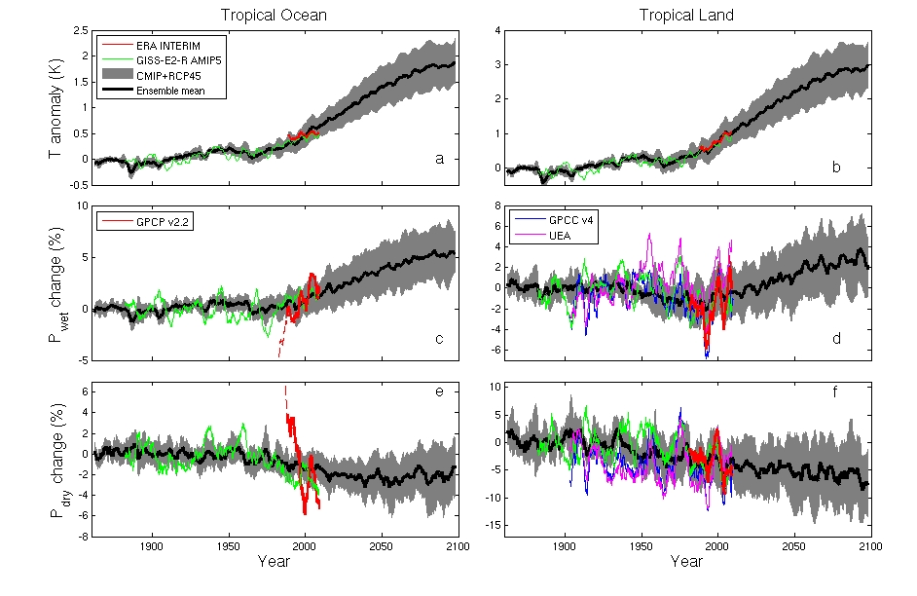
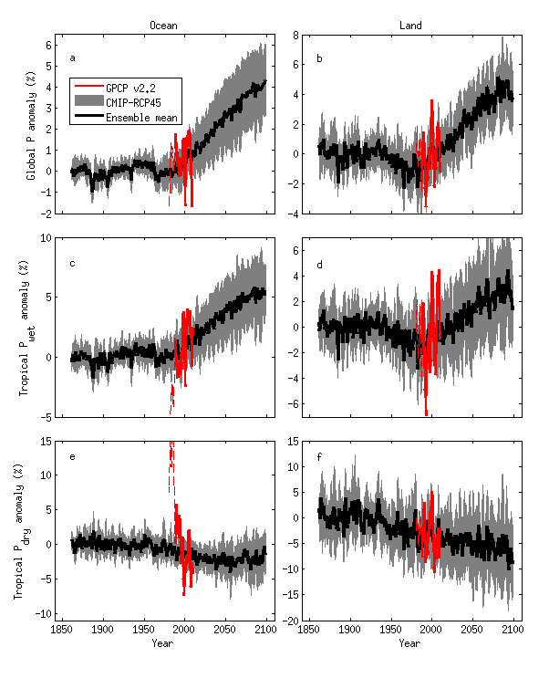
CMIP5 simulations: Wet regions get wetter, dry regions get drier
Ocean Land
Pre 1988 GPCP ocean data does not contain microwave data
Tropical dry Tropical wet
Robust drying of dry tropical land
30% wettest gridpoints vs 70% driest each month
Liu and Allan in prep; see also Allan et al. (2010) ERL.

Slide 15
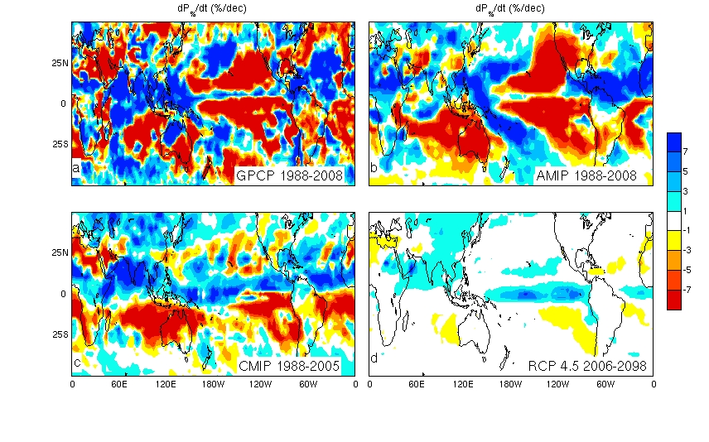
Spatial signatures of Precipitation trends
Raw trends (%/decade)
Chuunlei Liu, work in prep

Slide 16
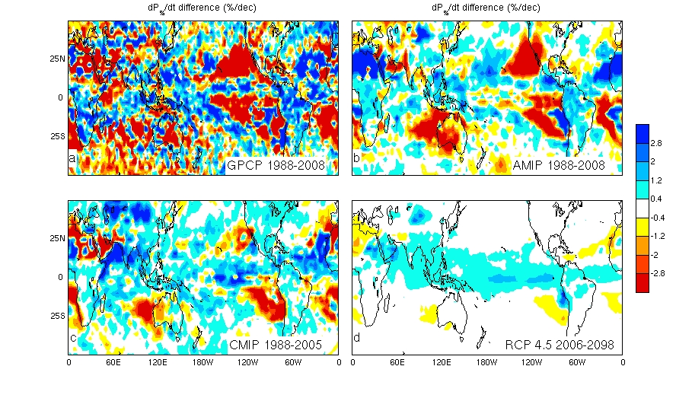
Spatial signatures of Precipitation trends
Residual “thermodynamic” trends (%/decaded)
Chuunlei Liu, work in prep

Slide 17
Use of NWP simulations
“Employ global NWP forecasts to evaluate model drifts from analyses linking mean state errors to predicted hydrological response”
Looking at model drifts at the model time-step provides an opportunity for investigating process level responses

Slide 18
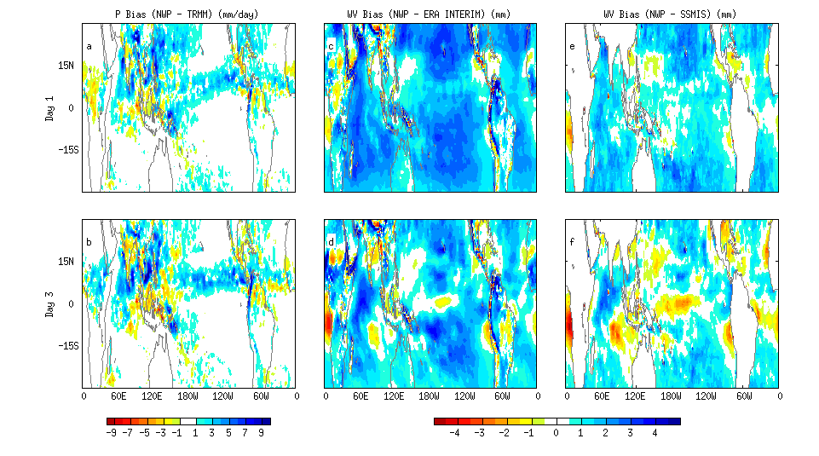
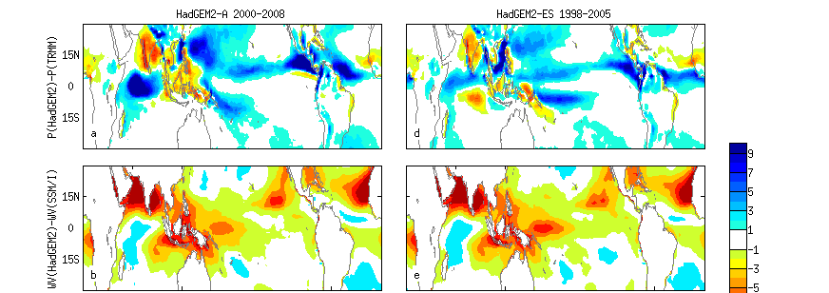
Systematic biases in water vapour and precipitation in NWP and climate models
Precipitation NWP – OBS Water vapour NWP – OBS
Water vapour Precipitation NWP day 3
HadGEM2-AMIP – OBS HadGEM2-ES historical – OBS

Slide 19
Diurnal Cycle in Precipitation:
UK Met Office NWP vs TRMM data
Precipitation (mm/day)

Slide 20
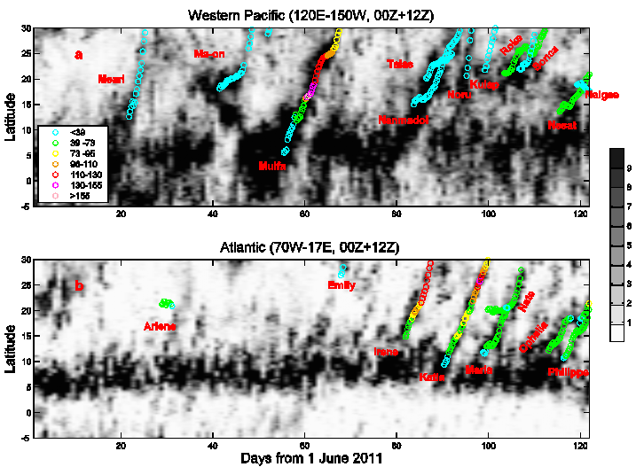
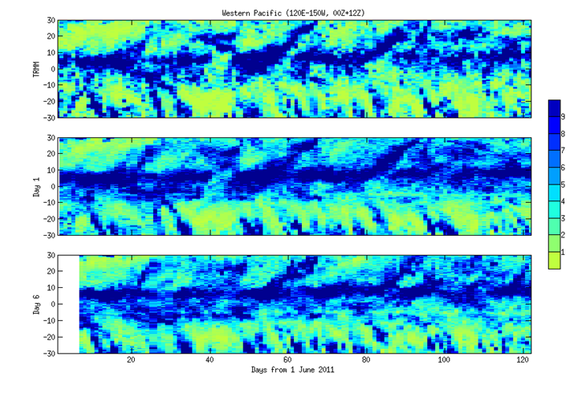
Propagation of precipitation anomaly
Distinct propagation of precipitating systems northward from the West Pacific every 20-30 days: captured by NWP simulations
Western Pacific zonal mean Precipitation (mm/day): simulation TRMM
Days since 1 Jun: 40 60 80 100 120

Slide 21
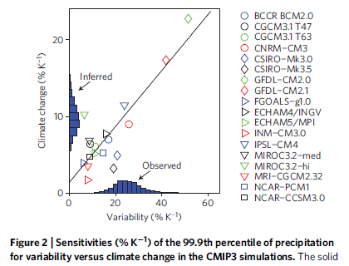
Evaluating climate model simulations of precipitation extremes
Can observations be used to constrain the projected responses in extreme precipitation?
O’Gorman (2012) Nature Geosciences
See also Allan and Soden (2008) Science

Slide 22
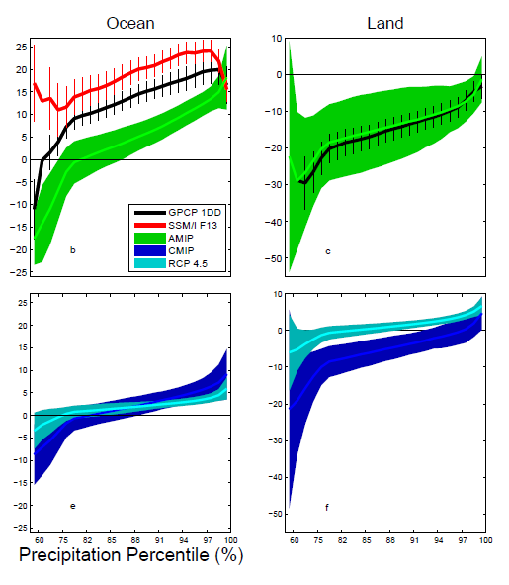
Response of 5-day Precip intensity distribution to warming:
CMIP5 and observations
dP_{i}/dT (%/K)
CMIP5 AMIP/OBS
Allan et al. (2013) Surv. Geophys, in press

Slide 23
Floating Tasks in WP3
Calculate energy and water budgets
P-E fields and links to salinity (ongoing collaboration with WP2)
heat flux feedbacks in the tropical central Pacific
fingerprints of terrestrial evaporation in observations and models (CEH)
Update the CRUTS3.0 precipitation dataset (UEA)

Slide 24
Links to PAGODA WPs and other projects
P-E collaboration with WP2
Metrics (WP1, 4, 5)
Datasets and NWP (Met Office partners)
Links to other CWC projects

Slide 25
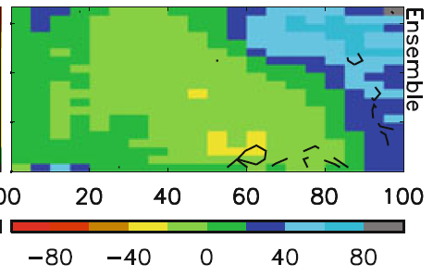
Fingerprints: precipitation bias and response by dynamical regime
Warmer surface temperature →
Model biases in warm, dry regime
Strong wet/dry fingerprint in model projections (below)
Stronger ascent →
Allan (2012) Clim. Dyn.
Stronger ascent →

Slide 26


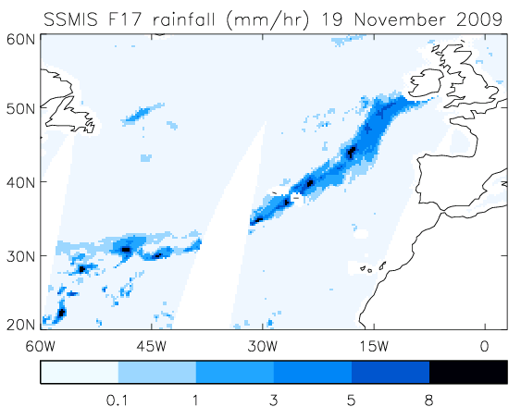
Applications: Linking flooding to moisture transports (HydEF)
HydEF project: Importance of large-scale atmospheric precursors for flooding e.g. 2009 Cumbria floods
Lavers et al. (2011) Geophys. Res. Lett.

Slide 27
Identifying “Atmospheric Rivers” simulated by climate models
AMIP CMIP
← Coarse-scale climate models able to capture flood-generating mid-latitude systems
Will thermodynamics dominate over changes in dynamics under climate change? →
…work in progress (HydEF)
Allan et al. (2013) Surv. Geophys, in press

Slide 28
Science outcomes
Evaluation of blended observations (precip, water vapour)
  Liu & Allan (2012) JGR [LINK to Met Office partners]
Quantification of trends/hydrological sensitivity at global to largest regional scales (including extremes)
  Liu & Allan (2012) JGR; Liu et al. (2012) GRL; Allan et al. (2013) Surv Geophys in press [LINK to WP2]
  Process-based metrics (tropical wet/dry-land/ocean, dP/dT, dMF/dT) [LINK to WP4/5]
  Allan (2012) Clim. Dyn.; Allan et al. (2013) Surv. Geophys in press; Lavers et al. (2011) GRL; Zahn and Allan (2013) WRR in prep
Linking NWP forecast drift with climate model bias
  Liu et al. in prep [LINK to Met Office partners]
Links to other NERC projects (HydEF, PREPARE)

Slide 29
Science outcomes
Robust increases in water vapour & transports with warming (~7%/K) [O’Gorman et al. 2012; Allan et al. 2013; Zahn & Allan 2013]
Erroneous P variability in reanalyses and some satellite datasets over the ocean [Liu & Allan 2012]
AMIP simulations can reproduce observed land P variability (relating to ENSO) [Liu et al. 2012; Allan et al. 2013]
Little agreement between AMIP and satellite data over ocean before 1996 [Liu et al. 2012]
Interannual P sensitivity to Ts may provide a constraint upon future projections [Liu & Allan 2012; see O’Gorman 2012]
Tropics: wet get wetter, dry get drier (when dynamically define regimes) [Allan 2012; Liu et al. 2012; Liu in prep]
Systematic water vapour and precipitation biases in climate models linked to NWP model drift [Liu in prep]
Notes:
29
Projected Responses in Extreme Precipitation and Atmospheric Radiative Energy

Slide 31
PAGODA WP3 Outputs
R. P. Allan, C. Liu, M. Zahn, D. A. Lavers, E. Koukouvagias and A. Bodas-Salcedo (2013) Physically consistent responses of the global atmospheric hydrological cycle in models and observations, Surv. Geophys., doi:10.1007/s10712-012-9213-z . PDF
Allan, R.P., (2012) Regime dependent changes in global precipitation, Climate Dynamics 39, 827-840 10.1007/s00382-011-1134-x Online
Liu, C., R. P. Allan, and G. J. Huffman (2012) Co-variation of temperature and precipitation in CMIP5 models and satellite observations, Geophys. Res. Lett., 39, L13803, doi:10.1029/2012GL052093 Online
Liu, C.-L. and R. P. Allan, (2012) Multi-satellite observed responses of precipitation and its extremes to interannual climate variability, J. Geophys. Res. 117, D03101, doi:10.1029/2011JD016568 Online
O'Gorman, P. A., R. P. Allan, M. P. Byrne and M. Previdi (2012) Energetic constraints on precipitation under climate change, Surv. Geophys., 33, 585-608, doi: 10.1007/s10712-011-9159-6 PDF
R. P. Allan (2012) The role of water vapour in Earth's energy flows, Surv. Geophys., 33, 557-564, doi: 10.1007/s10712-011-9157-8. PDF

