Slide 1




Accounting for circulation changes to interpret water cycle responses
Department of Meteorology
Richard Allan r.p.allan@reading.ac.uk @rpallanuk
Thanks to Chunlei Liu

Slide 2
introduction
Changes in the global water cycle are dictated by radiatve transfer and thermodynamics but dominated locally by circulation changes
There is a distinction between detection, physical understanding and prediction of regional changes in the water cycle but all are linked
How can the influences of circulation and thermodynamics be separated to better understand & predict regional water cycle?

Slide 3
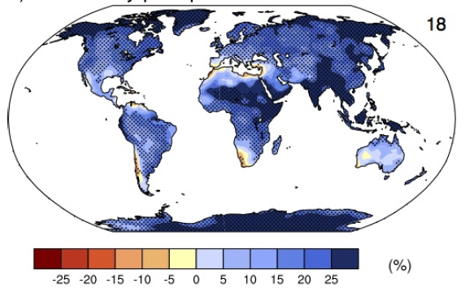
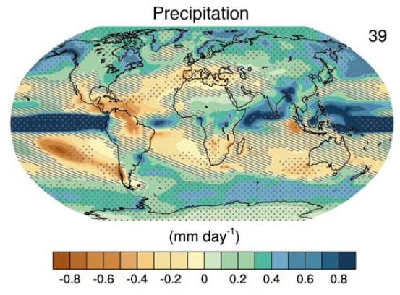
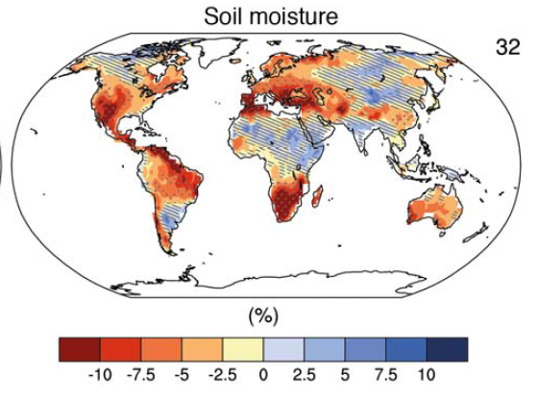
How will water cycle change?
Precipitation intensity
More global mean precip.
More intense rainfall
More intense droughts?
Intensification of wet and dry seasons?
Regional projections??
e.g. Liu & Allan (2013) ERL
IPCC (2013)
Notes:
PRECIPITATION: [Tech Summ Fig. 2]
RCP8.5 ANN: Multi-model CMIP5 average mm/day change.
Hatching: multi-model mean change is small (<1SD of internal variability)
Stippling: multi-model mean change is big (>2SD of internal variability and 90% of models agree on sign)
P INTENSITY:
Percent change in annual maximum 5-day precipitation 2081-2100 relative to 1981-2000 for RCP8.5 CMIP5 ensemble.
Fig. 12.26, Chapter 12.
Stippling → significant change
SOIL MOISTURE: [Tech Summ, Fig. 2]
RCP8.5 ANN change in %, Upper 10cm
Hatching: multi-model mean change is small (<1SD of internal variability)
Stippling: multi-model mean change is big (>2SD of internal variability and 90% of models agree on sign)

Slide 4
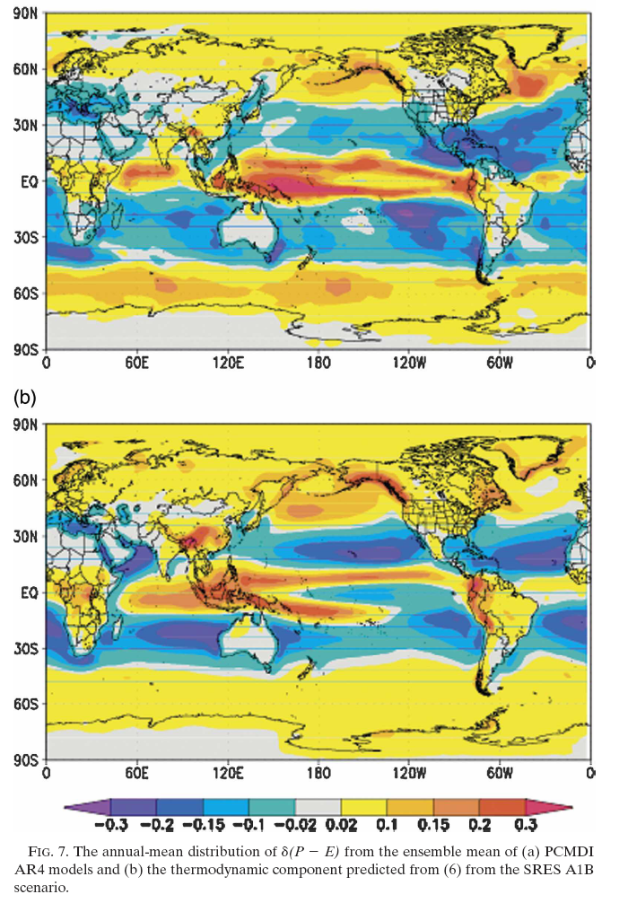

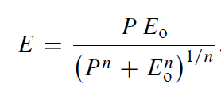
Moisture balance constraint
Enhanced moisture transport F leads to amplification of:
(1) P–E patterns (left)
Held & Soden (2006) ; Mitchell et al. (1987)
(2) ocean salinity patterns
Durack et al. (2012) Science
≈
Model d(P-E)
Changes over land are less clear as multi-annual P-E > 0 & RH changes
Simple scaling d(P-E)
Budyko framework useful (e.g. Roderick et al. 2014 ; Greve et al. 2014 )

Slide 5
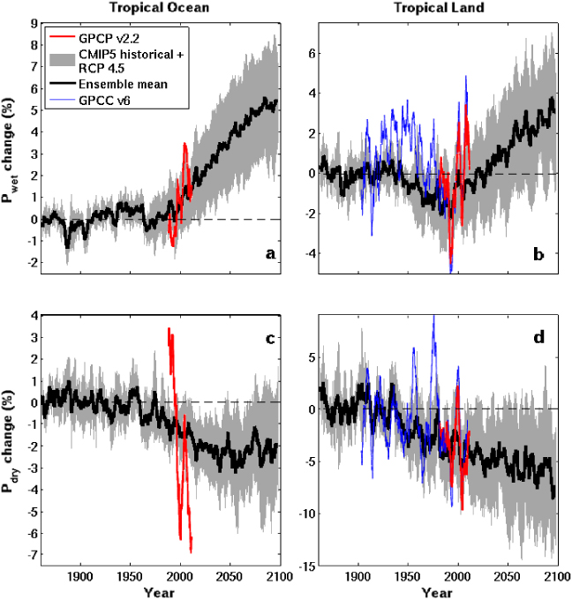
Moisture transport and intensification of wet/dry seasonS
Tropical Land
Increased moisture with warming implies amplified P-E (e.g. Held & Soden 2006)
Multi-annual P-E > 0 over land implies increased P-E (e.g. Greve et al. 2014)
Changes in T/RH gradients also important (Byrne & O’Gorman 2015)
P-E < 0 in dry season over land: more intense dry and wet seasons? (Chou et al. 2013; Liu & Allan 2013; Kumar et al. 2014)
Aridity metrics more relevant (Scheff & Frierson 2015; Greve & Seneviratne 2015; Roderick et al. 2014 ; Kumar et al. 2016 )
Changes in circulation dominate locally (e.g. Scheff & Frierson 2012; Chadwick et al. 2013; Muller & O’Gorman 2011; Allan 2014)
6
4
2
0
-2
-4
GPCC GPCP
WET
Precipitation Change (%)
1900 1950 2000 2050 2100
5
0
-5
-10
-15
DRY
CMIP5 Simulations
1900 1950 2000 2050 2100
Liu & Allan 2013 ERL

Slide 6
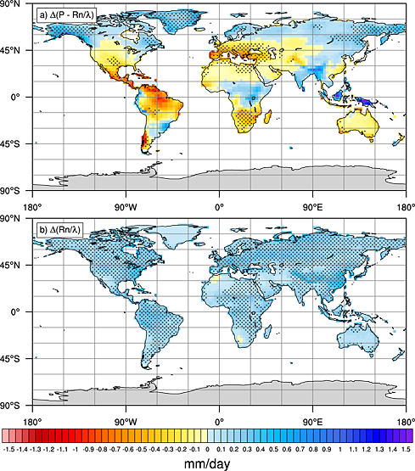
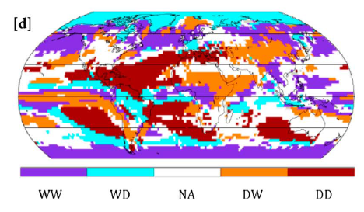
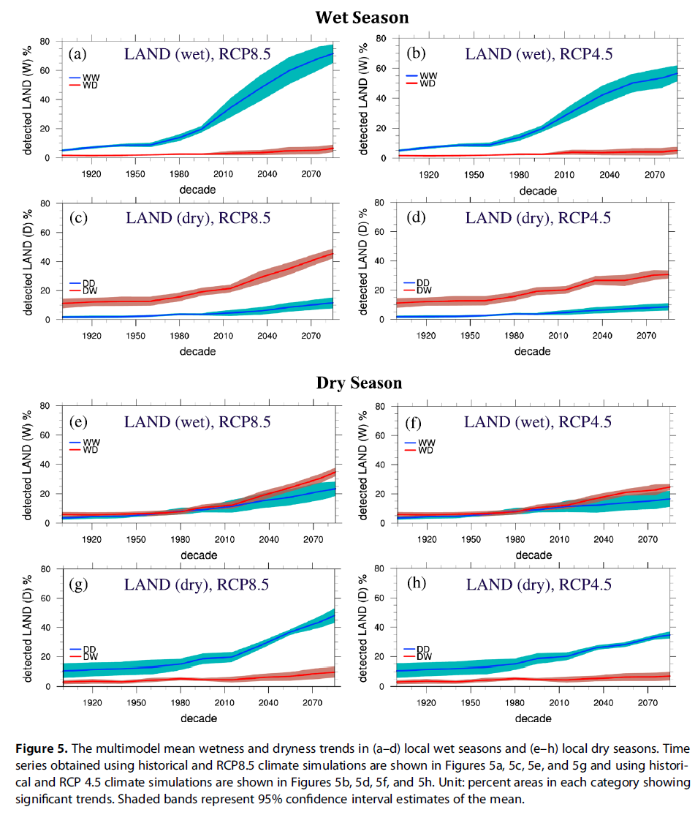
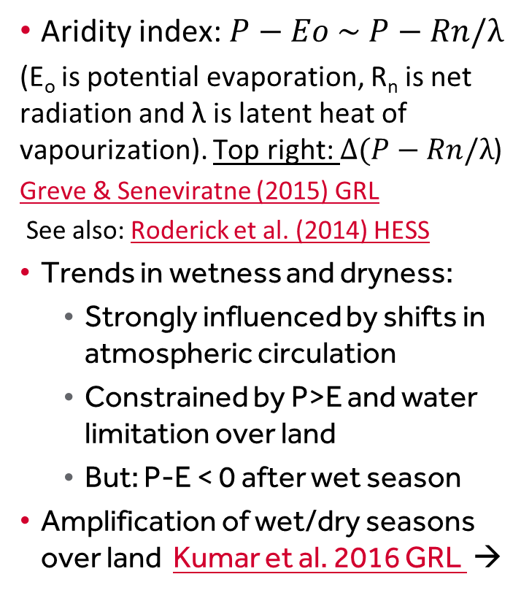
Amplification of wet/dry seasons?
Aridity index: $P−Eo \sim P−Rn/λ$
(E_{o} is potential evaporation, R_{n} is net radiation and λ is latent heat of vapourization). Top right: $Δ(P−Rn/λ$)
Greve & Seneviratne (2015) GRL
See also: Roderick et al. (2014) HESS
Trends in wetness and dryness:
  Strongly influenced by shifts in atmospheric circulation
  Constrained by P>E and water limitation over land
  But: P-E < 0 after wet season
Amplification of wet/dry seasons over land Kumar et al. 2016 GRL →
RCP8.5: Dry land, dry season
dry drier
dry wetter
Wet land, wet season
wet wetter
wet drier

Slide 7
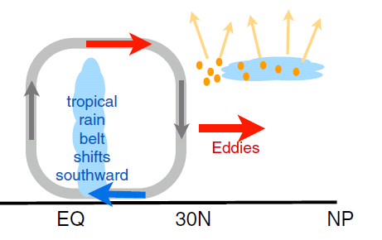
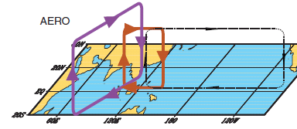
earth’s energy budget & regional changes in the water cycle
Regional precipitation biases/changes sensitive to asymmetries in Earth’s energy budget e.g. Loeb et al. (2015) Clim. Dyn; Haywood et al. (2016) GRL
N. Hemisphere cooling: less heat transport out of hemisphere
Reduced Sahel rainfall from:
Anthropogenic aerosol cooling 1950s-1980s: Hwang et al. (2013) GRL →
Asymmetric volcanic forcing e.g. Haywood et al. (2013) Nature Climate
Enhanced energy transport
cooling
Anomalous heat fluxes
Sulphate aerosol effects on Asian monsoon e.g. Bollasina et al. 2011 Science (left) & links to drought in Horn of Africa? Park et al. (2011) Clim Dyn
GHGs & Sahel rainfall recovery? Dong & Sutton (2015) Nature Clim
Also: posters by Laura Wilcox, Angus Ferraro, Matt Hawcroft

Slide 8
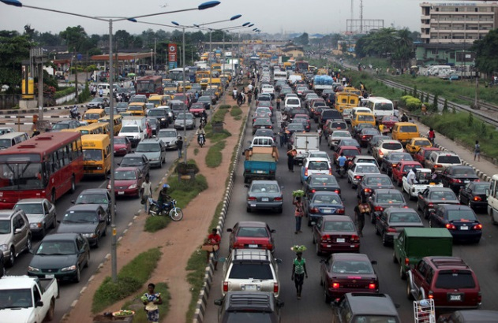

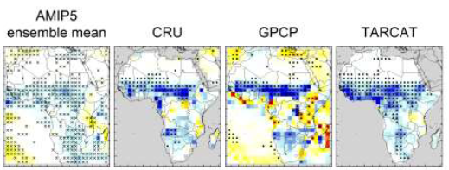

Africa rainfall and circulation changes
Regional rainfall sensitive to radiative forcings, inter-hemispheric heating & internal variability
Africa susceptible to changes in water cycle: monitoring essential (e.g. TAMSAT group)
West Africa - mix of pollution/cloud/dynamics: DACCIWA project, Knippertz et al. 2015
Recent trends Africa rainfall: Maidment et al. (2015) GRL - see also poster by Rachel James
Role of GHGs in Sahel rainfall recovery:
Dong & Sutton (2015) Nature Clim
Radiative forcing?
Internal variability?

Slide 9
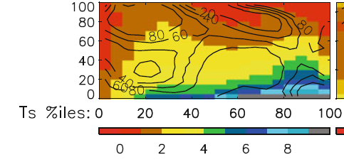
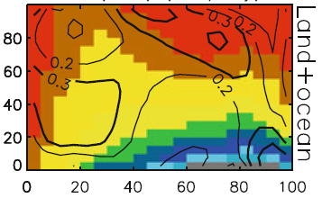
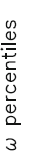

Using dynamical regime composites to analyse precipitation
Subtropical, dry
Model ensemble mean GPCP observations
←Stronger ascent
Precipitation (mm/day)
Warmer surface temperature →
Allan (2012) Clim. Dyn
Extra-tropical
Tropical moist
Composite precipitation by percentiles of vertical motion (strong decent to strong ascent) and temperature
Contour values enclose % of total area (left) or show percentage contribution of each composite box to total area (right)

Slide 10
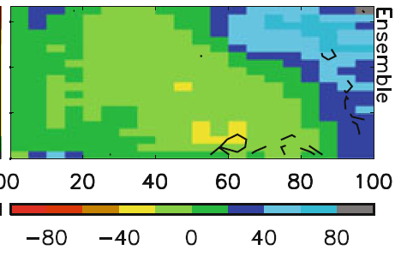
Precipitation bias and response by dynamical regime
Warmer surface temperature →
Model biases in warm, dry regime
Strong wet/dry fingerprint in model projections (even for land) Allan (2012) Clim. Dyn
←Stronger ascent
.
Note: Since P constrained by energetics to increase more slowly than water vapour and static stability increases, reduced circulation/regional adjustments in circulation likely, e.g.: Bony et al. (2013) Nat Geosci ; Chadwick et al. (2012) J Clim ; Zelinka & Hartmann (2010) JGR
←Stronger ascent

Slide 11
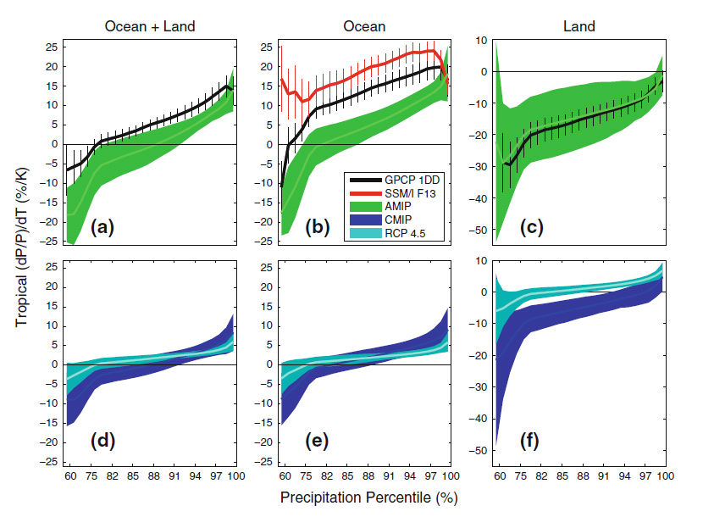
Probability distribution approach to precipitation extremes
Allan et al. (2014) Surv. Geophys
②
dP/dT (%) Tropics
①
③
1998-2008
5-day means (observations and simulations)
① More positve dP/dT for heavier percentiles (observations & models)
② Observations have more positive sensitivity over the ocean
③ Mostly negative dP/dT for all percentiles over land due to less rainfall over land during El Niño when warmer tropical mean Temperatures
Notes:
5-day means.
More positve dP/dT for heavier percentiles (obs and models)
Higher observed sensitivity than models over ocean, good agreement over land.
Mostly negative dP/dT for all percentiles (apart from heaviest) over land. Partly due to less rainfall over land in El Nino when warmer tropical T
Coupled models: similar picture over ocean. Smaller sensitivity for highest percentiles under climate change since global increases in P with warming are muted by increasing CO2 levels.

Slide 12
Probability distribution approach to precipitation extremes
Allan et al. (2014) Surv. Geophys
①
RCP4.5
2080-2099 minus 1985-2005
amip
amip
dP/dT (%) Tropics
③
Historical 1985-2005
②
① Smaller dP/dT sensitivity for coupled simulations (historical vs amip)
② Smaller dP/dT sensitivity under climate change (historical vs rcp4.5) as dP/dT supressed by direct atmospheric heating from rising greenhouse gases
③ More positive dP/dT over land under climate change (rcp4.5 vs historical) as Temperature rises un-related to ENSO for climate change response
CONCLUSIONS: a. Amplification of precipitation extremes with climate warming
b. Interannual variability is not a good proxy for climate change over land
Notes:
5-day means.
More positve dP/dT for heavier percentiles (obs and models)
Higher observed sensitivity than models over ocean, good agreement over land.
Mostly negative dP/dT for all percentiles (apart from heaviest) over land. Partly due to less rainfall over land in El Nino when warmer tropical T
Coupled models: similar picture over ocean. Smaller sensitivity for highest percentiles under climate change since global increases in P with warming are muted by increasing CO2 levels.

Slide 13
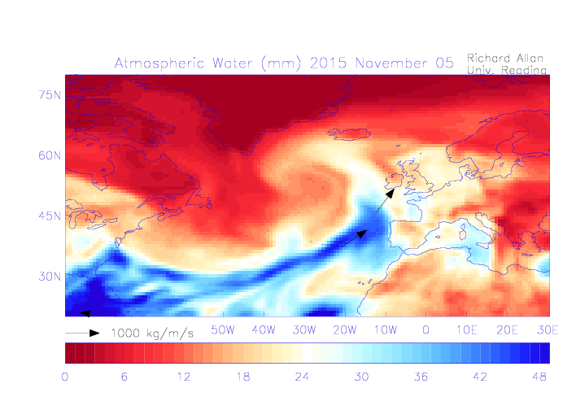
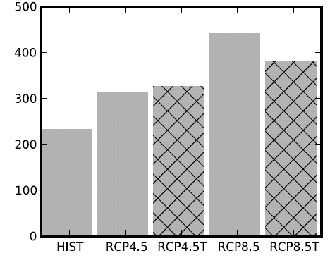
Projecting Impact- relevant metrics
UK winter flooding linked to strong moisture transport events
  Cumbria November 2009 (Lavers et al. 2011 GRL)
  “Atmospheric Rivers” (ARs) in warm conveyor
  Lavers et al. (2013) ERL
Future increase in moisture explains most (but not all) of intensification of AR events
  Confident in the mechanisms and physics involved
Number of ARs
NorESM1-M

Slide 14
conclusions
Changes in the global water cycle are dictated by radiatve transfer and thermodynamics but dominated locally by circulation changes
Separating thermodynamic/dynamic factors necessary for detection, physical understanding and prediction of regional changes in the water cycle
Some regional changes are unpredictable – deal with it!
  e.g. when weather patterns deliver hydrological extremes they are liable to be more severe in a warmer world

Slide 16
conclusions
Radiative transfer & Thermodynamics explain increased global precipitation with warming ≈ 2%/K
  Radiative forcings also directly affect water cycle responses
  Greenhouse gas & absorbing aerosol forcing supress global precipitation response to warming (“hydrological sensitivity”)
Inter-hemispheric heating, moisture budget & unforced variability dictate regional responses and determine climate model biases
  Decadal changes in ITCZ and global atmospheric/ocean circulation
  Heterogeneous forcing (e.g. aerosol, ozone)
  Has the “hiatus” affected water cycle?
  How do changes in cloud/circulation fit in?
Changes in the global water cycle are dictated by radiatve transfer and thermodynamics but dominated locally by circulation changes
There is a distinction between detection, physical understanding and prediction of regional changes in the water cycle but all are linked
How can the influences of circulation and thermodynamics be separated to better understand & predict regional water cycle

Slide 17
Conclusions (1)
Method for consistently comparing model and observations using dynamical regimes
Large precipitation biases in subtropical dry regimes
Clear wet/dry tropical signal of climate change
Reduced Walker circulation offsets but does not cancel this thermodynamical signal
Sampling daily or sub-daily data required for better representing regimes and extremes

Slide 18
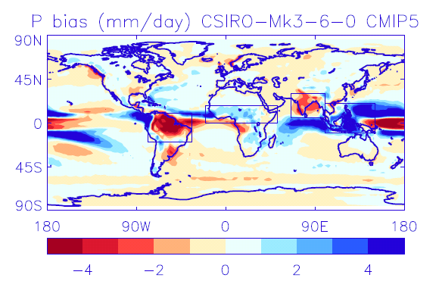
Precipitation bias & response
Positional errors?
Process errors?
Disagreement in sign of precipitation change

Slide 19
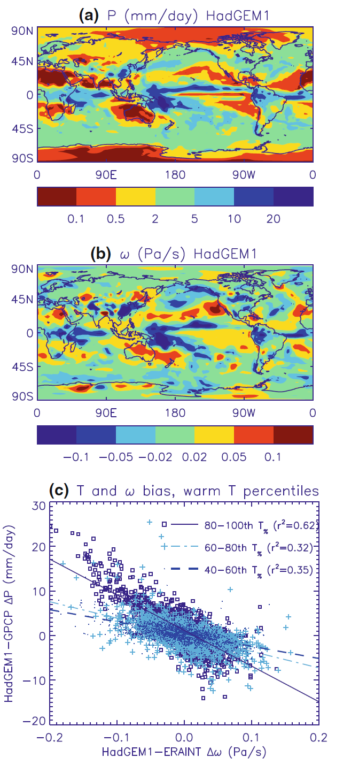
Accounting for dynamical changes
Most tropical precipitation where air is rising…
  500 hPa vertical motion commonly used diagnostic
  Strong association between model bias in precipitation and vertical motion (below)
  Thermodynamics also crucial

Slide 20
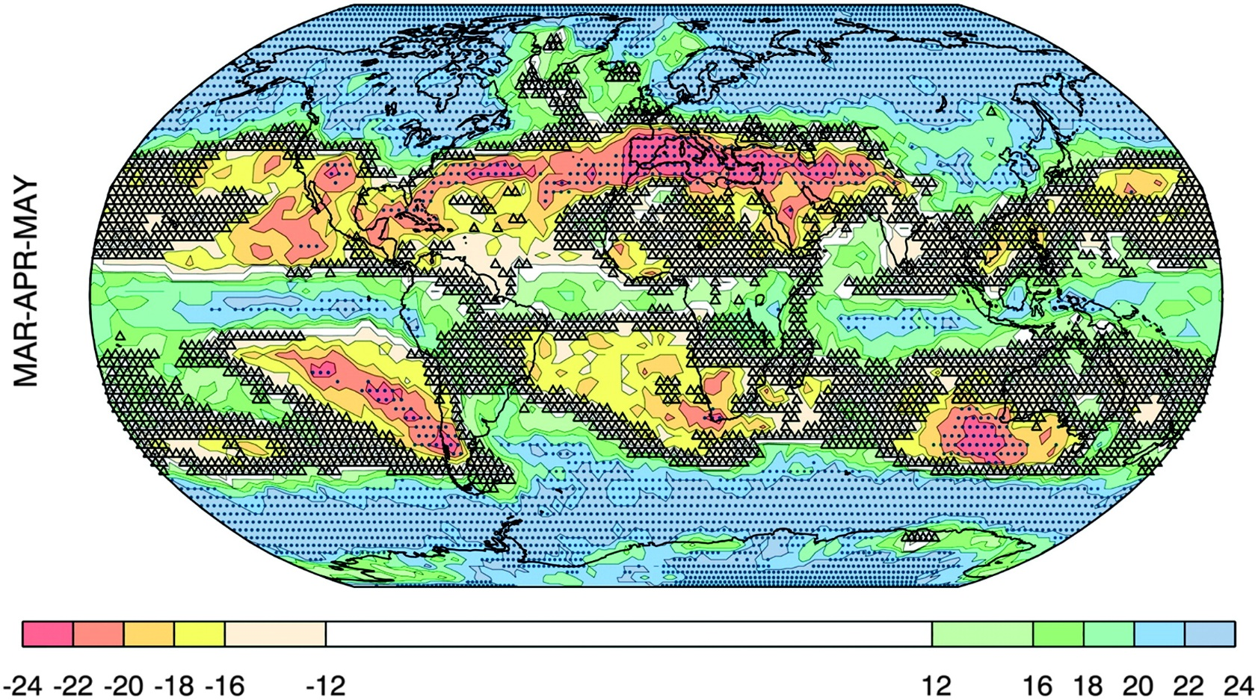
Changing PRECIPITATION:
WHERE IS BIG/SMALL CHANGE ROBUST?
Change > σ_{models}
Small change vs. variability
Number of models that agree on sign of change
Power, et al. (2012) J. Climate
Notes:
The degree of consensus on the sign of the projected change (colored shading), the areas where the MMEM change exceeds the intermodel standard deviation (dots), and regions where the projected change is very likely small relative to variability (small triangles). In virtually all cases triangles only appear where the degree of consensus is very low or absent—for MAM only.

Slide 21
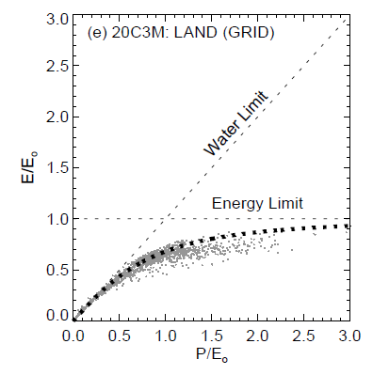
Constraints on evaporation over land
Energy & precipitation (P) constraints on evaporation (E)
Budyko Framework
E_{o} is maximum theoretical evaporation (E is energy limited)
E is also limited by water availability (determined by P)
n is a catchment-specific parameter
If P>>E_{o}, E→E_{o}
If E_{o}>>P, E→P
Roderick et al. (2014) HESS
Notes:
As P→big, E

Slide 22
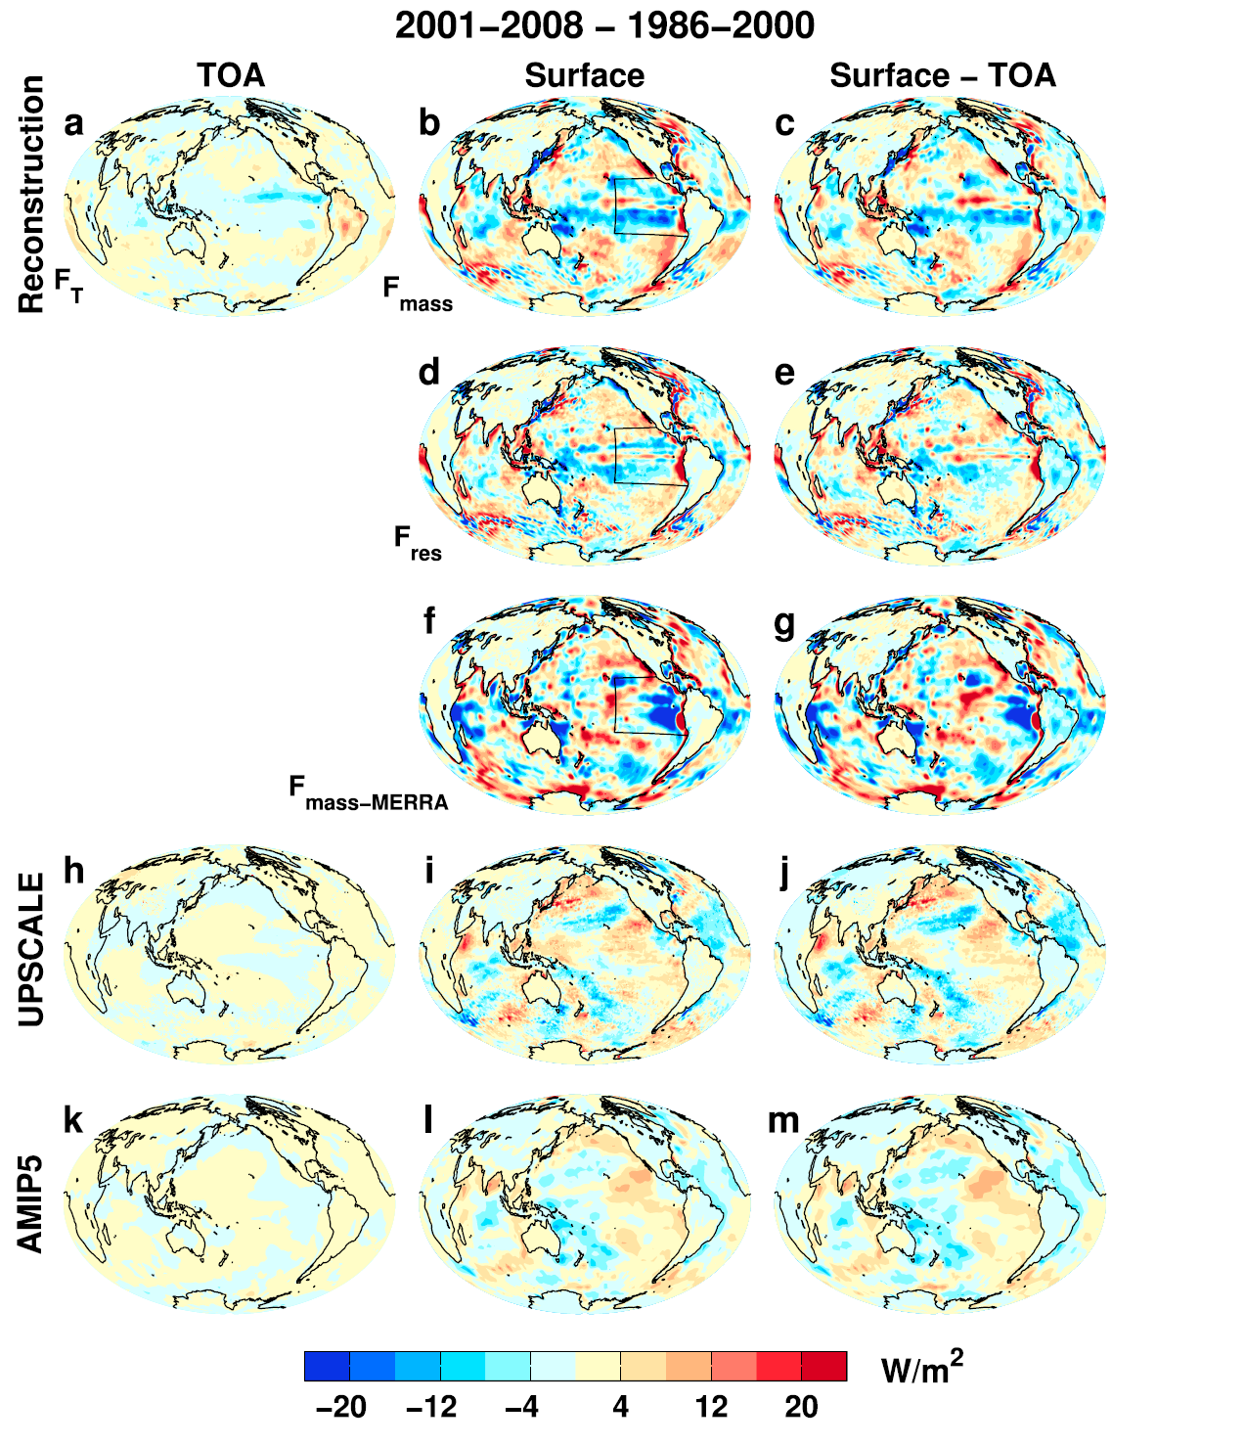

Where is the heat going? changes in surface energy flux
Changes in energy fluxes 1986-2000 to 2001-2008
Surface energy flux dominated by atmos. transports
More investigation of mechanisms & feedbacks by…
Liu et al. (2015) JGR

Slide 23
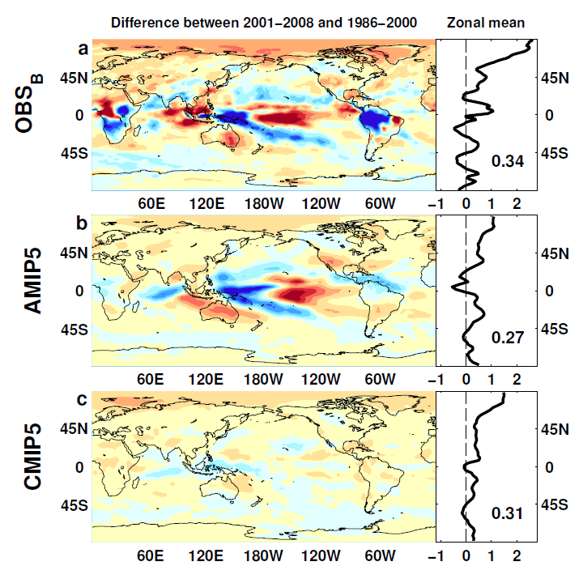

Outgoing Longwave Radiation
Wm⁻²

Slide 24
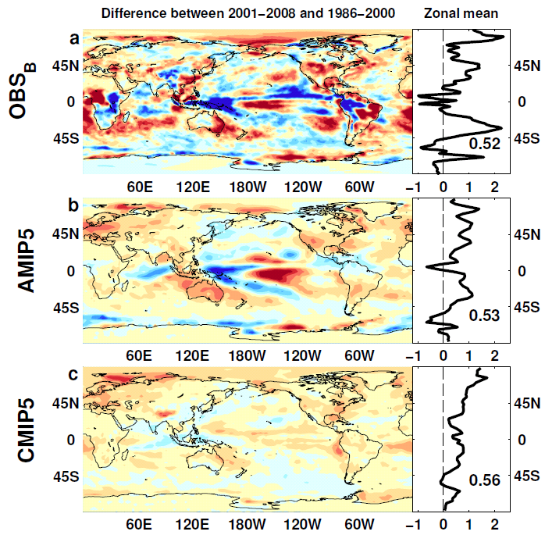
Absorbed Shortwave Radiation
Wm⁻²

Slide 25
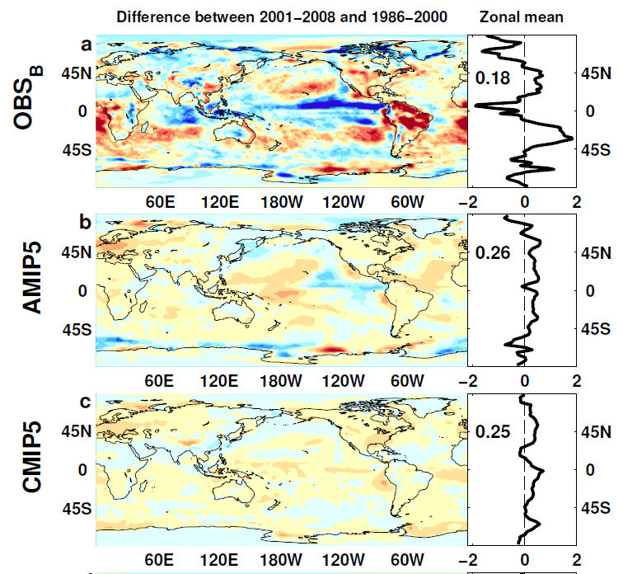

NET Radiation

Slide 26
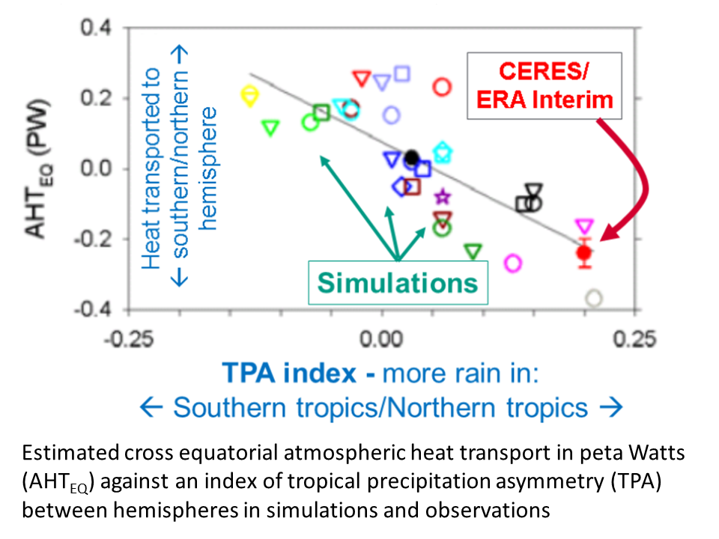
Cross-Equatorial heat transport linked to model precipitation bias
Clear link between bias in cross-equatorial heat transport by atmosphere and inter-hemispheric precipitation asymmetry Loeb et al. (2015) Clim. Dyn
Also: Haywood et al. (2016) GRL

