Slide 1




changes in Earth’s ENERGY balance and implications for the water cycle
Department of Meteorology
GU01
Venue: Fancy Paris Conference
Richard Allan r.p.allan@reading.ac.uk @rpallanuk
Thanks to Chunlei Liu, Norman Loeb and all co-authors

Slide 2
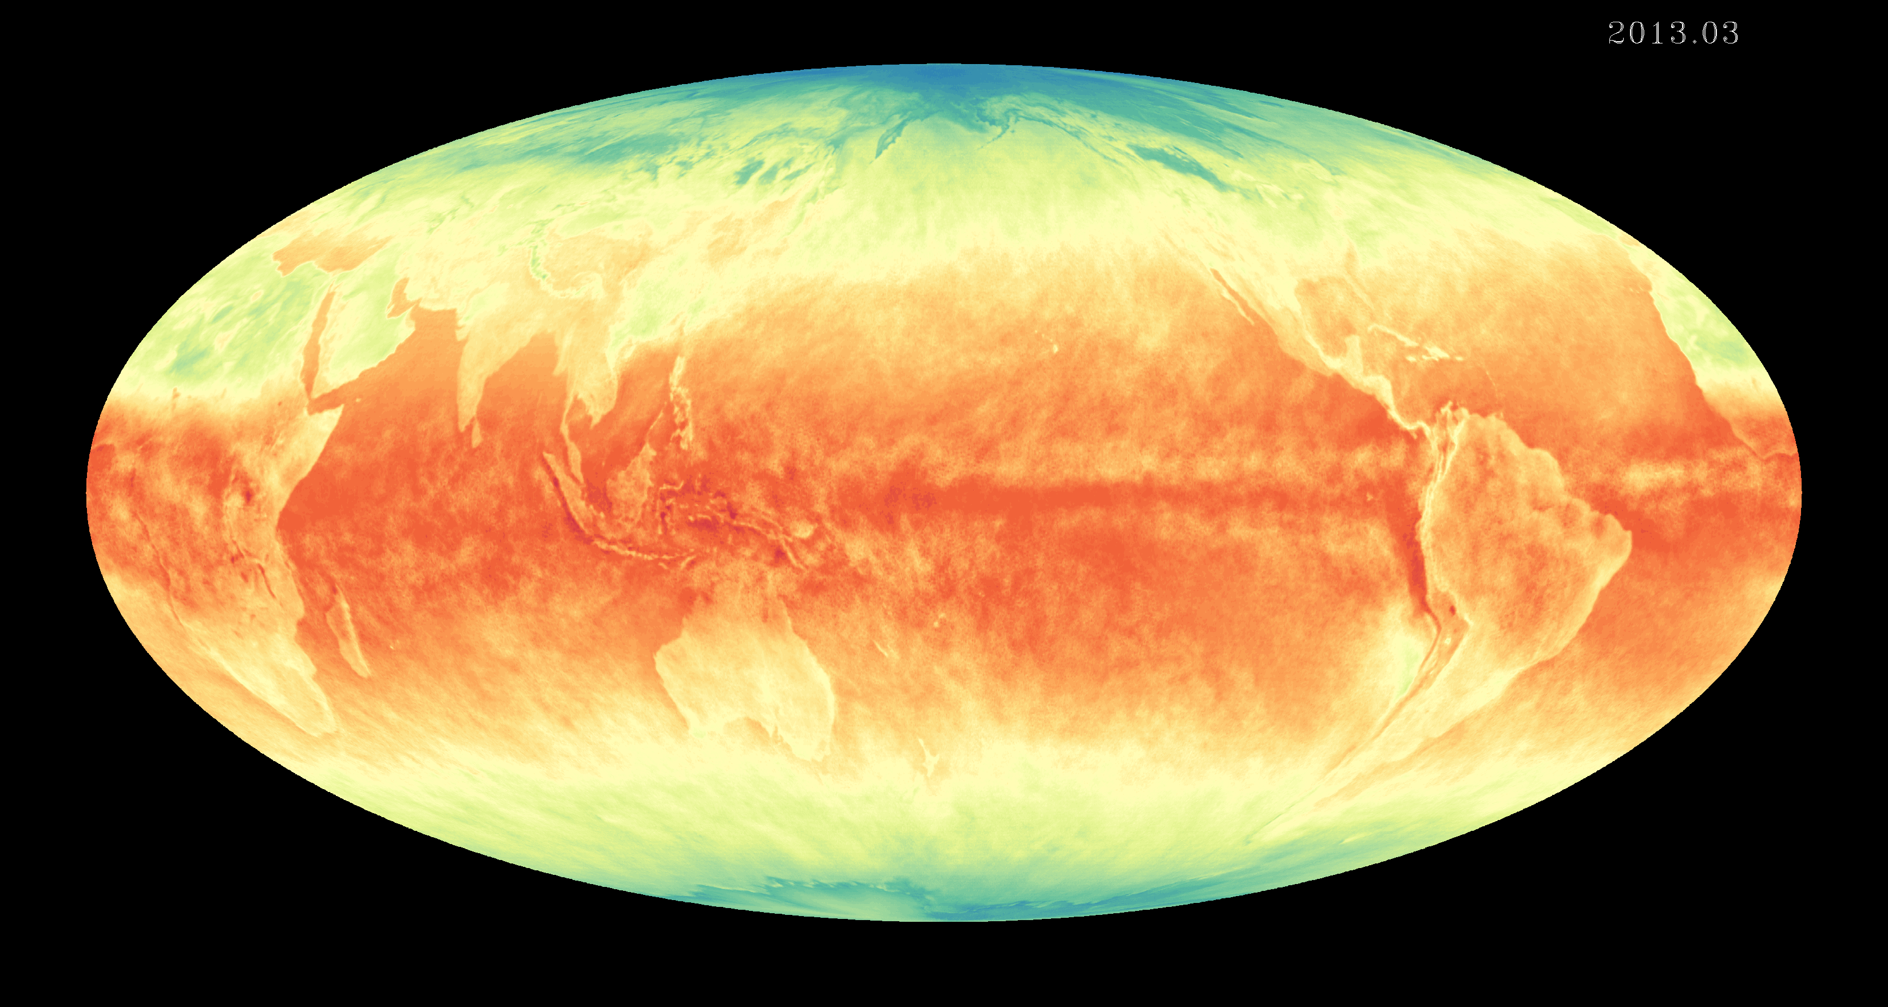
introduction
Earth's energy budget determines the trajectory and magnitude of climate change
Both a powerful constraint on and diagnostic of the water cycle globally and regionally
Flows of energy and moisture between land/ocean, northern/southern hemispheres and high/low latitudes fundamental for determining climate that societies depend upon
How is Earth’s energy imbalance currently changing and what are the implications for the global water cycle?

Slide 3
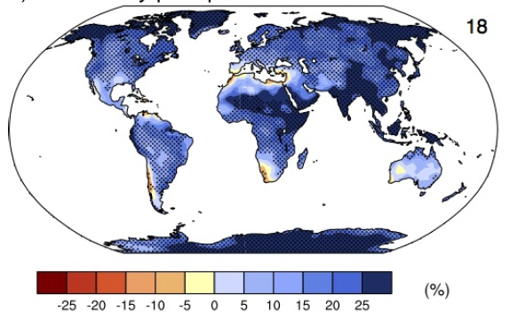
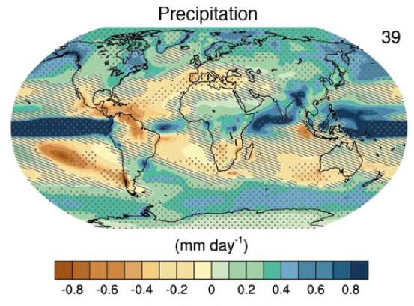
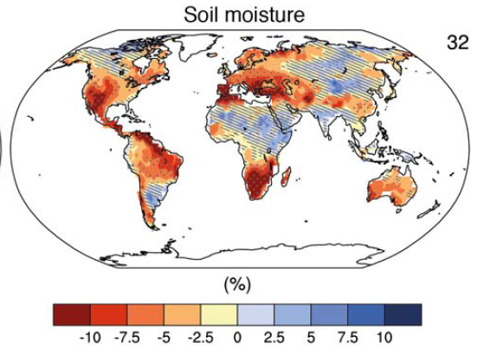
How will water cycle change?
Precipitation intensity
More global mean precip.
More intense rainfall
More intense droughts
Intensification of wet and dry seasons?
Regional projections??
e.g. Liu & Allan (2013) ERL
IPCC (2013)
Notes:
PRECIPITATION: [Tech Summ Fig. 2]
RCP8.5 ANN: Multi-model CMIP5 average mm/day change.
Hatching: multi-model mean change is small (<1SD of internal variability)
Stippling: multi-model mean change is big (>2SD of internal variability and 90% of models agree on sign)
P INTENSITY:
Percent change in annual maximum 5-day precipitation 2081-2100 relative to 1981-2000 for RCP8.5 CMIP5 ensemble.
Fig. 12.26, Chapter 12.
Stippling → significant change
SOIL MOISTURE: [Tech Summ, Fig. 2]
RCP8.5 ANN change in %, Upper 10cm
Hatching: multi-model mean change is small (<1SD of internal variability)
Stippling: multi-model mean change is big (>2SD of internal variability and 90% of models agree on sign)

Slide 4
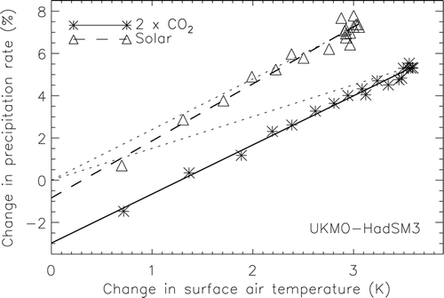
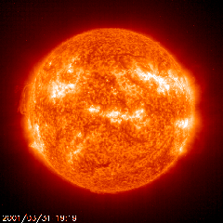
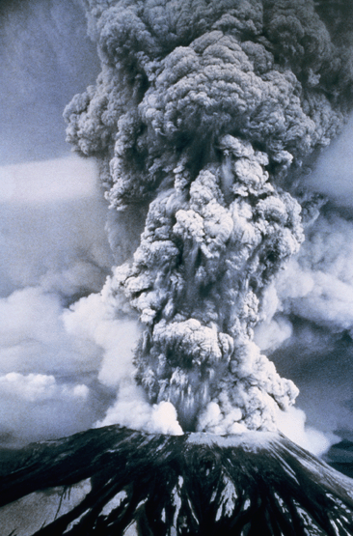
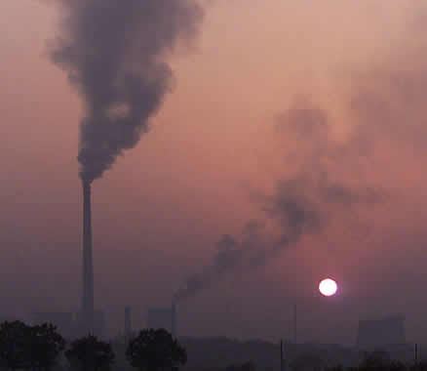
Earth’s Energy budget and precipitation response
Andrews et al. (2009) J Clim
LΔP ≈
kΔT – f_{F}ΔF
ahem?
k
ΔSH
See also: Allen and Ingram (2002) Nature ; O’Gorman et al. (2012) Surv. Geophys ; Bony et al. 2014 Nature Geosci.
Notes:
4

Slide 5
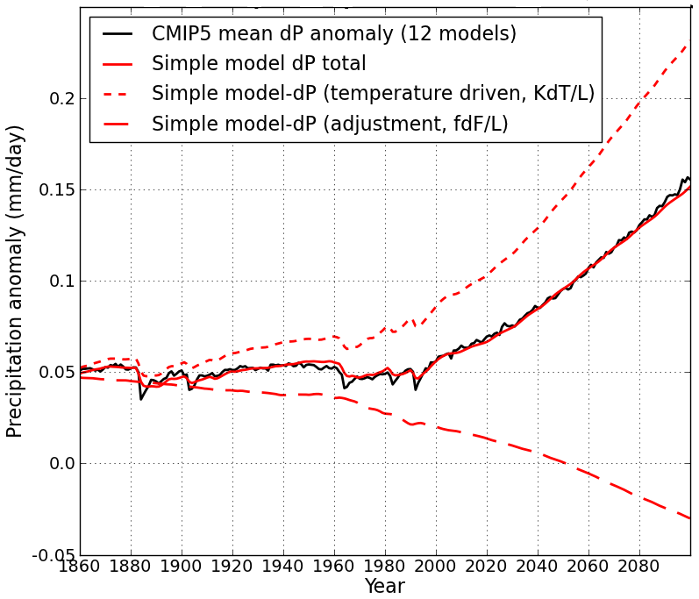
Simple model for global precipitation
Using simple model:
LΔP = kΔT – f_{F}ΔF
Precipitation change (mm/day)
N=ΔF – YΔT_{m}
CMIP5 historical/RCP8.5
ΔT_{m}
D
ΔT_{D}
Zahra Mousavi (PhD project)
After Allan et al. (2014) Surv. Geophys and Thorpe and Andrews (2014) ERL
Notes:
5
There is huge uncertainty in global precipitation projections, relating both to climate sensitivity and mitigation pathways.
In PAGODA we are understanding the precipitation changes at the largest scales relating both to the warming (in response to radiative forcings) and and also the direct effect of the radiative forcings themselves on precipitation.

Slide 6
Disproportionate global precipitation response to ozone
Detailed modelling of radiative response to ozone changes (ECLIPSE project inc. Bill Collins, Keith Shine, Nicolas Bellouin)
Precipitation response to ozone changes >50% that due to CO₂, even though the RF is only ~20%
Increased ozone pollution at low levels effective at increasing P
Stratospheric ozone depletion also contributes to increased P
CO₂
Change in Precipitation (mm/day)
O₃
O₃
strat
MacIntosh et al. (2016) GRL

Slide 7
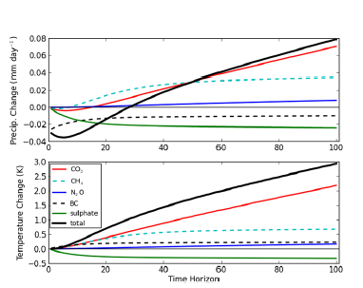
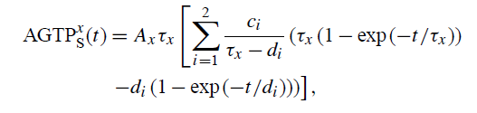
Metrics for global precipitation
Shine et al. (2015) ESD
Metrics linking change in precipitation to emissions
Precipitation and temperature response to constant emissions after 2008
But what about regional changes?
Time horizon/years
Using Absolute Global Temperature Potential (AGTP) due to sustained emissions and radiative forcing over time horizon, H.

Slide 8
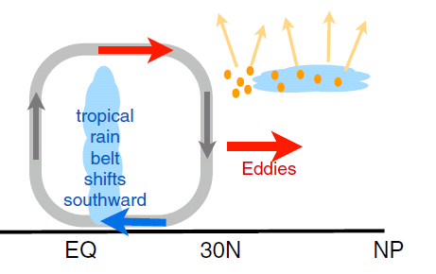
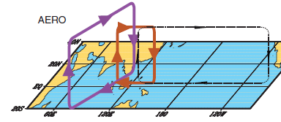
earth’s energy budget & regional changes in the water cycle
Regional precipitation changes sensitive to asymmetries in Earth’s energy budget
N. Hemisphere cooling: less heat transport out of hemisphere
Reduced Sahel rainfall from:
Anthropogenic aerosol cooling 1950s-1980s: Hwang et al. (2013) GRL →
Asymmetric volcanic forcing e.g. Haywood et al. (2013) Nature Climate
Enhanced energy transport
cooling
Anomalous heat fluxes
Sulphate aerosol effects on Asian monsoon e.g. Bollasina et al. 2011 Science (left)
Links to drought in Horn of Africa? Park et al. (2011) Clim Dyn
GHGs & Sahel rainfall recovery?
Dong & Sutton (2015) Nature Clim.

Slide 9
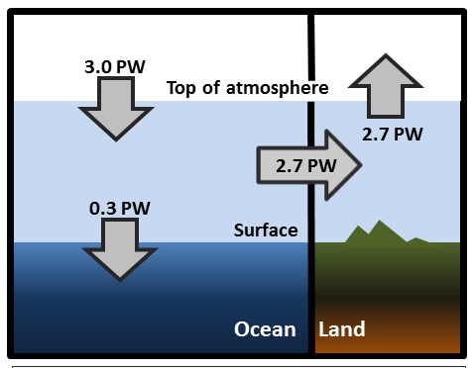
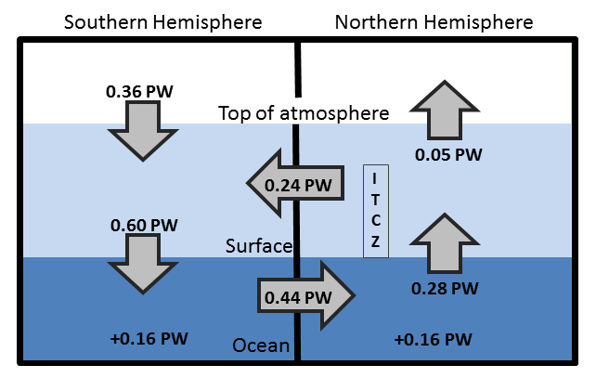
Observed Asymmetry in earth’s energy budget
Adapted from Liu et al. (2015) JGR (above) & Loeb et al. (2015) Clim. Dyn. (left)
Observed inter-hemispheric imbalance in Earth’s energy budget
Not explained by albedo: brighter NH surface but more clouds in SH (Stephens et al. 2015)
Inter-hemispheric heat transports determine and are influenced by position of ITCZ (e.g. Frierson et al. 2013)

Slide 10
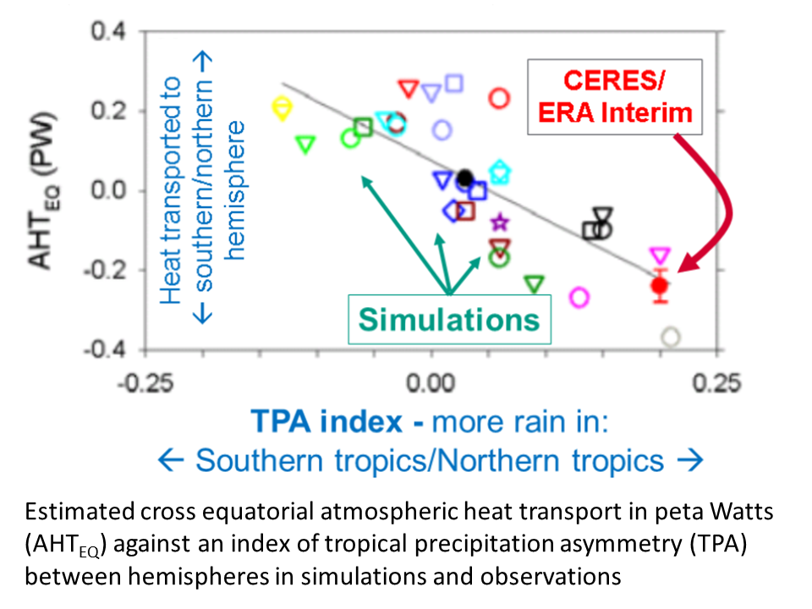
Cross-Equatorial heat transport linked to model precipitation bias
Clear link between bias in cross-equatorial heat transport by atmosphere and inter-hemispheric precipitation asymmetry Loeb et al. (2015) Clim. Dyn
Also: Haywood et al. (2016) GRL
Ahmad Alkamali BSc project

Slide 11
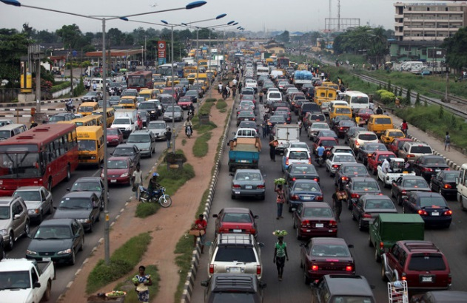

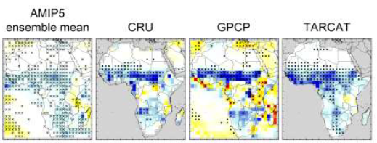
Africa rainfall and circulation changes
Africa rainfall sensitive to radiative forcings, inter-hemispheric heating & internal variability
Africa susceptible to changes in water cycle: monitoring essential (TAMSAT group)
West Africa – particularly complex mix of pollution /cloud/dynamics: observations essential: DACCIWA project (inc. Christine Chiu et al.) Knippertz et al. 2015
Recent changes in Africa rainfall:
Role of GHGs in Sahel rainfall recovery:
Dong & Sutton (2015) Nature Clim
Maidment et al. (2015) GRL
Seasonality: Caroline Dunning PhD project

Slide 12
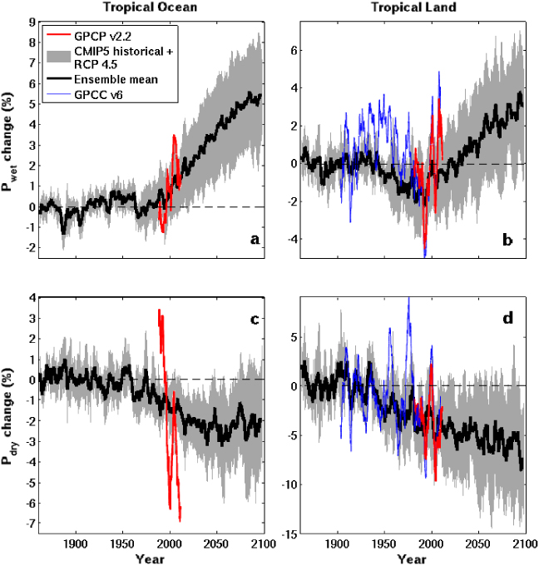
Moisture transport and intensification of wet/dry seasonS
Tropical Land
Increased moisture with warming implies amplified P-E (e.g. Held & Soden 2006)
Multi-annual P-E > 0 over land implies increased P-E (e.g. Greve et al. 2014)
Changes in T/RH gradients also important (Byrne & O’Gorman 2015)
P-E < 0 in dry season over land: more intense dry and wet seasons? (Chou et al. 2013; Liu & Allan 2013; Kumar et al. 2014)
Aridity metrics more relevant (Scheff & Frierson 2015; Greve & Seneviratne 2015; Roderick et al. 2014 ; Kumar et al. 2016 )
Changes in circulation dominate locally (e.g. Scheff & Frierson 2012; Chadwick et al. 2013; Muller & O’Gorman 2011; Allan 2014)
6
4
2
0
-2
-4
GPCC GPCP
WET
Precipitation Change (%)
1900 1950 2000 2050 2100
5
0
-5
-10
-15
DRY
CMIP5 Simulations
1900 1950 2000 2050 2100
Liu & Allan 2013 ERL

Slide 13
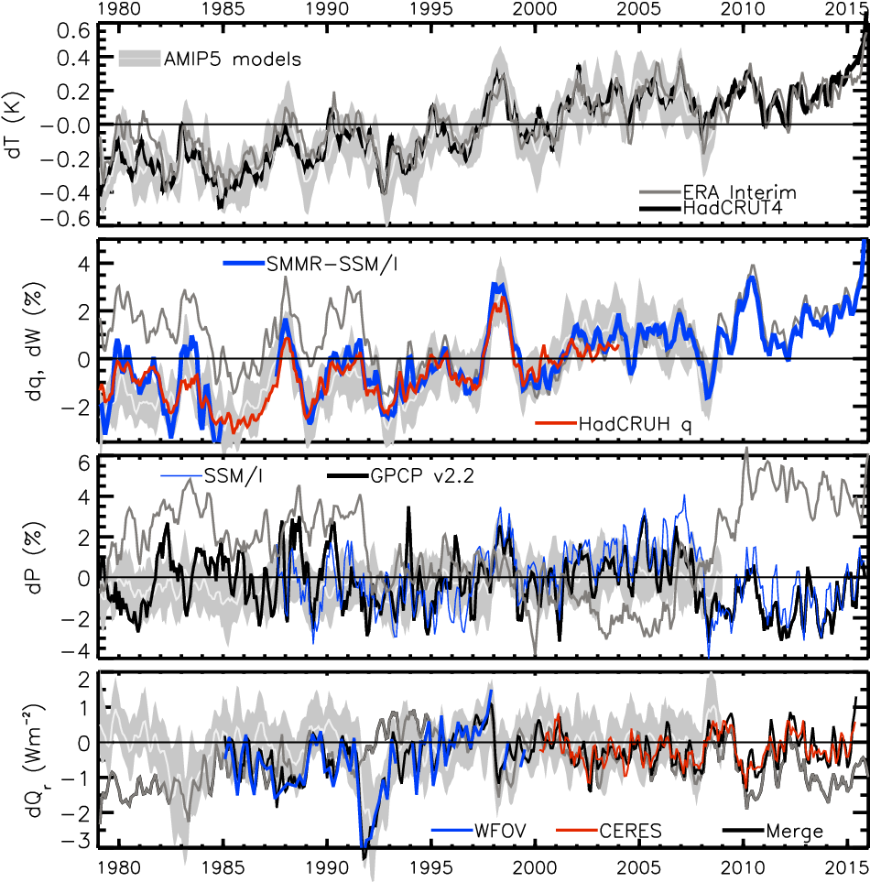
TRACKING global climate change
HEATING (Wm⁻²) PRECIP (%) MOISTURE (%) TEMPERATURE (K)
Update from Allan et al. (2014) Surv. Geophys & Allan et al. (2014) GRL

Slide 14
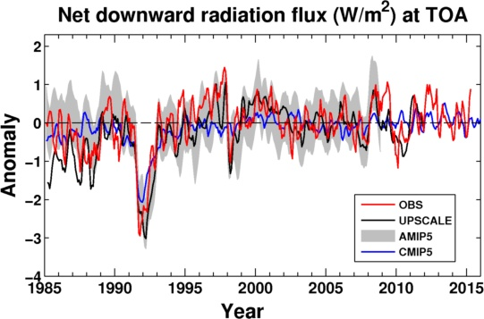
Net Imbalance Anomaly (Wm⁻²)
How is EARTH’s ENERGY BALANCE CHANGING?
Imbalance: 0.21 0.02 0.82 0.67 0.67 0.61 (Wm⁻²)
0.35±0.67 Wm⁻²
0.65±0.43 Wm⁻²
La Niña
El Niño
Volcano
Allan et al. (2014) GRL
See also: Wielicki et al. (2002) Science; Wong et al. (2006) J Climate; Harries & Belotti (2010) J. Climate ; Loeb et al. (2012) Nature Geosci

Slide 15
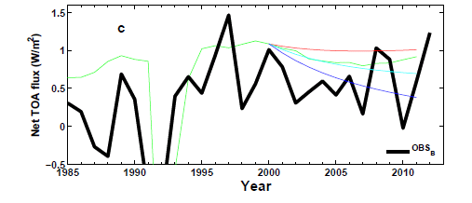
Understanding changes in net imbalance
+ve RF trend
AR5 RF
0 RF trend
-ve RF trend
N
N=ΔF–YΔT_{s}
Analysis using simple energy balance model Allan et al. (2014) GRL supplementary
ΔT_{s}
D
ΔT_{D}

Slide 16
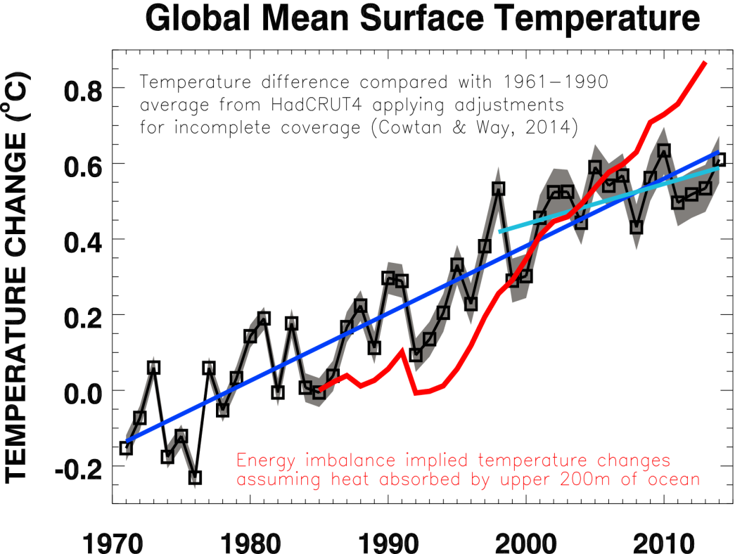
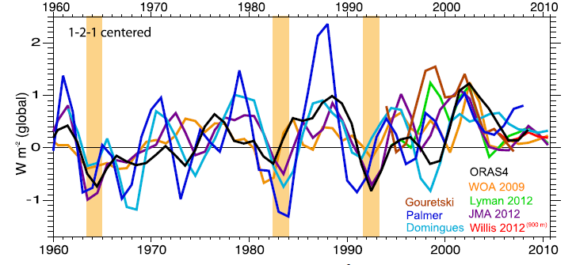
At what rate is Earth heating?
What are implications for climate sensitivity and the global water cycle?
Upper ocean heating rate (Wm⁻²)
Trenberth et al. (2014) J Clim see also Loeb et al. (2012) Nat. Geosci; Glecker et al. Nature Clim.

Slide 17
Discrepancy between radiation budget AND ocean heating?
Large ocean heating anomaly in 2002
Inconsistent with radiation budget observations and simulations
Changing observing system influence?
Slight drop in net flux 1999-2005?
Smith et al. (2015) GRL

Slide 18
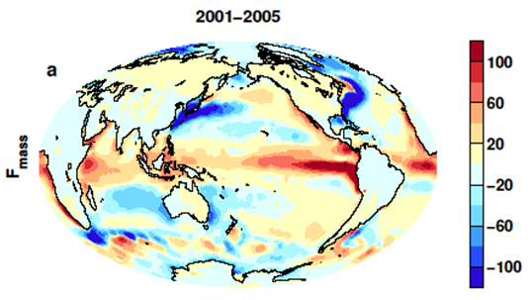
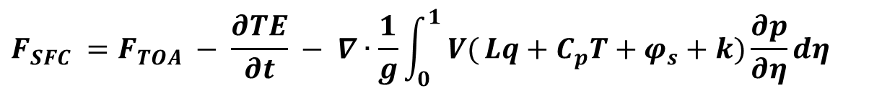
Indirect estimates of air-sea energy
fluxes from satellite/reanalysES
$$F_{SFC} =F_{TOA} − \frac{∂TE}{∂t} − ∇∙\frac{1}{g}\int_{0}^{1}{ V(}Lq+C_{p}T+φ_{s}+k)\frac{∂p}{∂η}dη$$
CERES/Argo Net Flux
Estimate horizontal energy flux
Surface Flux
Net surface downward energy flux (Wm⁻²)
Liu et al. (2015) JGR
see also: Loeb et al. (2015) Clim. Dyn , Trenberth et al. (2001) Clim. Dyn.

Slide 19
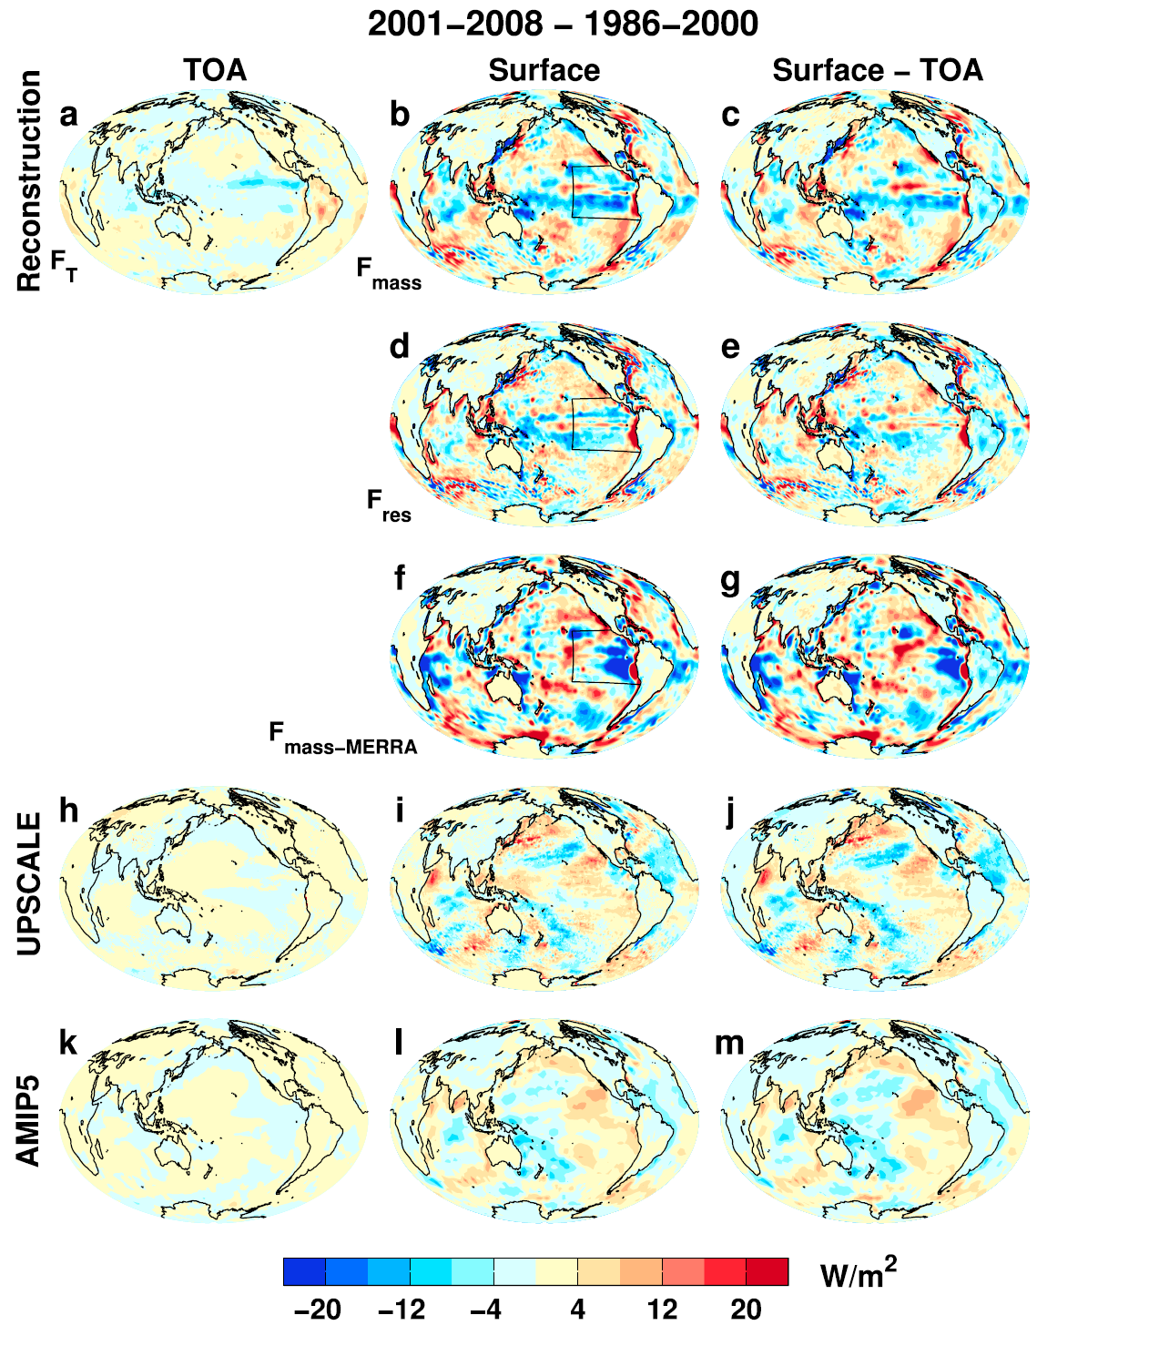

Where is the heat going? changes in surface energy flux
Changes in energy fluxes 1986-2000 to 2001-2008
Surface energy flux dominated by atmos. transports
More investigation of mechanisms & feedbacks by…
Liu et al. (2015) JGR

Slide 20
conclusions
Heating of Earth continues at rate of ~0.6 Wm⁻²
  Manifest as positive imbalance in Southern Hemisphere
  Variability from radiative forcings & ocean changes
Radiative transfer & Thermodynamics explain increased global precipitation with warming ≈ 2%/K
  Radiative forcings also directly affect water cycle responses
  Greenhouse gas & absorbing aerosol forcing supress global precipitation response to warming (“hydrological sensitivity”)
Inter-hemispheric heating, moisture budget & unforced variability dictate regional responses and determine climate model biases
  Decadal changes in ITCZ and global atmospheric/ocean circulation
  Has the “hiatus” affected water cycle?
  How do changes in cloud/circulation fit in?
  Where is energy going and can we constrain climate sensitivity & feedbacks on internal variability? DEEP-C and SMURPHS projects…

Slide 21

CLAP IMMEDIATELY!!!

Slide 22
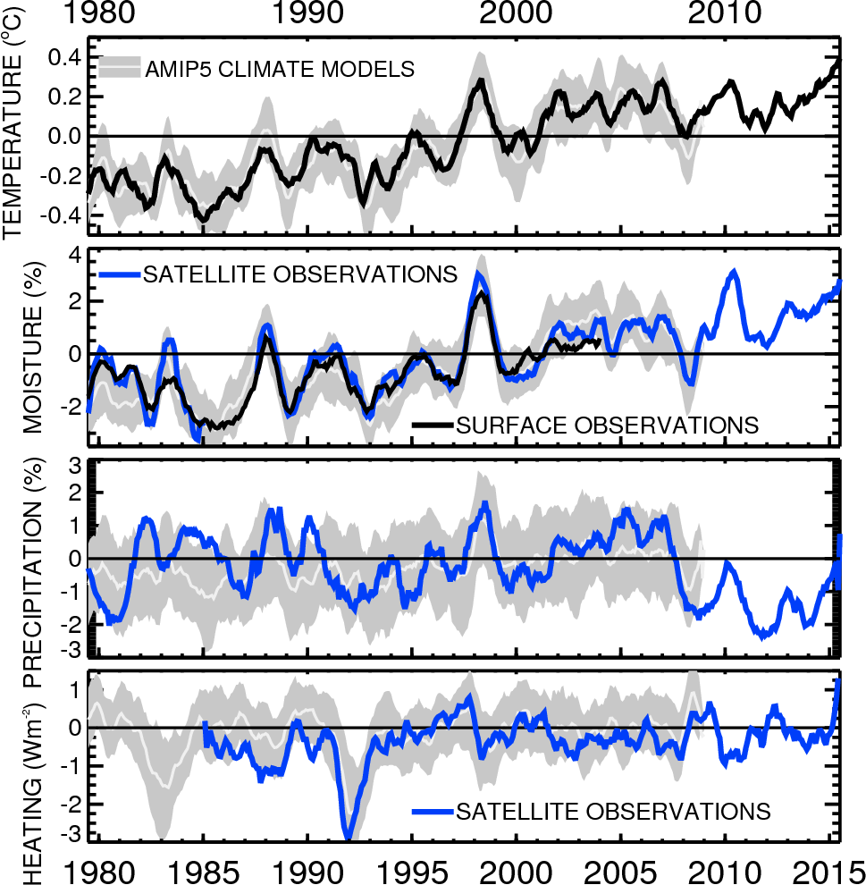

Slide 23
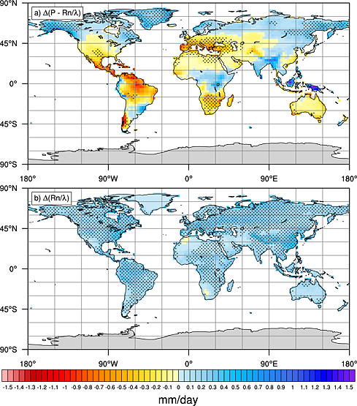
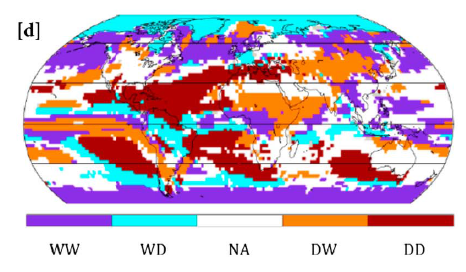
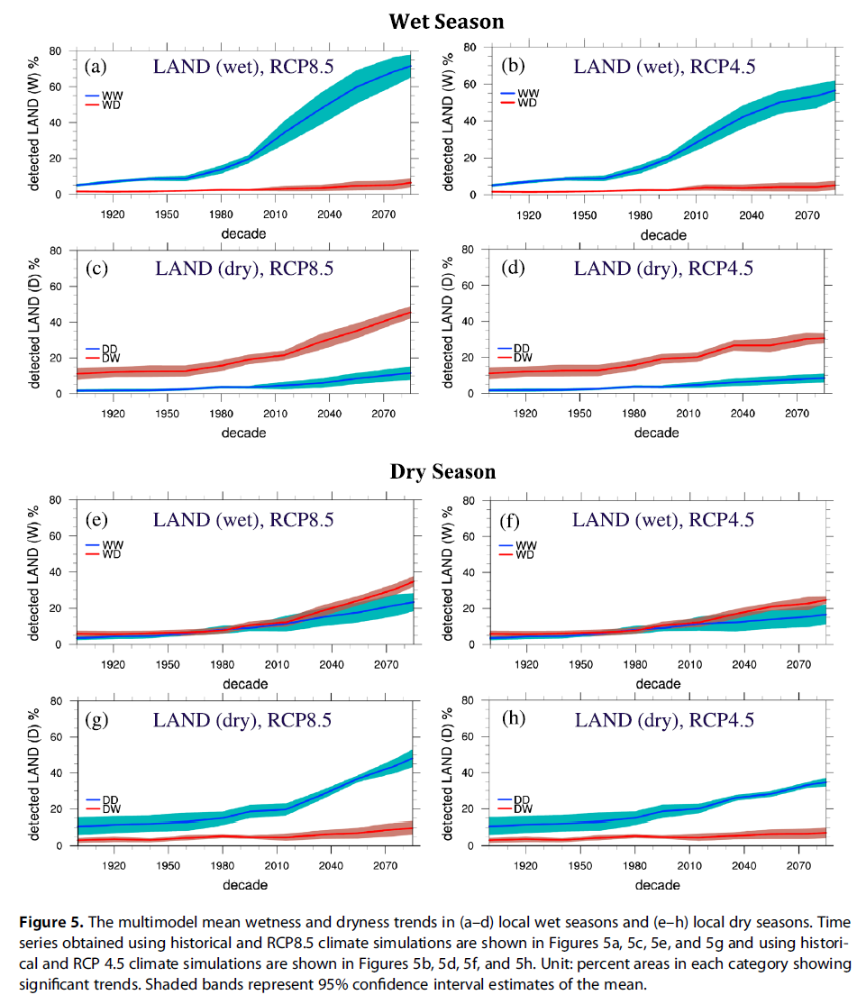
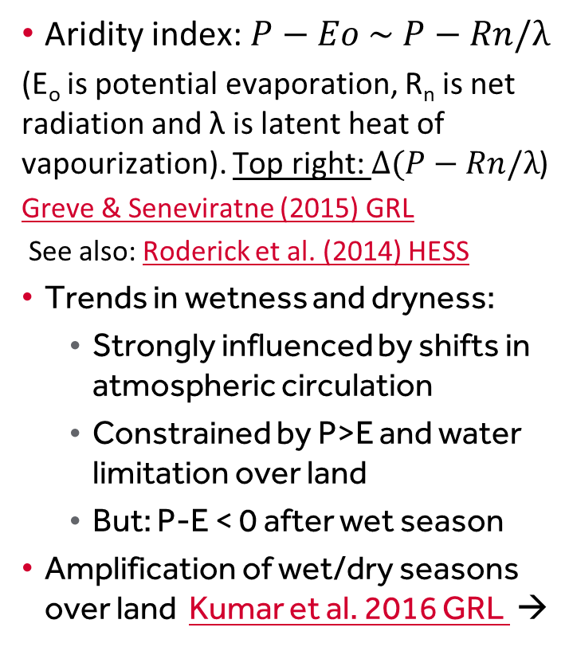
Amplification of wet/dry seasons?
Aridity index: $P−Eo \sim P−Rn/λ$
(E_{o} is potential evaporation, R_{n} is net radiation and λ is latent heat of vapourization). Top right: $Δ(P−Rn/λ$)
Greve & Seneviratne (2015) GRL
See also: Roderick et al. (2014) HESS
Trends in wetness and dryness:
  Strongly influenced by shifts in atmospheric circulation
  Constrained by P>E and water limitation over land
  But: P-E < 0 after wet season
Amplification of wet/dry seasons over land Kumar et al. 2016 GRL →
RCP8.5: Dry land, dry season
Wet land, wet season

Slide 24
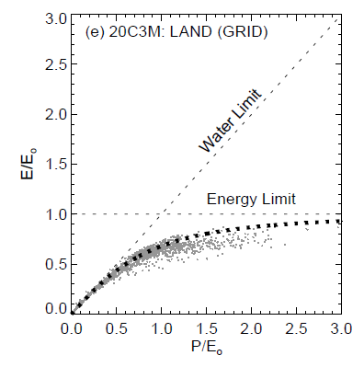
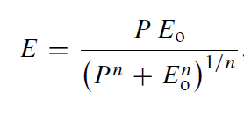
Constraints on evaporation
Energy & precipitation (P) constraints on evaporation (E)
Budyko Framework
E_{o} is maximum theoretical evaporation (E is energy limited)
E is also limited by water availability (determined by P)
n is a catchment-specific parameter
If P>>E_{o}, E→E_{o}
If E_{o}>>P, E→P
Roderick et al. (2014) HESS
Notes:
As P→big, E

Slide 25
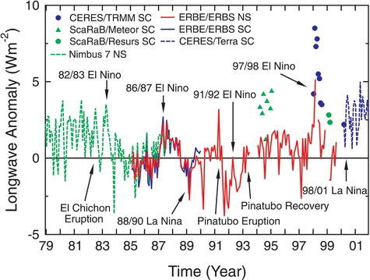
How is earth’s energy balance changing & what are implications?
20°N-20°S
Wong et al. (2006) J Clim; Wielicki et al. (2002) Science

Slide 26
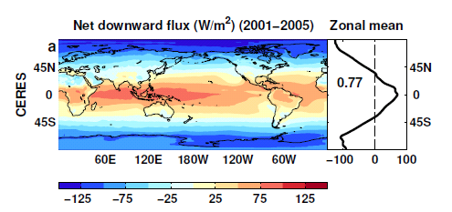
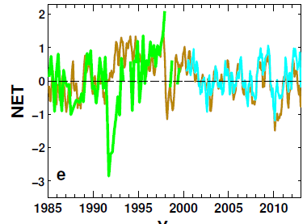
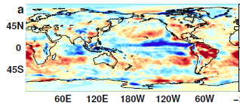
Reconstructing global radiative fluxes since 1985
ERBS/CERES variability
CERES monthly climatology
ERBS WFOV
CERES
ERA Interim
ERA Interim spatial anomalies
Combine CERES/ARGO accuracy, ERBS WFOV stability and reanalysis circulation patterns to reconstruct radiative fluxes

Slide 27
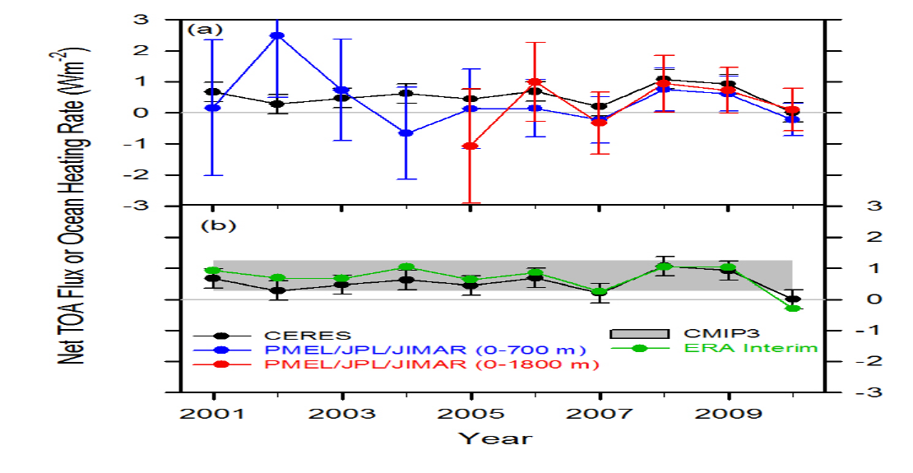
Combining Earth Radiation Budget and Ocean Heat Content data (2)
Replotted so that CERES and ERA Interim sample 6-months later than ARGO
Is there a lag in the system?
Where in ocean is energy accumulating?
Mechanism?
Notes:
Fi gure 3 (a) Global annual average net TOA flux from CERES observations and (b) ERA Interim reanalysis are anchored to an estimate of Earth’s heating rate for 2006–2010 ⁵ The Pacific Marine Environmental Laboratory/Jet Propulsion Laboratory/Joint Institute for Marine and Atmospheric Research (PMEL/JPL/JIMAR) ocean heating rate estimates⁴ use data from Argo and World Ocean Database 2009; uncertainties for upper ocean heating rates are given at one-standard error derived from sampling uncertainties. The gray bar in (b) corresponds to one standard deviation about the 2001–2010 average net TOA flux of 15 CMIP3 models.

Slide 28
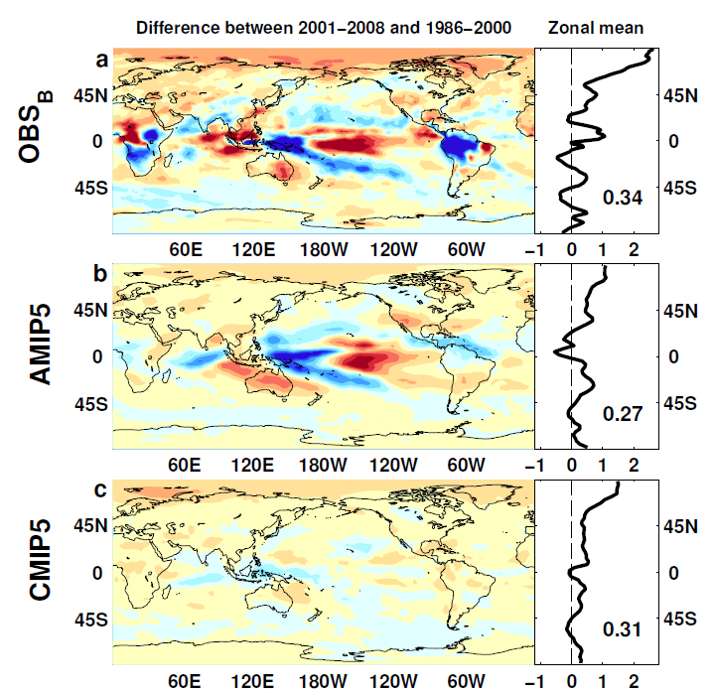

Outgoing Longwave Radiation
Wm⁻²

Slide 29
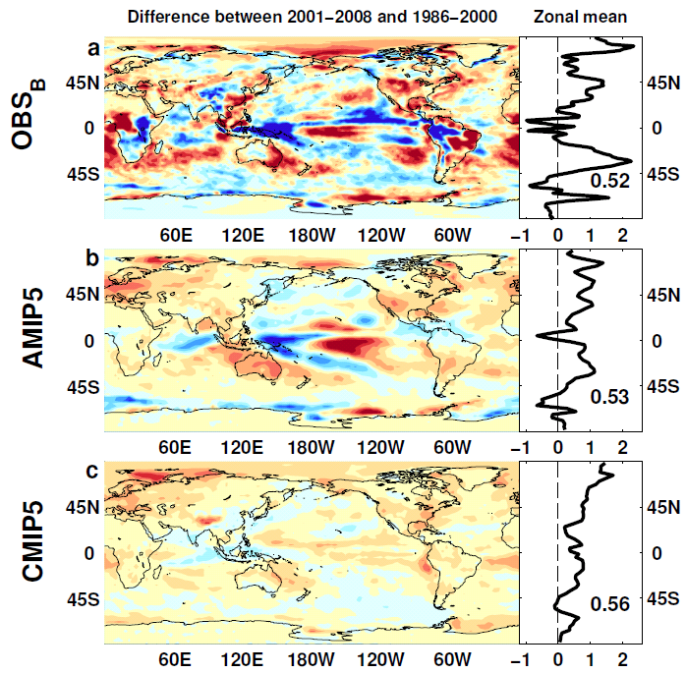
Absorbed Shortwave Radiation
Wm⁻²

Slide 30
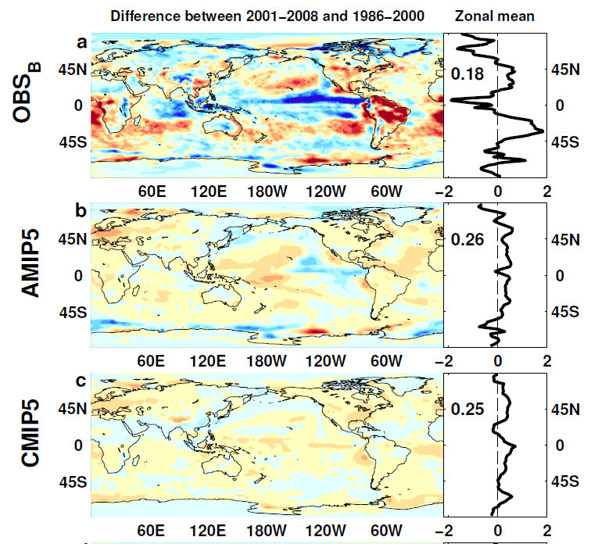

NET Radiation

Slide 31
lw & sw fluxes

