Slide 1
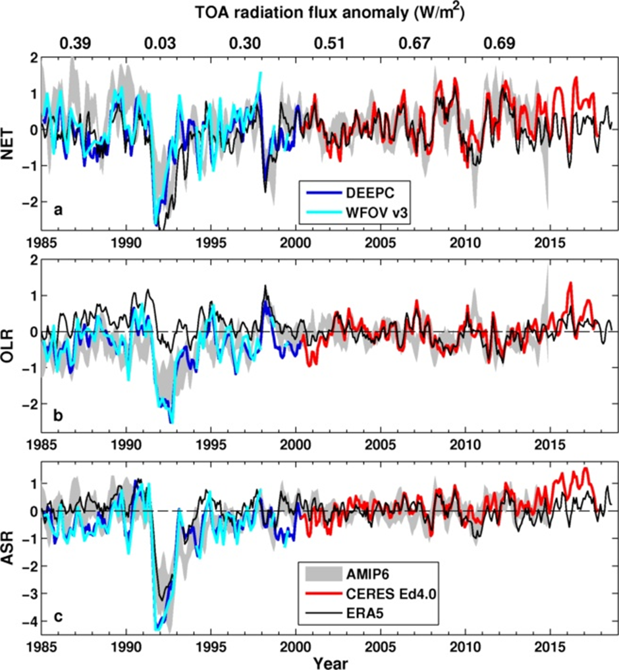
CURRENT Energy Budget Changes
Preliminary comparison with AMIP6 and ERA5
Large uncertainty in pre-CERES EEI remains
ERA5 does not capture observed ASR increase after warming slowdown (e.g. Loeb et al. 2018)
AMIP vs reconstruction:
  NET: r = 0.46
  OLR: r = 0.57
  ASR: r = 0.70
Consistent with ocean heat content (Cheng et al. 2017 Sci. Adv.) lower than new independent estimate by Resplandy et al. (2018) Nature

Slide 2
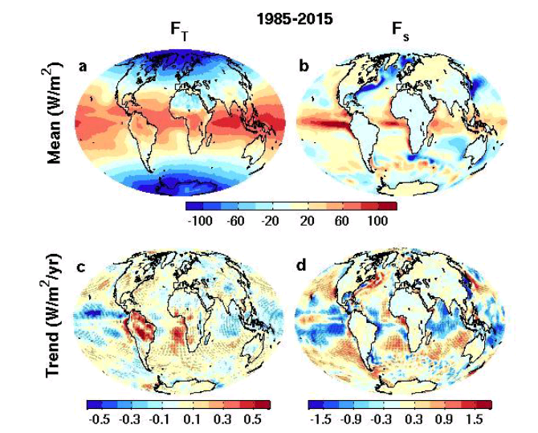
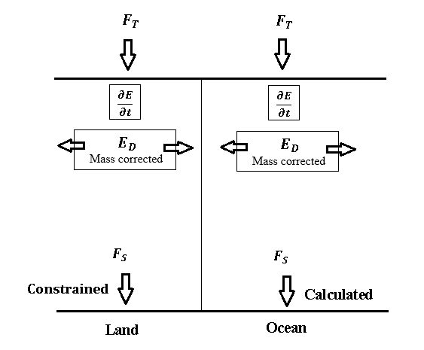

New global surface flux estimates
top of atmosphere surface
ERBS CERES
reanalyses
Surface energy flux dataset combines top of atmosphere satellite reconstruction with reanalysis energy transports: Liu et al. (2015) JGR
Liu et al. (2017) JGR Data: http://dx.doi.org/10.17864/1947.111

Slide 3
(a) Multiannual mean (2006–2013) northward total meridional ocean heat transports (unit is PW) in Atlantic derived from the updated net DEEPC surface fluxes and observations (symbols, error bars show one standard deviation). The ocean heat storage derived from observational data of Desbruyeres et al. [2017] is also taken into account. (b) Northward meridional ocean heat transports at 26oN of Atlantic from RAPID observations (red) and updated DEEPC net surface fluxes taking into account the ocean heat storage of ORAS4 0-700m (solid black), together with the transports inferred from ERA-Interim model surface fluxes (dashed grey line) and the one with mass corrected atmospheric energy divergences (but no land surface flux adjustment) (solid light grey line). The multiannual mean (April 2004 – March 2014) transports are also displayed in the plot.

Slide 4
(a) Updated observations of energy flows between ocean and land regions in the climate system in petawatts (PW) over 2006–2013. TOA radiative flux is from CERES EBAF 4.0 anchored to 0.71 Wm-2 (0.36 PW) over 2006–2013. (b) Time series of the transport from ocean to land, together with the MEI index which is divided by 10 and shifted up to match the transport. The five year mean transports are displayed at the top.

Slide 5
Time series of global meridional transports at 30◦N, equator and 30◦S in ocean (left column) and atmosphere (right column). Contributions of net surface energy flux and heat storage integrated from the north pole to oceanic transport are also plotted. Heat storage contribution and MEI index are all adjusted up and down for clarity.

Slide 6

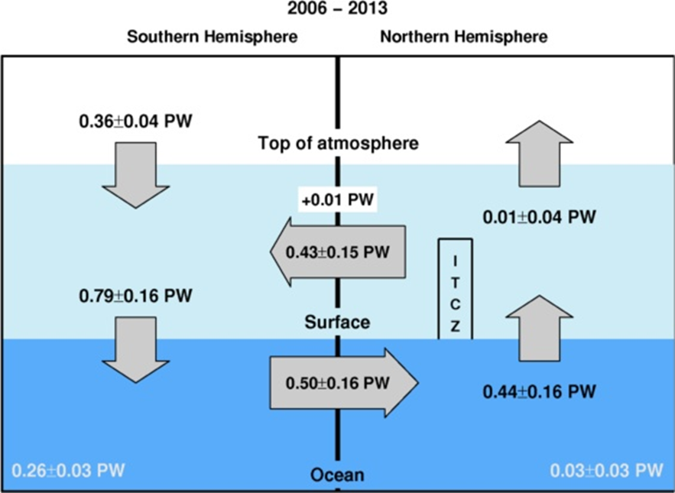
Hemispheric Asymmetry
In EARTH’S Energy Budget
Mean position of the tropical rainy belt in northern hemisphere determined by northward energy transport by ocean e.g. Frierson et al. (2013) Nature Geosci
Important to quantify hemispheric energy budget:
← Inferred 2006-2013 cross equatorial energy flux (updated from Liu et al. 2017 & Loeb et al. (2015) Clim. Dyn using ocean heating from Roemmich et al. (2015) Nature Clim or ORAS4 reanalysis

Slide 7
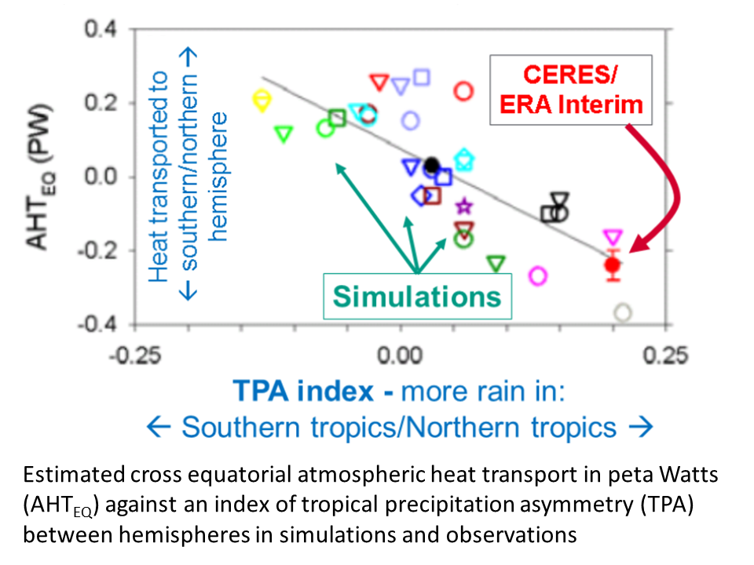
Cross-Equatorial heat transport & precipitation bias LINKED
← Many climate models simulate incorrect sign of cross equatorial energy flow and northern minus southern hemispheric precipitation difference
Loeb et al. (2015) Clim. Dyn
Also: Haywood et al. (2016) GRL
Hawcroft et al. (2016) Clim. Dyn.
Many processes contribute to hemispheric asymmetry…
?

Slide 8
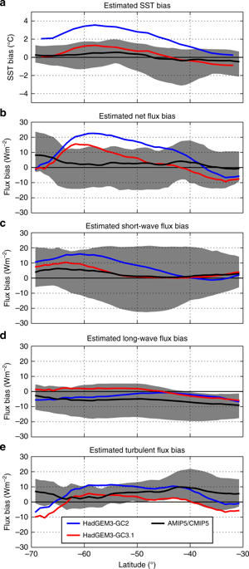
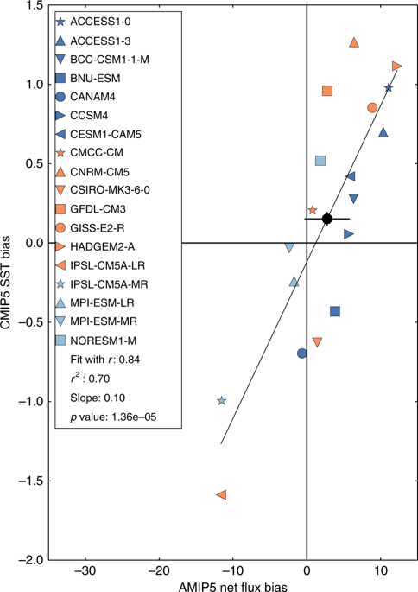
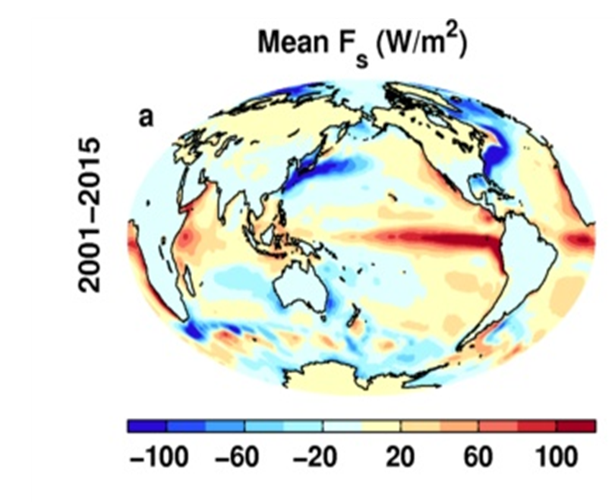
How do cloud errors contribute to evolving systematic model biases?
Combine AMIP/CMIP to understand fast/slow evolution of model biases
External partner: Met Office
Hyder et al. 2018 Nature Comms

Slide 9
Do models simulate realistic interannual cloud feedbacks?
Evaluating cloud feedback using satellite data (CERES EBAF)
CERES
AMIP
Collaboration with Norman Loeb (NASA Langley)
External links with Met Office and NASA Langley.
TOA RSW 2014-2017 El Nino minus 2000-2014 climatology

Slide 10
Anomaly correlation coefficient over 1985-2016 between surface temperature and TOA (a) OLR, (b) ASR, (c) NET and (d) surface net energy flux Fs. The reference period is 2001-2005. The OLR is positive upward here. Also shown are the anomaly scatter plots between surface temperature and (e) TOA ASR and (f) TOA OLR.

Slide 11
Cloud-aerosol effects on clouds remain uncertain
Volcanic aerosol effect on cloud droplet size observable and consistent with simulations
Further indirect effects in cloud water not detectable
Malavelle et al. (2017) Nature
More complex sub-sampling appears to show substantial effects for mid-latitude cyclones and marine stratocumulus
McCoy et al. (2018) ACPD, Rosenfeld et al. (2019) Science
Are simulated cloud-aerosol effects too large or does this mask underestimated climate sensitivity?
External links with Exeter, Leeds, …
MODIS-Aqua Observations
Cloud water Droplet size
Malavelle et al. (2017) Nature

