Slide 1
Global hydrological forcing: current understanding
ΔF
ΔP(ΔF-ΔFs)
ΔP(ΔT)
ΔFs
ΔT
Fast response to forcing
Slow response to temperature
For more details, see: Andrews et al. (2010) GRL and Ming and Ramaswamy (2010) GRL which build on work by Gregory and Webb (2008) J Clim.

Slide 2
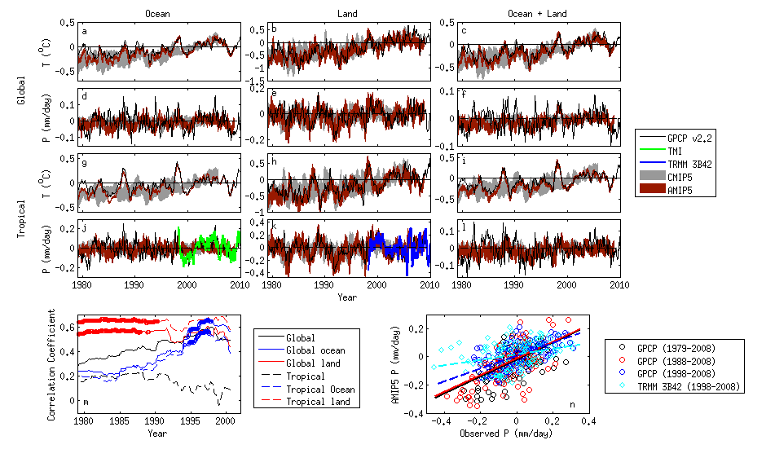
Global hydrological forcing: current understanding
ΔF
ΔT
ΔP(ΔF-ΔFs)
ΔP(ΔT)
ΔFs
ΔT
ΔP
Fast response to forcing
Slow response to temperature
?
Is there evidence of discrepancy between models and observations
What is the physical basis for changes

Slide 3
Anticipated changes in the hydrological cycle
Radiative constraint: dP/dT~2-3%/K
(e.g. Allen and ingram, 2002, Nature)
Radiative forcings and fast responses: how much can this change the dP/dT response?
(e.g. Andrews et al. 2010 GRL)
Moisture constraint:
  Increases in extreme precipitation (7%/K?)
  Amplification of P-E patterns
(e.g. Held and Soden, 2006)

Slide 4
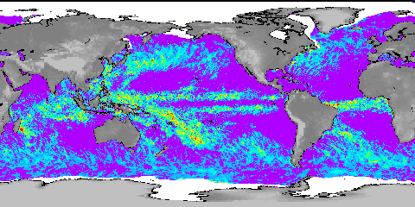
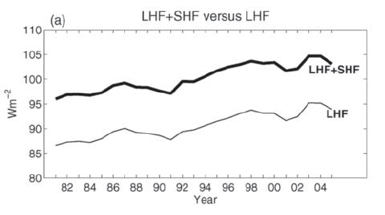
Are models underestimating current precipitation/evaporation responses?
(Wentz et al. 2007, Science)
Yu and Weller (2007) BAMS
Notes:
NOTE: if mean Precip rises at same rate as extreme precip, there should not be a contrasting response in wet and dry regions.

Slide 5
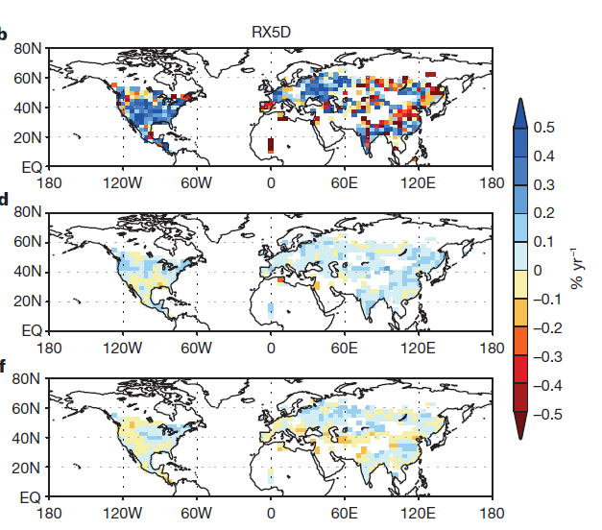
Are models underestimating response of extreme precipitation?
ALL ANT OBS
Min et al. (2011) Nature
http://www.nature.com/nature/journal/v470/n7334/full/nature09763.html
Notes:
Figure 1 | Geographical distribution of trends of extreme precipitation
indices (PI) during 1951–99. a, b, Observations (OBS); c, d, model
simulations with anthropogenic (ANT) forcing; e, f, model simulations with
anthropogenic plus natural (ALL) forcing. For each pair of panels, results are
shown for annual maximum daily (RX1D) and five-day (RX5D) precipitation
amounts. For models, ensemble means of trends from individual simulations
are displayed. Units: per cent probability per year.
5

Slide 6
Are models underestimating response of extreme precipitation?
Allan et al. (2010) Environ. Res. Lett.
Tropical oceans
Notes:
Both obs and models show enhanced frequency of extreme precipitation with warming over tropical oceans.
The larger observed response requires further scrutiny.
The model response (AMIP3) displays substantial uncertainty relating to contrasting changes in updraft velocity within storms with warming. This requires assessment in CMIP5 model simulations.

Slide 7
Do models underestimate regional responses?
Zhang et al. 2007 Nature

Slide 8
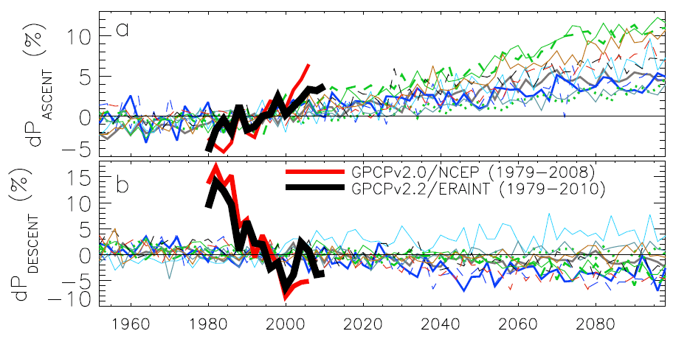
Contrasting precipitation response in wet and dry regions of the tropical circulation
ascent
Observations
Models
Precipitation change (%)
descent
Sensitivity to reanalysis dataset used to define wet/dry regions
Updated from Allan et al. (2010) Environ. Res. Lett.
Notes:
Note that the wet getting wetter and dry getting drier signal in the tropics is robust in models. The recently updated GPCP observations (black) show a slightly larger trend in the wet region. The dry region trend is probably spurious before 1988 since microwave data began in 1987.

Slide 9
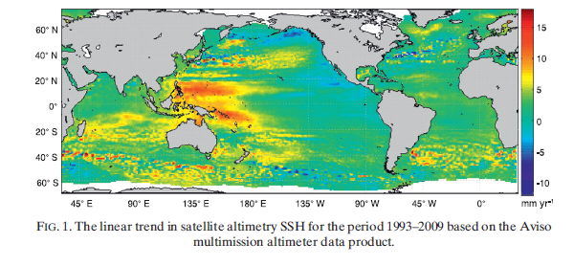
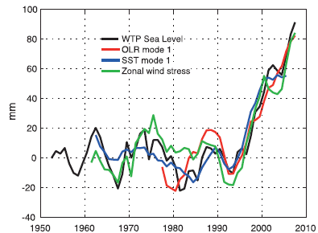
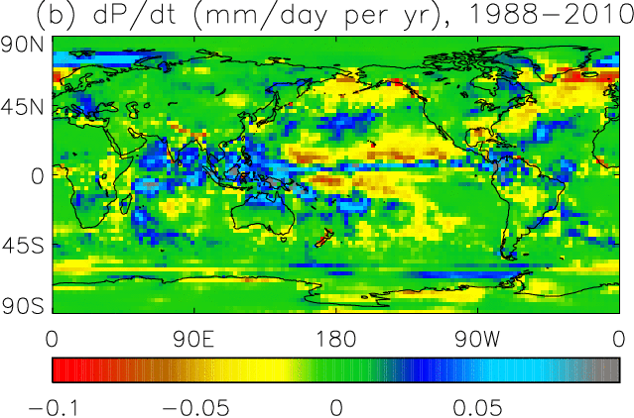
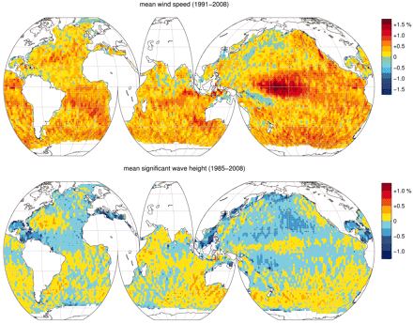
Changes in tropical circulation?
Wind-driven changes in sea surface height Merrifield (2011) J Clim
http://journals.ametsoc.org/doi/abs/10.1175/2011JCLI3932.1
Increases in satellite altimeter wind speed?
Young et al. (2011) Science
http://www.sciencemag.org/content/332/6028/451.full

Slide 10
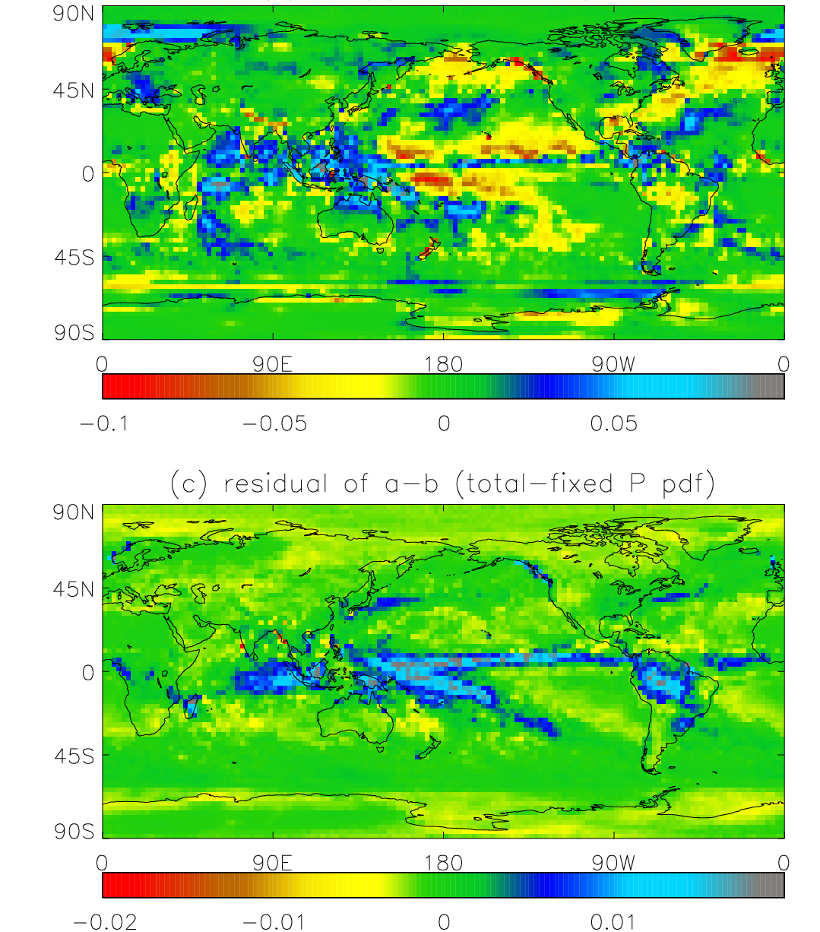
Observed Precipitation trend in mm/day per year over the period 1988-2010
Top: Trend due to changes in the atmospheric circulation
Bottom: Residual trend unrelated to atmospheric circulation changes

Slide 11
Interannual changes in tropical precipitation (mm/day) in climate models & observations since 1979
Top: tropical land
Bottom: All tropics

Slide 12
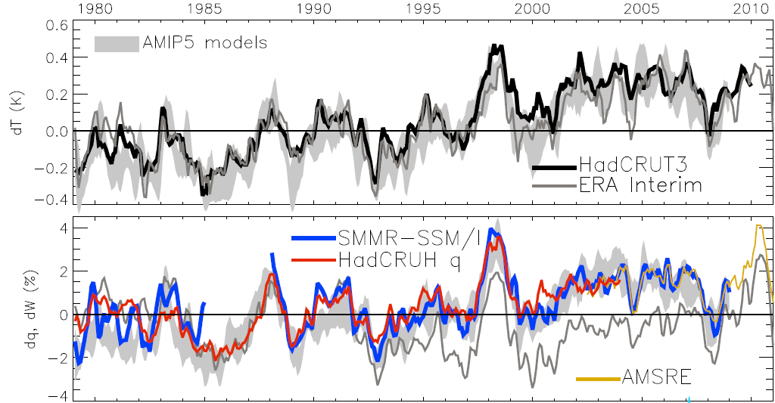
Optional: Global changes in water vapour
Updated from O’Gorman et al. (2012) submitted; see also John et al. (2009) GRL
Notes:
The main point to note is that models and observations are consistent in showing increases in low level water vapour with warming. Reanalyses such as ERA Interim, which are widely used, are not constrained to balance their energy or water budgets.
For ocean-only satellite datasets I apply ERA Interim for poleward of 50 degrees latitude and for missing/land grid points.
Note that SSM/I F13 2003-2007 CWV = 24.7794 mm; AMSRE 2003-2007 CWV = 24.8850

Slide 13
WP3: Exploiting satellite observations
We are currently assessing and exploiting satellite and gauge-based estimates of precipitation
Liu and Allan (2011) submitted
Notes:
We are analysing tropical and global variability and responses of PDFs of precipitation to present day temperature variability.
We have identified two outliers: HOAPS (divided by 3 on plot) data overestimates variability while TRMM 3B42 (widely used) displays spurious variability over the oceans.

Slide 14
WP3: CMIP5 comparisons
Chunlei Liu

Slide 15
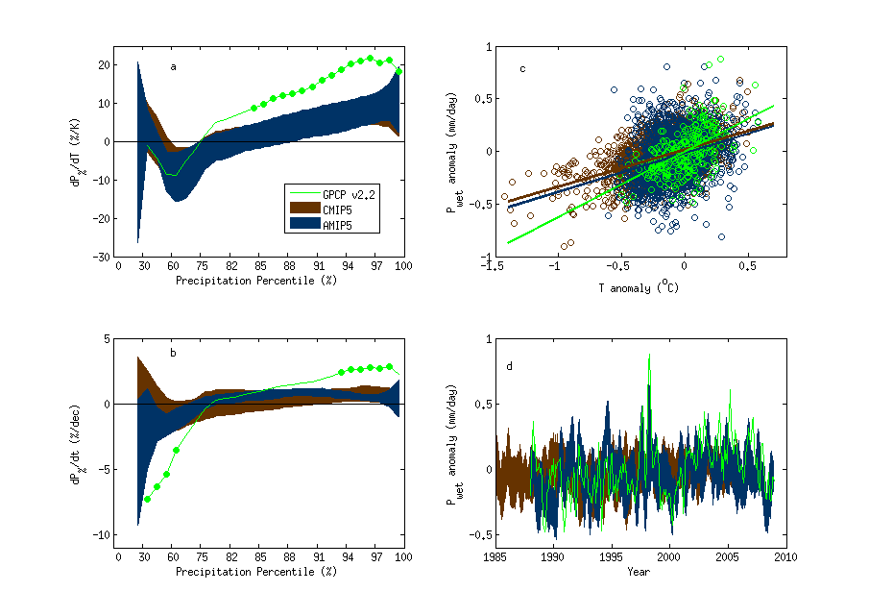
GPCP vs CMIP5 models
dP%/dTs
P% trend
Wettest 30% of tropical gridpoints

Slide 16
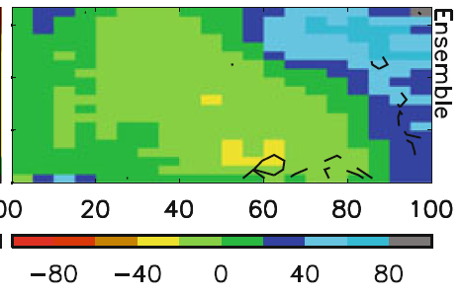
Simulated/observed precipitation fingerprints
Warmer surface temperature →
Model biases in warm, dry regime
Strong wet/dry fingerprint in model projections (below)
Stronger ascent →
Stronger ascent →

Slide 17
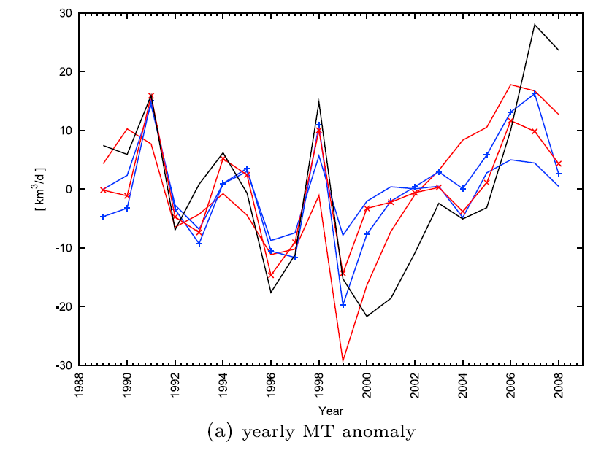
Moisture transports from ERA Interim
Instantaneous field
Moisture transport into tropical ascent region
Significant mid-level outflow
Plans: generate budgets & compare E-P/ocean salinity
outflux
influx
Zahn and Allan (2011) JGR
Notes:
We are also interested in calculating observationally based water budgets including moisture transports and P-E and how this relates to ocean salinity observations.

