Slide 1
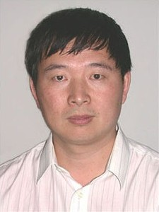


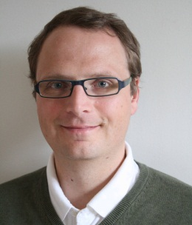
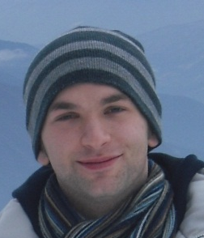

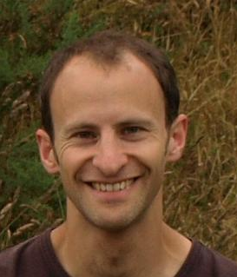




Other links:
Christine Chiu (DACCIWA?)
Charlie Williams (CALM)
Ellie Highwood (FENNEC, SAPRISE)
NCAS Climate
NCEO
Pier Luigi Vidale, Emily Black, …
Chunlei Liu
Harry Pitt Wing
Horyuji PAGODA
DEEP-C
Till Kuhlbrodt
Jonathan Gregory
PhD projects
Ross Maidment
(TAMSAT group)
Kerrian Ferreira (with Nigel Arnell)
Zahra Mousavi
(with Keith Shine)
Matthias Zahn
Harry Pitt Wing
PREPARE project
With Lennart Begtsson
SINATRA?
Hannah Cloke
GES/Met
Richard Allan
2U15
JCWRP HadIR
David Lavers
Walker institute
HydEF project
With Andrew Wade & David Brayshaw
Viju John Met Office
Global energy and water cycle group

Slide 2



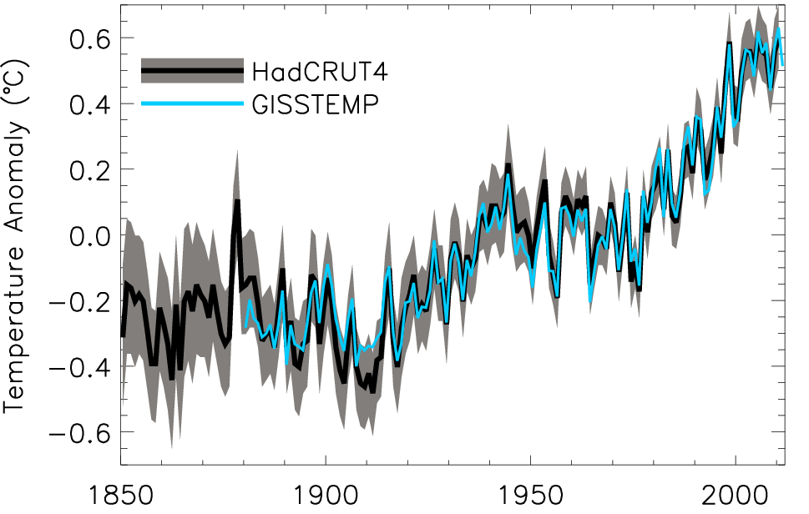
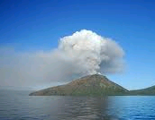
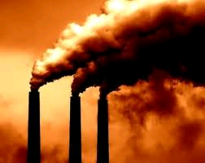
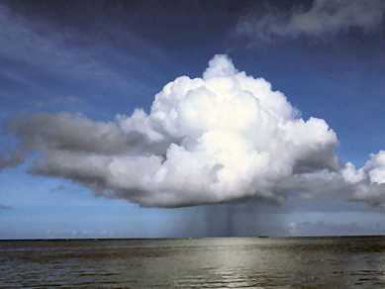
Diagnosing Earth’s Energy Pathways in the Climate System (DEEP-C) NERC project
Where is the excess energy currently going?
Global annual average temperature anomalies relative to 1951–1980 mean (shading denotes lower and upper 95% uncertainty range for HadCRUT4)
See also Loeb et al. (2012) Nature Geosci.
Notes:
By combining satellite data with ARGO observations we estimate a heating rate of around 0.5 Wm-2 in the period 2000-2010. There is no “missing energy” in the climate system, as argued by Trenberth and Fasullo (2010): the satellite and ocean data are in agreement to within observational uncertainty. We plan to seek funding to extend this work to understand the processes involved in “hiatus” decades using climate modelling, ocean observing systems and satellite Earth radiation budget datasets.

Slide 3


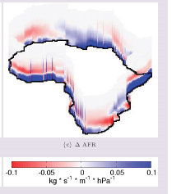
Moisture transports & extremes of rainfall
21C-20C moisture transports
Below: HydEF project linking flooding with atmospheric precursors
Above: PREPARE project investigating climate change response of moisture transports e.g. Zahn & Allan (2013) J Clim; Zahn and Allan (2013) in prep
Lavers et al. (2011) GRL.; Lavers et al. (2012) JGR

Slide 4
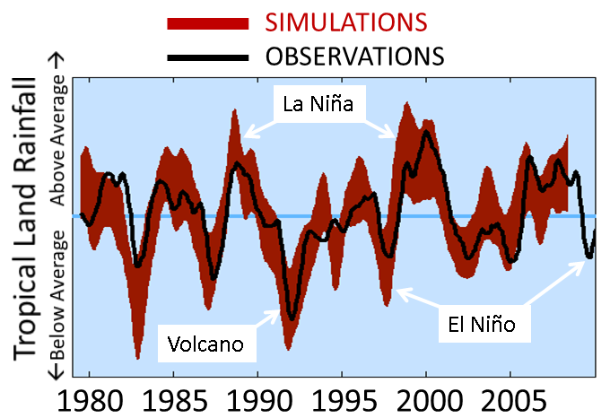

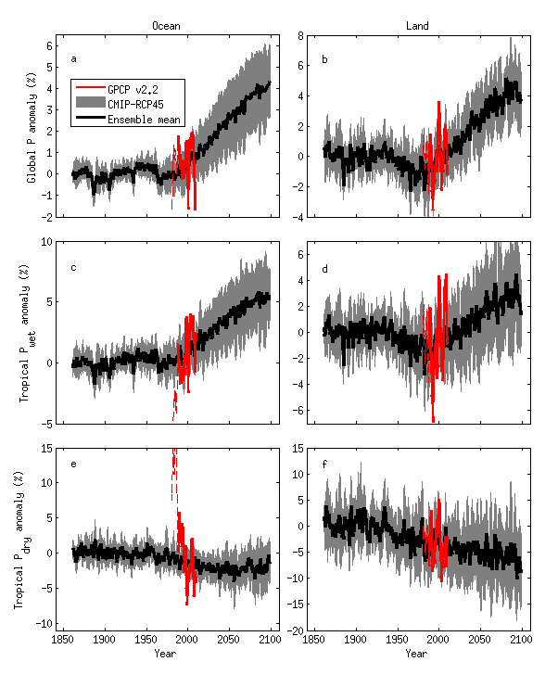

Evaluation of CMIP5 simulations of tropical precipitation
Tropical Land
“wet”
AMIP simulations capture observed interannual variations associated with ENSO [Liu et al. 2012 GRL]
Climate change: rich get richer [Liu et al. in prep]
% change in precipitation
“dry”
Liu et al. (2012) GRL; Liu & Allan (2012) JGR

