Slide 1
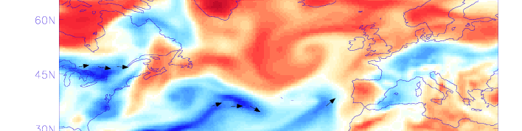
ST2.2 Atmospheric Precursors
Department of Meteorology
Richard Allan, Adrian Champion (University of Reading)
Stephen Blenkinsop, Hayley Fowler (Newcastle University)

Slide 2
St1.3/ST2.2 atmospheric precursors
Atmospheric precursors to heavy 3hr summer rainfall events (Blenkinsop et al. 2016); extends daily analysis (Allan et al. 2015; Champion et al. 2015)
e.g. August 1990 Monthly Weather Reports: “During the 28th and 29th part of a trailing cold front crossed most areas… Thundery outbreaks occurred… more extensively in Eastern parts on 29th…” [+British Rainfall] →
Composite analysis of anomalous atmospheric conditions prior to heavy rainfall events as context for end to end system (see also Lavers et al. 2014)
1-4pm*
140mm
*this is on “Hailstone Hill” near Bacup!

Slide 3
EXAMPLE composites (top 25 events NW)
Td’ (K), PMSL’ (hPa) E’ (mm), Z200’ (m) WV’ (mm), IVT’ (kg/m/s)
Day 0 Day -2 Day -4
Td
Z200
IVTn
IWV
PMSL

Slide 4
This page is intentionally blank

Slide 5
NW UK composites (top 25 events)
Td’ (K), PMSL’ (hPa) E’ (mm), Z200’ (m) WV’ (mm), IVT’ (kg/m/s)
Day 0 Day -2 Day -4

Slide 6
SE england composites (top 25 events)
Td’ (K), PMSL’ (hPa) E’ (mm), Z200’ (m) WV’ (mm), IVT’ (kg/m/s)
Day 0 Day -2 Day -3

Slide 7
Outputs/Deliverables
Dissemination: Various talks on SINATRA work (e.g. EMS conference)
Outreach: schools events, talks to general public, development of online courses, twitter, media interviews
Additional Activities:
- Meetings with FFC, Nigel Roberts and Newcastle to discuss diagnostics
- 2 MSc projects: daily/hourly rain gauge datasets (inc. link to XL Catlin)
Publications/Reports:
Champion, A.J., R.P. Allan and D.A. Lavers, (2015) Atmospheric Rivers don't explain UK Summer Extreme Rainfall, Journal of Geophysical Research, 120, 6731-6741, doi: 10.1002/2014JD022863
Allan, R. P., D. A. Lavers and A. J. Champion (2015), Diagnosing links between atmospheric moisture and extreme daily precipitation over the UK, Int. J. Climatol., in press, doi: 10.1002/joc.4547.
Allan R.P. (2015) Scientific Knowledge of Meteorological Drivers of Widespread Flooding, report to JBA/Environment Agency

Slide 8
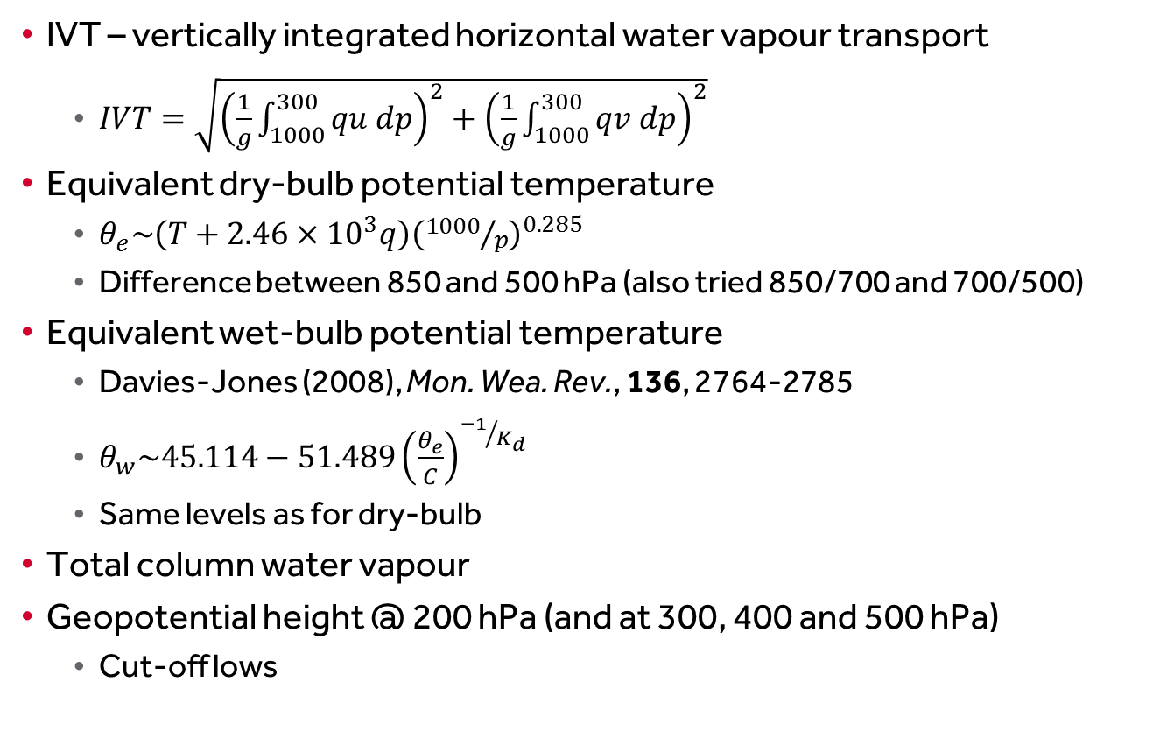
IVT – vertically integrated horizontal water vapour transport
  $IVT=\sqrt{{\left(\frac{1}{g}\int_{1000}^{300}{qu dp}\right)}^{2}+{\left(\frac{1}{g}\int_{1000}^{300}{qv dp}\right)}^{2}}$
Equivalent dry-bulb potential temperature
  $θ_{e}\sim \left(T+2.46×{10}^{3}q\right){\left({1000}/p\right)}^{0.285}$
  Difference between 850 and 500 hPa (also tried 850/700 and 700/500)
Equivalent wet-bulb potential temperature
  Davies-Jones (2008), Mon. Wea. Rev., 136, 2764-2785
  $θ_{w}\sim 45.114−51.489{\left(\frac{θ_{e}}{C}\right)}^{{−1}/{K_{d}}}$
  Same levels as for dry-bulb
Total column water vapour
Geopotential height @ 200 hPa (and at 300, 400 and 500 hPa)
  Cut-off lows

