Slide 1
Towards a fast shortwave radiance forward model for exploiting MSI measurements
Robin Hogan and Alessio Bozzo
ECMWF

Slide 2
The challenge of modelling shortwave radiances
To exploit solar radiances from MSI in retrievals (or indeed to assimilate any solar radiances into a weather forecast model) we need a forward model
State-of-the-art is the discrete ordinate method e.g. DISORT
Discretize radiance distribution in elevation by N streams
Expand the radiance distribution in azimuth as a cosine series
For each cosine term, solve large matrix problem for multiple layers
Computational cost proportional to N³
Probably too expensive to run iteratively in a retrieval
Challenging to code the adjoint of such a model
Typically calculations performed offline to generate a 5D lookup table as a function of solar zenith angle, instrument zenith angle, optical depth, particle effective radius, surface albedo
Not feasible to represent multiple layers containing different particle types (e.g. thin ice clouds over aerosol or liquid cloud), even if information on such layering is available from active instruments
z

Slide 3
The two-stream source function technique (Toon et al. 1989)
First try to adapt the Toon et al. (1989) infrared model to the shortwave
Direct beam obeys:
Very fast, accuracy adequate for fluxes (used in weather and climate models)
Not very accurate for radiances due to wide forward lobe in the phase function
Compute profile of direct solar radiation
Two-stream scheme for diffuse fluxes
Single-scattering contribution to radiance simply reading off phase function at ζ₀
For multiple-scattering contribution to radiance, perform 1D radiance calculation using diffuse fluxes as the source function
F₀
ζ₀
$$\frac{dF_{0}}{dτ}=−\frac{F_{0}}{cos\left(θ_{0}\right)}$$

Slide 4
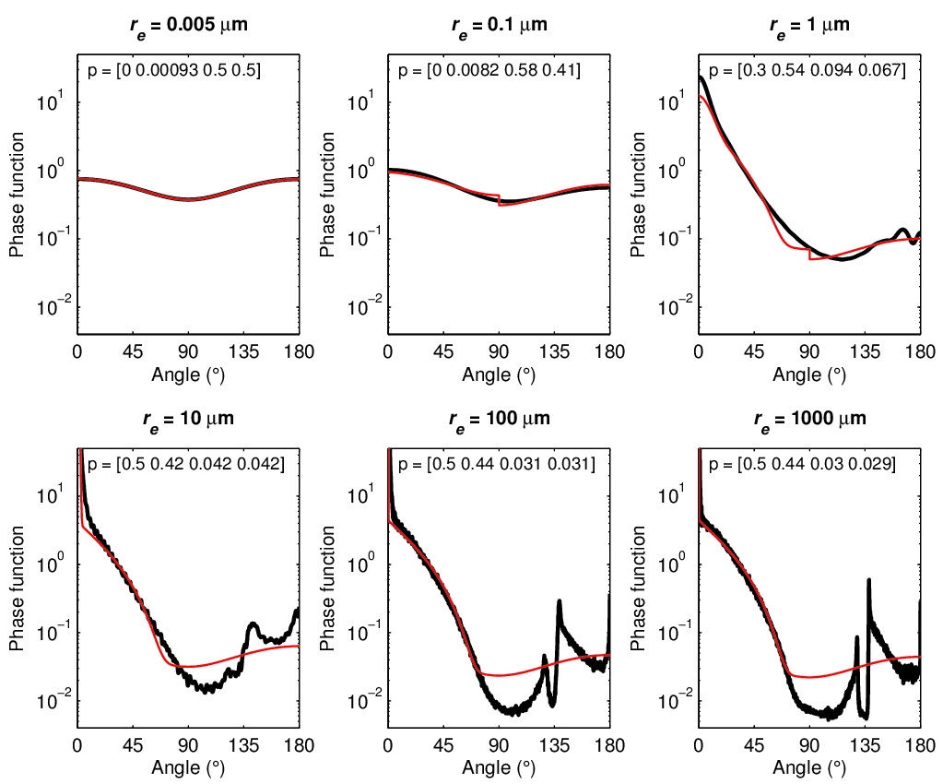
Partitioning the phase function: lobe $∝exp[−2.29 tan\left(θ\right)]$
Clear sky
Aerosol
Quasi-delta function
Forward lobe
Forward diffuse
Backward diffuse
TOTAL
Cloud
Rain

Slide 5
Forward-Lobe Two-Stream rAdiance Model (FLOTSAM)
Explicit calculation of fluxes in the forward lobe
Lobe flux obeys:
Very fast, straightforward to code up adjoint
Some flexibility in how the forward lobe is specified
Is it accurate?
Compute profile of direct solar radiation
Compute profile of radiation in the forward lobe with effective zenith angle θ₁
Two-stream scheme for diffuse fluxes
Single-scattering contribution to radiance
Lobe contribution to radiance by reading off smoothed phase function at ζ₁
Multiple-scattering contribution to radiance
Also treat lobe in path to satellite
F₀
F₁
ζ₀
ζ₁
$$\frac{dF_{1}}{dτ}=pF_{0}−q\frac{F_{1}}{cos\left(θ_{1}\right)}$$

Slide 6
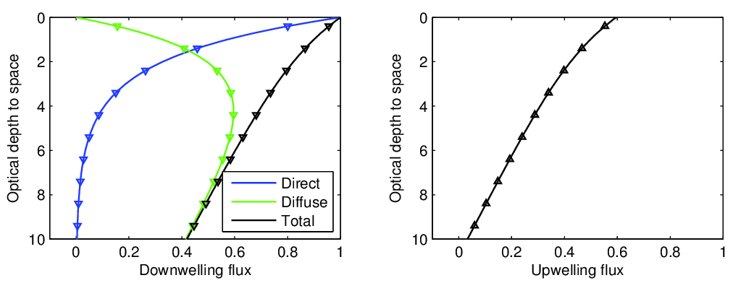
Flux profiles: two-stream source function technique
Mie phase function, effective radius 10 microns
Optical depth 10, single-scattering albedo 0.999
Solar zenith angle 60 degrees
Use delta-Eddington scaling: $τ^{′}=0.28τ$

Slide 7
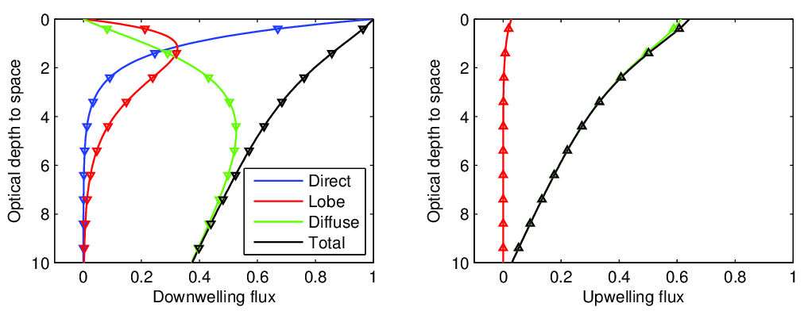
Flux profiles: FLOTSAM
Mie phase function, effective radius 10 microns
Optical depth 10, single-scattering albedo 0.999
Solar zenith angle 60 degrees
Appropriate delta scaling now removes only diffraction lobe: $τ^{′}=0.5τ$

Slide 8
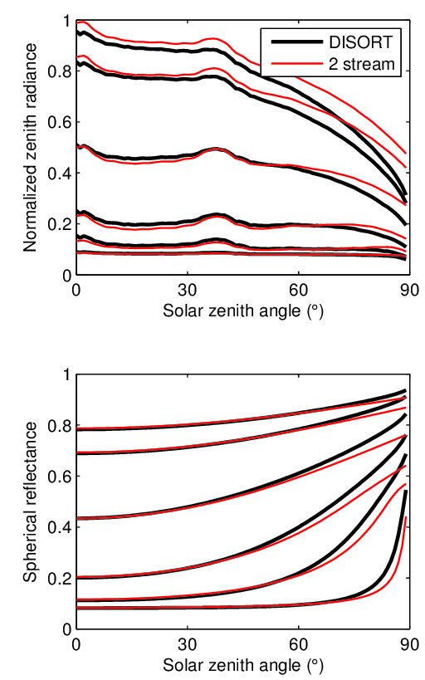
Zenith radiances: Two-stream
$$τ=100$$
$$τ=31$$
EarthCARE’s synergetic algorithms would use zenith radiances: MSI on Joint Standard Grid
Radiance normalized such that it equals the albedo over a Lambertian surface
Radiances:
Structure in phase function appears too strongly
Overestimate at high optical depths
Fluxes:
Good performance at small solar zenith angle
Underestimate at large solar zenith angle
$$τ=10$$
$$τ=3.1$$
$$τ=1$$
$$τ=0.1$$
FLUXES RADIANCES
$$τ=100$$
$$τ=31$$
$$τ=10$$
$$τ=3.1$$
$$τ=1$$
$$τ=0.1$$

Slide 9
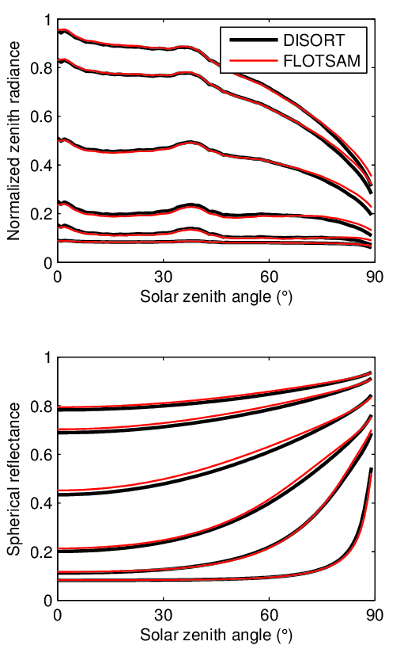
Zenith radiances: FLOTSAM
$$τ=100$$
$$τ=31$$
EarthCARE’s synergetic algorithms would use zenith radiances: MSI on Joint Standard Grid
Radiance normalized such that it equals the albedo over a Lambertian surface
Radiances:
Excellent for solar zenith angles up to 75 degrees
Overestimate for large solar zenith angle
Fluxes:
Overestimate at small solar zenith angle
Good at high solar zenith angles
$$τ=10$$
$$τ=3.1$$
$$τ=1$$
$$τ=0.1$$
FLUXES RADIANCES
$$τ=100$$
$$τ=31$$
$$τ=10$$
$$τ=3.1$$
$$τ=1$$
$$τ=0.1$$

Slide 10
Full radiance field: Two-stream source function
Solar zenith angle = 60 degrees, optical depth = 10, effective radius = 10 microns
Radiance field not sufficiently accurate

Slide 11
Full radiance field: FLOTSAM
Solar zenith angle = 60 degrees, optical depth = 10, effective radius = 10 microns
Radiance field is accurate when angular separation of sun and instrument is less than around 100 degrees
Radiance is too high for larger angular separations: need to improve representation of forward lobe

Slide 12
Full radiance field: Rayleigh scattering
Solar zenith angle = 60 degrees, optical depth = 10, Rayleigh scattering
Note that Rayleigh optical depth at MSI wavelengths is much less than 10

Slide 13
Summary
New fast shortwave radiance model “FLOTSAM” under development
Explicitly estimates the fraction of radiation in the forward lobe
Work required to improve representation of the forward lobe and hence radiances looking towards the sun
Coded in C++ using Adept library for automatic differentiation: should be straightforward to incorporate into ACM-CAP
Additional speed-up possible for shortwave radiances because layers with similar phase functions can be combined
Rayleigh
Ice cloud
Rayleigh
Aerosol

