Slide 1
What is the impact of 3D cloud radiative effects on weather and climate?
Robin Hogan
ECMWF and the University of Reading
Contributions from
Sophia Schäfer and Christine Chiu (University of Reading, UK)
Carolin Klinger and Bernhard Mayer (LMU, Germany)
Maike Ahlgrimm, Alessio Bozzo and Shoji Hirahara (ECMWF)
Mike Jensen (BNL, USA)

Slide 2
Overview
From Maxwell to the two-stream equations
Radiation schemes are slow: mitigating errors due to calling them infrequently in time and space
How can we represent cloud structure in radiation schemes?
A new method to capture 3D effects
How big is a cloud?
Towards an estimate of the global impact of 3D radiation

Slide 3

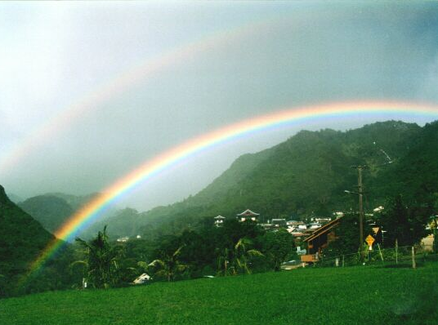
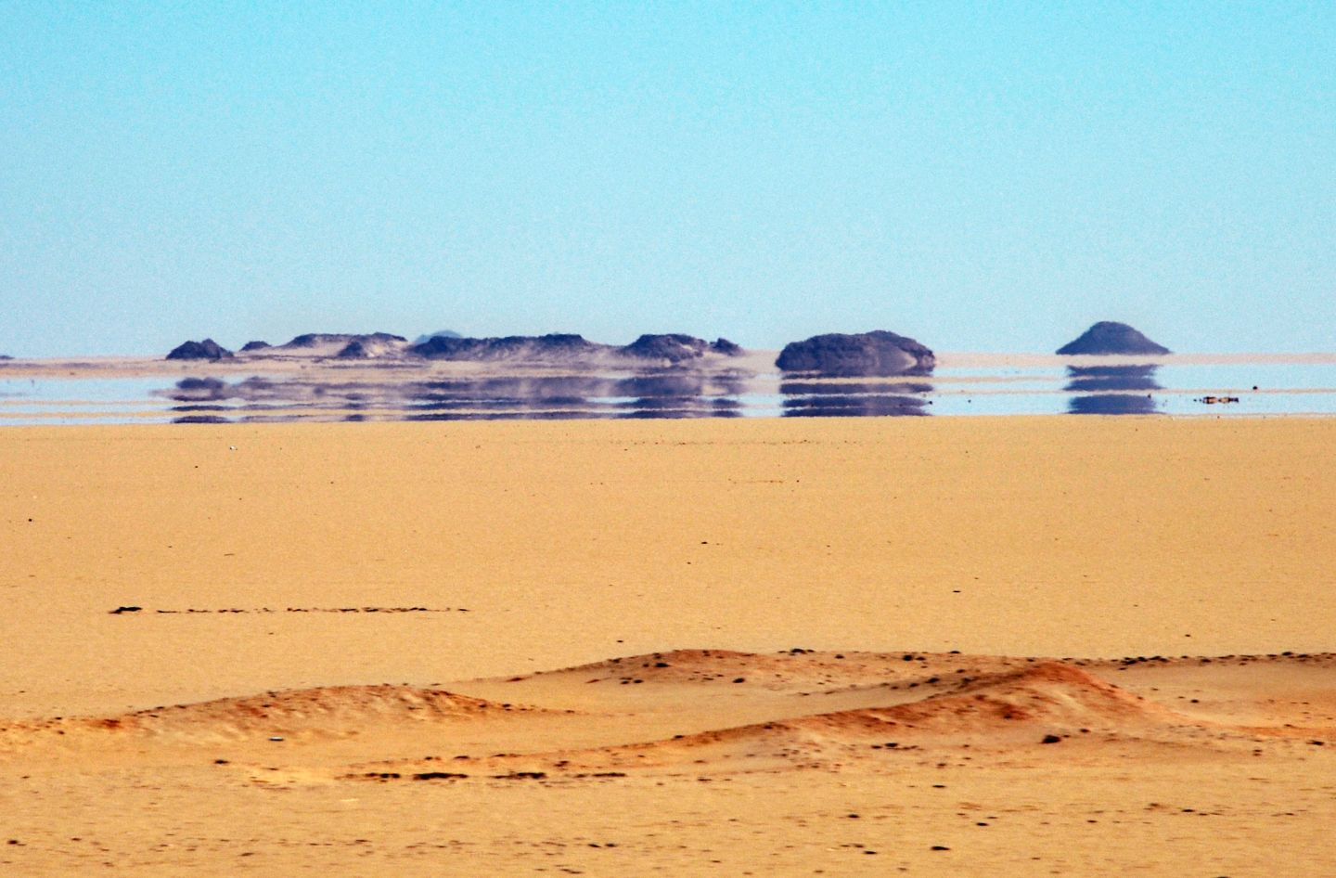
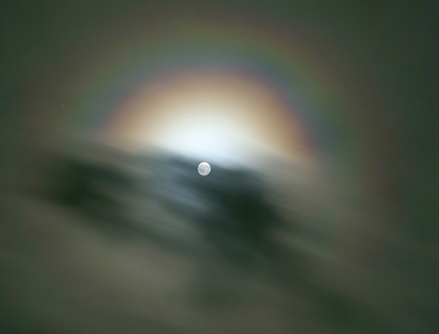
Optical phenomena explained by Maxwell’s equations
Need quantum mechanics to explain emission and absorption
All other atmospheric optics explained by electromagnetic radiation exciting a dipole in a dielectric material which then re-radiates
  Described by Maxwell’s curl equations + Newton’s 2nd law for bound charges
Illustrated with a 2D “Electromagnetic Weather Forecast”
  Gridsize 0.02 μm and timestep 50 picoseconds
B_{y}
E_{z}
E_{z}
B_{x}
B_{x}
B_{y}
  Staggered grid in time and space (Yee 1966)
E_{z}
E_{z}

Slide 4
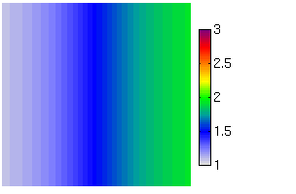

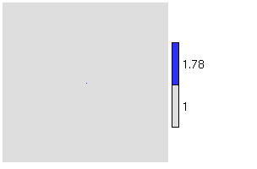

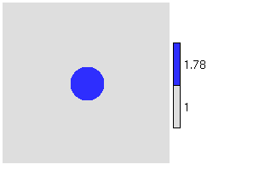

The Electromagnetic Weather Forecast
n gradient
Refraction
(a mirage)
Rayleigh scattering
(blue sky)
A sphere
(silver lining)
Refractive index Total E_{z} field
Single dipole
Refractive index Total E_{z} field
Scattered field

Slide 5
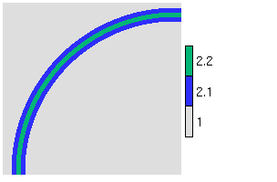
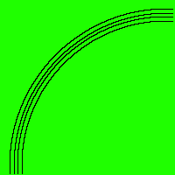
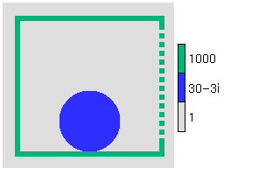
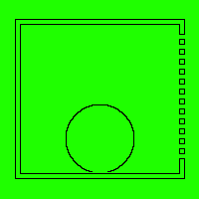
Non-atmospheric examples
Single-mode optic fibre
Potato in a microwave oven
Refractive index Total E_{z} field
Many more animations at www.met.rdg.ac.uk/clouds/maxwell
(interferometer, diffraction grating, dish antenna, clear-air radar, laser…)

Slide 6
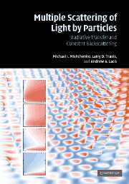
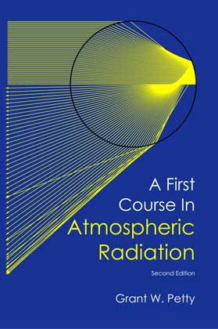
From Maxwell… …to the two-stream equations
Maxwell’s equations in terms of fields E(x,t), B(x,t)
Mishchenko et al. (2007)
Reasonable assumptions:
  Ignore polarization
  Ignore time-dependence (sun is a continuous source)
  Particles are randomly separated so intensities add incoherently and phase is ignored
  No diffraction around features larger than individual particles
Unreasonable assumptions:
  Diffuse radiances in all directions represented by only 2 discrete directions
  Atmosphere within a model gridbox is horizontally infinite and homogeneous
  Details of the phase functions represented by one number, the asymmetry factor
3D radiative transfer in terms of monochromatic radiances I (x,Ω,ν)
Petty (2006)
1D radiative transfer in terms of two monochromatic fluxes F ±(z,ν)

Slide 7
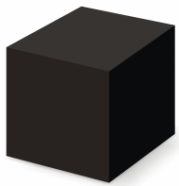
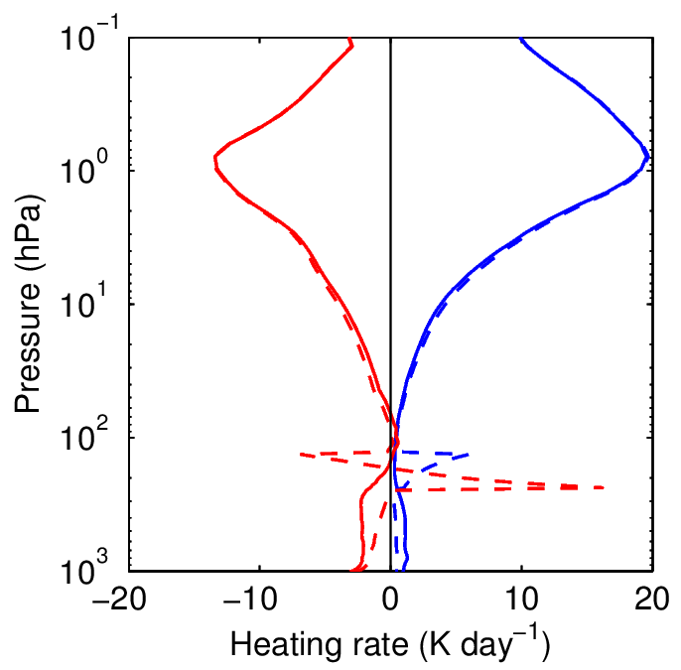
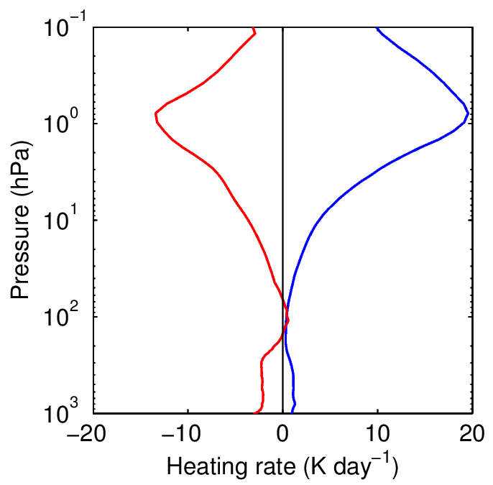
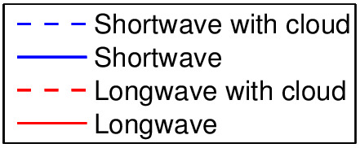
What does a radiation scheme do?
Input profile: temperature, pressure, gas concentrations, cloud properties…
Radiation scheme
ECMWF radiation scheme uses RRTM-G for gas optics (224 spectral intervals) so is quite slow
Only run every 6 model columns and every 1 or 3 hours, which leads to errors…
Surface fluxes
A term in the model’s thermodynamic equation

Slide 8
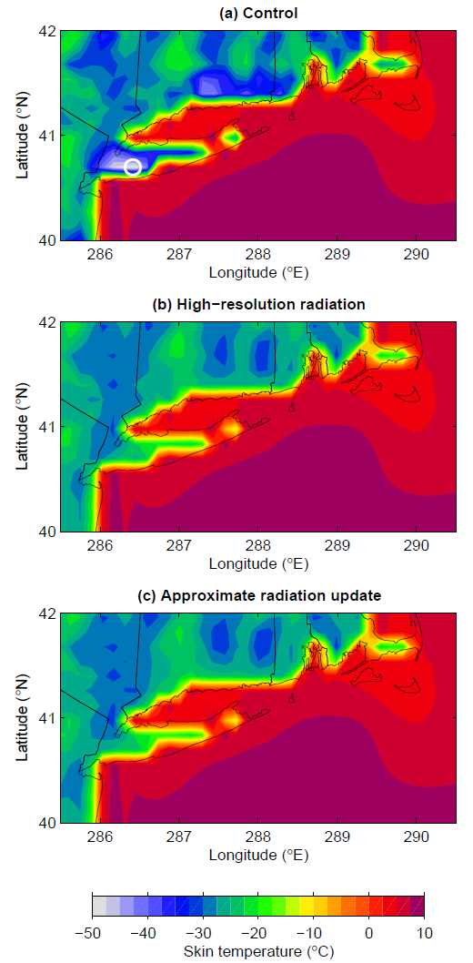
Fixing coastal errors due to coarse spatial sampling
T_{skin} 10 K warmer
T_{skin} 25 K colder
Large coastal errors on clear winter nights
New scheme updates longwave and shortwave fluxes every timestep and gridpoint in response to surface albedo and skin temperature
Cost: only around 2% of the radiation scheme
Long Island 0700 LT
Hogan & Bozzo (JAMES 2015)

Slide 9
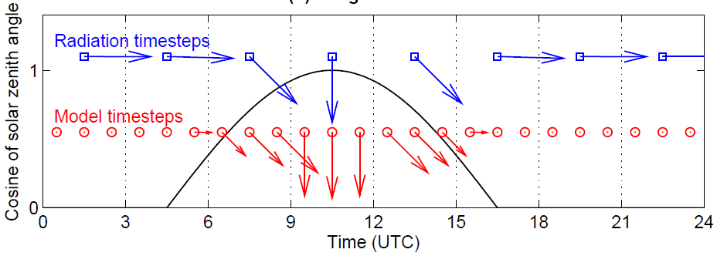
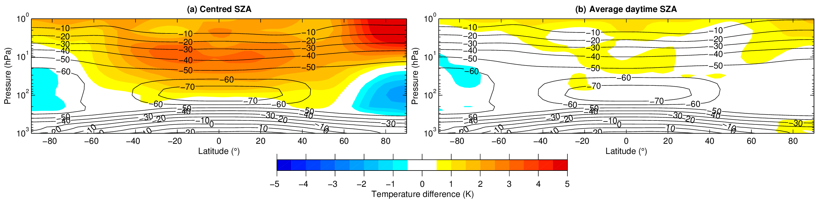
Fixing stratospheric errors due to coarse temporal sampling
All but one operational ECMWF model configurations call radiation scheme only every 3 h
At dawn & dusk, sun angle at centre of 3-h period too shallow: absorption too high
Stratosphere too warm by 3-5 K (compared to running radiation scheme every timestep)
Fix by averaging cosine of solar zenith angle over sunlit part of radiation timestep
Also fixes “wiggles” in mean fluxes versus longitude
Hogan & Hirahara (GRL 2016)

Slide 10
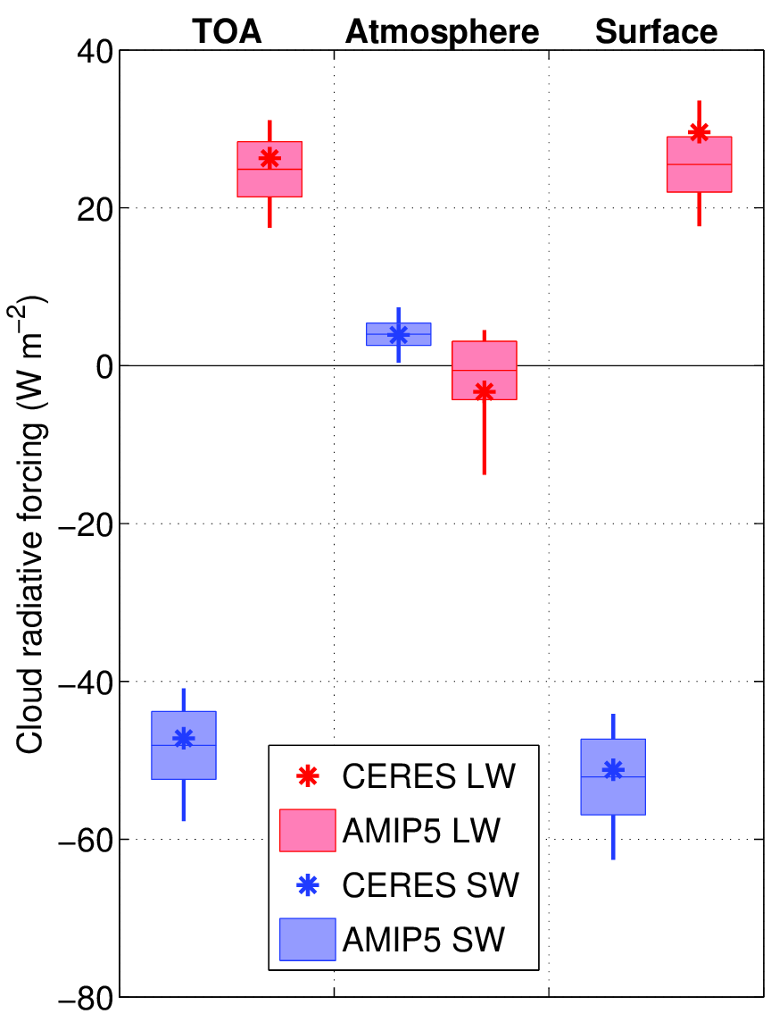
How reliable are cloud radiative effects in climate models?
Some outliers but global agreement is reasonable
Data from Wang et al. (2014)
Massive differences in cloud water content
Lauer and Hamilton (2013)

Slide 11
Why is it difficult to represent clouds in radiation schemes?
Model provides water content and cloud fraction to the radiation scheme
  Lots of reasons why these are not right but not the subject of this talk
Additional errors in fluxes possible due to uncertain:
  Effective radius
  Ice particle shape and scattering properties
  Cloud overlap
  Cloud horizontal inhomogeneity
  Not representing longwave cloud scattering
  Use of only two streams for all possible radiation directions
  Not representing 3D effects

Slide 12
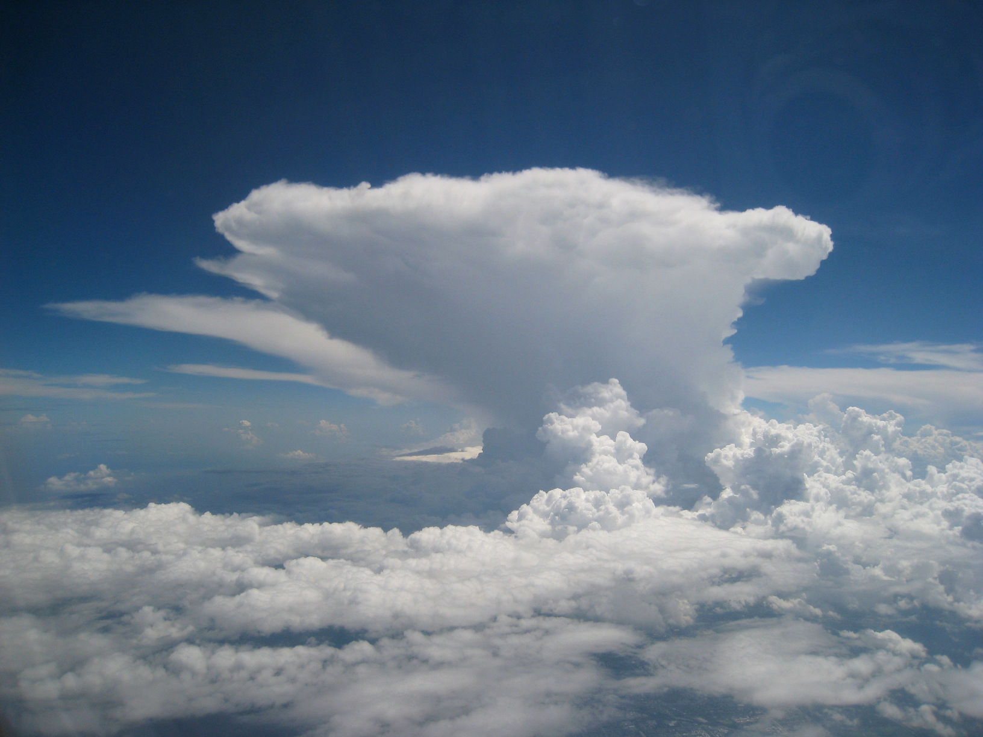
How do we compute how this interacts with radiation?

Slide 13
Plane-parallel, maximum-random overlap
Most models circa 2000
Model variables needed: cloud fraction, water content
Reflection & transmission computed for clear & cloudy regions separately
Fluxes merged at layer interfaces according to cloud fraction

Slide 14
Realistic overlap
Increases cloud cover and hence cloud radiative effect
Extra input: overlap decorrelation length from cloud radar ~2 km
  Ground-based (Hogan & Illingworth 2000, Mace & Benson-Troth 2002)
  CloudSat (Barker 2008, Shonk et al. 2010)

Slide 15
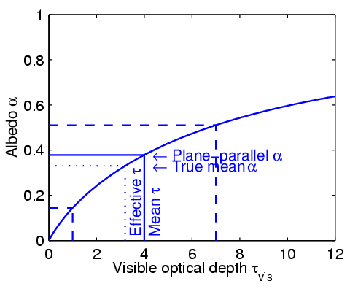
Tripleclouds (Shonk & Hogan 2008)
Cloud structure reduces cloud radiative effect
Cloud water fractional standard deviation ~0.75
  Satellite & cloud radar (Barker, Shonk, Cahalan, Oreopoulos, Rossow…)
Cloud water overlap decorrelation length ~1 km
  Ground-based cloud radar (e.g. Hogan & Illingworth 2003)

Slide 16
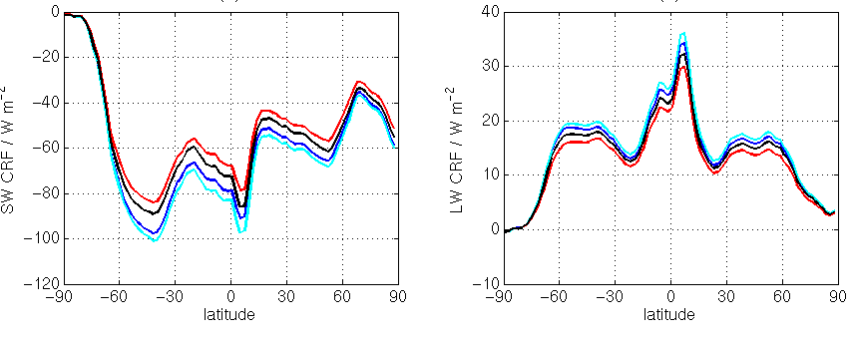
Global impact of cloud inhomogeneity and overlap
Plane-parallel, maximum-random
Top-of-atmosphere cloud radiative forcing
Shortwave
Longwave
Fix only overlap
Fix only inhomogeneity
Fixing just horizontal structure (blue to red) would overcompensate the error
Fixing just overlap (blue to cyan) would increase the error
Need to fix both overlap and horizontal structure
Fix overlap and inhomogeneity
Shonk & Hogan (2010)

Slide 17
Monte-Carlo Independent Column Approximation (McICA) – Pincus et al. (2005)
Info required similar to Tripleclouds but computationally a little faster
Use of stochastic cloud generator leads to some noise in fluxes
Now used in many (most?) global weather and climate models

Slide 18
Full Monte Carlo (being investigated by Barker et al.)
“It’s better to solve the right problem approximately than the wrong problem exactly,” or “random errors are better than biases.”
Use 3D cloud distribution generated by a stochastic model in each gridbox
How many light rays are needed for random errors to be tolerable? 500?
  NWP models can tolerate random errors less than climate models
Monte Carlo at least provides good benchmark for approximate schemes

Slide 19
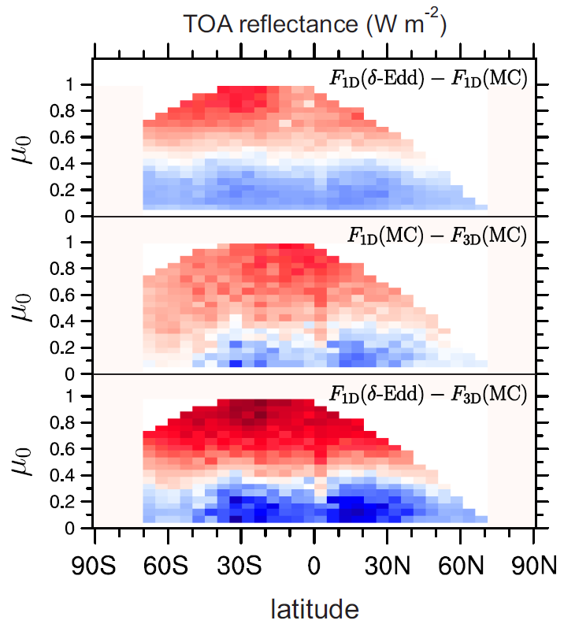
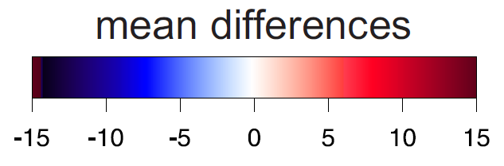
Shortwave errors due to 2-stream and 1D approximations
Barker et al. (2015) using A-Train scenes
Overhead sun
Error due to only 2 streams
  2 streams minus infinite streams
  Up to around 10% of cloud radiative effect
Error due to neglecting 3D effects
  1D minus 3D
  Up to around 10% of cloud radiative effect
  Warning! Scenes are strictly only 2D
Error due to both assumptions
  Errors strongly correlated
Sun near horizon

Slide 20
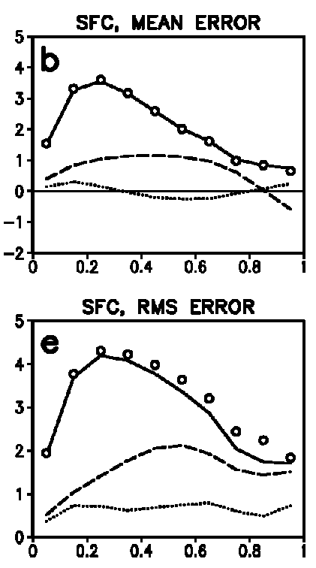

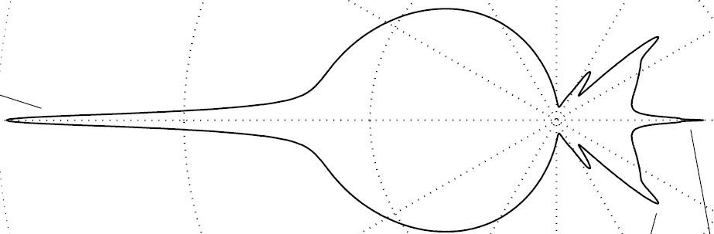
Reducing 2-stream errors
2-stream
Main problem is in optically thin clouds
  Single scattering dominates, so full details of phase function needed to predict reflection/transmission at all sun angles
  Almost all 2-stream models use the highly simplified δ-Eddington phase function (including the ECMWF model)
4 streams much more accurate but 8x the cost
Räisänen (2002) significantly reduced error by tuning the 2-stream γ coefficients separately for droplets, ice crystals and aerosols
2-stream (tuned)
4-stream
*
Mie phase function
δ-Eddington phase function
Sun near horizon
Overhead sun

Slide 21
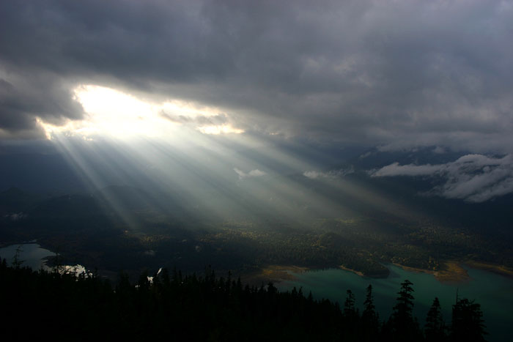
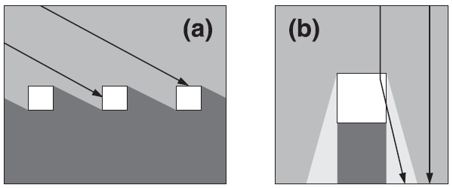
Errors due to neglecting 3D effects
Shortwave side illumination
  Strongest when sun near horizon
  Increases chance of sunlight intercepting cloud
Shortwave side escape
  Strongest when sun near zenith
  Forward scattering leads to more sunlight reaching the ground
Longwave effect
  Radiation can now be emitted from the side of a cloud
  3D effects can increase surface cloud forcing by a factor of 3 (for an isolated, optically thick, cubic cloud in vacuum!)

Slide 22
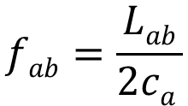
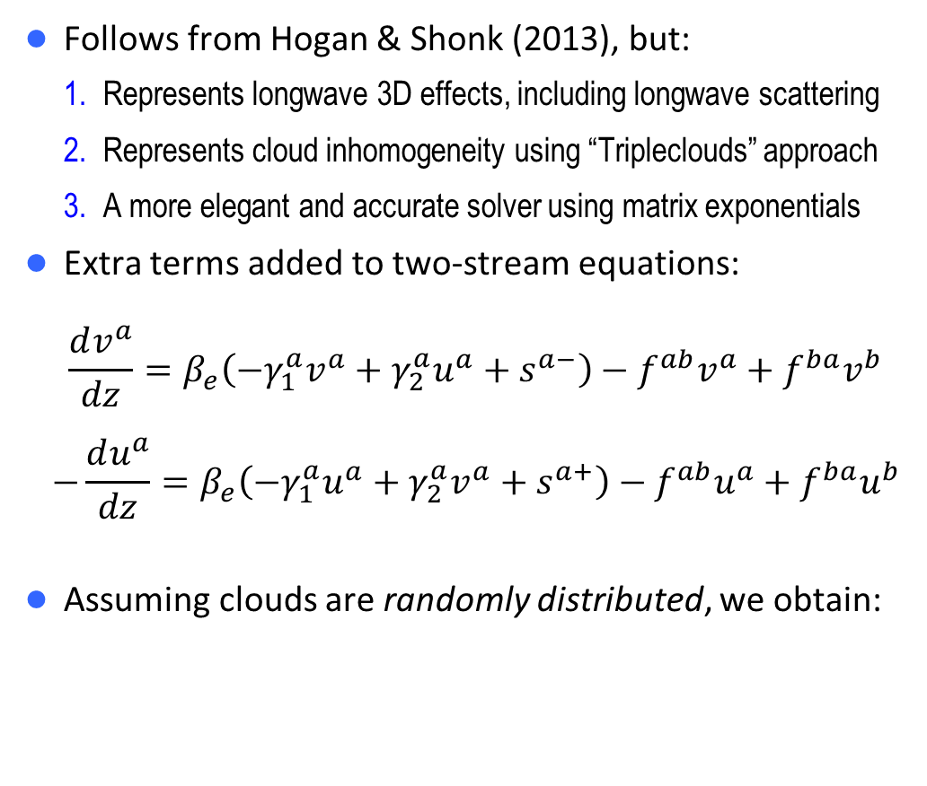
SPARTACUS “Speedy Algorithm for Radiative Transfer through Cloud Sides”
a
Follows from Hogan & Shonk (2013), but:
  Represents longwave 3D effects, including longwave scattering
  Represents cloud inhomogeneity using “Tripleclouds” approach
  A more elegant and accurate solver using matrix exponentials
Extra terms added to two-stream equations:
$$\frac{dv^{a}}{dz}=β_{e}\left(−γ_{1}^{a}v^{a}+γ_{2}^{a}u^{a}+s^{a−}\right)−f^{ab}v^{a}+f^{ba}v^{b}$$
$$−\frac{du^{a}}{dz}=β_{e}\left(−γ_{1}^{a}u^{a}+γ_{2}^{a}v^{a}+s^{a+}\right)−f^{ab}u^{a}+f^{ba}u^{b}$$
Assuming clouds are randomly distributed, we obtain:
vª
uª
a
b
c
v^{b}
u^{b}
a
b
c
a
New terms representing exchange between regions
$$fab=\frac{Lab}{2ca }$$
Length of cloud perimeter per unit gridbox area
Fraction of gridbox occupied by clear skies (region a)

Slide 23
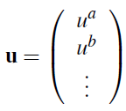
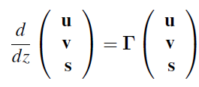
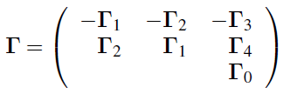
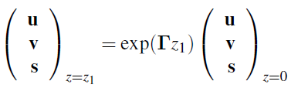
Matrix solution in a single layer (shortwave)
Define diffuse upwelling, diffuse downwelling and direct downwelling as vectors u, v and s:
Write two-stream equations as: where 9x9 matrix is composed of known terms analogous to γ₁-γ₄ in the standard two-stream equations:
(coupled linear homogeneous ODEs)
Solution for layer of thickness z₁:
Matrix exponential
Waterman (1981), Flatau & Stephens (1998)
Can compute using Pade approximant plus scaling & squaring method (Higham 2005)

Slide 24


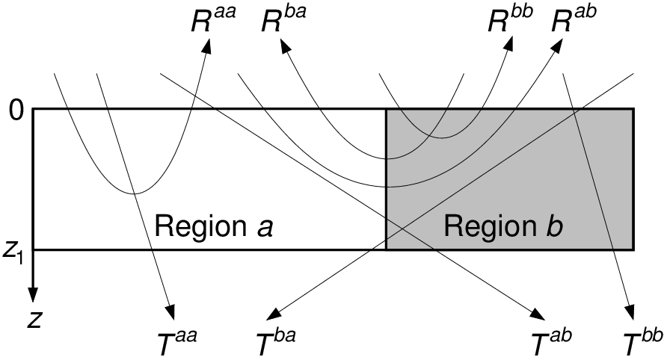
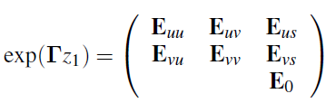

Reflection and transmission matrices
s(0)
v(0)
u(0)
We want relationships between fluxes of the form:
Transmission matrix for 2 regions given by:
and likewise for R and S±
If matrix exponential is decomposed as:
then reflection and transmission matrices given by:
For scalars, get same answer as traditional Meador & Weaver (1980) formulas
For speed, only use matrix exponential for partially cloudy layers
u(z₁)

Slide 25

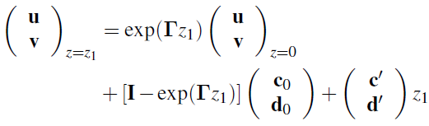
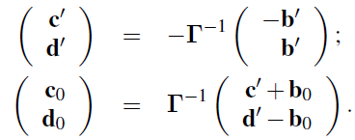
Longwave equivalent
Two-stream equations now look like this:
(No solar beam and Planck function assumed to vary linearly in optical depth via inhomogeneous terms)
Solution is a bit more complex:
where:

Slide 26
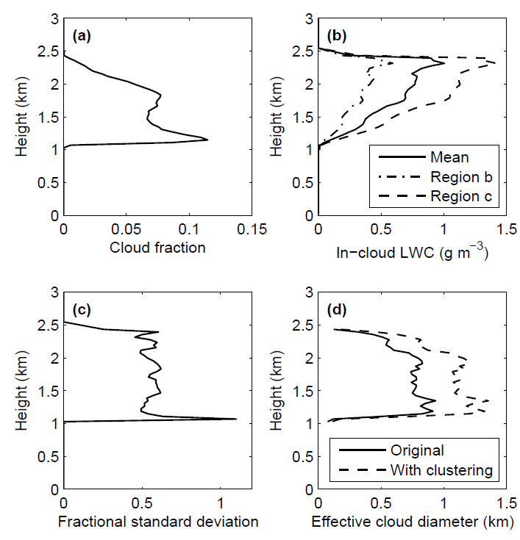
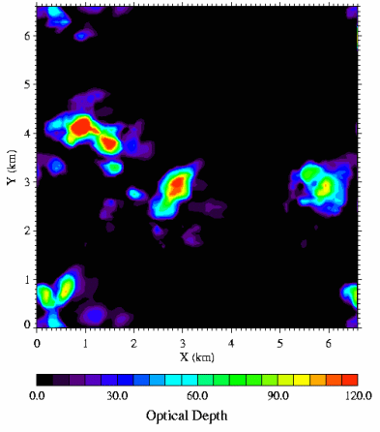
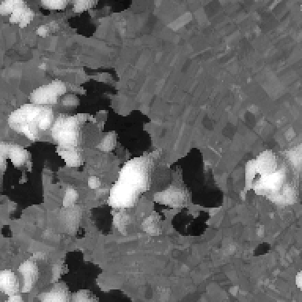
Test with I3RC cumulus cloud
Fully 3D simulations with MYSTIC
Inputs needed by SPARTACUS
  Thanks to Carolin Klinger & Bernhard Mayer, LMU Munich

Slide 27
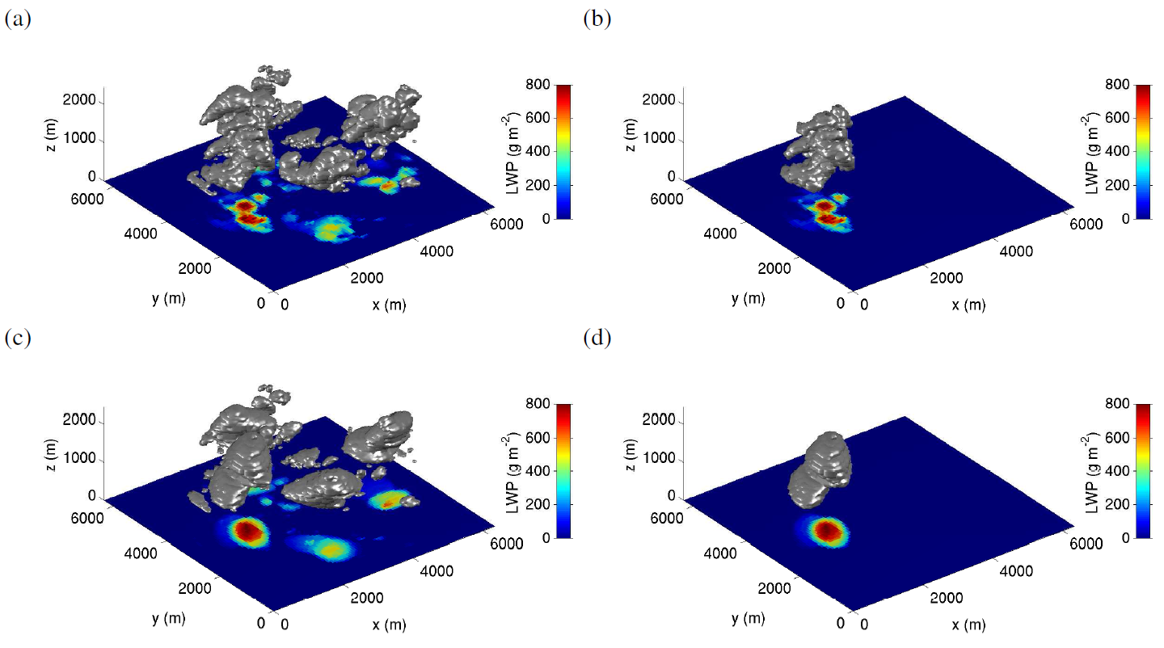
What is longwave radiatively effective cloud edge length?
Single cloud Full cloud field
MYSTIC: solid lines
SPARTACUS: dashed lines
Ellipses remove radiatively irrelevant small-scale structure
Clustering reduces effective edge length (nearest-neighbour spacing is 280 m vs. random value of 430 m)
“Ellipsified” clouds Original clouds

Slide 28
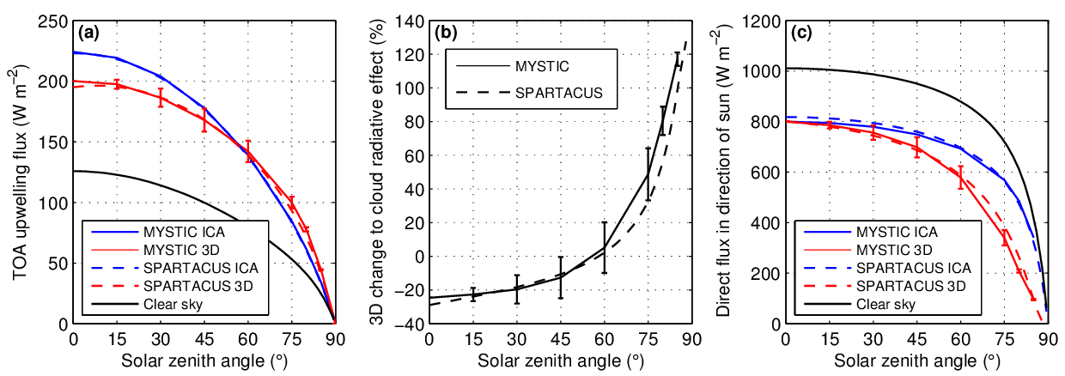
Broadband shortwave SPARTACUS vs MYSTIC (Monte Carlo)
SPARTACUS coded up in Fortran 90 with RRTM-G for gas absorption
  Mean of 4 solar azimuths, error bar indicates standard deviation due to sun orientation
Good match!
3D effect up to 20 W m⁻², similar to inhomogeneity effect
Large difference in direct surface flux at large solar zenith angle

Slide 29
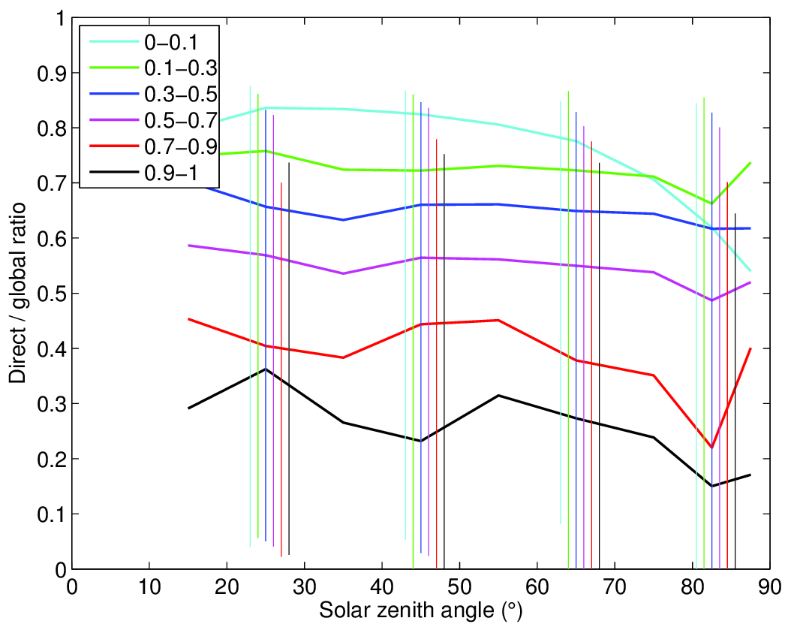
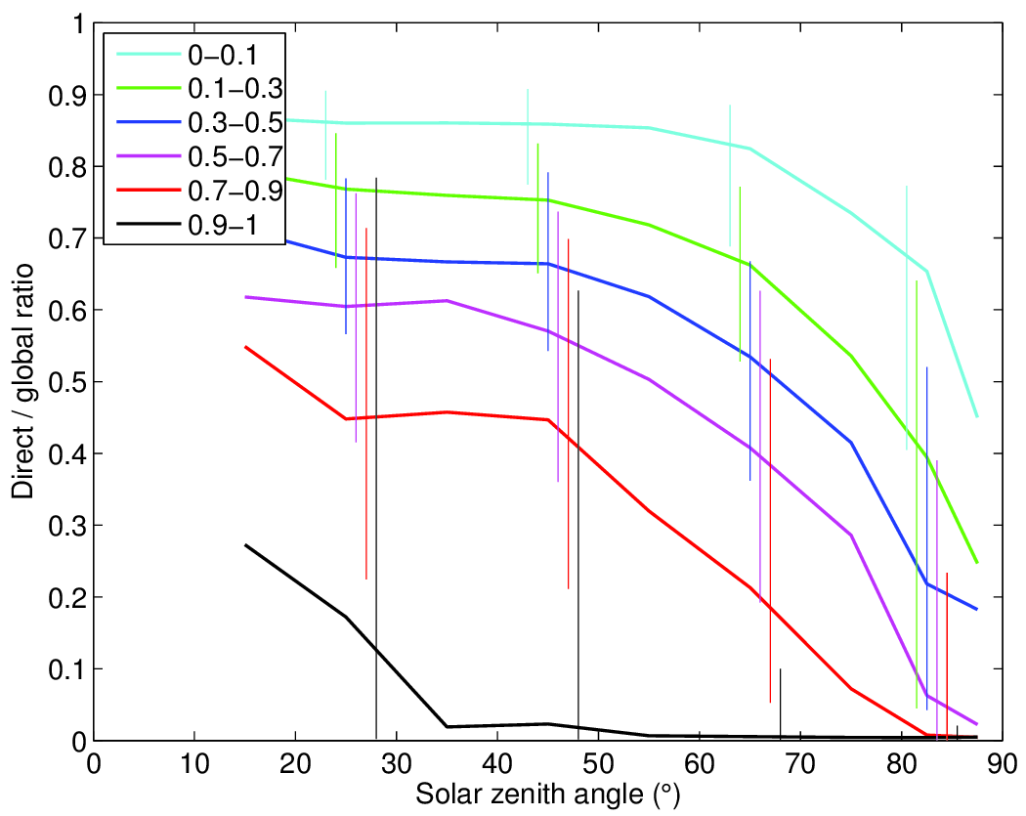
3D effects in observations of direct/total downwelling flux
Troccoli & Morcrette (2014) reported biases in ECMWF direct solar radiation from, important for solar energy industry
Bin observations and model by solar zenith angle and cloud fraction, considering only cases of boundary-layer clouds (thanks to Maike Ahlgrimm):
Next step: apply new 3D radiation scheme to the ECMWF cloud fields to verify that differences are due to 3D effects
ECMWF model
ARM SGP (13 yrs)

Slide 30
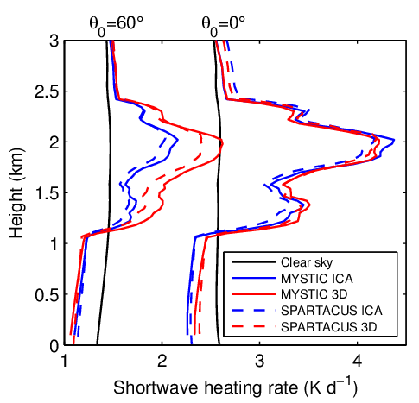
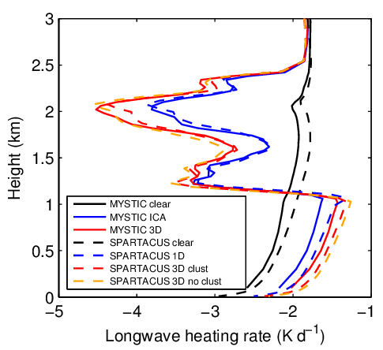
Heating-rate comparisons with MYSTIC
Shortwave
Longwave
Clustering has a fairly small effect on atmospheric heating rates
3D effects increase longwave CRF at surface by 30% in both MYSTIC and SPARTACUS (42% in SPARTACUS if clustering effect not represented)

Slide 31
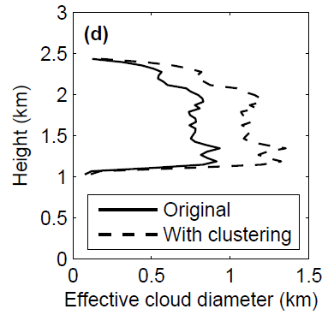
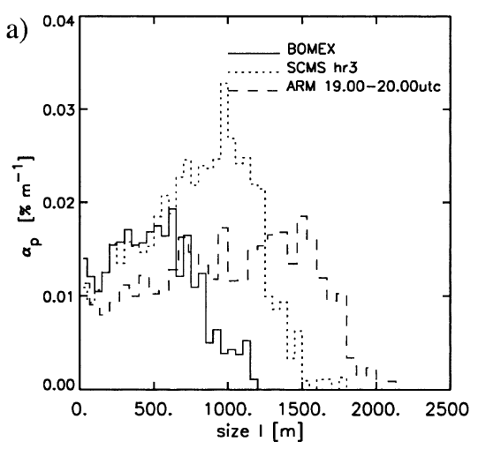
What is the effective size of typical cumulus clouds?
This study: between 0.5 and 1 km
Neggers et al. (2003): cloud resolving model applied to a range of cumulus experiments

Slide 32



Cloud perimeter from satellite data
Morcrette (2012): MSG
MSG infrared
Jensen et al. (2006) data: MODIS stratocumulus
Cloud mask

Slide 33

Characterizing cloud perimeter vs. cloud fraction
Jensen et al. (2006) proposed effective cloud diameter D: diameter of identical circular clouds that have the same perimeter and area as the actual cloud field
  If cloud area A = π(D/2)² and perimeter P = πD then
  Effective cloud diameter D = 4A/P = 4 x cloud cover / normalized perimeter
Problem with this concept is that effective cloud diameter computed from real cloud fields is strongly dependent on cloud cover
We seek an effective cloud scale S that is independent of cloud cover, and can be parameterized in GCMs
Jensen et al. (2006) data: MODIS stratocumulus

Slide 34

Morcrette (2012)
Conceptual model: fill a checkerboard randomly with squares of size S:
Morcrette (2012) found that perimeter simulated in this way behaves the same as in observations:
P=4A(1-A)/S
His MSG data for all clouds yields S of around 10 km
Simulations MSG data

Slide 35



Apply concept to MODIS data
1-km MODIS is higher resolution than MSG
Application to Jensen et al. stratocumulus data suggests effective cloud scale of around 10 km

Slide 36


Effective size of deep convection (Stein et al., BAMS 2015)
Radar observations suggest cores of UK storms around 10 km wide
Don’t trust size of storms in models with grid spacing larger than around 1 km (Met Office model in this case)

Slide 37



Towards a global estimate of the impact of 3D effects
Instantaneous cloud radiative forcing applying SPARTACUS to one ERA-Interim clouds
To get cloud edge length, assume cumulus horizontal length scale is 750-m, all other clouds 10 km
Solar zenith angle
Night-time: positive LW effect
Low sun:
negative SW effect
High sun:
positive SW effect

Slide 38

3D effects in a 4-member 1-year climate simulation
More reflection by clouds
More emission to surface
Shortwave effect wins: surface cooling

Slide 39

Zonal-mean cloud radiative forcing

Slide 40

Computational cost inside ECMWF model
Matrix exponential and other matrix operations are the main cost: further optimization needed

Slide 41
Summary and outlook
For the first time, we have the capability to represent 3D radiative effects quite accurately in a global model
First estimates suggest 4 W m⁻² global impact on net fluxes at surface and TOA
  Similar to the impact of cloud inhomogeneity and overlap
  Less than local radiative impact of errors in the model’s cloud distribution
However, need analysis of cloud observations and LES to better characterize the radiatively effective cloud edge length for different cloud types
SPARTACUS forms part of a new radiation package (including McICA) to be released under an open source license
  SPARTACUS needs further optimization: currently 4-5 times slower than McICA
  Perhaps SPARTACUS can be used as a kind of benchmark for more approximate schemes to represent 3D effects, e.g. perturbing cloud overlap (Tompkins & DiGuiseppe)
SPARTACUS idea will also be used to compute 3D effects in urban and vegetation canopies
a
a
a

Slide 43


Slide 44

Extension to multiple layers: the adding method
The adding method (e.g. Lacis and Hansen 1974) can be used to combine the reflectance and transmittance matrices of pairs of layers
In N-stream radiative transfer (e.g. N=16), the elements of the flux vector would represent different streams, but the method works just as well for different regions
We work up from the surface and compute the albedo of the whole atmosphere below each half-level
Albedo $A=\left(\begin{matrix}Aaa & Aba \\ Aab & Abb\end{matrix}\right)$
After this we can head back down again to compute the fluxes
For one region, this is exactly the same as solving a tridiagonal system with forward elimination followed by backsubstitution
A_{aa}
A_{ab}
A_{ba}
A_{bb}

Slide 45

How do we deal with cloud overlap?
Edwards-Slingo method: overlap matrices
Downward overlap $V=\left(\begin{matrix}Vaa & Vba \\ Vab & Vbb\end{matrix}\right)$
(similarly for upward overlap U)
Matrix elements calculated from a decorrelation length following Shonk et al. (2010)
Albedo just above a half level (A) is related to albedo just below a half level (B) by A=UBV
V_{aa}
V_{ab}
V_{bb}
V_{ba}
Half-level

