Slide 1
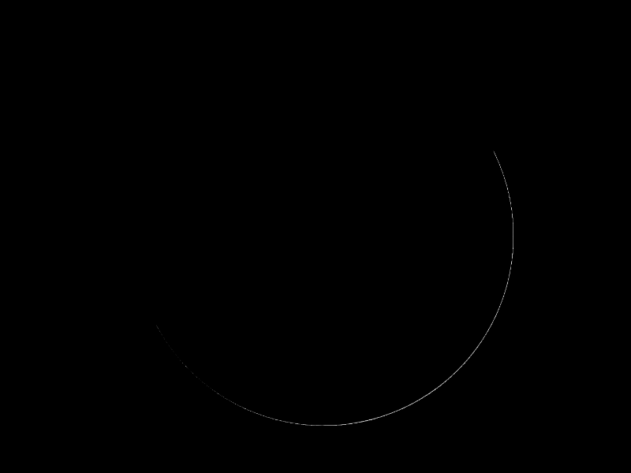
Radiation in Numerical Weather Prediction
Recent advances and future challenges
Robin Hogan
ECMWF
r.j.hogan@ecmwf.int
Thanks to: Maike Ahlgrimm, Howard Barker, Alessio Bozzo, Mark Fielding, Thomas Haiden, Inna Polichtchouk, Tristan Quaife and many others
Simulation of visible imagery using FLOTSAM, a fast radiance model being developed at ECMWF

Slide 2
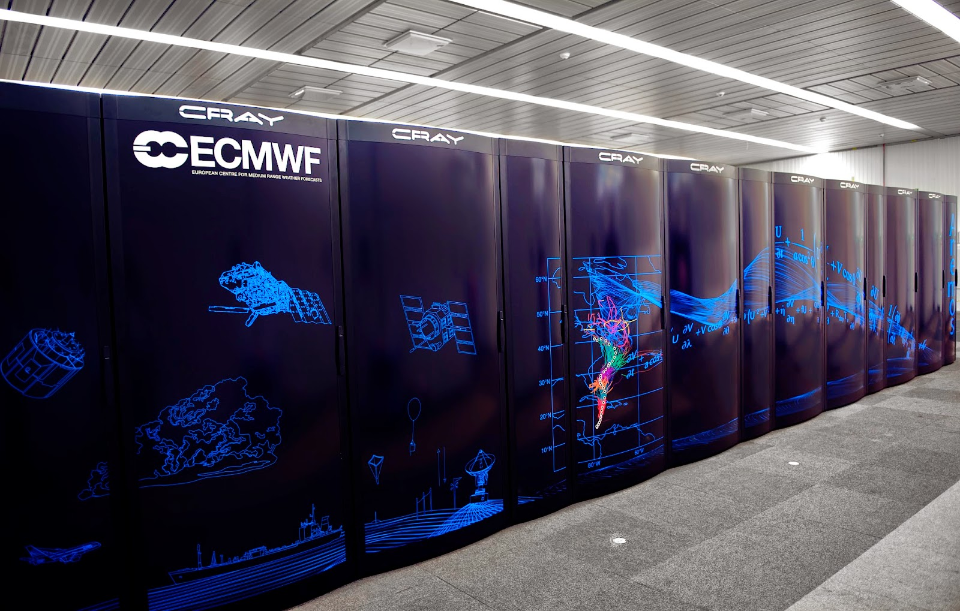
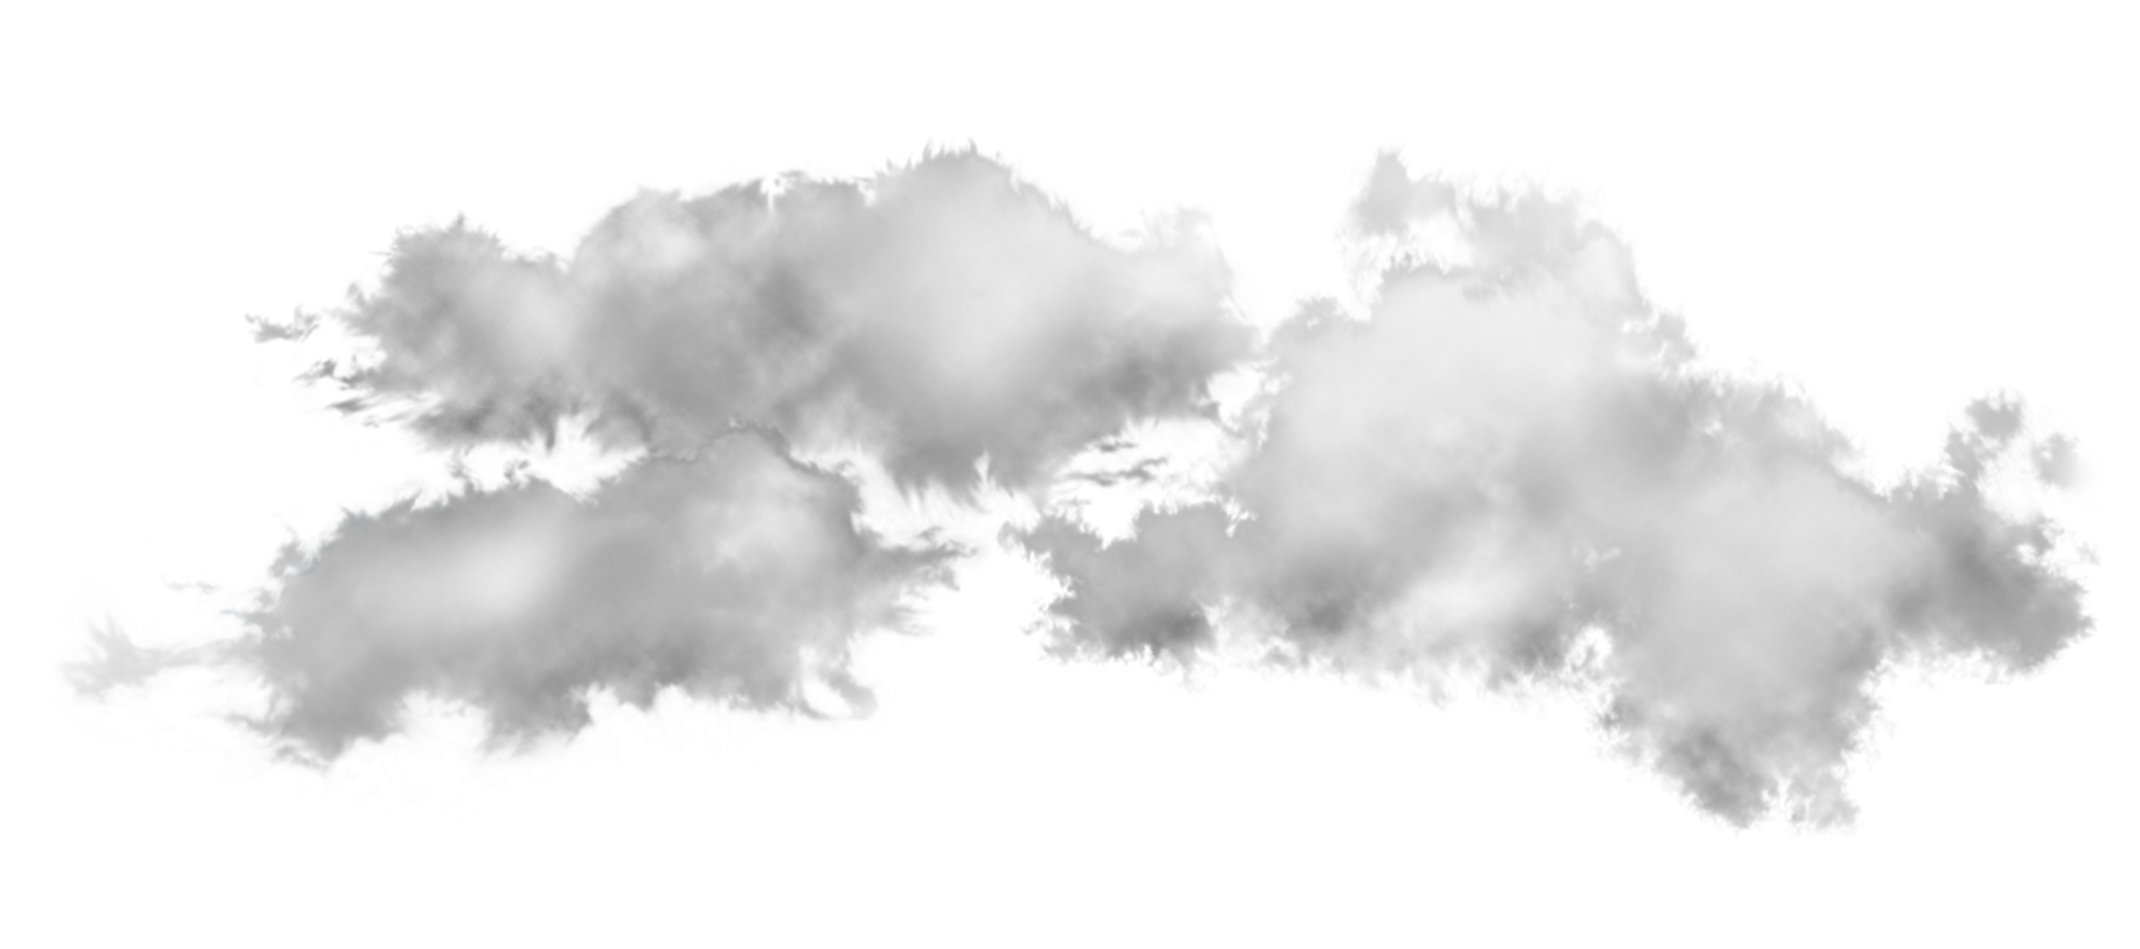
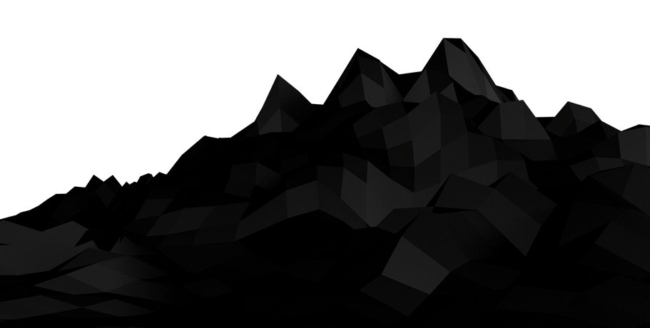
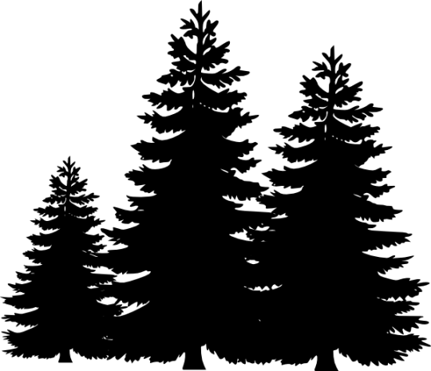
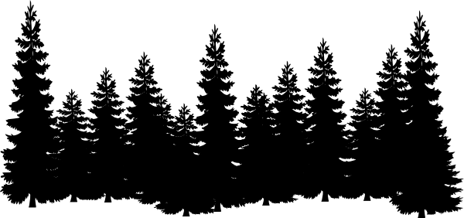
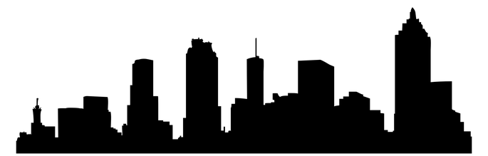
Five “Grand Challenges” for radiation in NWP models
Solar spectrum
Code optimization
Water vapour biases
4: Middle atmosphere
GPUs
Ozone
5: Efficiency
Spatial/temporal/spectral resolution
2: Clouds
Overlap
Sub-grid heterogeneity
Water vapour continuum
3D effects
Particle size
3: Clear-sky absorption
Optical properties
Longwave scattering
Aerosols
Sea emissivity
Forests
Urban areas
Orography
Snow albedo
1: Surface
Land albedo datasets
Coastlines

Slide 3
Overview of talk
Brief history of the ECMWF radiation scheme
ecRad: a new radiation scheme
Climate of the ECMWF Integrated Forecasting System (IFS)
Five “Grand Challenges” for radiation in NWP
  Surface... and a new way to treat 3D radiative effects
  Clouds
  Clear-sky absorption
  Middle atmosphere
  Efficiency
Outlook

Slide 4
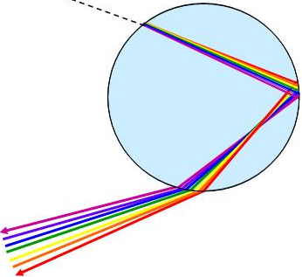
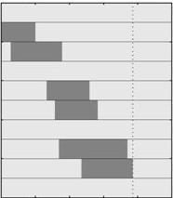

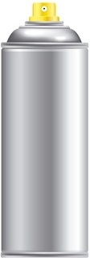
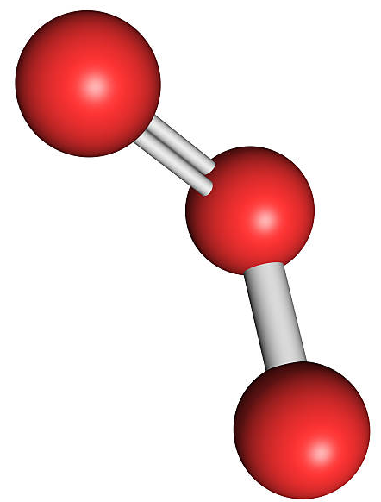

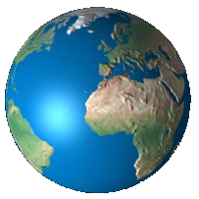
History of ECMWF radiation scheme
 | 2000 | 2002 | 2004 | 2006 | 2008 | 2010 | 2012 | 2014 | 2016 | 2018
Fouquart liquid optics
Slingo, Lindner & Li
SOCRATES liquid optics
Solver: Clear/cloudy regions
McICA solver
Faster, reduced noise
4 bands
14 bands (RRTM-G)
Solar cycle
6 bands
16 bands (RRTM-G)
RRTM-G update
Morcrette scheme
McRad
ecRad
Aerosol: Tanré
Tegen
CAMS
Ozone: Fortuin and Langematz
GEMS
MACC
CAMS
1 h in DA
1 h in HRES
Reduced radiation grid
Approx updates every timestep and gridpoint
3 h
ERBE albedo
60-km MODIS
5-km MODIS

Slide 5
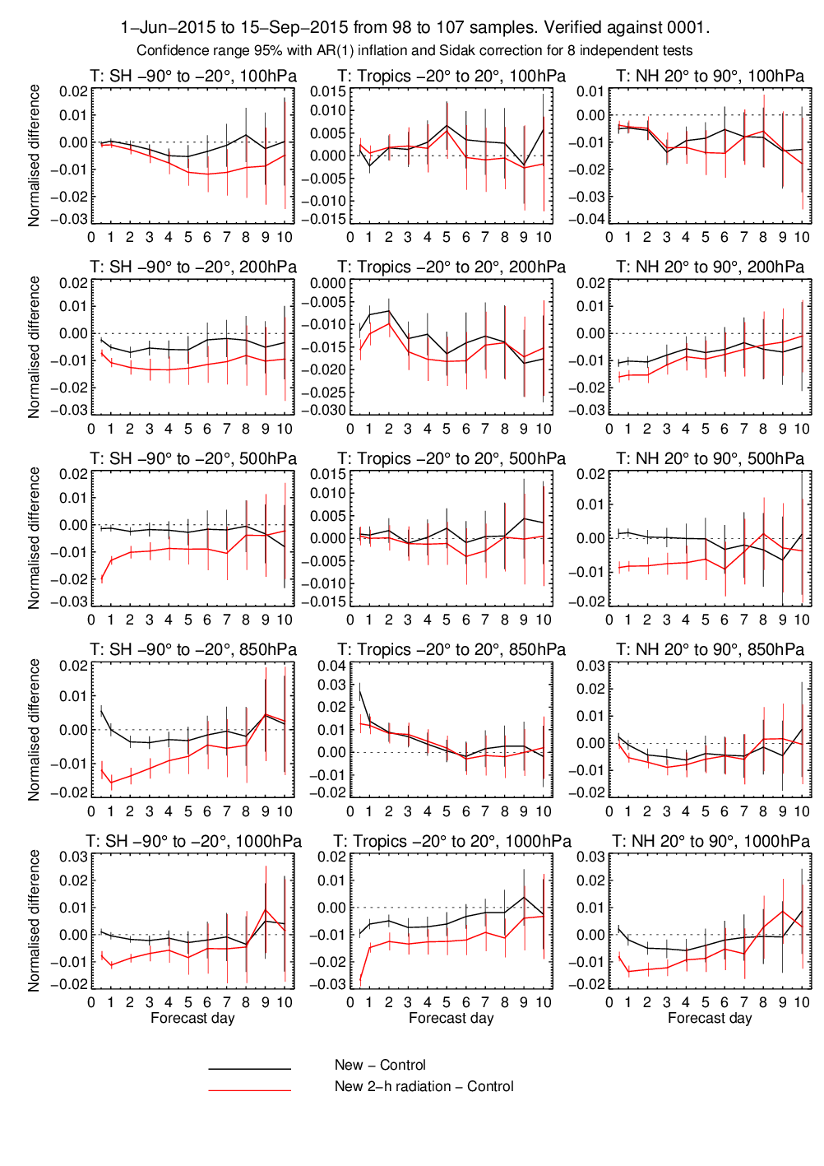
ecRad: operational in July 2017
Immediate benefits
  Better solution to longwave equations improves stratosphere biases (see later)
  31-34% faster, far smaller memory footprint
  Lower noise: slight reduction in temperature errors
Longer term benefits
  Flexibility and modularity: facilitate future developments
  Option to use new “SPARTACUS” solver for representing 3D radiative effects
  Feedback from users of offline version
Speed up
1000 hPa
ecRad 3h radiation timestep
ecRad 2h radiation timestep

Slide 6
Evaluation of surface radiation budget against Wild et al. (2015) observations (W m⁻²)
 | Global SW dn | Global LW dn | Global SW net | Global SW net | Land SW dn | Land LW dn | Land SW net | Land LW net
Observations | 184.7 | 341.5 | 160.1 | −56.7 | 184 | 306 | 136 | −66
43 climate models | 4 ± 5 | −2 ± 4 | 5 ± 4 | −2 ± 3 | 6 ± 10 | −4 ± 7 | 5 ± 8 | 3 ± 6
ERA-Interim | 3.7 | −0.1 | 4.5 | 0.1 | 3.6 | −2.0 | 4.1 | −1.0
ERA5 | 3.5 | −2.3 | 3.7 | −1.2 | 5.3 | −2.4 | 1.8 | 1.1
Uncoupled IFS climate 43R3 | −0.2 | −2.2 | 0.5 | −0.3 | −0.4 | −0.2 | −1.5 | 0.4
Coupled IFS climate 43R3 | −0.4 | −0.9 | 0.3 | −0.3 | 0.4 | 0.7 | −1.1 | 0.0
<2 ≥2 ≥4 W m⁻²

Slide 7
Challenge 1: Surface

Slide 8
Tropics ~2 K too cold in the day
Boreal forests ~5 K too warm at night in winter
Europe ~0.5 K too cold,
except summer T_{min} too warm

Slide 9
What is the cause of near-surface temperature errors at individual sites?
Some locations are much more difficult than others!
  Sapporo is a large city, by the coast, surrounded by mountains, with large annual snowfall
ECMWF has a new task force to unpick the causes of surface temperature errors (including BL, clouds, surface schemes)
But there are obvious areas where radiation needs to be improved, e.g. coastlines, forests and urban areas
Far too little downwelling LW: not enough cloud?
Early evening error could also be signature of urban heat island (Oke 1982), not in model

Slide 10
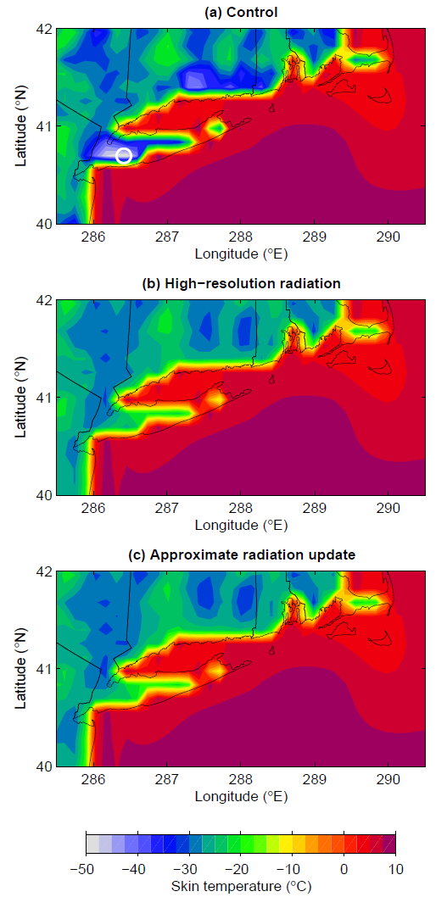
Approximate radiation updates (operational from March 2016)
Since McRad, coarser radiation grid (6-10 times fewer gridpoints) led to errors at coastlines: sea temperature and albedo used to compute net fluxes over adjacent land area
Benchmark calculation is from running radiation every gridbox and timestep (radiation 24x more expensive)
Now perform approximate updates of flux profile every model gridbox and timestep, using local skin temperature and surface albedo (radiation only 2% more expensive)
T_{skin} 25 K colder
Approximate update scheme better matches observations (coastal point in northern Norway)
0700 Local Time, 4 Jan 2014
Hogan and Bozzo (JAMES 2015)

Slide 11
Towards a consistent treatment of complex surfaces
Reflectance of vegetation over snow is very crudely modelled at ECMWF, leading to large temperature errors; absorbed sunlight by vegetation is used in dynamic vegetation models, transpiration rates in NWP and CO₂ emission in chemistry models
Urban areas ignored completely (except for albedo), yet most users of ECMWF forecasts are in cities!
How can we represent complex 3D effects efficiently in radiation schemes? …SPARTACUS!

Slide 12
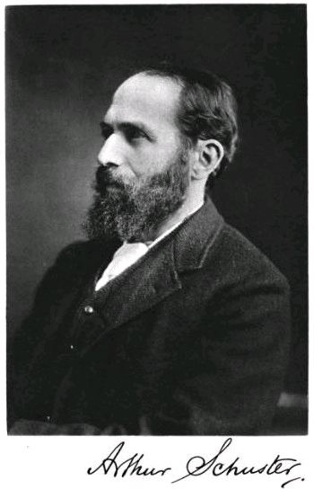
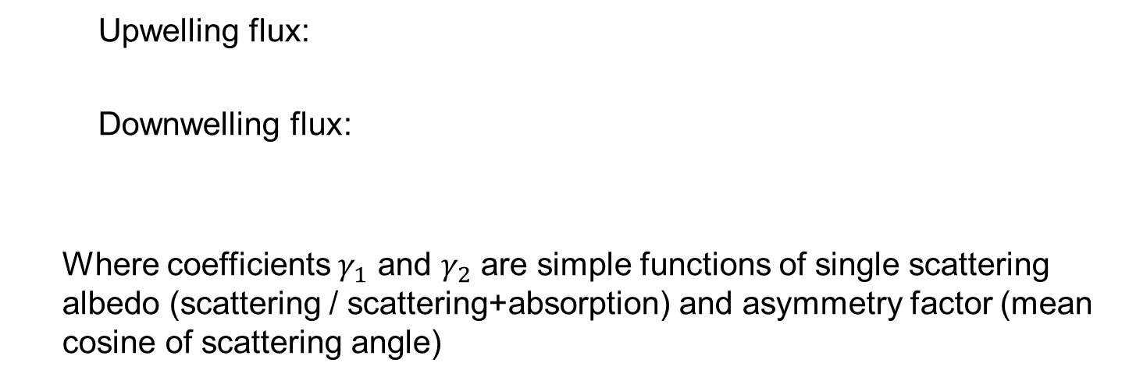
Two-stream equations for diffuse flux
Extinction coefficient (gas, aerosol & cloud optical depth per metre)
Loss of flux by scattering or absorption
Gradient of flux with height
Gain in flux by scattering from other direction
Source from scattering of the direct solar beam (shortwave) or emission (longwave)
Upwelling flux:
Downwelling flux:
Where coefficients $γ_{1}$ and $γ_{2}$ are simple functions of single scattering albedo (scattering / scattering+absorption) and asymmetry factor (mean cosine of scattering angle)
Original idea from Schuster (1905)

Slide 13
Exact solution
Origin of sources
Meador & Weaver (1980) provide analytic solutions to 2-stream equations per layer in terms of:
  Diffuse reflectance & transmittance R_{i} , T_{i}
  “Sources” emerging from top and bottom of layer S_{i}⁺, S_{i}⁻
Adding Method (Lacis & Hansen 1974):
  Sweep up: Compute albedos at half-levels
  Sweep down: Compute fluxes at half-levels
Shortwave: scattering of direct solar beam
Longwave: thermal emission
Layer i–1
A_{i – 1/2} = R_{i} + T_{i} A_{i+1/2}T_{i} + T_{i} A_{i+1/2}R_{i}A_{i+1/2}T_{i} +…
= R_{i} + T_{i} (1 – A_{i+1/2}R_{i})^{–1}A_{i+1/2}T_{i}
Layer i
Diffuse albedo A_{i+1/2}
Layer i+1

Slide 14
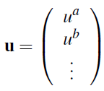
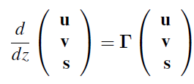
The SPARTACUS method applied to vegetation
SPARTACUS = Speedy Algorithm for Radiative Transfer through Cloud Sides (Hogan et al. 2016)
Idea: apply the two stream equations in each of three regions, with new terms representing horizontal exchange of radiation between regions
Define u = diffuse up, v = diffuse down, s = direct down:
f^{ab}
uª
u^{b}
Two diffuse streams, one direct
become nine

Slide 15
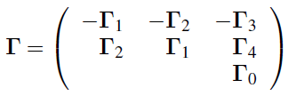

How do we relate exchange matrix to vegetation properties?
Write as:
Rate of change of diffuse radiation along its path is sum of old and new terms:
From geometry arguments, rate of exchange between regions a and b is:
Assumptions:
Rate of exchange proportional to length of interface between regions
Trees are randomly separated
Tree fractional cover
Tree crown diameter
Hogan, Quaife and Braghiere (GMDD 2017)

Slide 16
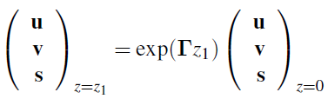
Exact solution
Solution to coupled ODEs in a single layer:
Manipulate matrix exponential to get reflectance and transmission matrices:
Use matrix version of Adding Method to obtain flux profile
Matrix exponential
Waterman (1981), Flatau & Stephens (1998)
Can compute using Padé approximant plus scaling & squaring method (Higham 2005)
Hogan, Quaife and Braghiere (GMDD 2017)

Slide 17
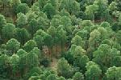
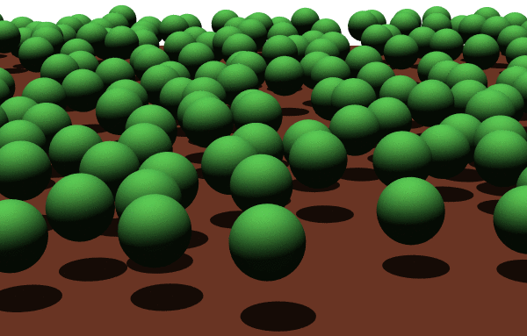
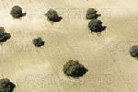
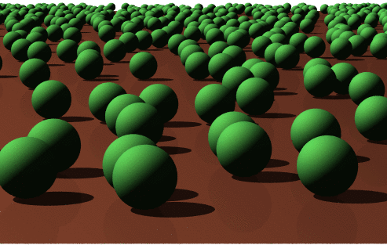
Evaluation: RAMI4PILPS (Widlowski et al. 2011)
Open forest canopy:
Shrublands:
≈
≈

Slide 18
Visible, bare soil Visible, snow Near-infrared, bare soil
Reflectance of forests over snow in current IFS (Dutra et al. 2010)
Shrubland Open forest canopy
Monte Carlo calculations from Jean-Luc Widlowski

Slide 19
Comparison to “traditional” two-stream scheme
(soil)
(snow)
1-region: homogenize forest horizontally, Sellers (1985) as in JULES
  Significantly less reflective; photosynthesis rate too high
2-region: homogenize trees
  Passable approximation, especially when leaf-area index poorly known
Tree height and forest cover now available globally from satellite
Hogan, Quaife and Braghiere (GMDD 2017)

Slide 20
Preliminary application of SPARTACUS to urban areas
Currently urban areas are forests or cropland in the ECMWF model!
Development of an “urban tile” shortly to start, including turbulent and radiative exchanges between streets, walls and roofs
To apply SPARTACUS to cities, only three geometric variables are required:
Analysis of building geometry data: “effective building size” is amazingly constant for London: 14.3±2.6 m so amenable to parameterization
Effective building size: diameter of a cylindrical building in an equivalent idealized city composed of identical cylindrical buildings with the same building perimeter and coverage as the actual city: D = 4A_{building}/P_{building}

Slide 21
Example broadband calculation for central London
Next step: evaluation!

Slide 22
Challenge 2: Clouds

Slide 23
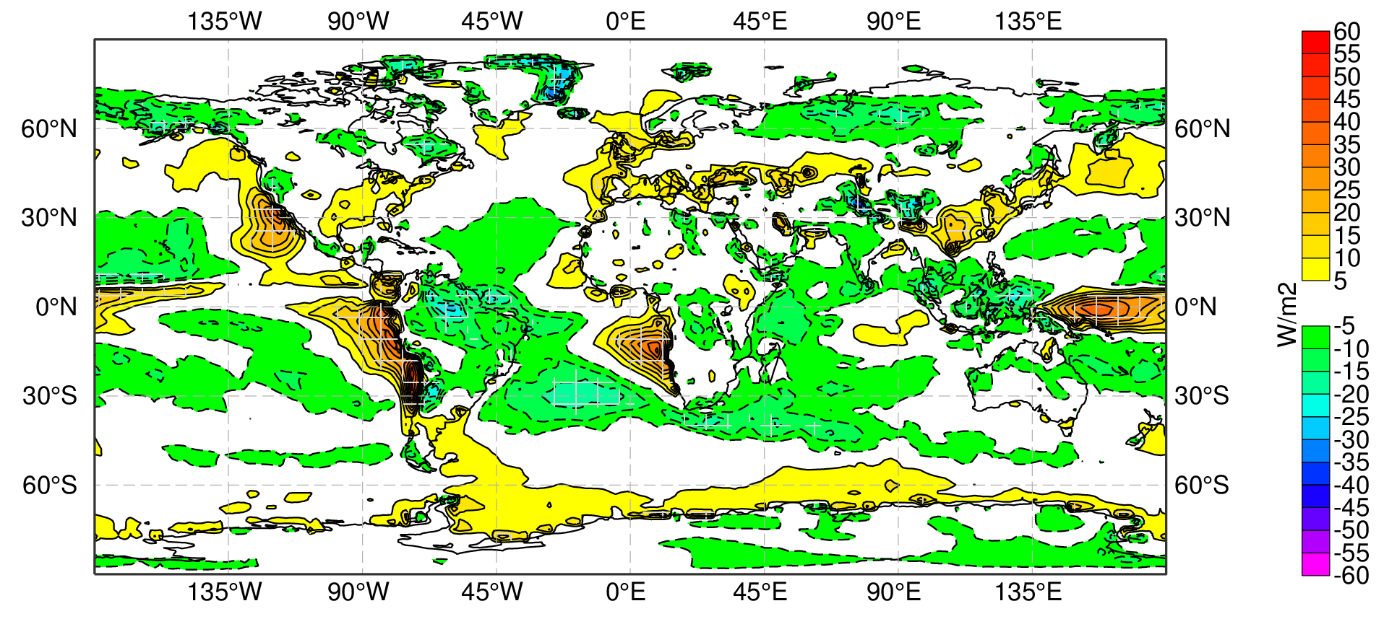
What is cause of errors in SW cloud radiative effect?
Cumulus
Stratocumulus
Too bright
Too dark
MAGIC ship track
OK!
Too few
Effective radius Liquid water Cloud cover SW reflectance
Too dry
Too wet
Cumulus in many models are “too bright, too few”
Cumulus in IFS are too bright, too wet, with droplets too small
Treatment of cloud sub-grid structure in radiation also significantly affects cloud radiative effect
Too small
23

Slide 24
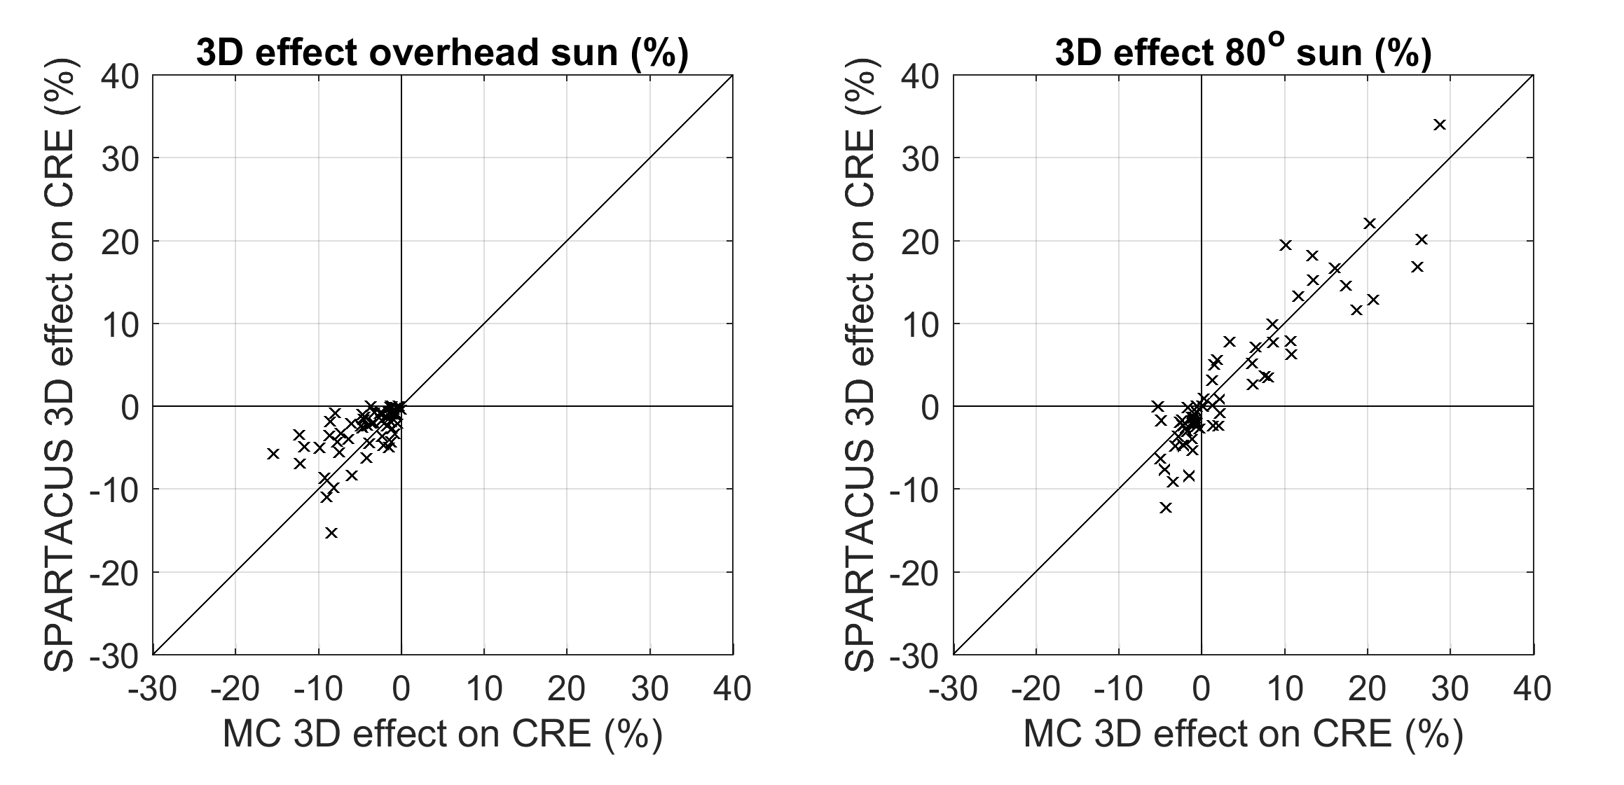
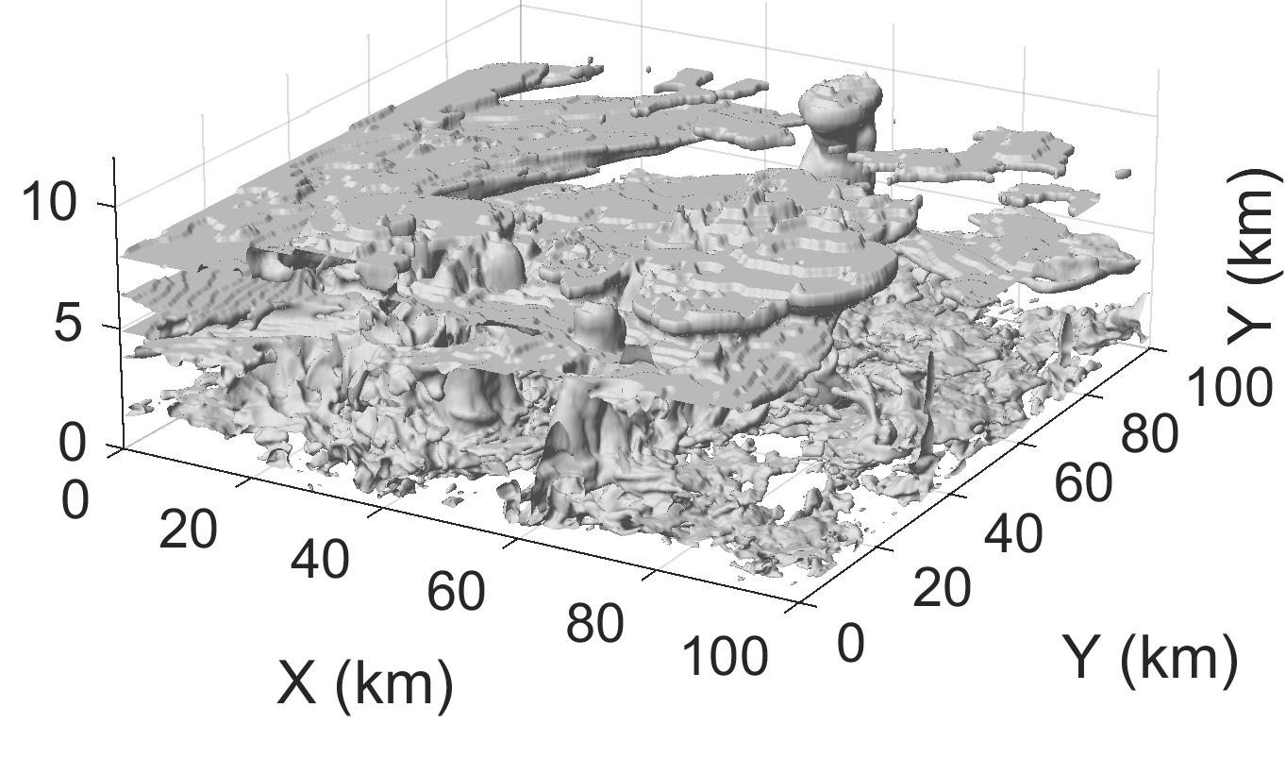
Evaluation of “SPARTACUS” solver for representing 3D radiative effects
ecRad is the only GCM radiation scheme with option to represent 3D effects rigorously in shortwave and longwave (4.5x more expensive)
Tested offline against Monte Carlo calculations for 59 varied scenes from Canadian and Met Office models at ~200 m resolution
Encroachment under clouds reduces cloud radiative effect
Interception by cloud sides increases cloud radiative effect

Slide 25
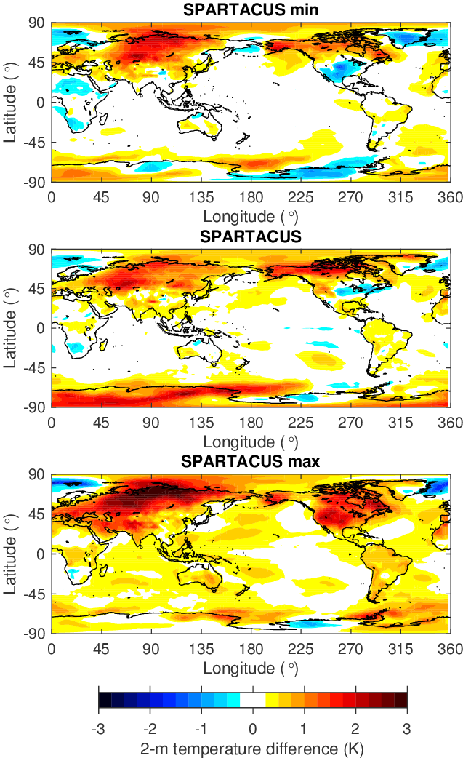
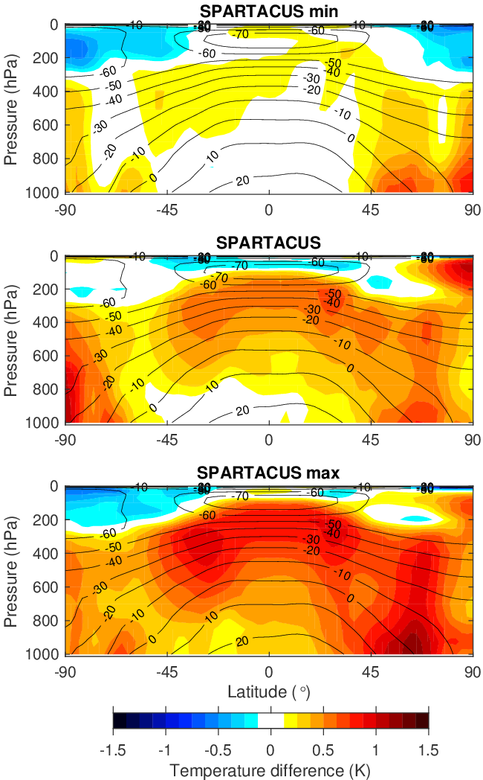
Impact in 4x 1-year coupled simulations
Global-mean surface downwelling longwave and shortwave both increased by around 1 W m⁻²
Similar magnitude to effect of uncertainties in cloud structure, overlap and particle size
Land surface warms by 0.5 degrees
Need longer climate simulations to see effect with the full ocean response

Slide 26
Challenge 3: Clear-sky shortwave absorption

Slide 27
Aerosols
Bozzo et al. (2017)
bias
Atmospheric forcing depends on absorption optical depth:
Reduced absorption over Arabia in new CAMS climatology weakens the overactive Indian Summer Monsoon, halving the overestimate in monsoon rainfall
Increased absorption over Africa degraded 850-hPa temperature, traced to excessive biomass burning in CAMS
We can measure the impact of aerosols on the tropical atmosphere more easily than the absorption optical depth itself! Use to provide information on aerosol errors?
Tegen JJA (pre 43R3)
CAMS JJA (43R3)
bias

Slide 28
Revised water vapour continuum in near infrared
Impact on climate of coupled model
Measurements from “CAVIAR” project (Shine et al. 2016) suggest water vapour continuum in near-IR could be up to a factor of 10 too small in RRTM-G
Tested CAVIAR continuum in IFS
In coupled climate runs, troposphere warms by ~0.5 K; 1 K over summer pole
In uncoupled forecasts, marginal improvement in skill in tropical temperature and mid-latitude winds
Need to reassess with coupled forecasts
Blue is good
Red is good

Slide 29
Challenge 4: Middle atmosphere

Slide 30
Upper stratosphere warm bias
Historically, IFS has had a huge warm bias in upper stratosphere and above
Improved in recent cycles (better longwave in ecRad, CAMS ozone, better solar zenith averaging)
Remaining bias could be removed in stratosphere by updating solar UV which is 7-8% too high in IFS
Lower mesosphere could be improved with a diurnal cycle of ozone (even if approximate)
But resolution-dependence of lower stratosphere temperature (due to waves) needs to be addressed
IFS Cycle 41R1
Hogan & Hirahara (2016)
IFS Cycle 43R3

Slide 31
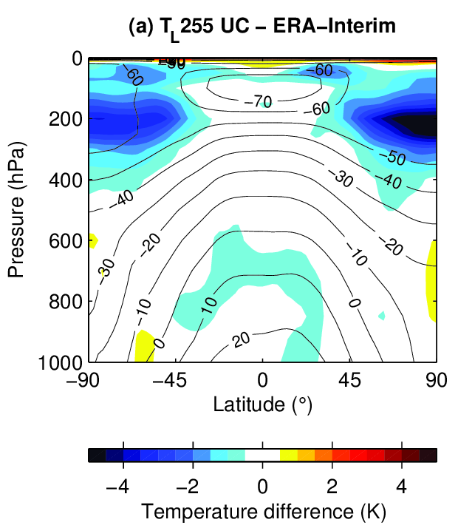
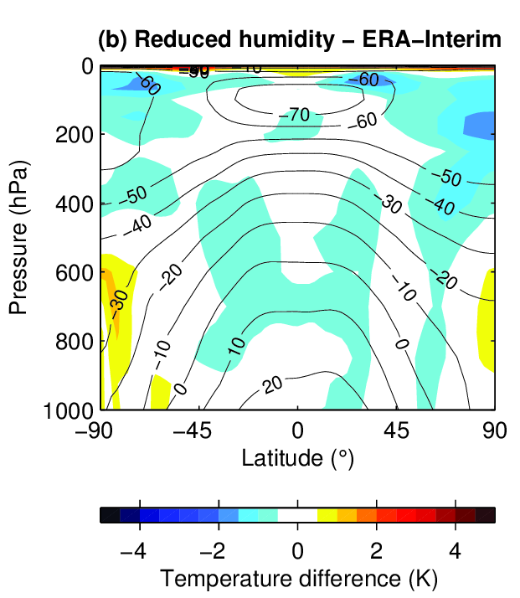
Extra-tropical lower stratosphere cold bias
Very longstanding 5 K cold bias at 200 hPa in polar/extra-tropical areas (also in most other global models)
Cause: water vapour 3x too high here; too much LW cooling
Experiment artificially reducing humidity seen by radiation removes bias and also leads to improvement in troposphere monthly forecast skill
What is the mechanism? Renewed impetus to solve problem properly
Reduce humidity in target areas

Slide 32
Challenge 5: Efficiency

Slide 33
Efficiency: temporal versus spatial resolution
Radiation is now 5% of high-resolution (HRES) model time, compared to 19% a decade ago
Cost of radiation is a trade-off between temporal/spatial/spectral resolution and physical sophistication, and compared to other global NWP centres, ECMWF has lowest temporal/spatial resolution and highest spectral resolution (Met Office uses 3.7 times fewer spectral intervals!)
Spatial coarsening is severe, but thanks to approximate radiation updates, 6.25x more spatial resolution (and cost) gives only marginal improvement in 2-m temperature, whereas reducing radiation timestep from 3h to 1h improves forecasts by 2-4%
How can we afford 1 h radiation in ENS and more physical sophistication (longwave scattering, 3D effects)?

Slide 34
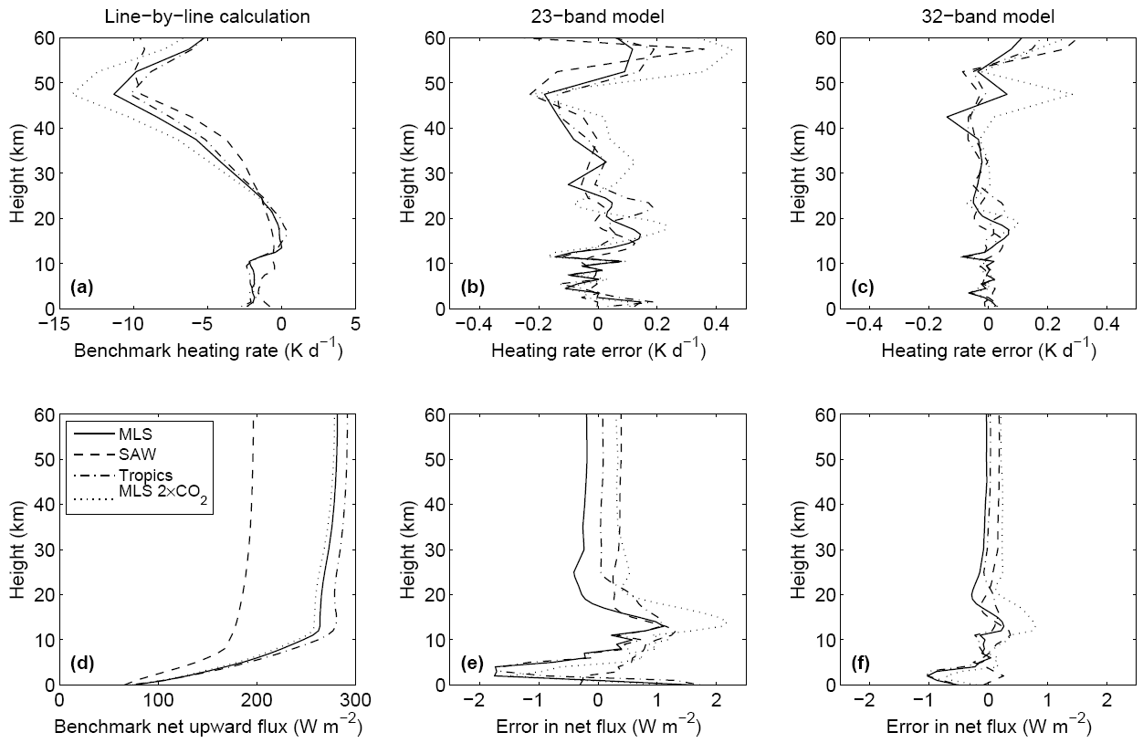
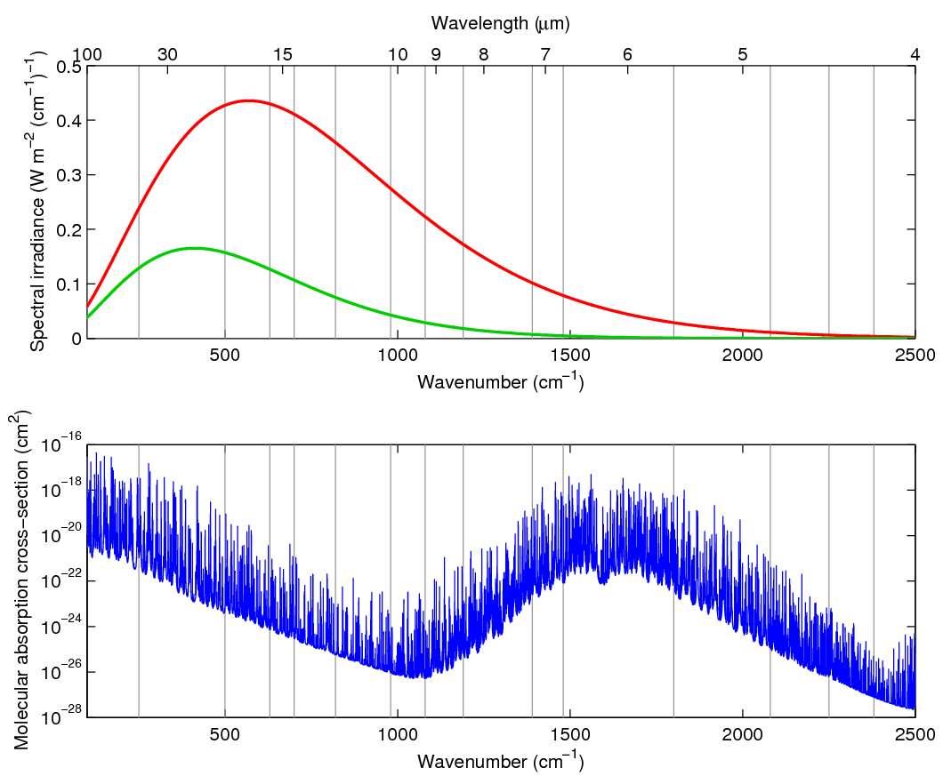
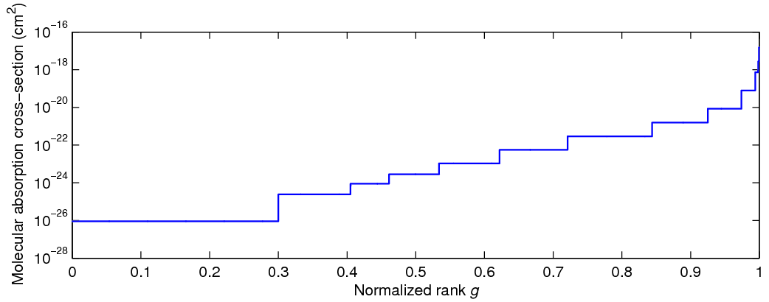
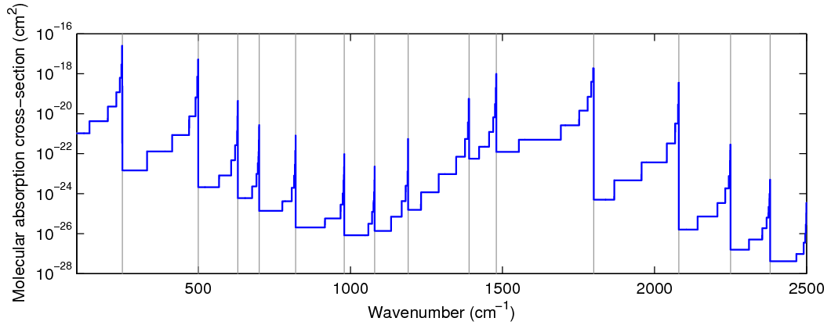
How can we optimize the spectral integration?
Three options under consideration:
  RRTMGP: optimized RRTM-G from U. Colorado
  Neural network: collaboration with NVIDIA
  Full-spectrum correlated-k scheme (Pawlak et al. 2014, Hogan 2010)
Water vapour spectrum
RMSE
~0.04 K d⁻¹ below 40 km
RRTM-G uses 16 LW bands…
reorder and discretize to 140 spectral intervals
FSCK reorders the entire spectrum: only 30-35 intervals required for same accuracy?
Hogan (JAS 2010)

Slide 35
Summary and outlook
Global tropospheric climate of the IFS is excellent, but need concerted effort on many fronts to tackle much larger regional and stratospheric biases
New ecRad scheme is good platform for future developments, but interaction and consistency between schemes is also very important
Intriguing impacts of radiative heating on predictive skill: water vapour and stratosphere-troposphere coupling, and aerosols and monsoon systems
Outlook for the “Grand Challenges” in the coming years:
  Overhaul surface treatment, including 3D interactions with cities and forests
  Package of physically-based improvements to clouds
  Role of aerosols in predictability; upgrade water vapour continuum
  Remove middle-atmosphere temperature bias via new UV solar spectrum
  Much more efficient gas optics and spectral integration, we need 1-h radiation timestep in all model configurations

Slide 37
Why do we need a good radiation scheme in NWP models?
Radiation provides the energy that drives the global circulation, and hence determines the model climate
  The tropospheric climate of the IFS is in many ways excellent
A good climate model is not enough, we want to push the boundaries of predictive skill:
  Shorter range 2-m temperature forecasts, where surface treatment is important
  Extended/seasonal timescales, where biases in regional and stratospheric climate become important, as well as the interaction of radiation with weather systems and weather regimes
To make progress we have to get a lot of things right…

Slide 38
Model climate continued: annual-mean temperature
Troposphere climate of uncoupled model is excellent
Large longstanding cold bias in polar lower stratosphere
…but coupling to ocean leads to significant tropical warming
…and 3x more horizontal resolution cools the lower stratosphere (under investigation…)

Slide 39
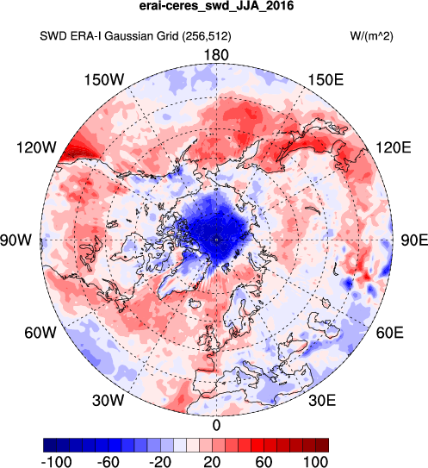
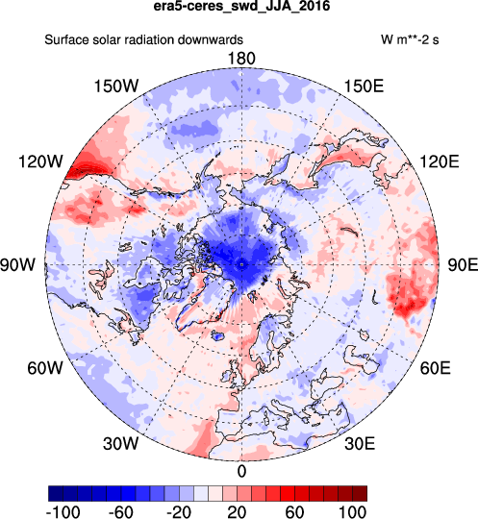
Arctic surface radiation errors in reanalysis estimated from CERES

Slide 40
Cumulative impact of improvements to clouds in radiation scheme
Fix longstanding bug in LW ice optics: cools surface
Countered by adding LW scattering (cost 10%)
Replace EXP-EXP overlap with observationally based EXP-RAN overlap: cools
Reduce sub-grid heterogeneity to more closely match observations: further cooling
Introduce 3D effects (factor of 4.5 more expensive): significant warming
Further work required

Slide 41
3D effects could significantly improve forecasts for solar power
Observed direct-beam fraction for different low-cloud covers
IFS forecast without 3D effects

