Slide 1
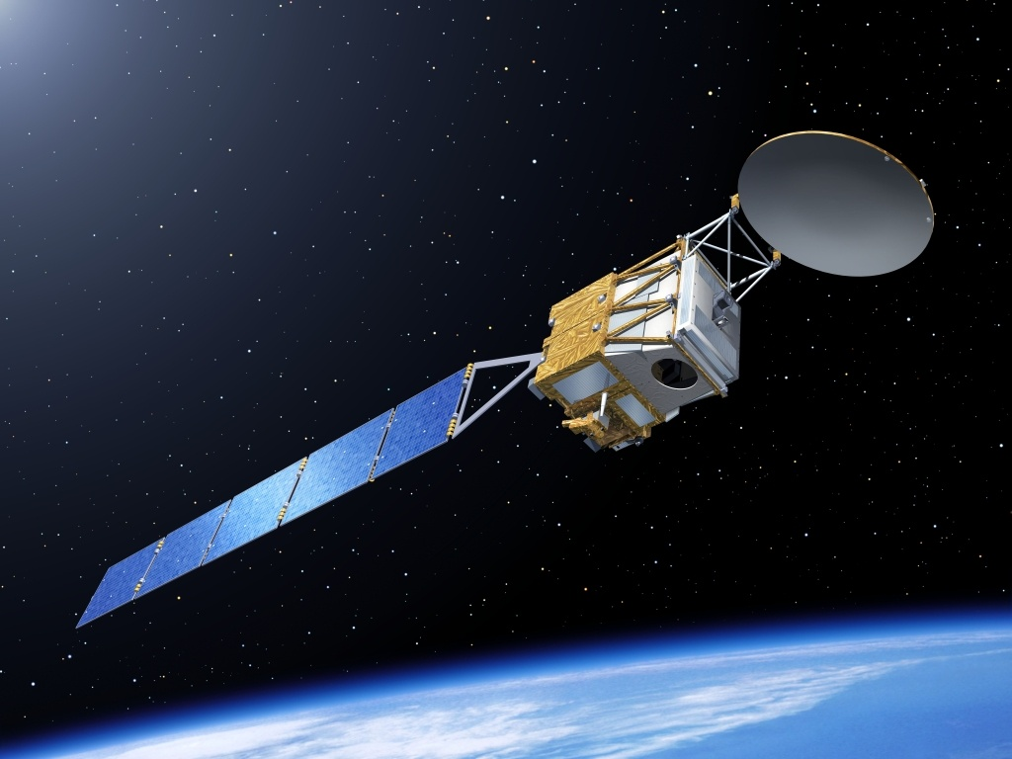
Overview of combined cloud retrievals from active instruments in space
Robin Hogan
University of Reading
Thanks to Nicola Pounder, Julien Delanoe, Chris Westbrook, Thorwald Stein
4 March 2014

Slide 2
Overview
What do we need to retrieve?
Importance of classification
A-Train, EarthCARE and unified retrieval algorithms
General synergy retrieval framework
Sources of uncertainty
Ice retrievals
  Radar plus: lidar, another radar, Doppler… which is best?
  Importance of radar scattering model
Liquid cloud retrievals
  The problem of drizzle
  Potential exploitation of multiply scattered signal from Calipso
A mixed-phase case
Outlook
  This talk is limited to satellite measurements
  No cost functions will be shown in this talk

Slide 3



What do we need to retrieve?
Interaction of clouds with natural radiation depends on:
  First-order importance: extinction coefficient β_{e}
    If :
    Valid for SW ice & liquid, LW ice (but liquid clouds often black bodies)
  Second-order importance: asymmetry factor, single-scattering albedo
Models predict or diagnose:
  Liquid water content, ice water content, cloud fraction
  Rain rate, snowfall rate, ice/snow/rain fall speed
Also need measures of particle size:
  Effective radius is used by models:
    To convert ice/liquid water content to extinction coefficient:
    To parameterize asymmetry factor, single-scattering albedo
  Physical size (e.g. for fall-speed calculation)
    Note that ice effective radius is typically much less than physical size (~50 μm vs. ~1 mm)
$$β_{e}≈2\int{n\left(r\right)A\left(r\right)dr}$$
$$r≫\text{l}$$
$$β_{e}≈\frac{3}{2}\frac{WC}{ρr_{e}}$$

Slide 4
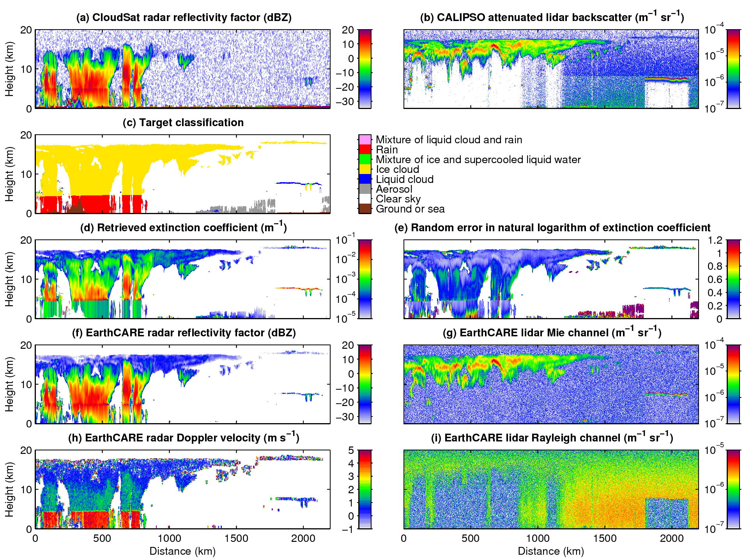
Classification…
Classification:
Ceccaldi et al. (JGR 2013)
“Unified” retrieval (for EarthCARE) provides microphysical properties for all target types
  Error estimates include contribution from measurement and model error
  Looks impressive but is it right?
…Retrieval
Illingworth et al. (BAMS 2014)

Slide 5
What would EarthCARE see?
Compared to the A-Train, EarthCARE (launch 2016) has:
  7-dB more sensitive radar with Doppler capability
  High spectral resolution lidar: better extinction profiles
  Imager (like MODIS) and broad-band radiometer (like CERES)

Slide 6
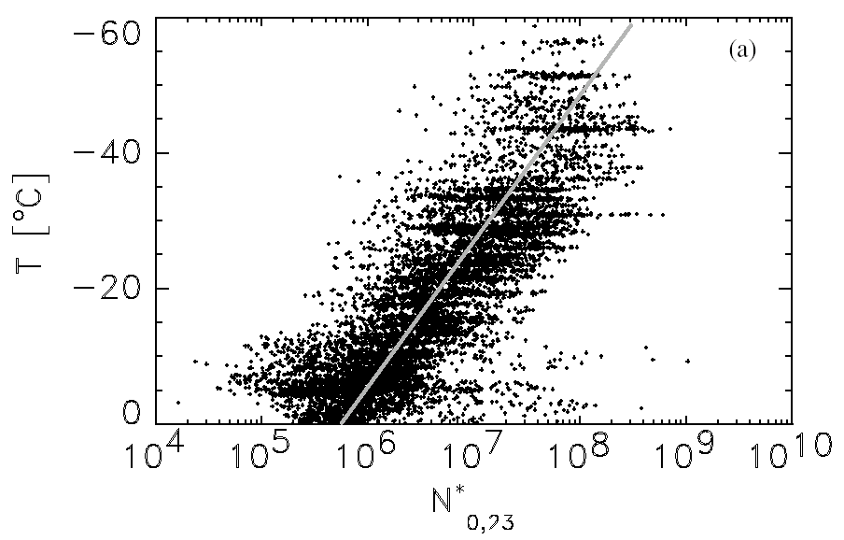
General retrieval framework
One measurement → one retrieved variable via empirical relationship
  E.g. IWC(Z)
Two measurements → two retrieved variables
  Second measurement (e.g. another wavelength, Doppler) often doesn’t give independent information all the time
  Top tip: make one of the retrieved variables a measure of (normalized) number concentration with good prior (e.g. temperature)
  Then automatically falls back to best one-measurement retrieval
Three measurements…
  Can we get a handle on other variables, e.g. ice density, particle habit?
Field et al. (2005)

Slide 7
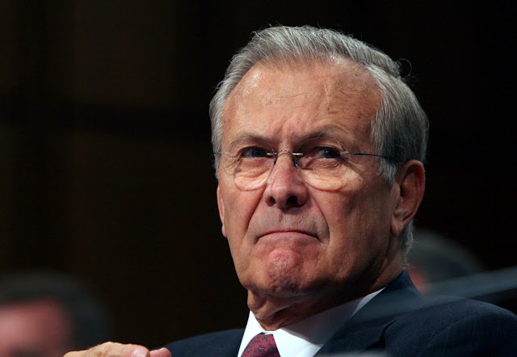
There are known knowns. These are things we know that we know.
There are known unknowns. That is to say, there are things that we know we don't know.
But there are also unknown unknowns. There are things we don't know we don't know.
Donald Rumsfeld

Slide 8
A Rumsfeldian taxonomy
The known knowns, things we know so well no error bar is needed
  Drops are spheres, density of water is 1000 kg m⁻³
The known unknowns, things we can explicitly assign an well-founded error bar to in a variational retrieval
  Random errors in measured quantities (e.g. photon counting errors)
  Errors and error covariances in a-priori assumptions (e.g. rain number conc. parameter N_{w} varies climatologically with a factor of 3 spread)
The unknown unknowns where we don’t know what the error is in an assumption or model
  Errors in radiative forward model, e.g. radar/lidar multiple scattering
  Errors in microphysical assumptions, e.g. mass-size relationship
  How do errors in classification feed through to errors in radiation?
  How do we treat systematic biases in measurements or assumptions?
(also the ignored unknowns that we are too lazy to account for!)
How can we move more things into the “known unknowns” category?

Slide 9
 | Number concentration | Size distribution width/shape | Particle shape | Radar scattering & absorption | Lidar scattering & absorption
Warm liquid droplets | Miles et al. (2000) | Many aircraft campaigns | Sphere | Mie | Mie
Rain | Many distrometer studies | Illingworth & Blackman (2002) | Spheroid, known aspect ratio | T-matrix (Mie OK too) | Mie is OK
Drizzle | Abel and Boutle (2012) | Aircraft studies? | Sphere | Mie | Mie
Supercooled droplets | A few aircraft studies? | Same as for warm droplets? | Sphere | Attenuation unknown! | Mie
Ice | Delanoe and Hogan (2008), Field et al. (2005) | Delanoe et al. (2005), Field et al. (2005) | Aggregate aspect ratio 0.6; mass-size relation? | Spheroid agrees with obs (Hogan et al. 2012) | Retrieved lidar ratio encapsulates variations
Snow (possibly rimed) | Same as ice? | Same as ice? | How do we represent riming? | Hogan & Westbrook (2014)? | Lidar ratio encapsulates variations
Melting ice | Lies between snow & rain? | Lies between snow & rain? | Very uncertain | Attenuation uncertain! | Ignore
Known knowns | Known unknowns | Unknown unknowns | Ignored unknowns

Slide 10
Ice retrievals
Radar
Dual-λ Hogan et al. (1999)
IWC(Z), IWC(Z, T)
What is the best supplement to radar reflectivity factor?
Doppler Matrosov, EarthCARE
Donovan et al. (2001), Okamoto et al. (2003)
CloudSat: Austin et al. (2009)
Delanoe and Hogan (2010), EarthCARE “unified”
HSRL EarthCARE
LIRAD (Platt)
Chiriaco et al. (2004)
MODIS etc.
CALIPSO, Klett etc.
Radiometer
Lidar

Slide 11
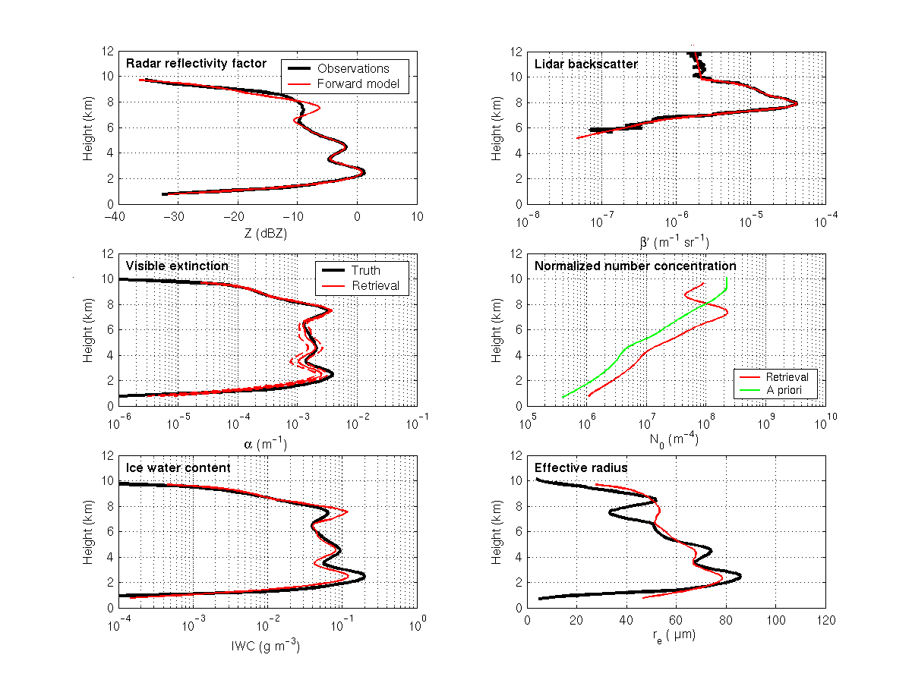
Lidar-radar combination
Advantages
  Lidar much more sensitive to thin cirrus: with radar gives great coverage
  Synergy extracts lidar attenuation: exactly what we want to know
  Radar-lidar ratio is very sensitive to particle size
Limitations
  Signal extinguished in many deep clouds: revert to radar-only information
  Tricky to use: many papers try to correct lidar for attenuation first, but it is much more accurate to use the radar to help the inversion
  Retrieved lidar backscatter-to-extinction profile assumed constant with height: leads to biases if there is really a vertical gradient (problem resolved using infrared radiances or EarthCARE’s HSRL)

Slide 12
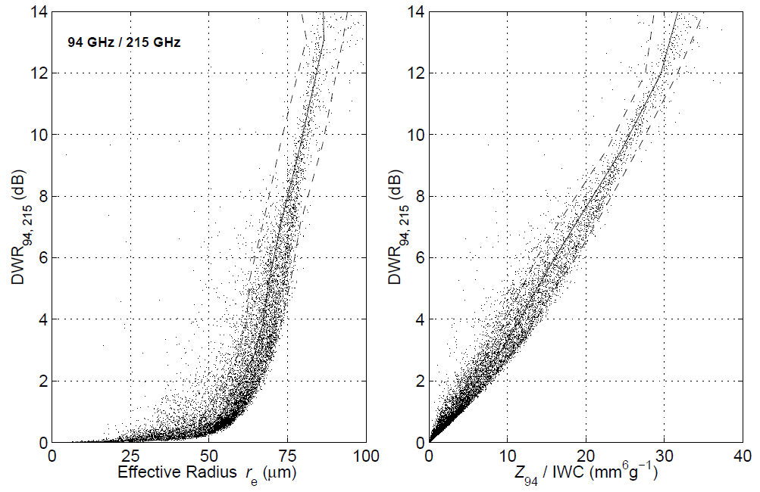
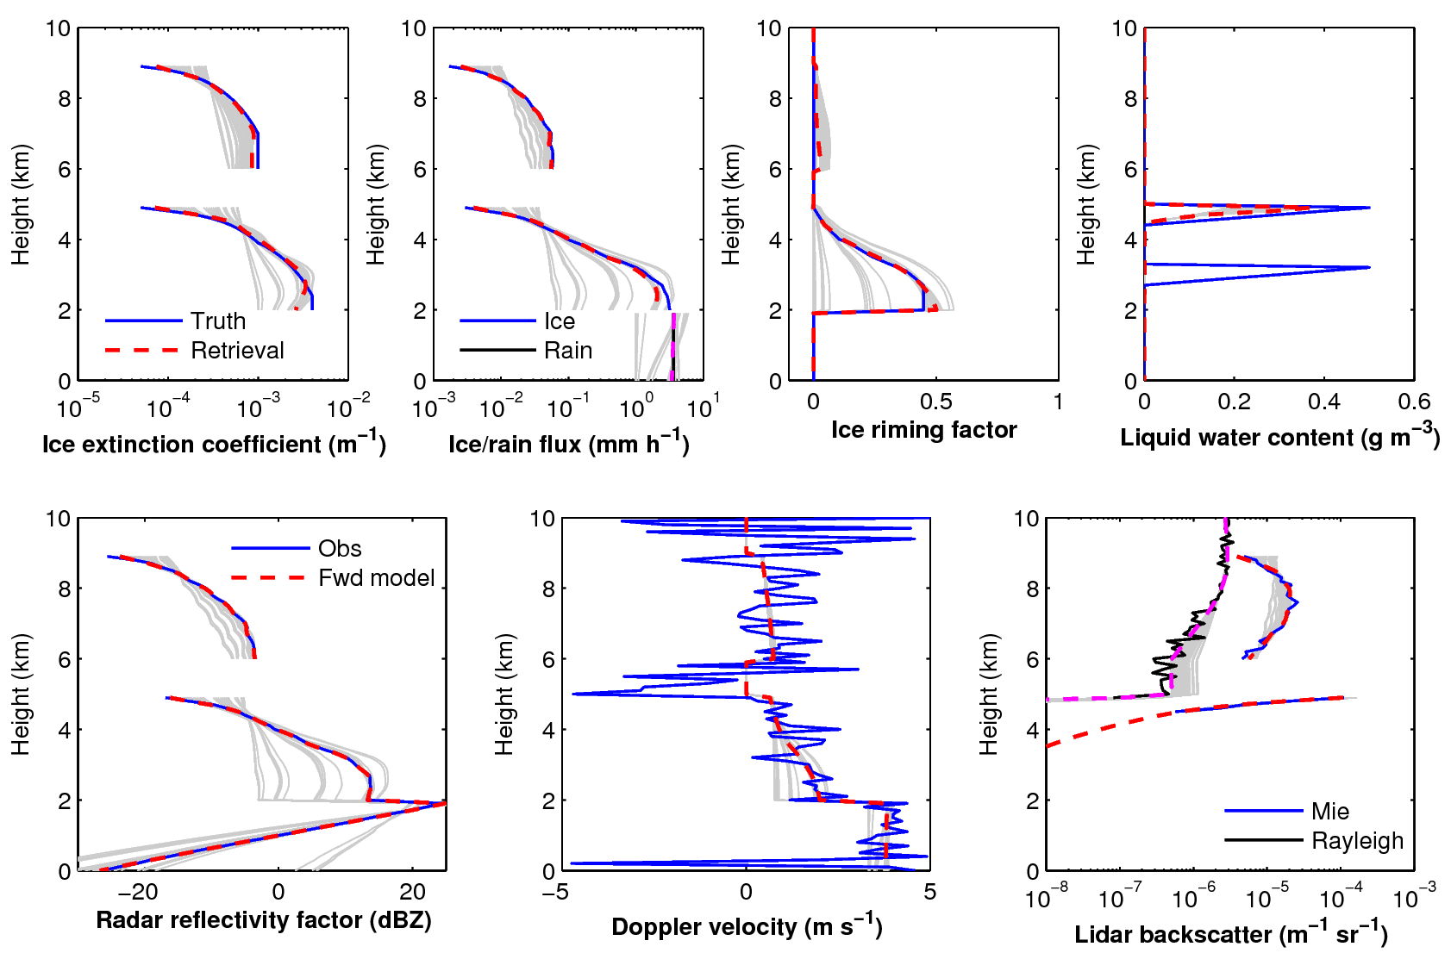
Additional radar information
Additional 215 GHz radar
  Size info deep in cloud: complements lidar
  Dependent on good radar scattering model
Doppler (e.g. EarthCARE)
  Sensitive to ice density and therefore riming
  Need high signal-to-noise
  No use in convective clouds

Slide 13
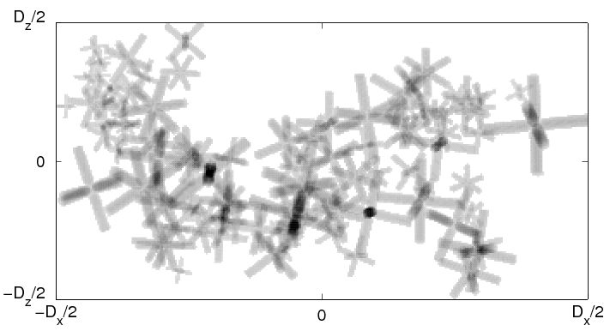
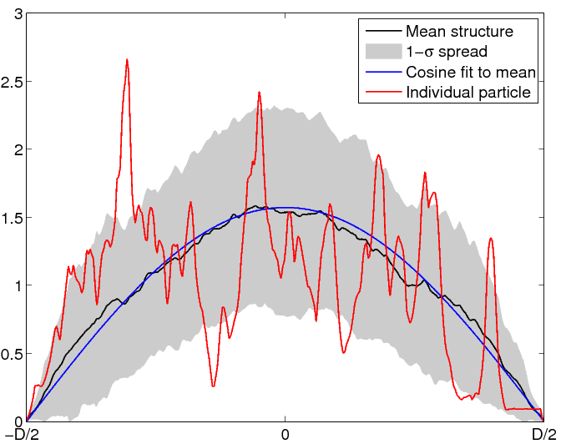
Snow
Simulated aggregate (Westbrook et al.)
What’s the 94 GHz backscatter cross-section of this?
Spheroid model works up to D ~ λ, but not for larger particles
Rayleigh-Gans approximation works well: describe structure simply by area of particle A(z) as function of distance in direction of propagation of radiation
Area of slice through particle A(z)

Slide 14
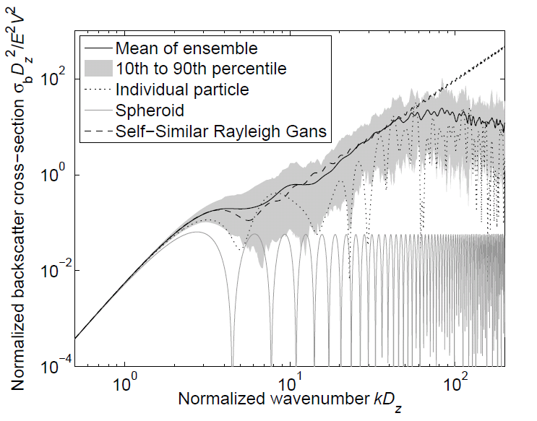
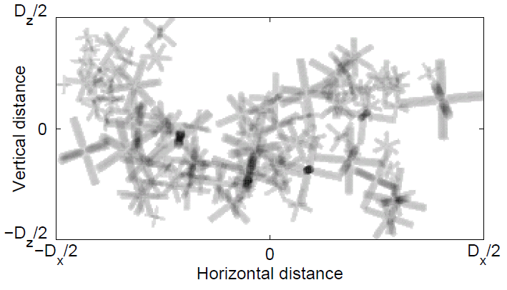
Radar scattering by ice
1 mm ice
1 cm snow
Realistic aggregate snowflake
Soft spheroid
Hogan and Westbrook (2014) used simulated ice aggregates to derive an equation for radar backscatter: the “Self-Similar Rayleigh Gans approximation”
For snowflakes, internal structures on scale of wavelength lead to significantly higher higher backscatter than “soft spheroids”

Slide 15
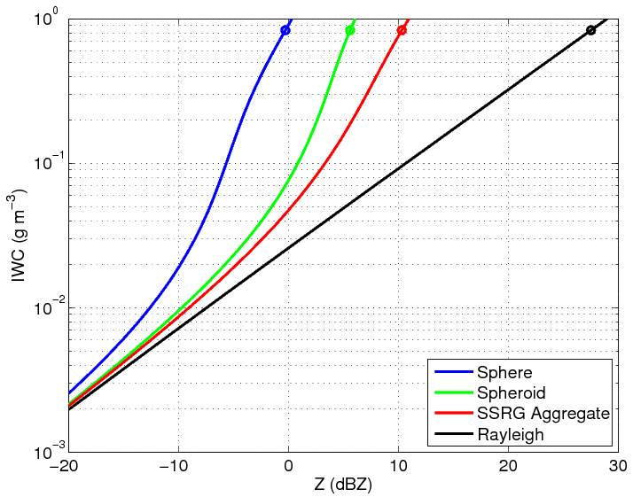
Impact of scattering model
4.5 dB
Factor of 5 error
Field et al. (2005) size distributions at 0°C
Circles indicate D₀ of 7 mm reported from aircraft (Heymsfield et al. 2008)
Lawson et al. (1998) reported D₀=37 mm: 17 dB difference

Slide 16
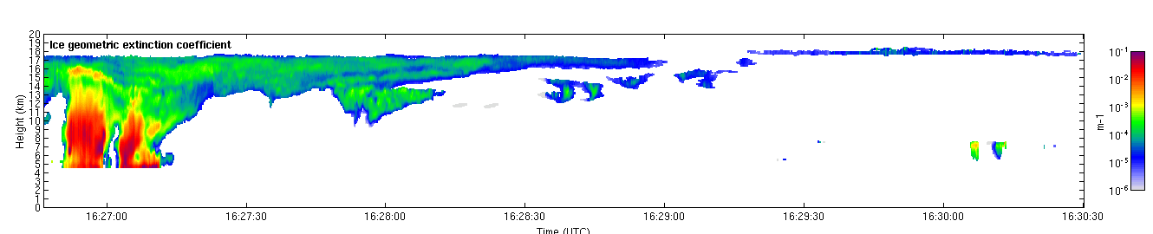
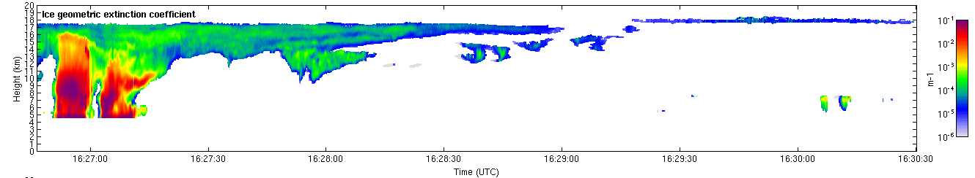
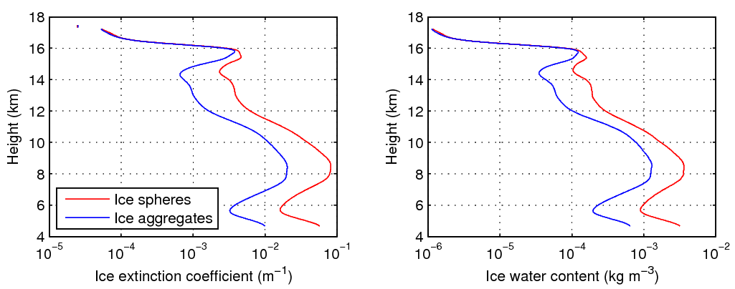
Impact of ice shape on retrievals
Ice aggregates
Ice spheres
Spheres can lead to overestimate of water content and extinction of factor of 3
All 94-GHz radar retrievals affected in same way

Slide 17
Liquid cloud retrievals
Radar
PIA
Lebsock et al. (2011)
Drizzle-free: LWC(Z)
CloudSat: Austin & Stephens (2001)
Optically very thin: Spinhirne et al. (1989)
MODIS etc.
Wide-FOV Pounder et al. (2012)
Radiometer
Lidar

Slide 18
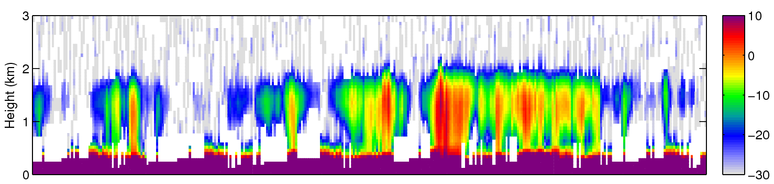
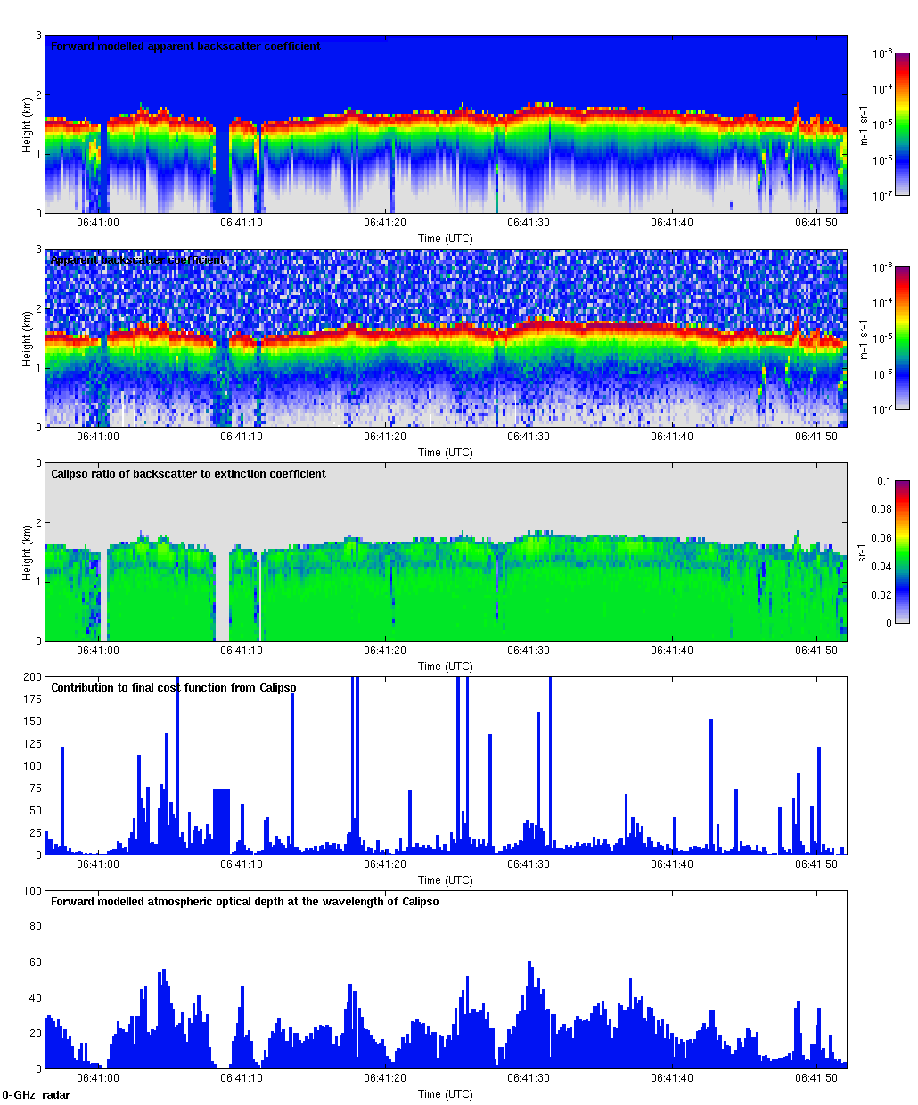
The problem with liquid clouds
90% of liquid clouds over the oceans; 90% of those contain drizzle
Lidar signal strongly attenuated & contaminated by multiple scattering
Very useful constraints from radar path integrated attenuation (PIA) providing liquid water path (over ocean only) and MODIS providing optical depth (daytime only), but vertical profile very uncertain
CloudSat radar reflectivity factor (dBZ)
Where is cloud base?
Calipso lidar backscatter (m⁻¹ sr⁻¹)

Slide 19
New liquid cloud retrieval
Pounder, Hogan et al. (2012) proposed variational method to retrieve extinction profile in stratocumulus exploiting the multiple scattering from multiple field-of-view lidar (use fast “multiscatter” model)
This idea works for single field-of-view lidar with footprint > 50 m
  Add constraint on LWC to be no steeper than adiabatic
  Calipso alone can retrieve optical depth and cloud base height
  Estimated LWP can then be compared to that from CloudSat PIA
  Complements other methods: land and sea, but night-time only
Forward modelled backscatter
Observed backscatter

Slide 20
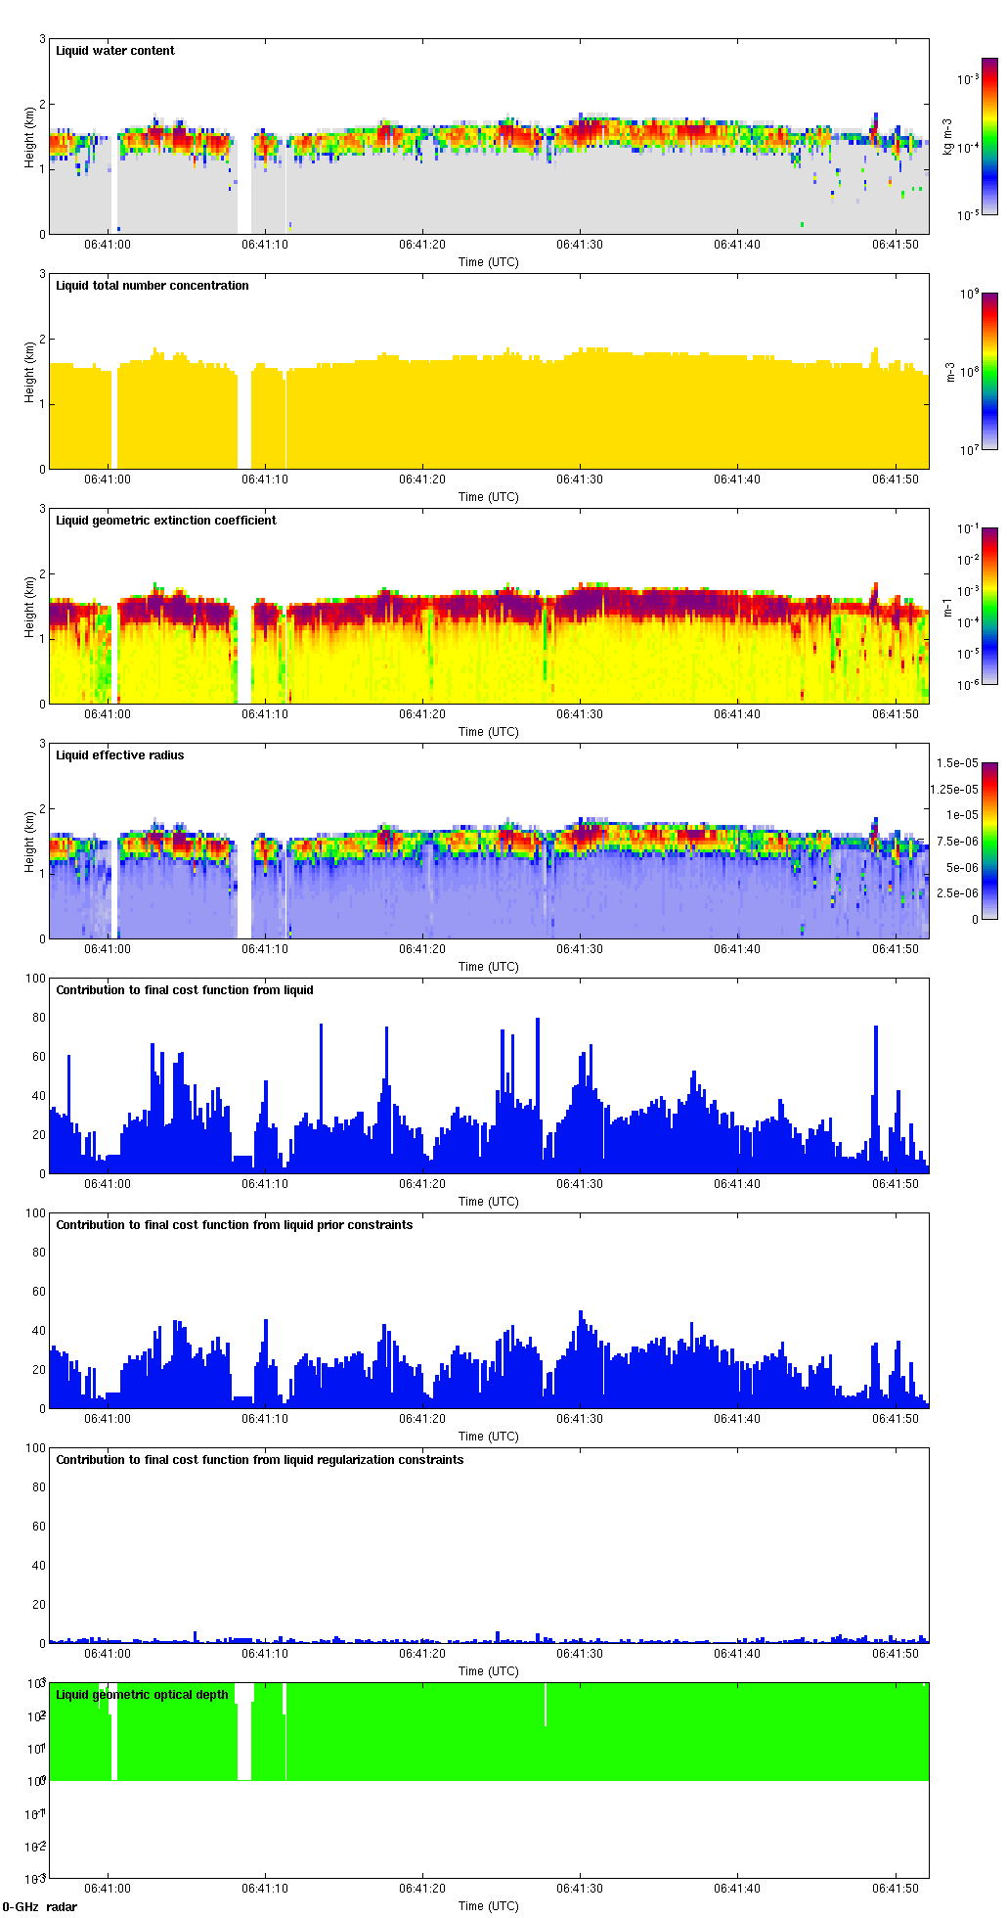
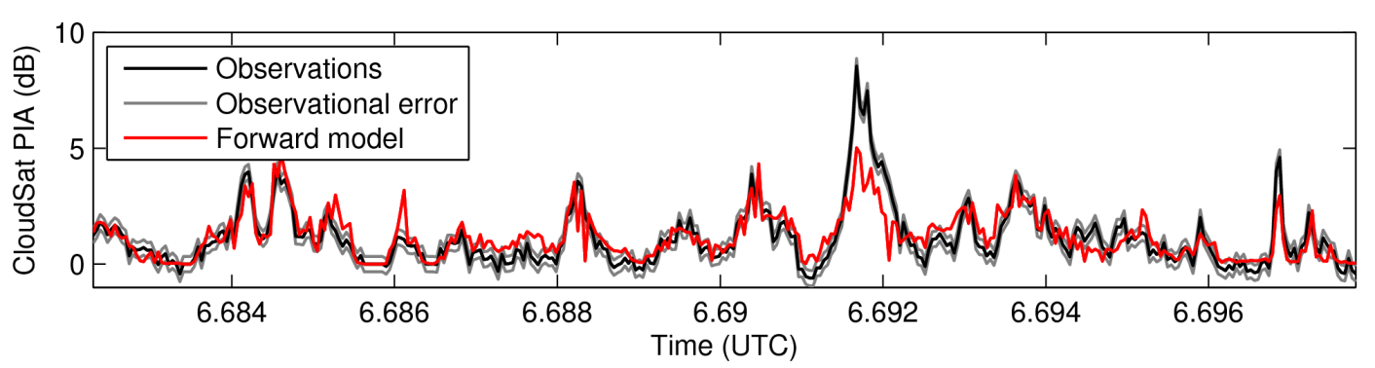
Calipso-only retrievals (assume fixed N_{d} )
LWC
Effective radius
Optical depth
CloudSat PIA

Slide 21
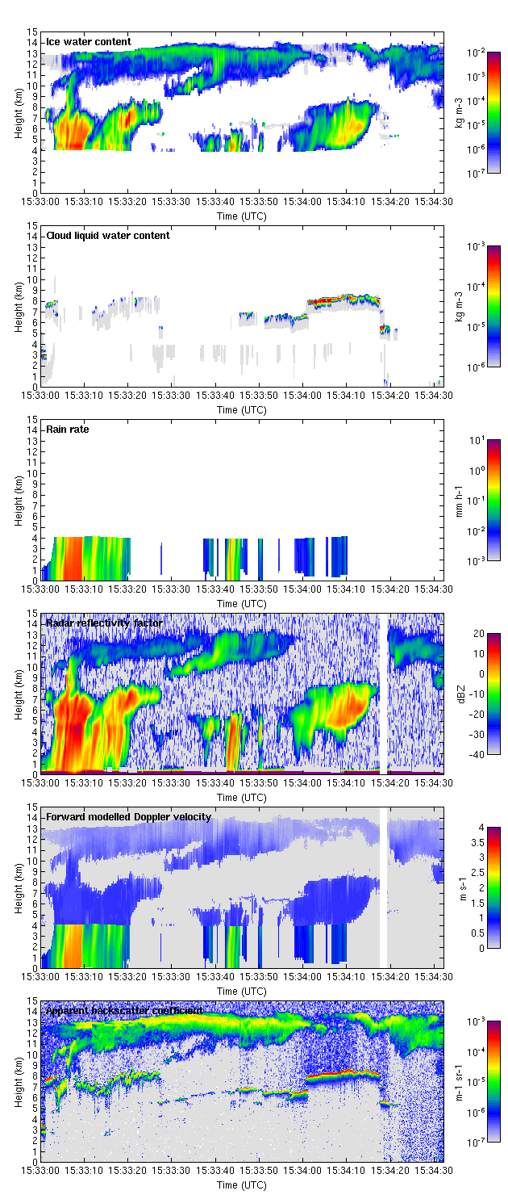
A mixed-phase case
Observations
Unified algorithm automatically uses radar to constrain ice and lidar to constrain liquid retrievals
  No idea what to do with embedded liquid unseen by lidar
  Note that quasi-Newton scheme uses many iterations…
Retrievals

Slide 22
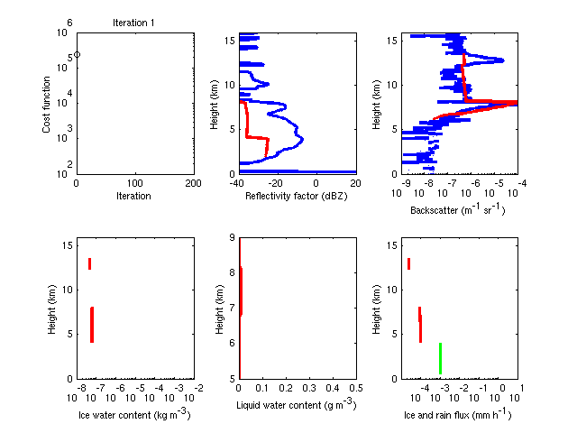

Slide 23
Outlook
EarthCARE is the exciting next step to the A-Train
  Better ice retrievals, especially for thin ice clouds: radar 7 dB more sensitive: HSRL gives direct extinction
  Doppler provides useful information on ice density and riming (as well as better retrievals of rain and drizzle rate)
  On-board 3-view broadband radiometer tests for radiative consistency
What are the next steps for active cloud sensing in space?
  Multiple field-of-view lidar to retrieve extinction profile in stratocu
  Combined 94-215 GHz radars for particle sizing deep into ice cloud
  Radar measures linear depolarization to identify and exploit multiple scattering in deep convection
  Combine with Oxygen A-band spectrometer
  Combine with narrow-view microwave radiometers
  Better synergy algorithms with robust error estimates!

Slide 25
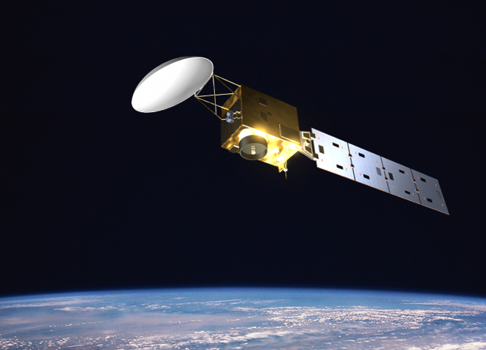
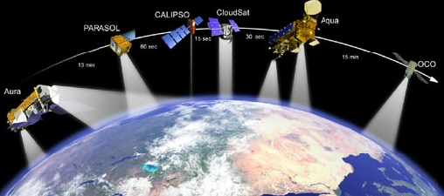
The A-Train versus EarthCARE
The A-Train (fully launched 2006)
  NASA
  Multiple platforms
  700-km orbit
  CloudSat 94-GHz radar
  Calipso 532/1064-nm lidar
  CERES broad-band radiometer
  MODIS multi-wavelength radiometer
EarthCARE (launch 2016)
  ESA and JAXA
  Single platform
  393-km: higher sensitivity
  94-GHz Doppler radar
  355-nm High spectral res. lidar
  3-view broad-band radiometer
  Multi-spectral imager

Slide 26
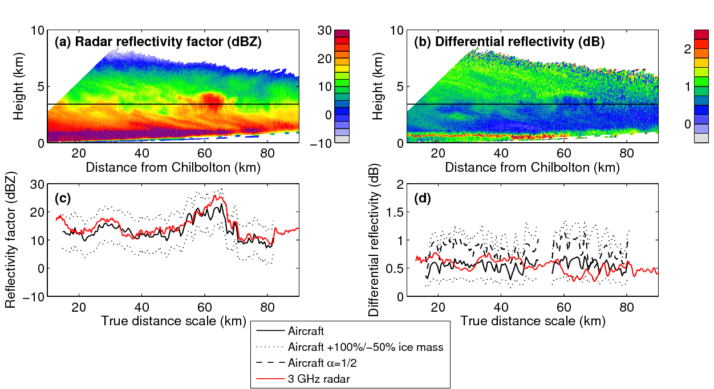
Chilbolton 10-cm radar + UK aircraft
Reflectivity agrees well, provided Brown & Francis mass used with D_{mean}
Differential reflectivity agrees reasonably well for oblate spheroids
CWVC IV: 21 Nov 2000

Slide 27
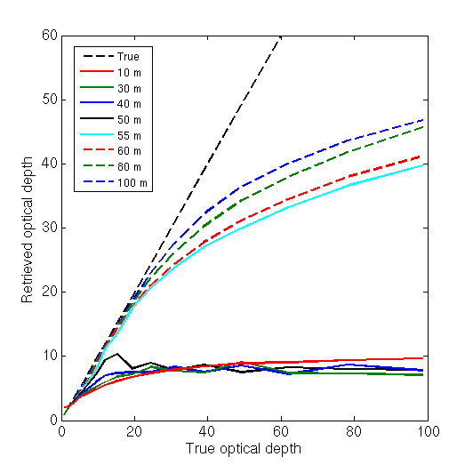
Will this work with EarthCARE?
Simulated retrieval of optical depth for idealized adiabatic clouds, using spaceborne lidar with varying field of view (FOV)
For FOV less than around 50 m, there is simply too little multiple scattering signal to retrieve extinction and optical depth
FOV >= 55 m (e.g. Calipso)
FOV <= 50 m (e.g. EarthCARE)
…No!

Slide 28
Unified retrieval
1. Define state variables to be retrieved (x)
Use classification to specify variables describing each species at each gate
Ice and snow: extinction coefficient, N₀’, lidar ratio, riming factor
Liquid: extinction coefficient and number concentration
Rain: rain rate, drop diameter and melting ice
Aerosol: number concentration, particle size and lidar ratio
Ingredients developed
Not yet completed
2. Forward model
2a. Radar model
With multiple scattering, Doppler and PIA
2b. Lidar model
Including HSRL channels and multiple scattering
2c. Radiance model
Solar & IR channels
4. Iteration method
Derive a new state vector: quasi-Newton or Levenberg-Marquardt scheme
3. Compare to observations (y)
Check for convergence
Not converged
Converged
5. Calculate retrieval error
Error covariances & averaging kernel
Proceed to next ray of data

Slide 29
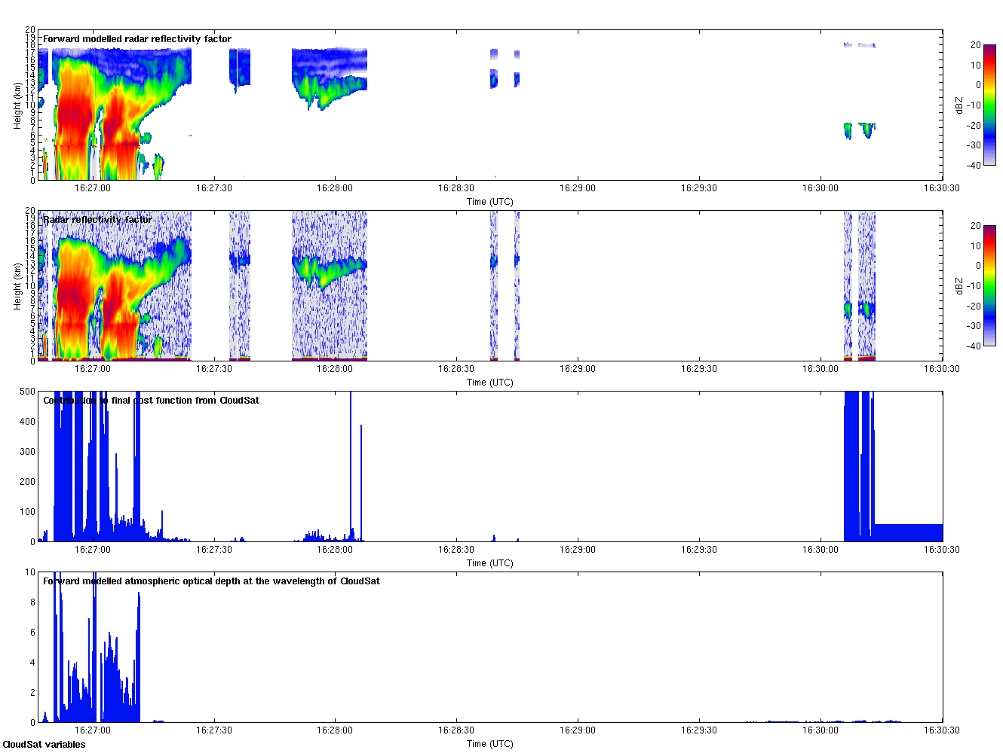
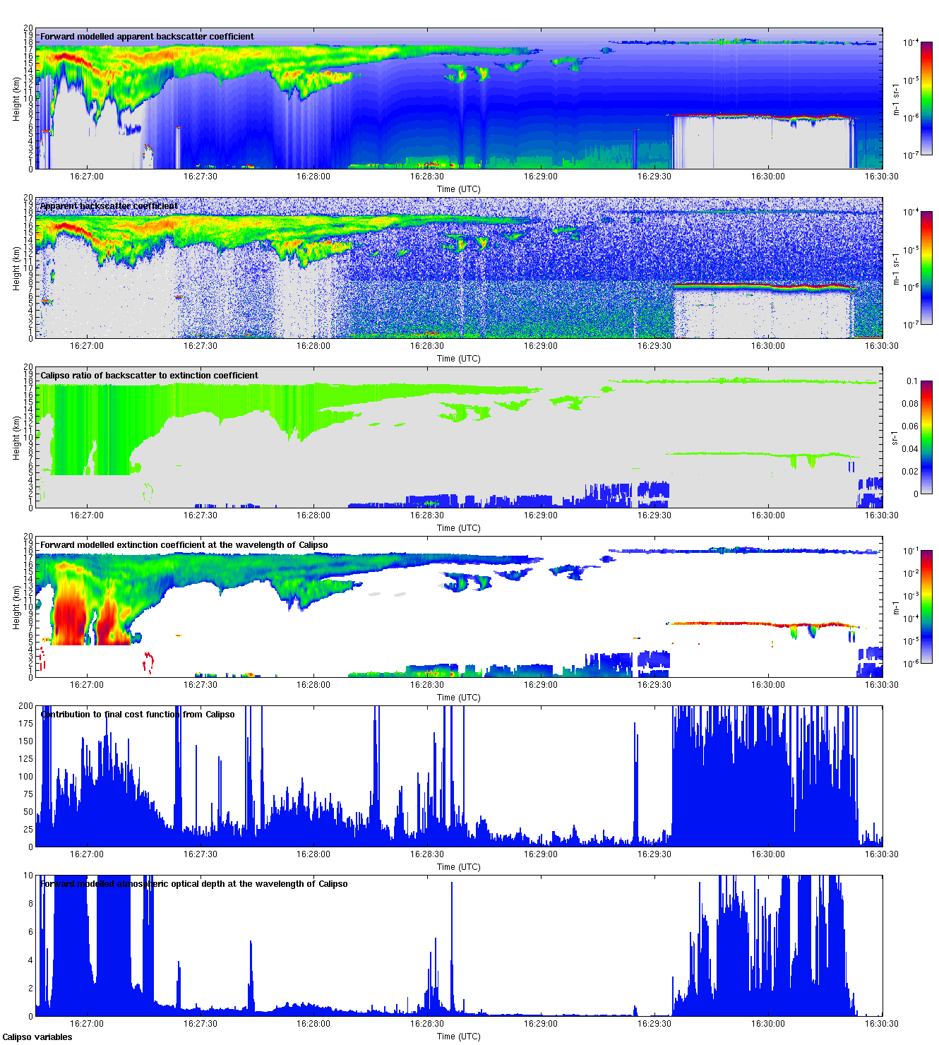
What the results look like so far
CloudSat observations
CloudSat forward model
Calipso observations
Calipso forward model

Slide 30
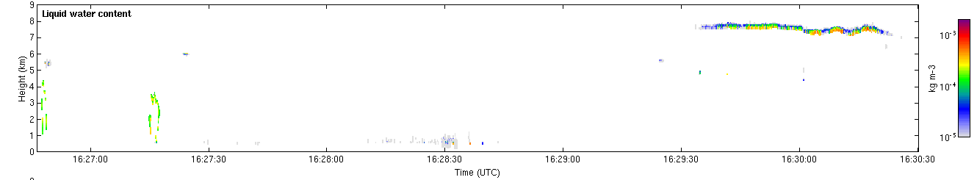
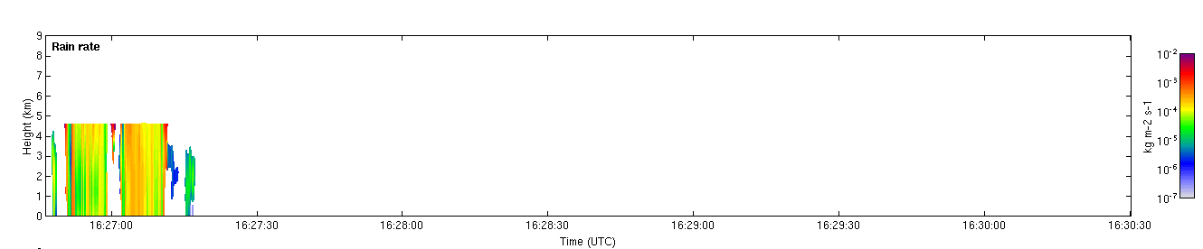
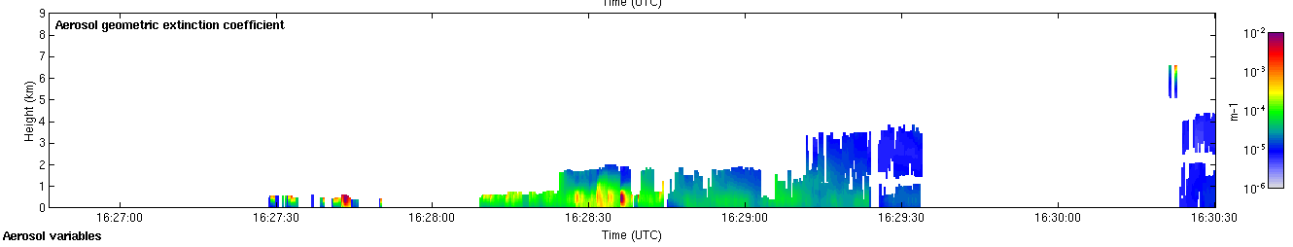
Ice extinction coefficient
Liquid water content
Rain rate
Aerosol extinction coefficient

Slide 31
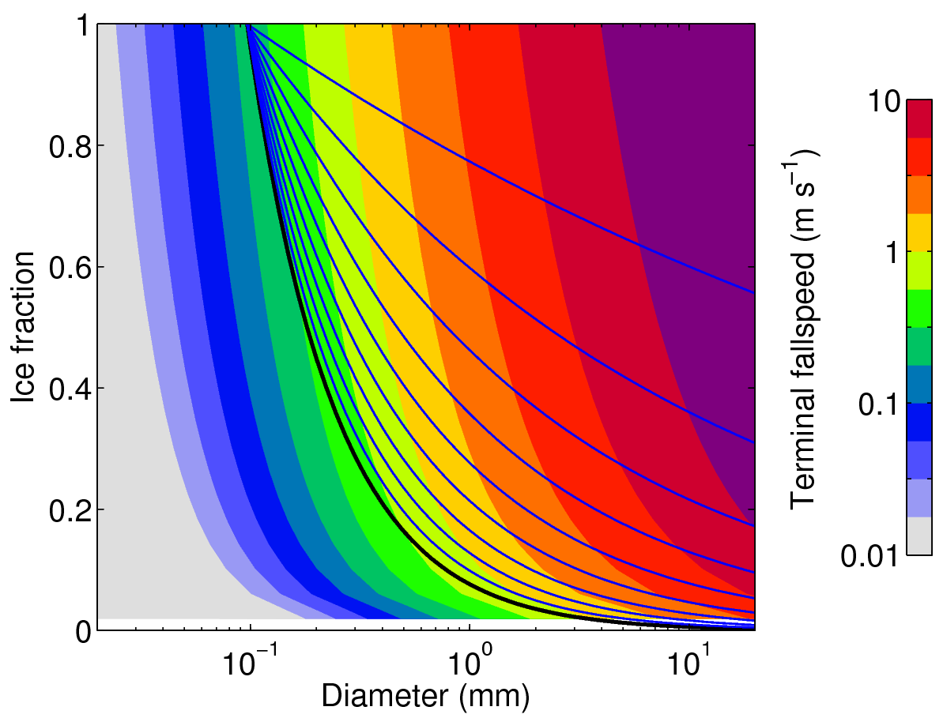
Extending ice retrievals to riming snow
Heymsfield & Westbrook (2010) fall speed vs. mass, size & area
Brown & Francis (1995) ice never falls faster than 1 m/s
Retrieve a riming factor (0-1) which scales b in mass=aD^{b} between 1.9 (Brown & Francis) and 3 (solid ice)
0.9
0.8
0.7
0.6
Brown & Francis (1995)

Slide 32
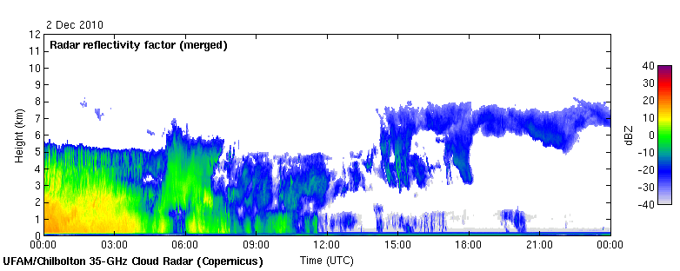
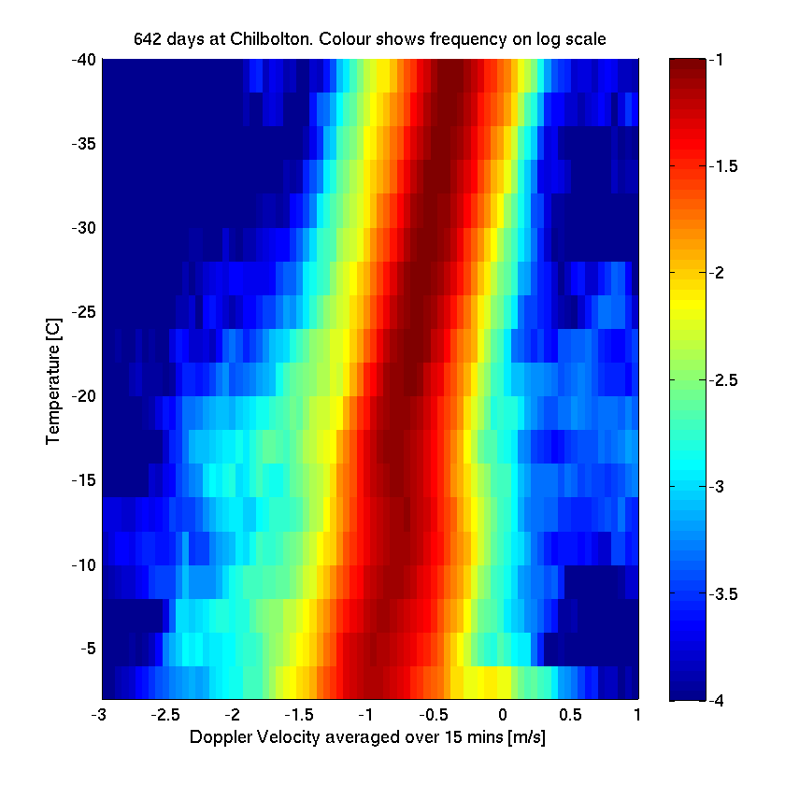
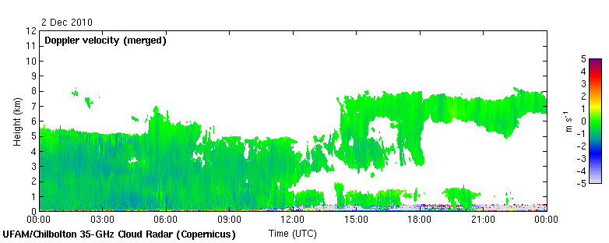
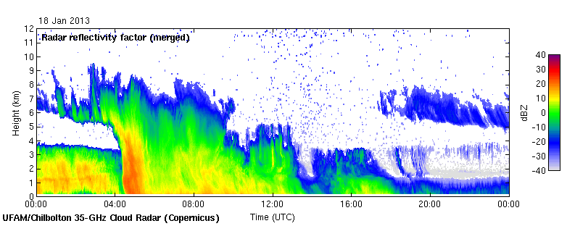
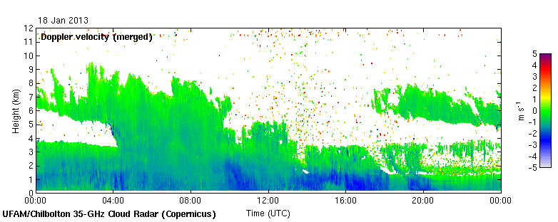
Examples of snow
35 GHz radar at Chilbolton
1 m/s: no riming or very weak
2-3 m/s: riming?
PDF of 15-min-averaged Doppler in snow and ice (usually above a melting layer)

Slide 33
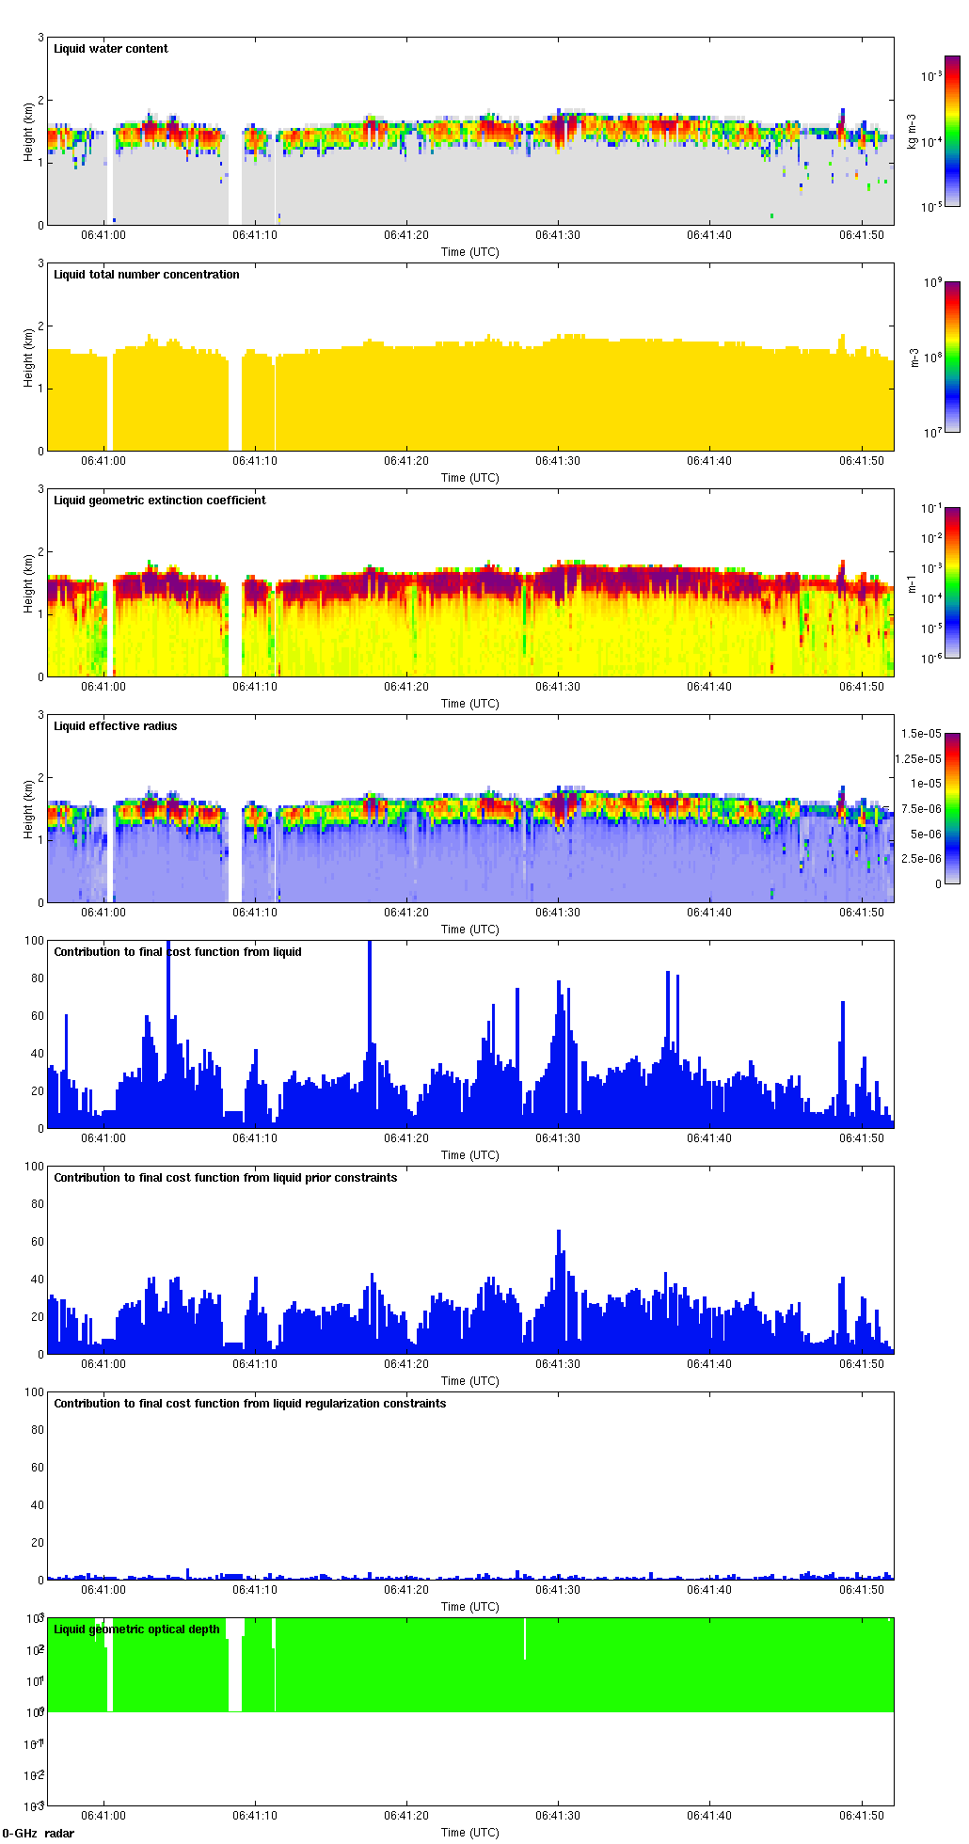
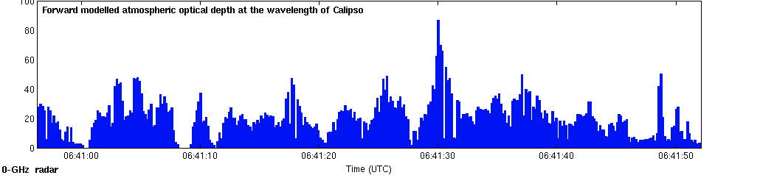
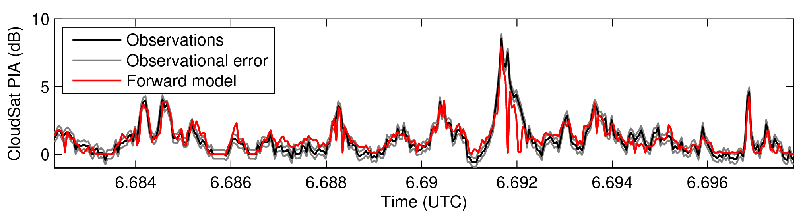
Assimilate also CloudSat PIA
LWC
Effective radius
Optical depth
CloudSat PIA

Slide 34
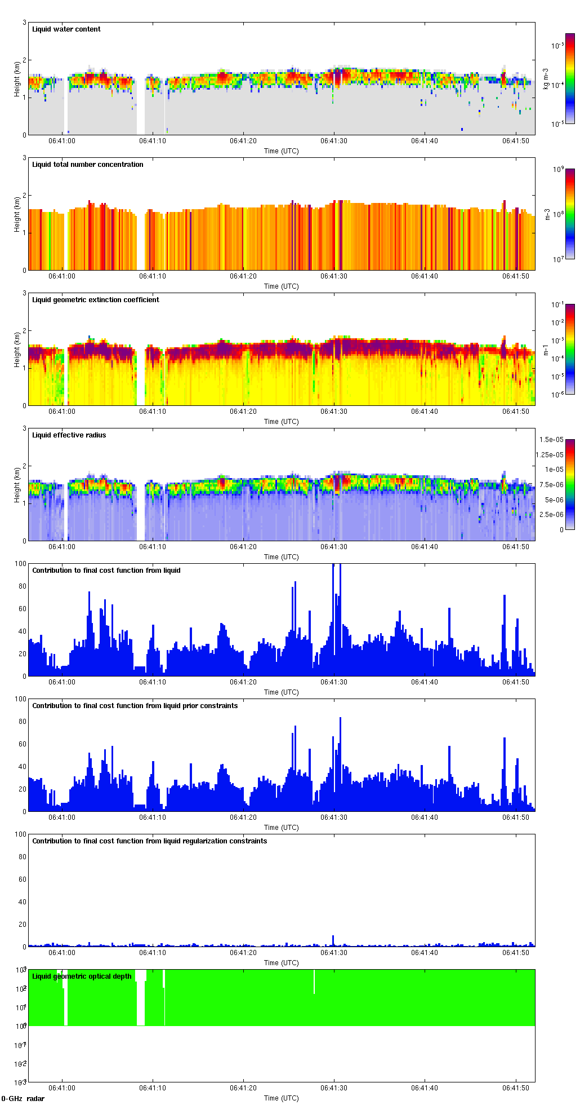
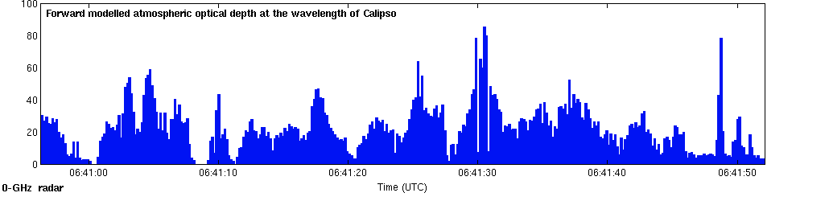
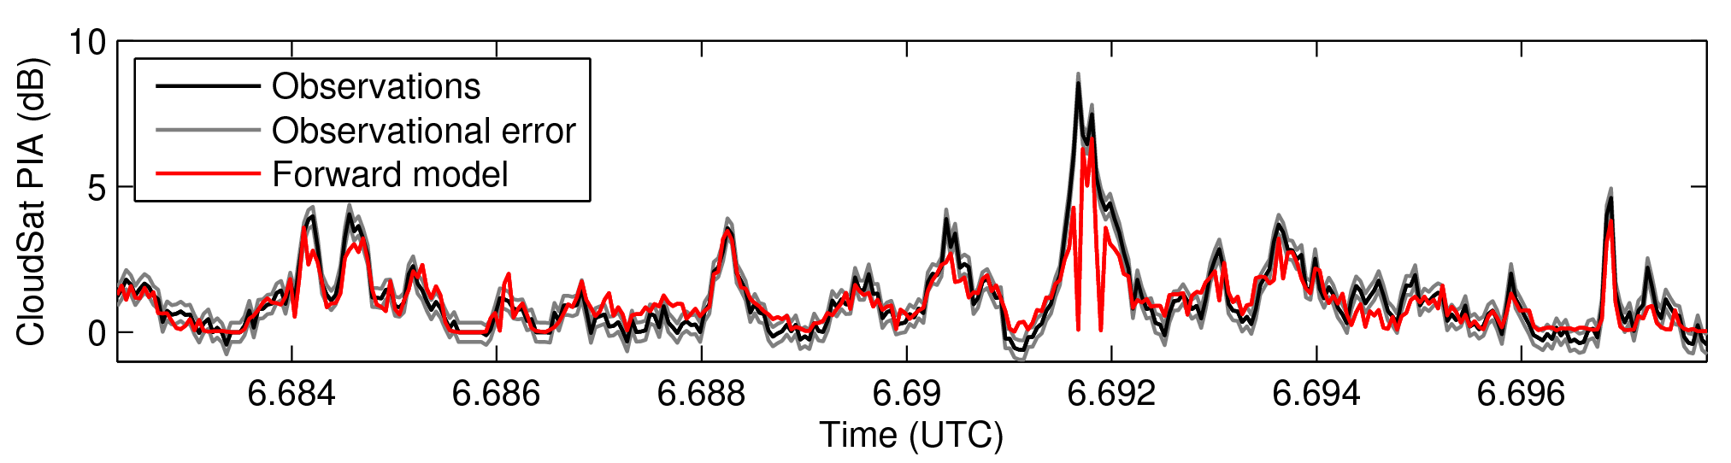
Retrieve number concentration
LWC
Effective radius
Optical depth
CloudSat PIA
Number concentration

Slide 35
