Slide 1
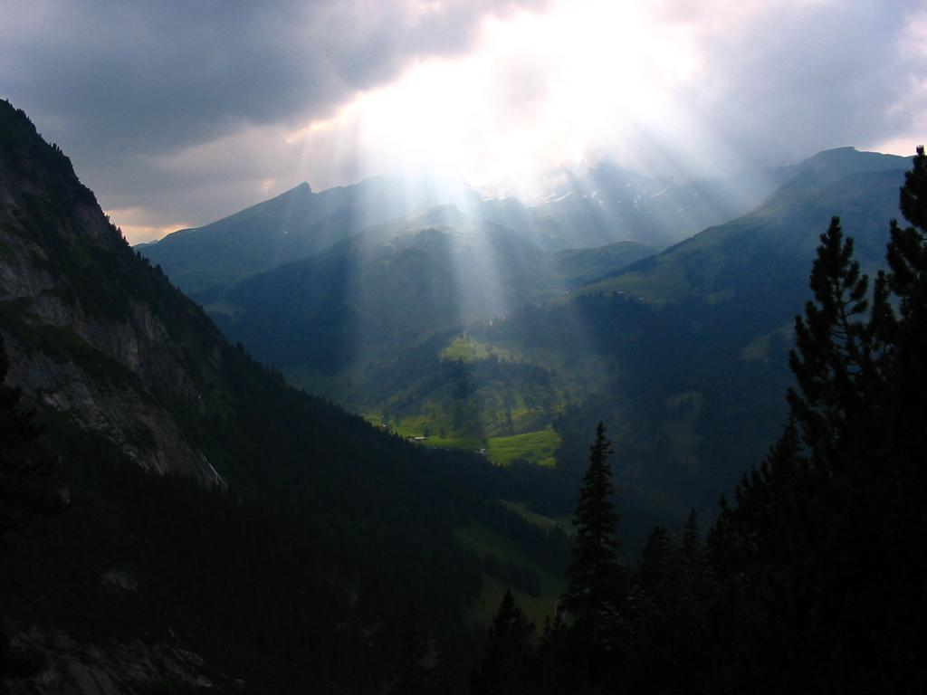
Radiative transfer in numerical models of the atmosphere
Robin Hogan
Slides contain contributions from Jean-Jacques Morcrette, Alessio Bozzo,Tony Slingo and Piers Forster

Slide 2
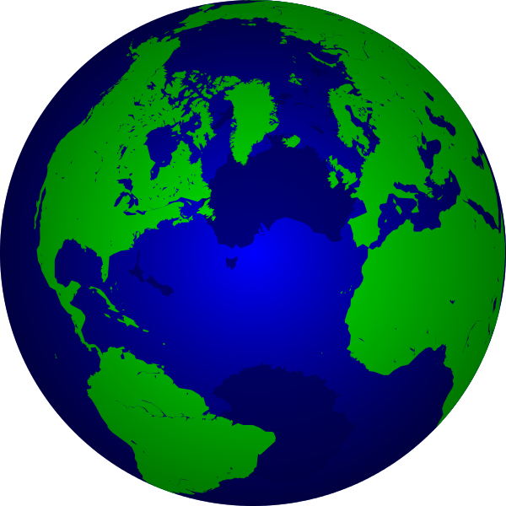
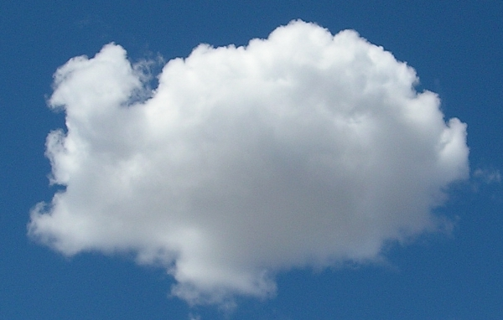
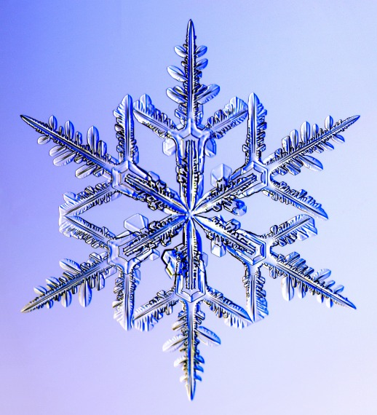
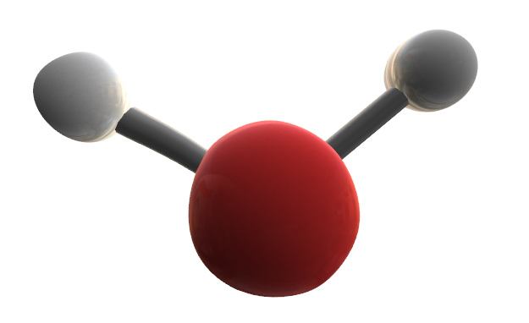
Outline
Lectures 1 & 2
  Global context
  From Maxwell to the two-stream equations
  Gaseous absorption and emission
Lecture 3 (Alessio Bozzo)
  The ECMWF radiation scheme
Lecture 4
  Representing cloud structure
  Some remaining challenges

Slide 3
Part 4: Representing cloud structure
Representing cloud fraction, overlap and inhomogeneity
What is the impact of overlap and inhomogeneity on the radiation budget?

Slide 4
Cloud fraction parametrization
If cloud is diagnosed only when gridbox-mean q_{t} > q_{s} then resulting cloud fraction can only be 0 or 1
Cloud fraction can be diagnosed from prognostic or diagnostic sub-grid distribution of humidity and cloud
ECMWF uses a prognostic equation for cloud fraction
Sub-grid PDF of q_{t} (implicit or explicit)
q_{s}(T)
q_{t} = q + q_{l}
1
Cloud fraction
  Cloud can form when gridbox RH < 100%
0

Slide 5
Multi-region two stream
a
b
E.g. Met Office Edwards-Slingo scheme
Solve for two fluxes in clear and cloudy regions
  Matrix is now denser (pentadiagonal rather than tridiagonal)
Layer 1
a
b
Layer 2
  Note that coefficients describing the overlap between layers have been omitted

Slide 6
Are we using computer time wisely?
Radiation is an integral:
Dimension | Typical number of quadrature points | How well is this dimension known? | Consequence of poor resolution
Time | 1/3 (every 3 h) | At the timestep of the model | Changed climate sensitivity (Morcrette 2000); diurnal cycle (Yang & Slingo 2001)
Angle | 2 (sometimes 4) | Well (some uncertainty on ice phase functions) | ±6 W m⁻² (Stephens et al. 2001)
Space | 2 (clear+cloudy) | Poorly (clouds!) | Up to a 20 W m⁻² long-term bias (Shonk and Hogan 2009)
Spectrum | 100-250 | Very well (HITRAN database) | Incorrect climate response to trace gases?

Slide 7
Three further issues for clouds
Clouds in older GCMs used a simple cloud fraction scheme with clouds in adjacent layers being maximally overlapped
  Observations show that vertical overlap of clouds in two layers tends towards random as their separation increases
  Real clouds are horizontally inhomogeneous, leading to albedo and emissivity biases in GCMs (Cahalan et al 1994, Pomroy and Illingworth 2000)
  Radiation can pass through cloud sides, but these 3D effects are negelcted in all current GCMs

Slide 8
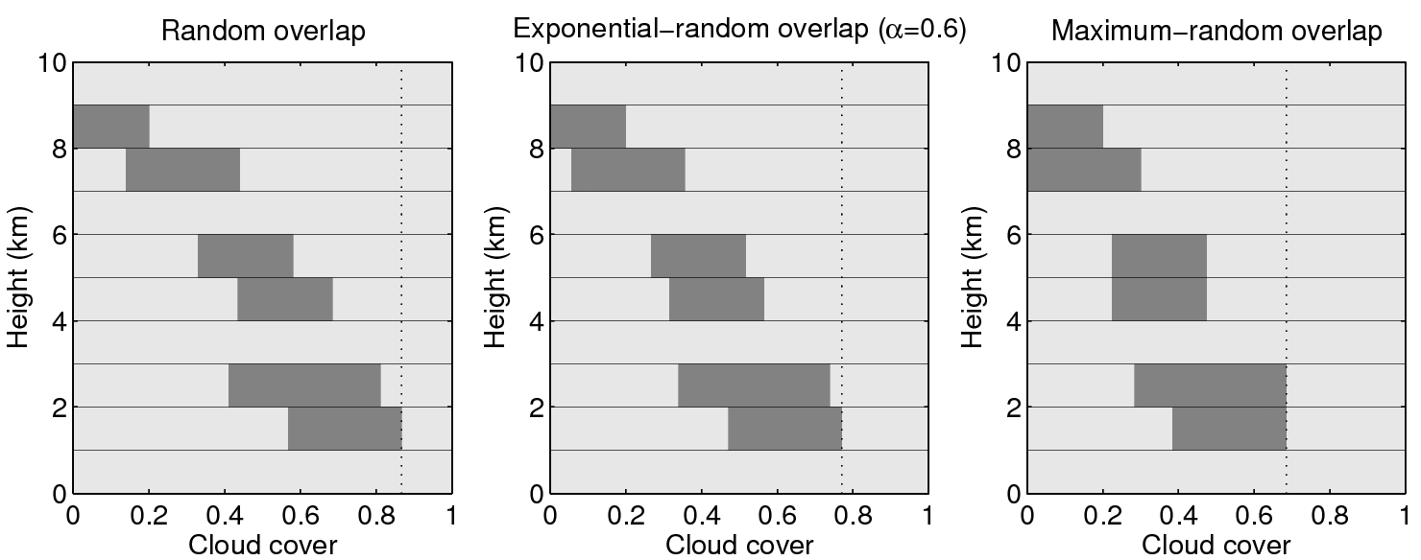
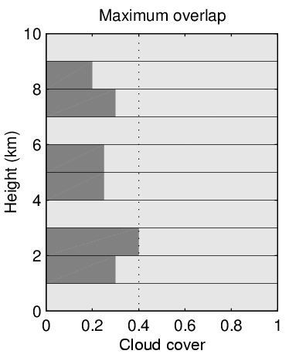
Cloud overlap parametrization
Even if can predict cloud fraction versus height, cloud cover (and hence radiation) depends on cloud overlap
  sdfsdfs
Observations (Hogan and Illingworth 2000) support “exponential-random overlap”:
  Non-adjacent clouds are randomly overlapped
  Adjacent clouds correlated with decorrelation length ~2km
  Many models still use “maximum-random overlap”

Slide 9
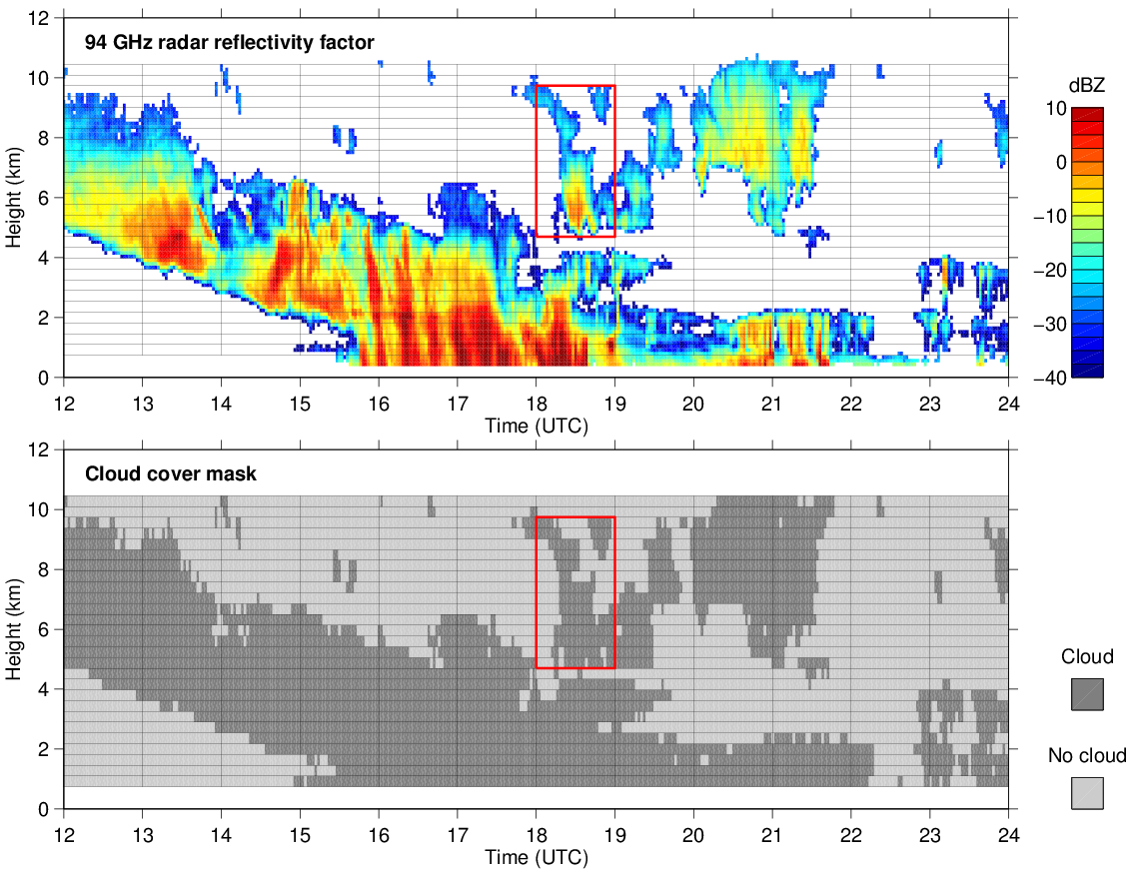
Cloud overlap from radar: example
Radar can observe the actual overlap of clouds

Slide 10
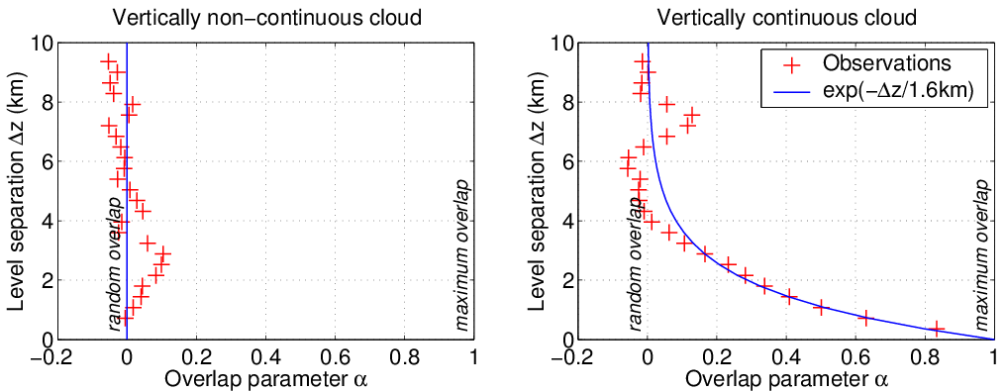
Cloud overlap: results
Vertically isolated clouds are randomly overlapped
Overlap of vertically continuous clouds becomes rapidly more random with increasing thickness, characterized by an overlap decorrelation length z₀ ~ 1.6 km
Hogan and Illingworth (QJ 2000)

Slide 11
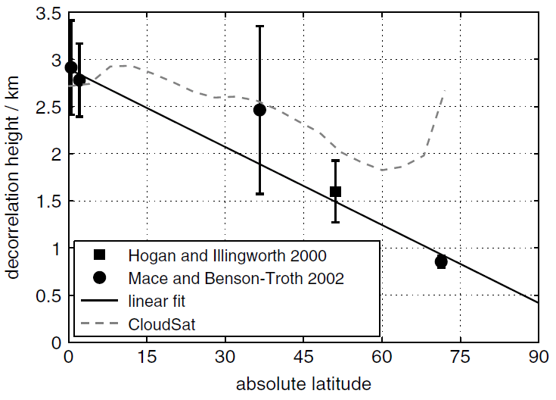
Cloud overlap globally
Latitudinal dependence of decorrelation length from Chilbolton and the worldwide ARM sites
  More convection and less shear in the tropics so more maximally overlapped
Maximum overlap
TWP (Mace & Benson 2002)
SGP (Mace & Benson 2002)
Latitudinal dependence available as an option in the ECMWF model
Chilbolton (Hogan & Illingworth 2000)
NSA (Mace & Benson 2002)
Random overlap
Shonk et al. (QJ 2010)

Slide 12
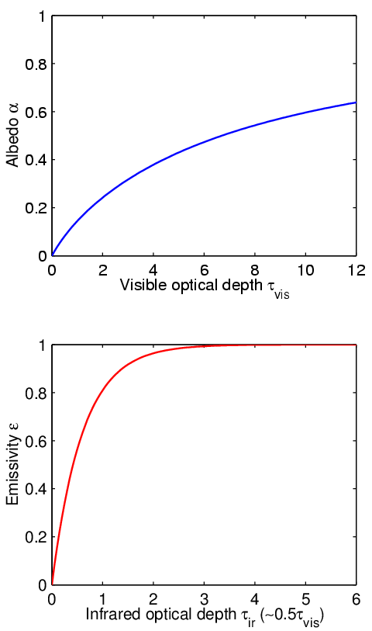
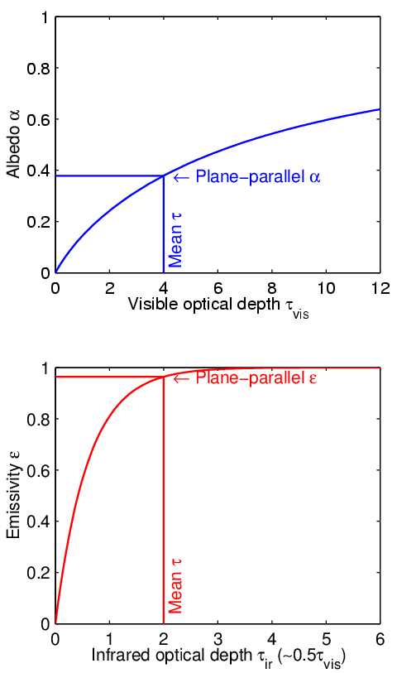
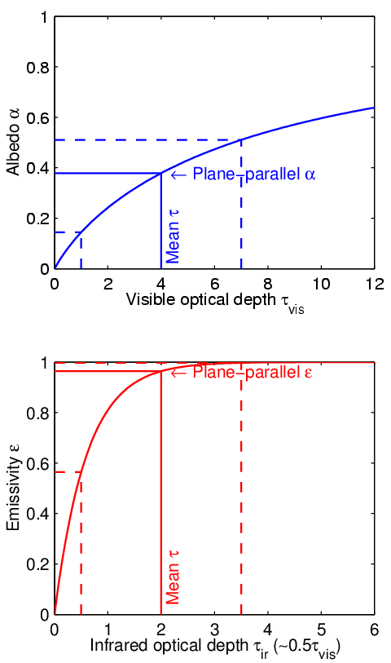
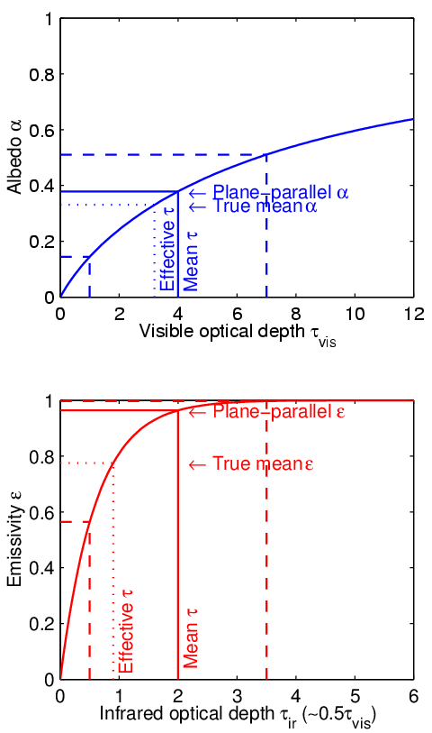
Why is cloud structure important?
An example of non-linear averaging
Clear air Cloud
Inhomogeneous cloud
Non-uniform clouds have lower mean emissivity & albedo for same mean optical depth due to curvature in the relationships
Infrared absorption optical depth

Slide 13
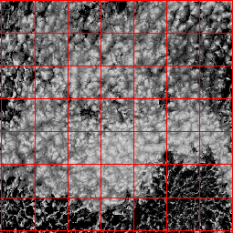
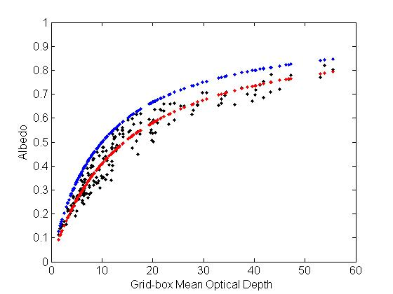
Example from MODIS
MODIS Stratocumulus
100-km boxes
Plane-parallel albedo
True mean albedo
PP albedo for scaled optical depth
By scaling the optical depth it appears we can get an unbiased fit to the true top-of-atmosphere albedo
  Until McRad (2007), ECMWF used a constant factor of 0.7
  Now a more sophisticated scheme is used

Slide 14
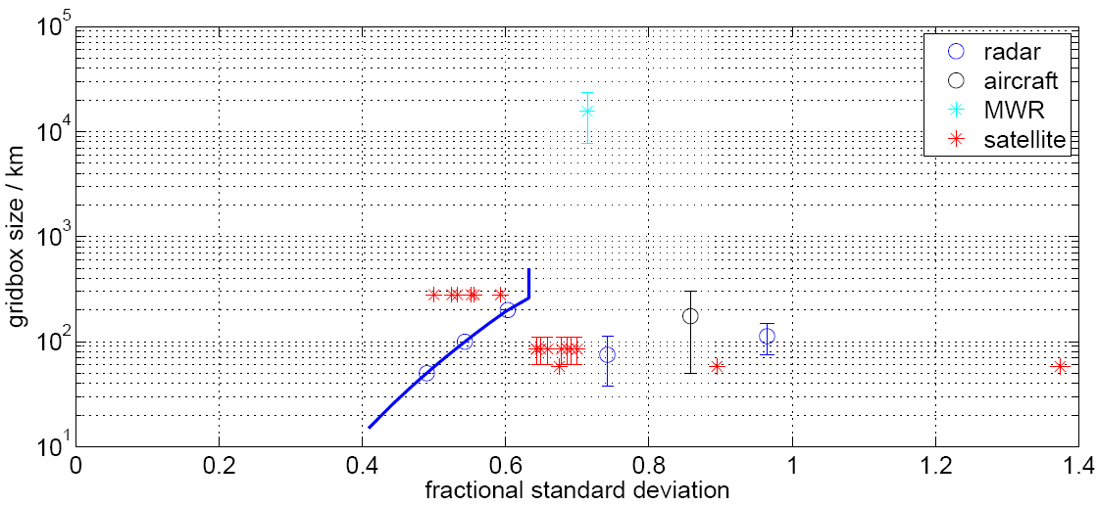
Observations of horizontal structure
Rossow et al. (2002)
Satellite (ISCCP)
Cahalan et al. (1994)
Microwave radiometer
Shonk and Hogan (2008)
Radar & microwave radiometer
Sc
Sc, Ac, Ci
Ci
Ci
Sc
Cu
Ci
Sc & Ci
Sc
Barker et al. (1996)
Satellite (LandSat)
Hogan and Illingworth (2003)
Radar
Oreopoulos and Cahalan (2005)
Satellite (MODIS)
Smith and DelGenio (2001)
Aircraft
Typical fractional standard deviation ~0.75
Shonk et al. (QJRMS 2012)

Slide 15
Monte-Carlo ICA
GCM
Observations
Cloud fraction
Water content
(Variance?)
Variance
Overlap assumption
Generate random sub-columns of cloud
  Statistics consistent with horizontal variance and overlap rules
ICA could be run on each
  But double integral (space and wavelength) makes this too slow (~10⁴ profiles)
Cloud generator
Raisanen et al. (2004)
Water content
McICA solves this problem
  Each wavelength (and correlated-k quadrature point) receives a different profile -> only ~10² profiles
  Modest amount of random noise not believed to affect forecasts
Height
Horizontal distance
Pincus, Barker and Morcrette (2003)

Slide 16
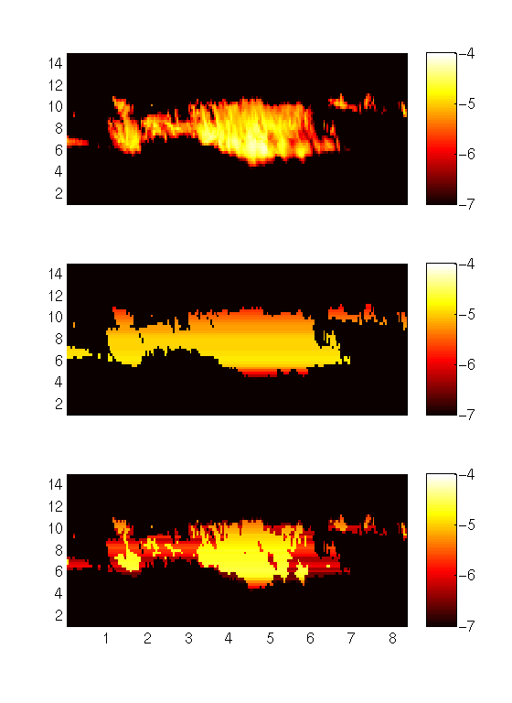
Alternative method: Tripleclouds
Ice water content from Chilbolton radar, log₁₀(kg m^{–3})
Plane-parallel approx:
  2 regions in each layer, one clear and one cloudy
“Tripleclouds”:
  3 regions in each layer
  Alternative to McICA
  Uses Edwards-Slingo capability for stratiform/convective regions for another purpose
Height (km)
Height (km)
Height (km)
Time (hours)
Shonk and Hogan (JClim 2008)

Slide 17
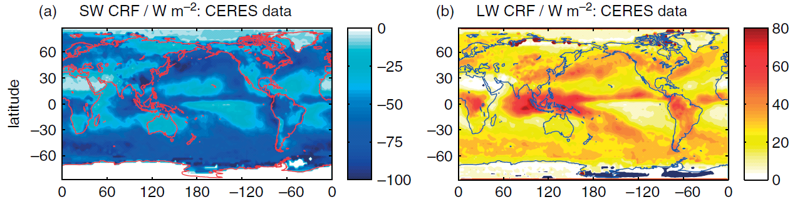
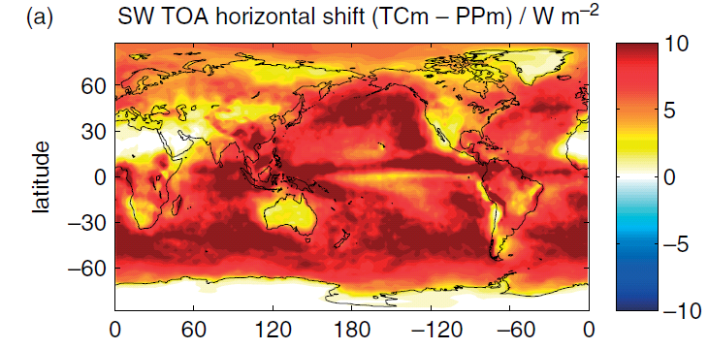
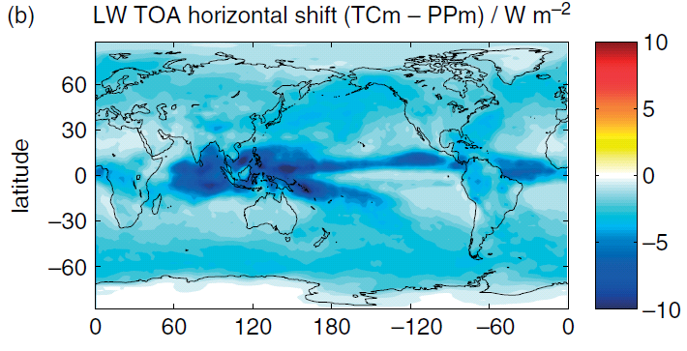
Global impact of cloud structure
Shonk and Hogan (2010)
Cloud radiative forcing (CRF) is change to top-of-atmosphere net flux due to clouds
Clouds cool the earth in the shortwave and warm it in the longwave:
Representing horizontal cloud structure reduces absolute CRF by around 12%:

Slide 18
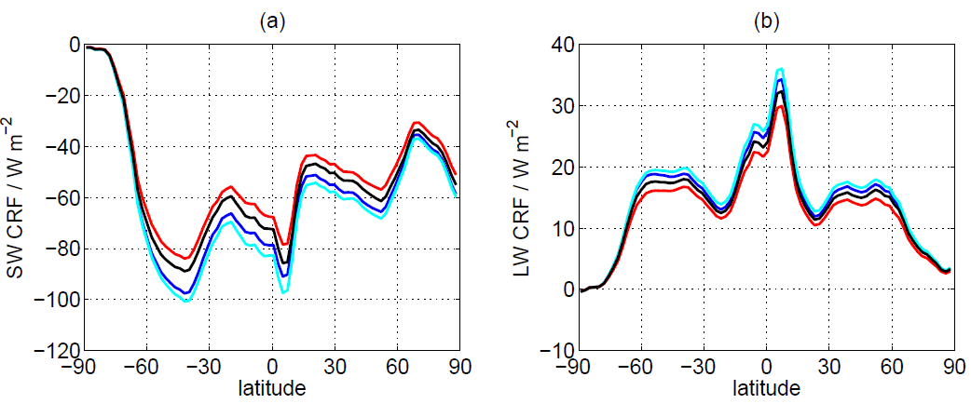
Horizontal versus vertical structure
Horizontal structure, maximum overlap
Horizontal structure, realistic overlap
Horizontally homogeneous, max overlap
Horizontally homogeneous, realistic overlap
Correcting cloud structure changes cloud radiative effect by around 10%
Impact of adding horizontal structure about twice that of improving vertical overlap
Note that uncertainties in the horizontal structure effect are much larger than in the vertical overlap effect

Slide 19
Part 5: Remaining challenges
Improve efficiency
  Radiation schemes often the slowest part of the model, so may called infrequently and not in every model column
Improve accuracy
  Better spectroscopic data, particularly the continuum
  Better treatment of upper stratosphere/mesosphere to enable satellite observations here to be assimilated
  Evaluate against new observations
Add new processes
  Radiative properties of prognostic aerosols
  Three dimensional radiative transfer in presence of clouds
  Non-local-thermodynamic equilibrium for high-top models
  Cloud inhomogeneity information from cloud scheme

Slide 20
Why do we need bands?
Because the Planck function should not vary significantly within a band (Fu & Liou 1992)
To minimize number of active gases in each band, due to expense of treating many gases (Mlawer et al. 1997)
Because some techniques assume spectral overlap of different gases is random, not valid over large intervals (Edwards 1996)
To represent the slow variation of cloud and aerosol absorption and scattering across the spectrum (Ritter & Geleyn 1992)
But Modest & Zhang (2002) proposed full-spectrum correlated-k (FSCK) method for combusting gases
  Their formulation is unnecessarily complex and can be simplified
  Pawlak et al. (2004) showed that this method works in the shortwave
  More tricky to apply FSCK to longwave atmospheric radiative transfer, where variations in Planck function and spectral overlap are important

Slide 21
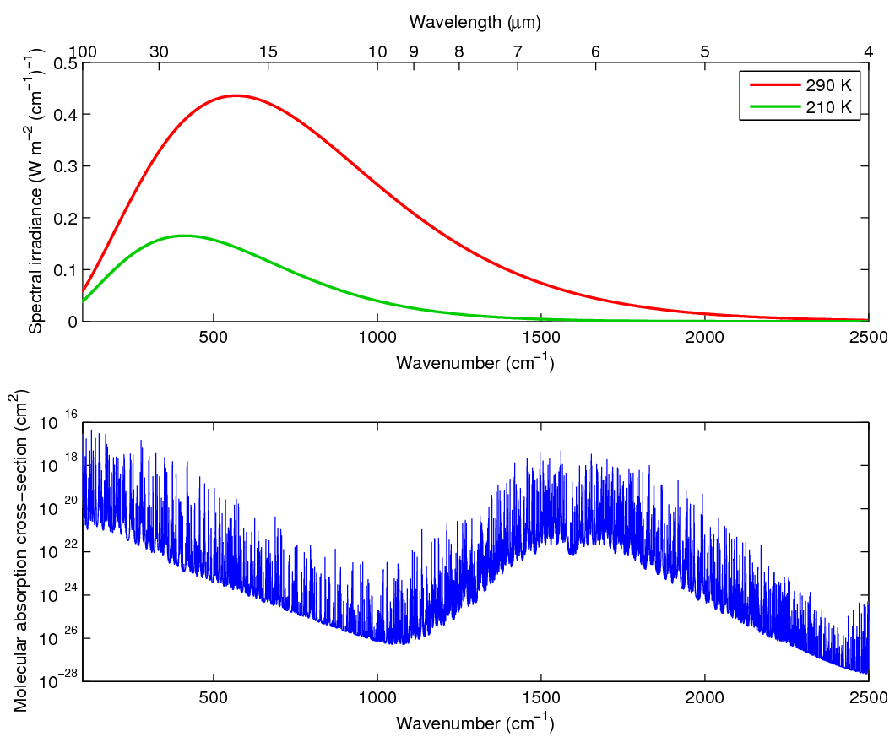
Full-spectrum correlated-k (FSCK) method
Water vapour spectrum Planck function

Slide 22
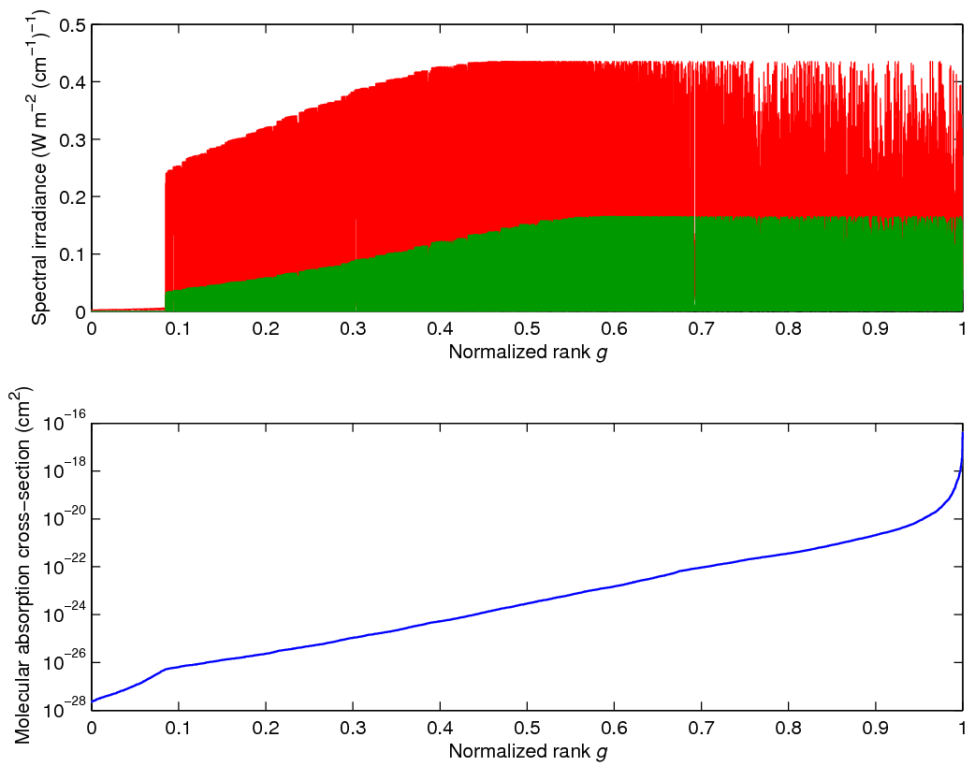
Full-spectrum correlated-k (FSCK) method
Water vapour spectrum Planck function
Reorder the entire longwave spectrum

Slide 23
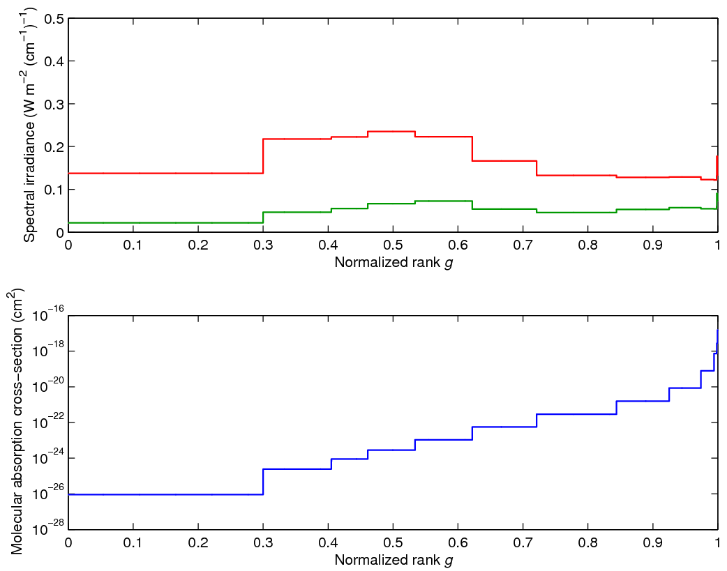
Full-spectrum correlated-k (FSCK) method
Discretize such that heating rate error in each interval is less than some tolerance
Integrate Planck function across interval
Only 10-20 intervals required for H₂O
Water vapour spectrum Planck function
Optimum representative absorptions to be chosen later…

Slide 24
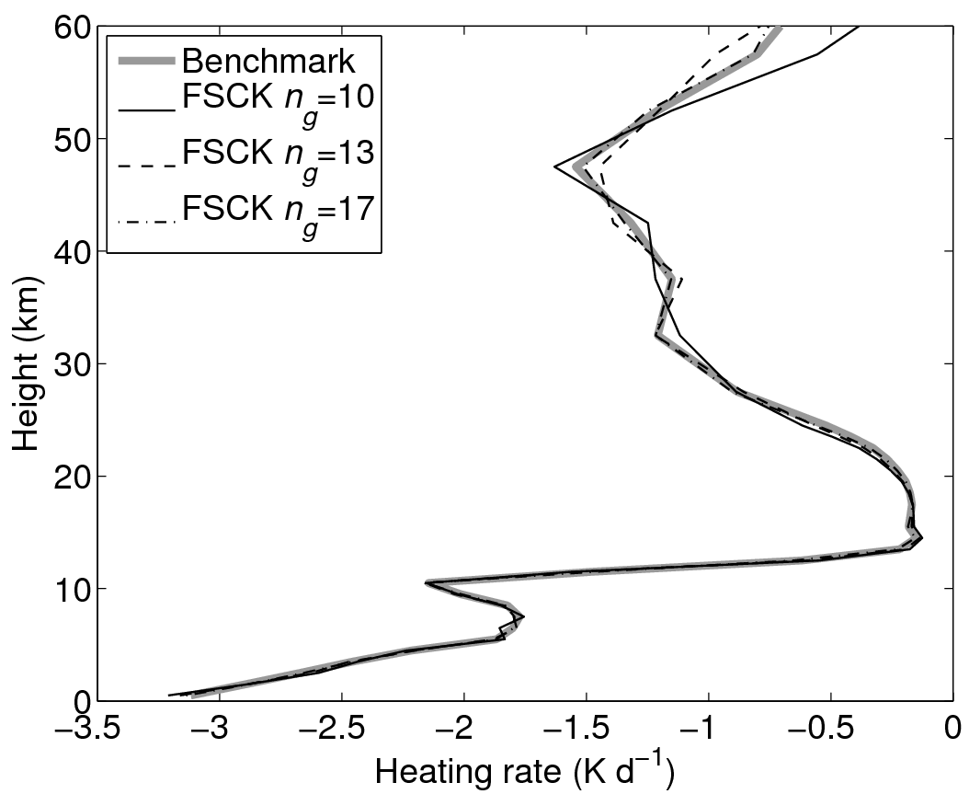
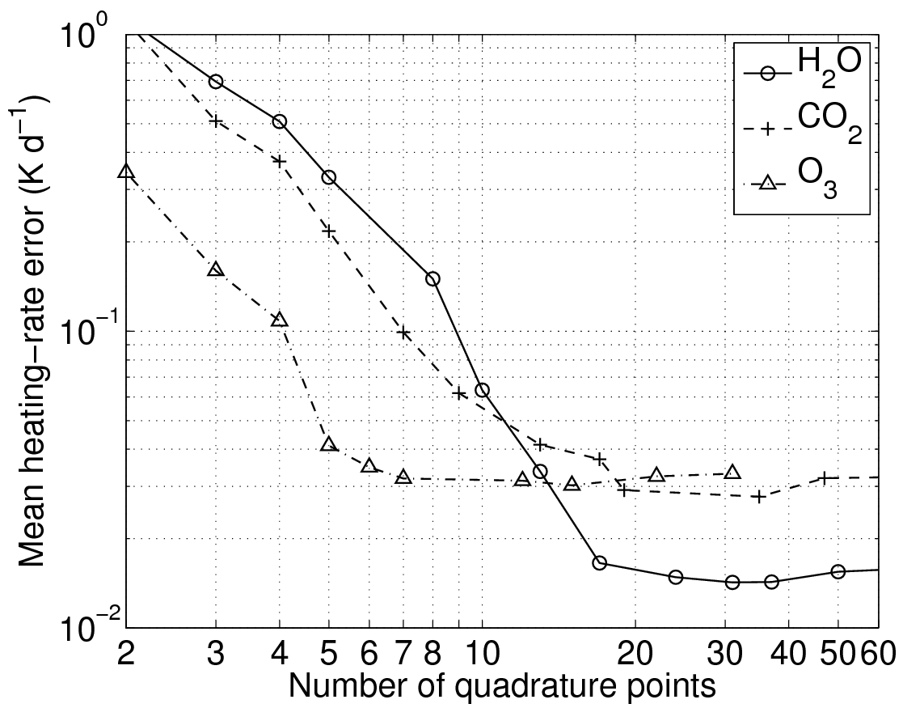
Atmospheres containing one gas
Heating-rate error converges rapidly (~2nd order) with number of points in integration
Flattens off because of imperfect spectral correlation at different heights due to pressure broadening
Mid-latitude summer standard atmosphere, water vapour only
Select discretizations of the spectrum of each gas with similar error: 0.035 K d⁻¹ → n_{H2O}=13, n_{CO2}=15, n_{O3}=6

Slide 25
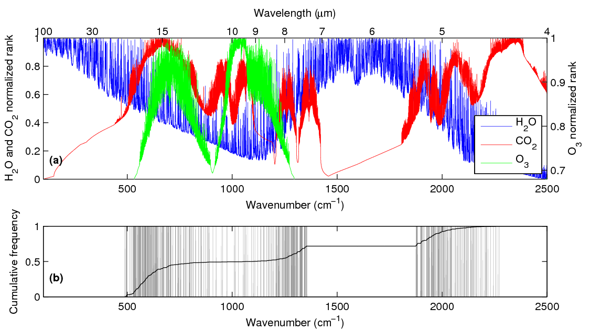
How can we treat overlapping gases?
Gases with important contribution over a substantial part of the spectrum are water vapour, carbon dioxide and ozone

Slide 26
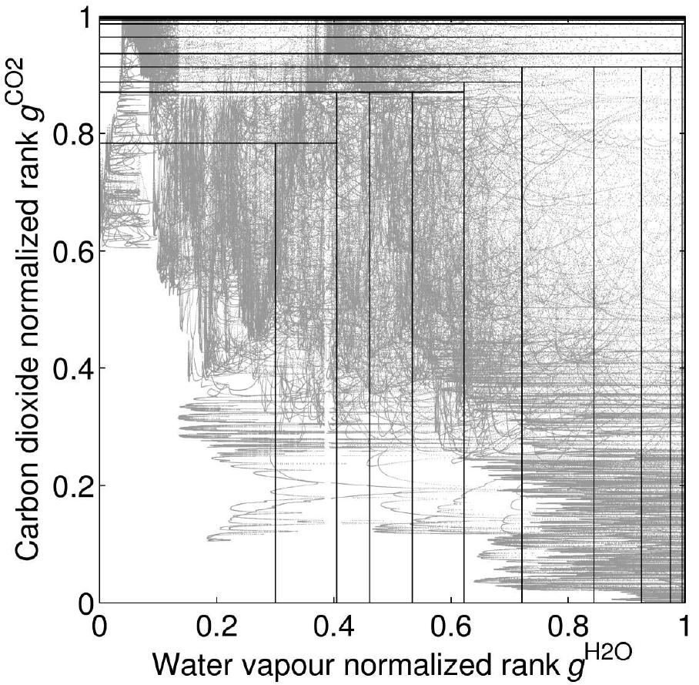
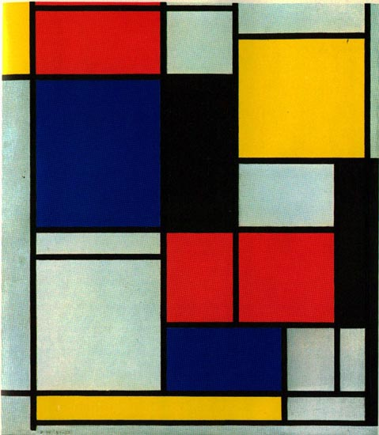
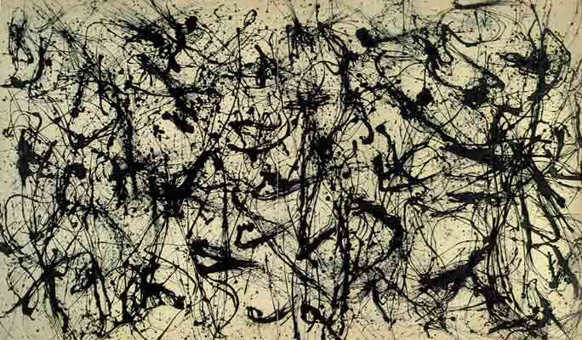
Overlap of two gases…
Inefficient method: n_{H2O}×n_{CO2}=195
Efficient method: often one gas dominates: n_{H2O}+n_{CO2}–1=27
Piet Mondrian, 1921-25: Tableau 2
Jackson Pollock, 1950: Number 32, Enamel on canvas

Slide 27
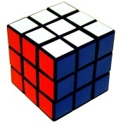
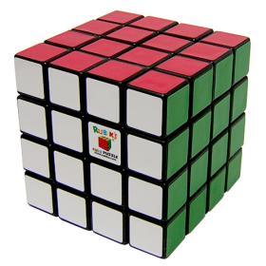
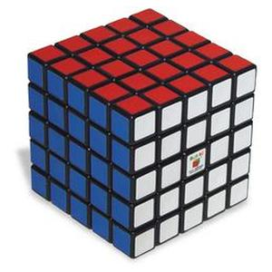
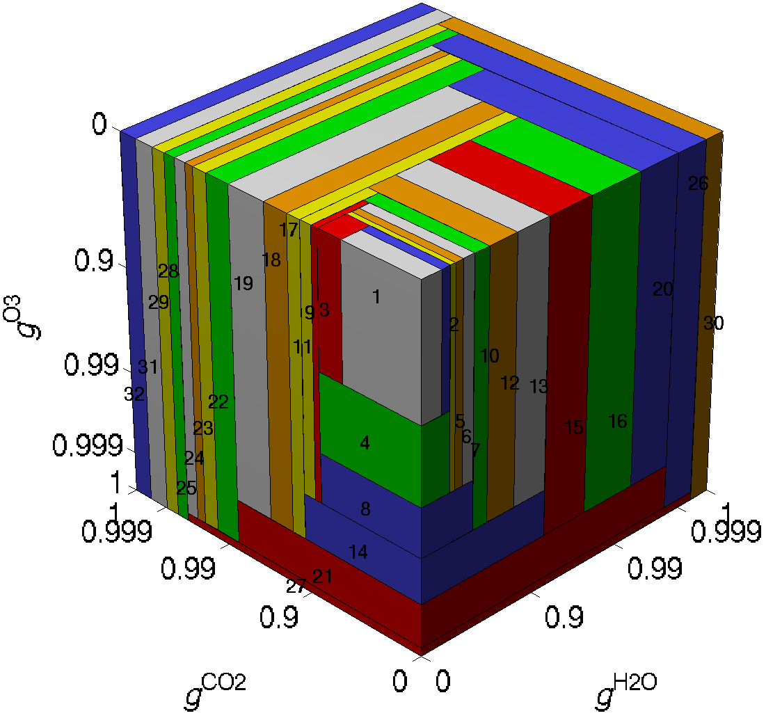
Overlap of many gases
Use a cube for 3 gases
  n_{H2O}+n_{CO2}+n_{O3}-2=32 regions
  “Hypercube” for more
Properties in each region
  Integral of Planck function stored as a lookup table vs T
  Gas absorptions in each regions chosen to minimize a cost function expressing difference in heating-rate and flux profile from line-by-line benchmark in a number of test profiles
Hogan (JAS 2010)

Slide 28
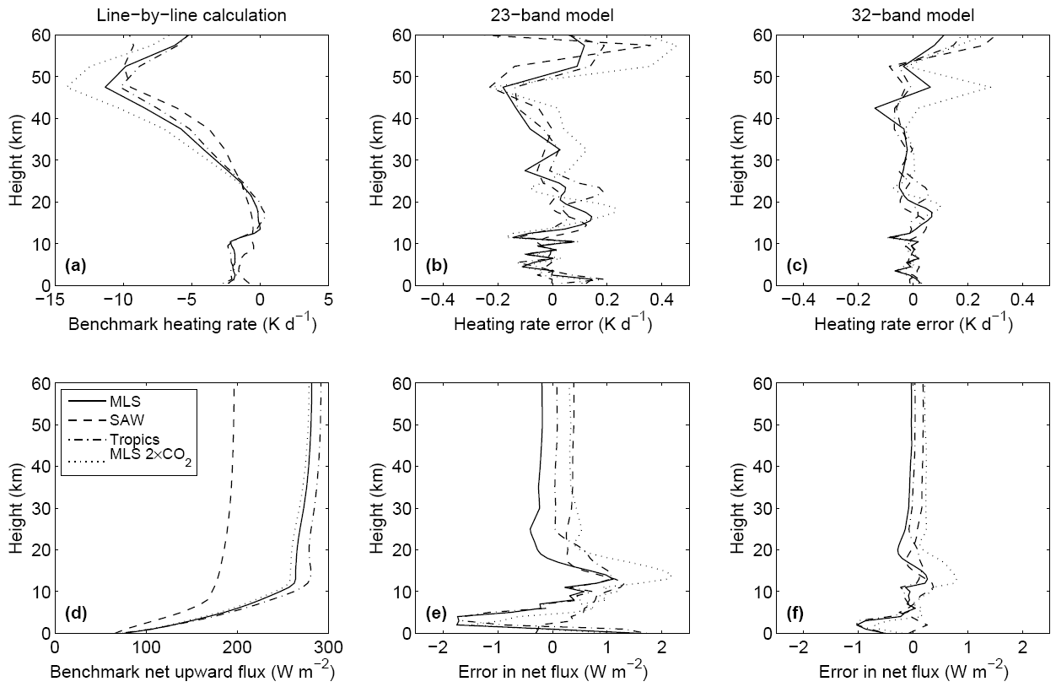
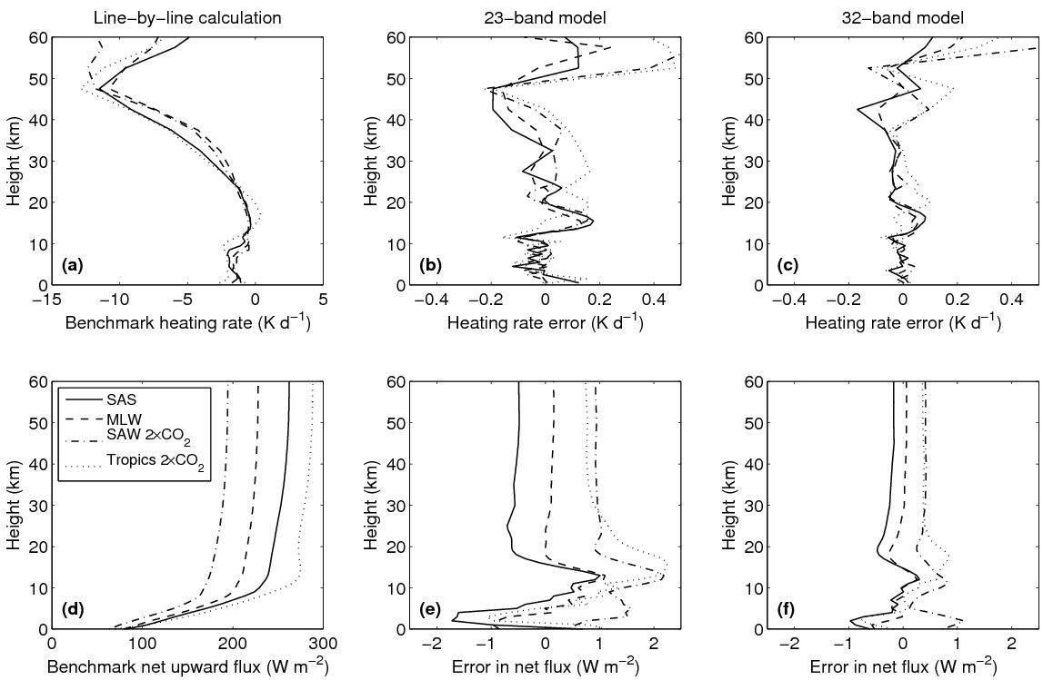
Evaluation of FSCK
4 training profiles: mid-lat summer, sub-arctic winter, tropical and MLS 2xCO₂
Top-of-atmosphere flux errors (W m⁻²):
Error in change to top-of-atmosphere flux due to doubling CO₂:
4 other profiles
 | Benchmark | 23-point FSCK | 32-point FSCK
MLS | 281.75 | –0.18 | –0.03
SAW | 196.69 | 0.41 | 0.19
Trop | 291.89 | 0.09 | 0.04
MLS | 2.87 W m⁻² | –17% | –8%
SAW | 1.82 W m⁻² | –29% | –12%
Trop | 3.31 W m⁻² | –20% | –10%
Not part of training dataset

Slide 29
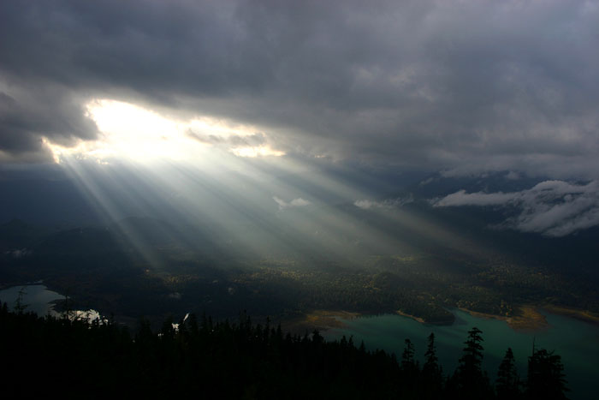
3D radiative transfer!
Is this effect important?
And how can we represent it in a GCM?

Slide 30
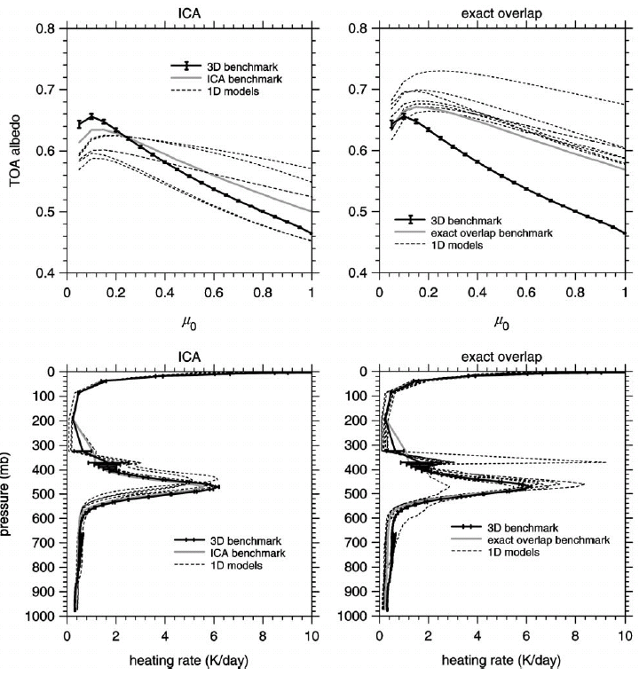
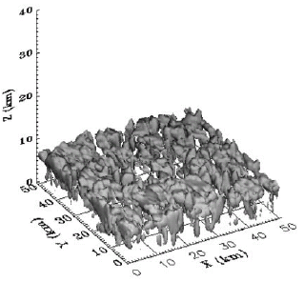
3D cloud benchmark
Barker et al. (JClim 2003)
Large spread in 1D models, whether used in ICA mode or with cloud-fraction scheme

Slide 31
The three main 3D effects
3D radiation
ICA
Effect 1: Shortwave cloud side illumination
  Incoming radiation is more likely to intercept the cloud
  Affects the direct solar beam
  Always increases the cloud radiative forcing
  Maximized for a low sun (high solar zenith angle)
  Flux is less for low sun, so diurnally averaged effect may be small

Slide 32
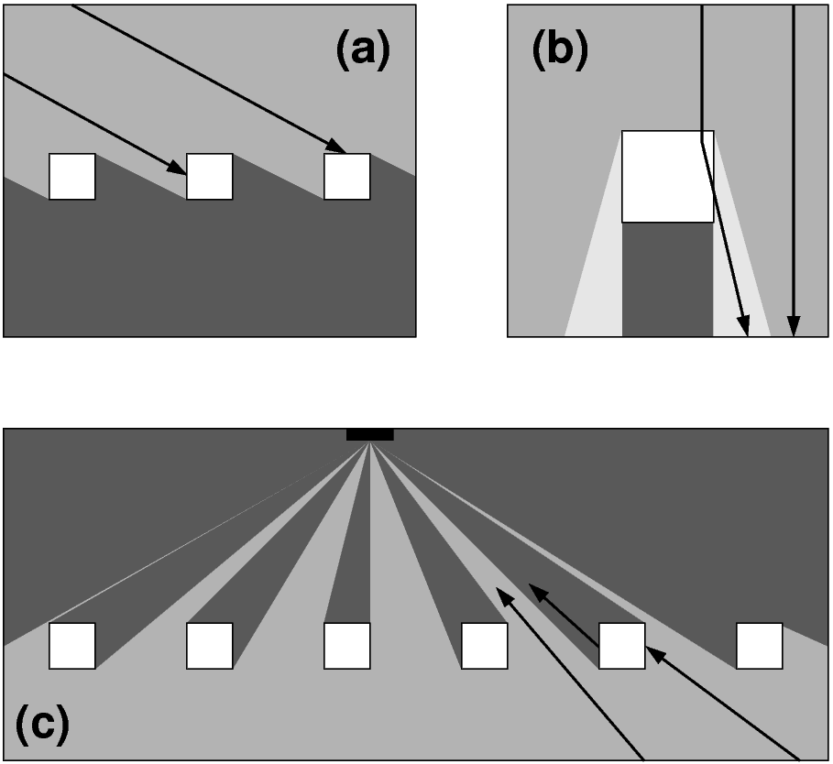
Three main 3D effects continued
Effect 2: Shortwave side leakage
  Maximized for high sun and isolated clouds
  Results from forward scattering
  Usually decreases cloud radiative forcing
  But depends on specific cloud geometry
  Affects the diffuse component
Effect 3: Longwave side effect
  Above a field of clouds, the clouds subtend a larger fraction of the downward-looking hemisphere than the areal cloud coverage (accounting for cos θ dependence of contribution to upwelling irradiance)
  Hence longwave cloud radiative forcing is typically increased

Slide 33
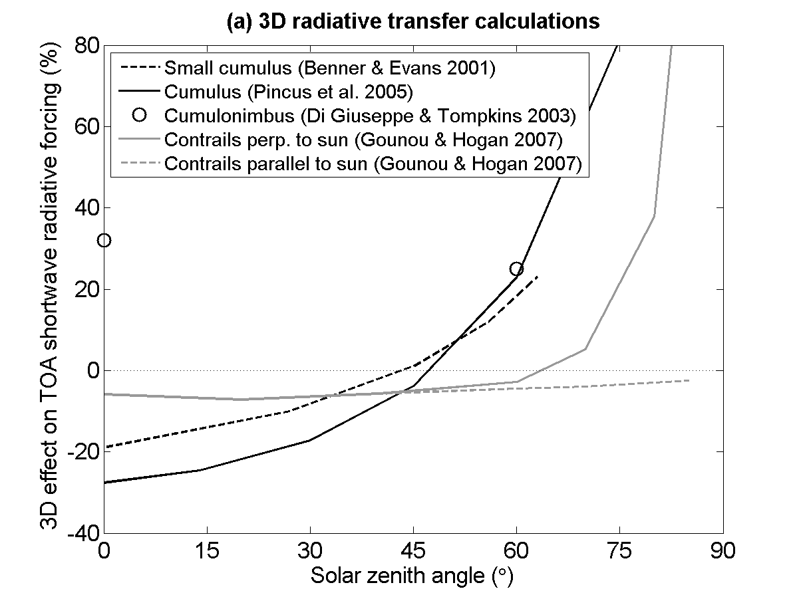
3D shortwave effects
1. Shortwave side illumination
3D effects significant in convective clouds
  Cumulus (Benner & Evans 2001, Pincus et al. 2005)
  Deep convection (DiGiuseppe & Tompkins 2003)
2. Shortwave leakage effect
3D effects much smaller in stratiform clouds
  In cirrus, SW and LW effects up to 10% for optical depth ~1, but negligible for optically thicker clouds (Zhong, Hogan and Haigh 2008)
How can we represent this effect in GCM radiation schemes?

Slide 34
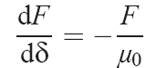
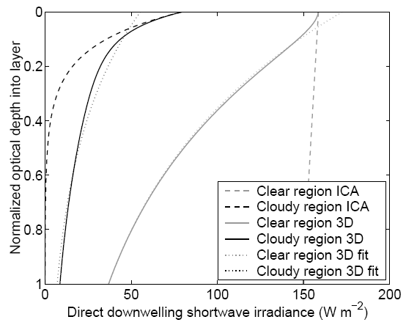

Direct shortwave calculation
ICA
First part of a shortwave calculation is to determine how far direct (unscattered) beam penetrates
  Solve this equation independently in the clear and cloudy regions (δ is optical depth):
Cloudy region
Clear region
  The solution is Beer’s law:

Slide 35
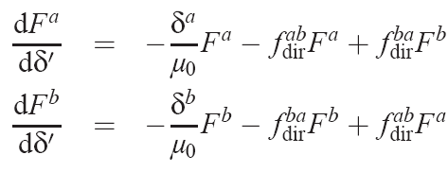
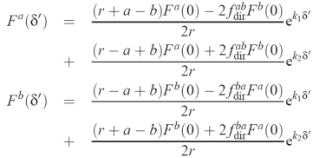
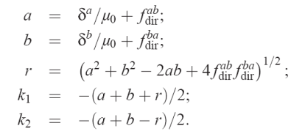
Direct shortwave calculation
3D radiation
Alternative: add terms expressing exchange between regions a & b:
  New terms depend on geometric constants f ^{ab} and f ^{ba}
  Solution of pair of coupled ODEs:
  Result: much less radiation gets through to next atmospheric layer!
a b
Cloudy region
Clear region

Slide 36
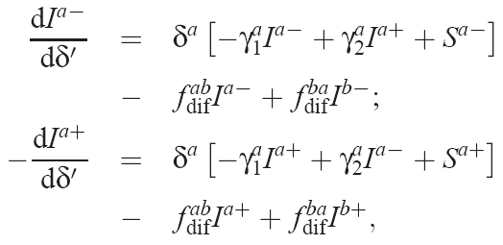
Diffuse calculation
The next step is to use the two-stream equations to calculate the diffuse part of the radiation field
  Downwelling stream:
  Upwelling stream:
New terms
Represent exchange between regions
Source terms
Shortwave: direct solar beam
Longwave: Planck function
  Solution a little more complex when integrated across a layer, but efficient enough to be implemented in a GCM

Slide 37
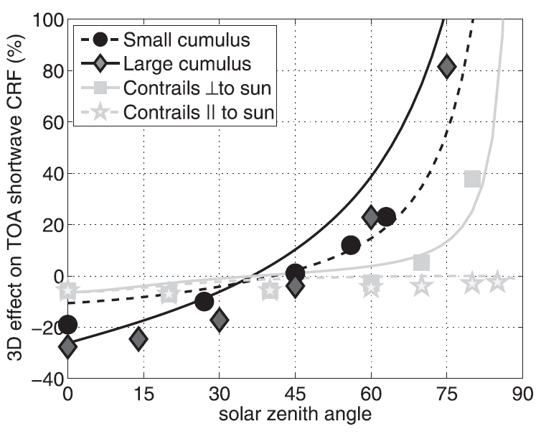
Results of new scheme
New idea tested using a single layer of homogeneous cloud illuminated by a monochromatic beam
  Performs surprisingly well against 3D calculations
Next step: longwave
Cloud fraction f
Aspect ratio r
Optical depth δ
Hogan and Shonk (2013)

Slide 38
Summary
The radiation scheme is a key part of both weather, seasonal and climate forecasts
While the physics is known, there are still challenges in implementing this accurately and efficiently in models
Significant errors still remain, particularly in the representation of clouds

