Slide 1
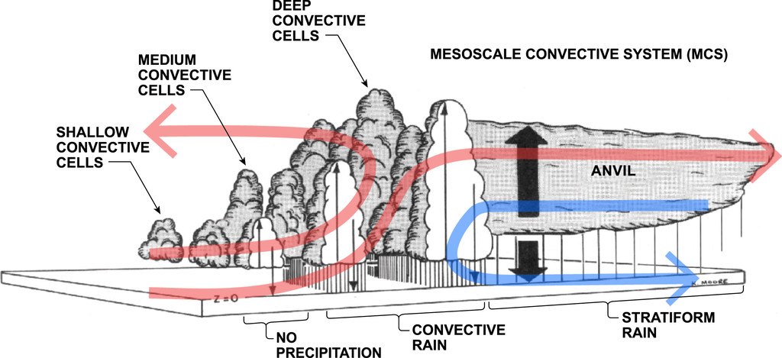
An introduction to MCS:PRIME
Department of Meteorology
Bob Plant, Hannah Christensen, Mark Muetzelfeldt, Zhixiao Zhang, Mitch Moncrieff, Zhe Feng, Ruby Leung, Alison Stirling, Keith Williams, Warren Tennant, Chiara Piccolo
ParaCon Plenary
Met Office
20-21 June 2022

Slide 2
Basic idea
Target Δ ~10-50 km, grey zone for MCS
Model may represent aspects of a mature MCS, but parameterization critical in initiation and early growth
Physics-dynamics coupling acutely important but inherently uncertain
Existing methods often applied indiscriminately (Shutts, SCV; Moncrieff, MCSP; Khouider/Majda, multicloud model)
Simple-minded shear threshold beneficial for MCSP (Chen et al 2021)

Slide 3
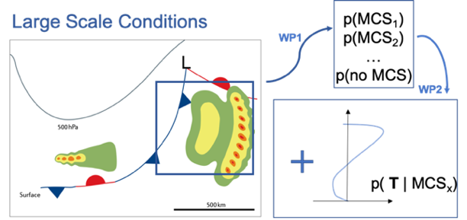
Basic Idea
Build a stochastic parameterization for missing tendencies due to MCS
Does the resolved-scale flow indicate that conditions are ripe for an MCS to develop (with some probability)?
What is the distribution of additional tendencies we should randomly sample if MCS development is indicated?

Slide 4
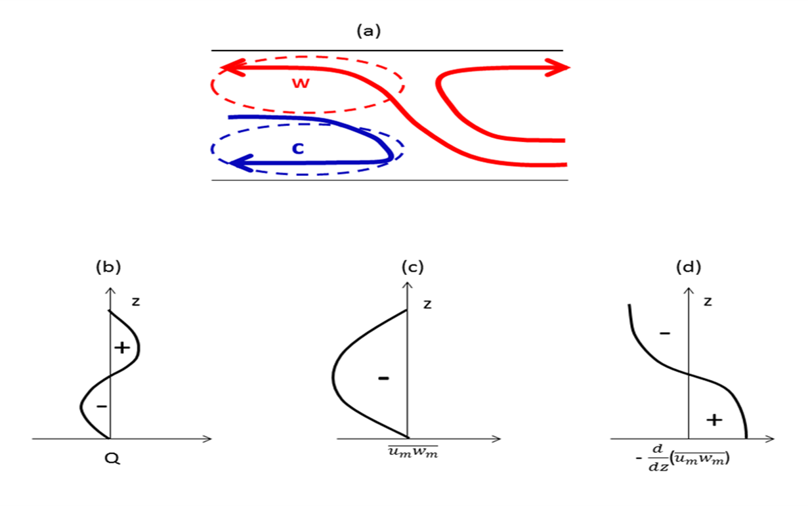




Moncrieff et al (2017) scheme
Idealization of slantwise overturning MCS model
Scaled by integrated heating from the convection parameterization
Propagation
Direction

Slide 5
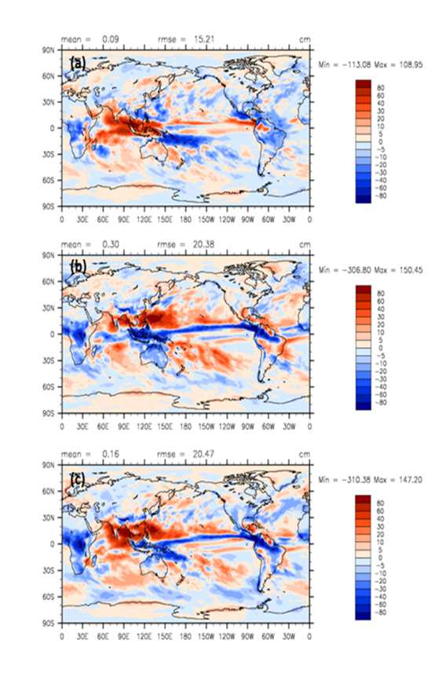
Effects on precipitation
(a) Momentum transport
(b) Heating
(c) Both
Improvements across ITCZ and maritime continent in CAM, E3SM
Moncrieff et al, 2017

Slide 6
Q1 Are conditions suitable?
Analyse database of observed MCS (Feng et al, 2021)
Establish probabilistic connections between MCS occurrence and resolved-scale indicators
Examine dependence on those indicators of the resulting MCS characteristics including their time and space scales

Slide 7
The Database
Based on merged geostationary satellite Tb data (NASA Global Merged IR V1)
Combined with merged satellite precipitation data (IMERG V06B)
Continuous global coverage from 60°S to 60°N with resolution ~4 km and 30 min
MCS identification / tracking validated against weather radar data from US and China
Cold cloud shield > 4 × 10⁴ km² containing precipitation feature with major axis length >100 km
PF area, mean rain rate, rain rate skewness, and heavy rain volume ratio > than lifetime dependent thresholds
CCS and PF exist continuously for > 4 h

Slide 8
Database

Slide 9
#MCS and associated precip fraction
Feng et al, 2021

Slide 10
Q2 What are the additional tendencies?
Study operational archive of analysis increments for times and locations where MCS are found in the database
Focus on situations where the model has an MCS in the ic’s. Associate increments with errors in the coupling of the MCS to the large scales
Do such increments match with SCV or MCSP?
Characterise the probabilistic dependency of the MCS-associated tendencies on indicators
Final scheme might be thought of as a targetted version of Piccolo et al (2019) method for perturbing ensemble

Slide 11
Plans
(Underway) Get to grips with database and analyse MCS existence and properties alongside large-scale state
(Autumn) implement the Moncrieff et al (2017) scheme in the UM alongside CoMorph
(Later) probabilistically activate it according to likelihood of developing an MCS given the resolved-scale conditions
(Later still) improve the assumed tendency structure using probabilistic forms obtained from analysis increments

Slide 12
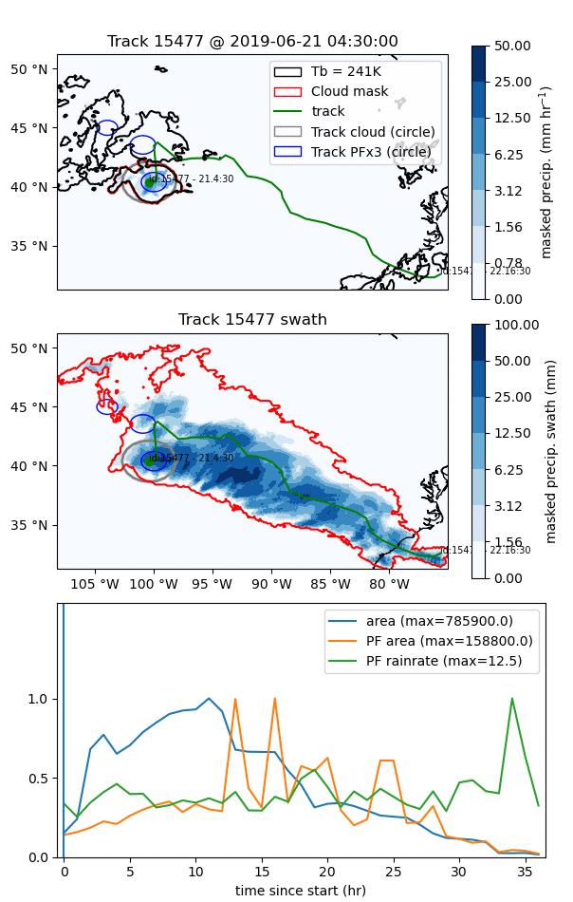
An example MCS
(21/06/19 over US)
Top: brightness temp (black), the MCS (red) and its path (green). Cloud area (grey circle) and precip cores (blue circles).
Middle: Precip swath and outline of cloud mask over MCS lifetime
Bottom: MCS area, precipitation feature (PF) area, and PF rainrate

Slide 13
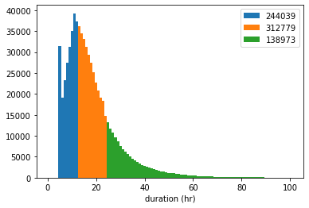
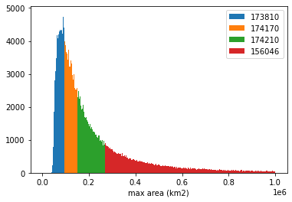
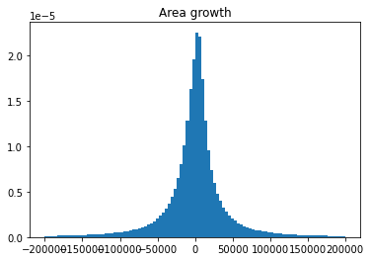
Distributions of all MCS
Durations and max area (grouped for possible stratification)
Area growth rate in 1h

Slide 14
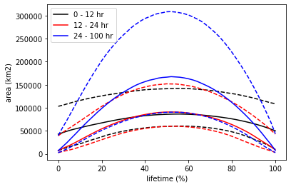
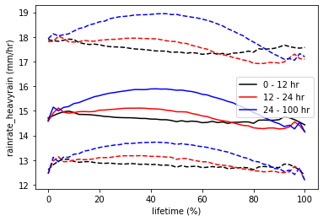
Composite lifecycles
Area
Black = short lived
Red = medium
Blue = long lived
Solid is median, dashed 25/75%
Mean rain rate within core (>10mm/h)

Slide 15
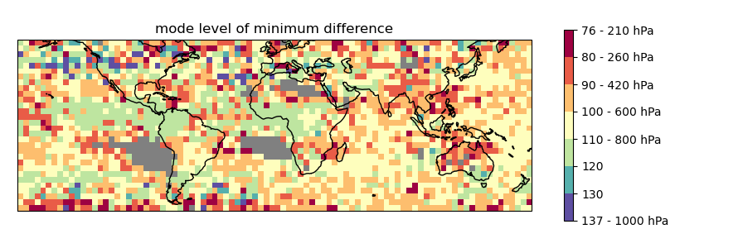
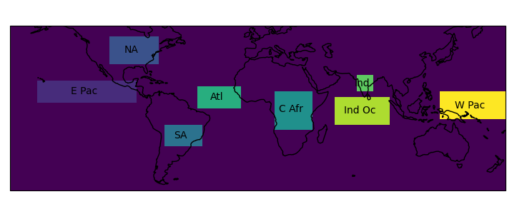
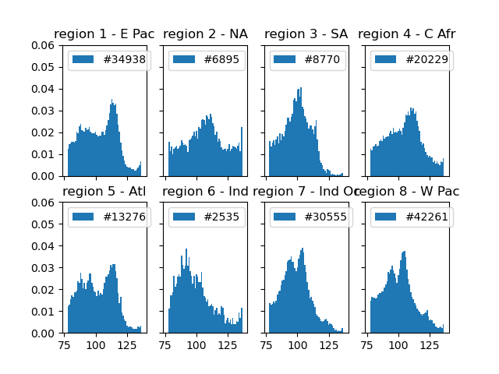
Linking to ERA5
A steering level: where does (u,v) in ERA5 best match with the average propagation of the MCS?
2019 results only

Slide 16
Summary
Attempt to build a representation of MCS effects
Main differences from existing approaches are:
To target these effects
  We don’t assume all convection is MCS-like (as in MCSP, SCV etc)
  Or that all convection is non-MCS like (as happens if no MCS scheme in place)
To design extra tendencies around analysis increments associated with MCS
Coming soon(ish): CoMorph + MCSP should be an interesting starting point

Slide 17
References
Chen, C.-C., Richter, J. H., Liu, C., Moncrieff, M. W., Tang, Q., Lin, W., et al. 2021. Effects of organized convection parameterization on the MJO and precipitation in E3SMv1. Part I: Mesoscale heating. J. Adv. Model. Earth Syst., 13, e2020MS002401.
Feng, Z., Leung, L. R., Liu, N., Wang, J., Houze, R. A., Li, J., et al. 2021. A global high-resolution mesoscale convective system database using satellite-derived cloud tops, surface precipitation, and tracking. J. Geophys. Res.,126, e2020JD034202.
Moncrieff, M. W., Liu, C., & Bogenschutz, P. 2017. Simulation, modeling, and dynamically based parameterization of organized tropical convection for global climate models. J. Atmos. Sci., 74, 1363–1380.
Piccolo, C, Cullen, M. J. P., Tennant, W. J., Semple, A. T. 2019. Comparison of different representations of model error in ensemble forecasts. Q J .R. Meteorol. Soc. 145, 15– 27.

Slide 18
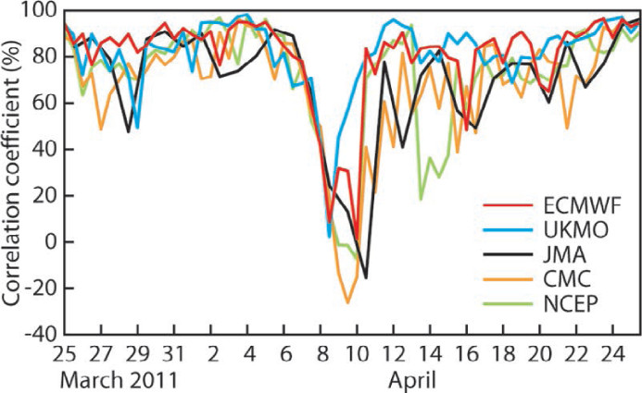
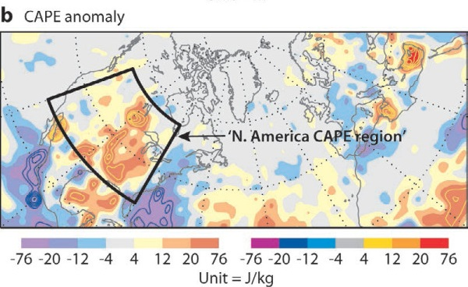
Forecast busts
In ECMWF model, forecast “busts” over Europe attributed to misrepresentations of MCS over US several days earlier
Spatial anomaly correlation of Z500 over Europe in T+6 day forecasts
Composite CAPE anomaly in the initial conditions for 584 busts
Rodwell et al, 2013

Slide 19
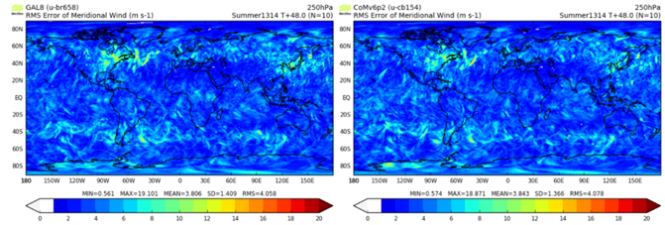
Forecast busts
Also occur in UM (even with CoMorph)
250hPa summer T+48 RMSEs of v for GA8 (left) and CoMorph 6.2 (right)
10 case studies over Summer
Alison Stirling, Adrian Lock, Michael Whitall, Keith Williams

Slide 20
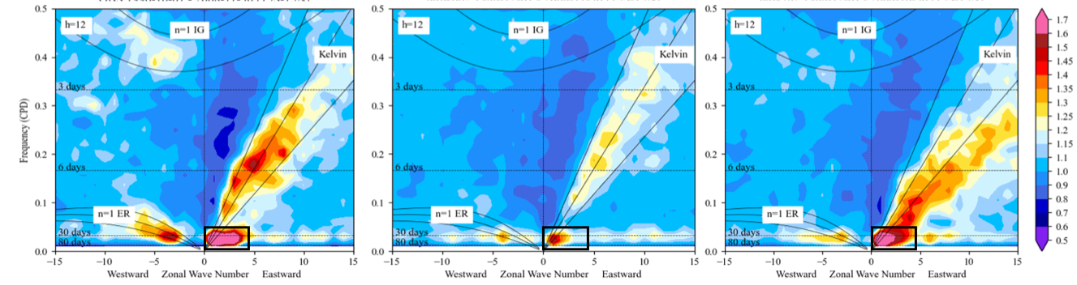
Build it on CoMorph
Good numerics an important foundation
Improved coupling to lower tropospheric moisture has led to improvements in tropical waves and MJO
Observations (left), current UM (centre), with CoMorph (right).

Slide 21
How is an MCS parameterization different?
An MCS is long-lived, spatially-organised group of individual convective elements, with coherent mesoscale overturning circulation on the scale of the system
Relative to an isolated cell, feedback is dynamic as well as thermodynamic, and the heating profile is top heavy
MCS form preferentially in environments with vertical wind shear, particularly low-level shear

